Slide 1
Chest conference
2019.06.13

Slide 2
Case 1) 김O숙 (8739053)
SS19-10592

Slide 3
SS19-10592
Lung, left loer lobe, CT guided biopsy

Slide 4
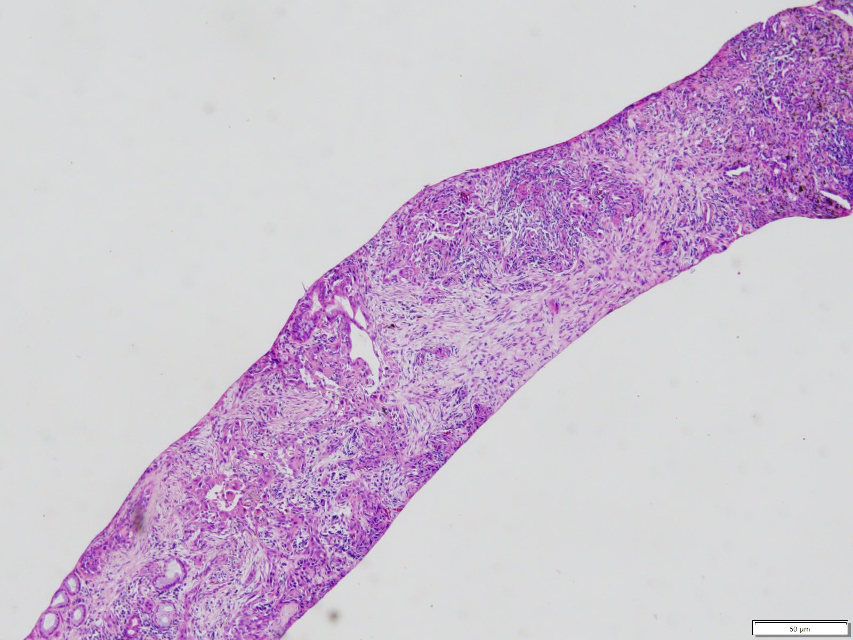

Slide 5
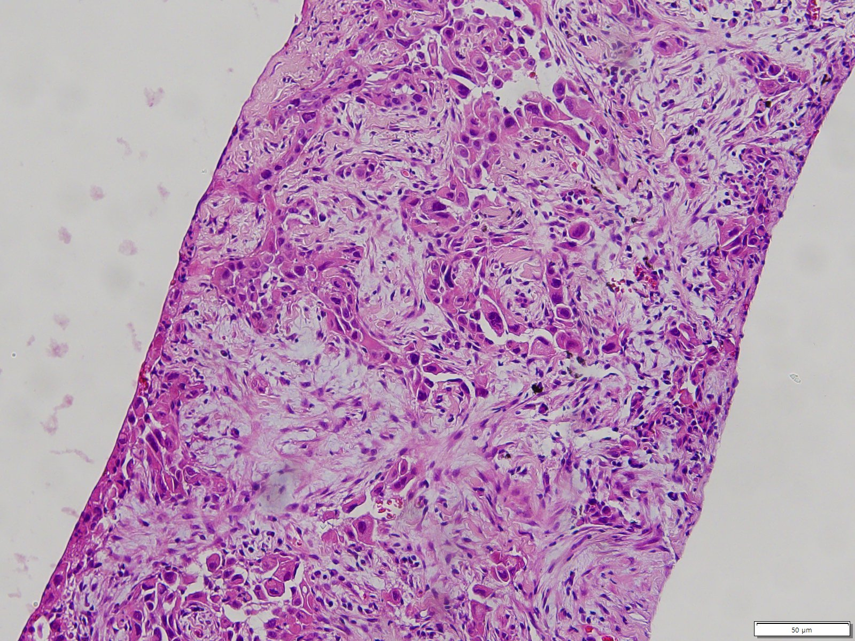

Slide 6
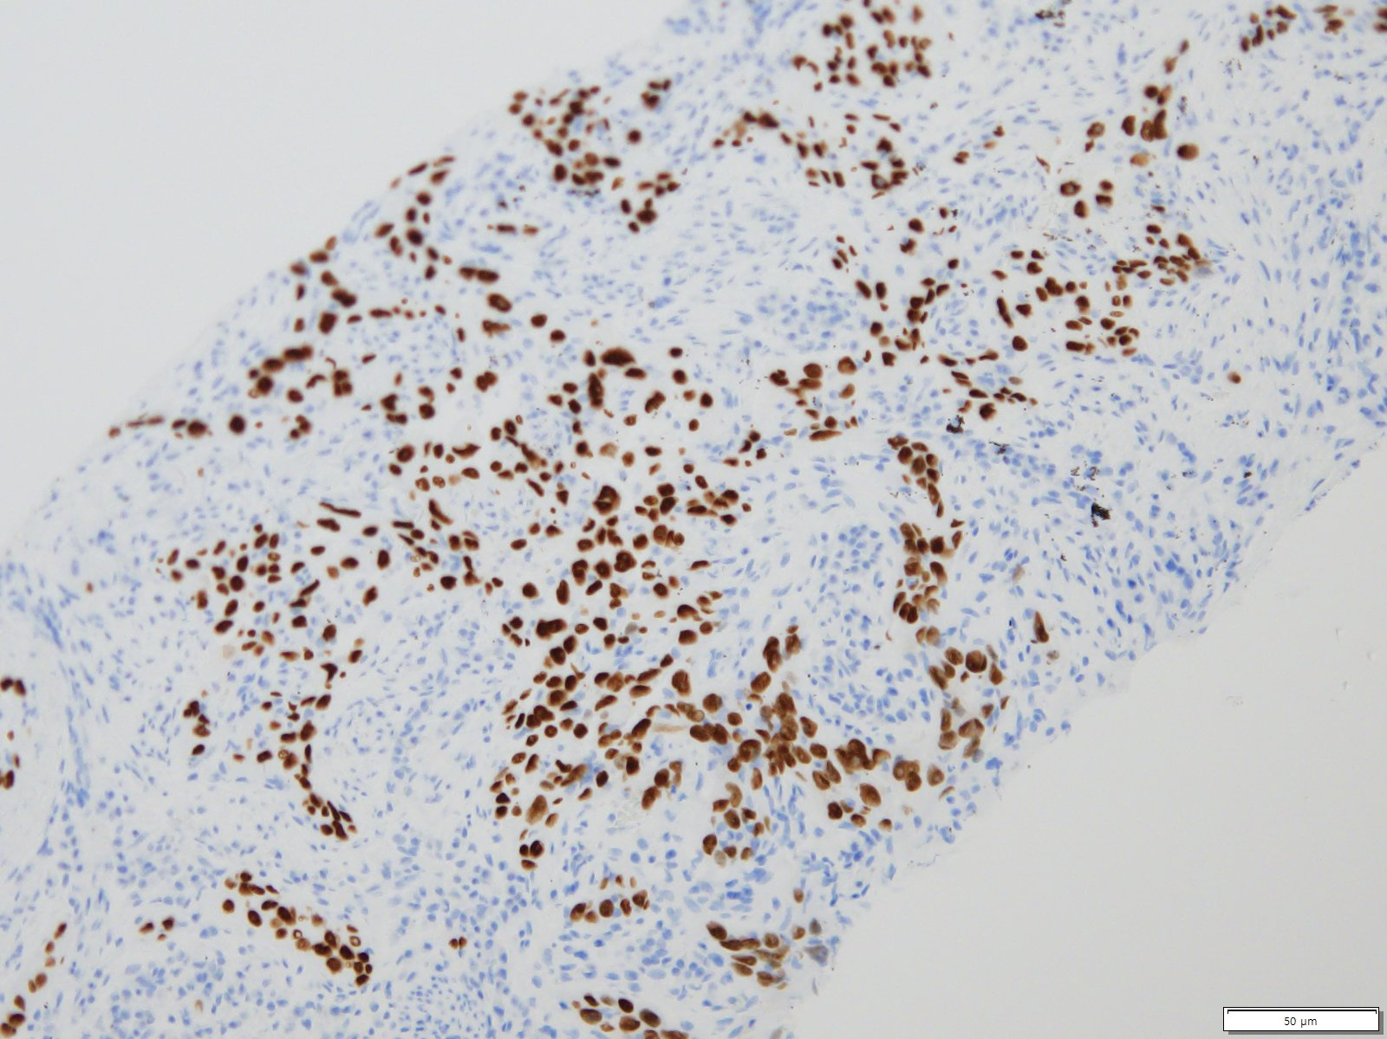
p40

Slide 7
Pathological diagnosis
Non-small cell carcinoma, favoring squamous cell carcinoma, see note.
Note)
1. Immunohistochemical staining results:
p40: Positive in tumor cells
TTF-1: Negative in tumor cells
ALK (D5F3) and ROS1: Negative in tumor cells (no detectable staining)
2. <VENTANA PD-L1 (SP263) Assay Result>
-Tumor Proportion Score: 80%
3. EGFR mutation (PNA Mutyper real time PCR): E19 del Mutant

Slide 8
Case 2) 이O서 (8696472)
SS18-48013
SS18-47256

Slide 9
SS18-47256
Lung, right upper lobe, CT-guided biopsy

Slide 10
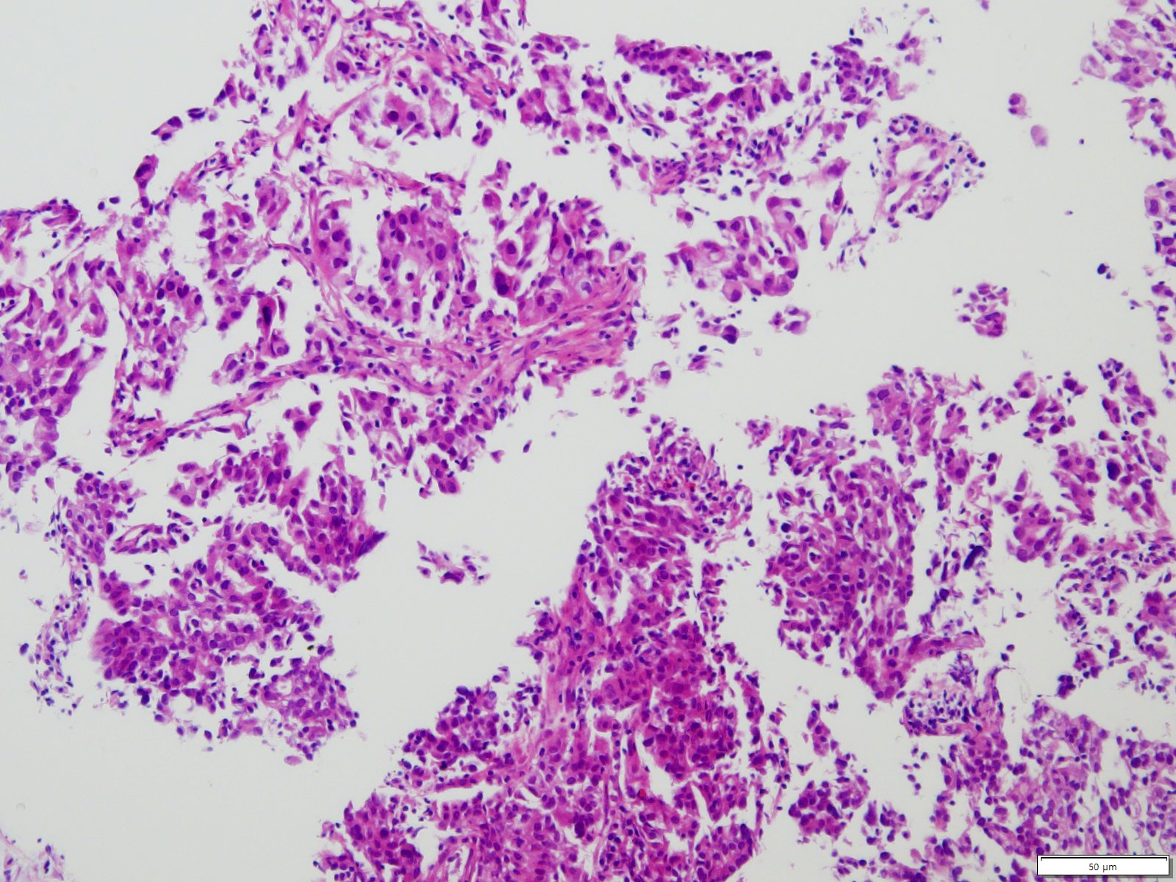

Slide 11
Pathological diagnosis
Adenocarcinoma, see note.
Note) An additional report will follow after immunohistochemical staining and EGFR mutation testing.
[Additional report-1]
The immunohistochemical stain results:
ALK (D5F3) and ROS1: Negative in tumor cells (no detectable staining)
[Additional Report-2]
<VENTANA PD-L1 (SP263) Assay Result>
-Tumor Proportion Score: 95%
[Additional Report-3]
EGFR mutation (PNA Mutyper real time PCR): E19 del Mutant

Slide 12
SS18-48013
Brain, craniotomy and removal

Slide 13
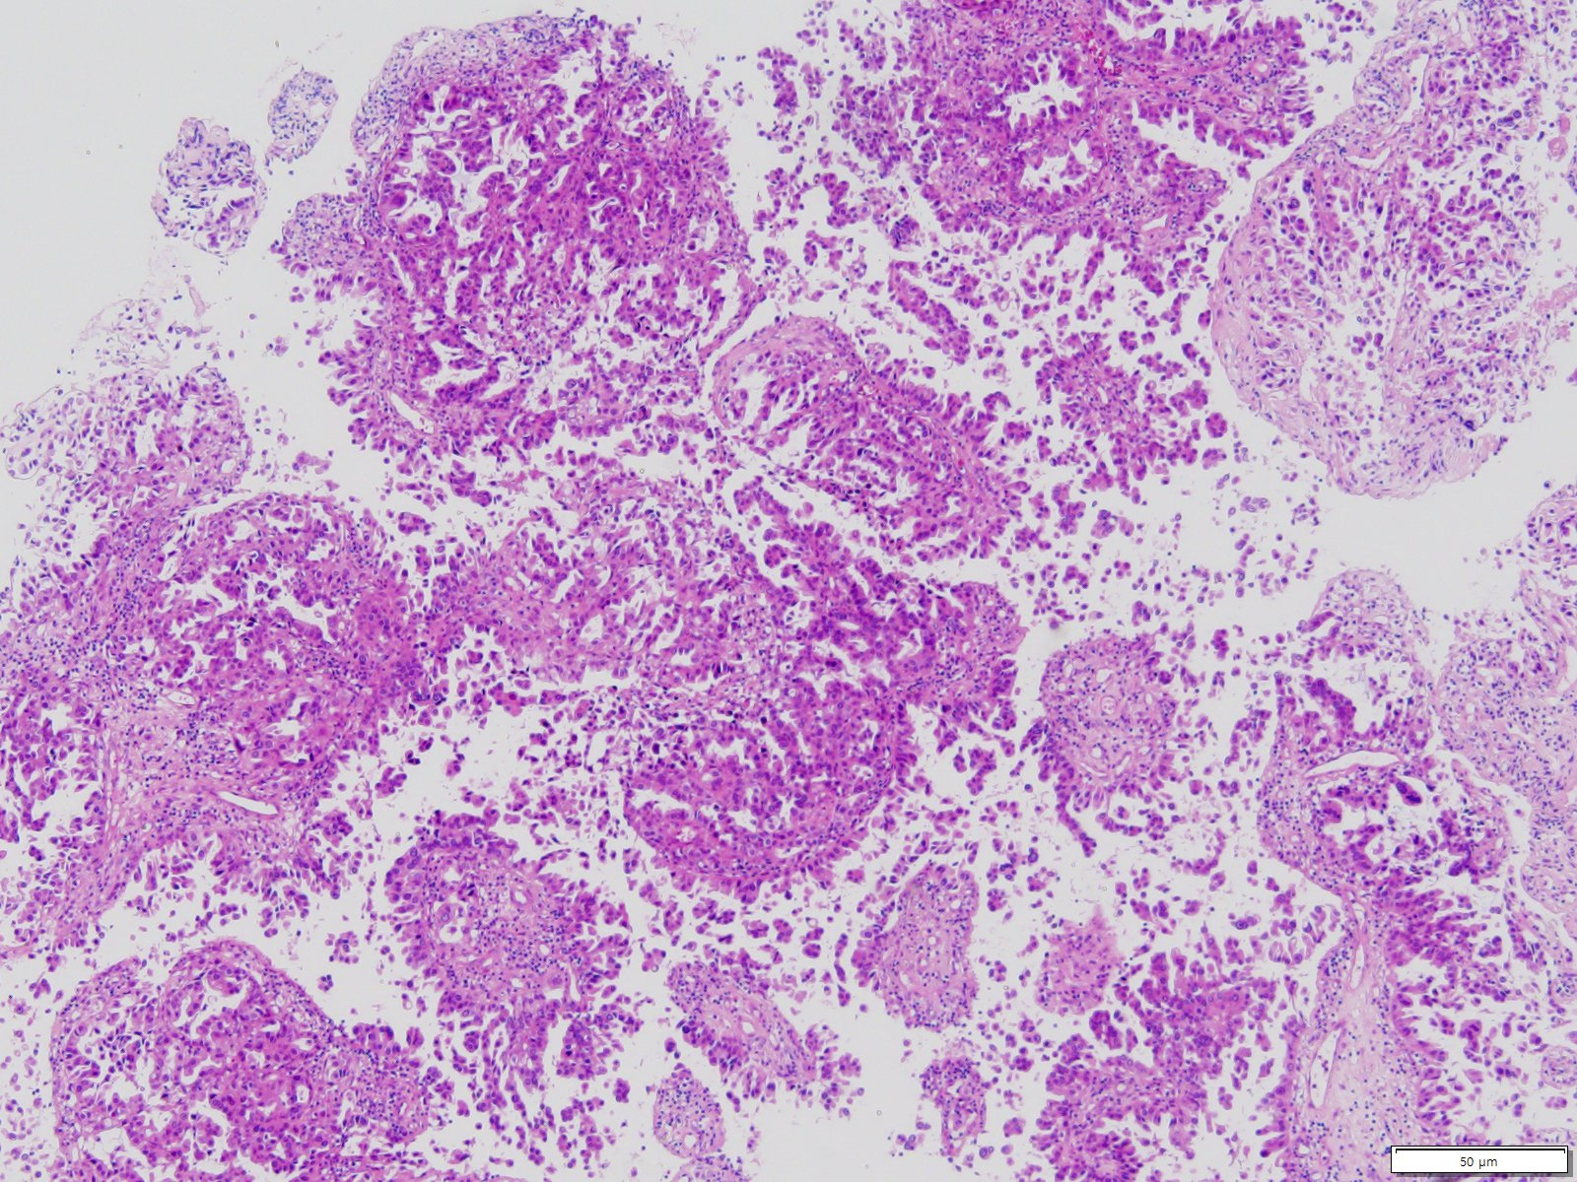

Slide 14
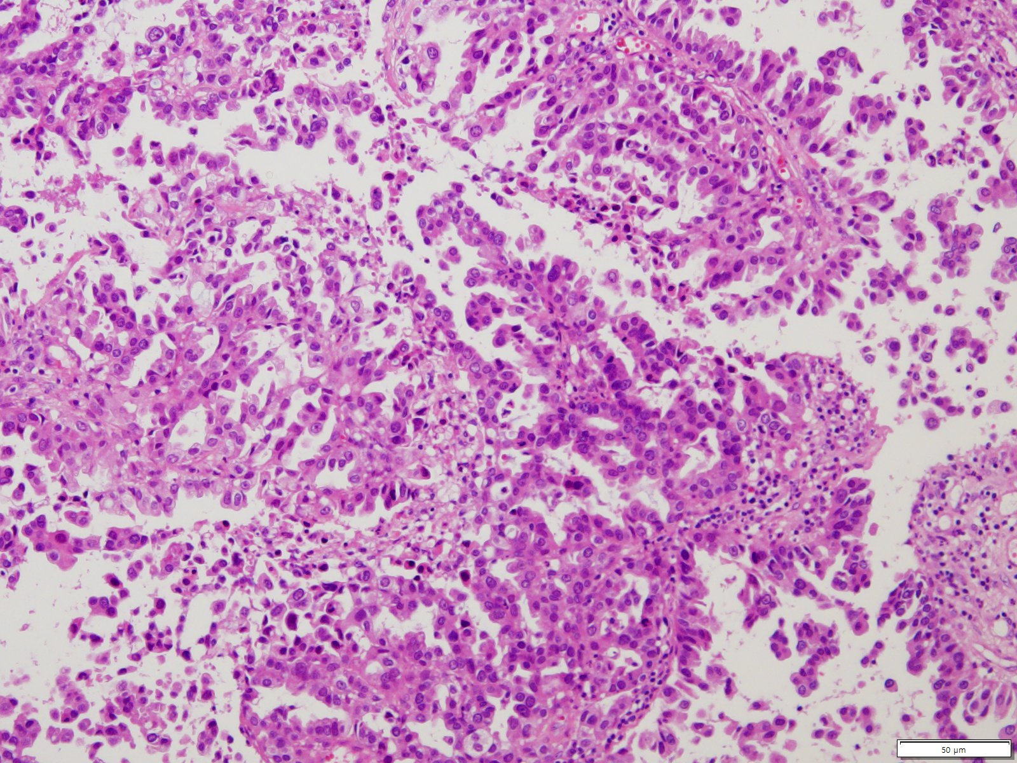

Slide 15
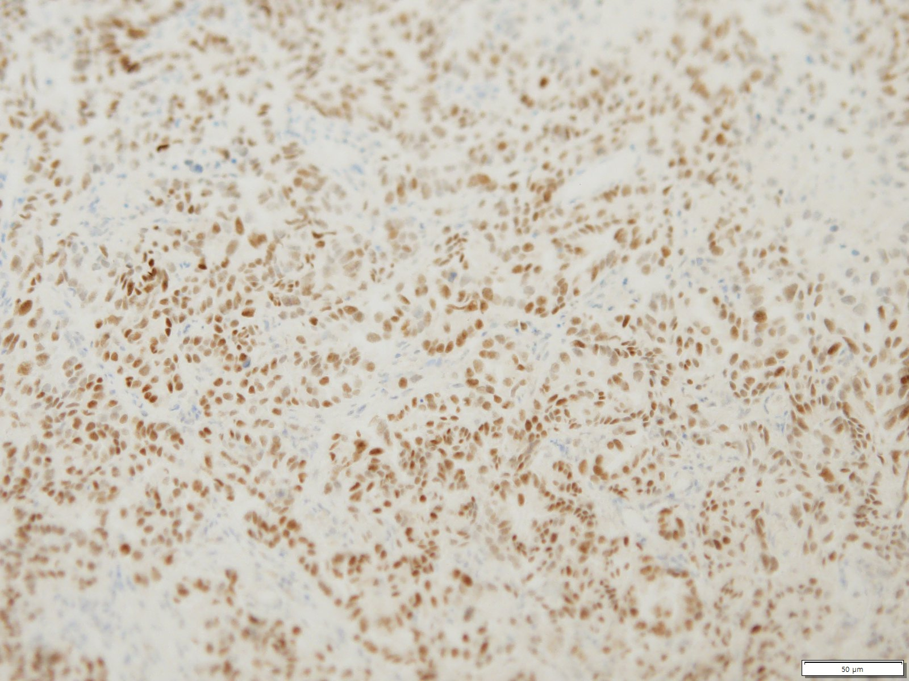
TTF-1

Slide 16
Pathological diagnosis
A. Brain tumor: Metastatic adenocarcinoma, clinically from lung, see Note
B. Normal: Free from tumor
Note)
1. The immunohistochemical stain results:
TTF-1: positive in tumor cells
p40: negative in tumor cells
2. 이러한 면역조직화학염색 결과는 lung 에서 기원한 adenocarcinoma 를 지지하는 소견입니다.

Slide 17
Case 3) 김O종 (8746400)
SF19-00977
SS19-12660

Slide 18
SF19-00977
Lung, right upper lobe, lobectomy and frozen section examination

Slide 19
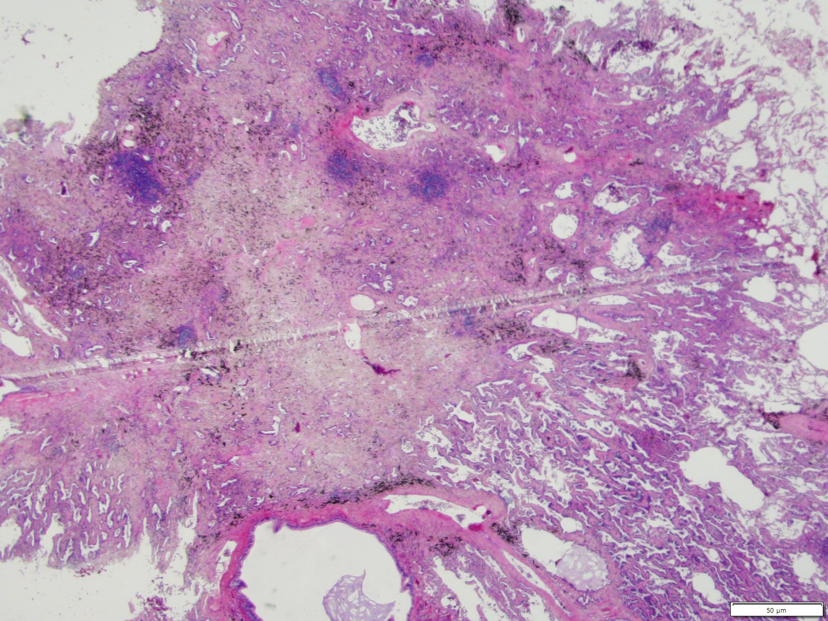

Slide 20
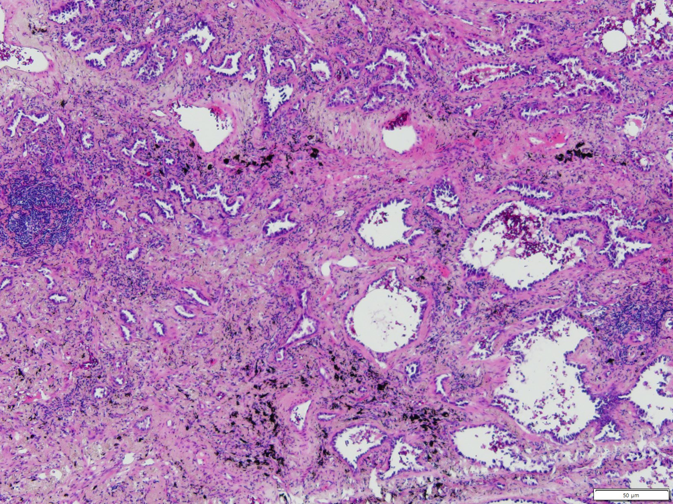

Slide 21
Pathological diagnosis
Lung, right upper lobe:
Adenocarcinoma, invasive, acinar predominant
◇ Tumor size (total): 1.7x1.0cm
◇ Tumor size (invasive): 1.0cm
◇ Bronchial involvement: Not involved
◇ Pleura, visceral: Not involved (PL0)
◇ Necrosis: Absent
◇ Lymphovascular invasion: Not identified
◇ Perineural invasion: Not identified
◇ Spread through air spaces: Not identified
◇ Non-neoplastic lung: Not remarkable
◇ Resection margin, bronchus: Free of carcinoma (safety margin: 3.0cm)
◇ Histologic component: acinar 70%, lepidic 30%
◇ pT1aN0 (AJCC 8th ed.), according to invasive size
[Additional report]
The immunohistochemical stain results:
ALK (D5F3): Negative in tumor cells (no detectable staining)
[Additional Report]
EGFR mutation (PNA Mutyper real time PCR): L858R Mutant

Slide 22
SS19-12660
Lung, right upper lobe, lobectomy and mediastinal lymph node dissection
Lung, right middle lobe, wedge resection

Slide 23
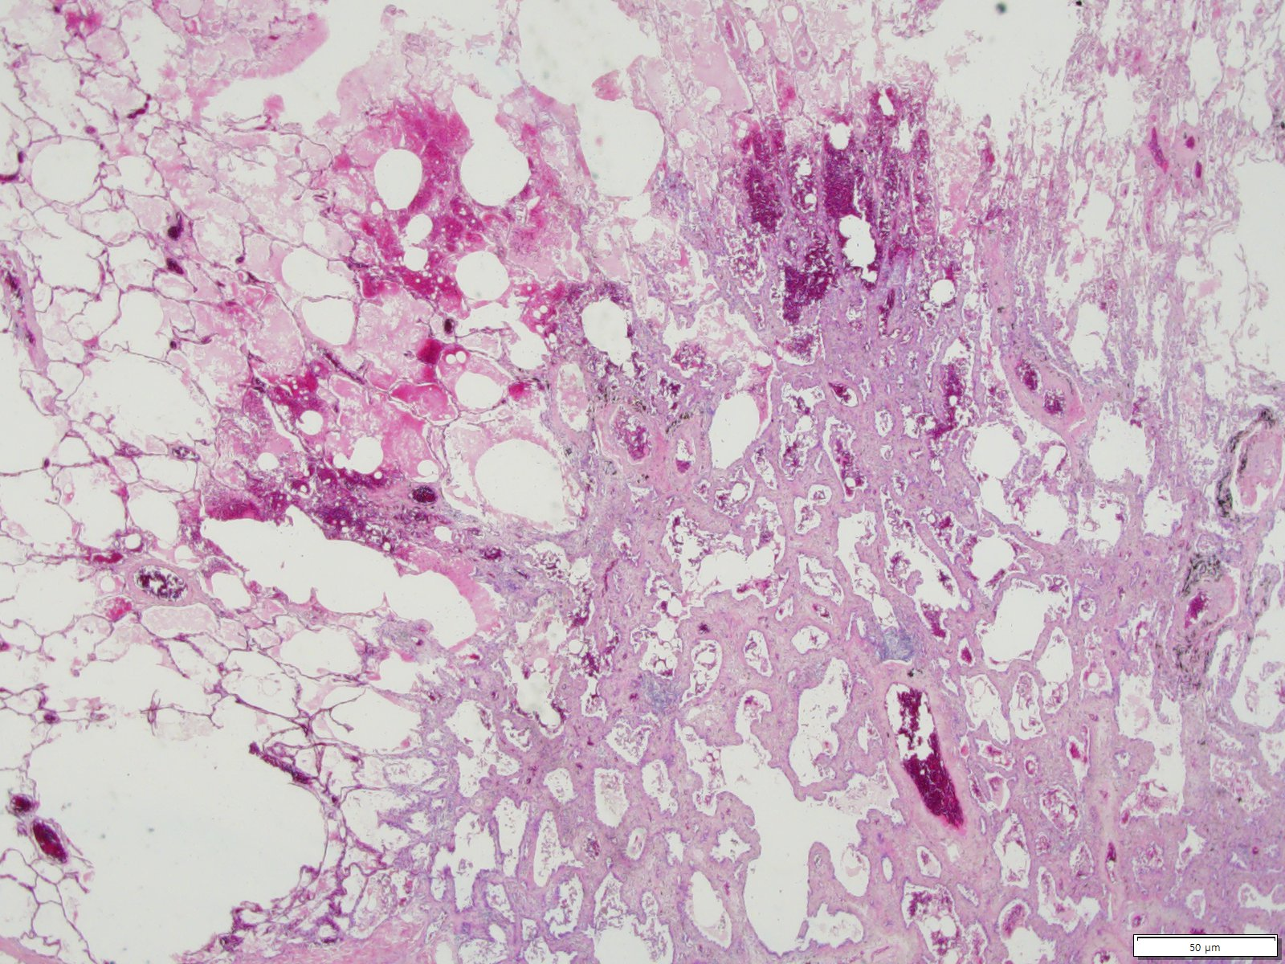

Slide 24
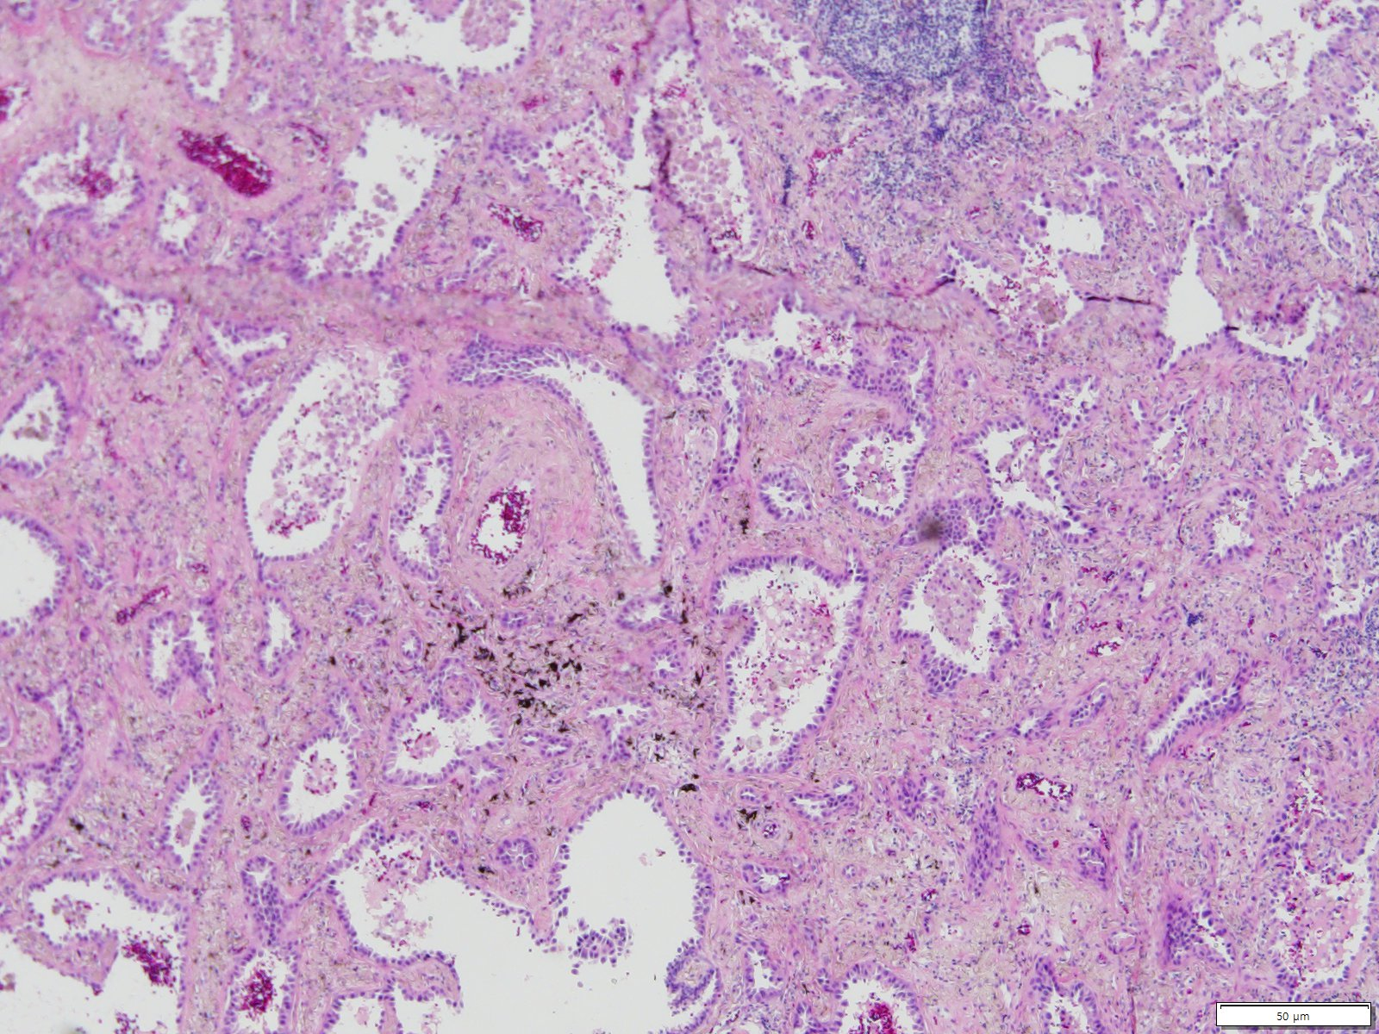

Slide 25
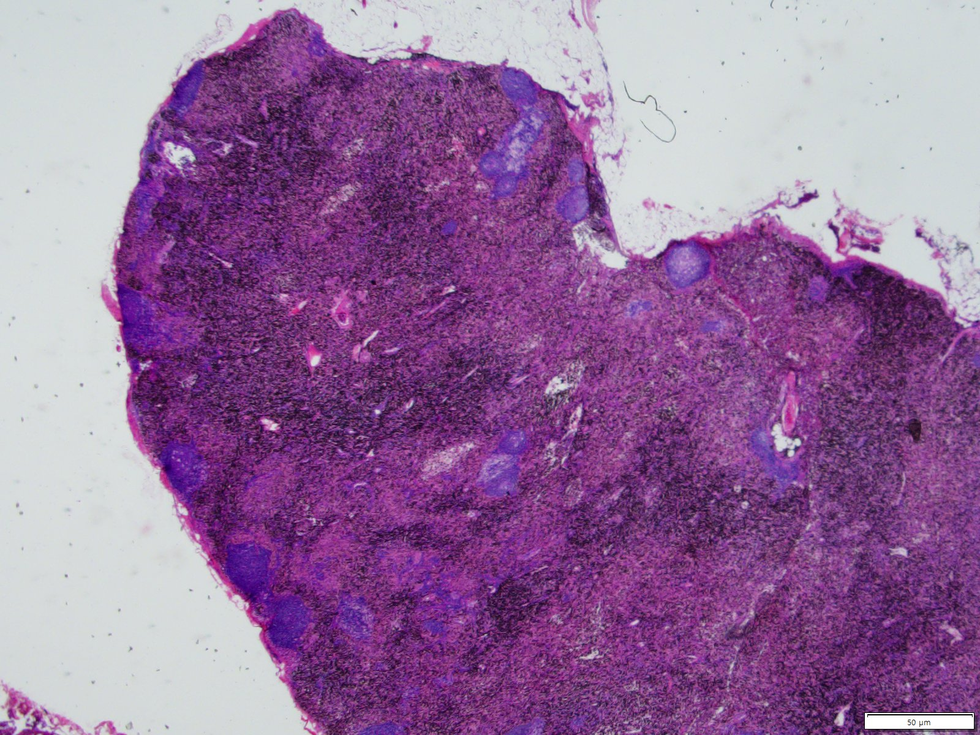

Slide 26
Pathological diagnosis
Lung, right upper lobe:
1. Status post wedge resection for frozen examination (see SF19-00977)
2. No residual carcinoma
◇ Non-neoplastic lung: Not remarkable
◇ Resection margins, bronchus and vessel: Free of carcinoma
◇ Lymph nodes, peribronchial (0/2): Free of carcinoma
◇ Lymph nodes, separately sent: upper paratracheal (0/5), lower paratracheal (0/5), subcarinal (0/10), IPL (0/2), hilar (0/9) and interlobar (0/3); total (0/34): Free of carcinoma
Lung, right middle lobe:
Adenocarcinoma, invasive, lepidic predominant
◇ Tumor size (total): 1.4x0.9cm
◇ Tumor size (invasive): 0.7cm
◇ Bronchial involvement: Not involved
◇ Pleura, visceral: Not involved (PL0)
◇ Necrosis: Absent
◇ Lymphovascular invasion: Not identified
◇ Perineural invasion: Not identified
◇ Spread through air spaces: Not identified
◇ Non-neoplastic lung: Not remarkable
◇ Resection margin, parenchyme: Abutting of tumor
◇ Histologic component: lepidic 55%, acinar 45%
◇ pT1aN0 (AJCC 8th ed.), according to invasive size
Note) 두 mass 모두 lepidic component가 존재하여 double primary tumor로 판단하였습니다.
[Additional Report]
Lung, right middle lobe mass:
EGFR mutation (PNA Mutyper real time PCR): L858R Mutant

