Slide 1
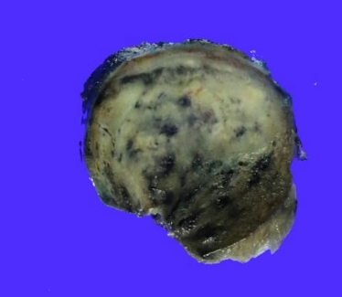
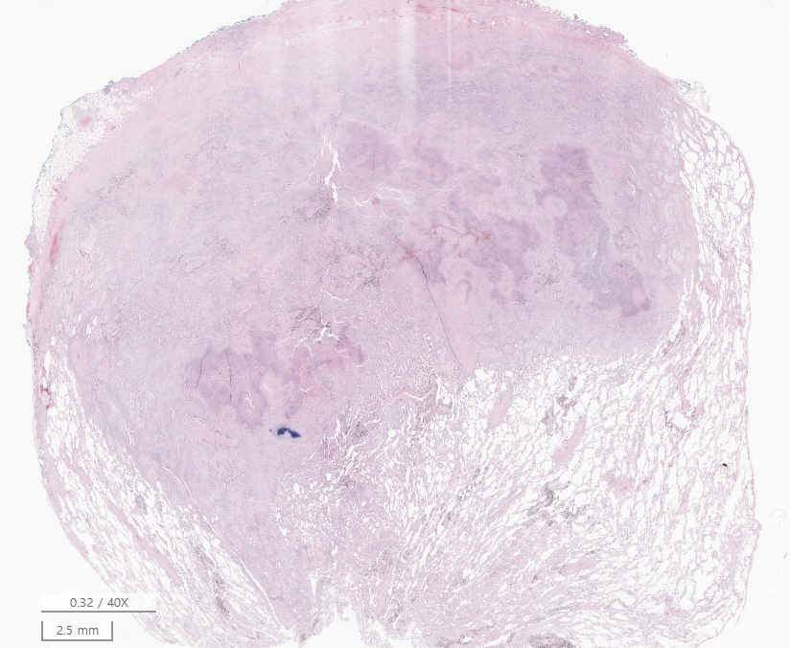
Case 1 양O호SS20-39247
Lung, right upper lobe, VATS assisted wedge resection

Slide 2
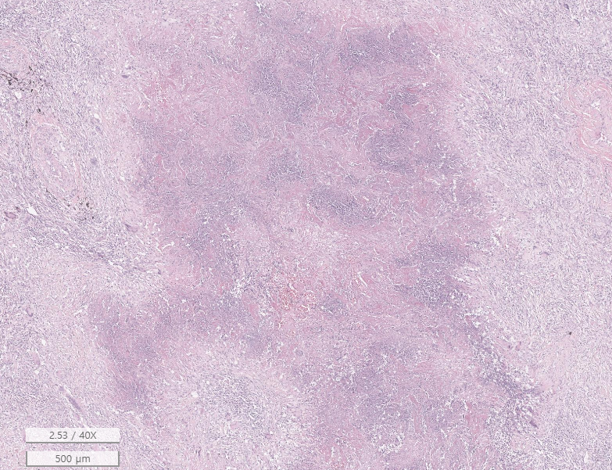
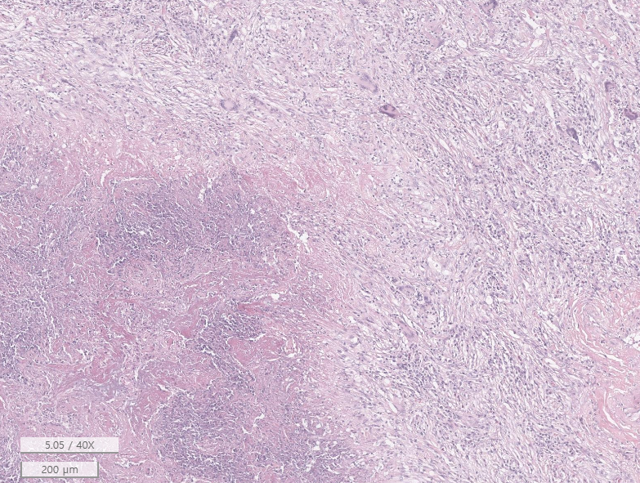

Slide 3
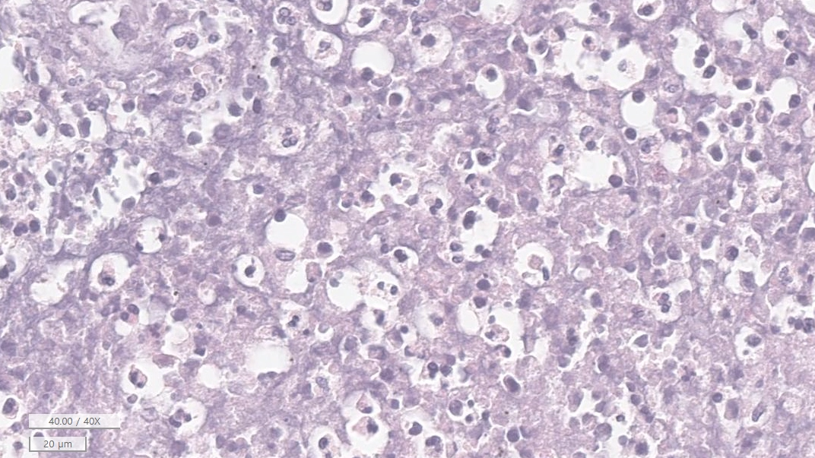

Slide 4
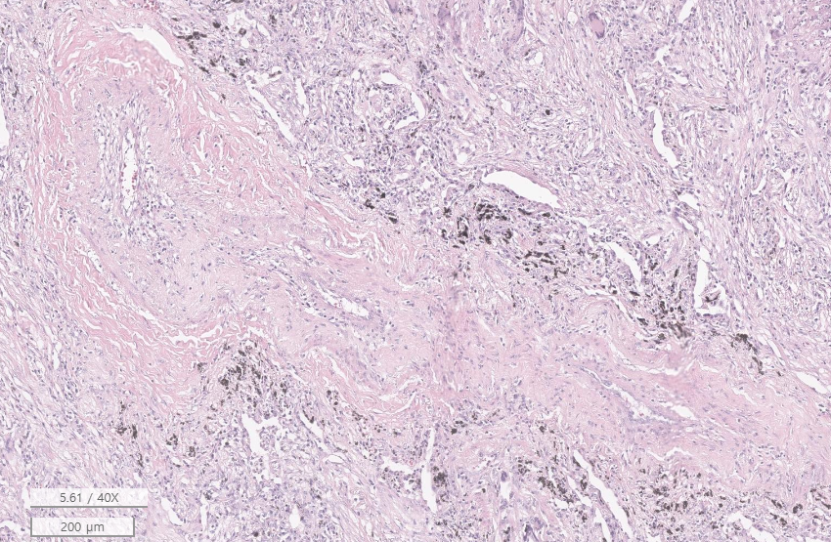
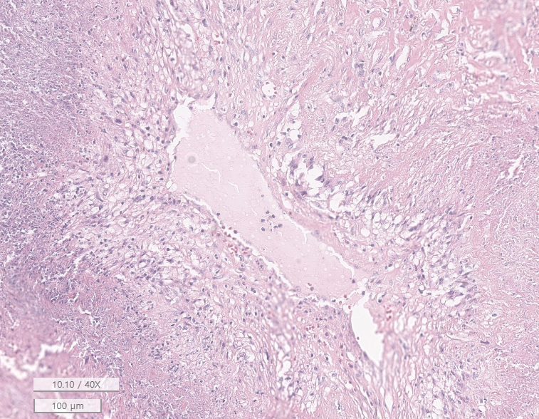
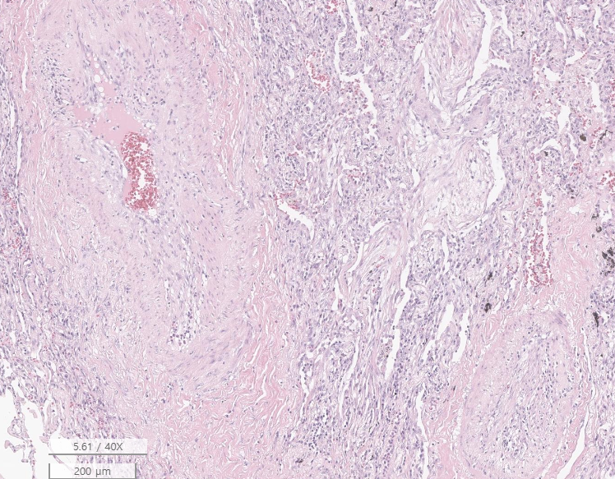
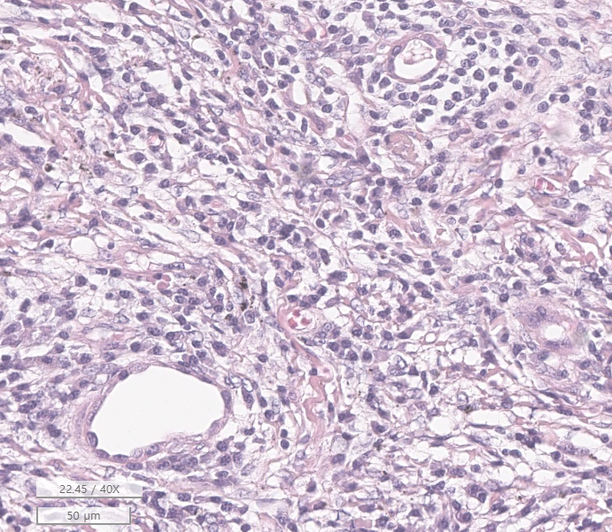

Slide 6
Lung, right upper lobe, VATS assisted wedge resection
Lung, right upper lobe: Multifocal necrotizing granulomatous
inflammation with necrotizing vasculitis, consistent with
granulomatosis with polyangiitis, see note.
[Additional report]
1. The special stain results:
Ziehl-Neelsen stain reveals no acid-fast bacilli.
D-PAS stain reveals no fungal hyphae.
2. Tb-PCR: Negative

Slide 7
Granulomatosis with polyangitis
Wegener granulomatosis
Pauci-Immune small vessel vasculitis
arterioles, capillaries, and venules, often muscular arteries
Upper airways, lungs, glomeruli, others
Extravascular necroinflammatory lesions typical, especially in lung
Necrotizing, cavitary lung lesions with basophilic necrosis
strong association with c-ANCA (PR3)

Slide 8
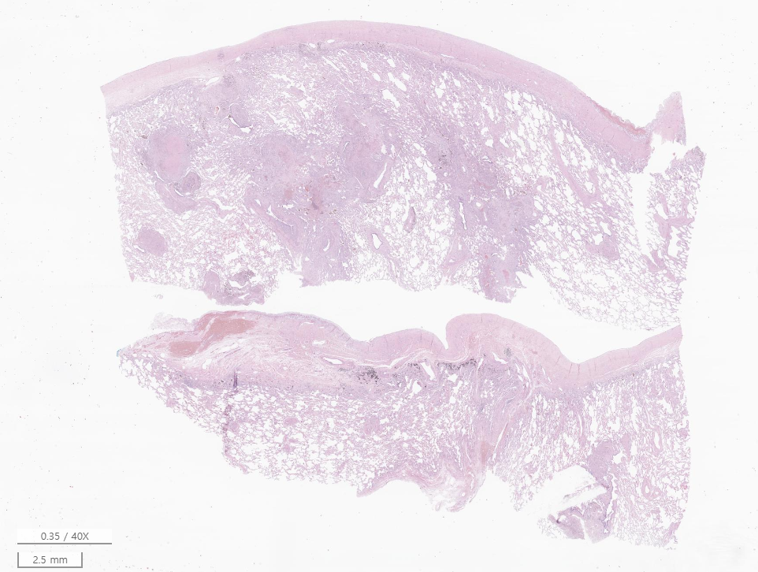
Case 2 모O태
SR22-03309
외부병원 슬라이드. 2017년 채취
Lung, right upper lobe, wedge resection

Slide 9
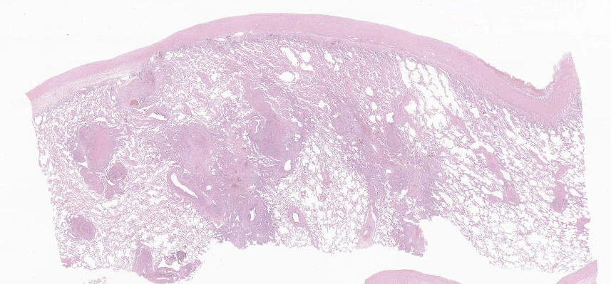

Slide 10
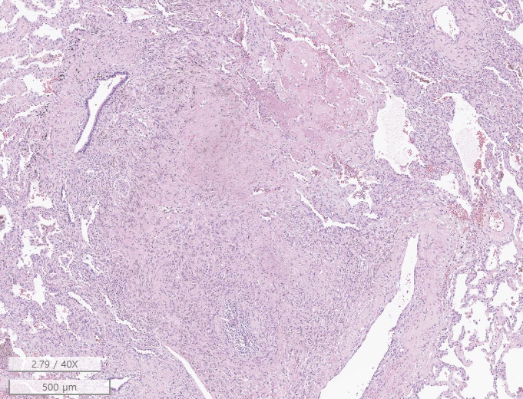
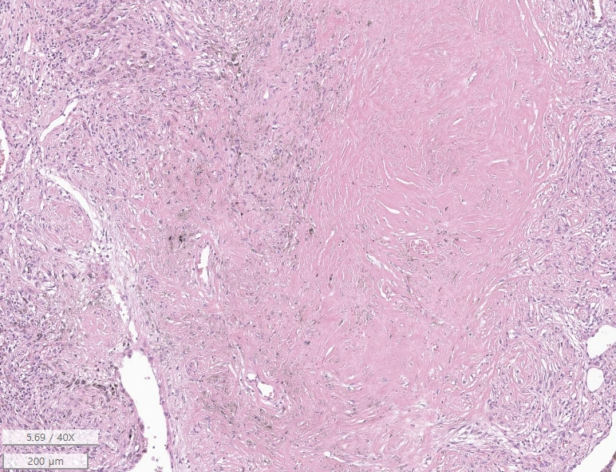
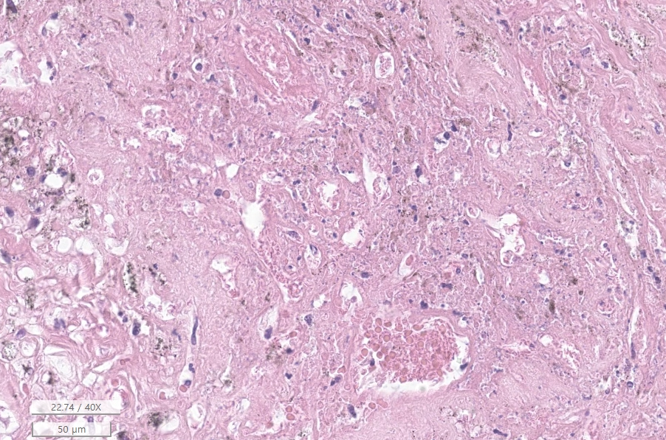

Slide 11
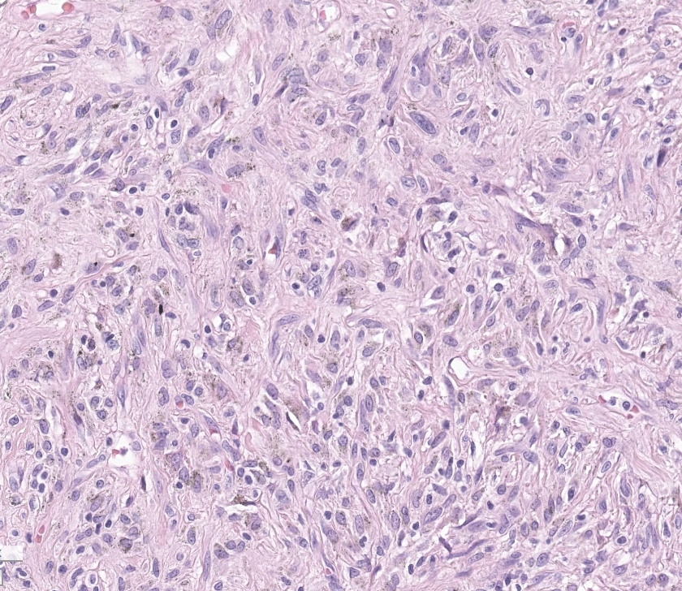
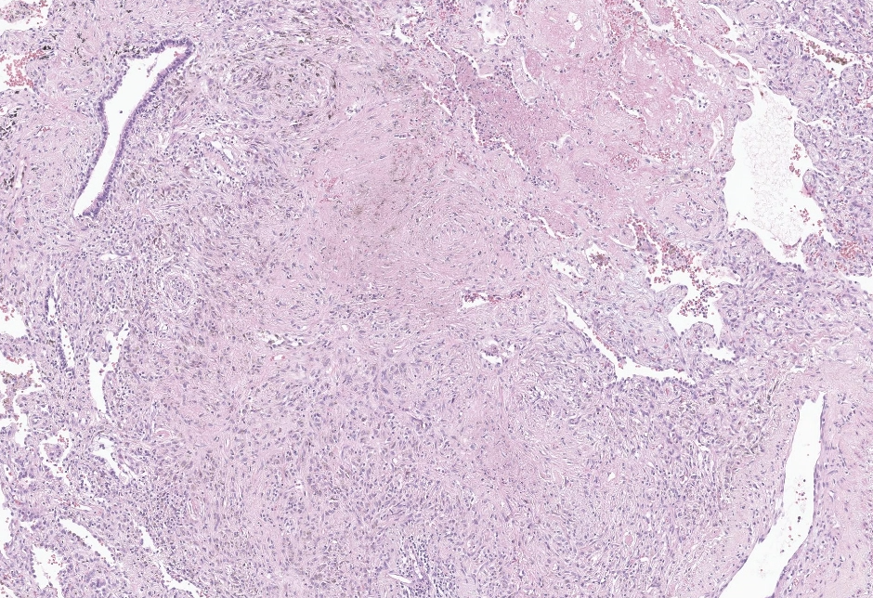

Slide 12
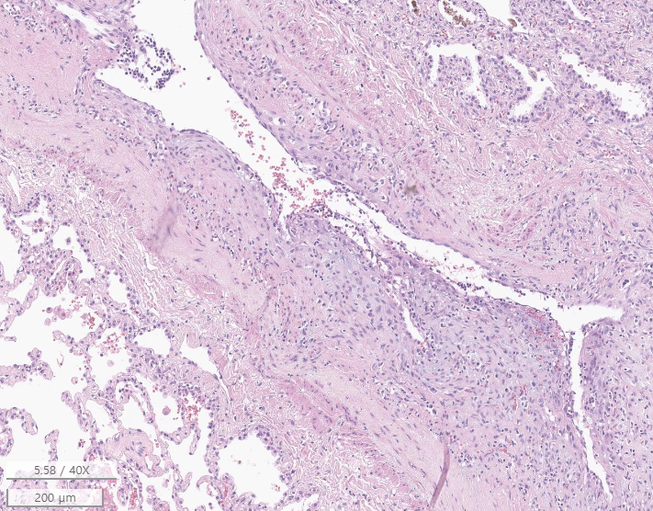
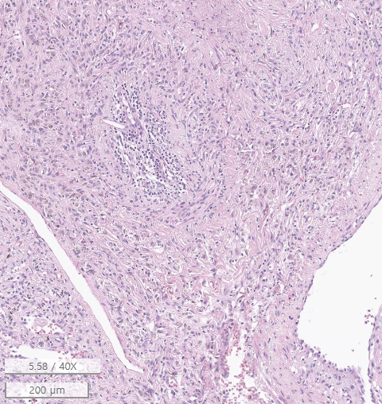

Slide 13
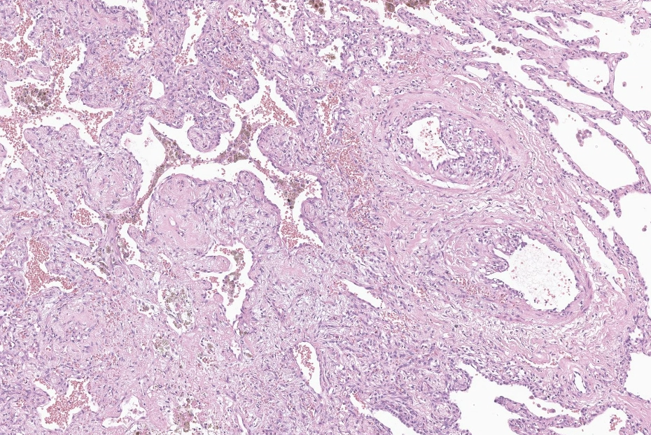

Slide 14
Case 2 모O태
SR22-03309
외부병원 슬라이드. 2017년 채취
Lung, right upper lobe, wedge resection
1. Multifocal interstitial fibrosis and elastosis with anthracotic
pigments and focal necrotic change, especially in perivascular
and subpleural area
2. Inflammatory cell infiltrates in vascular wall and vascular
luminal narrowing, see note
Note) Vessel wall에 염증 세포의 침윤 및 섬유화 소견이 관찰됩니다. Active inflammation (active stage) 소견은 아니지만, healing stage의 vasculitis 가능성을 배제할 수 없습니다. Clinical correlation 이 필요합니다.

Slide 15
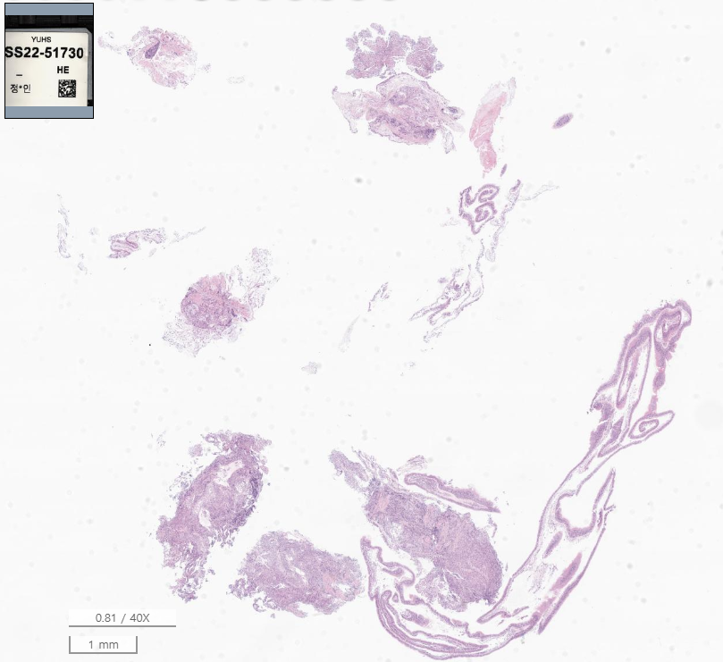
SS22-51730
Lung, right middle lobe, transbronchial lung biopsy

Slide 16
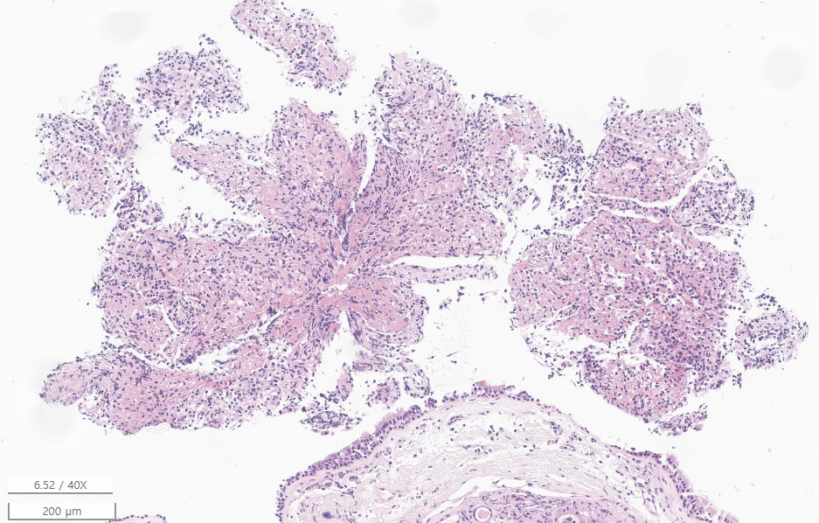
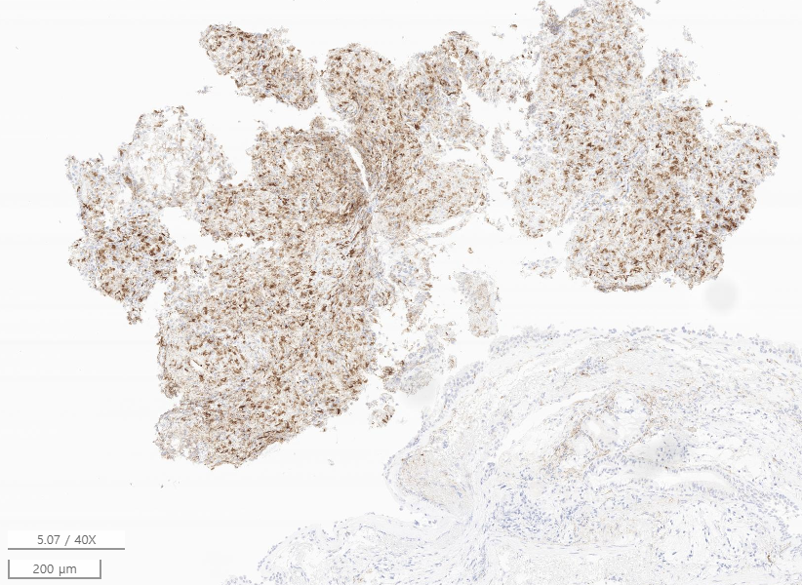
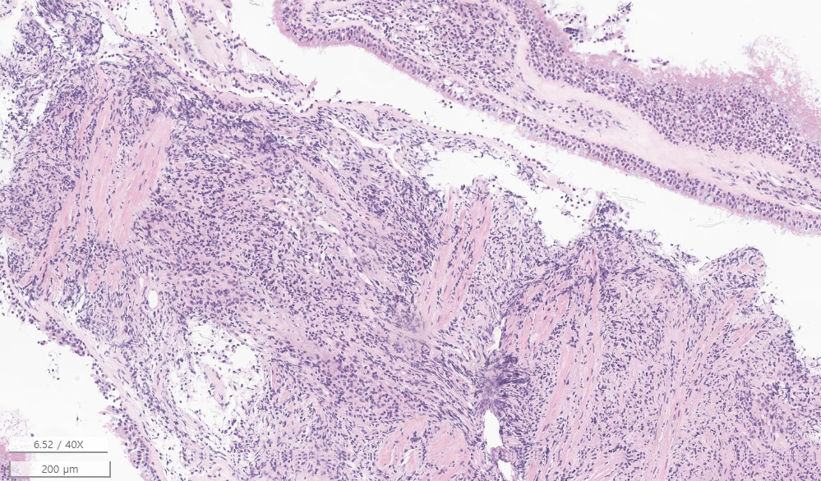
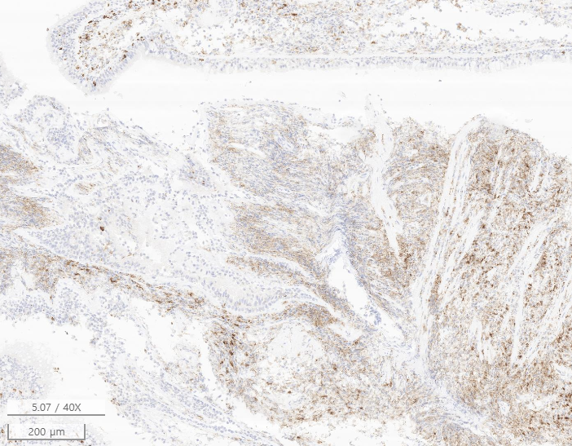
CD68
CD68

Slide 17
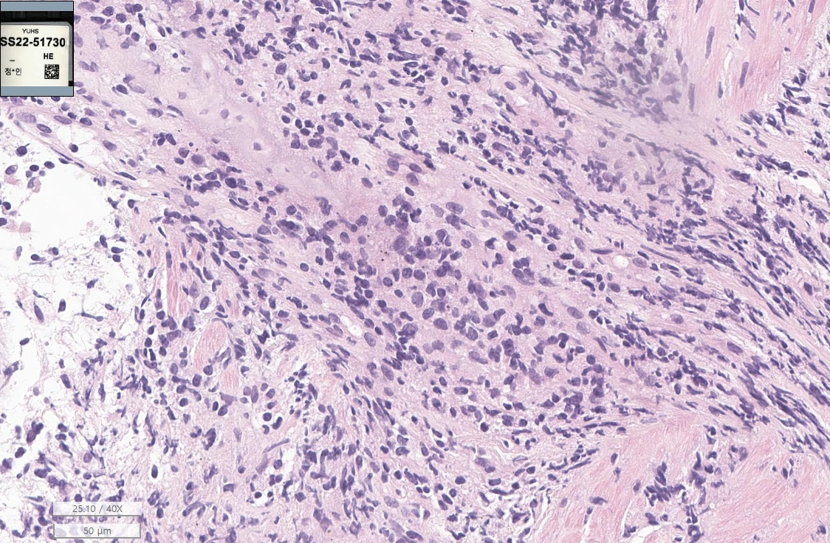

Slide 18
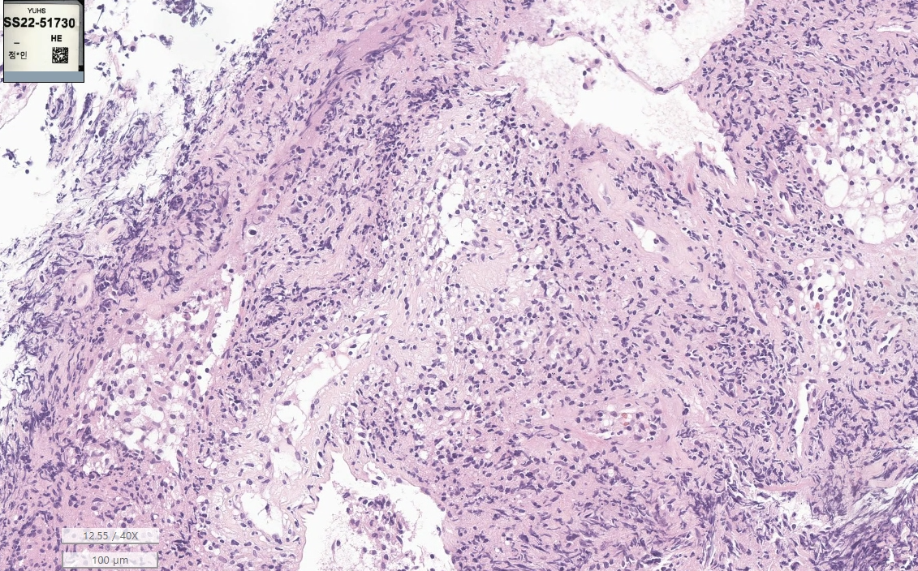

Slide 19
SS22-51730
Lung, right middle lobe, transbronchial lung biopsy
1. Chronic granulomatous inflammation with vasculitis
2. Focal features of acute fibrinous organizing pneumonia
Note)
1. 본 조직 내, malignant B/T cell lymphoma 및 hisitocytic neoplasm의 증거는 관찰되지 않습니다.
2. 임상적으로 infectious disease의 가능성이 완전히 배제된다면, non-infectious granulomatous inflammation (sarcoidosis, graulomatosis with polyangiitis 등등) 을 보일 수 있는 다양한 질환의 감별이 필요합니다. Clinical correlation 하시기 권유드립니다.
3. The immunohistochemical stain results:
- CD3, CD8 and CD20: Positive in reactive T and B cells
- CD68: Diffuse positivity denotes numerous histiocystes
- CD56: Negative
- Granzyme: Few positive
- CD163: Positive in histiocytes
- S100, CD1a and Langerin: Negative in histiocytes
- BRAF(VE1): Negative
4. EBV ISH: Negative
5. The special stain results:
- Ziehl-Neelsen stain: No acid-fast bacilli.
- GMS stain: No fungal hyphae.
6. Tb-PCR(중합효소연쇄교잡반응법): Negative
7. BRAF mutation (PNA real time PCR): Wild
8. TCR gamma, beta gene rearrangement: Both negative

Slide 20
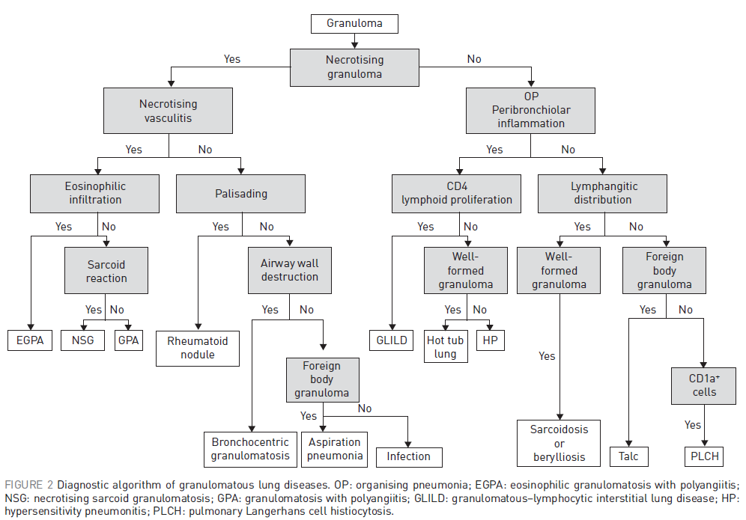
Number 4 in the Series “Pathology for the clinician” Edited by Peter Dorfmüller and Alberto Cavazza. 2017;26.

Slide 21
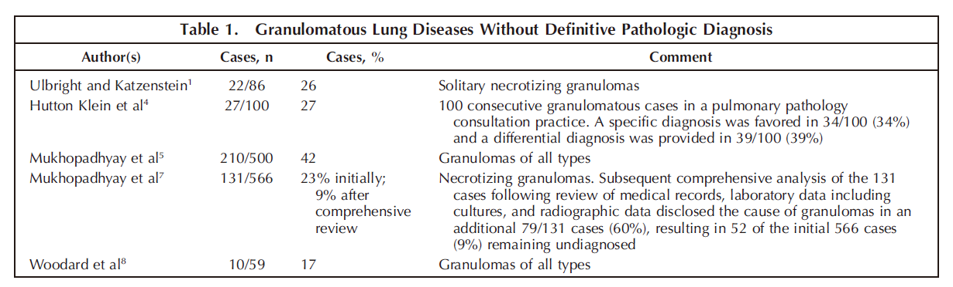
Rosen Y. Pathology of Granulomatous Pulmonary Diseases. Archives of Pathology & Laboratory Medicine. 2021;146:233-51.

Slide 22
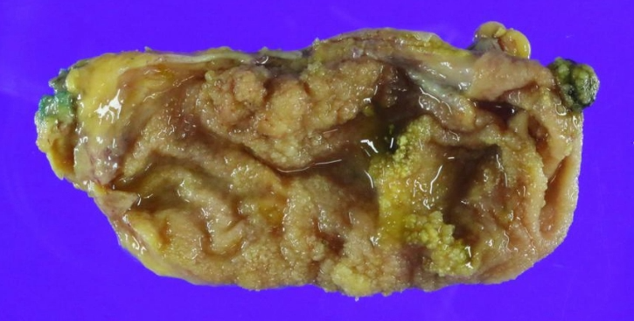
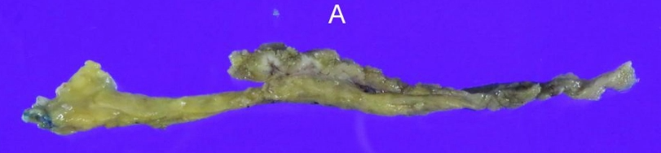
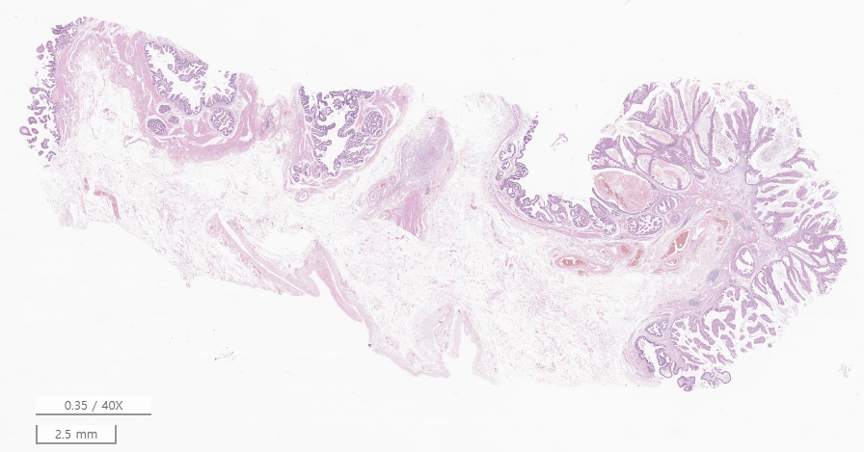
Case 3 장O진
SS19-03682
Gallbladder, laparoscopic cholecystectomy
Gallbladder:
1. Adenocarcinoma, moderately differentiated, associated with tubulopapillary adenoma, intestinal type
◇ Size of carcinoma: 0.9x0.7 cm
◇ Tumor extent: Invades lamina propria (T1a; AJCC 8th ed.)
◇ Lymphovascular invasion: Not identified
◇ Perineural invasion: Not identified
◇ Resection margins,
- Cystic duct: Free of carcinoma (safety margin: 2.8 cm)
- Circumferential: Free of carcinoma
2. Leukocytoclastic vasculitis with fibrinoid necrosis involving small to medium-sized blood vessel in subserosal layer
Separately sent, soft tissue, labeled as 'lymph node': Free of carcinoma

Slide 23
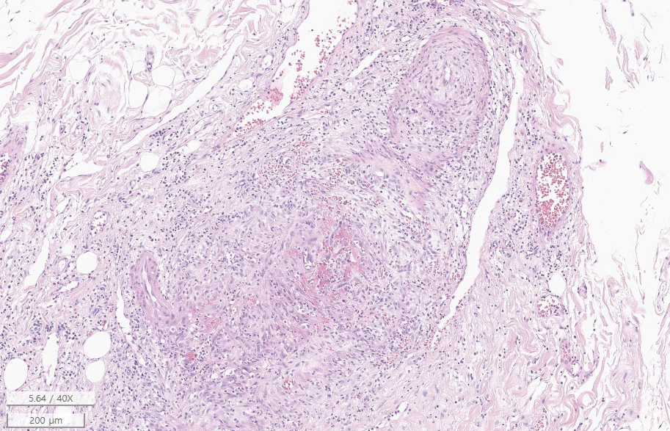
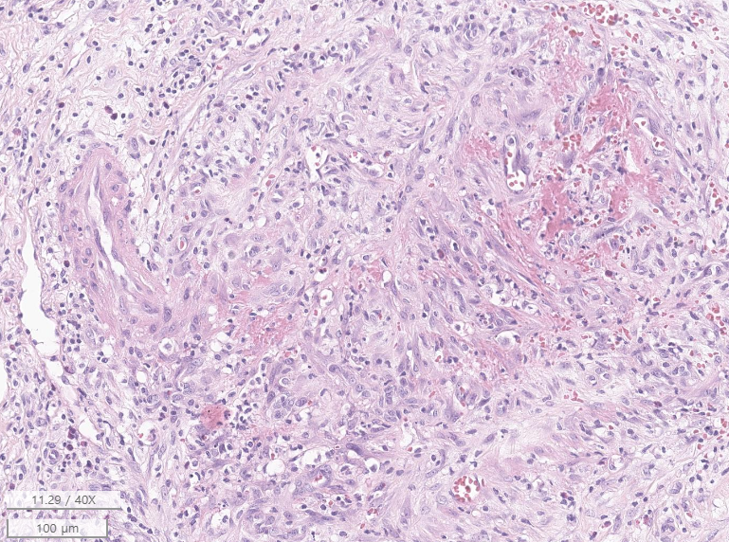

Slide 24
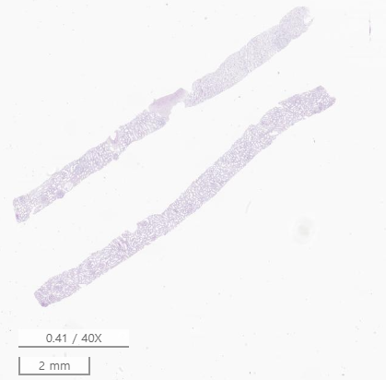
SS19-05387
Kidney, biopsy
Kidney: Henoch-Schonlein purpura nephritis, subclass IV according to Haas classification
◇ Key pathological features Oxford classification system
1. Mesangial score: <0.5 (M0)
2. Endocapillary hypercellularity: present (E1)
3. Segmental glomerulosclerosis: absent (S0)
4. Tubular atrophy/interstitial fibrosis: <25% (T0)
5. Crescent: >25% (C2)
LM: The sections demonstrate two cores of renal cortex and medulla, containing 24 glomeruli per section. One glomerulus shows global sclerosis. One glomerulus shows segmental sclerosis. Six glomeruli show cellular/fibrocellular crescent. Eight glomeruli show endocapillary hypercellularity (two global and six segmental). Focal mild mesangial hypercellularity is also present. The glomerular basement membrane is not thickened. The tubules show minimal atrophy. The interstitium is widened by minimal fibrosis and mild mononuclear infiltrate. The blood vessels are not remarkable.
IF: The sections were reacted with antibodies specific for heavy chains of IgG, IgA, and IgM, and against C3, C4, C1q, fibrinogen, kappa and lambda. There are 3 glomeruli present. Granular deposits of IgA(3+), IgM(1+), C3(1+), C1q(speck), fibrinogen(3+), kappa(1+) and lambda(1+) are present in the mesangium.
[Additional report]
EM: Two glomeruli were examined. Glomerular capillary loops show segmental subendothelial electron lucent widening associated with endothelial detachement and necrosis. Several platelets are present in the capillary lumen. The glomerular basement membrane is relatively even and not thickened. The epithelial foot processes are diffusely effaced. The mesangium is not expanded but has several electron-dense deposits.

Slide 25
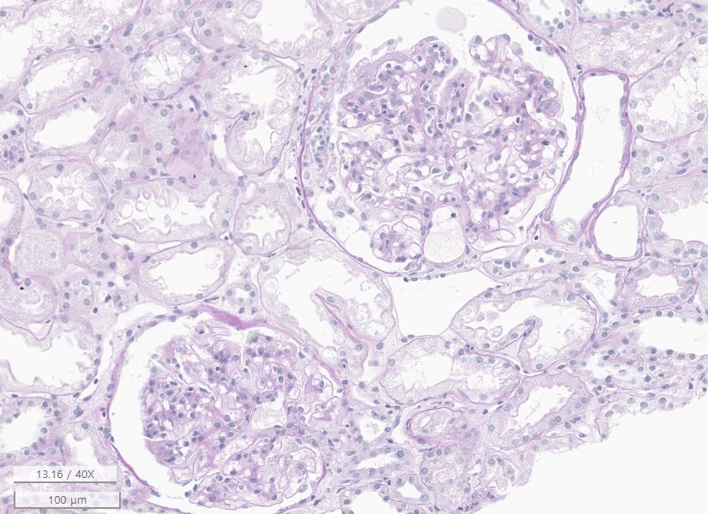
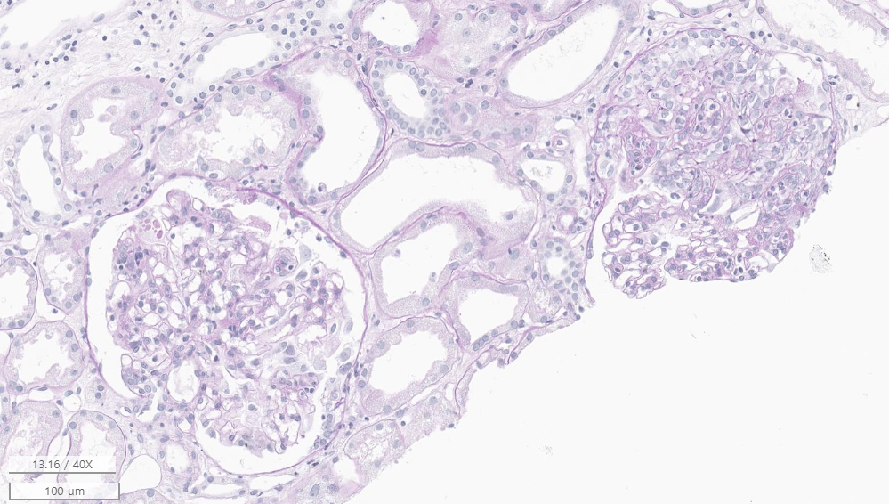

Slide 26
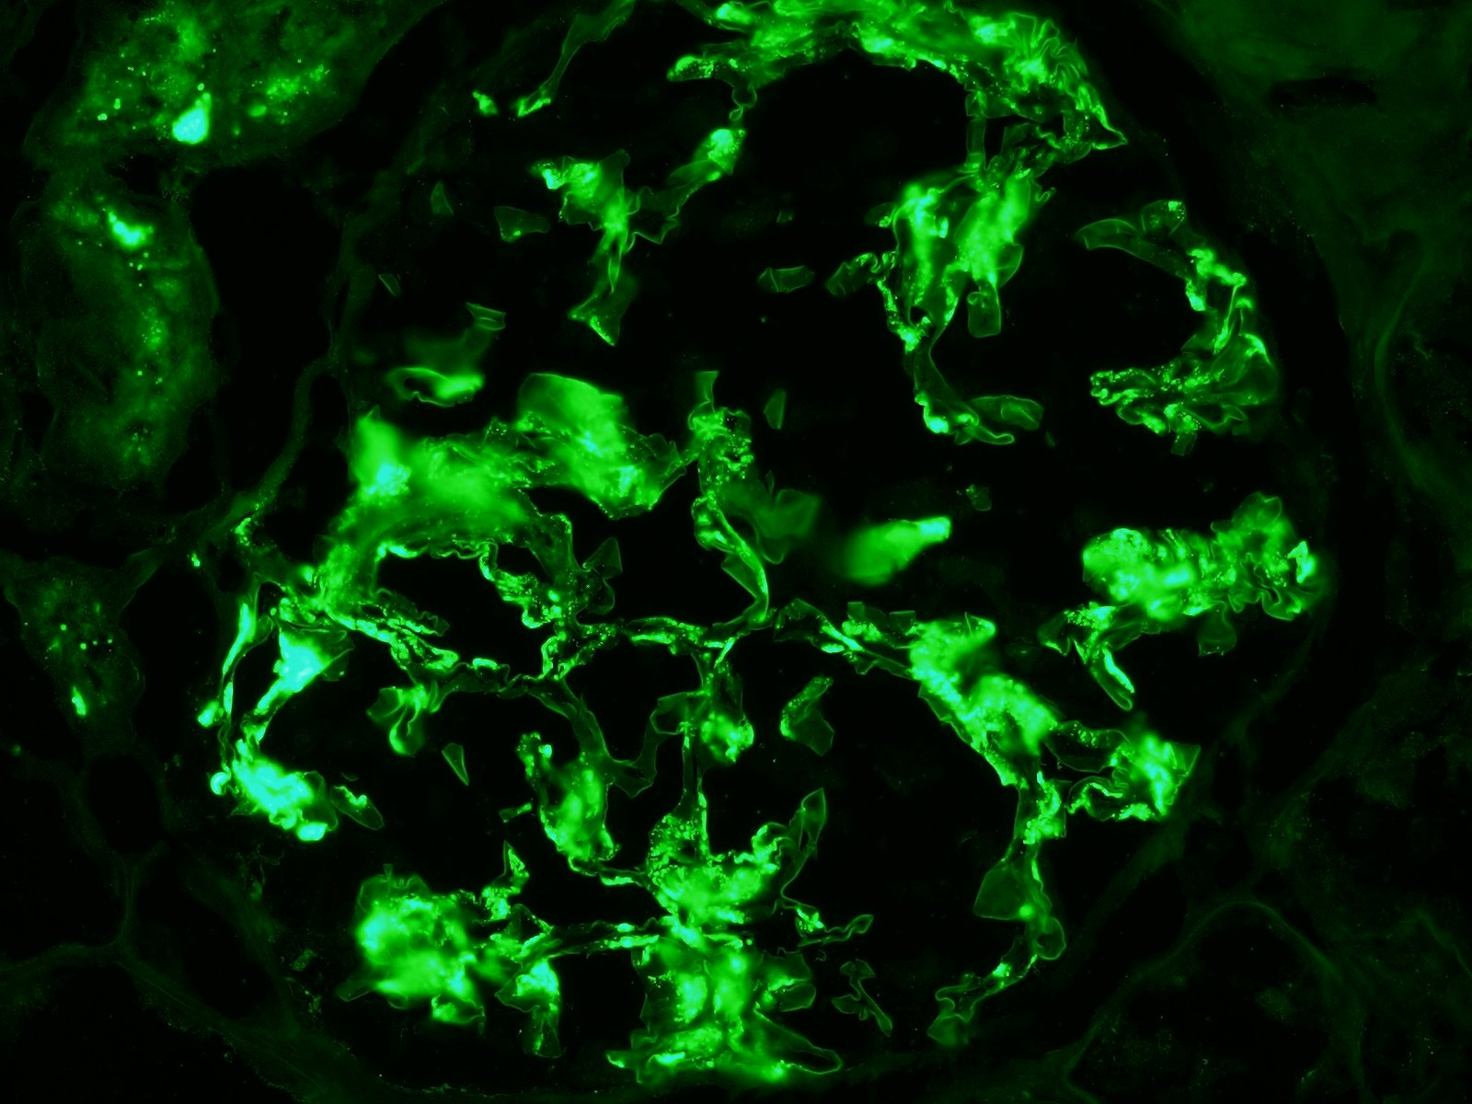
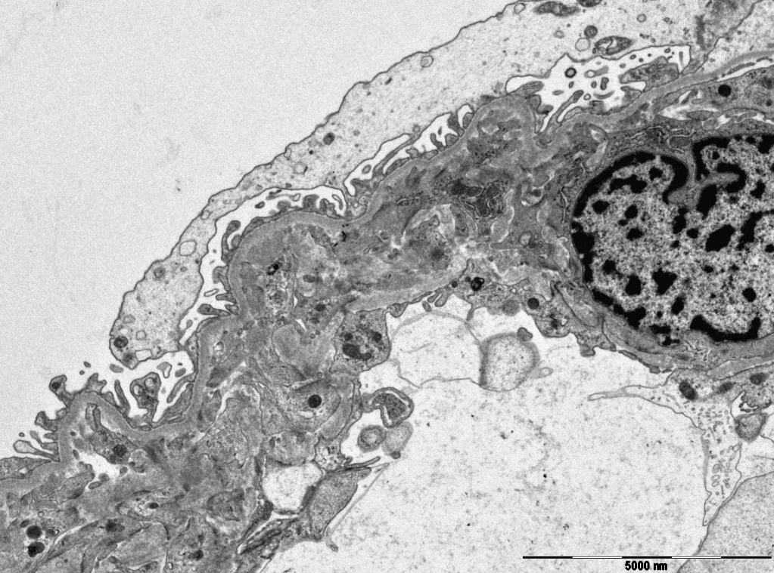
IF for Ig A
EM

Slide 27
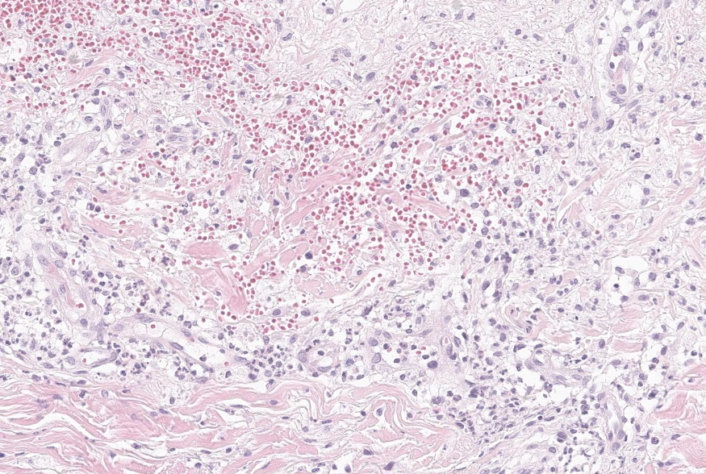
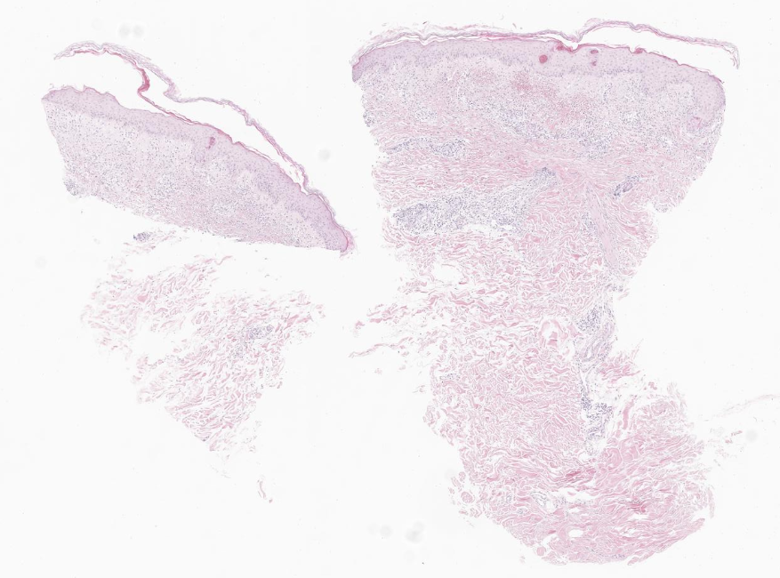
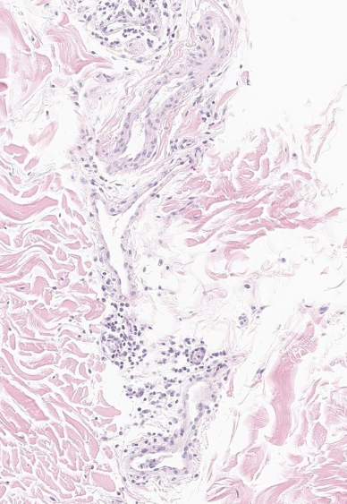
SS19-48236
Skin, leg, right, punch biopsy
A. Labeled 'upper': Favor leukocytoclastic vasculitis
B. Labeled 'lower': Favor leukocytoclastic vasculitis

Slide 28
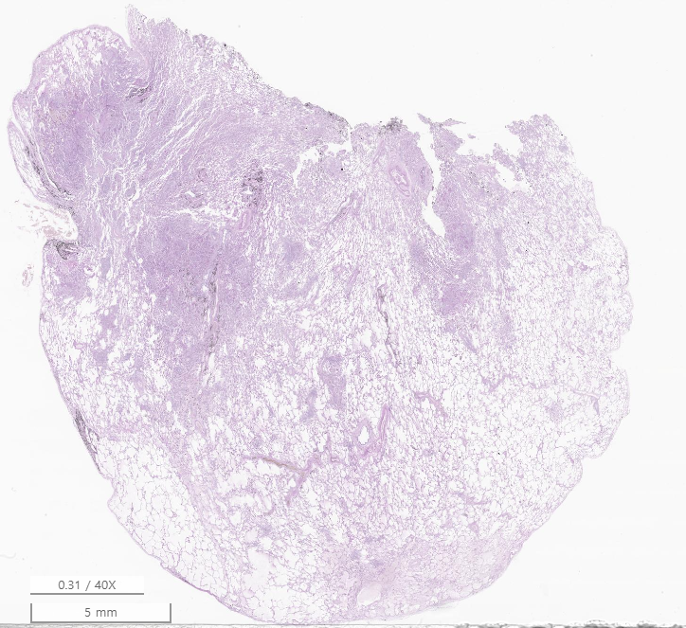
SS19-48246
Lung, right upper and lower lobe, wedge resection
Lung, right lower lobe:
1. Multifocal vascular and perivascular infiltrates of inflammatory cells, suggestive of involvement of vasculitis, see note.
2. Multifocal fibrinous and organizing pneumonia
◇ Lymph node, intrapulmonary (0/1): Reactive hyperplasia
Lung, right upper lobe:
Mild inflammatory cell infiltrates, non-diagnostic
Note)
1. EVG staining reveals vasculitis
2. The immunohistochemical staining results:
CD3: T lymphocyte infiltrates in vessels
CD20: Not remarkable
3. EBER in situ hybridization: Negative
4. The special stain results:
Ziehl-Neelsen stain reveals no acid-fast bacilli.
D-PAS stain reveals no fungal hyphae.
[Additional report]
Tb-PCR(Nested PCR): Negative

Slide 29
