Slide 1
Chest conference
병리과
2018.12.20

Slide 2
최O림 (8701511, F/56),
SS18-54955

Slide 3
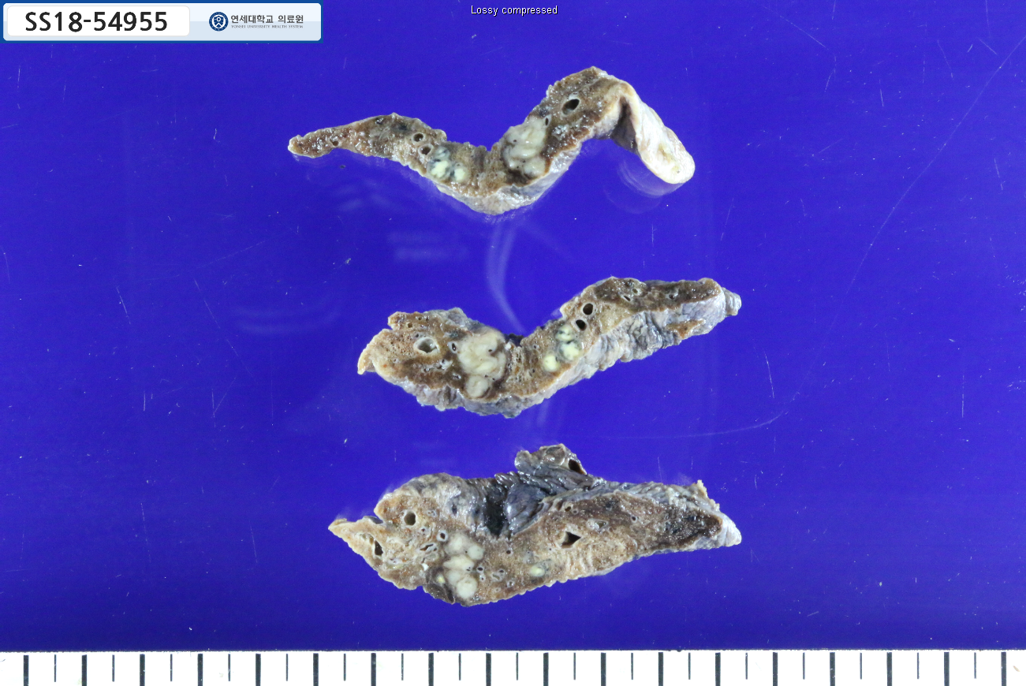

Slide 4
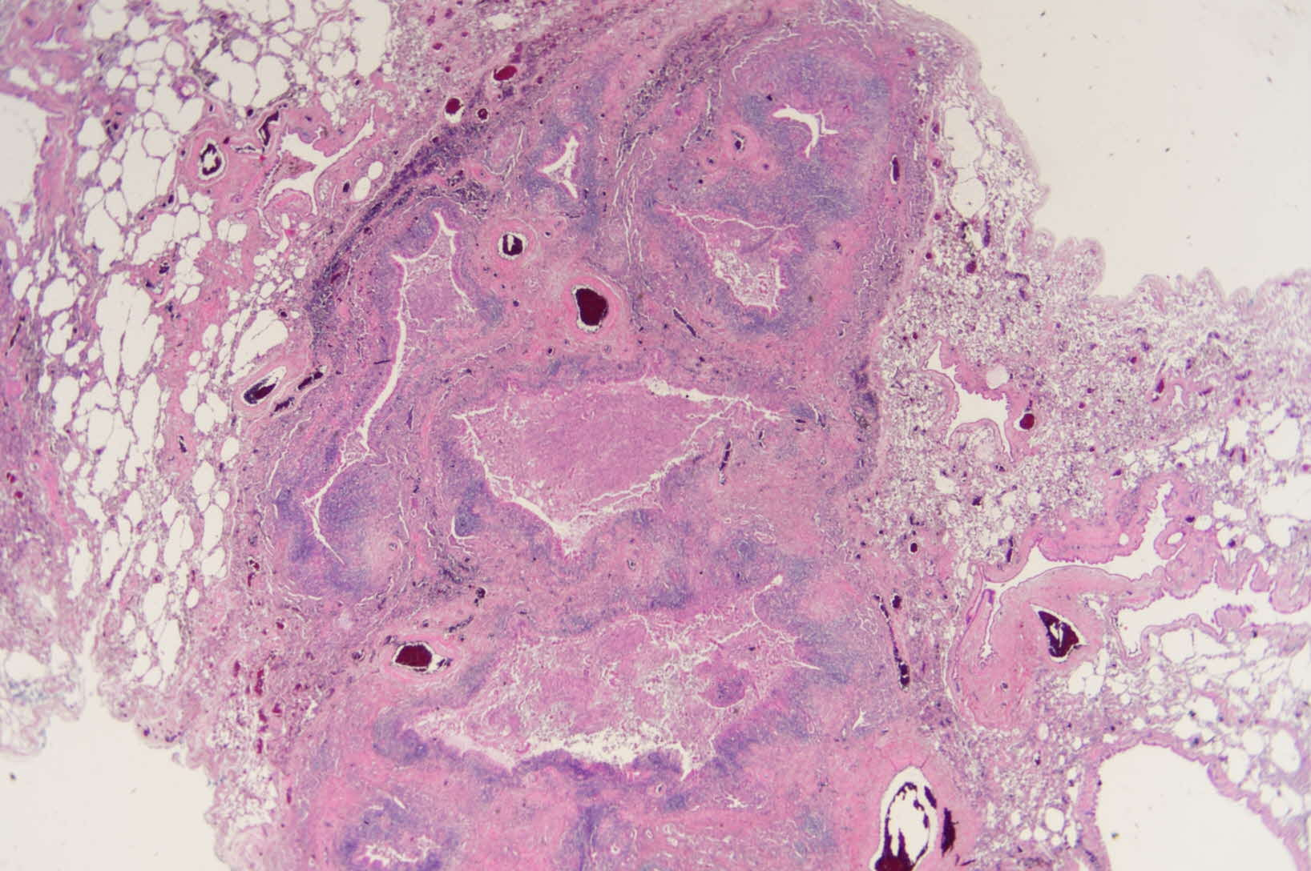

Slide 5
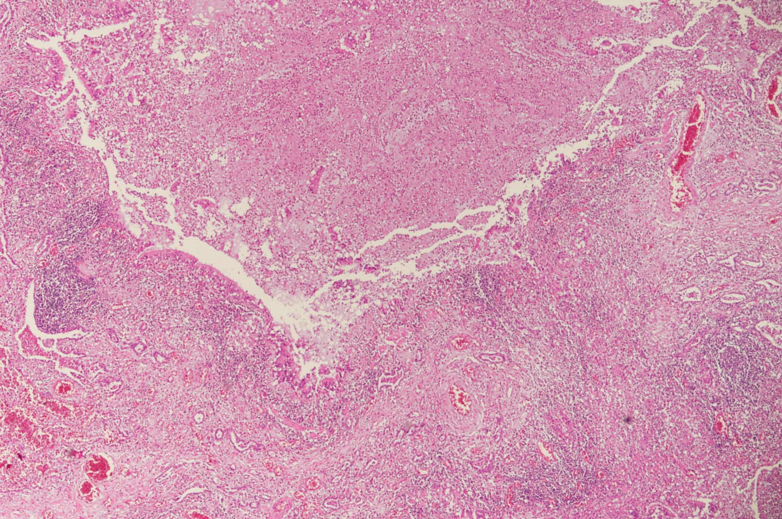

Slide 6
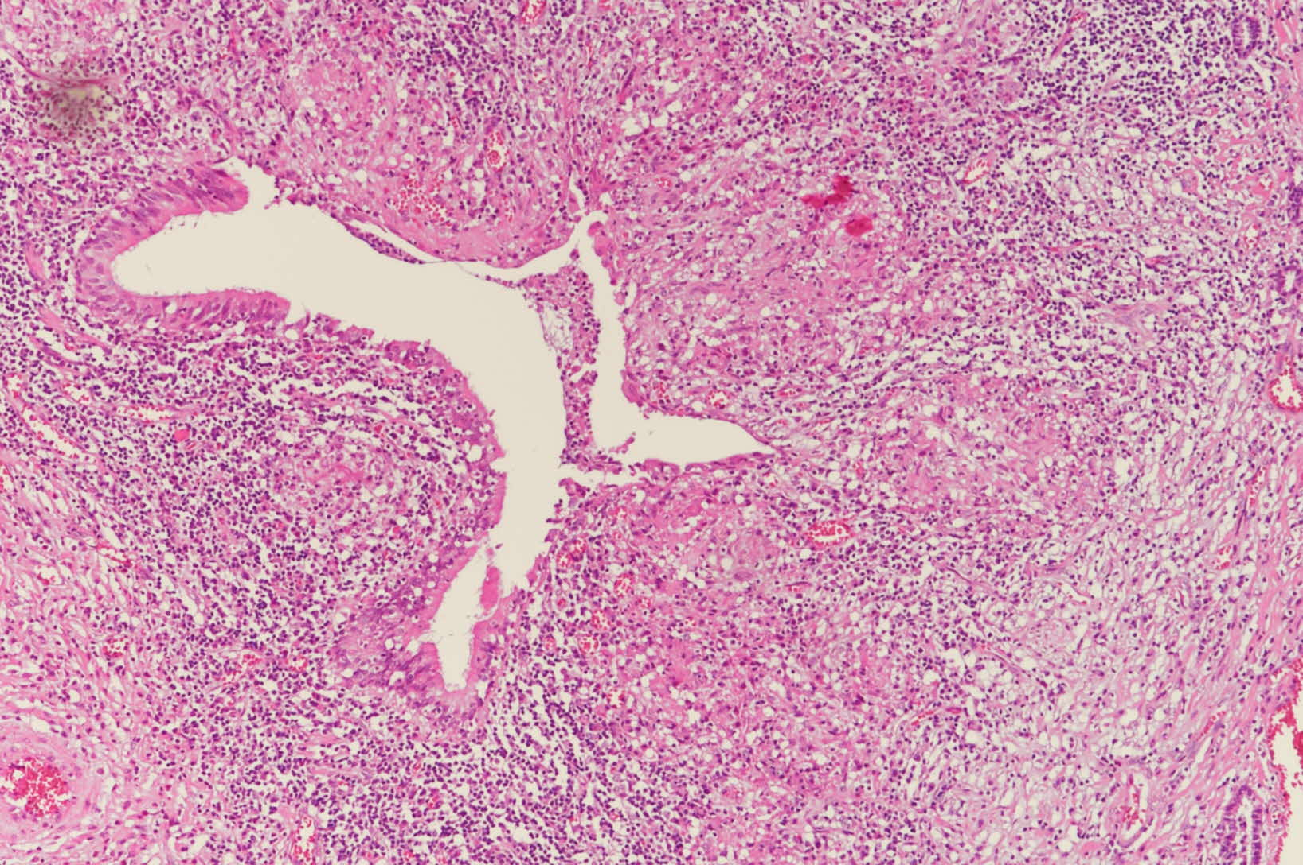

Slide 7
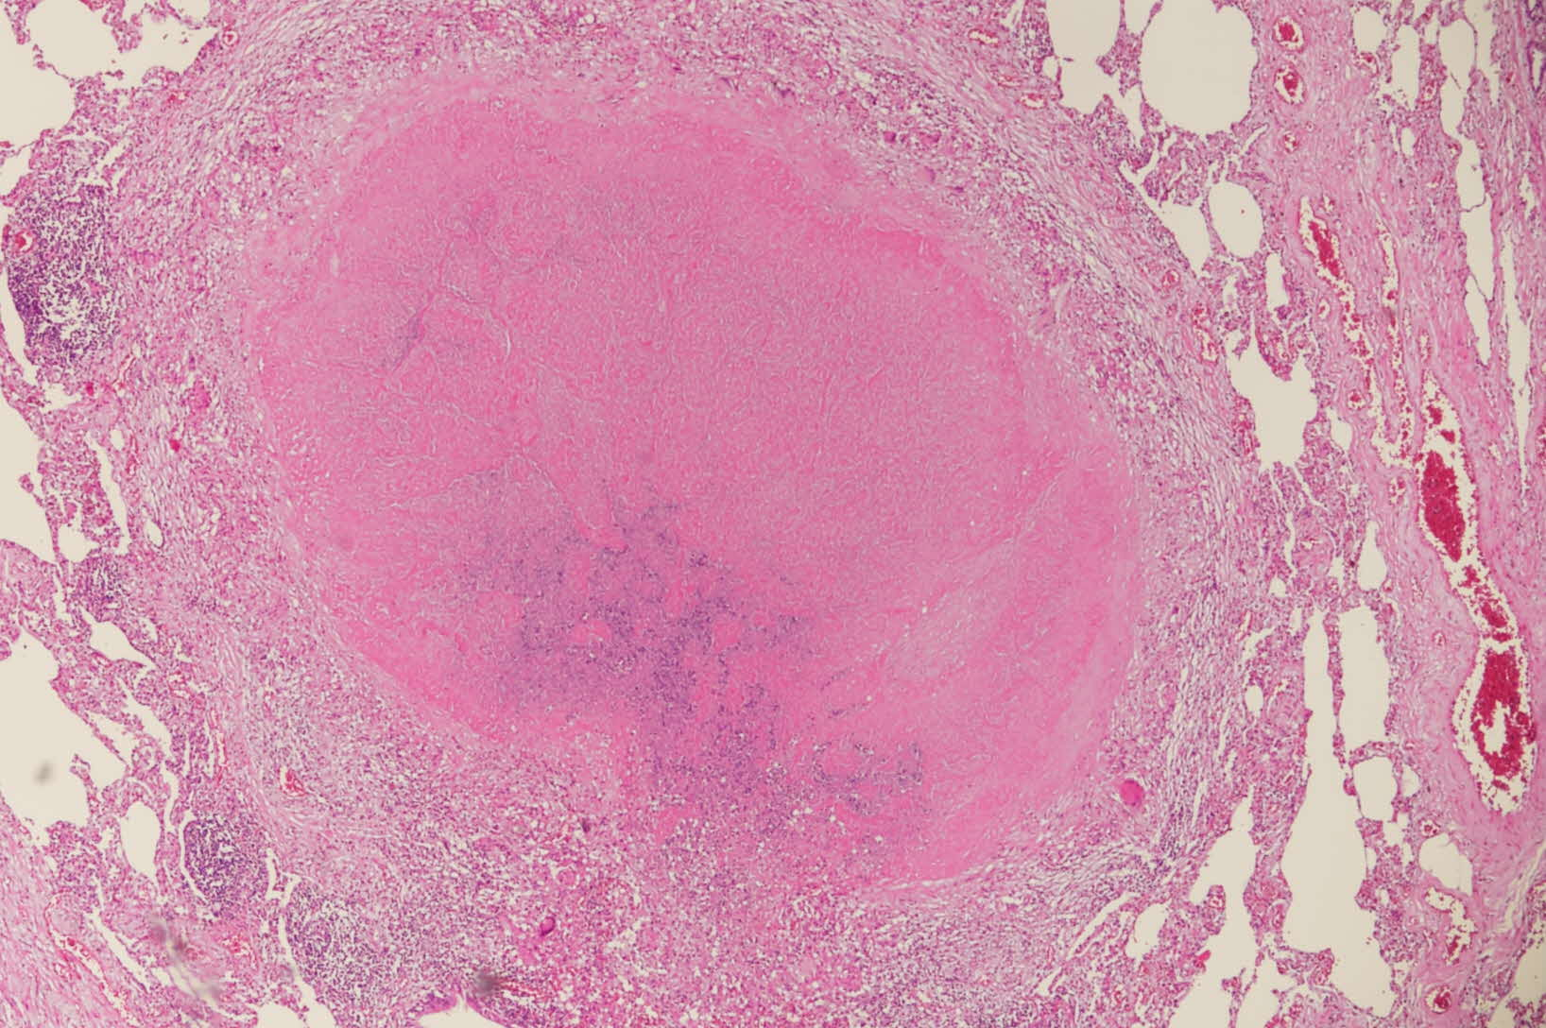

Slide 8
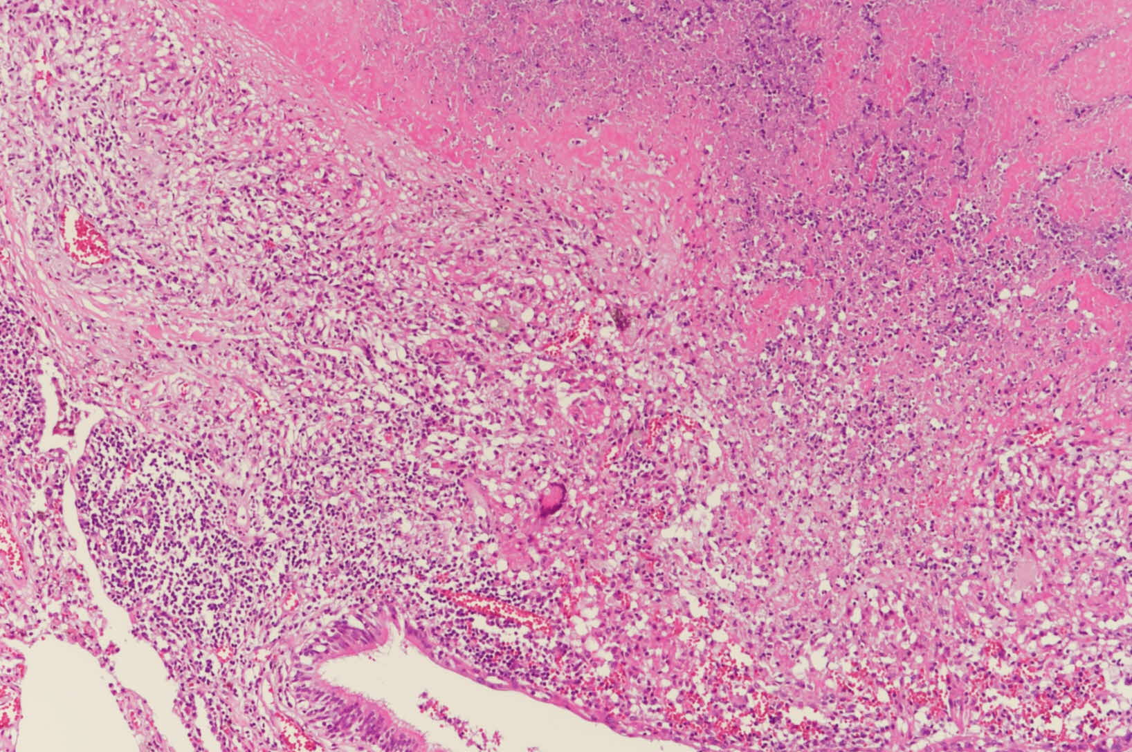

Slide 9
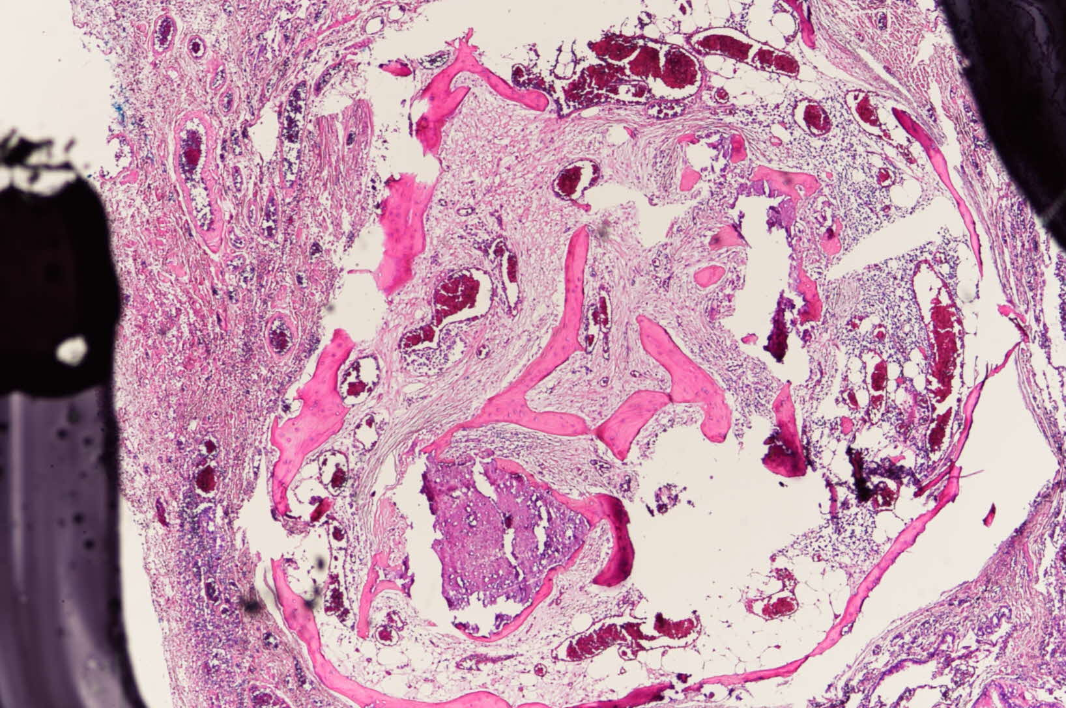

Slide 10
이O주 (8668665, F/51)
SS18-64814

Slide 11
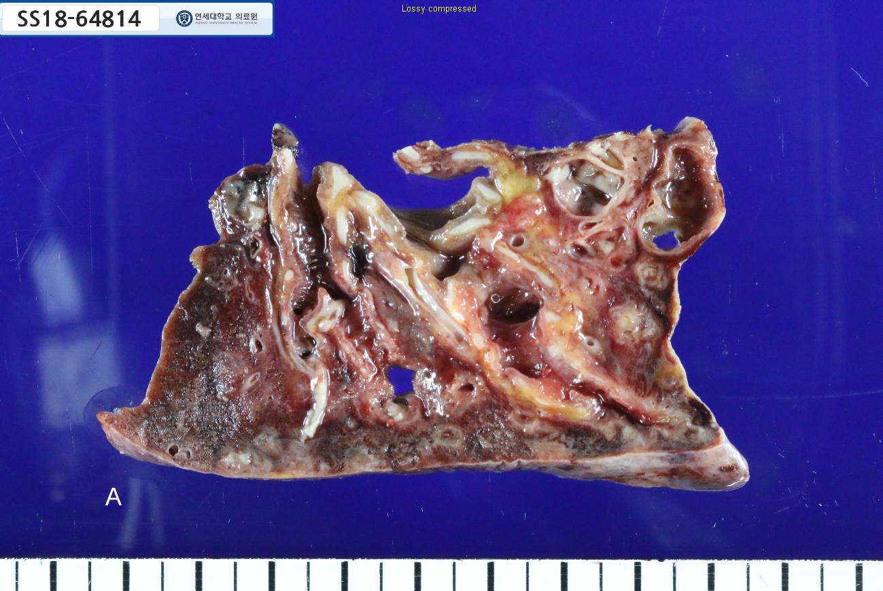

Slide 12
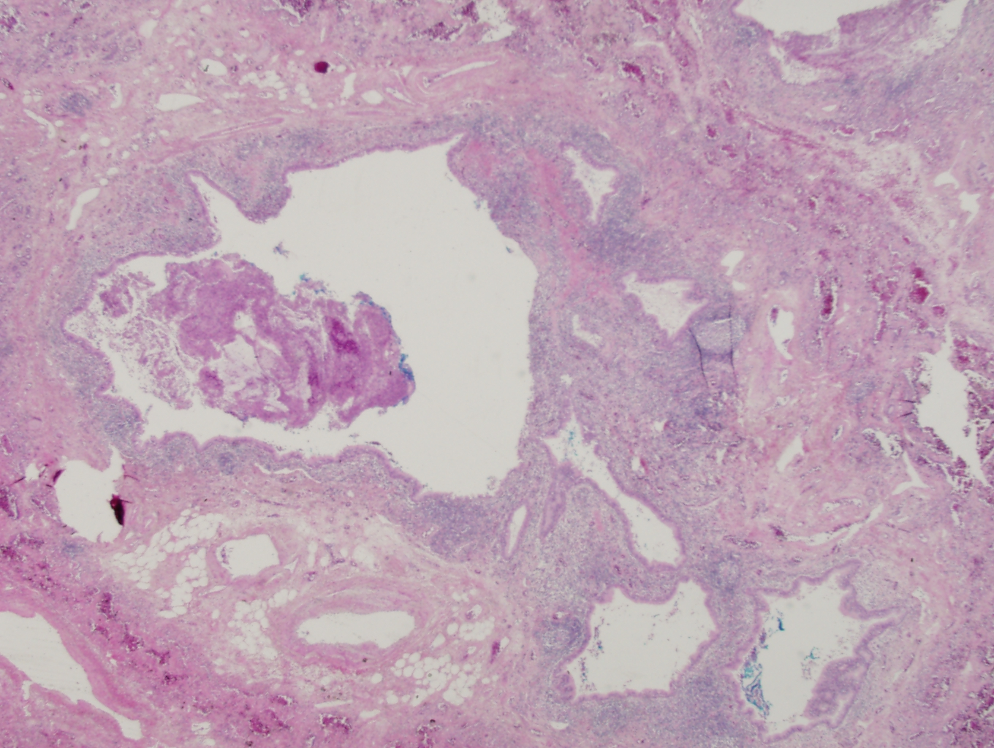

Slide 13
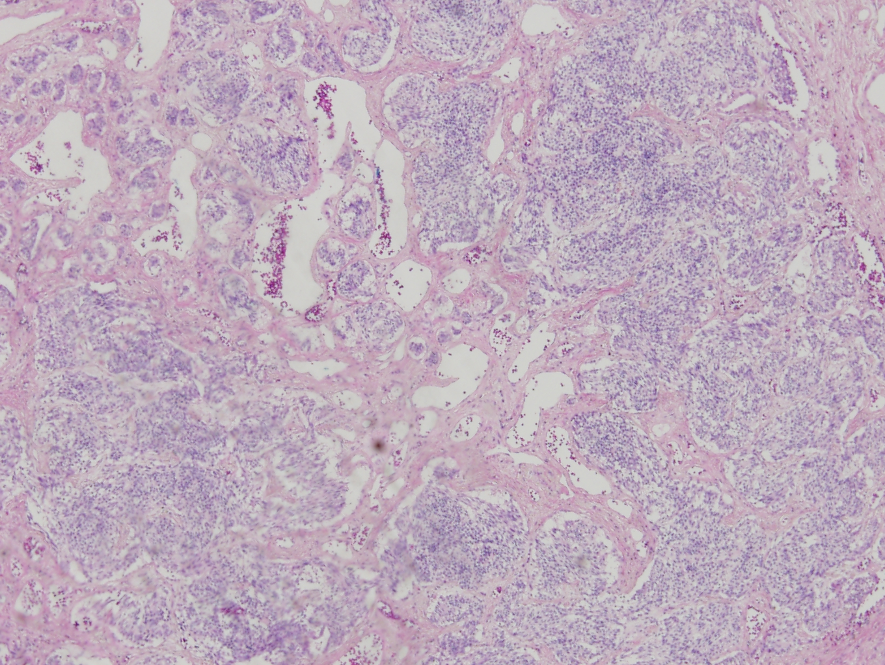

Slide 14
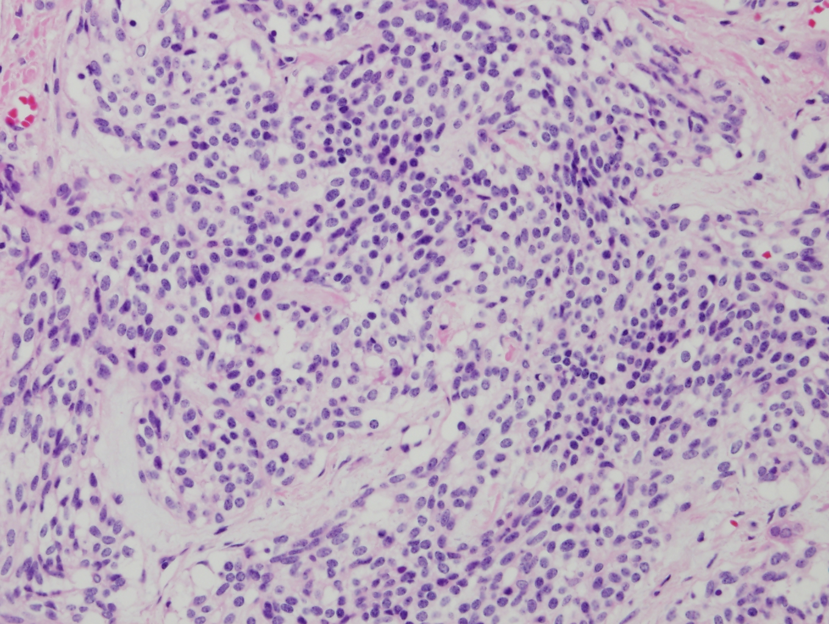

Slide 15
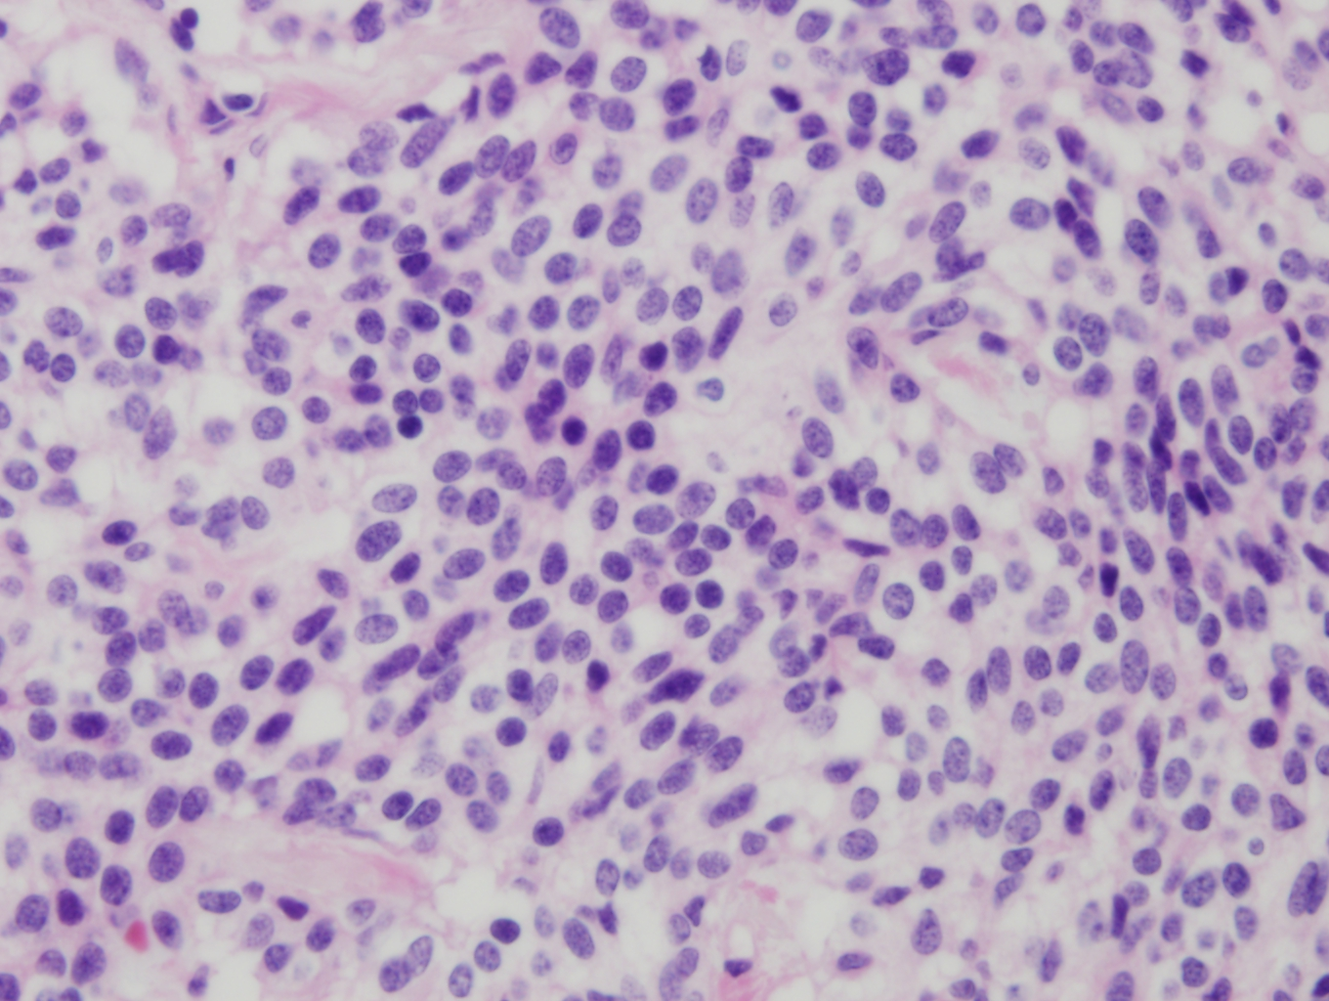

Slide 16
Lung, left lower lobe:
1. Bronchiectasis with chronic inflammation and fibrosis
2. Carcinoid tumorlet, multiple (size: 0.2x0.2cm in the largest one)
◇ Lymph nodes, peribronchial (0/1): Reactive hyperplasia
◇ Lymph nodes, separately sent, subcarinal (0/1) and interlobar (0/6); total (0/7): Reactive hyperplasia
Lung, left upper lobe: Bronchiectasis with chronic inflammation and fibrosis

Slide 17
최O이 (8655038, F/58)
SS18-65065

Slide 18
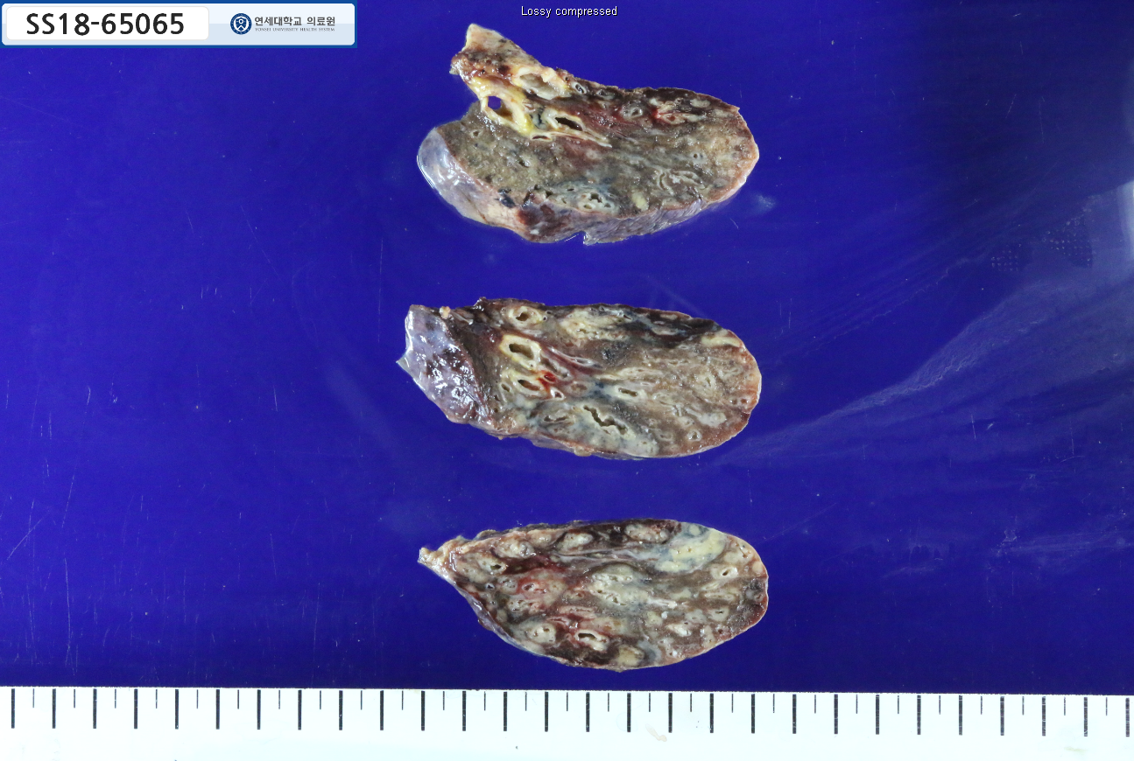

Slide 19
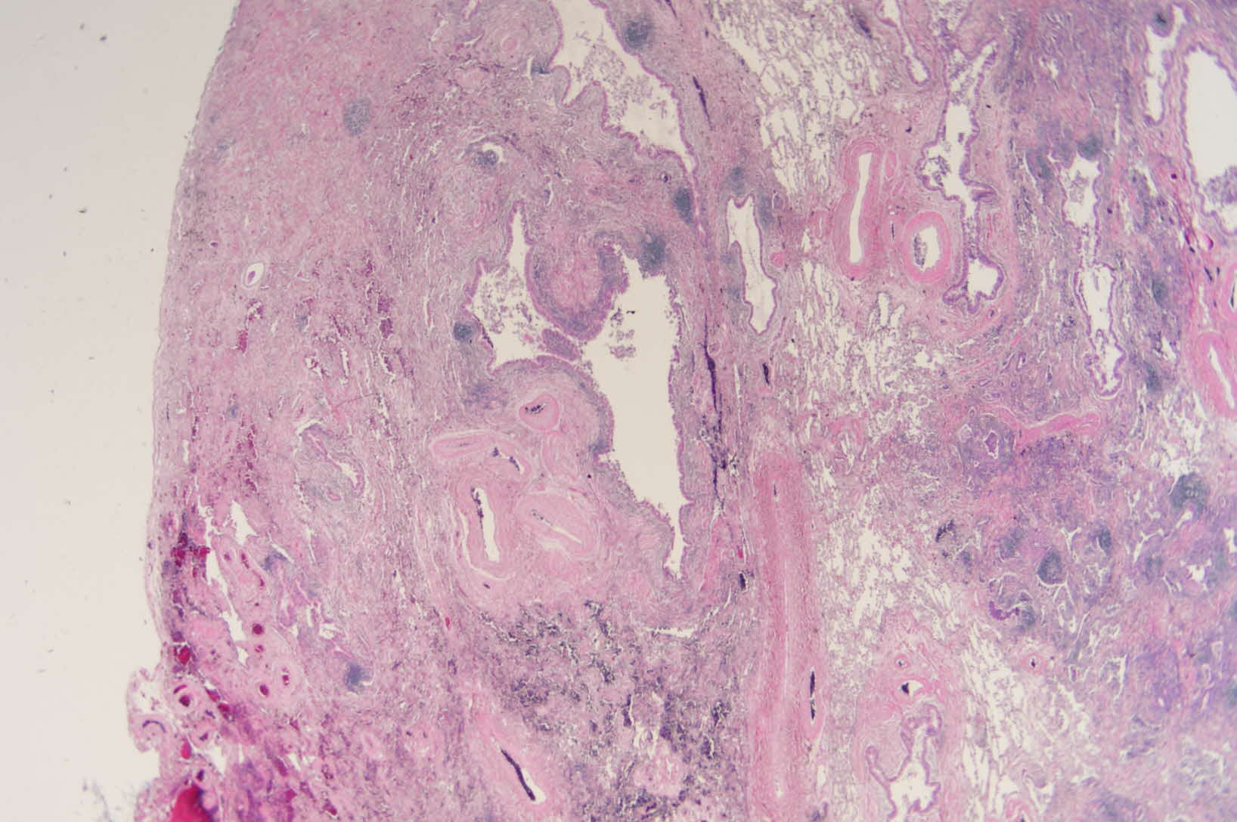

Slide 20
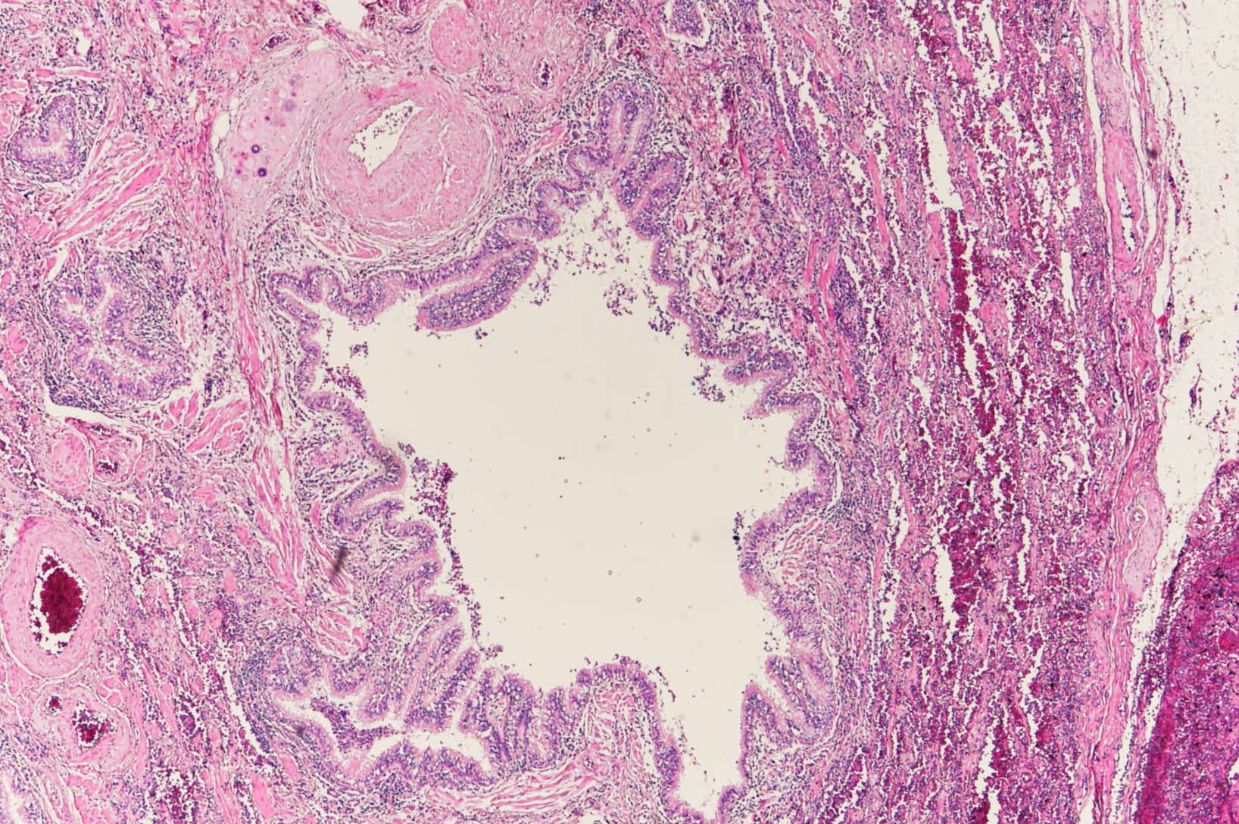

Slide 21
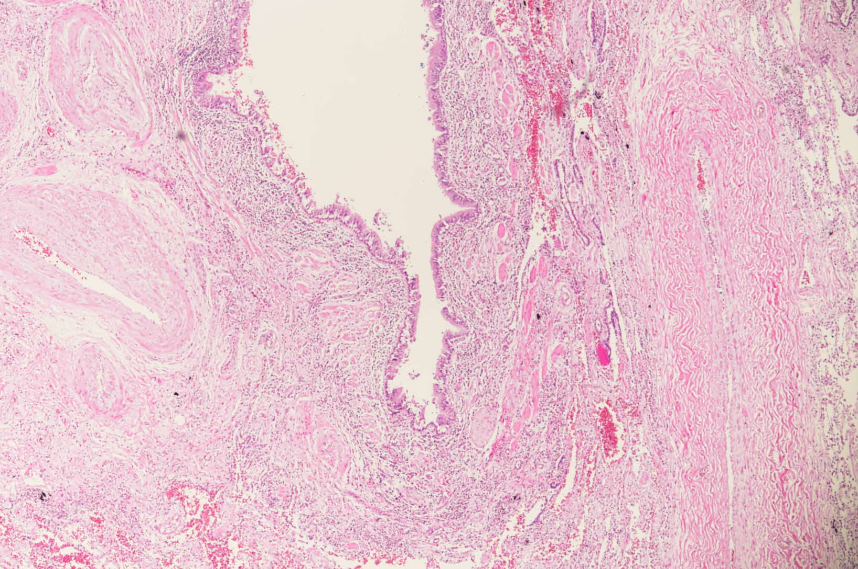

Slide 22
