Slide 1
Chest Conference
2020.08.13
Department of Pathology

Slide 2
Cases
Case 1. 남O일 5215750
Case 2. 김O동 5244628
Case 3. 김O호 4608821
Case 4. 박O춘 8307214

Slide 3
Case 1. 남O일 5215750

Slide 4
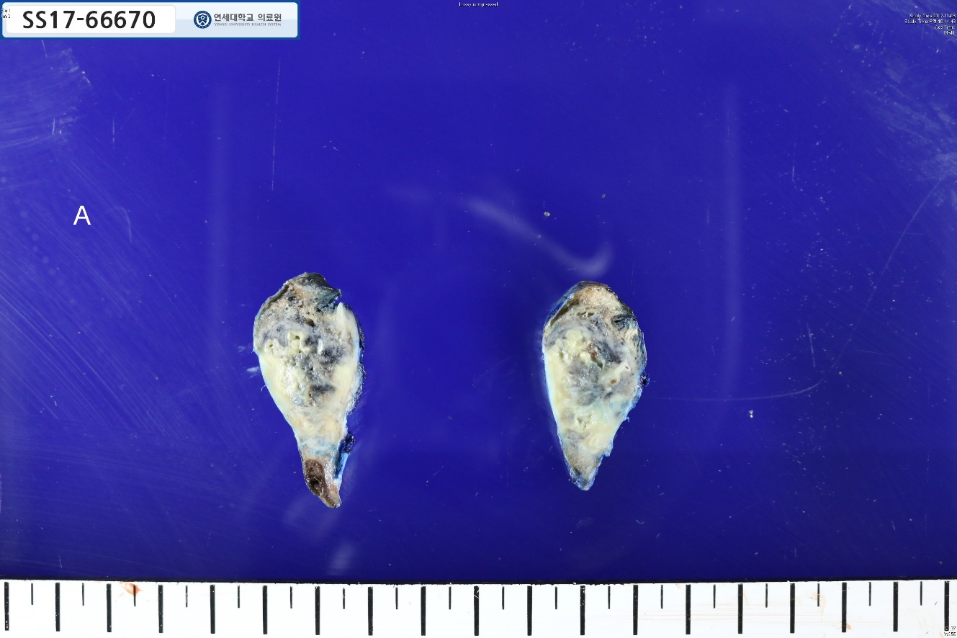
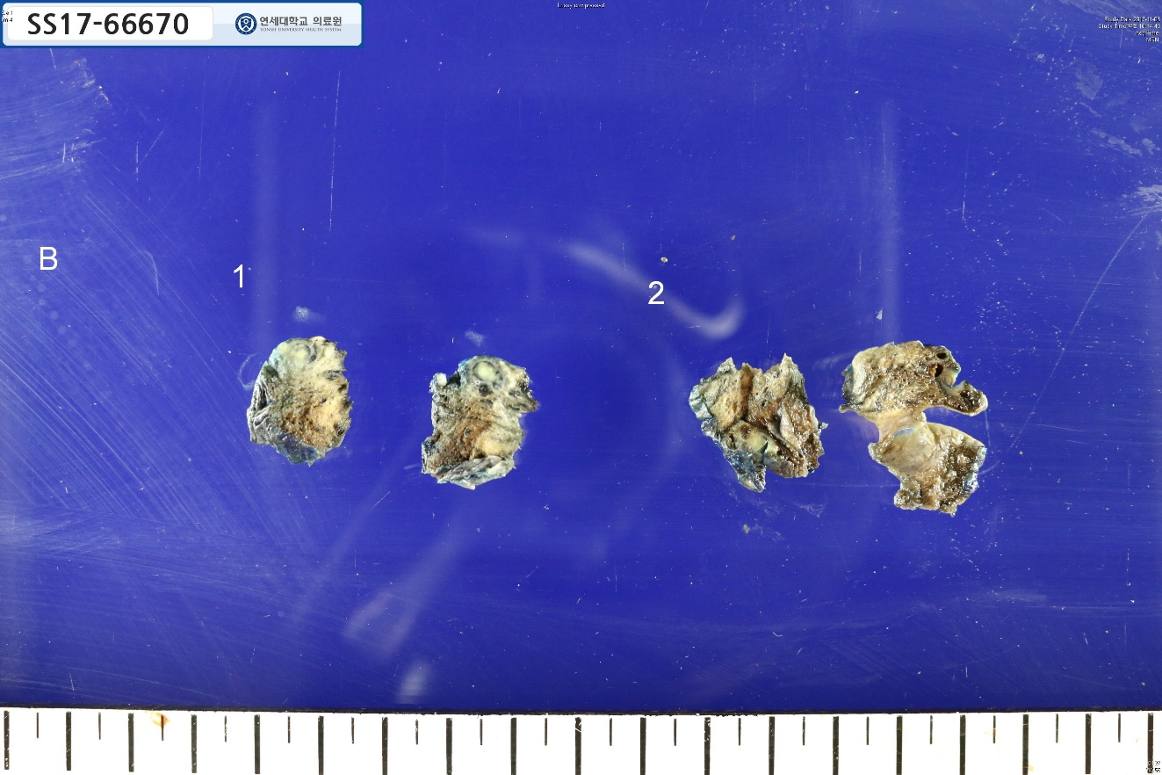
SS17-66670: Lung, right lower lobe, wedge resection

Slide 5
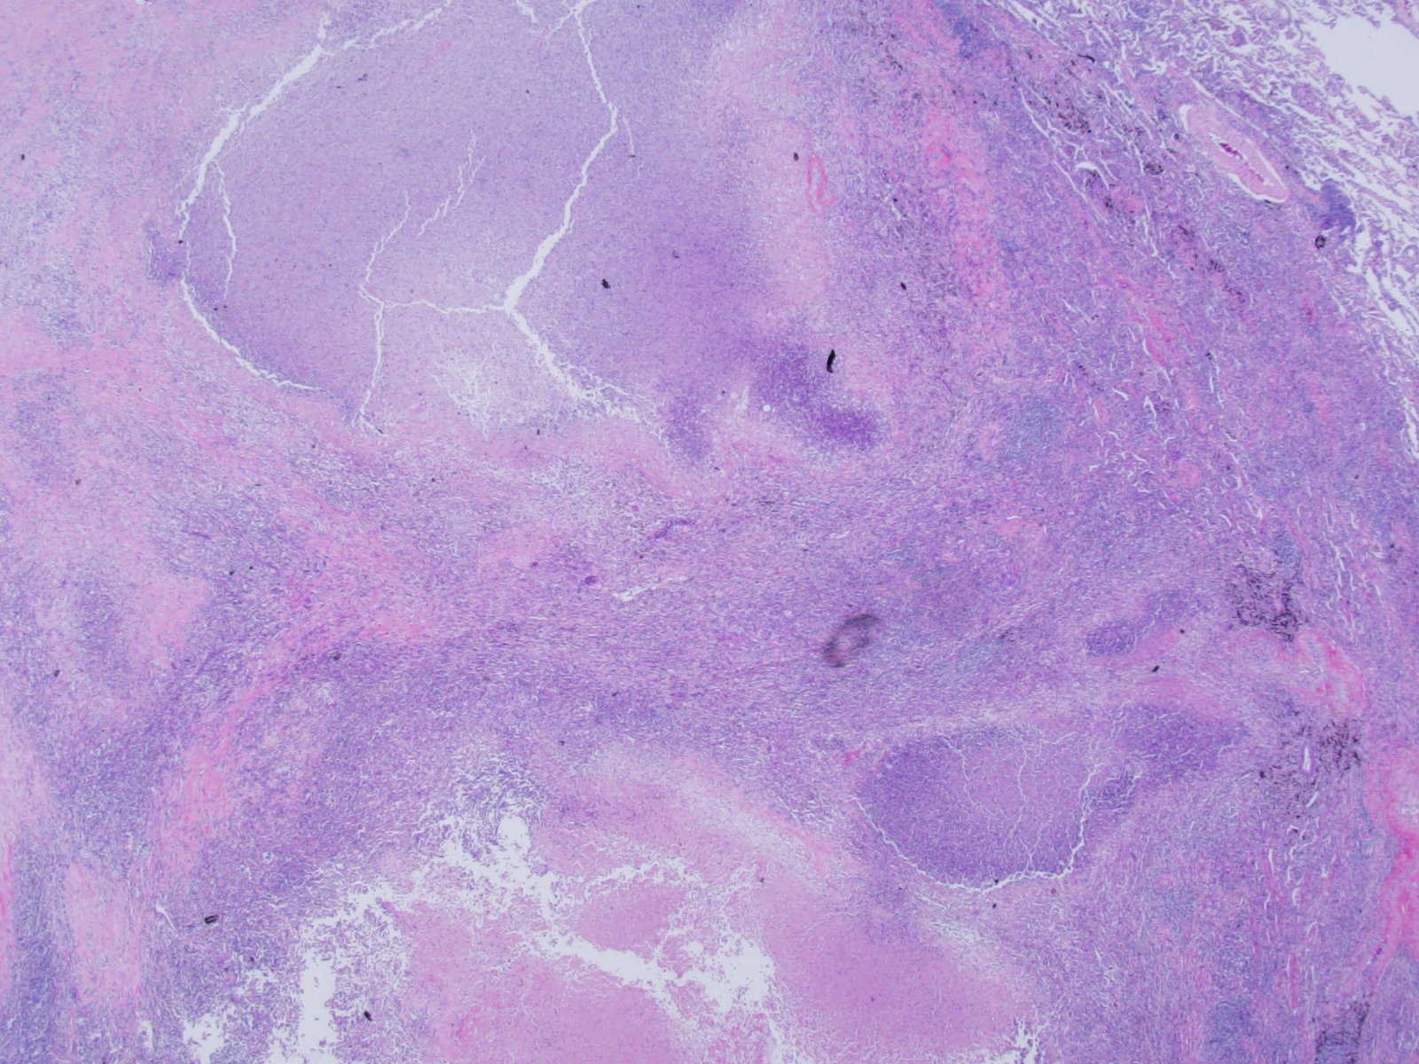
SS17-66670: Lung, right lower lobe, wedge resection

Slide 6
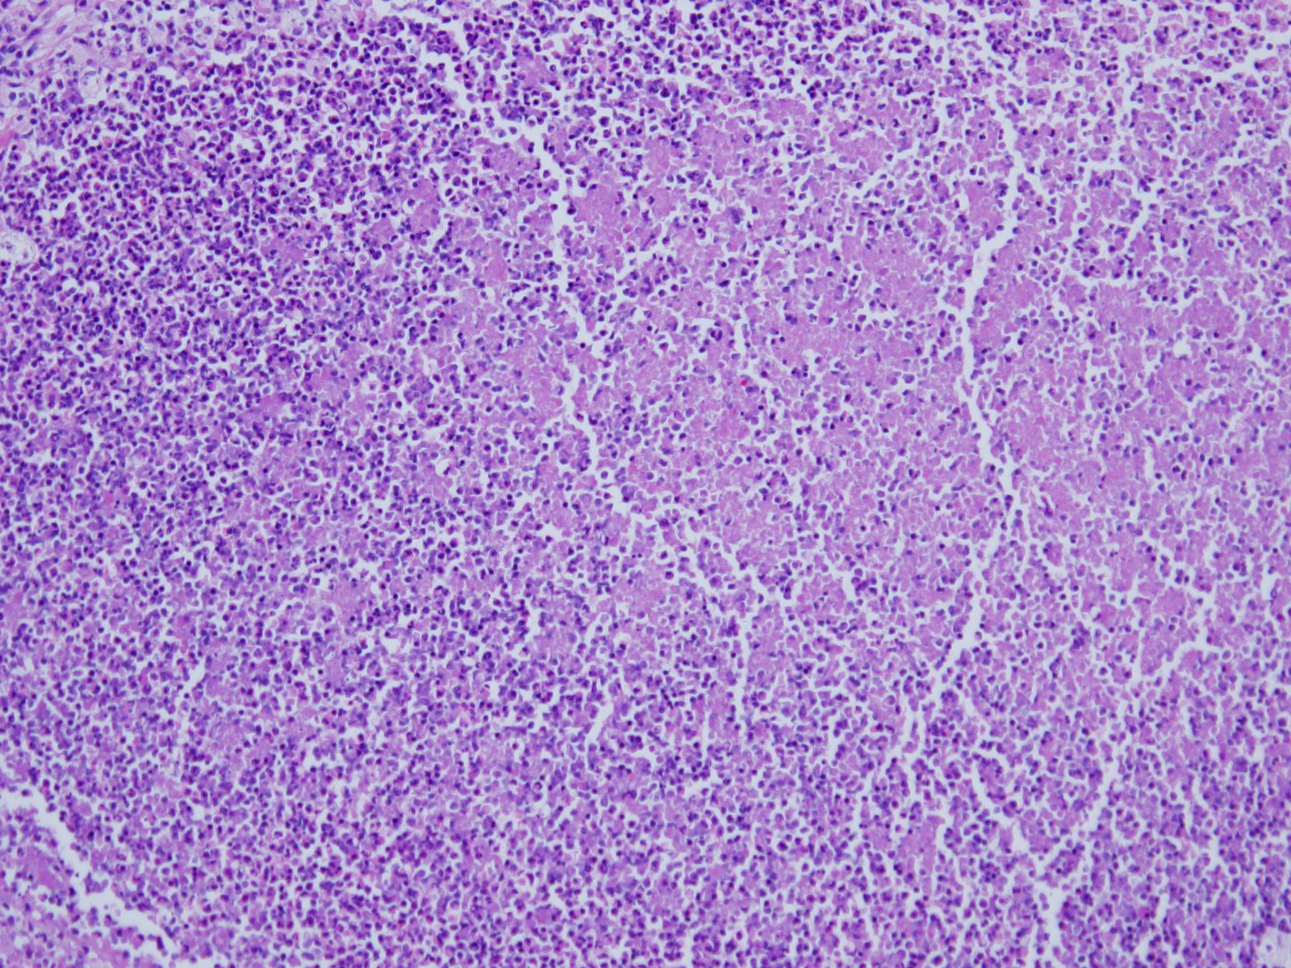

Slide 7
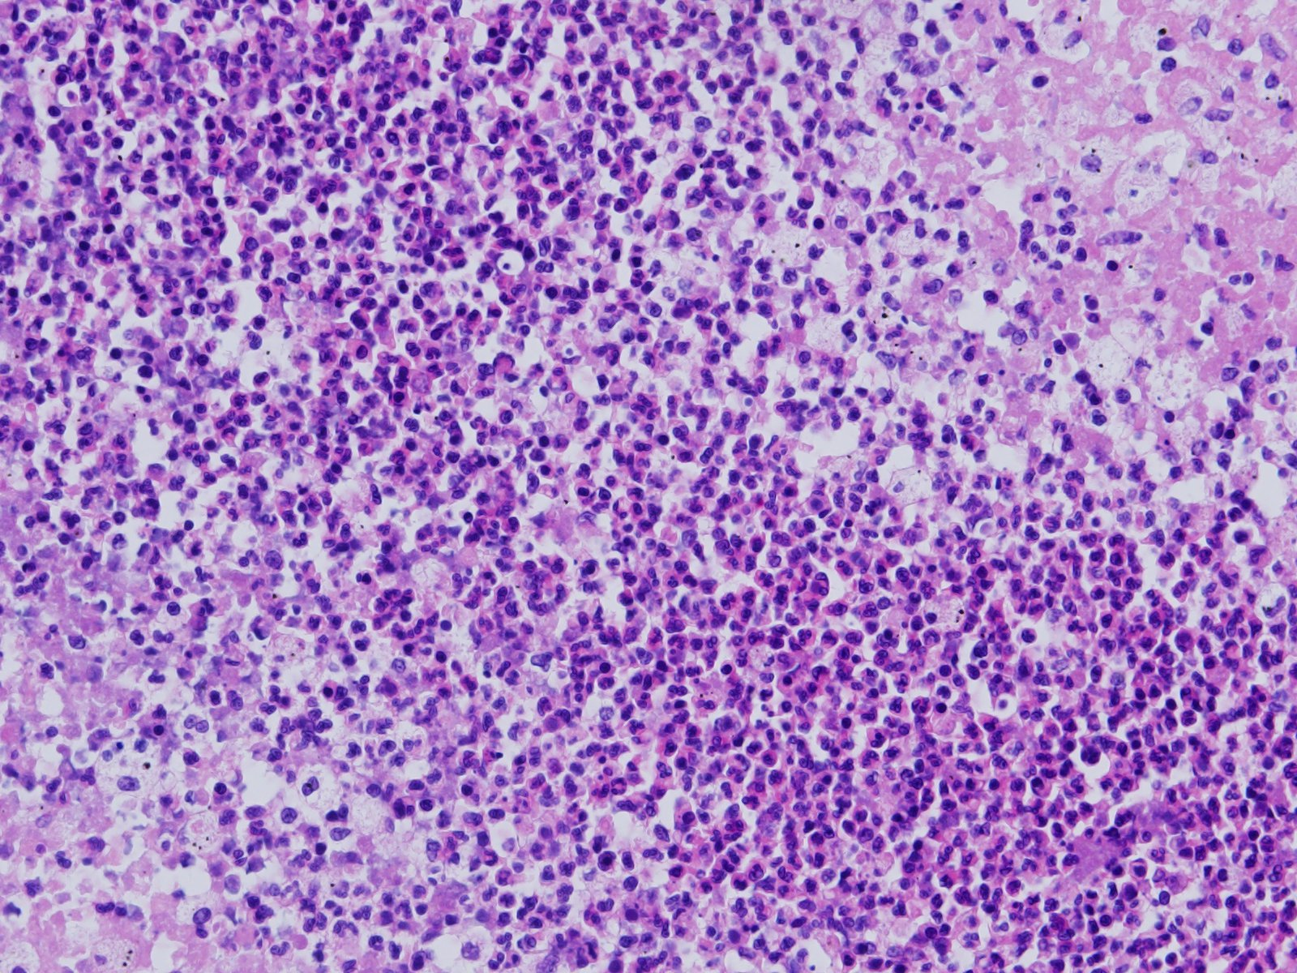

Slide 8
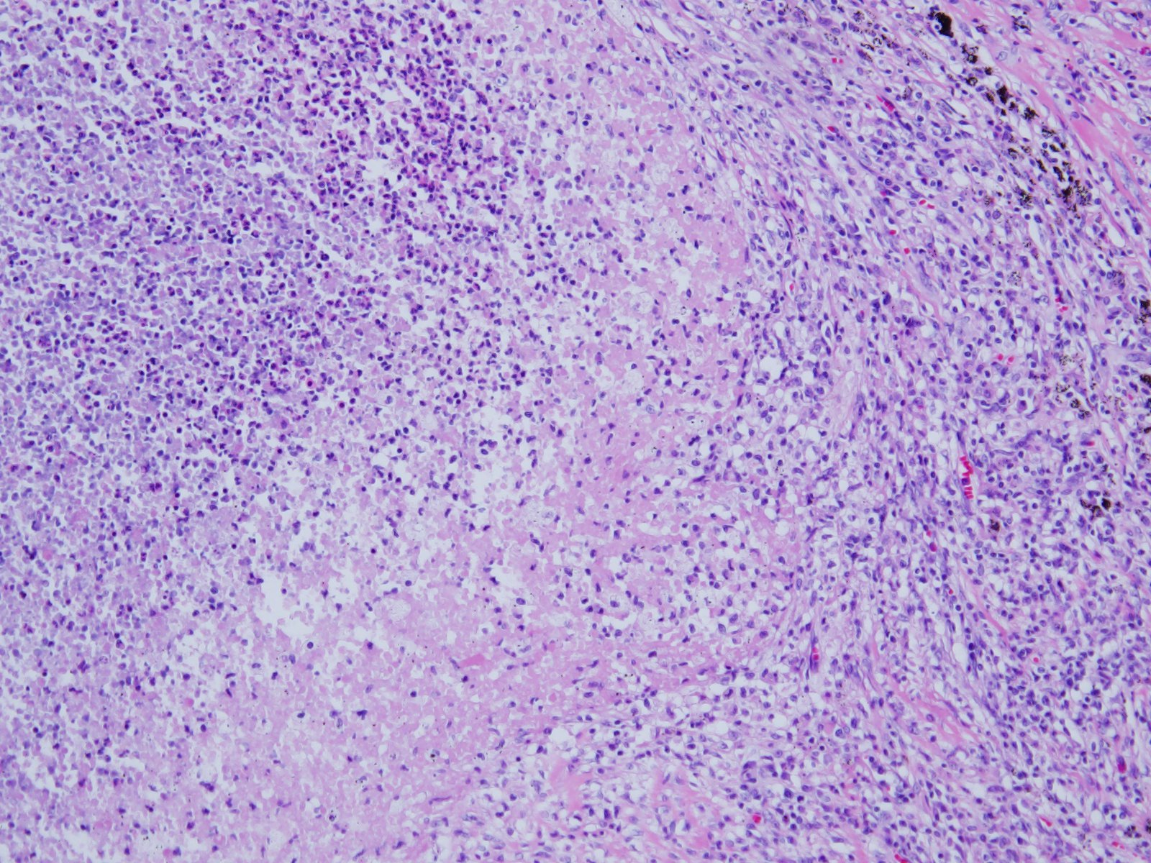

Slide 9
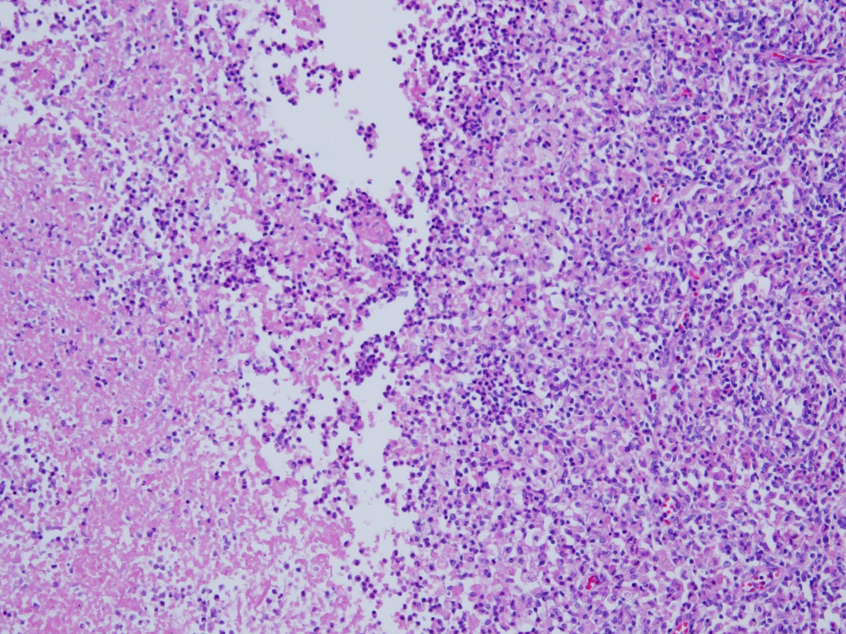

Slide 10
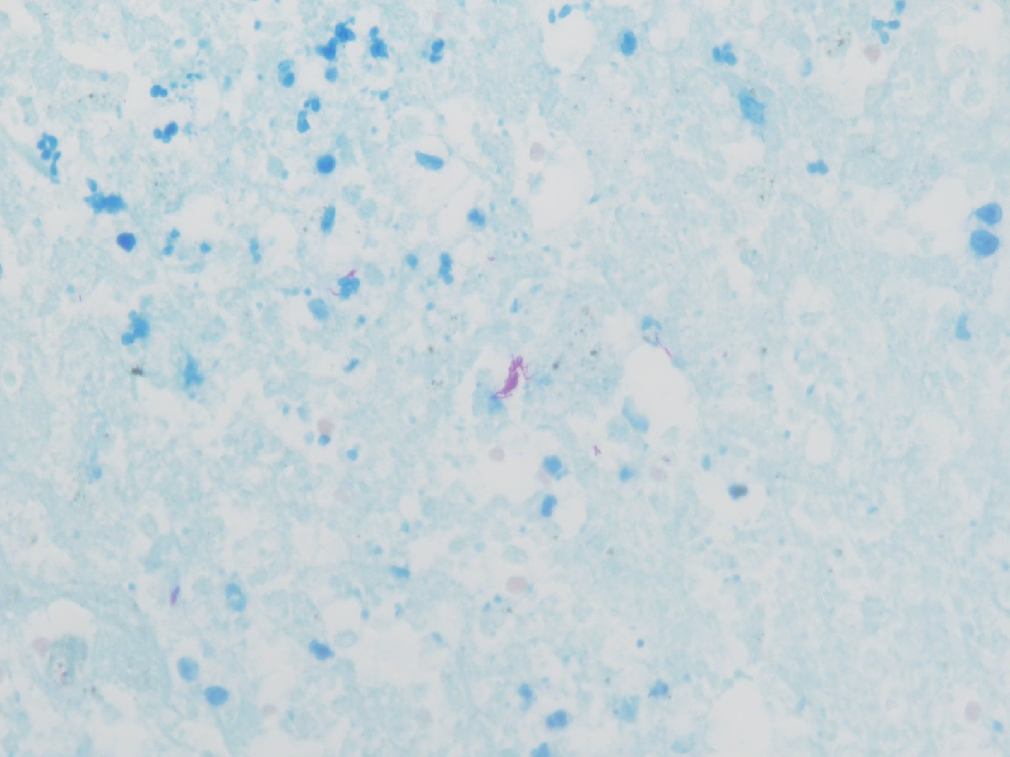

Slide 11
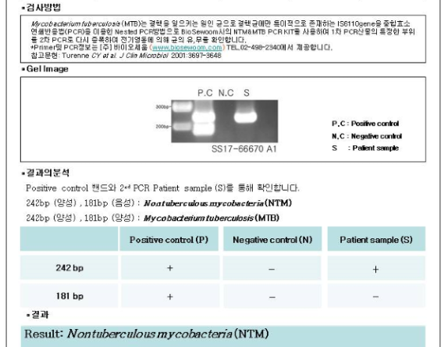

Slide 12
Case 2. 김O동 5244628

Slide 13
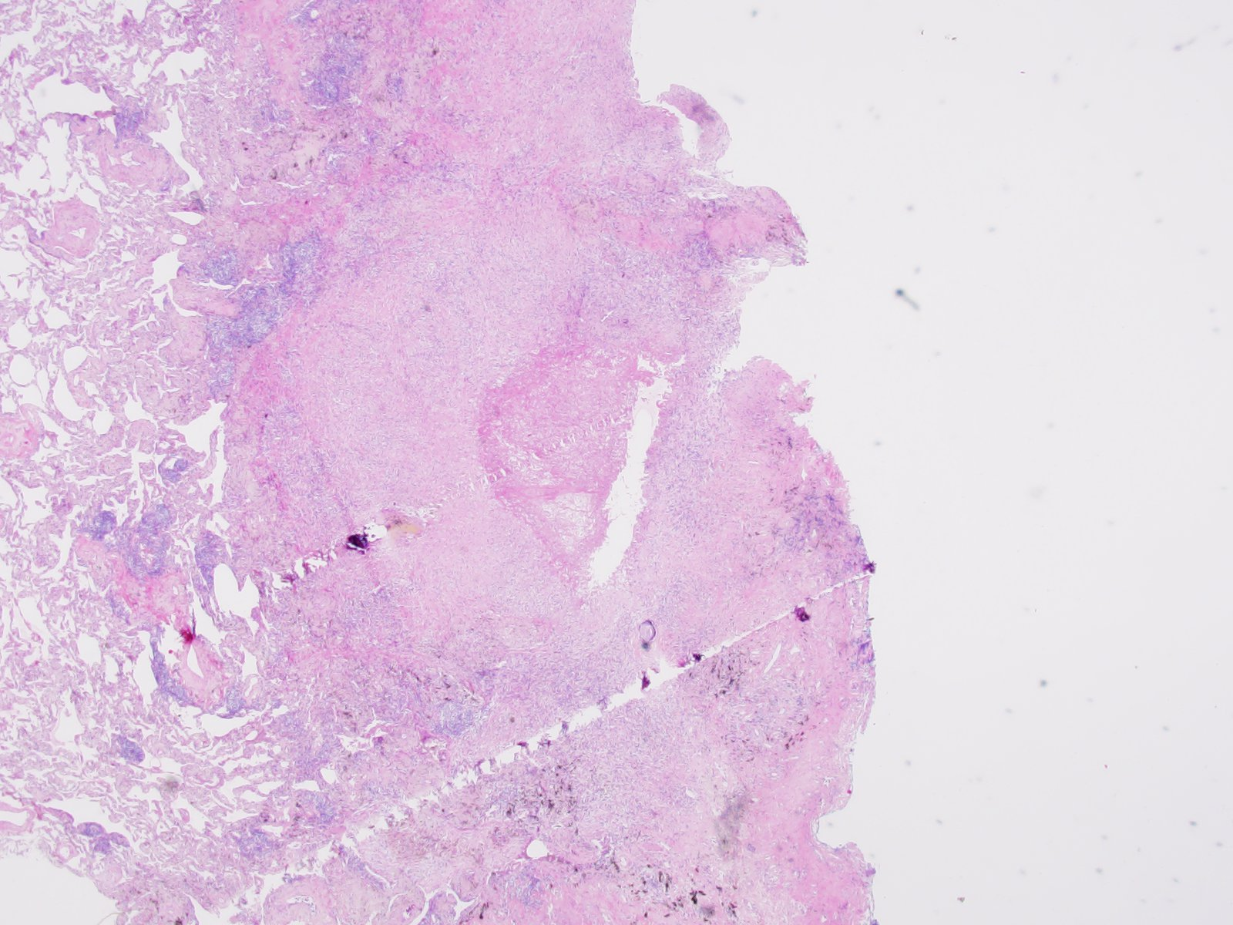
SF16-01291: Lung, right upper lobe, wedge resection (for frozen section)

Slide 14
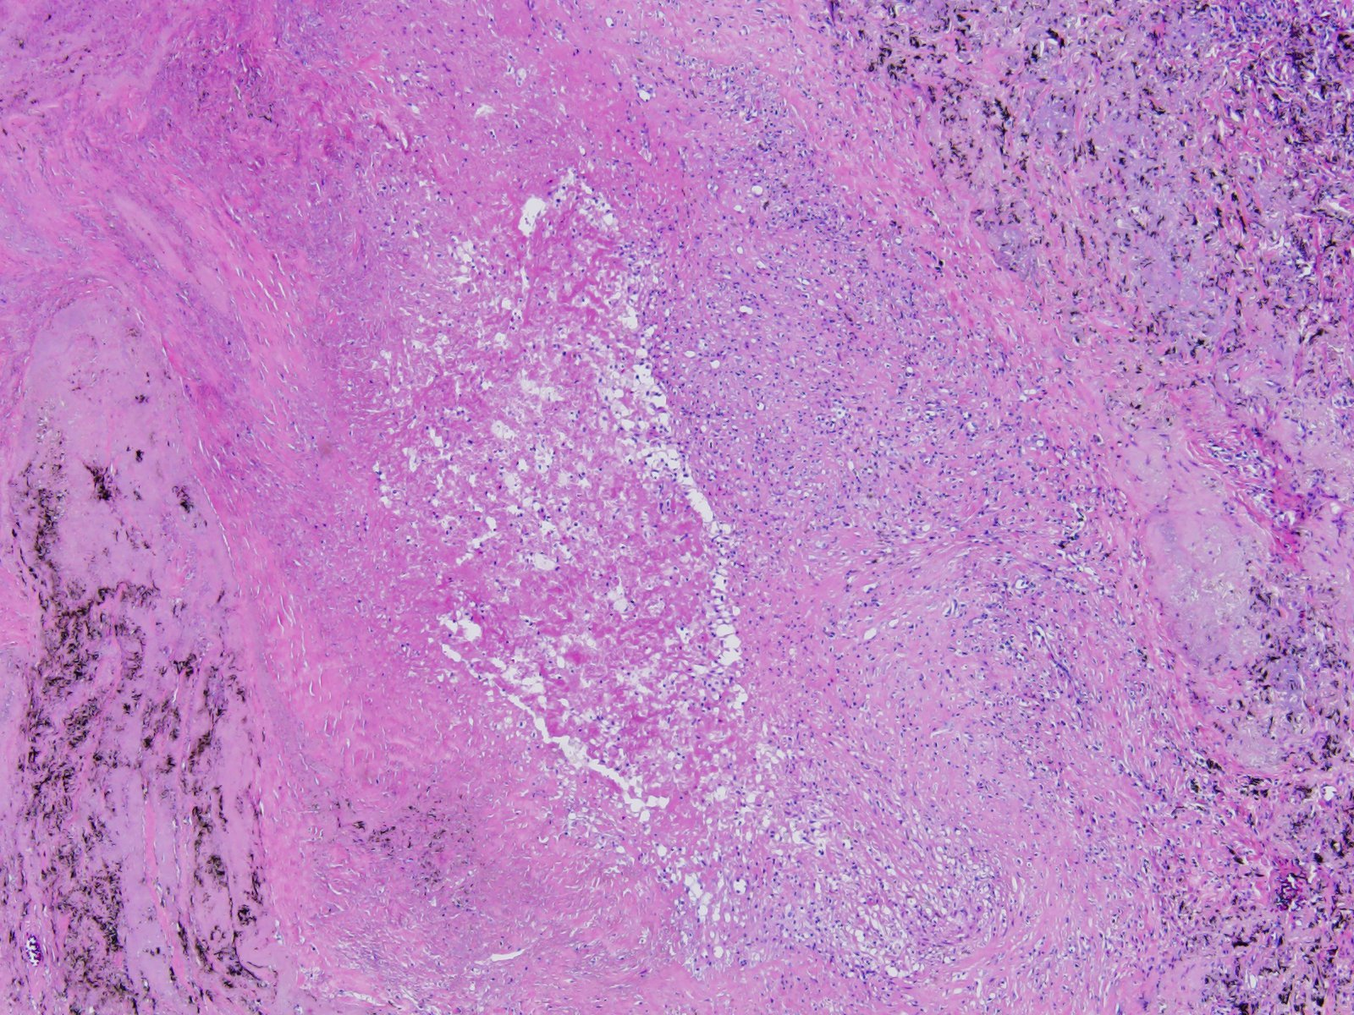

Slide 15
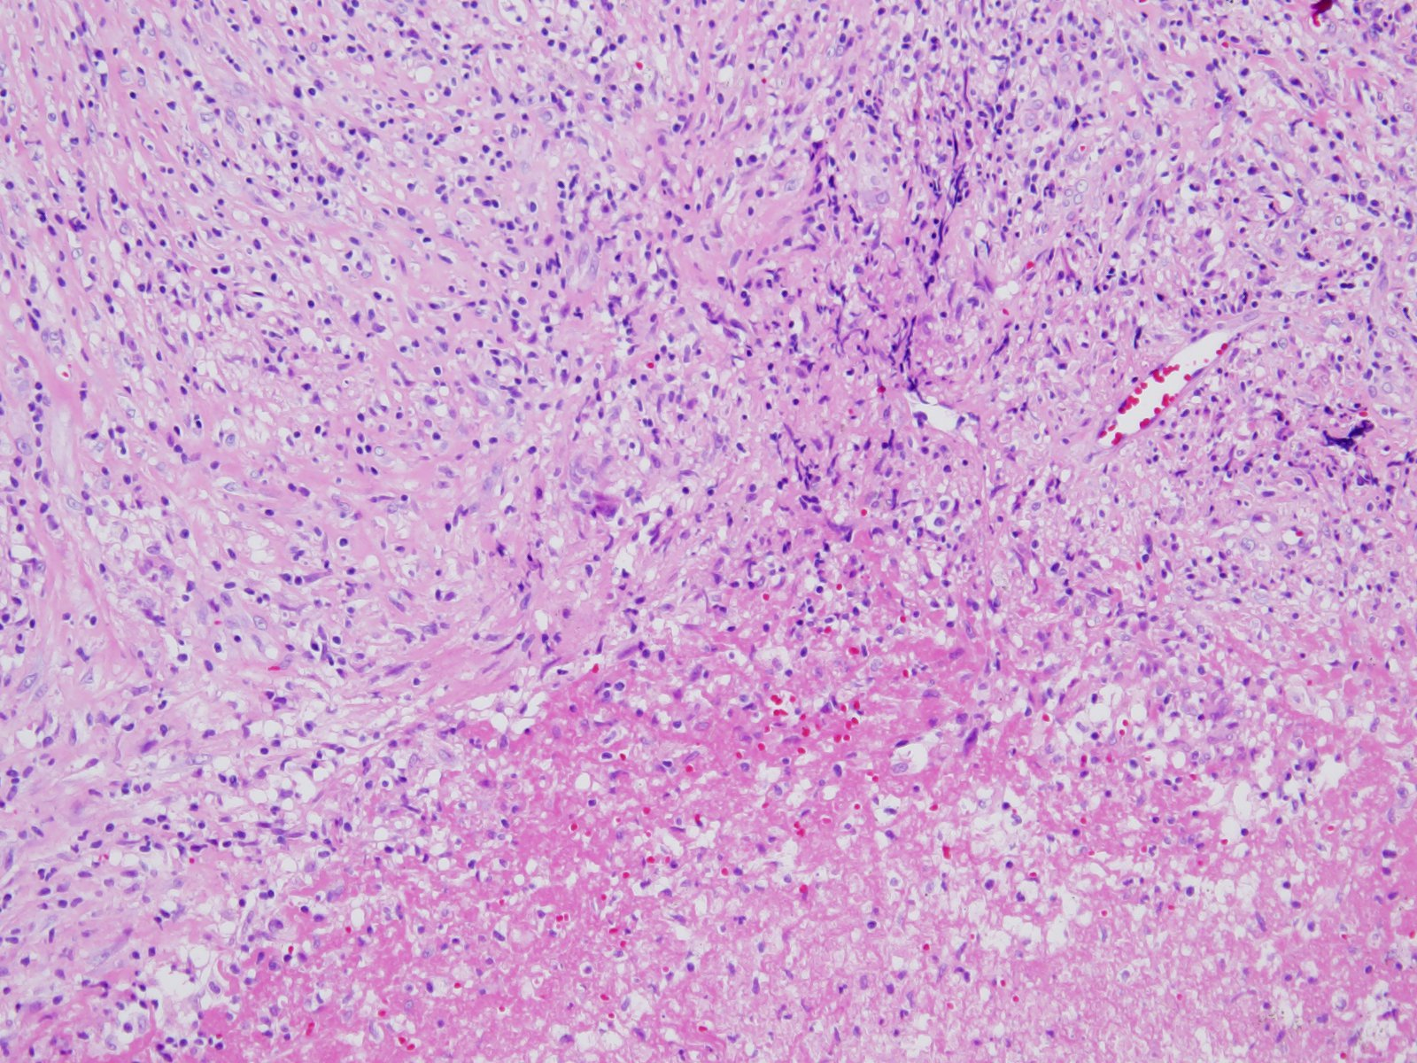

Slide 16
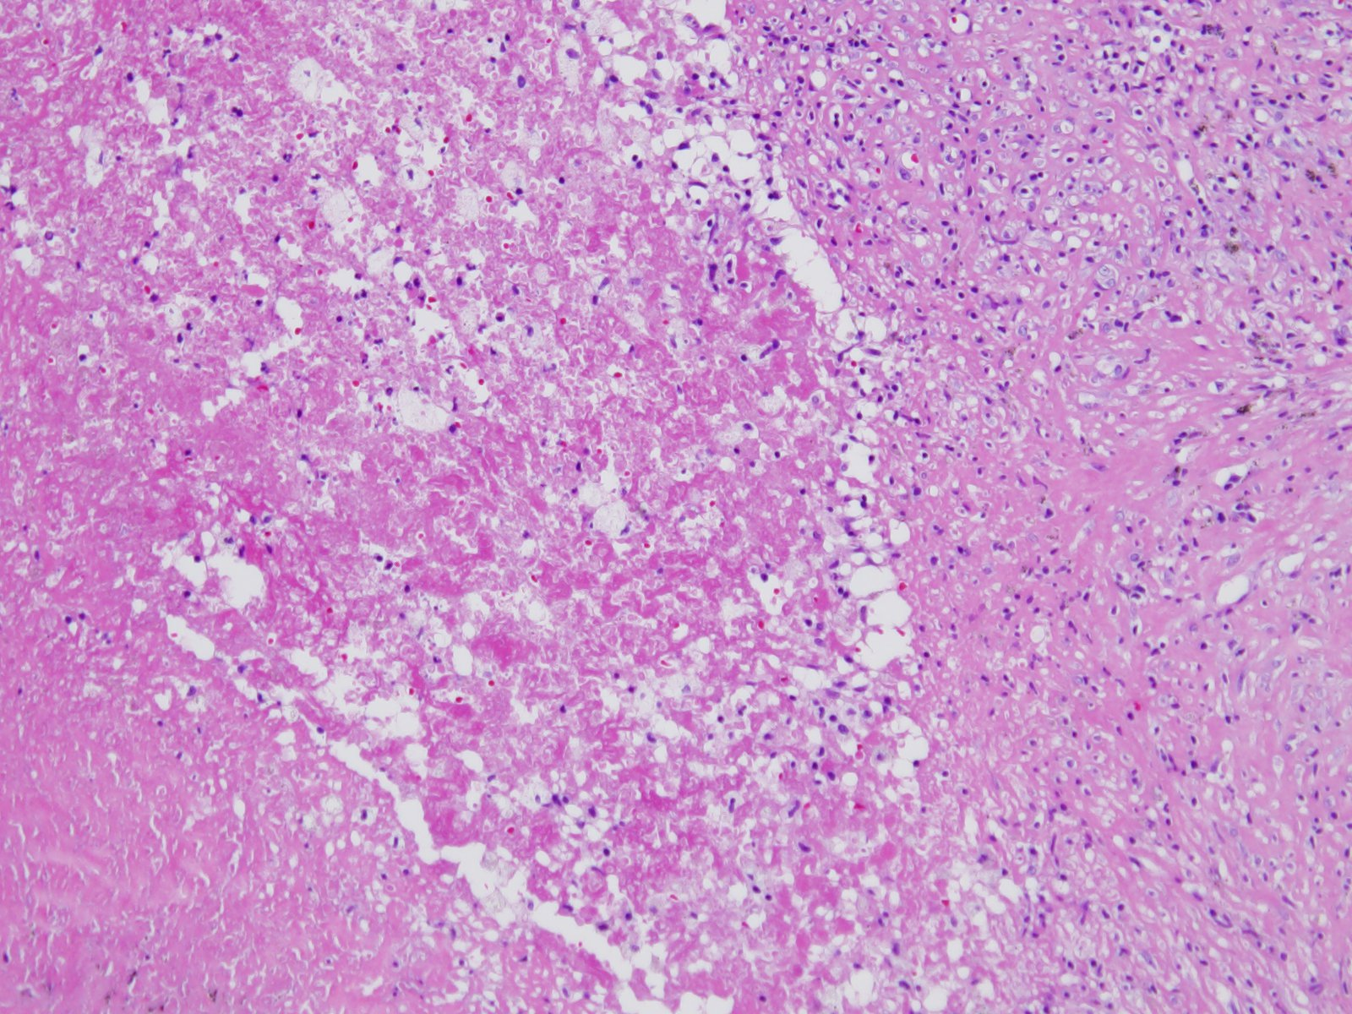

Slide 17
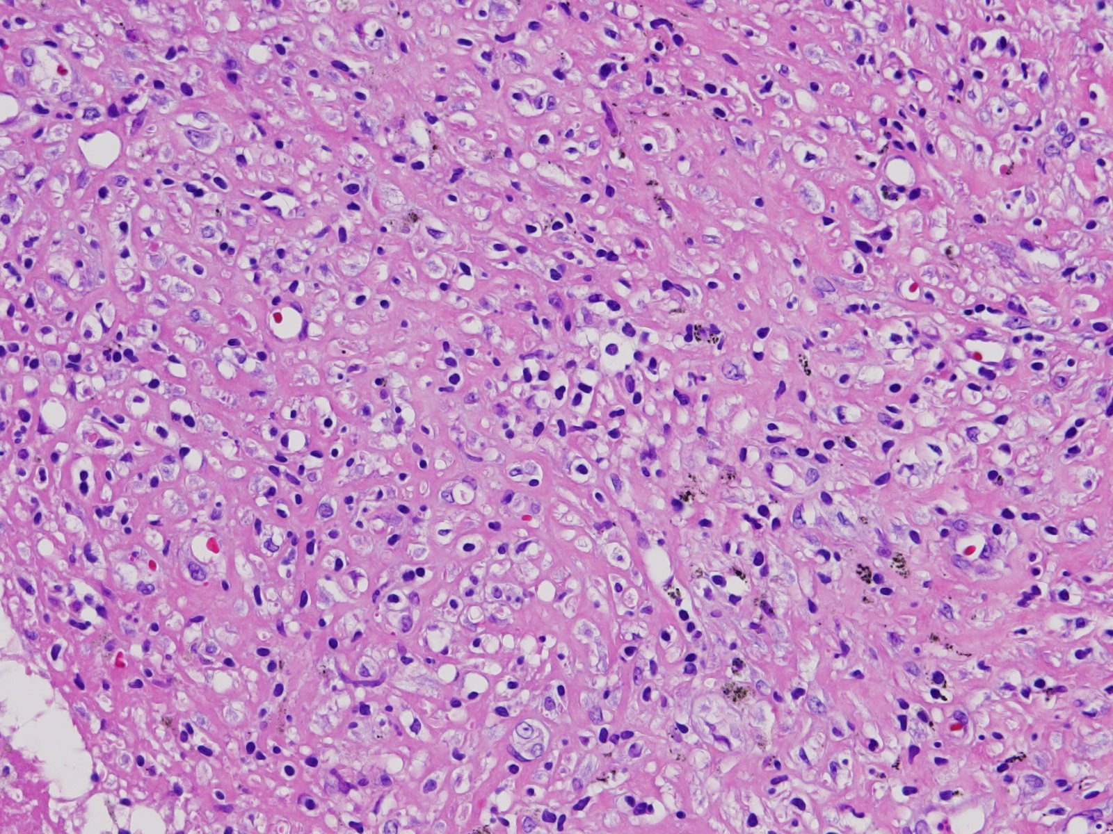

Slide 18
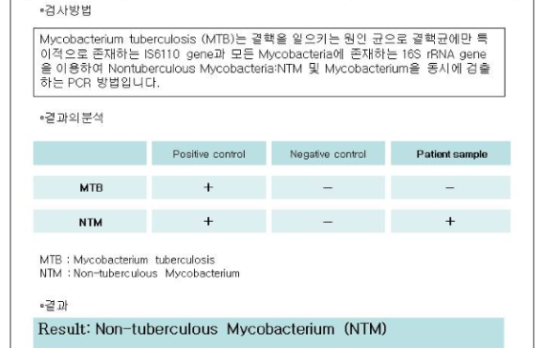

Slide 19
Case 3. 김O호 4608821

Slide 20
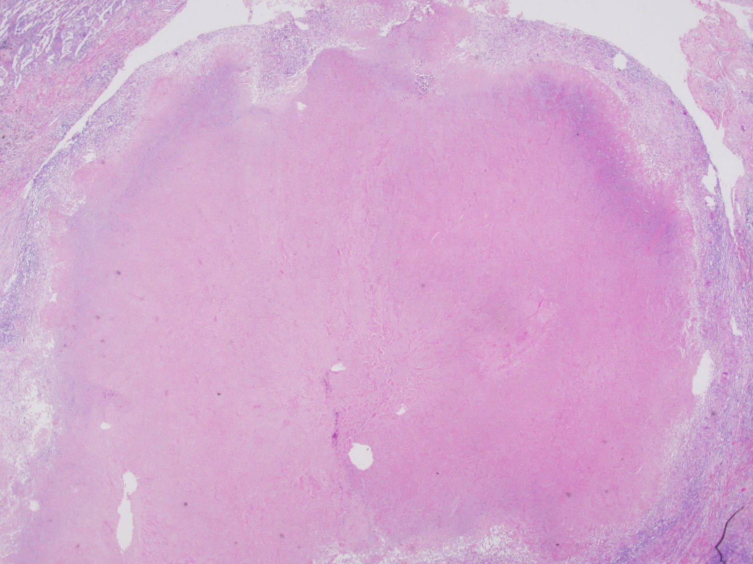
SF17-04357: Lung, left lower lobe, wedge resection (for frozen section)

Slide 21
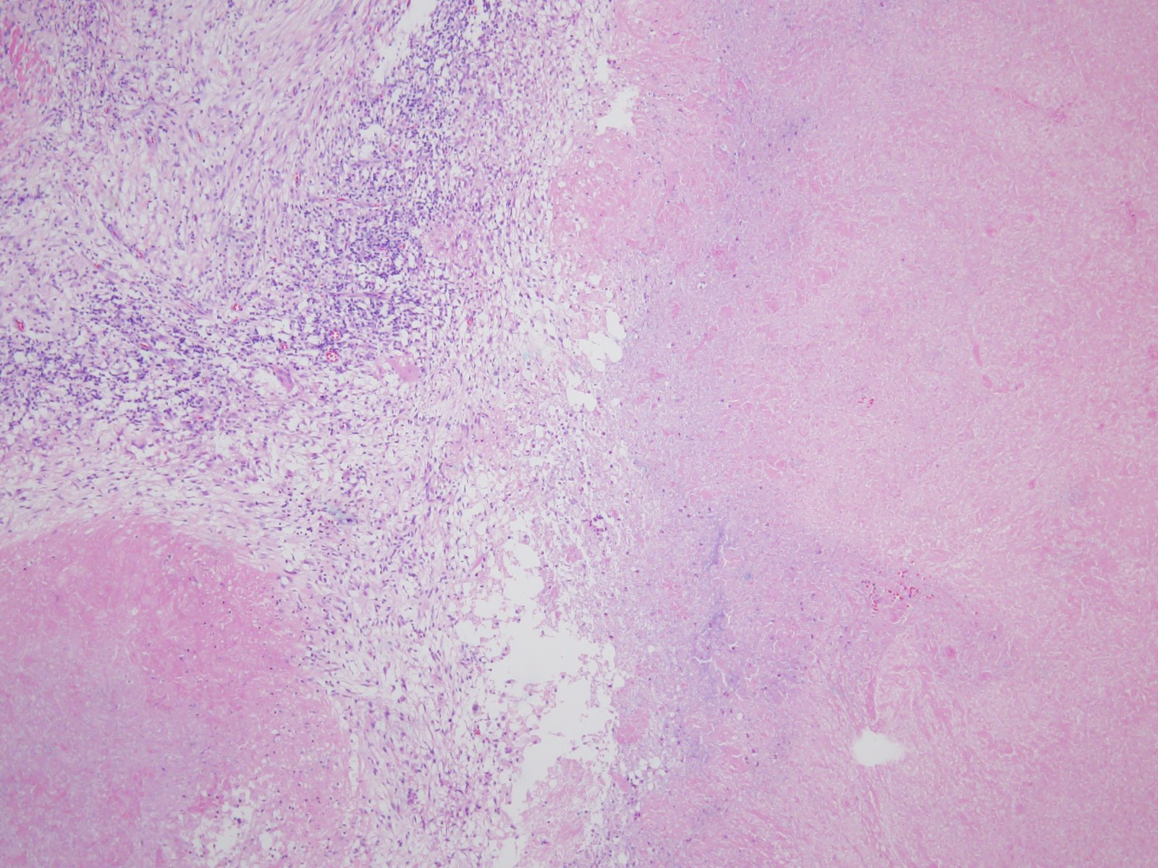

Slide 22
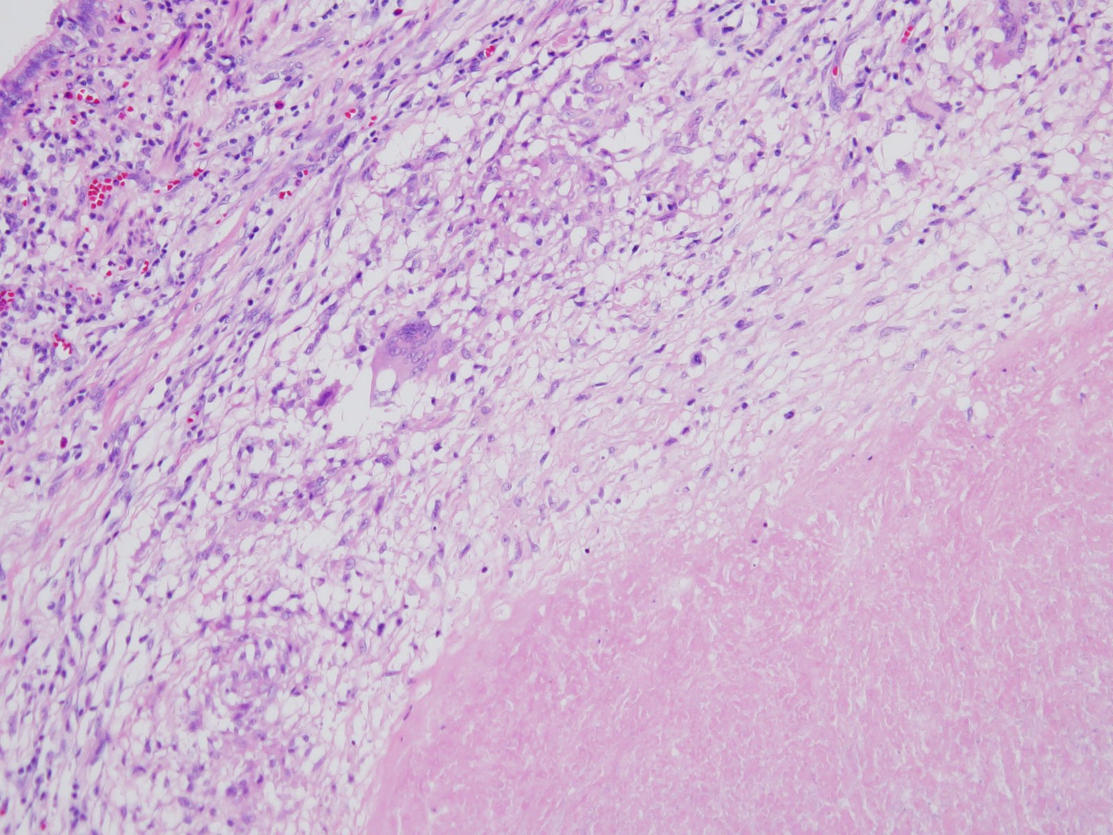

Slide 23
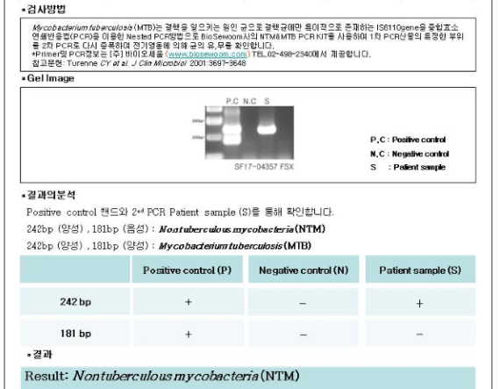

Slide 24
Case 4. 박O춘 8307214

Slide 25
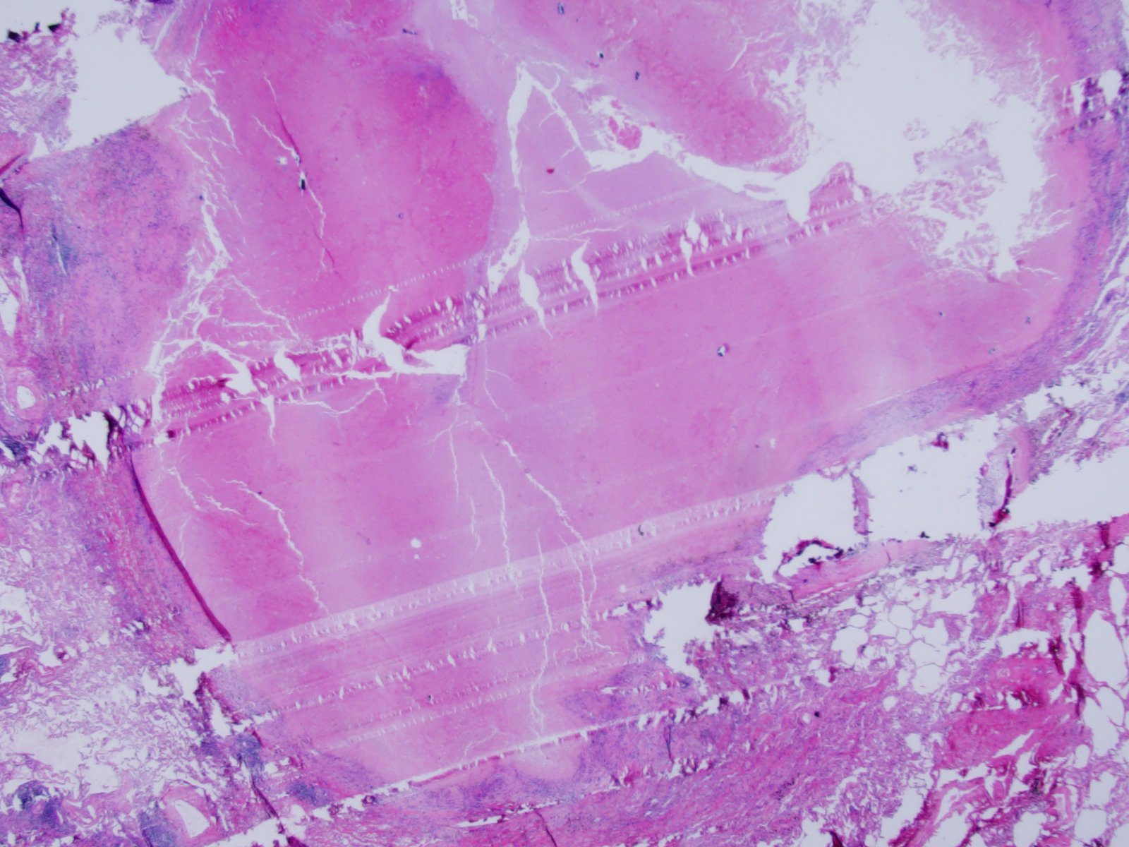
SF19-05531: Lung, right upper lobe, wedge resection (for frozen section)

Slide 26
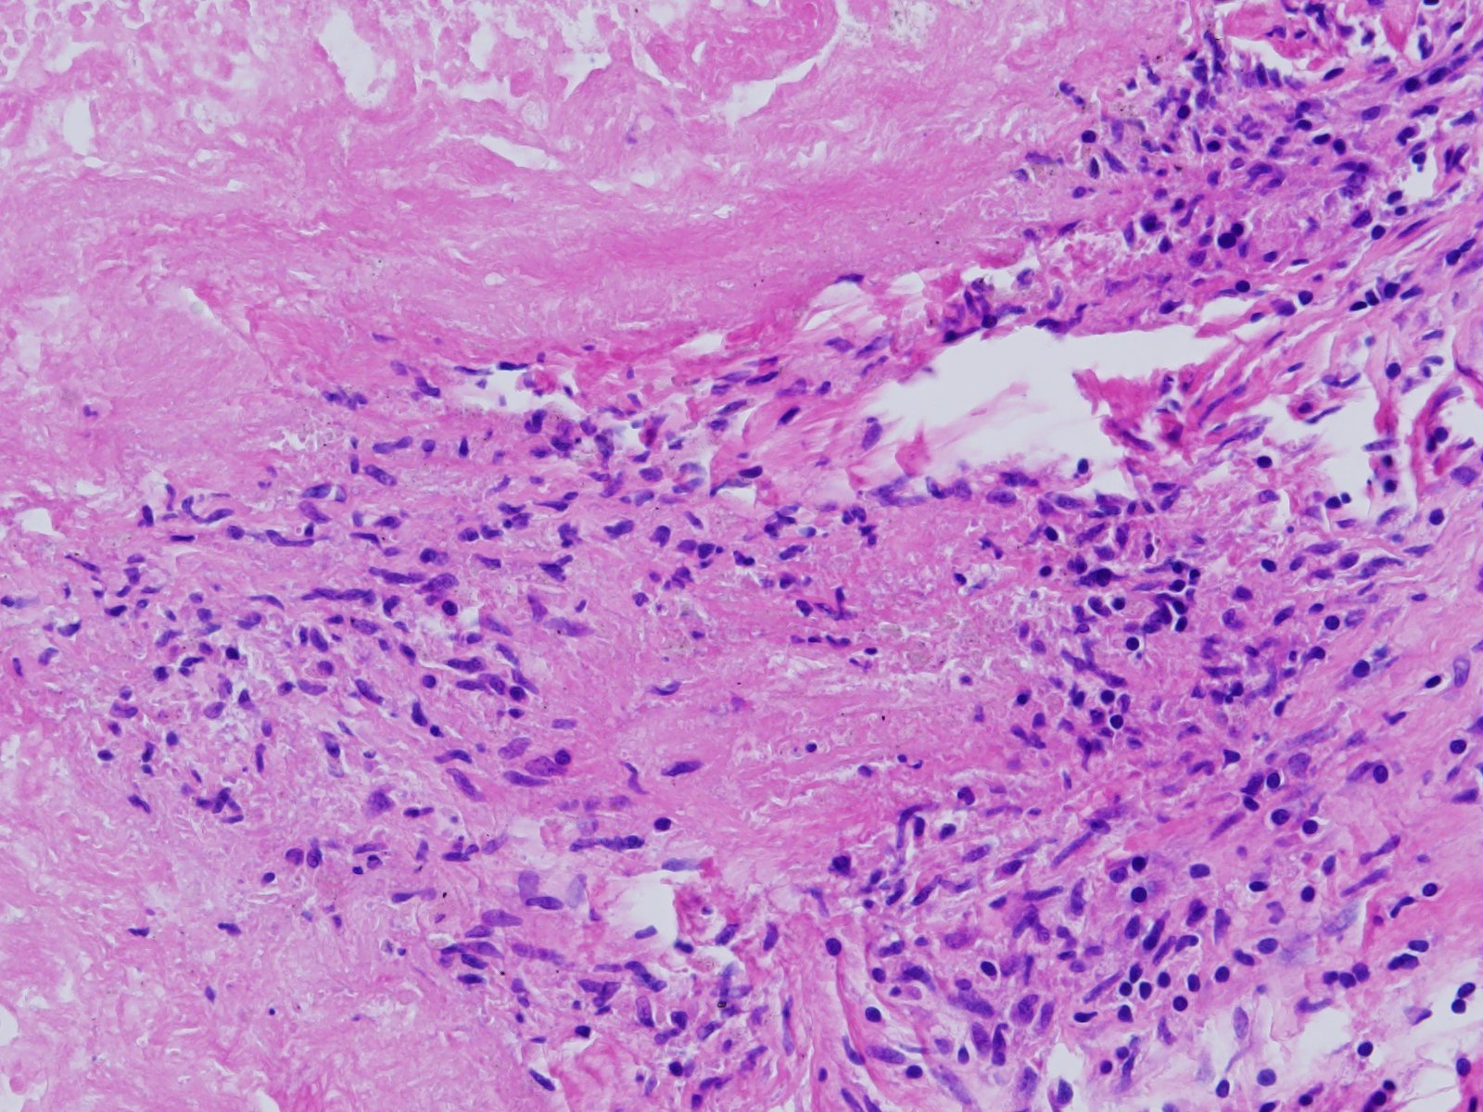

Slide 27
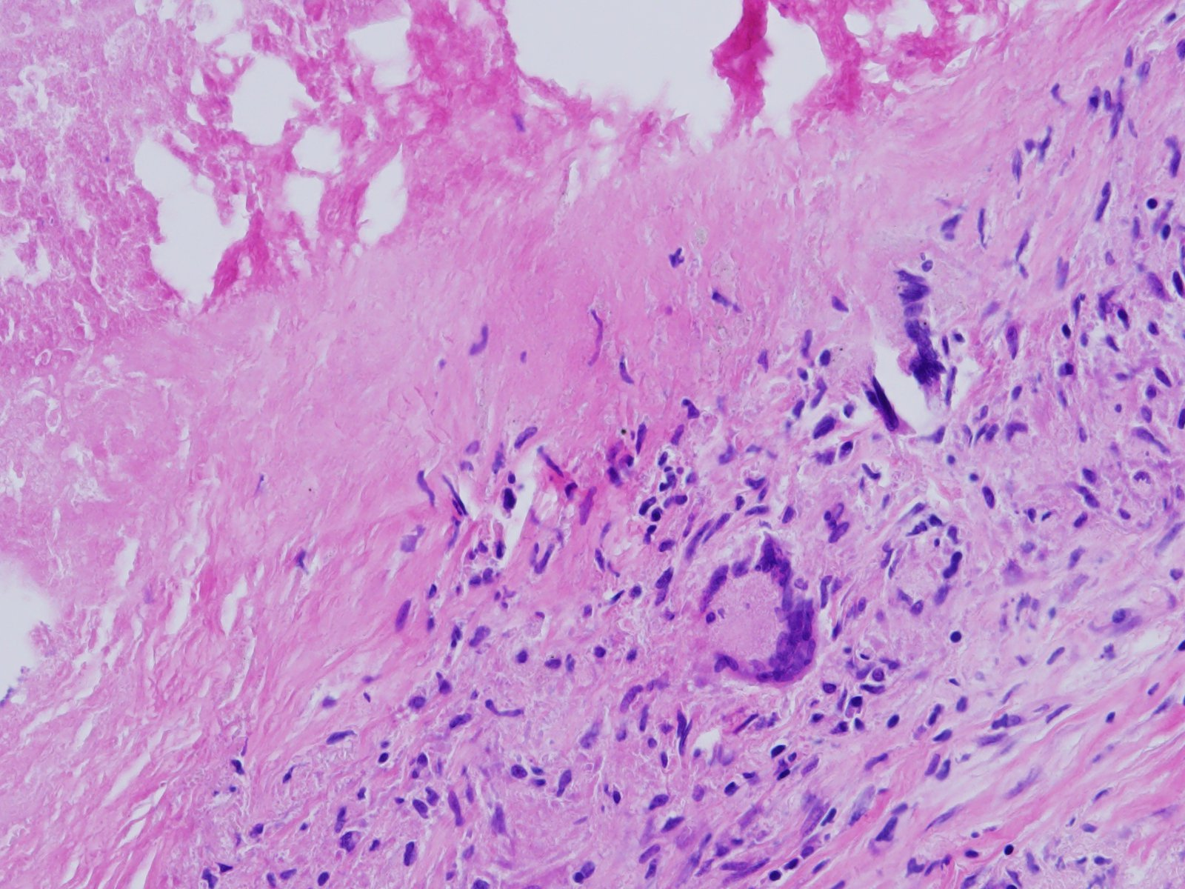

Slide 28
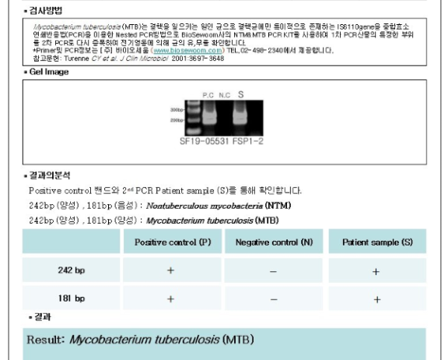

Slide 30
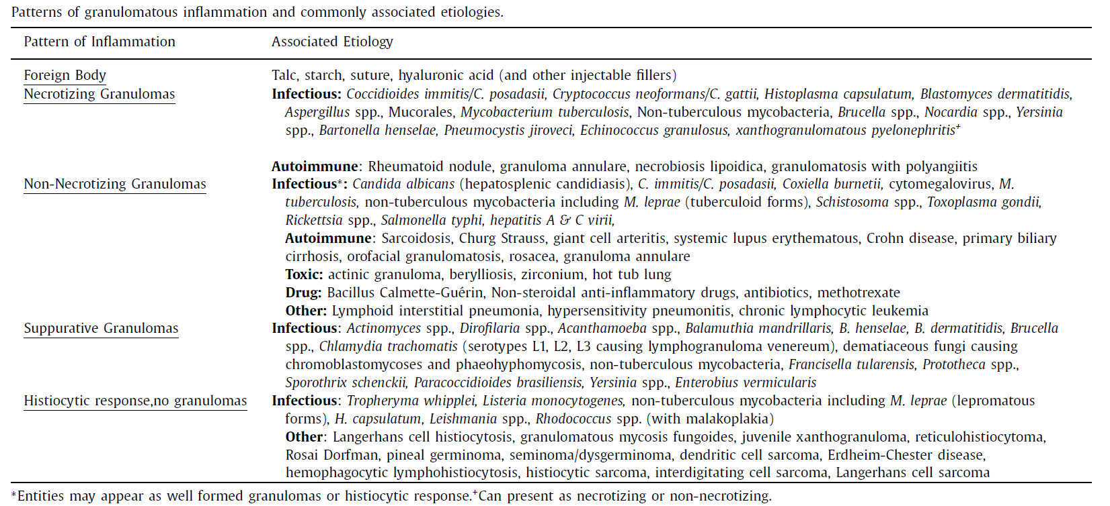
참고 자료
Journal of Clinical Tuberculosis and Other Mycobacterial Diseases 2017;7:1-12.

Slide 31
In immunocompromised patients, NTM infection is characterised by mycobacteria-containing foamy histiocytes, poorly formed granulomas or absence of an appropriate inflammatory response [15].
In immunocompetent patients, however, NTM infection demonstrates a wide variety of histological findings, including inflammation and both necrotising and nonnecrotising peribronchiolar granulomas [16].
The histological appearance of NTM alone is indistinguishable from that of TB.
Exposure to aerosolised NTM can cause a hypersensitivity pneumonitis-like disease known as “hot tub lung” .
Eur Respir Rev 2017; 26: 170012

Slide 32
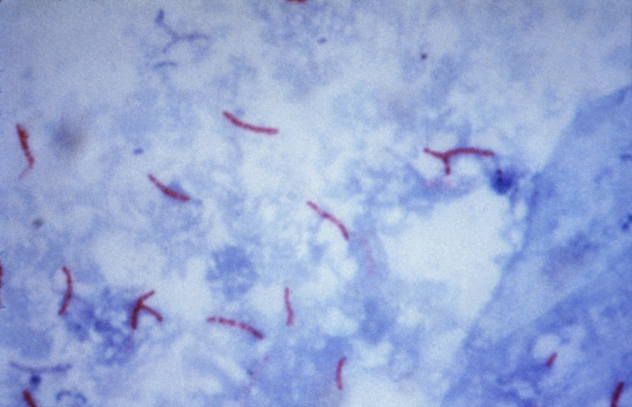
TB-PCR 검사

Slide 33
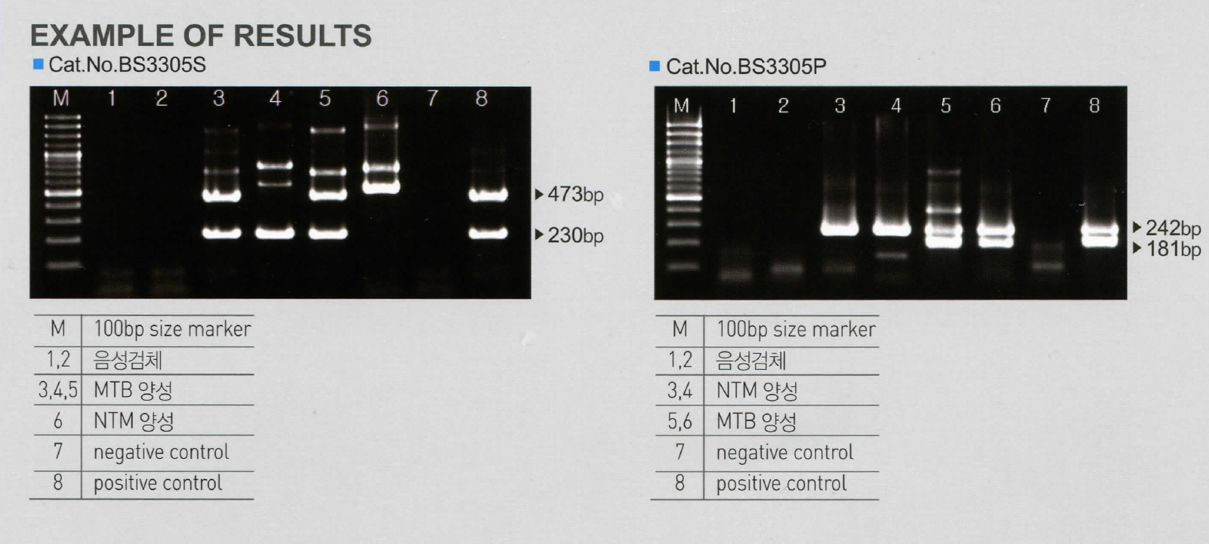
Nested PCR

Slide 34
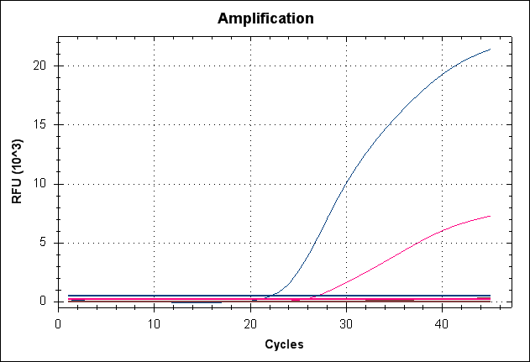
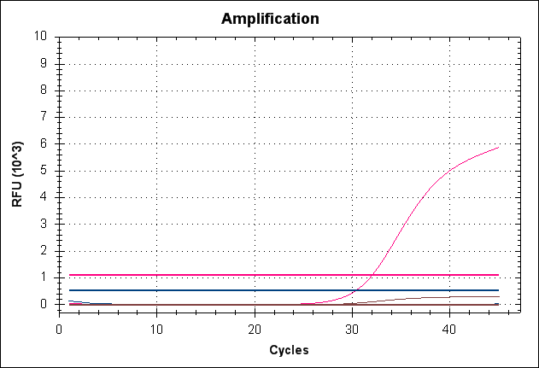
Real-time PCR
AnyplexTM MTB/NTM Real-Time
DNA extraction
(Boiling method)
AnyplexTM amplification test
(Real-Time PCR machine)
Direct Interpretation

