Slide 1
Chest Conference
2020.07.16
Department of Pathology

Slide 2
Cases
Case 1. 박O영 5847108
Case 2. 신O정 7653426
Case 3. 이O현 10028408

Slide 3
Case 1. 박O영 5847108

Slide 4
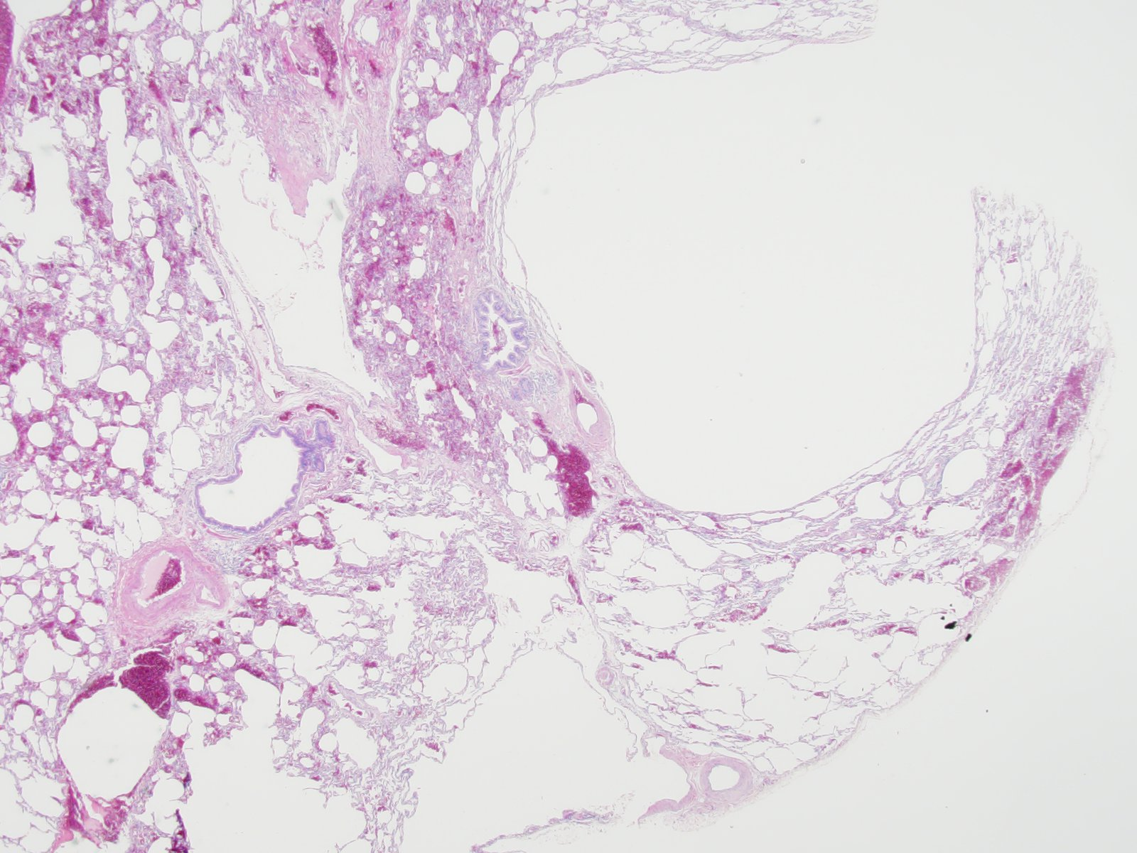
SS10-47396, Lung, left upper lobe, wedge resection

Slide 5
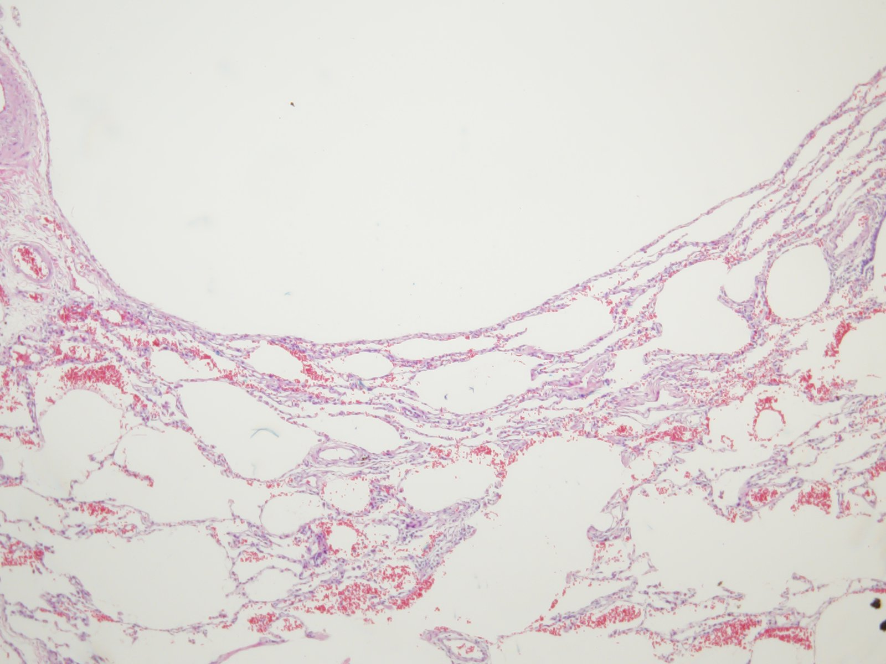

Slide 6
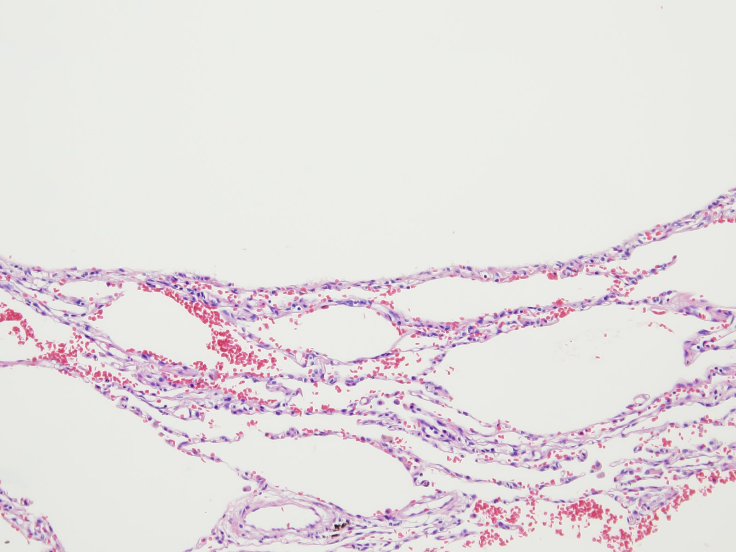

Slide 7
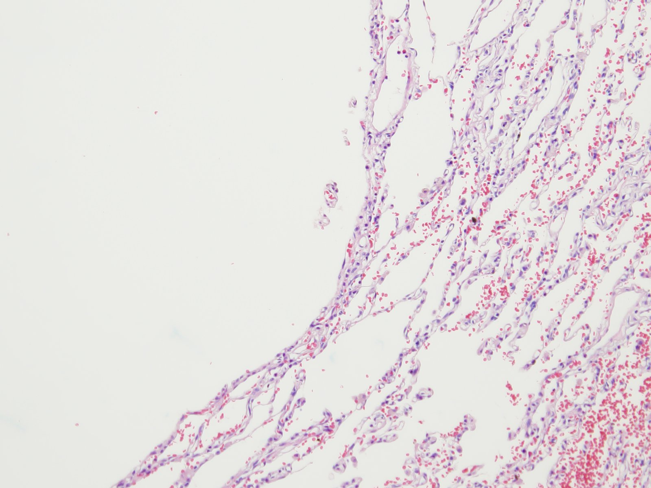

Slide 8
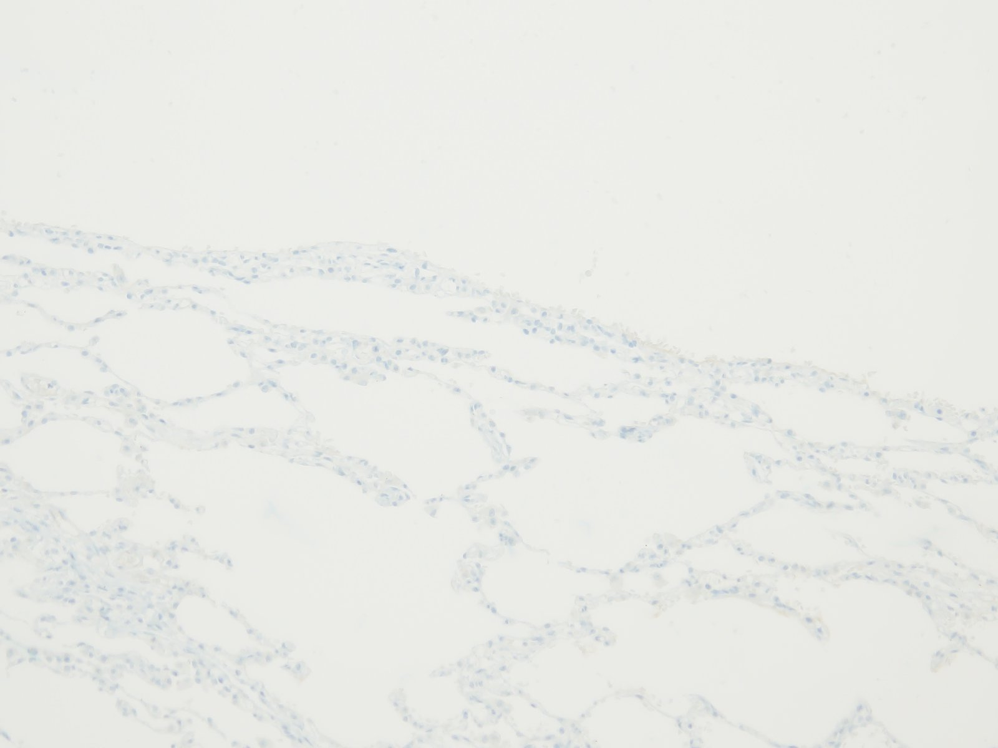
HMB45

Slide 9
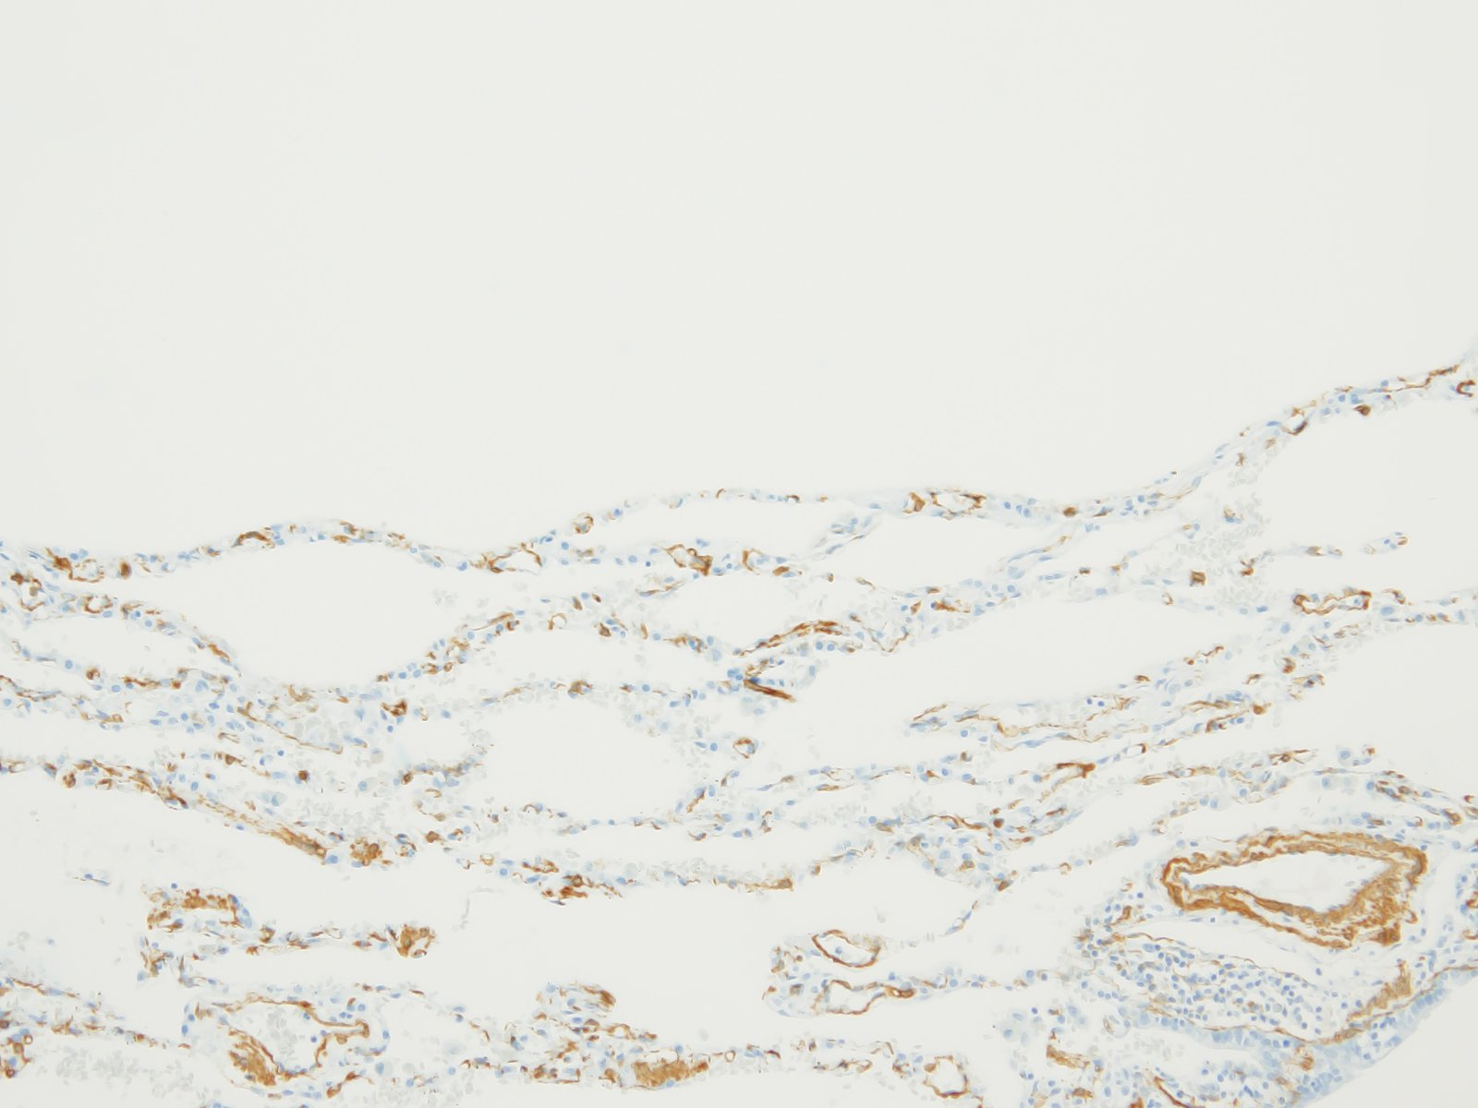
SMA

Slide 10
Case 2. 신O정 7653426

Slide 11
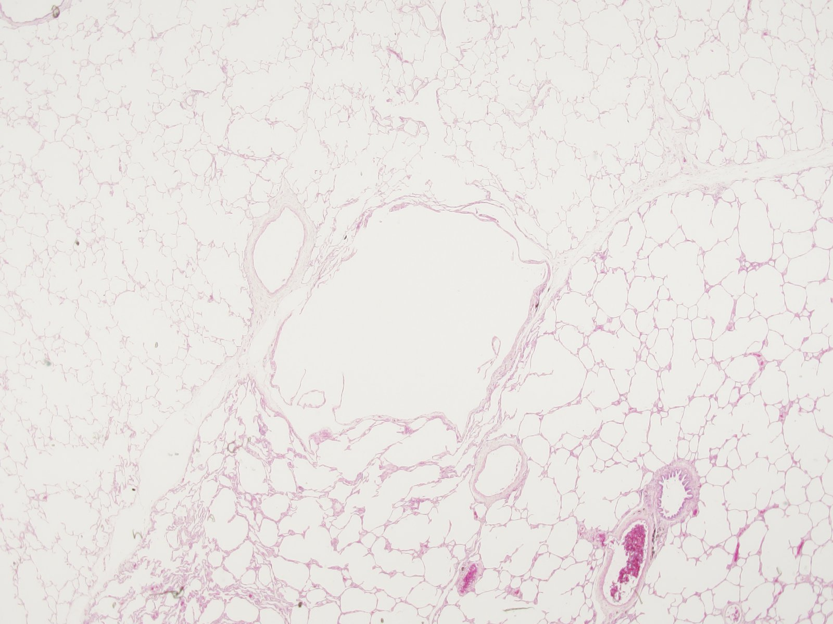
SS13-21238, Lung, left, bullectomy

Slide 12
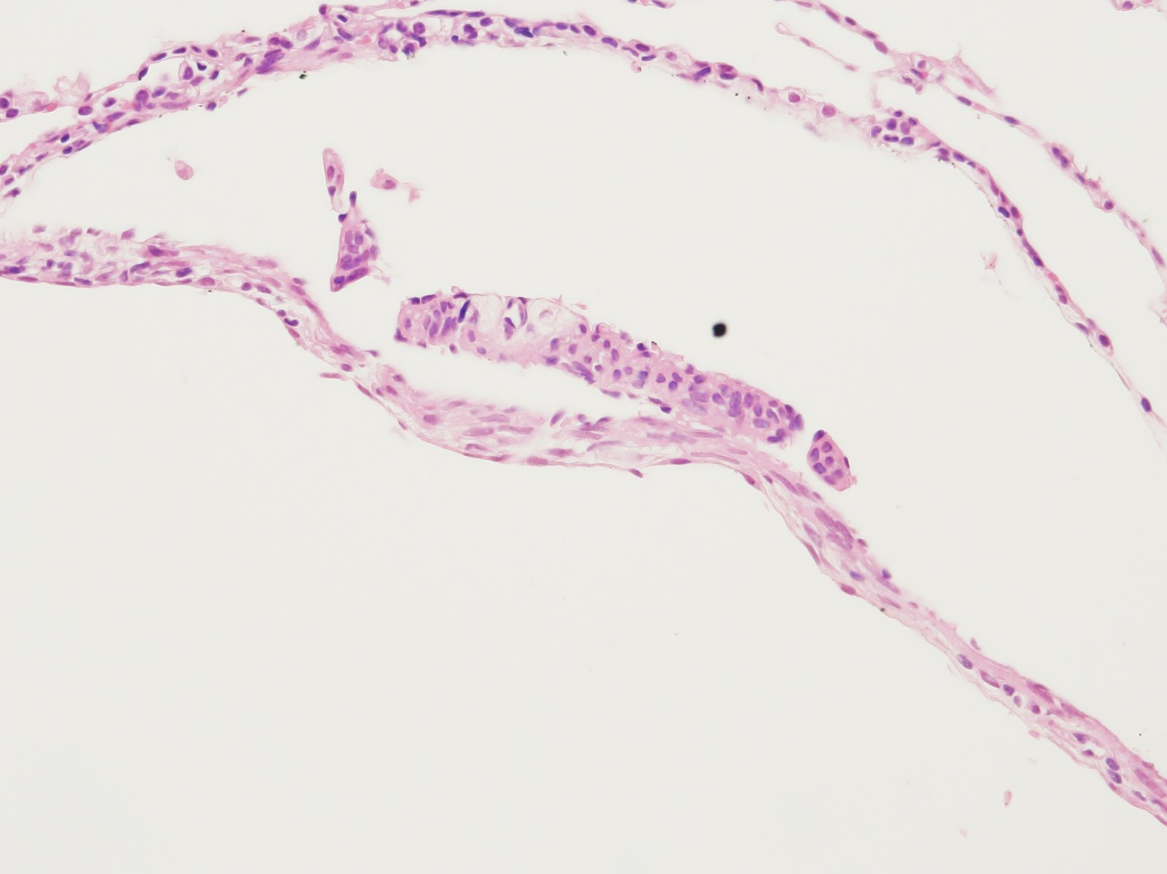

Slide 13
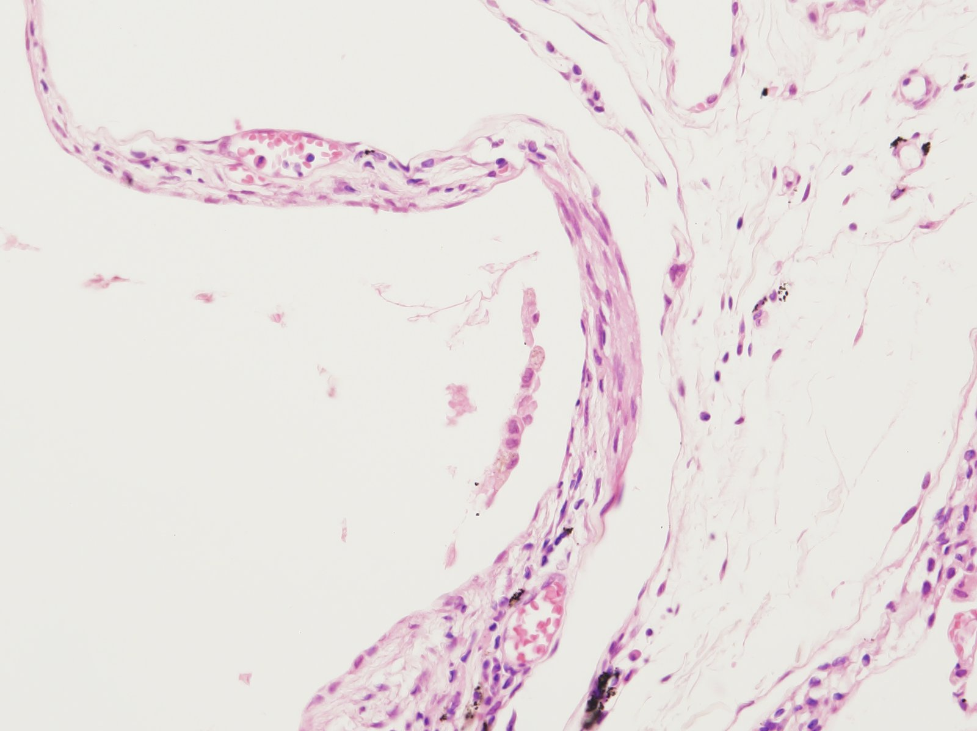

Slide 14
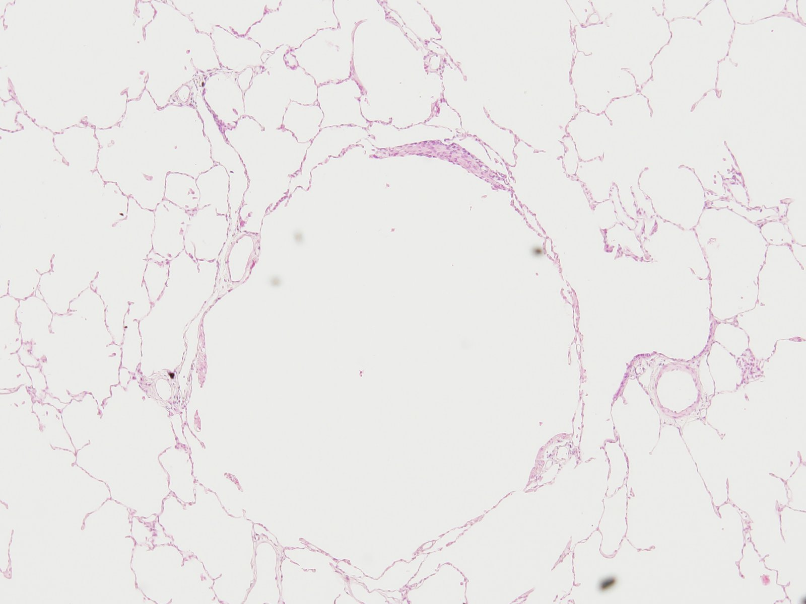

Slide 15
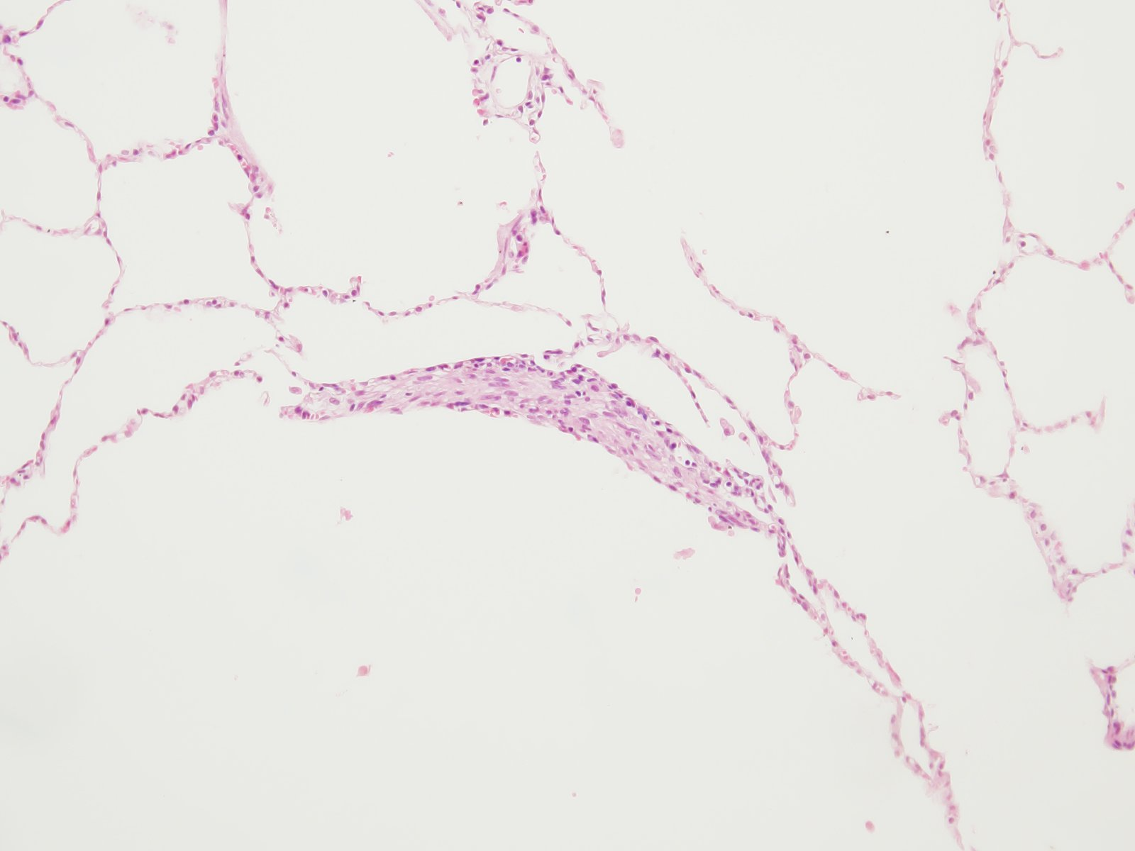

Slide 16
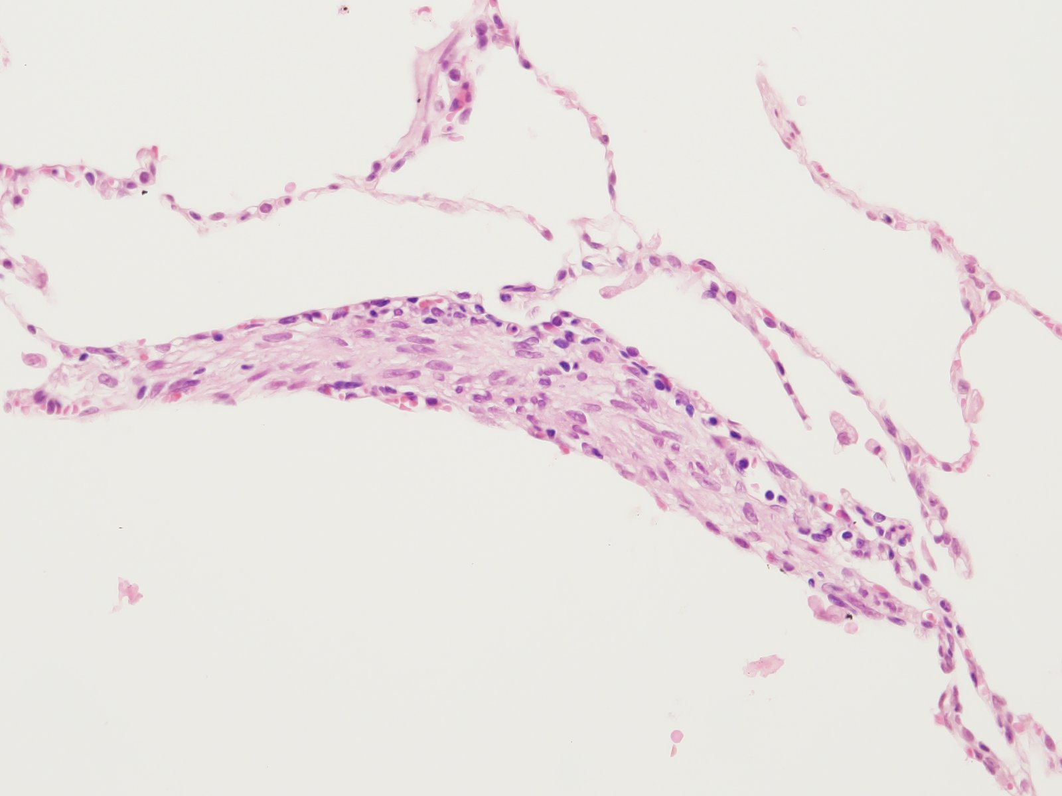

Slide 17
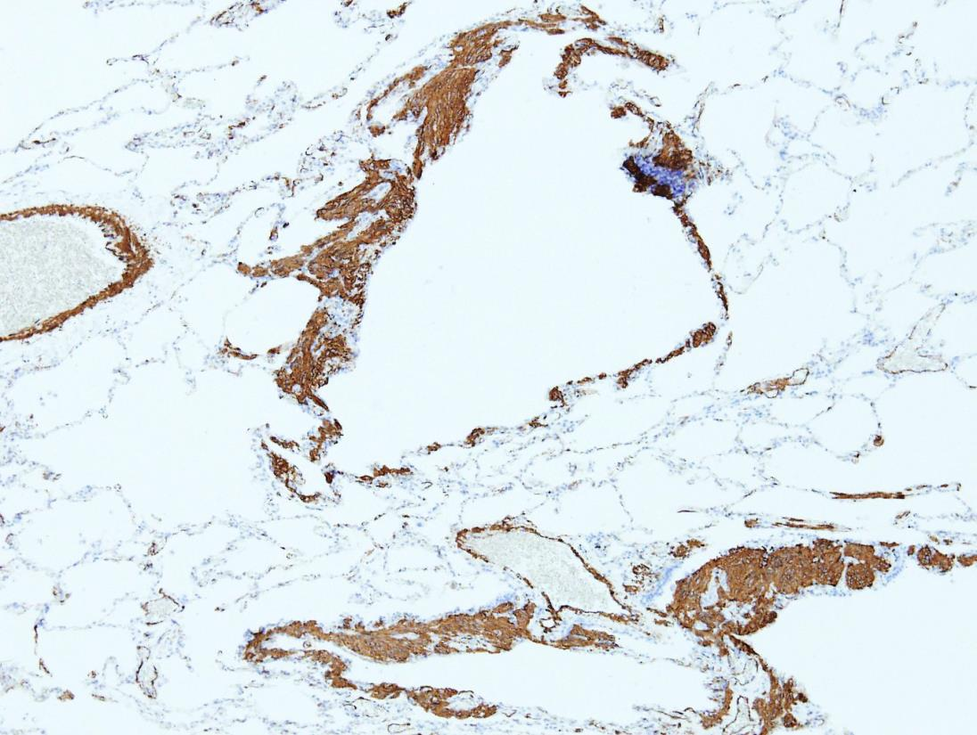
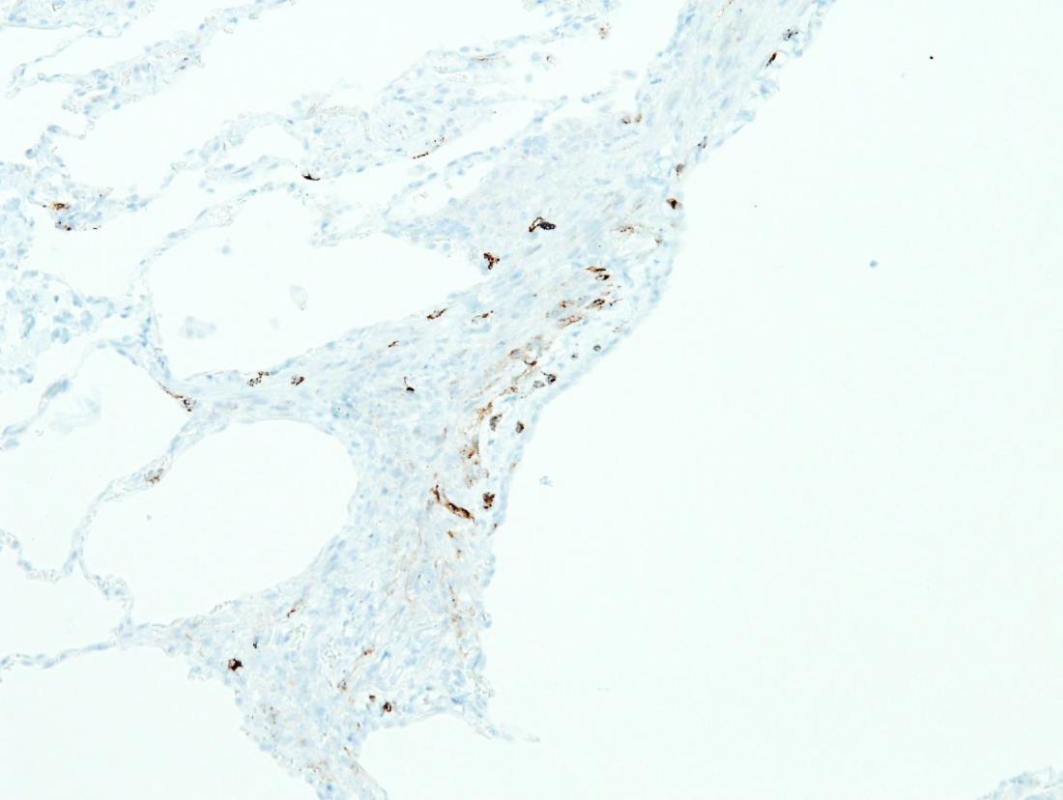
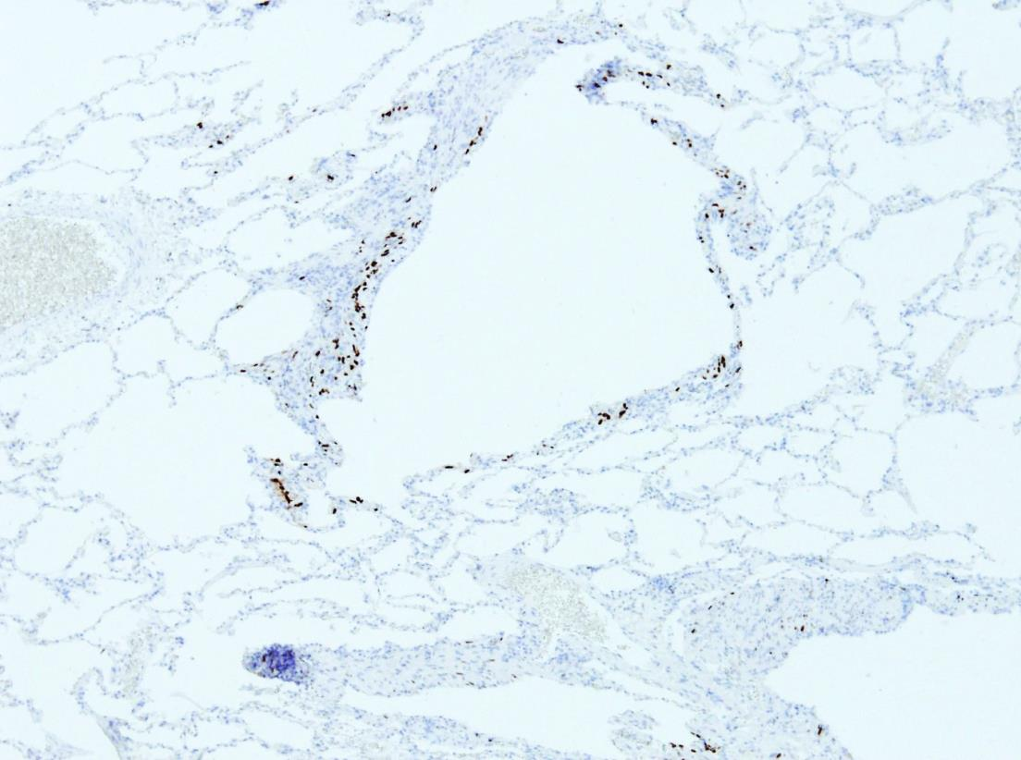
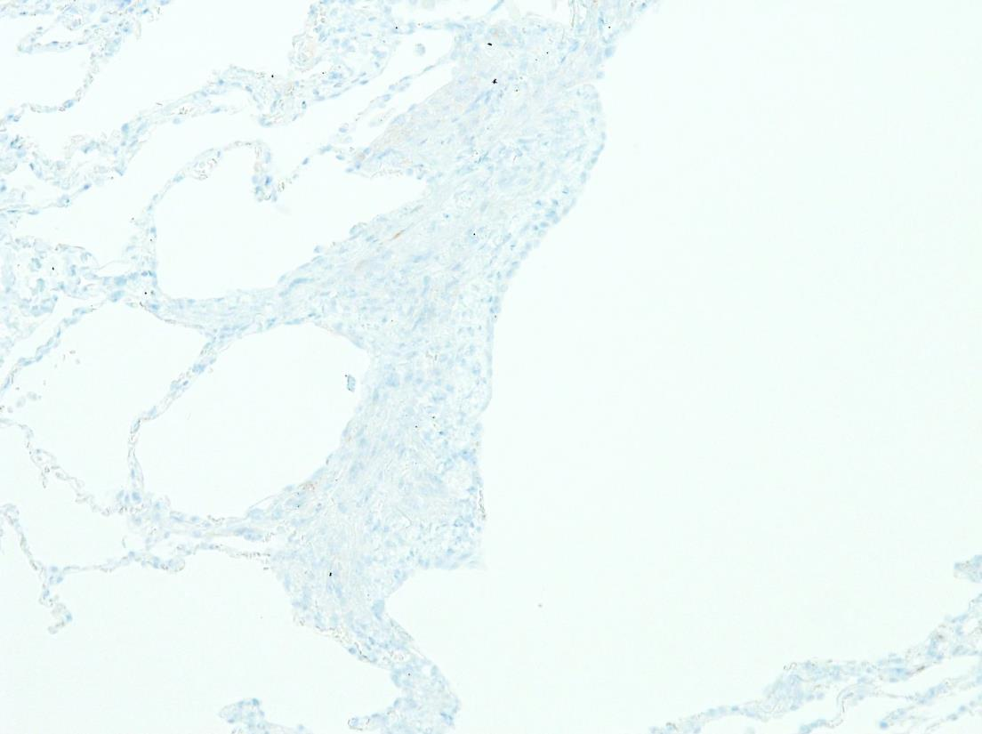
Cf) IHC of other case
Actin (SMA)
HMB45
PR
Melan A

Slide 18
Case 3. 이O현 10028408

Slide 19
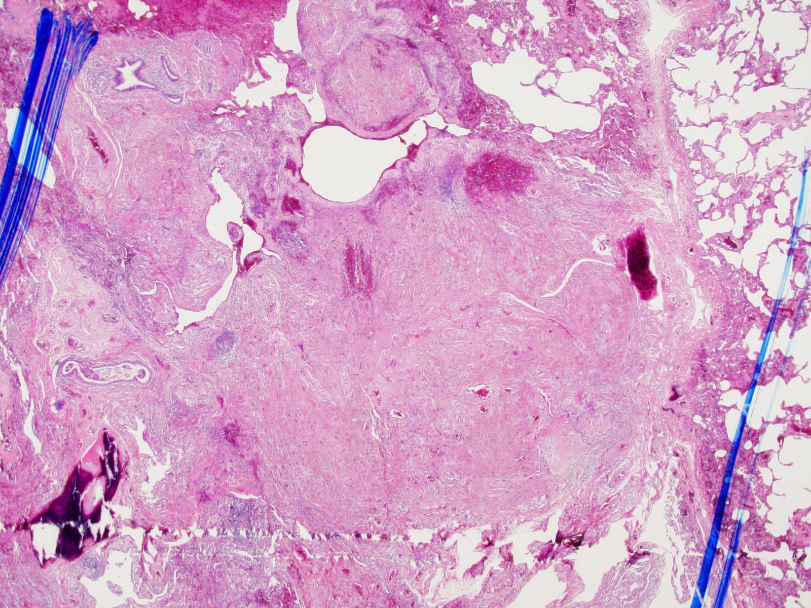
SS19-71570, Lung, left lower lobe, wedge resection

Slide 20
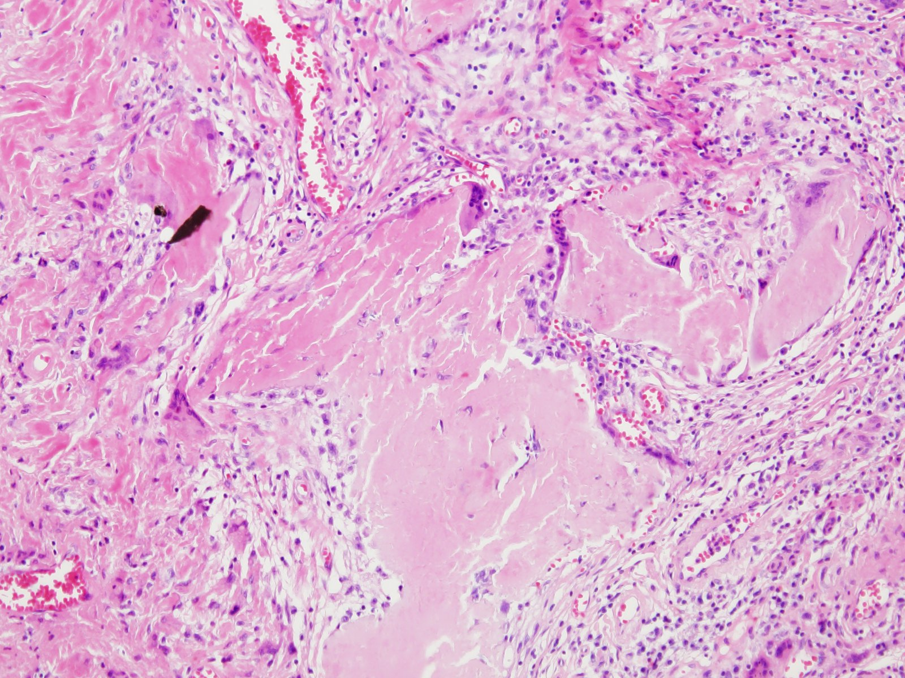

Slide 21
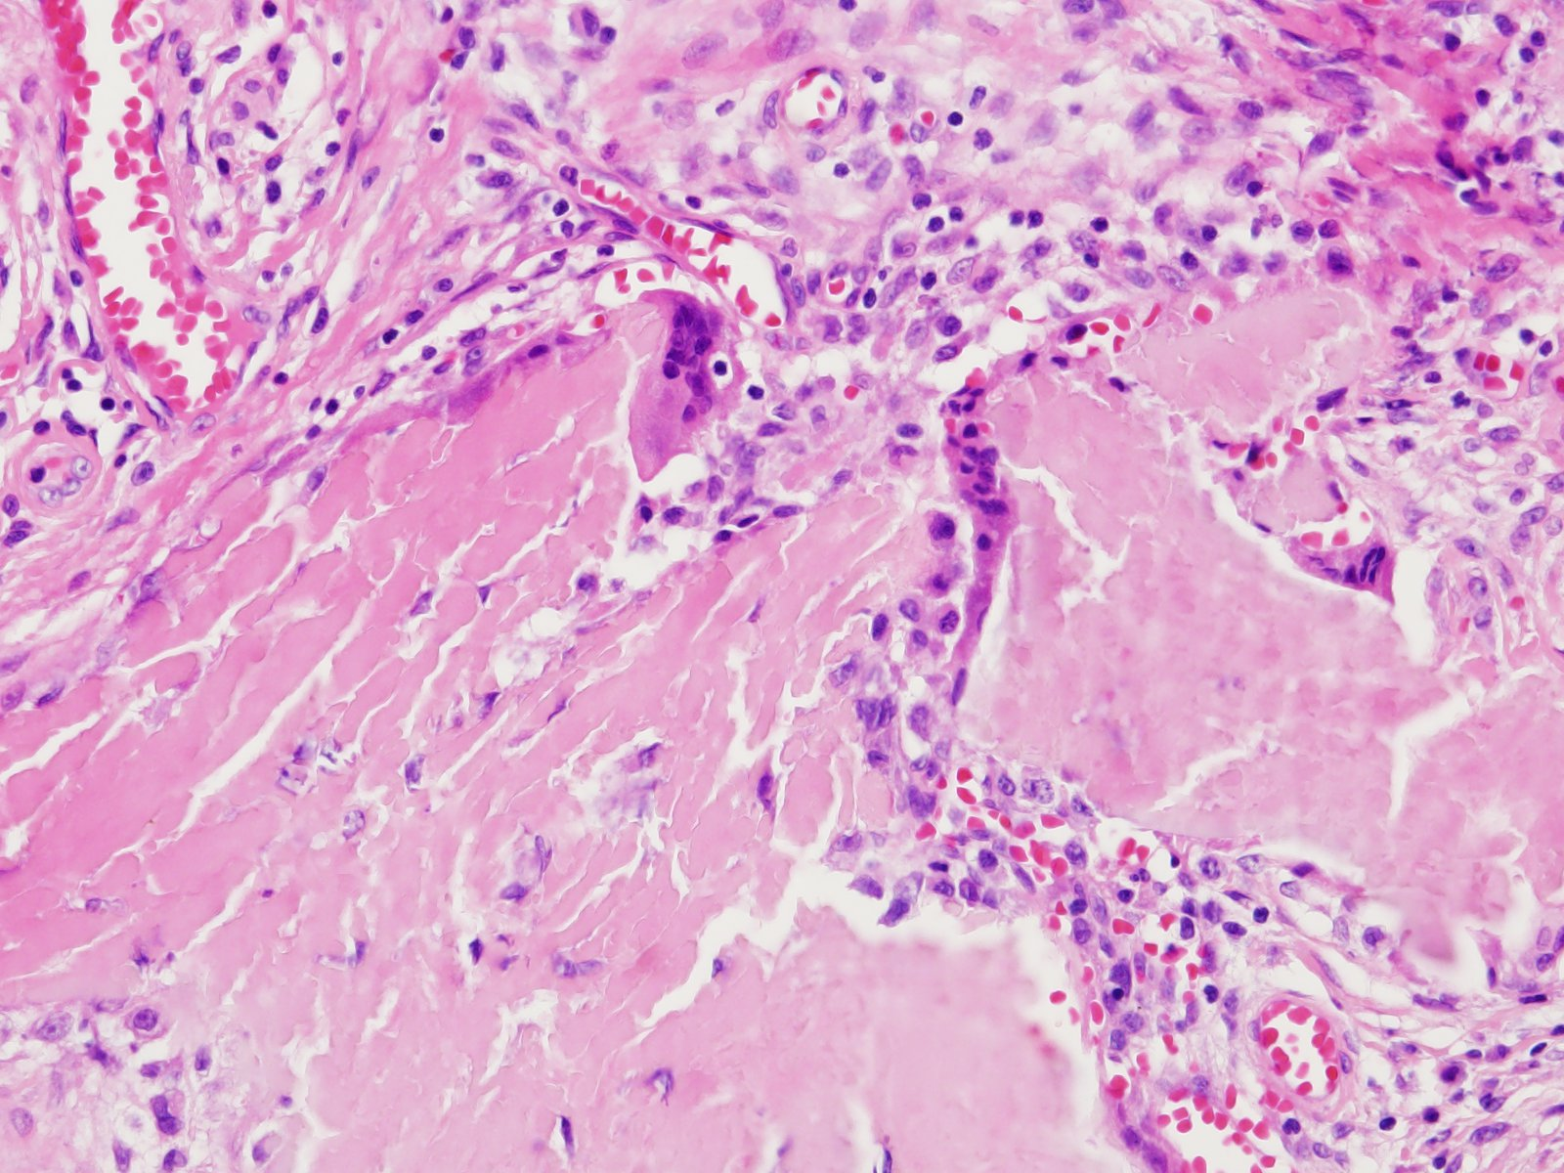

Slide 22
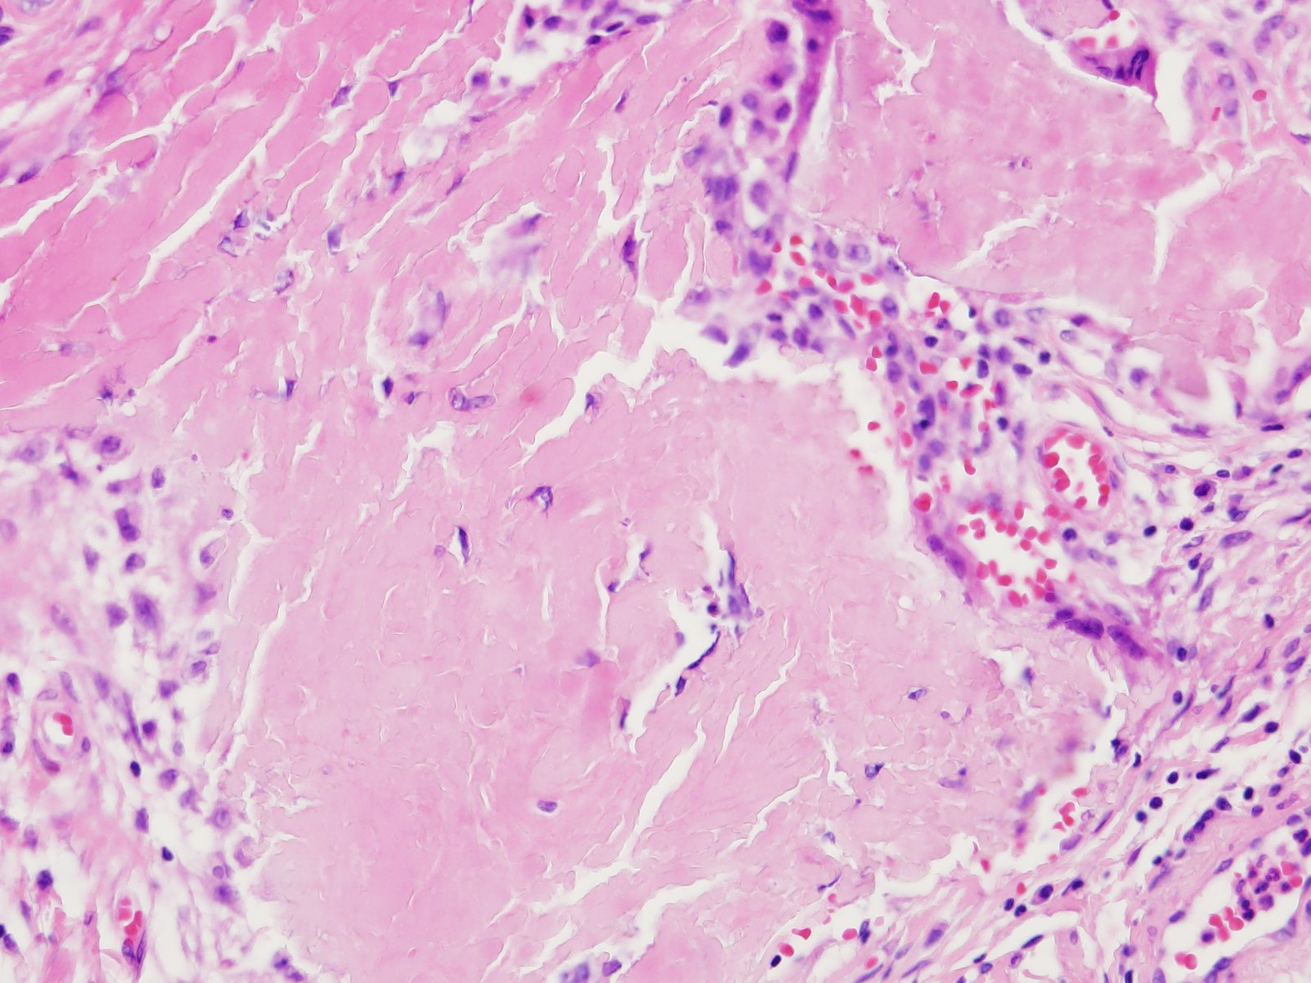

Slide 23
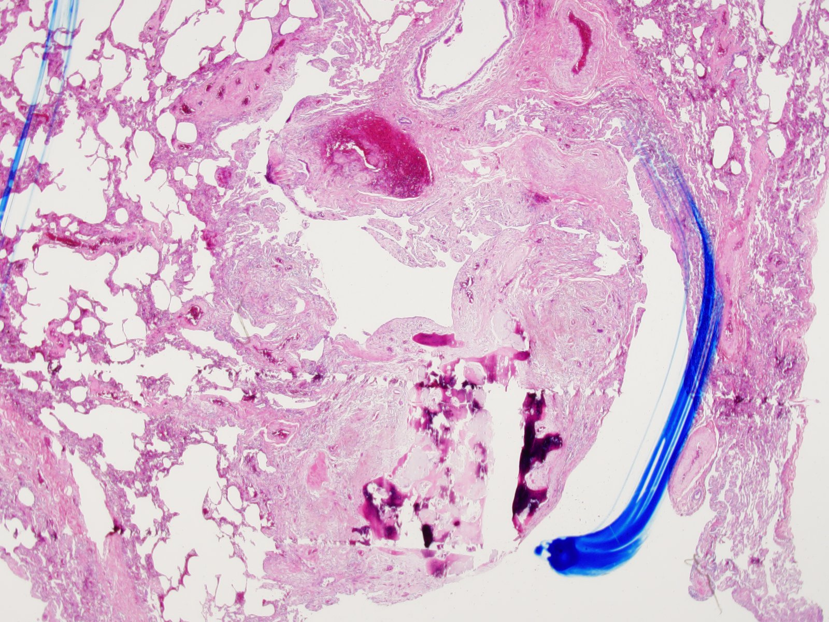

Slide 24
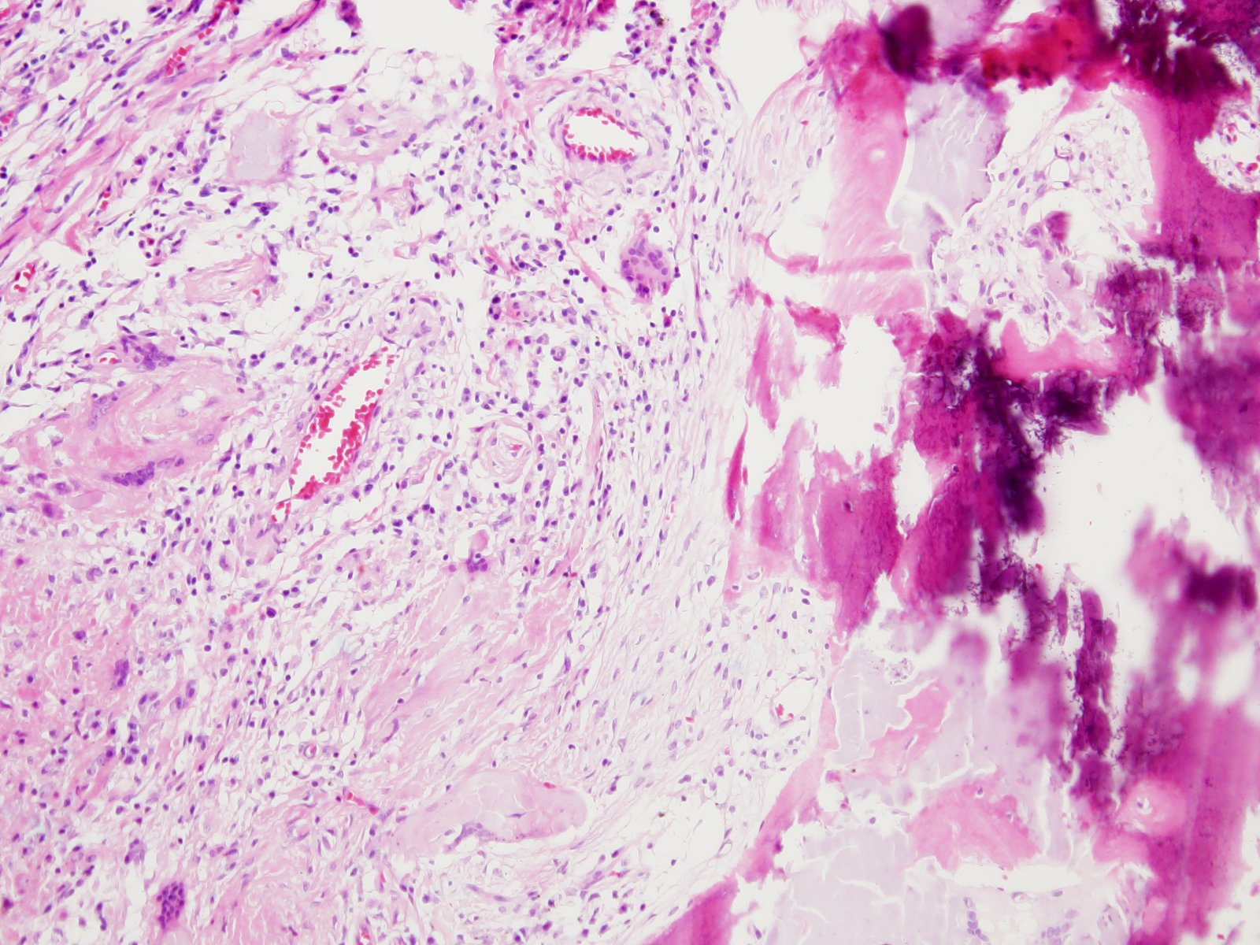

Slide 25
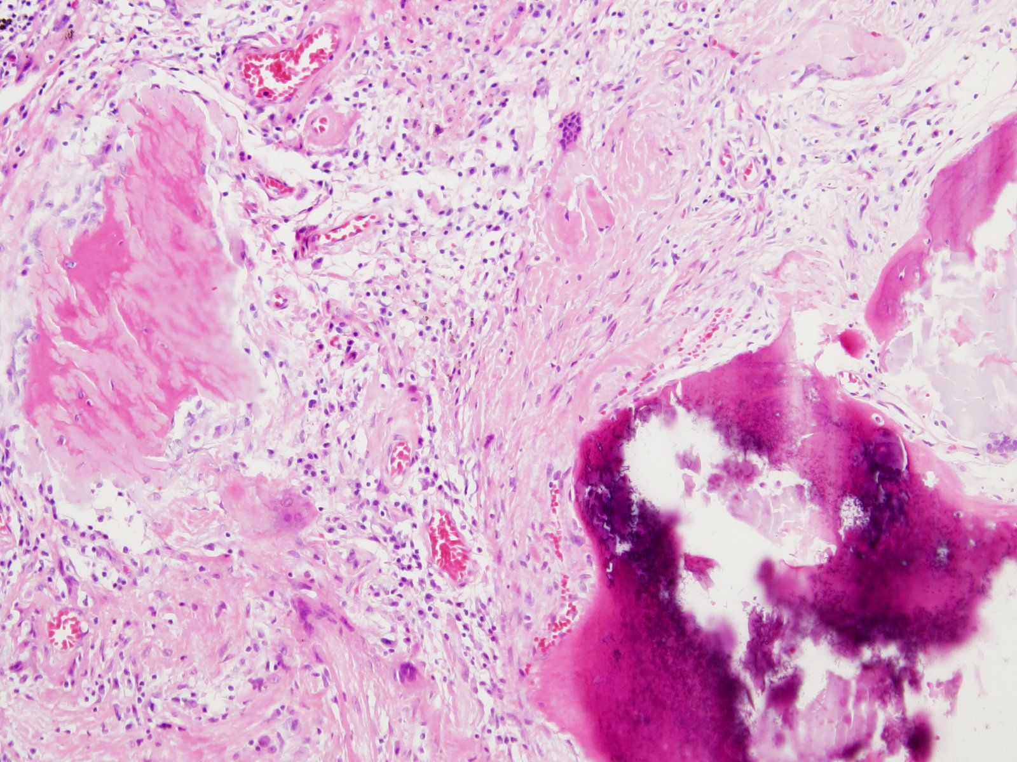

Slide 26
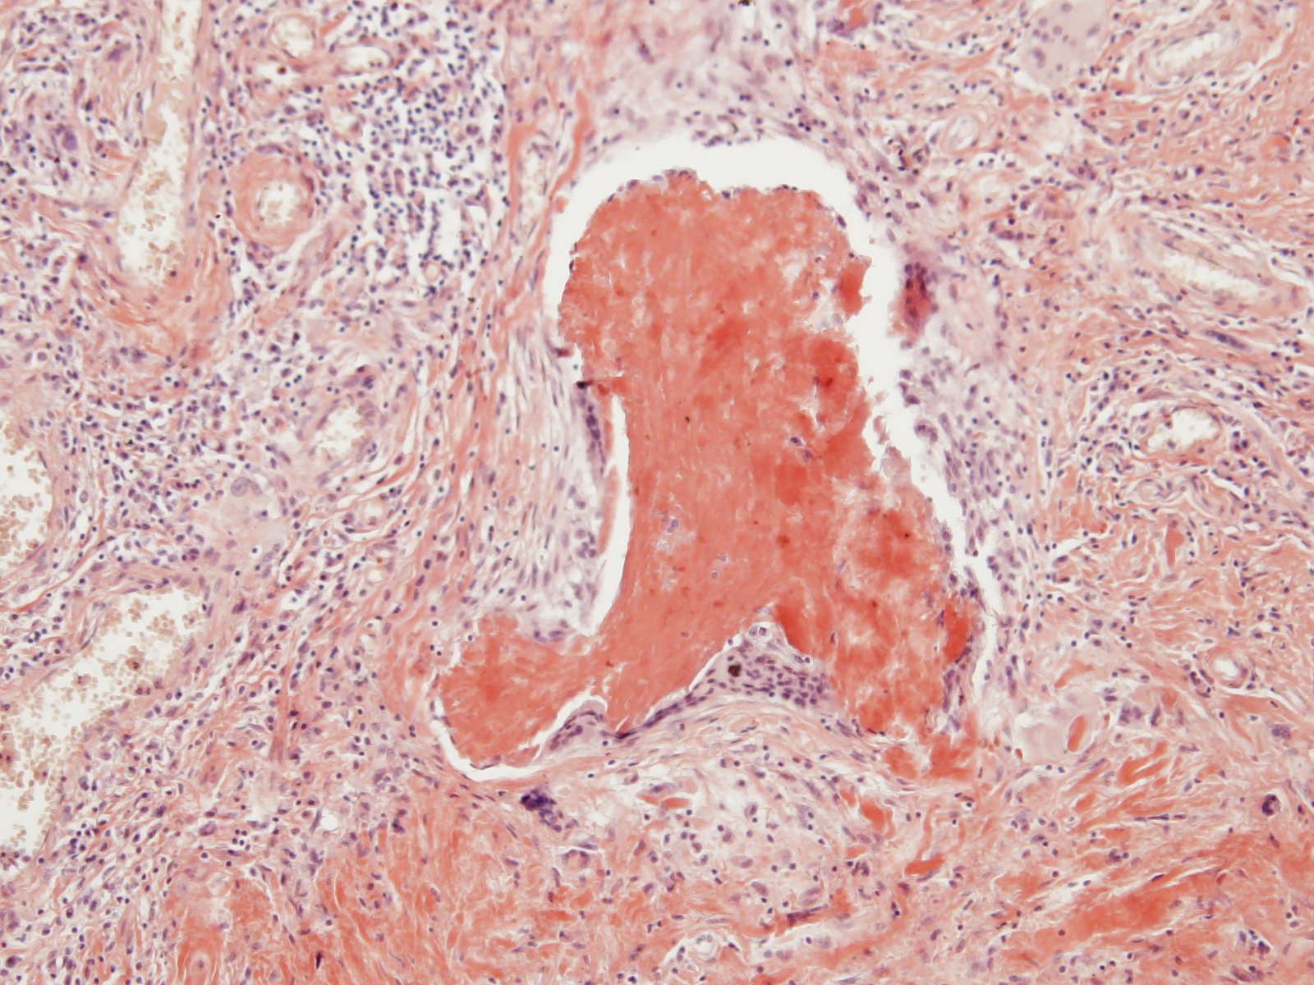
Congo red

Slide 27
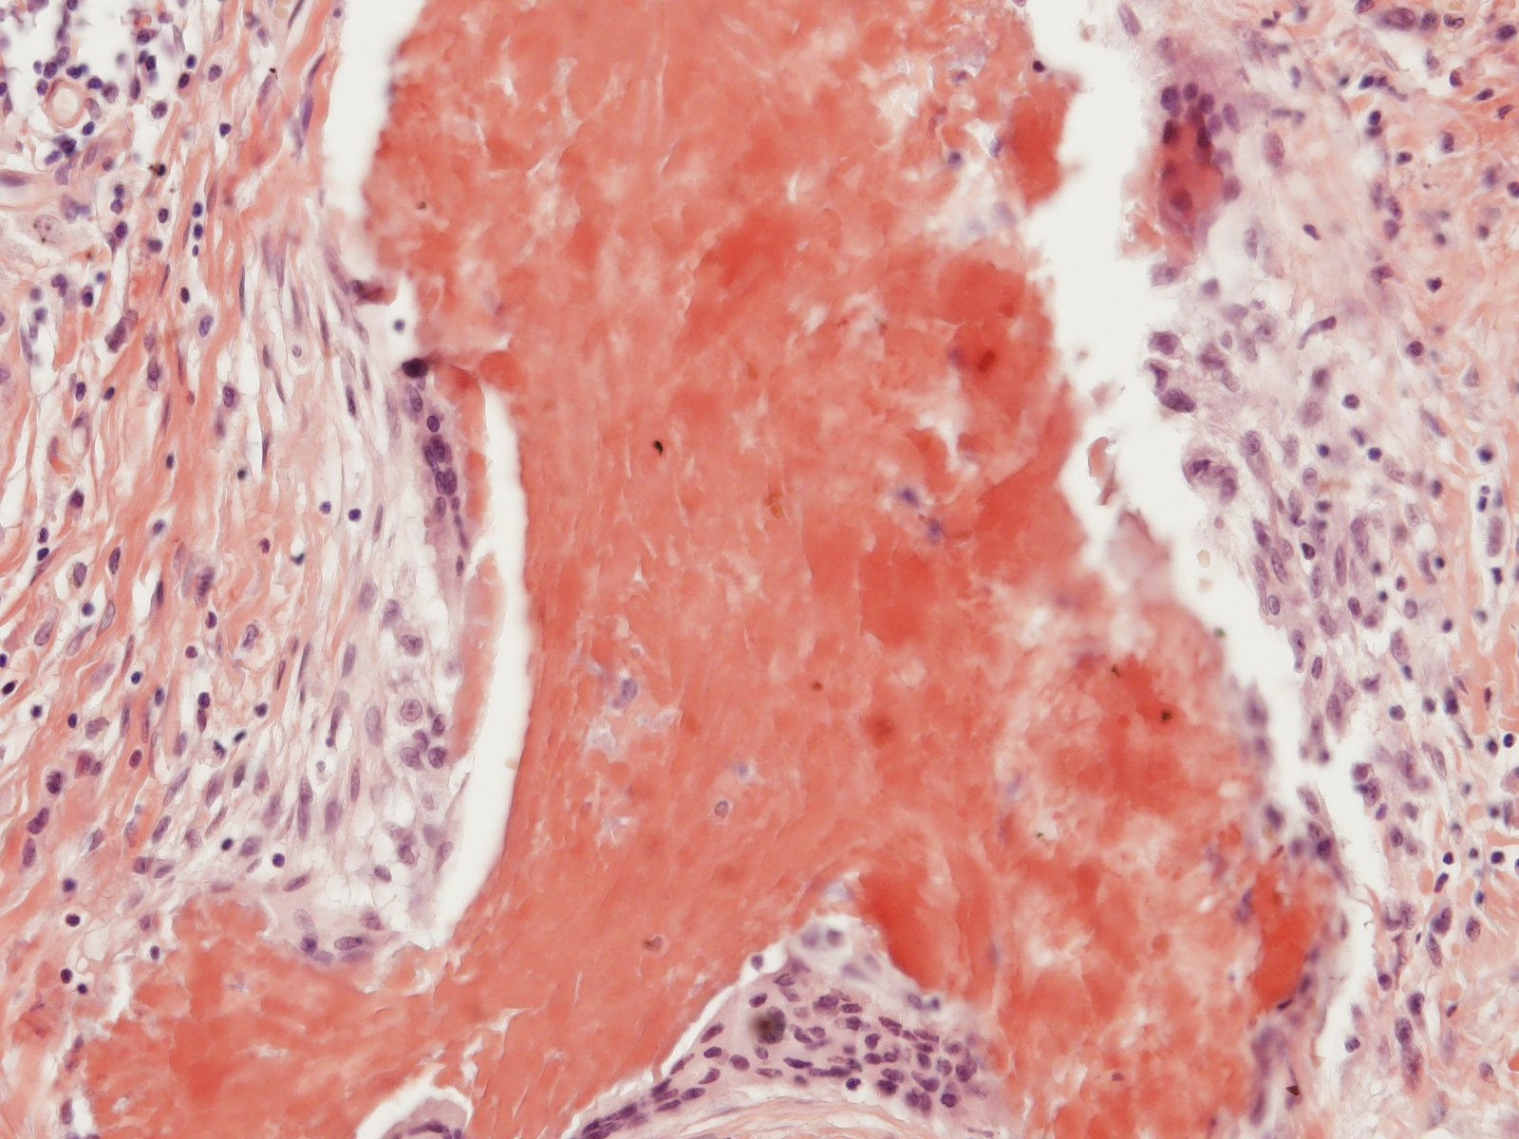

Slide 28
