Slide 1
Chest conference
2019.12.19
Department of Pathology

Slide 2
Cases
1. 문ㅇ자 F/46 #5093946
2. 전ㅇ애 F/59 #2741356
3. 김ㅇ숙 F/52 #2332145

Slide 3
CASE 2
전ㅇ애 F/59 #2741356

Slide 4
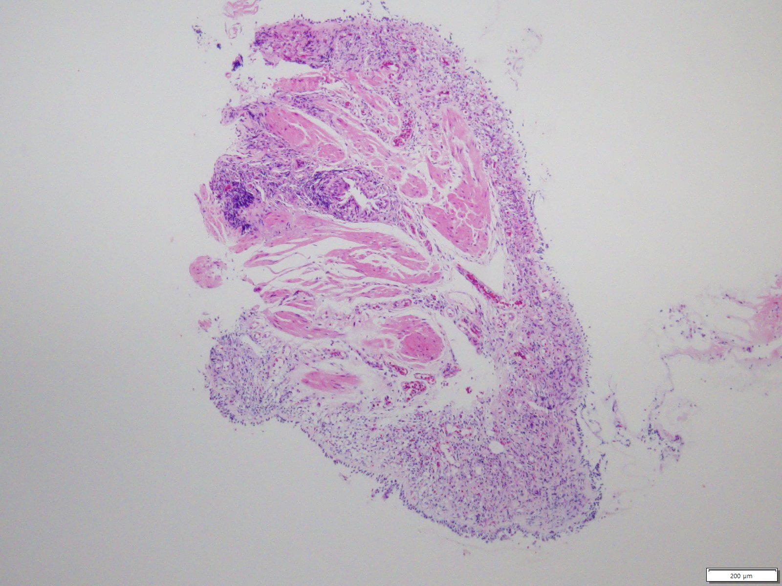
SS18-30552 | Bronchus, right upper lobe (RB3), endobrochial biopsy

Slide 5
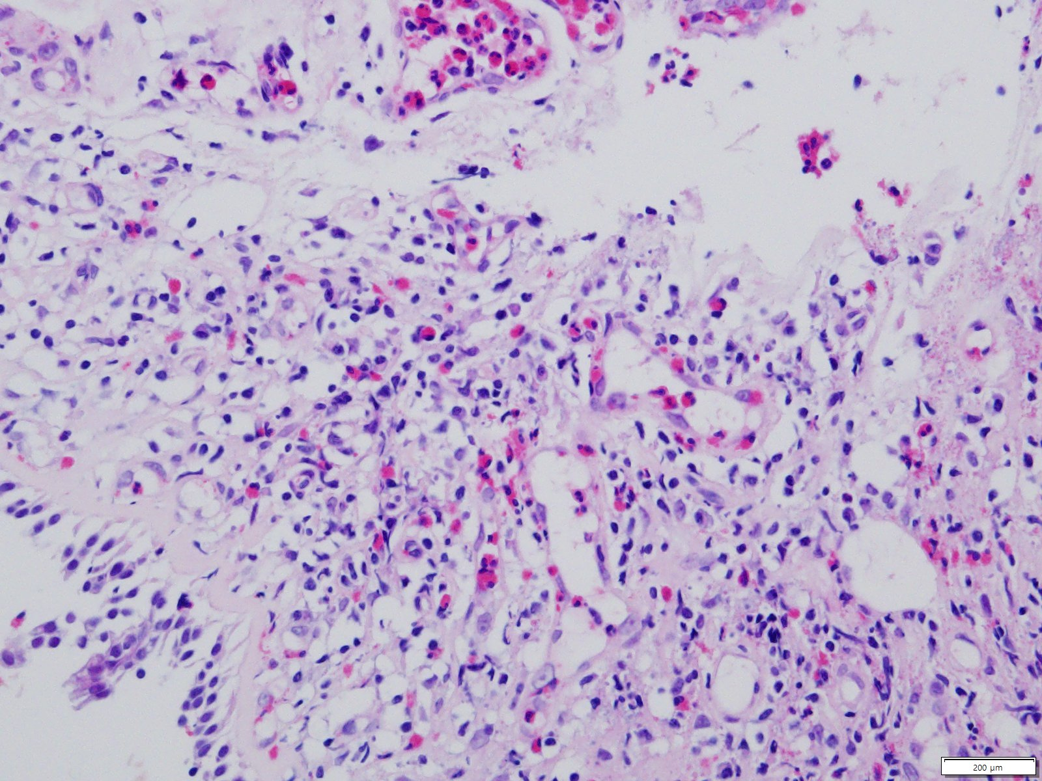

Slide 6
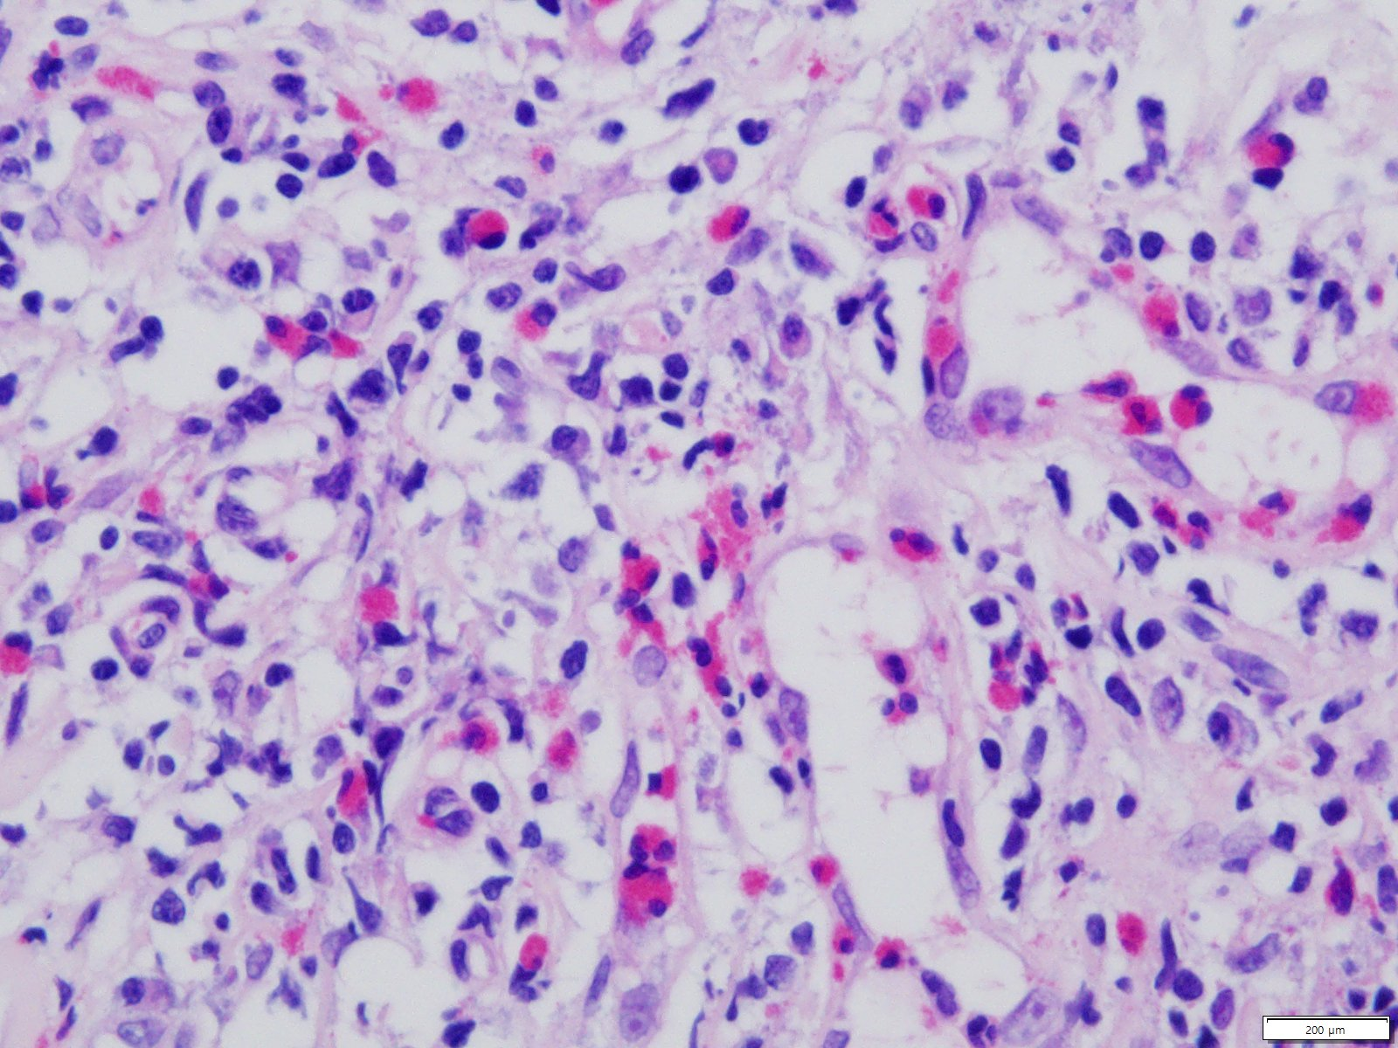

Slide 7
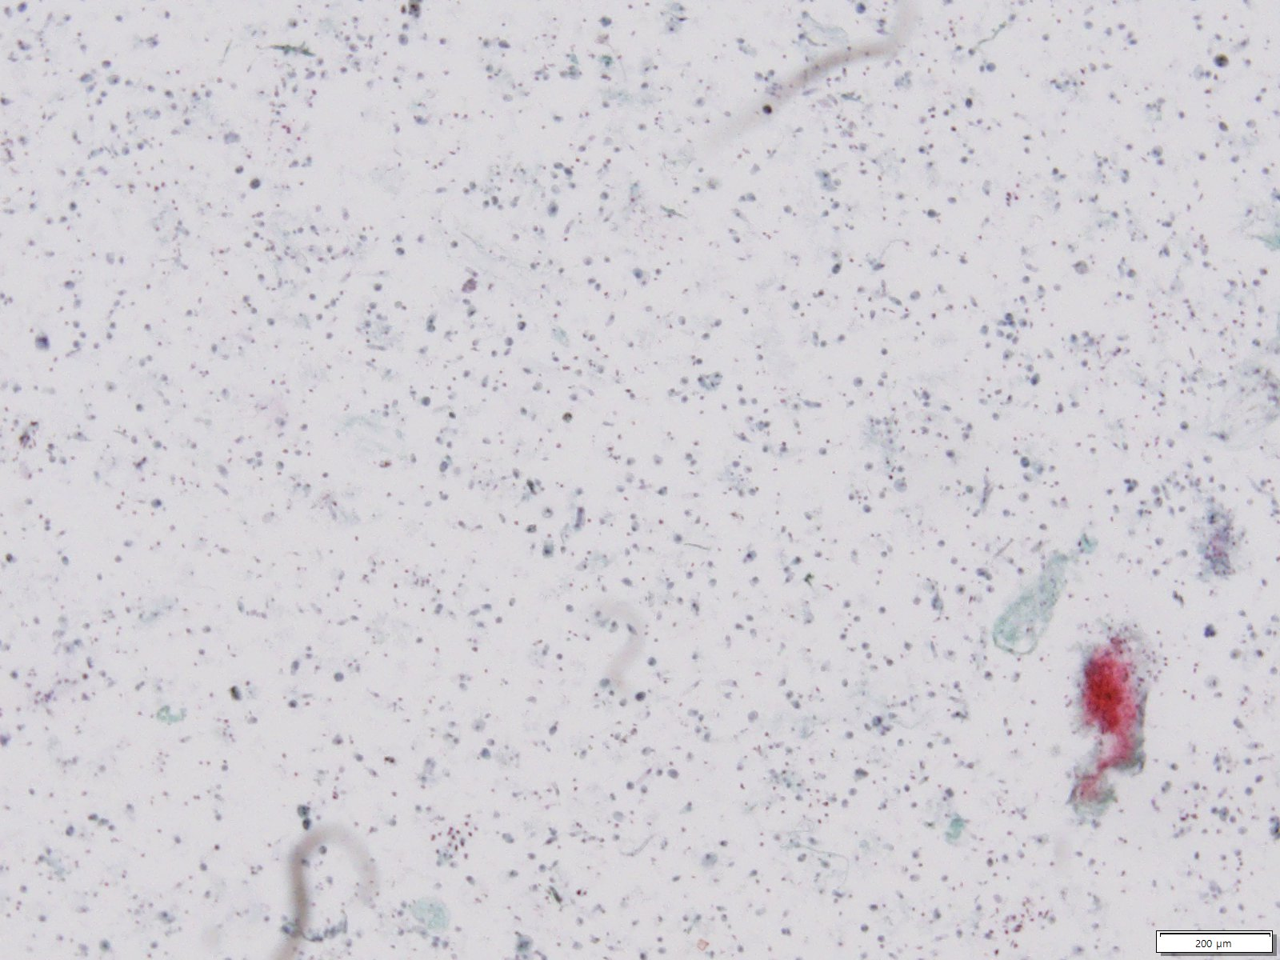
SC18-17398 | 검체유형: Bronchial Washing-Liquid Based Cytology

Slide 8
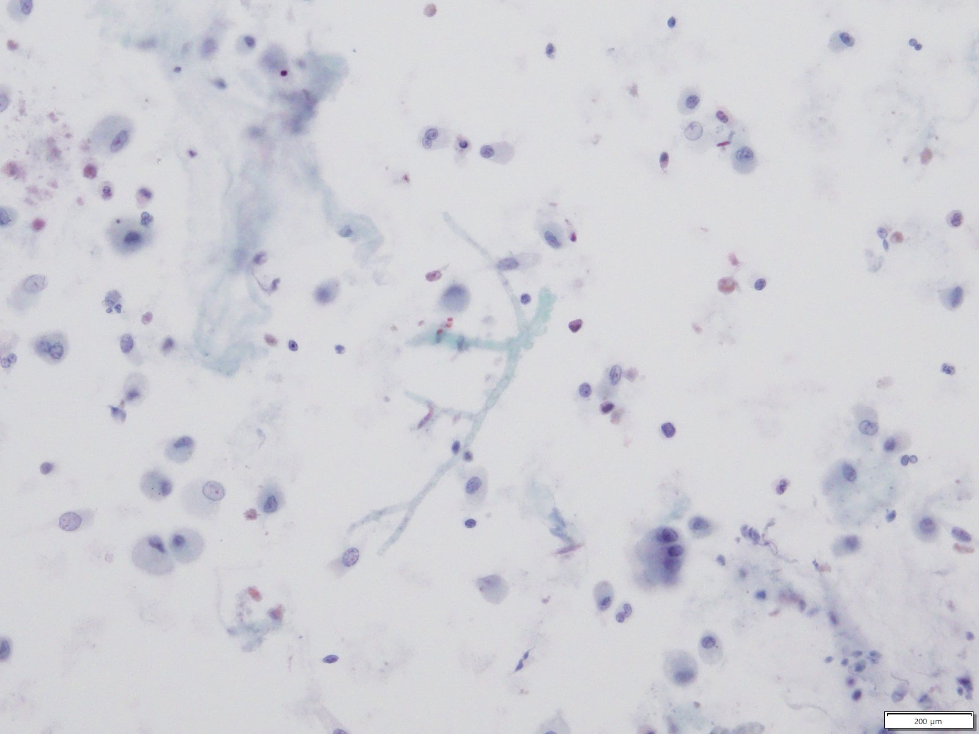

Slide 9
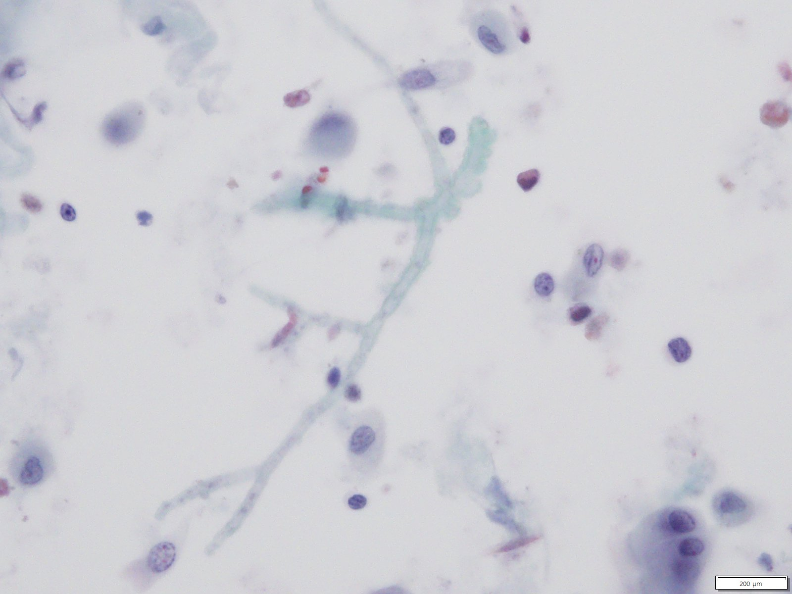

Slide 10
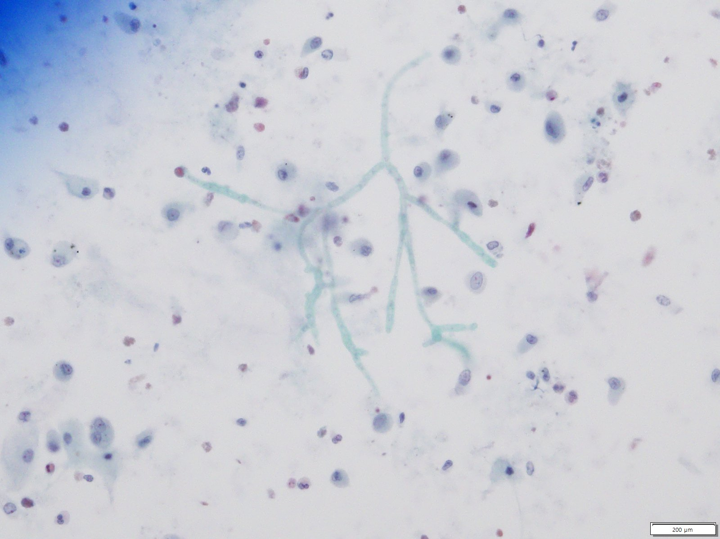

Slide 11
CASE 3
김ㅇ숙 F/52 #2332145

Slide 12
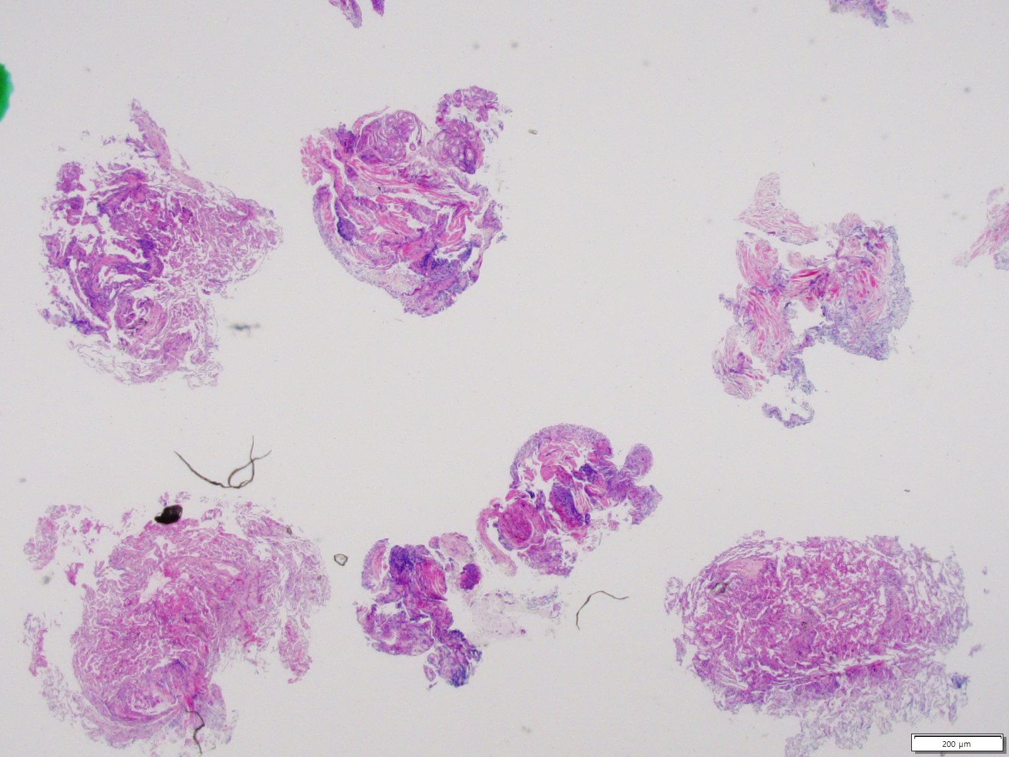
SS19-35999 | Lung, right, transbronchial lung biopsy

Slide 13
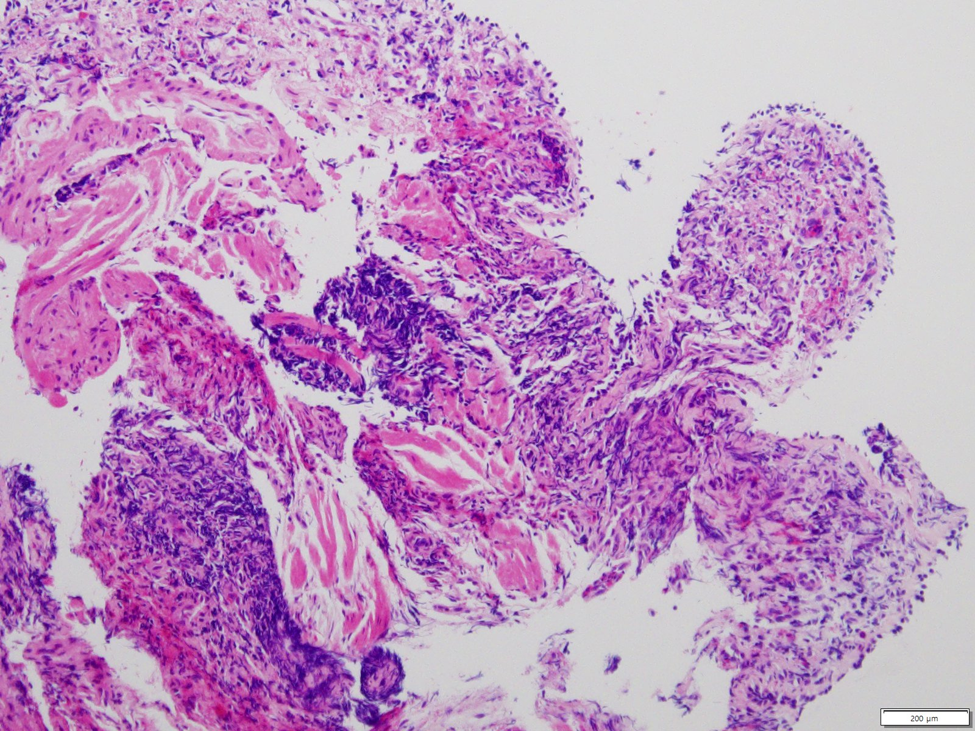

Slide 14
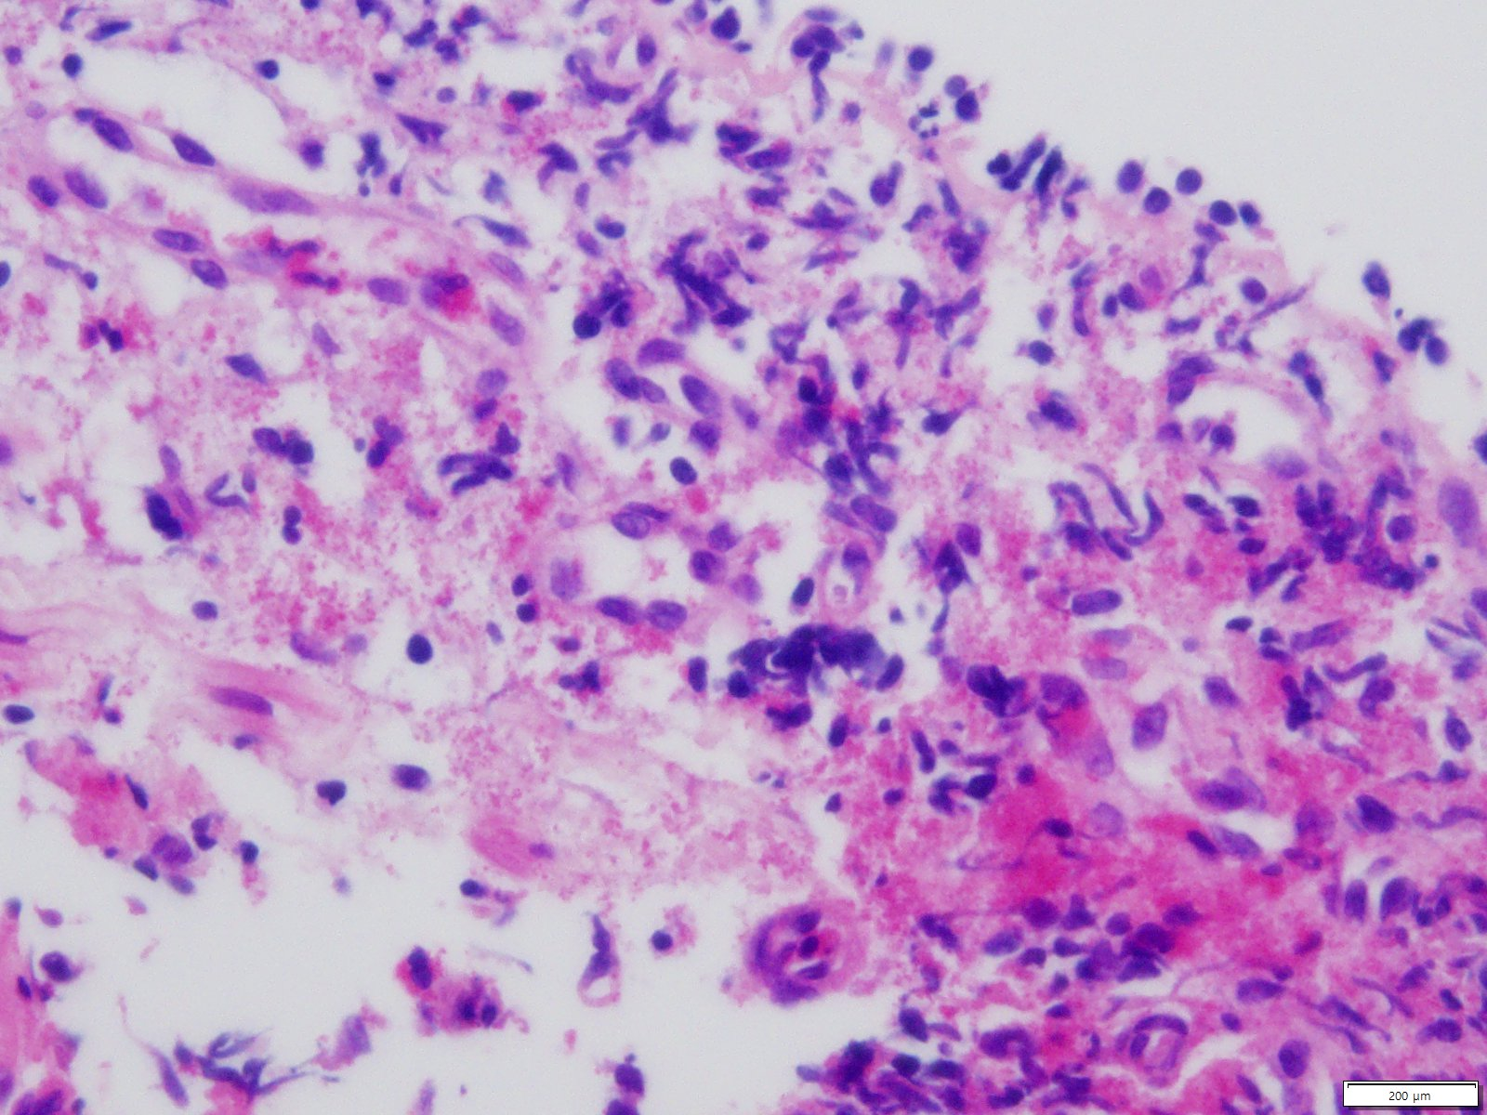

Slide 15
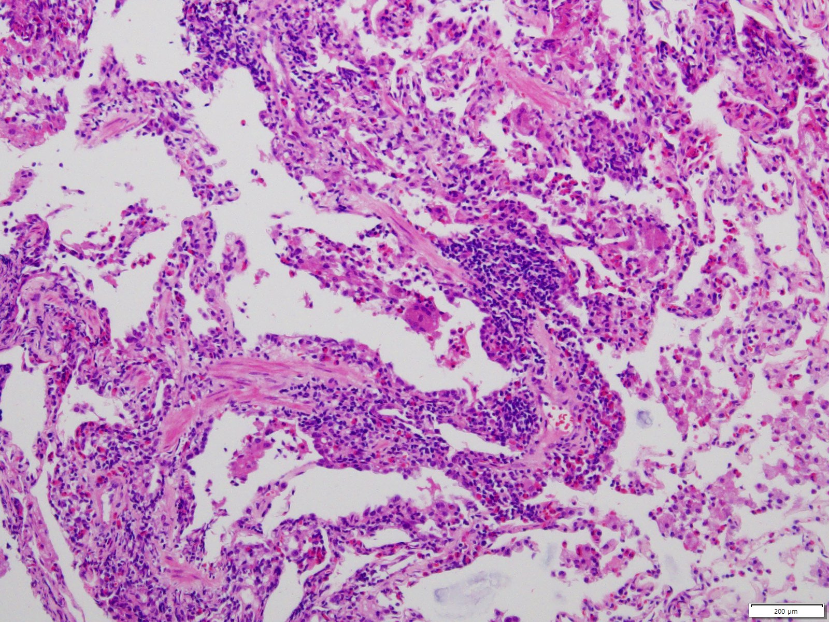

Slide 16
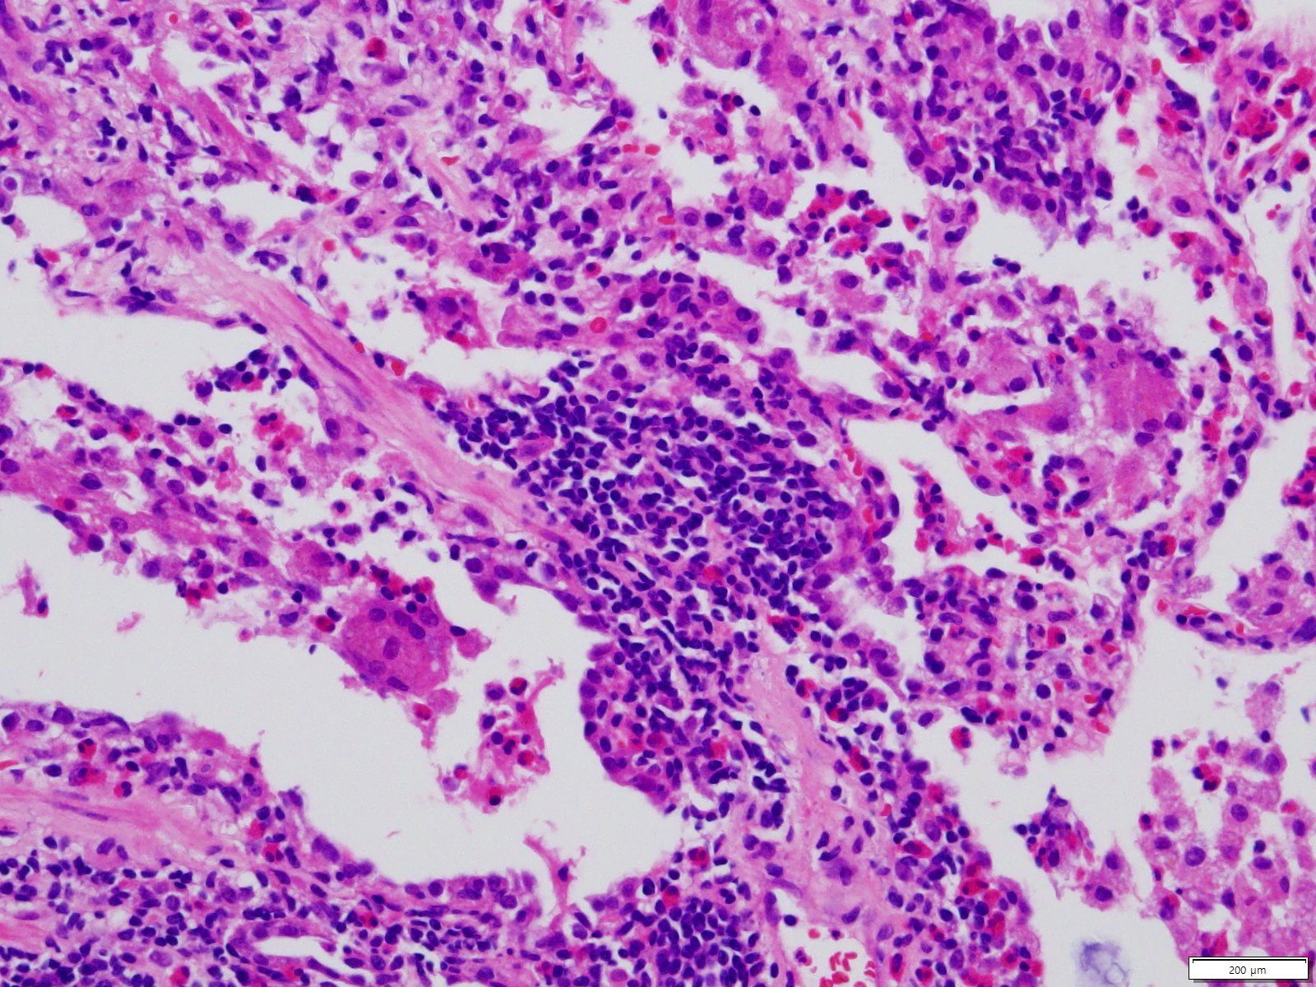

Slide 17
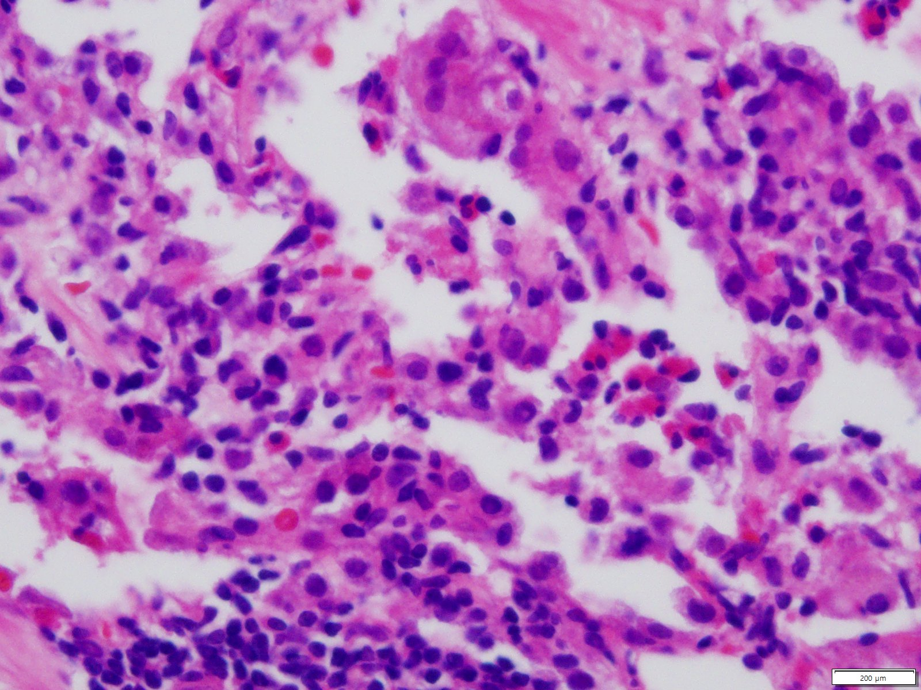

Slide 18
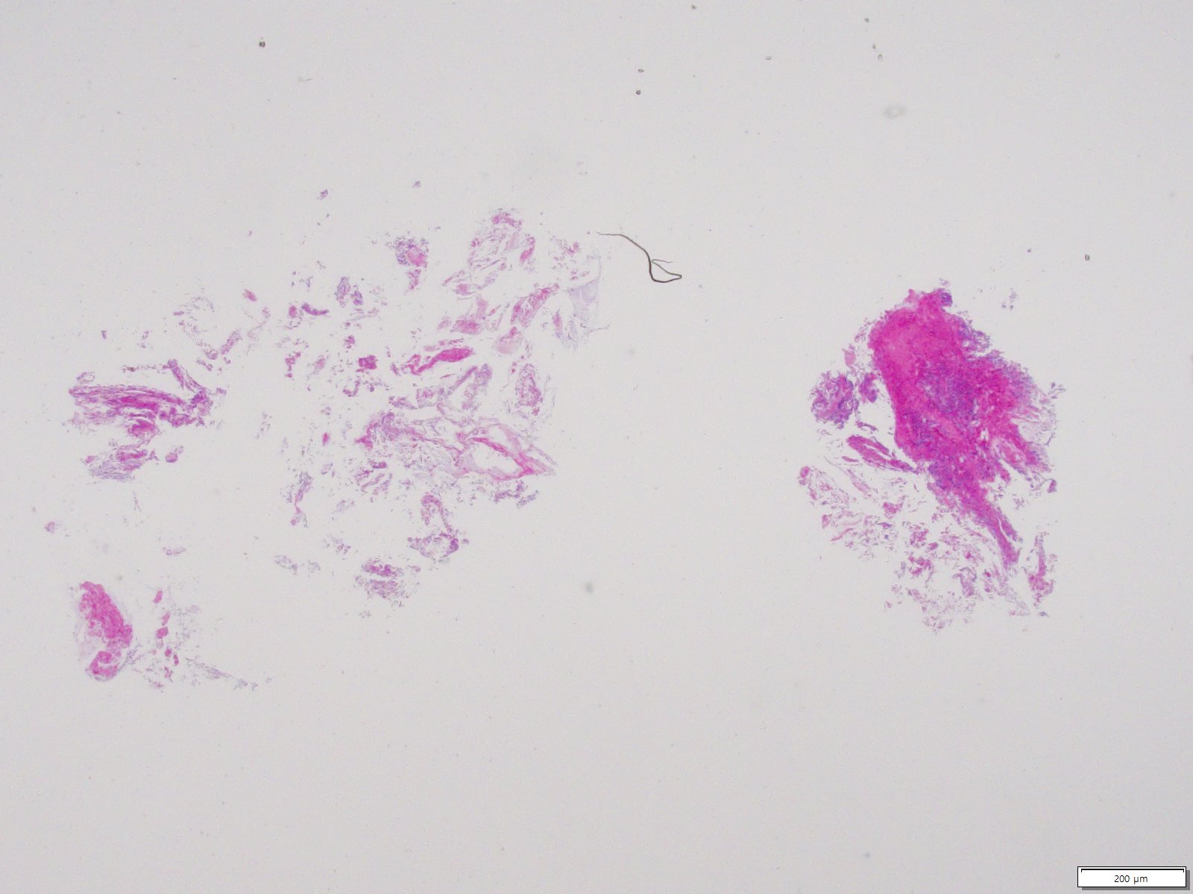
SS19-36684 | Lung, right lowre lobe, lung biopsy

Slide 19
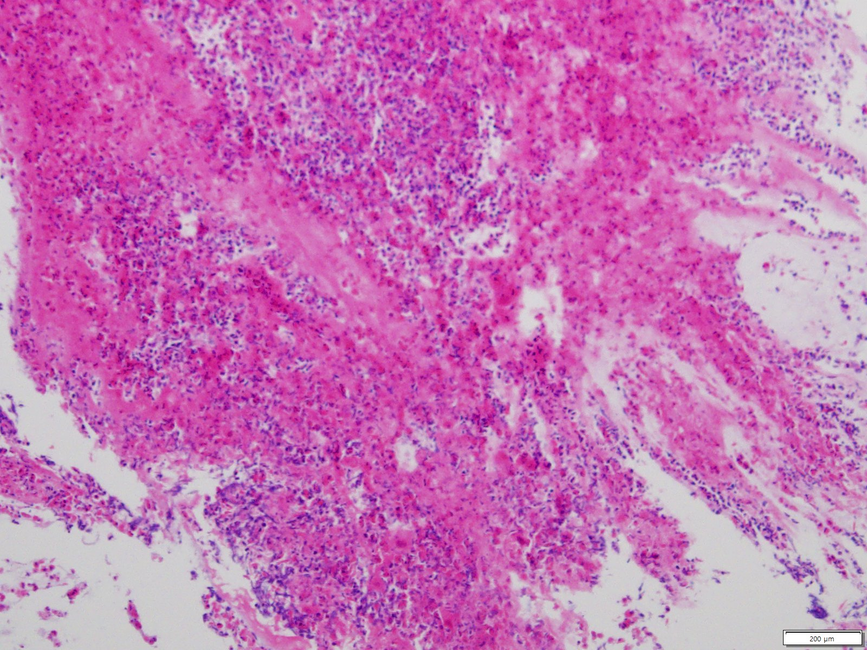

Slide 20
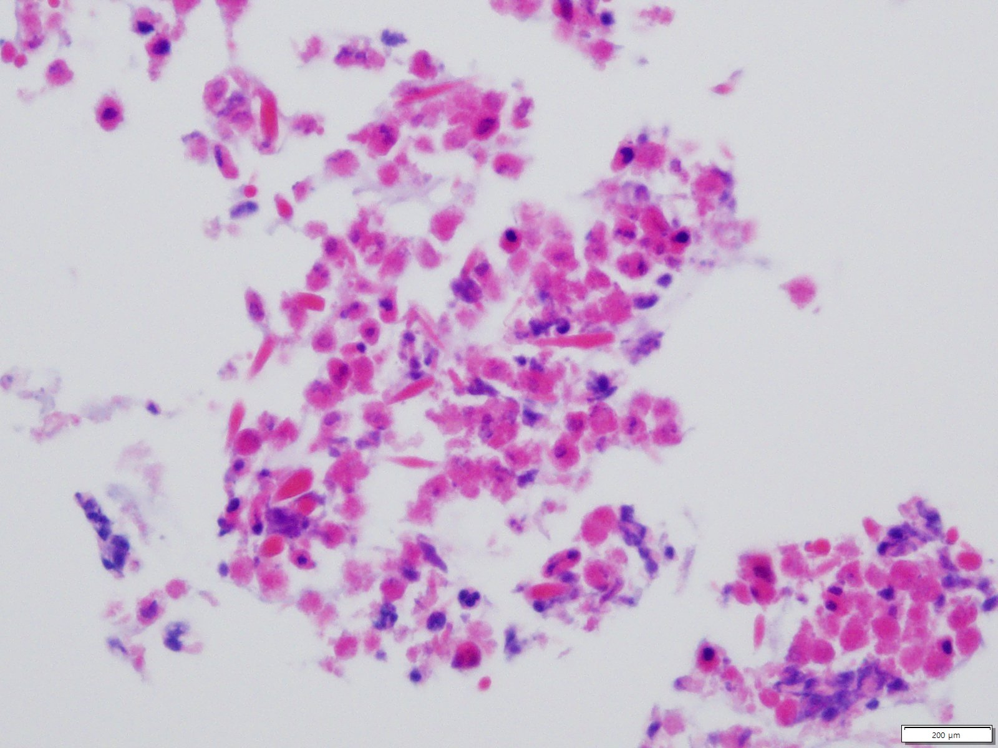
Charcot-Leyden crystals

