Slide 1

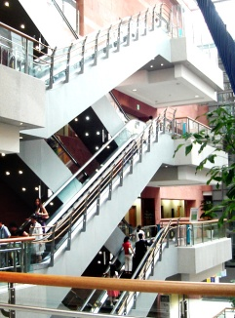


Bronchiolitis Obliterans after Allogeneic Hematopoietic
Stem Cell Transplantation
Hwang Eu Dong
Division of Pulmonology
Department of Internal Medicine
Yonsei University College of Medicine

Slide 2
Bronchiolitis obliterans(BO)
First described following HSCT in 1978.
:lymphocytic bronchitis in 10% of autopsies from patients who died following HSCT.
Characterised by the onset of new air flow
obstruction (AFO) following HSCT.
Notes:
-lymphocytic bronchitis in 10% of autopsies from patients who died following HSCT.

Slide 3
BOS
Bronchiolitis obliterans syndrome (BOS)
:clinical term defined by pulmonary function changes rather than histology.
Histologically characterized by patchy submucosal fibrosis involving the respiratory bronchioles, resulting in near-total or total occlusion of the airway lumen

Slide 4
NIH definition
NIH definition
: absence of active infection
:decreased FEV1 (<75% of predicted normal),
evidence of airway obstruction with FEV1/FVC <0.7
:elevated residual volume (>120% of predicted)
:expiratory chest CT or lung biopsy that reveals
air trapping (expiration) or bronchiectasis
-If a lung biopsy is not performed, another manifestation
of chronic graftvs- host disease is needed

Slide 5
INCIDENCE
Reported incidence of BOS following allo-HSCT varies widely from 1.7% to 26%.
: patients with chronic GVHD (32%)
: patients patients who received matched sibling (1.7%)
: peripheral blood stem cell transplantation
three-fold increase in the risk compared with BMT
:Nonmyeloablative vs myeloablative
(2.3% vs 17%)

Slide 6
PATHOGENESIS
Has not been well defined.
: multifactorial process involving both alloimmunologic and nonalloimmunologic
Murine models
: lymphocytes and associated chemokines, TNF α may be important contributors to the development of the chronic inflammatory process.
Am J Respir Crit Care Med. 2002;166
Notes:
-the heterogeneous histopathologic findings and clinical course

Slide 7
PATHOGENESIS
alloreactive immune process
:donor T-lymphocytes target the epithelial cells of the bronchioles.
:strong association between BO and chronic GVHD.
- stem cell transplantation with related donors
the conventional transplant group
VS
T-cell depletion transplant group
Notes:
2007 Group 1n=197 Group 2n=84

Slide 8
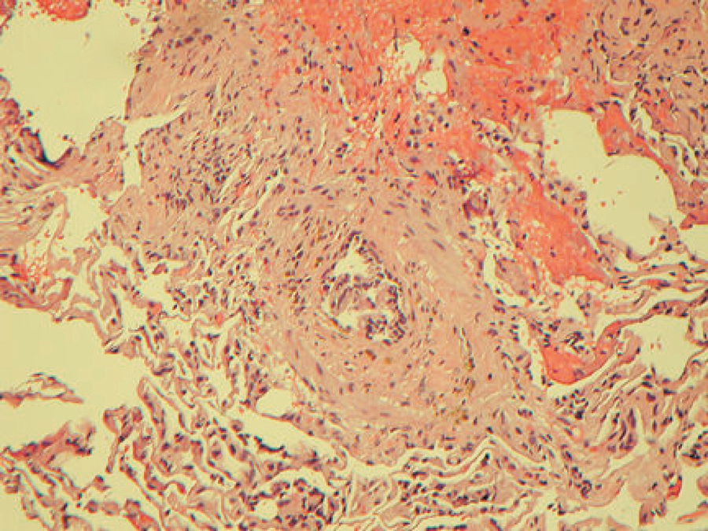
PATHOGENESIS
Nonalloimmunologic
: viral infections, recurrent aspiration, and conditioning chemoradiotherapy.
Notes:
recent report indicated that respiratory
tract infections with some community respiratory viruses
(parainfluenza virus and respiratory syncytial virus)
were associated with late airflow decline
Histology of BO. Characterized by concentric obstruction of the small airways and relative sparing of alveolar space.

Slide 9
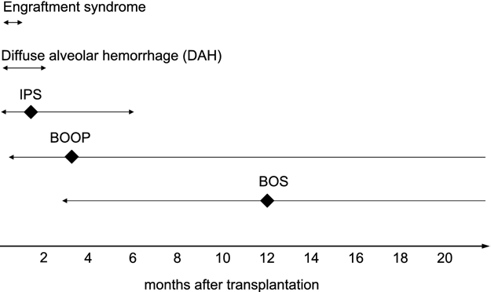
Time of occurrence
Biology of Blood and Bone Marrow Transplant 13:749-759 (2007).
Notes:
Usually presents after the first 100 days,80% of cases present between 6 and 2 months post-transplantation

Slide 10
Risk factors
Consistent | Allogeneic HSCT, Progressive chronic GVHD
Probable | De novo or quiescent chronic GVHD, Older age of recipient AFO prior to HSCT. Early respiratory viral infection
Possible | Acute GVHD, Busulfan-based conditioning regimen Methotrexate-based GVHD prophylaxis. Hypogammaglobulinaemia. CMV infection Older age of donor Underlying diseases (CML) Gastro-oesophageal reflux disease
Eur Respir J 2007; 29: 1007–1019.

Slide 11
CLINICAL PRESENTATION
Usually insidious
: 23% of patients upper respiratory tract symptoms.
:approximately 20% of patients are asymptomatic
(suspected based on PFT)
:dry cough (60–100%) ,dyspnea (50~70%), wheezing and sinusitis.
: fever is rare.
Notes:
- lack respiratory symptoms during mild stages, resulting in rare detection in the earliest stages
patients are physically limited due to severe obstructive airway disease and may require home oxygen
therapy. Some patients may develop features of bronchiectasis with recurrent respiratory tract infections and colonisation of
the airways by Pseudomonas spp., Staphylococcus aureus and, occasionally, Aspergillus spp.

Slide 12
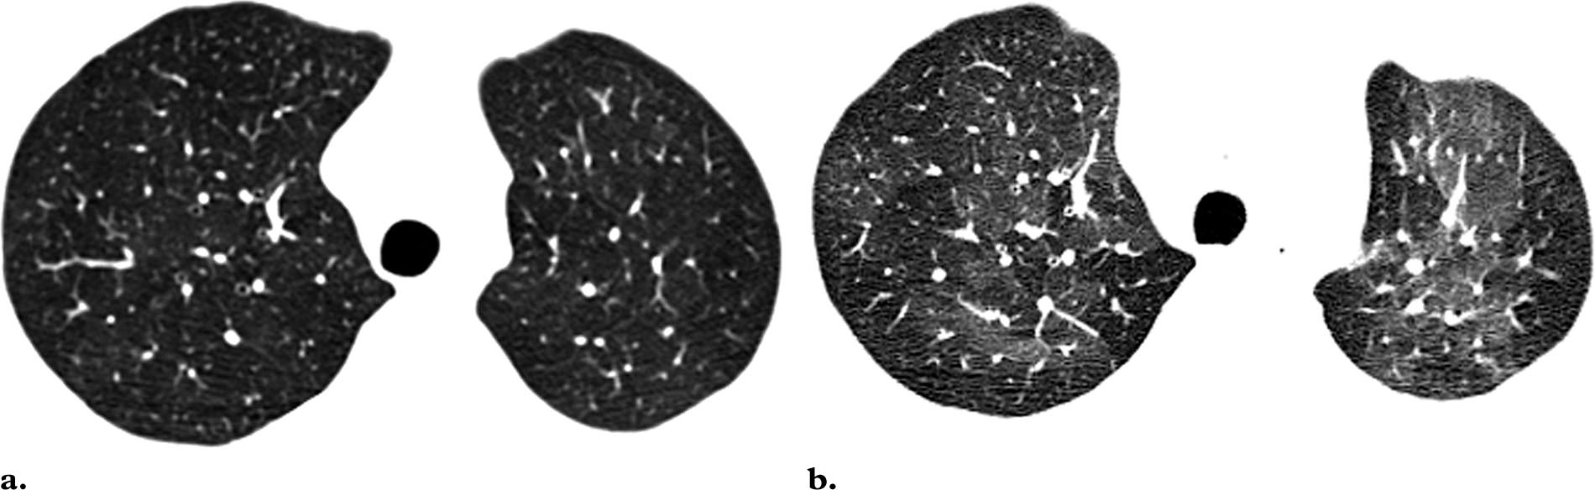
RADIOLOGICAL EVALUATION
-air trapping during the expiratory phase
-mosaic appearance is highly suggestive of BO,sensitivity and specificity (74–91%,67–94%)
-subsegmental bronchial dilatation, Tree in bud pattern
Notes:
Some studies demonstratedthat the presence of expiratory air trapping preceded the PFT criteria for BO

Slide 13
BRONCHOSCOPY
Limited role in the diagnosis.
:BAL carried out to rule out an infectious process.
:a few studies neutrophil predominance in the BAL
:higher levels of TNF-a were associated with a worse outcome.
Transbronchial biopsy not recommended
:disease is patchy and peripheral,
biopsy sample too small to show pathology

Slide 14
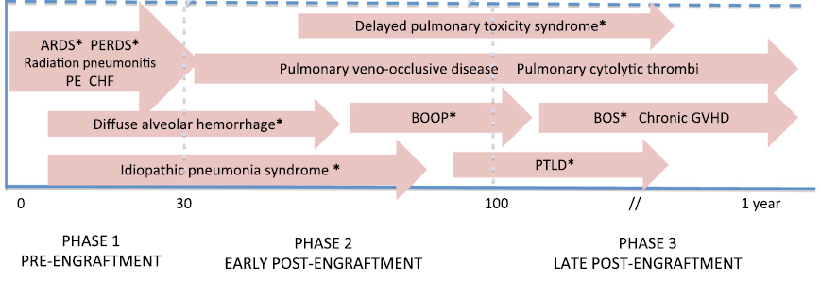
BRONCHOSCOPY
AnnalsATS Volume 10 February 2013
Notes:
evaluation of other potential causes of reduced lung function, including infection or acute allograft rejection

Slide 15
VATS
Useful
often avoided because of the surgical risks present.
BOS following HSCT is usually a clinical diagnosis.(PFT, radiologic)

Slide 16
PFT
main study used to diagnose and follow-up
lack of significant improvement in FEV1 post-bronchodilator.
A decline in FEV1 >5% per year with FEV1/FVC <0.8 has been shown to identify airflow obstruction after transplantation.
Notes:
A drop in FEV1 ,20% from baseline should alert clinicians to follow-up on those patients more
carefully for signs of BO.

Slide 17
PFT
The presence of early AFO was associated with an increased risk of long-term AFO.
patients who had the fastest decline in FEV1 (>10% per year) between day 100 and 1 yr, had the highest mortality risk.
Bone marrow transplantation (April 2004): 759-764.

Slide 18
Phenotypes and prognosis
Retrospective cohort
:between 1999 and 2010
:77 patient BOS
:53 typical obstructive lung defect (ratio<0.7)
:24 atypical patient (FEV1<80%,FVC<80%)
:median F/U 29.6 month.
Bone Marrow Transplantation (2013) 48, 819–824.

Slide 19
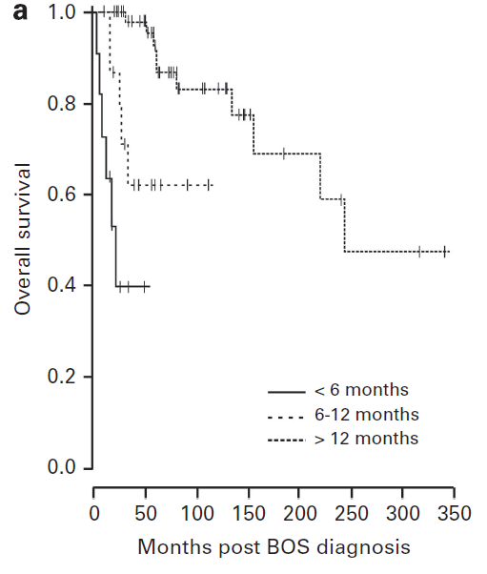
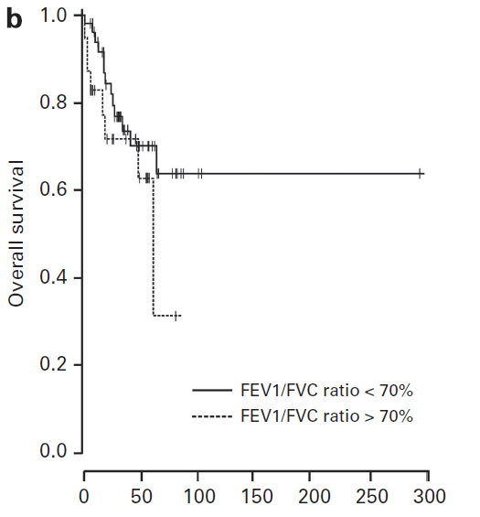
Phenotypes and prognosis
P<0.0001
P=0.24
Bone Marrow Transplantation (2013) 48, 819–824.
Notes:
Survival was significantly decreased for patients who experienced BOS early,

Slide 20
PFT
chronic GVHD academic community recommends
PFT every 3 months during the first year after transplantation in high-risk patients.
Infectious and radiographic investigation for any persistent decline
(either a decline of FEV1 >10% of predicted FEV1 or a decline of FEV1 >5% per year )

Slide 21
PROGNOSIS
progressive disease
agressive therapy results in improvement of lung function in only 8–20% of patients.
mortality rate, varies 14–100% (median of 65% )
Most patients with BO progress to respiratory failure, Patients with advanced BO usually die from pneumonia

Slide 22
PROGNOSIS
Factors associated with mortality
: rapid deterioration of FEV1 (>10% per year)
:age >60 yrs, progressive chronic GVHD, underlying disease relapse and history of respiratory viral infection
Not to be influenced By
: AFO prior to transplantation
: the source of stem cells ,CMV serological status.
Blood 1999; 93: 2196–2201.
Chest 2005;128: 153–161.

Slide 23
MANAGEMENT
No controlled trials
: small uncontrolled trials and
expert opinions.
Similar to management of chronic GVHD
:high-dose systemic corticosteroids
immunosuppressive therapy.
(cyclosporine A or tacrolimus with or without azathioprime)

Slide 24
MANAGEMENT
Corticosteroids
:prednisone at 1–1.5 mg/kg, for 2–6 weeks. tapered every 2 weeks for 6–12 months.
: pulse dose
- nine children with BO.
-10mg/kg for 3 days on monthly,6cycle
-stabilisation of FEV1 after 2 months of treatment
Bone Marrow Transplant 2005; 36: 135–138.
Notes:
Oxygen saturation increased significantly with normalization of oxygen saturation at the end of therapy in all individuals. Normal oxygen saturation was maintained in all but one patient during follow-up (mean follow-up period 42 {plus/minus} 20 months, range 19-67 months). Forced expiratory volume in 1 s (FEV1) was within the normal range prior BMT and significantly diminished at the time of BO diagnosis. Treatment led to stabilization of lung function, with a significant improvement of FEV1 after 2 months. In all, 7/9 patients remained in clinically stable condition without further deterioration of lung function during follow-up.

Slide 25
MANAGEMENT
Inhaled Steroids
: 13 patients. Median age 44
: Median follow-up 12.8 months
: Budesonide/formoterol
:>10% increase in FEV 1 in 13/13 patients.
(Mean increase in FEV 1 36±27%)
Bone Marrow Transplant 2007; 39: 547–553.

Slide 26
MANAGEMENT
Azithromycin
: experience using macrolides in the treatment of diffuse panbronchiolitis treatment . and BO following lung transplantation.
:down-regulate pro-inflammatory cytokines.
: Khalid, Eur Respir J (2005)
-Eight patients. Mean age 36
-500 mg /d for 3 days,followed by 250 mg three/times/week
for 3 months
->12% improvement in FEV 1 in 7/8 patients. (Mean 20.58%)

Slide 27
MANAGEMENT
Montelukast
: Five patients with BO
(Mean age 36)
: treatment 10 mg/d, period 16 months
(range 2–29)
:>30% increase in FEV 1 in 3/5 patients
Transplantation 2007; 83:577–581.
Notes:
10 mg * 1. Median treatment period 16 months

Slide 28
MANAGEMENT
TNF-α-Inhibitor
:no adequate data on the effectiveness
:steroid-refractory or dependent
:twice week for 4weeks
:partial response (steroid dose reduction)
Transplantation 2002 ; 73: 665–667.
Notes:
Etanercept subcutaneously 25 mg twice weekly for 4weeks,
(450%
improvement in symptoms, reduction in steroid dose or immunosuppressive agents).

Slide 29
MANAGEMENT
Rituximab
: Steroid refractory 11 patient
: Partial response.
Thalidomide
: 14 patients, follow-up 53 months
: Complete response 3/14.
: Partial response in 2/14 .
Haematologica 2010; 95: 1935–1942.
Bone Marrow Transplant 2003; 32: 165–170.
Notes:
375 mg/m 2 i.v. weekly for 4weeks, then monthly for 4months
Initially 50–100 mg 3, daily dose 400 mg, Median treatment
period 61 days

Slide 30
MANAGEMENT
Imatinib
:11 patients
:Prospective non-randomised single centrer .
: Complete remission 3/11.
:Partial remission in 4/11 (PFT or Sx)
Blood 2009; 114: 709–718.
Notes:
Initially 100 mg/day, increased over 4 months, Median treatment period 5

Slide 31
MANAGEMENT
Extracorporal photopheresis
: treatment of T-cell dependent disorders
(T-cell lymphoma, scleroderma..)
: selective effect on autoreactive T-cells.
Retrospective 11 patient
:Complete response in 1/11.
:Partial response in 5/11
(sustained improvement in FEV1)
Blood 2006; 107:3074–3080.

Slide 32
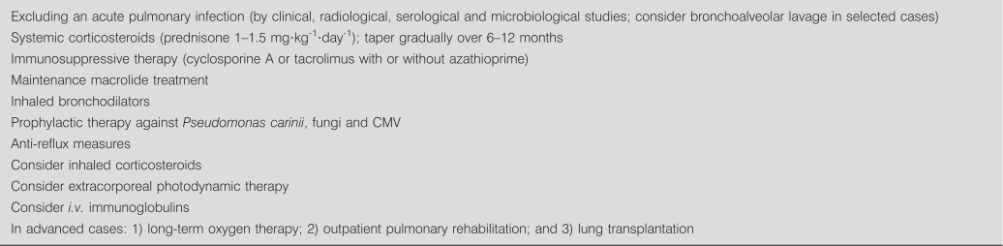
MANAGEMENT
Eur Respir J 2007; 29: 1007–1019.

