Slide 1


Medical treatment of bronchiectasis
Chest conference 2018.12.20
F1. 송명진

Slide 2
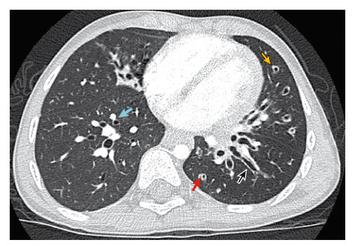
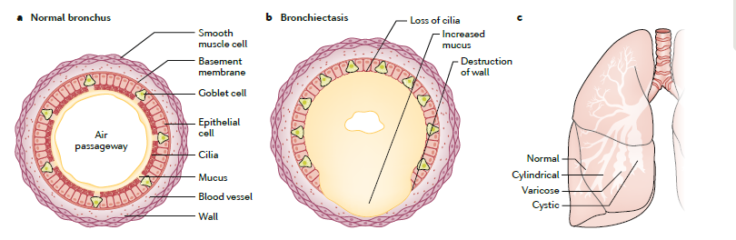
Introduction
Bronchiectasis is defined as permanent enlargement of the airways, and is mostly the result of an intrinsic airway pathology resulting in dilation.

Slide 3
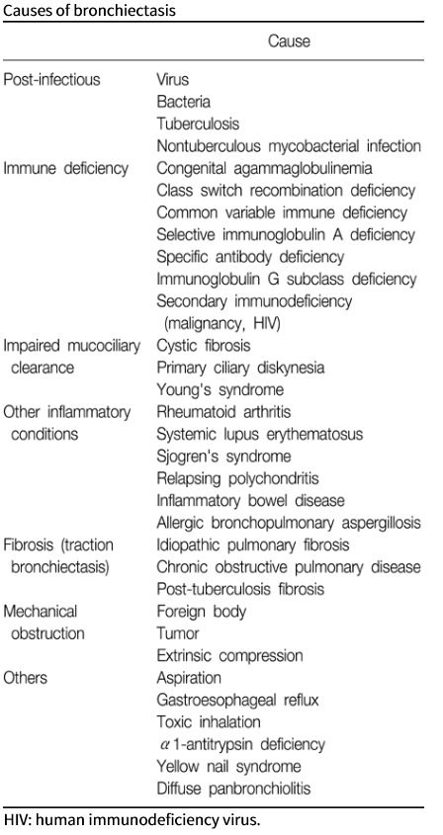
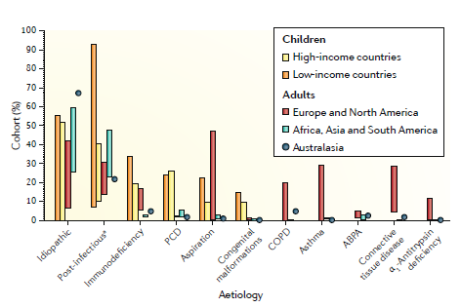
Cause of bronchiectasis
James D. Chalmers et al. Nature Reviews (2018) 4:45

Slide 4
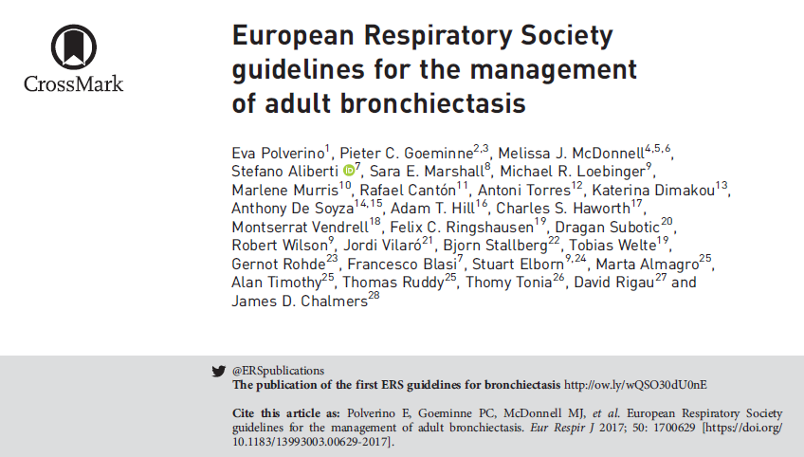
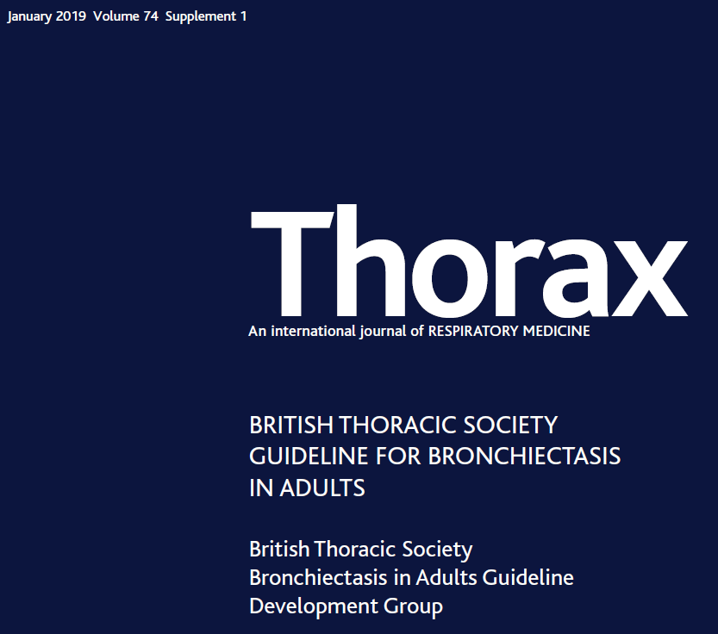
Cystic fibrosis,
children with bronchiectasis,
primary immunodeficiencies,
non-tuberculous mycobacteria (NTM) are excluded !!

Slide 5
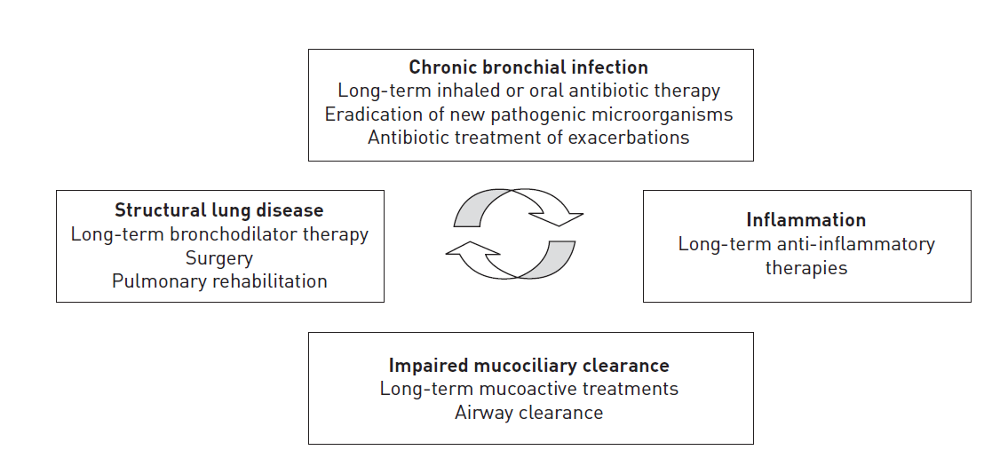
Treatment
Chronic bronchial infection
  1. Long-term inhaled or oral antibiotic therapy
  2. Eradication of new pathogenic microorganisms
  3. Antibiotic treatment of exacerbations
Inflammation
  4. Long-term anti-inflammatory therapies
Impaired mucociliary clearance
  5. Long-term mucoactive treatments
Structural lung disease
  6. Long-term bronchodilator therapy
  7. Pulmonary rehabilitation
  8. Surgery

Slide 6
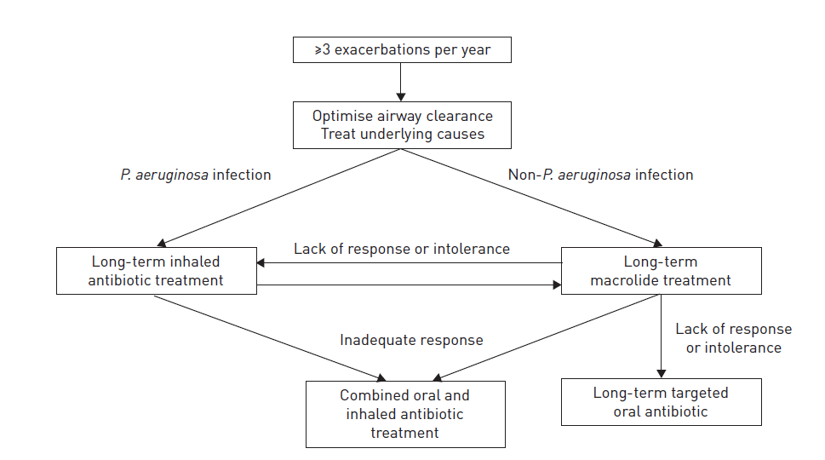
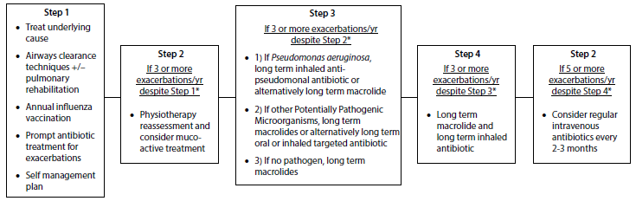
  1. Long-term (⩾3 months) antibiotic therapy in stable BRC
Consider long term antibiotics in patients with bronchiectasis who experience 3 or more exacerbations per year.
ERJ 2017
BTS 2018
Notes:
⩾3 exacerbation/yr with chronic P. aeruginosa infection
long-term treatment with an inhaled antibiotic
macrolides (azithromycin, erythromycin) in whom an inhaled antibiotic is contraindicated, not tolerated or not feasible.
macrolides (azithromycin, erythromycin) in addition to an inhaled antibiotic, for adults with bronchiectasis and chronic P. aeruginosa infection who have ahigh exacerbation frequency despite taking an inhaled antibiotic
⩾3 exacerbation/yr not infected with chronic P. aeruginosa
long-term treatment with macrolides (azithromycin, erythromycin)
oral antibiotic (choice based on antibiotic susceptibility and patient tolerance) for adults with bronchiectasis not infected with P. aeruginosa in whom macrolides are contraindicated, not tolerated or ineffective
long-term treatment with an inhaled antibiotic for adults with bronchiectasis not infected with P. aeruginosa in whom oral antibiotic prophylaxis is contraindicated, not tolerated or ineffective

Slide 7
1. Long-term (⩾3 months) antibiotic therapy in stable BRC
Effect of nebulised antibiotics
  144 adults with bronchiectasis + P. aeruginosa infection,
    Colistin 1MU delivered twice daily through the I-neb (6 months or till exacerbation)
    the median time to exacerbation was 168 days versus 103 days in the colistin and placebo groups (p=0.038).
  65 adults with bronchiectasis + H. influenzae (n=26, 46%) or P. aeruginosa (n=24, 42%)
    12-month, nebulised gentamicin (80 mg twice daily)
    showed significant benefits including fewer exacerbations compared to 0.9% saline-treated patients
Haworth CS et al. Am J Respir Crit Care Med 2014; 189: 975–982
Murray MP et al. Am J Respir Crit Care Med 2011; 183: 491–499
Notes:
Participants were randomly allocated
(1:1) to colistin, 1 million international
units, in 1-ml 0.45% saline or placebo (1 ml
0.45% saline).
Exacerbations were deﬁned as the
presence of three or more of the following
signs or symptoms for at least 24 hours:
increased cough, increased sputum
volume, increased sputum purulence,
hemoptysis, increased dyspnea, increased
wheezi ng, fever (>38
8
C) or malaise, and the
treating physician agreed that antibiotic
therapy was required.

Slide 8
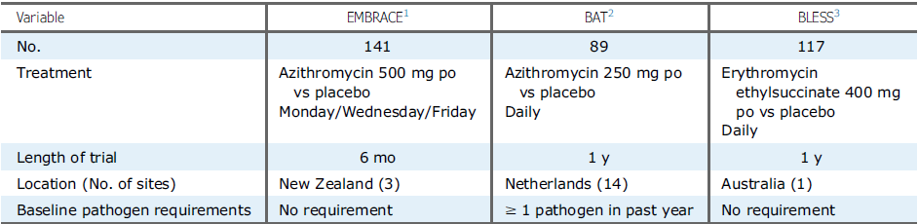
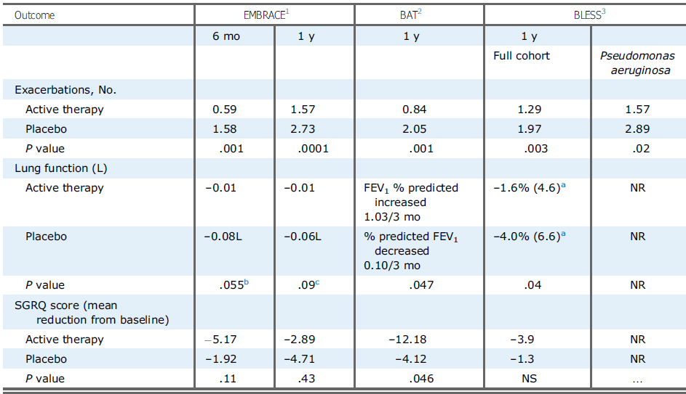
1. Long-term (⩾3 months) antibiotic therapy in stable BRC
Effects of macrolide antibiotics (azithromycin or erythromycin)
Wong C et al. Lancet 2012; 380: 660–667
Altenburg J et al. JAMA 2013; 309: 1251–1259
Serisier DJ et al. JAMA 2013; 309: 1260–1267
CHEST 2016; 150(6):1187-1193
Notes:
BAT = Bronchiectasis and Long-Term Azithromycin
Treatment; BLESS = Bronchiectasis and Low-Dose Erythromycin
Study; EMBRACE = Effectiveness of Macrolides in Patients with
Bronchiectasis Using Azithromycin to Control Exacerbations
Effects of macrolide antibiotics (azithromycin or erythromycin)
EMBRACE study : rate of event-based exacerbations was 0.59 per patient in the azithromycin group and 1.57 per patient in the placebo group in the 6-month treatment period (RR 0.38, 95% CI 0.26–0.54; p<0.0001), azithromycin 500 mg 3 times/wk
BAT study : median (IQR) number of exacerbations in the azithromycin group as 0 (0–1), compared with 2 (1–3) in the placebo group (p<0.001), azithromycin 250 mg daily
BLESS study : erythromycin significantly reduced exacerbations compared to placebo in the 12-month treatment period (mean 1.29, 95% CI 0.93–1.65 versus 1.97, 95% CI 1.45–2.48 per patient per year; p<0.003), erythromycin 400 mg twice daily

Slide 9
1. Long-term (⩾3 months) antibiotic therapy in stable BRC
IV antibiotics
  cyclical 8 weekly IV antibiotics
  19 patients with ⩾ 5 exacerbations/yr and ill health between antibiotic courses
  This approach demonstrated a small, statistically significant reduction in exacerbations and hospital bed days.
→ Cyclical intravenous antibiotics may reduce exacerbation number and hospital bed days in patients with ≥5 exacerbations and subjective ill health between exacerbations.
Mandal P, Sidhu MK, Donaldson LS, et al. Eight-weekly intravenous antibiotics is beneficial in severe bronchiectasis. QJM 2013;106:27–33.

Slide 10
1. Long-term (⩾3 months) antibiotic therapy in stable BRC
Good practice points
  Prior to starting long term inhaled aminoglycosides
    1) avoid using if creatinine clearance <30 mL/min;
    2) use with caution if the patient has significant hearing loss needing hearing aids or significant balance issues;
    3) inhaled antibiotics is associated with a 10–32% risk of bronchospasm. Supervised test dose with pre- and post-spirometry is recommended. Prior inhalation of a short-acting bronchodilator may prevent bronchospasm
  Prior to starting long term macrolides
    1) ensure no active NTM infection with at least one negative respiratory NTM culture;
    2) use with caution if the patient has significant hearing loss needing hearing aids or significant balance issues
    As adverse event frequency of azithromycin is likely to be dose related, 250 mg 3 x/week is a pragmatic starting dose which can then be increased according to clinical response and adverse events.

Slide 11
2. Eradication of new pathogenic microorganisms
Offer eradication antibiotics in new growth of P. aeruginosa (1st isolation or regrowth in the context of intermittently positive cultures) with stable BRC (± clinical deterioration)
There is no evidence to support eradication of organisms other than P. aeruginosa, the risk-benefit ratio is less in favour of eradication treatment (ERJ)
Offer patients with bronchiectasis associated with clinical deterioration and a new growth MRSA eradication. This should be attempted especially in view of infection control issues (BTS)
Sputum sample should be sent when clinically stable once per year, before and at each clinical attendance following antibiotics prescribed

Slide 12
2. Eradication of new pathogenic microorganisms
ORRIOLS et al. RCT in 35 patients with early P. aeruginosa infection.
  2wks of i.v. ceftazidime or tobramycin → 300 mg of nebulised tobramycin b.d. or placebo (3months)
  At the end of follow-up (12 mon), 54% were free of P. aeruginosa in the tobramycin group vs. 29% in the placebo group.
  The median time to recurrence of P. aeruginosa was longer and numbers of exacerbations and hospital admissions were lower in the nebulised tobramycin group.
WHITE et al. retrospective analysis, different eradication treatment regimens:
  i.v. anti (n=12), i.v. anti→ po cipro (n=13), oral ciprofloxacin alone (n=5)
  + 3 months of inhaled colistin.
  Initial clearance rate was 80%, 54% patients remained P. aeruginosa free at f/u and the exacerbation rate fell from 3.93 to 2.09 /yr
  2/3 of patients experienced clinical improvement
  lung function remained unchanged.
Orriols R et al. Respiration 2015; 90: 299–305.
White L et al. Respir Med 2012; 106: 356–360

Slide 13
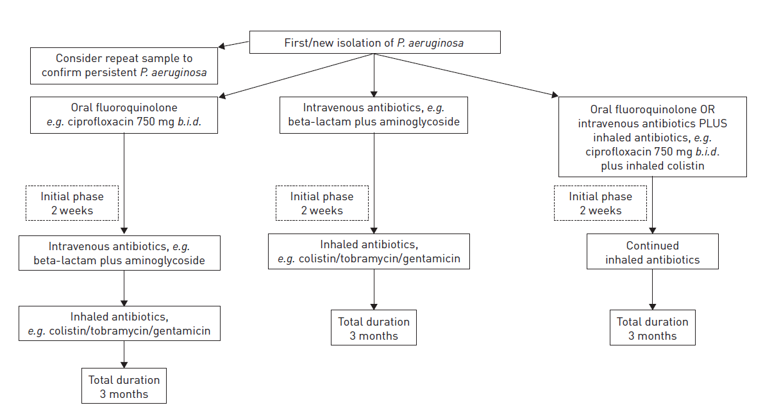
2. Eradication of new pathogenic microorganisms
Notes:
Definitions of chronic airway infection in bronchiectasis are not established but a systematic review identified that the most frequent definition used in bronchiectasis studies is two or more isolates of the same organism at least 3 months apart in 1 year

Slide 14
3. Antibiotic therapy in exacerbation
Acute exacerbations of bronchiectasis should be treated with 14 days of antibiotics
Previous sputum bacteriology results can be useful in deciding which antibiotic to use.
Empirical antibiotics can then be started while awaiting sputum microbiology.
No randomised placebo-controlled studies evaluating the efficacy of antibiotics in exacerbations in adults.
Patients are typically given prolonged courses of antibiotics of 14 days’ duration for infective exacerbations.
This recommendation is given in previous guidelines for BRC.
Cohort studies (by Murray et al and Bedi et al ) that documented good clinical outcomes with such treatment regimens.
Murray MP et al. Eur Respir J 2009;33:312–8.
Bedi P et al. NPJ Prim Care Respir Med 2014;24:14090.

Slide 15
3. Antibiotic therapy in exacerbation
Duration of antibiotic therapy
  Shorter (14 days) courses vs. 14–21 days of therapy.
    No direct evidence of benefit favouring either 14–21 days or shorter courses of antibiotic therapy in bacterial load and FEV1
  In patients with lack of recovery by 14 days of antibiotic therapy, re-evaluation of the patient’s clinical condition and a new microbiological investigation are needed to evaluate if initial therapy was adequate or not.
Pasteur MC et al. British Thoracic Society guideline for non-CF bronchiectasis. Thorax 2010
Bilton D et al. Chest 2006; 130: 1503–1510

Slide 16
4. Anti-inflammatory agent
Inhaled corticosteroids
  Do not routinely offer inhaled corticosteroids to patients with bronchiectasis without other indications (such as ABPA, chronic asthma, COPD).
  Inhaled corticosteroids have an established role in the management of asthma and a proportion of patients with COPD which are common co-morbid conditions in bronchiectasis.
Statin
  multiple anti-inflammatory and immunodulatory effects in addition to their effects on cholesterol.
  Do not routinely offer statins for bronchiectasis treatment.

Slide 17
4. Anti-inflammatory agent
Inhaled corticosteroids (ICS)
  HERNANDO et al. reported a double-blind randomised controlled trial over 6 months with 77 patients, inhaled budesonide 400 μg b.d. or placebo with a primary outcome of lung function.
  TSANG et al. reported a trial of inhaled fluticasone 500 μg b.d versus placebo over 12 months in 86 patients with co-primary end-points of 24 h sputum volume and annual exacerbation frequency.
  No effects on reducing exacerbation, no significant benefit for lung function.
Statin
  MANDAL et al. studied atorvastatin in 30 patients over 6 months compared to placebo with a primary outcome improvement in cough related quality of life.
  No effects on reducing exacerbation, no significant benefit for lung function.
Oral corticosteroids, PDE4 inhibitors, methylxanthines or leukotriene receptor antagonists in bronchiectasis : No randomised controlled trials to evaluate the role in BRC
Tsang KW et al. Thorax 2005; 60: 239–243
Mandal P et al. Lancet Respir Med 2014; 2: 455–463
Hernando R et al. Int J Clin Pharm 2012; 34: 644–650

Slide 18
5. Mucoactive treatment
Offer long-term mucoactive treatment (nebulized IS, HS, humidification) in adult patients with bronchiectasis who have difficulty in expectorating sputum.
Do not offer recombinant human DNase to adult patients with bronchiectasis.
Insufficient evidence to permit evaluation of the use of oral mucolytics such as carbocysteine for bronchiectasis
Notes:
Including expectorants (aid and/or induce cough)
Mucolytics (thin mucus)
Mucokinetics (facilitate cough transportability)
Mucoregulators (suppress mechanisms underlying chronic mucus hyper secretion) : erdosteine, glucocorticosteroids

Slide 19
5. Mucoactive treatment
Nebulized isotonic and hypertonic saline can improve cough related quality of life QoL and health related quality of life (HQoL)
Dry powder mannitol did not improve exacerbation frequency but was shown to increase the time to first exacerbation, demonstrated a small improvement in QoL and may reduce sputum plugging.
Recombinant human DNase increases exacerbation frequency in bronchiectasis.
bronchospasm
Hart A et al. Cochrane Database Syst Rev 2014; 5: CD002996.
Wilkinson M et al. Cochrane Database Syst Rev 2014; 5:CD001289.
Wills P et al. Cochrane Database Syst Rev 2002; 1:CD002996.
Nicolson CHH et al. Respir Med 2012; 106: 661–667.
Kellett R et al. Respir Med 2011; 105: 1831–1835.
Bilton D et al. Chest 2013; 144: 215–225.
Bilton D et al. Thorax 2014; 69: 1073–1079.

Slide 20
6. Long-term (⩾3 months) bronchodilator therapy
Use of bronchodilators in patients with bronchiectasis and co-existing COPD or asthma should follow the guideline recommendations for COPD or asthma.
Long acting beta-2-agonists /long acting anti-cholinergics may be beneficial in patients with symptoms of breathlessness.
If treatment with bronchodilators does not result in a reduction in symptoms it should be discontinued.
There is no evidence to support the use of bronchodilators routinely as part of the management of bronchiectasis patients without symptomatic breathlessness.

Slide 21
6. Long-term (⩾3 months) bronchodilator therapy
A systematic review that included a single trial, comparing high-dose ICS to medium-dose ICS/LABA
The results from this study indicate some positive effects on symptom control/symptomatic improvement, in particular decreased dyspnea, better cough control, better health-related quality of life (measured by SGRQ symptoms domain)
Specific side-effects were generally mild (tremor, nervousness and tachycardia).
Martínez-García MÁ et al. Chest 2012; 141: 461–468.
Goyal V, Chang AB. Cochrane Database Syst Rev 2014; CD010327.

Slide 22
7. Pulmonary rehabilitation
Patients with chronic productive cough or difficulty to expectorate sputum should be taught an airway clearance technique (ACT) by a trained respiratory physiotherapist to perform once or twice daily.
We recommend that adult patients with bronchiectasis and impaired exercise capacity should participate in a pulmonary rehabilitation programme and take regular exercise.

Slide 23
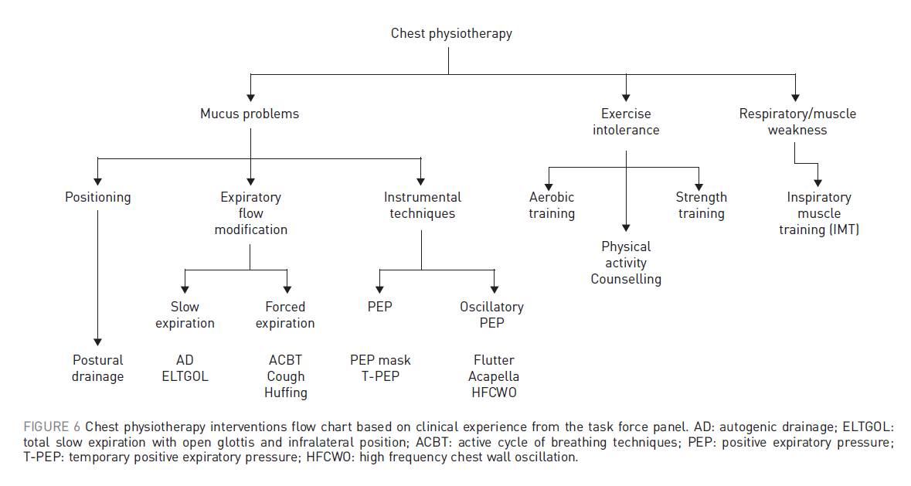
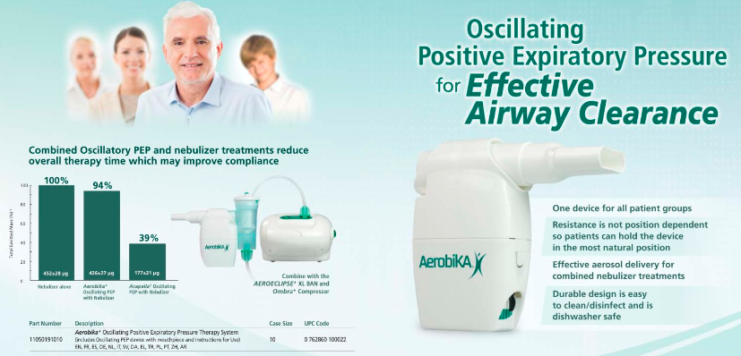

Slide 24
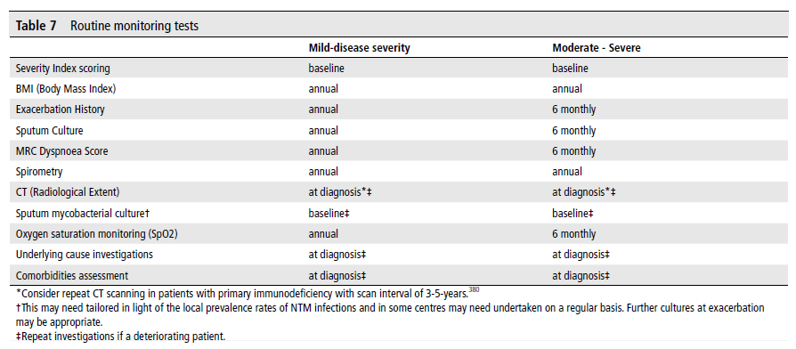
How should we monitor bronchiectasis?

Slide 25
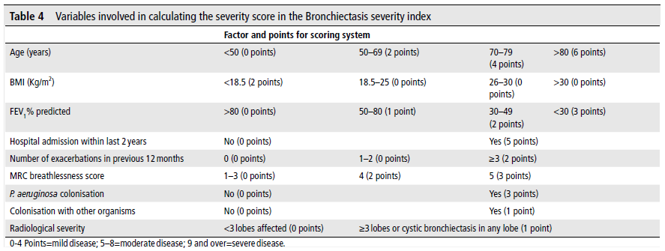
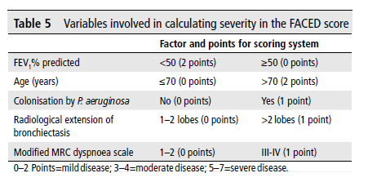
Severity scoring
Mild : 0%–2.8% mortality, 0%–3.4% hospitalization (1 year)
0%–5.3% mortality, 0%–9.2% hospitalization (4 years)
moderate : 0.8%–4.8% mortality, 1.0%–7.2% hospitalization (1 year)
4%–11.3% mortality, 9.9%–19.4% hospitalization (4 years)
severe : 7.6%–10.5% mortality,16.7%–52.6% hospitalization(1 year)
9.9%–29.2% mortality, 41.2%–80.4% hospitalization rates (4 years)
The 5 year mortality in
mild, moderate and severe disease is 4%, 25% and 56% respectively.

Slide 26


