Slide 1
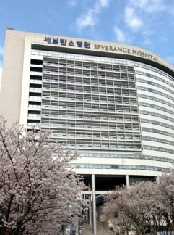



Bronchiolitis obliterans after lung transplantation
홍지영

Slide 2
Bronchiolitis obliterans(BO)
First described in 1984 at Stanford university in a patient after heart-lung transplantation
Histologically characterized by patchy submucosal Fibrosis involving the respiratory bronchioles, resulting in near-total or total occlusion of the airway lumen

Slide 3
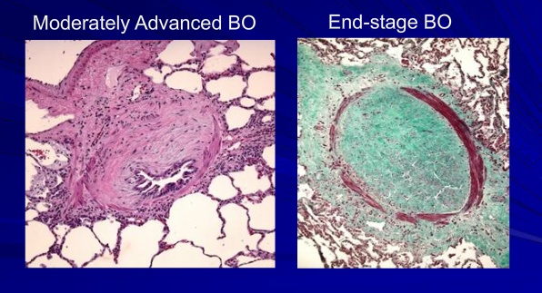
What is BOS?
BOS: clinical syndrome
ISHLT created BOS to identify lung transplant recipients that are likely to have underlying BO
BO: a histopathological entity
Notes:
near-total occlusion of a small airways lumen.
advanced BO with complete ﬁ brous obliteration of the air-
way lumen

Slide 4
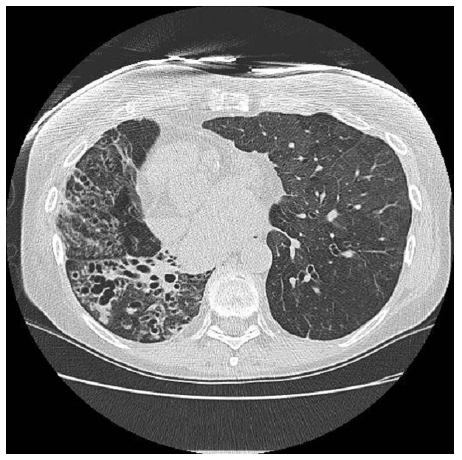
Radiologic images
Hyperlucency
Air trapping
Bronchiectasis
Thickening of septal lines
Mosaic pattern of attenuation
Tree in bud pattern

Slide 5
BOS ISHLT definition
Graft deterioration secondary to persistent airﬂow obstruction
  At least 3 weeks to exclude an acute, reversible process
Drop in FEV₁>20% relative to best posttransplant FEV₁
Exclude other acute allograft rejection, anastomotic complications or stricture, infection, or other disease affecting pulmonary function
Notes:
a sustained pulmonary decline with a reduced FEV1 for more than 3 weeks and
the exclusion of acute allograft rejection, anastomotic complications or stricture, infection, or other disease affecting pulmonary function

Slide 6
What is BOS?
Chronic rejection
-The leading cause of death beyond the first year post lung transplantation
The development of airway obstruction with a reduction of FEV₁ that does not respond to bronchodilators
Transbronchial lung biopsies(TBBs)
  -Low sensitivity(28%) and specificity(75%)

Slide 7
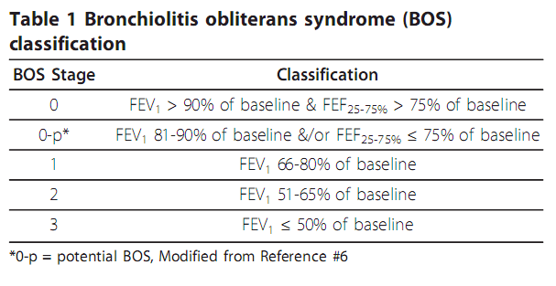
The maximum post-transplant FEV1 : assigned as 100%
(the mean of the two best postoperative FEV1 values with at least 3 weeks between the measurements)
Each with 2 subcategories : with and without pathologic evidence of OB
Notes:
a sustained pulmonary decline with a reduced FEV1 for more than 3 weeks and
the exclusion of acute allograft rejection, anastomotic complications or stricture, infection, or other disease affecting pulmonary function

Slide 8
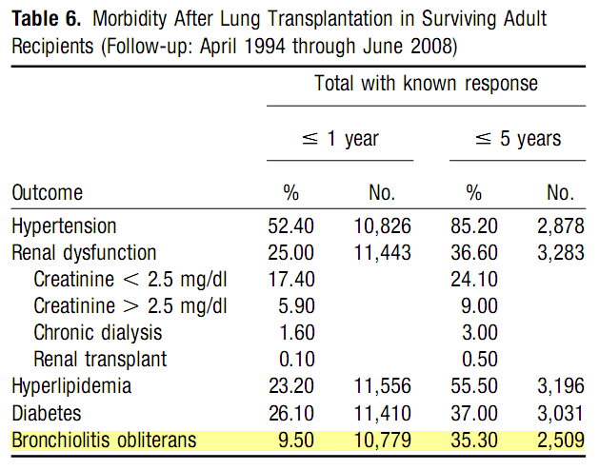
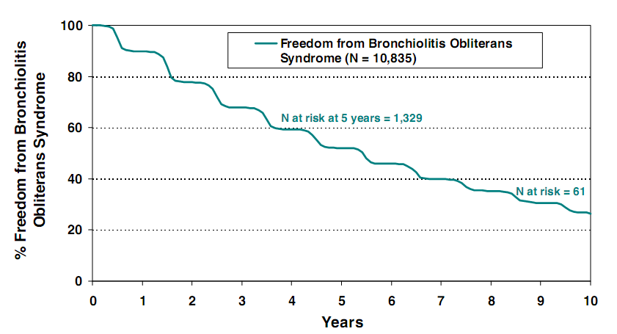
BOS in a majority of lung transplant Recepients
J Heart Lung Transplant 2009;28:1031–49.
Notes:
BOS had developed in 28% by 2.5 years
after transplantation and in 74% by 10 years.

Slide 9
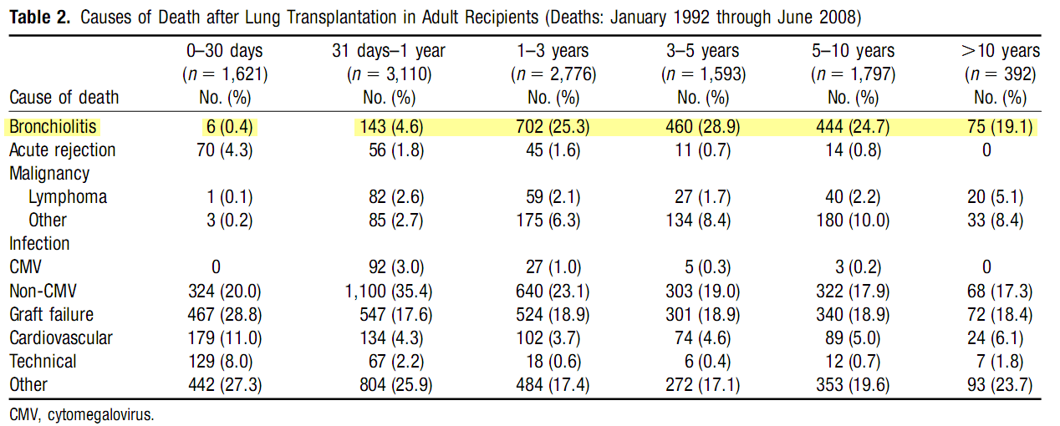
Impact of BOS in lung transplant
Onset of BOS also associated with worse overall
and pulmonary specific QOL.
J Heart Lung Transplant 2009;28:1031–49.

Slide 10
Is a BOS valid phenotype?
There is rarely pathological confirmation of BO in BOS, without surgical biopsy
Concern that other etiologies could contribute to a decline in FEV_{1.}
Heterogeneity in onset and natural history among BOS
Likely multiple forms of chronic lung allograft dysfuction

Slide 11
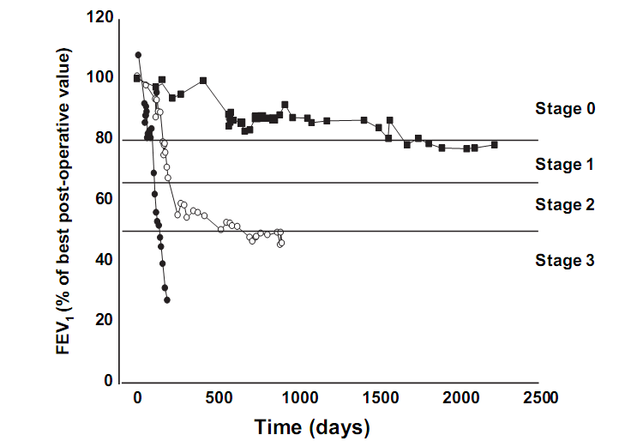
Clinical Heterogeneity of BOS
The highly variable pattern of functional evolution between patients
Clin Chest Med 32 (2011) 311–326

Slide 12
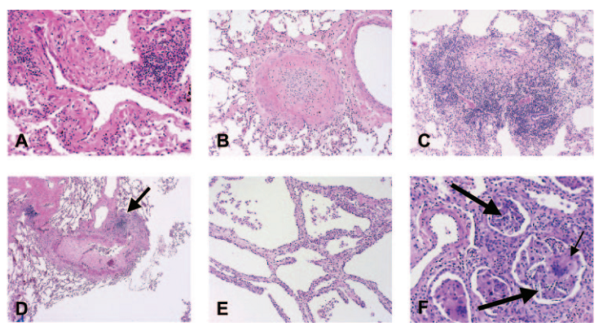
Histopathological heterogeneity of BOS
Patients with advanced BOS underwent retransplantation.
Significant histologic heterogeneity among patients → Variability of patient responses to treatment
Chest. 2006 Apr;129(4):1016-23
Notes:
the highly variable pattern of functional evolution between patients
affected by BOS

Slide 13
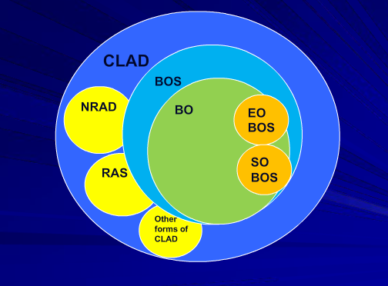
Chronic allograft dysfunction
Classical BOS
Neutrophilic reversible allograft dysfunction (NRAD)
Upper lobe fibrosis
Chronic pleural inflammation
Exudative/follicular bronchiolitis
Large airway stenosis/malacia

Slide 14
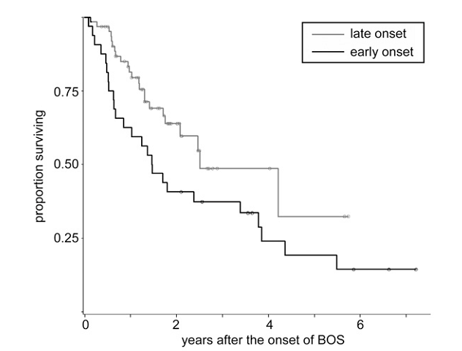
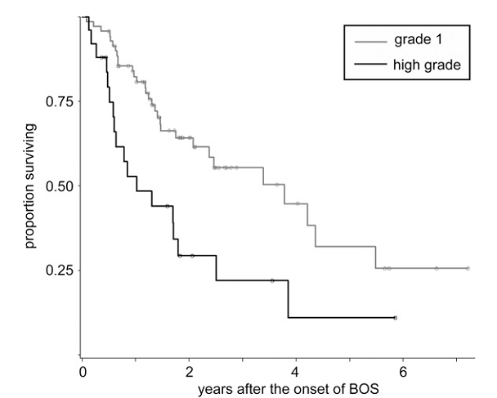
Survival and phenotype
Prior acute rejection or rejection treatments were not associated with survival after BOS.
BOS onset within 2 years of transplantation or BOS onset grade of 2 , 3 were predictive of signiﬁcantly worse survival
AJRCCM. Vol 182. pp 784–789, 2010

Slide 15
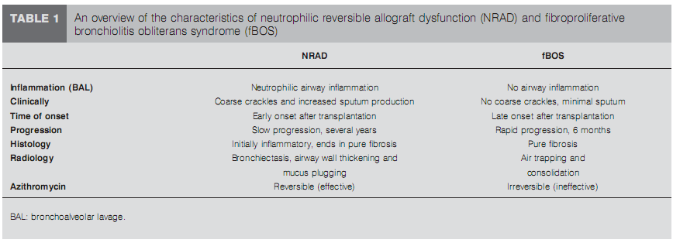
Response to azithromycin
Eur Respir J 2008; 32: 832–843

Slide 16
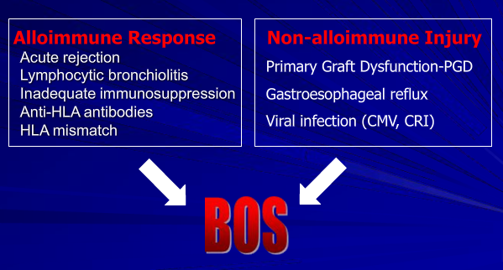
Risk factors for BOS

Slide 17
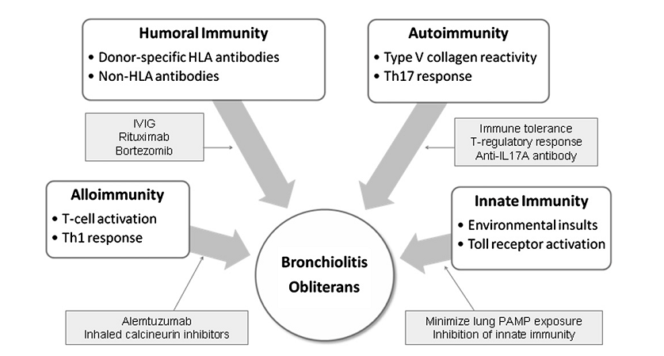
Pathogenesis of BO

Slide 18
Alloimmune T cell reactivity
Acute cellular rejection
T helper cell with interferon-r →upregulate expression of adhesion and costimulatory molecules by airway epithelial cells
→ augmenting the alloimmune response by stimulating lymphocyte infiltration and priming T-cell responses
  → The airway epithelial cell itself, once activated, generate proﬁbrotic milieu and result in tracheal obliteration.

Slide 19
Humoral immunity
The development of posttransplant
HLA antibodies in lung transplant recipients is correlated with an increased risk for BOS and worse overall survival.
Non-HLA antibodies targeted at the bronchial epithelium
Treat DSA(donor specific antibody)
  IVIG , rituximab
  Bortezomib: targets antibody producing mature plasma cell→eliminate DSA

Slide 20
Autoimmunity
Rejection is biphasic.
  Tissue injury (by ischemia, reperfusion injury)+ Autoimmunity
  Tissue injury exposes self-antigen→triggers for autoreactive T cell proliferation → sustain rejection even in the absence of persistent alloimmunity
Self antigen: Type 5 collagen [col(V)],
K-α1 tubulin
Tolerance generating & IL17A antibody

Slide 21
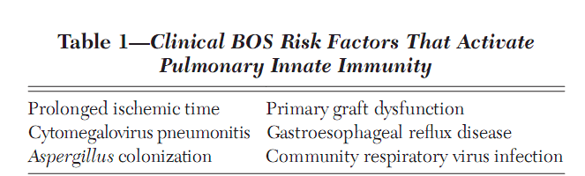
Innate Immunity and Response to Environmental Insults
Recognize microbial pathogen-associated molecular patterns (PAMPs) and damage-associated molecular patterns (DAMPs) by innate pattern recognition receptors (PRRs) (ex: TLR) .

Slide 22
Innate Immunity and Response to Environmental Insults
Avidance of infection , Timely vaccination
  Early recognition and treatment of pathogens
  ( Pseudomonas, gram + bacteria, fungus )
  The risk of CMV pneumonitis in the STOP cohort was significantly higher when GCV prophylaxis was discontinued within the first year
Aggressive treatment of GE reflux
  Gastric fundoplication?
  Side effect, no controlled studies to date
Therapies that target specific TLR or downstream signals

Slide 23
Management of BOS
There are no consistently proven approaches to prevent or treat BOS
Multicenter randomized clinical research/treatment trials are insufficient.

Slide 24
BOS treatment studies
Immunosuppressant therapy
  Add AZA to CSA+pred
  Conversion of cyclosporine to tacrolimus
  Mycophenolate mofetil
  ATG ,OKT3
  Add MTX, Cyclophosphamide, TLI
  Aerosolized cyclosporine
  Alemtuzumab, an anti-CD 52 antibody
    significantly improved the histological grade of BOS in 7 of 10 patients but had no impact on pulmonary function
Ann int med 1987;107:300-04
JHLT 2003, 22:50-7.
Ann Thorac Surg 1997, 64:945-8.
Chest 1996;109:874-78, JHLT 2000; 19: 1219-23
JHLT 1999; 18: 1139-42,JHLT 2000; 19: 263-269
Eur Respir J 2004, 23:384-90.
Am J Transplant 2007,7:2802-8..

Slide 25
BOS treatment studies
Azithromycin therapy
  Prolonged azithromycin (250 mg in a total of 34 patients with BOS with an improvement in the FEV1 for some patients
  24/81 (30%) patients with BOS had improvement in the FEV1 after 6 months of azithromycin therapy.
  azithromycin responders at 6 months demonstrated higher pre-treatment BAL neutrophils
  Prevention: BOS occurred less in AZM(12.5%) than placebo(44.2%).
Transplantation 2008, 85:36-41.
Eur Respir J 2011;37: 164–72.

Slide 26
BOS treatment studies
Statin therapy
  6-year survival of lung transplant recipients receiving statin therapy was much greater than patients not on statin therapy
  none of the 15 recipients started on statin therapy during the first postoperative
  year developed OB, whereas the cumulative incidence among control subjects was 37%.
AJRCCM. 2003, 167:1271-8

Slide 27
BOS treatment studies
Extracorporeal photopheresis
  Effective method of treatment of T-cell dependent disorders
  Induce nonspecific inflammatory mediator release →apoptosis of peripheral blood T cell populations →induce a clone specific suppressor T cell response →induce photodestruction
  60 lung transplant recipients experienced a reduction in the rate of decline in lung function associated with progressive BOS with extracorporeal photopheresis
  (116.0 mL/month vs 28.9 mL/month, P < 0.0001)
J Heart Lung Transplant 2010, 29:424-31.

Slide 28
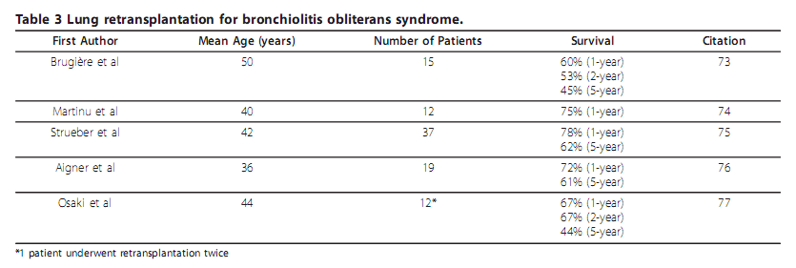
BOS treatment studies
Lung retransplantation
  Definitive treatment for BOS and BRC
  Survival rates for lung retransplantation were lower than survival rates for initial transplants (79% at 1 year and 52% at 5 years )

Slide 29
Management strategies
Initial prevention and aggressive treatment that target underlying mechanism
Risk reduction of primary graft dysfunction
  decreasing mechanical ventilation time for donors and reducing allograft ischemia time
  limiting cardiopulmonary bypass and blood product transfusions during transplantation
Early identification of BOS
  azithromycin treatment initiated before the development of BOS stage 2 → a significant reduction in the risk of death
Notes:
azithromycin treatment initiated before
the development of BOS stage 2 was independently asso-
ciated with a significant reduction in the risk of death.

