Slide 1
Aspergillus infection
호흡기내과 F2 최지연

Slide 2
▶ More than 200 000 documented human life-threatening aspergillosis infections annually
▶ From allergic diseases to invasive aspergillosis, depending on the host’s immune state
: allergy, airway or lung invasion, cutaneous infection, or extrapulmonary dissemination
▶ Risk factors
Underlying conditions that compromise pulmonary and systemic immune responses
① Severe and prolonged neutropenia
② Receipt of high doses of glucocorticoids
③ Other drugs or conditions that lead to chronically impaired cellular immune responses
eg, immunosuppressive regimens
autoimmune diseases
to prevent organ rejection
AIDS
Immunocompromised patients
① Hematopoietic cell transplant (HCT) recipients
② Airway colonization in lung transplant recipients with cystic fibrosis
③ Liver transplant recipients: immunosuppression, hemodialysis, CMV infection
④ Renal transplant recipients: a longer duration of hemodialysis, leukopenia ((≤3m after Tx)
Patients with no or milder immunosuppression
① Chronic obstructive pulmonary disease, with receipt of glucocorticoid therapy
② Intensive care unit (ICU) admission
③ Certain viral infections (eg, influenza, SARS-CoV-2, respiratory syncytial virus)

Slide 3
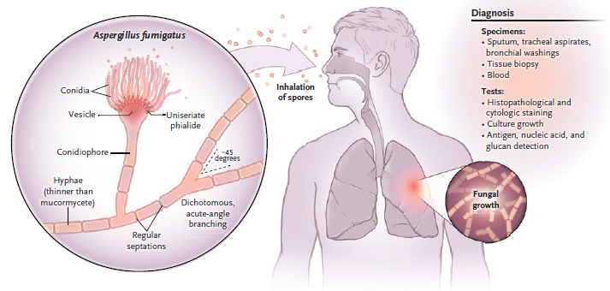
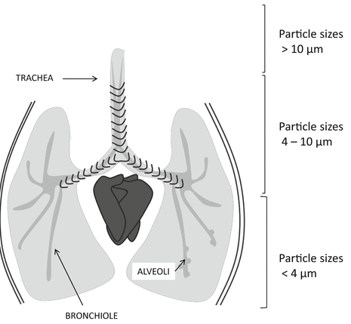
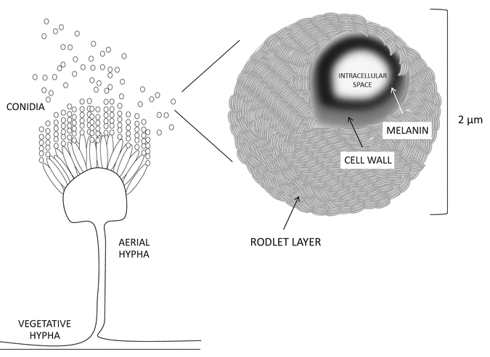
▶ Pathogenesis
Aspergillus conidia (spores) : ubiquitous in the environment
▷ soil and on other vegetative or moist material
▷ exist as saprobes
▷ Spores
: appropriate surface charge, hydrophobicity, and size (2 to 5 μm)
: by transfer in air
: colonizing airways in the pulmonary tree, sinuses or leading to cutaneous or ocular infection
Notes:
pulmonary system은 항상 aspergillus conidia에 노출이 되어있고, 이 시스템은 rapid pathogen elimination을 통한 면역반응이 일어나는 곳
특히, proximal airways에서 mucociliary clearance을 통한 제거가 중요한 기전,
이러한 기능들이 잘 안되는 lung disease ((e.g., in cystic fibrosis and bronchiectasis) 에서는 colonization 혹은 infection 이 생길 수 있겠다

Slide 4
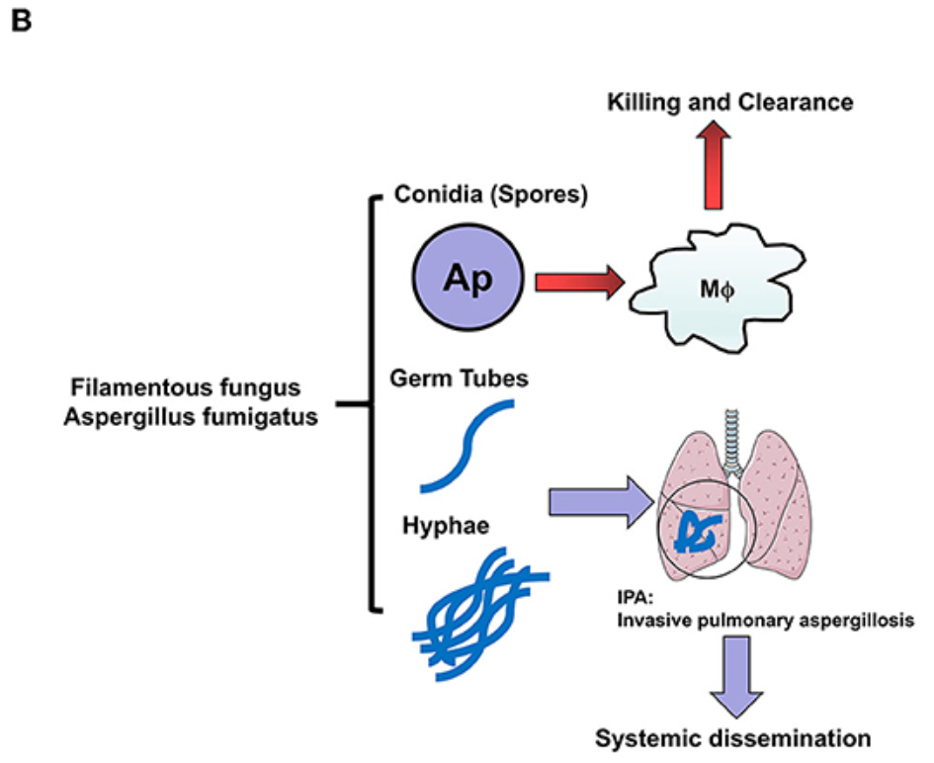
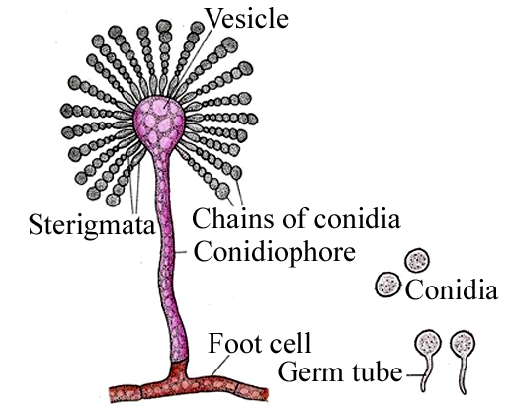
▶ Pathogenesis
First line of defense
: Airway epithelial cells and alveolar macrophages
: phagocytosed conidia / internalize conidia
> Signaling pathways
NADPH-dependent reactive oxidant species (ROS)
: defects in this pathway (chronic granulomatous disease)
calcium–calcineurin–NFAT (T-cell activated)
: disrupted by calcineurin inhibitors
stem-cell or solid-organ transplants,
Bruton’s tyrosine kinase inhibitors such as ibrutinib
Pathogenic fungal infection in the lung, Front. Immunol., 03 July 2019
Notes:
proximal airways에서 mucociliary clearance을 통한 제거가 중요한 기전,

Slide 5
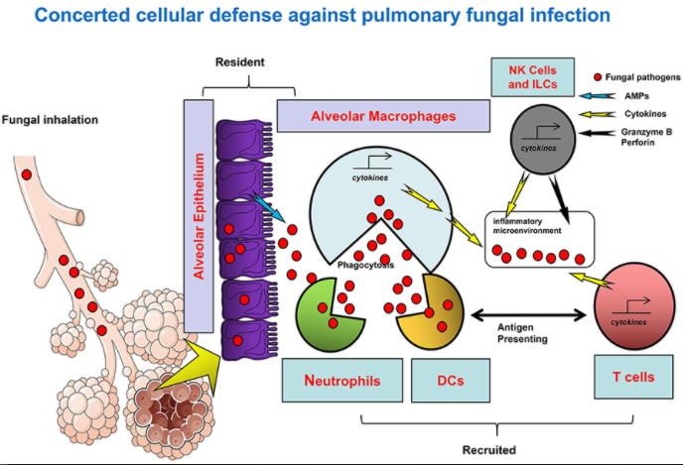
▶ Pathogenesis
Neutrophils
: depends on chemokine release from lung epithelial cells
caspase recruitment domain–containing protein 9) signaling
: defects in this latter pathway lead to extrapulmonary asper.
Alveolar macrophages
: NADPH oxidase–induced ROS production
T cells
: also essential in the host defense, both CD4 and CD8 cells
: Chronic noninvasive forms, by aberrant T-cell responses
allergic bronchopulmonary aspergillosis
chronic pulmonary aspergillosis A dominant
▷ A. fumigatus cell wall contains PAMP (pathogen-associated molecular pattern)s
: β-1,3-glucan, chitin, which are recognized by host PRRs
: PRRs, such as dectin 1 and CR3 (complement receptor 3) on innate immune cells
Pathogenic fungal infection in the lung, Front. Immunol., 03 July 2019
Notes:
Inhaled conidia are met by the innate defenses provided by resident phagocytes, specifically airway epithelial cells and alveolar macrophages [1,2]. Little is known about the contribution of epithelial cells in clearing conidia. Relatively more is known about macrophages, which contribute to both conidial clearance and the production of secondary inflammation. These cells secrete inflammatory mediators after recognition of key cell wall components (eg, beta-D-glucan) exposed after conidial germination into hyphal forms. These mediators result in neutrophil recruitment and the activation of cellular immunity, which are important in killing potentially invasive microbial forms (hyphae) and determining the extent and nature of the immune response. Hence, risks for disease and the type of disease that occurs are the combined result of multiple cellular functions that impact proximal events in conidial clearance, production of inflammation, and killing of invasive forms [1].
Microbial factors that impact disease potential include toxins, proteases, and secondary metabolites that exert multiple effects on the host's local pulmonary and systemic defense. These include cellular products that:
Histopathologically, invasive aspergillosis is characterized by progression of the infection across tissue planes. One hallmark of infection is vascular invasion with subsequent infarction and tissue necrosis. Presumably, fungal cell surface components bind to vessel wall components, including basement membrane, extracellular matrix, and cellular constituents, and can cause ischemia and infarction of structures distal to invaded arteries.

Slide 6
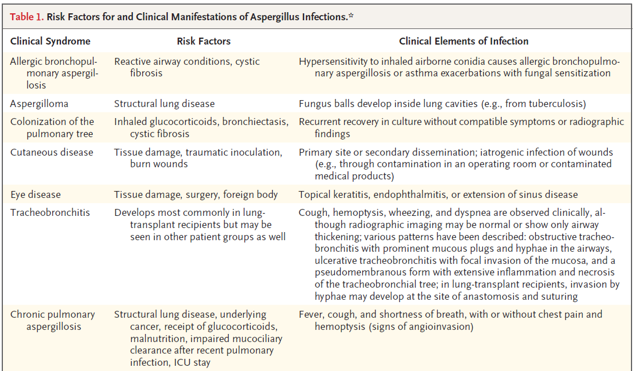
▶ Clinical features

Slide 7
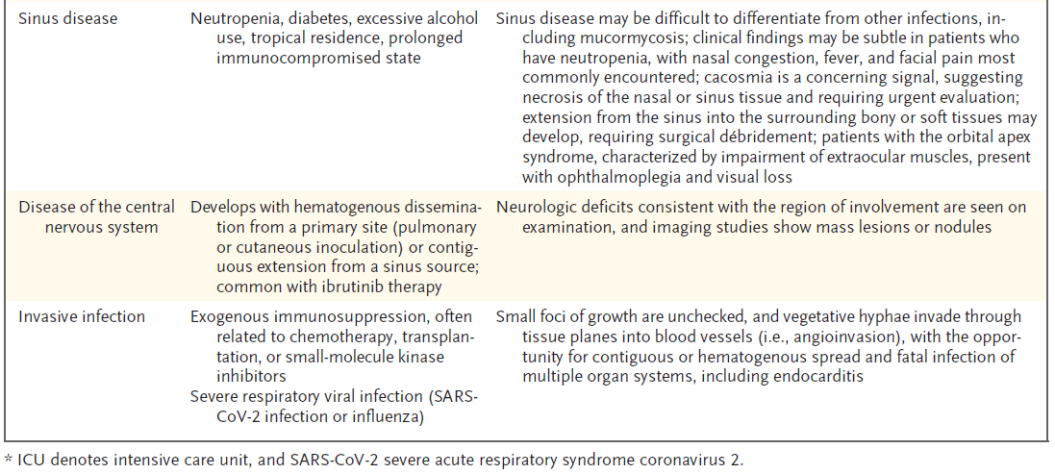
the use of glucocorticoids/other immunomodulating medications during treatment of severe SARS-CoV-2 infection may confer a predisposition to pulmonary mold infections

Slide 8
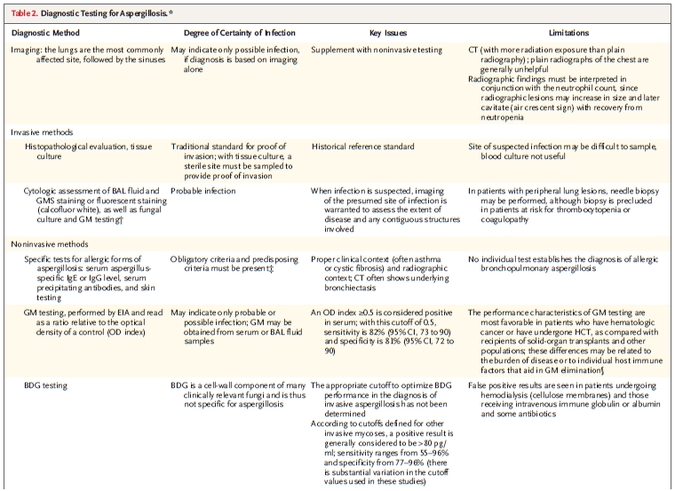

▶ Diagnosis
Based on the integration of
clinical,
radiological and
microbiological data
Content
> Invasive aspergillosis
> Chronic pulmonary aspergillosis
Aspergilloma
Tracheobronchitis
> ABPA (Allergic bronchopulmonary aspergillosis)

Slide 9
Invasive aspergillosis
▶ Approximately 43-80% of the cases (adult patients without haematological malignancy)
▶ SOT recipients: average incidence of IA ranges from 0.1% to 11.6%
small bowel (11.6%) > lung (8.6%) transplant recipients > liver (4.7%) > heart (4.0%) > pancreas (3.4%) > kidney (1.3%) grafts
▶ Half the cases will occur in the first 3 months after transplantation
High-risk
  Neutropenia >10 days
  Allogeneic stem-cell transplantation
  Prolonged steroid use (at least 0.3 mg/kg/day prednisone for >3 wㅏㄴTreatment with recognized T-cell immunosuppressant
  Inherited severe immunodeficiency (e.g., chronic granulomatous disease)
  Severe influenza (and possibly COVID-19)
Intermediate risk
  Neutropenia <10 days
  Steroid use (less than 0.3 mg/kg/day prednisone for >3 weeks)
  COPD
  Cirrhosis
  Malignancy treated with cytotoxic chemotherapy
  Lung transplant, small bowel transplant, autologous stem cell transplantation
  Advanced AIDS (e.g., CD4 count <50, or neutropenia due to antiviral therapy)
Low risk
  Non-lung solid organ transplantation (heart, kidney, liver, pancreas)
  Short course steroid (e.g., <7 days)
  Prolonged ICU stay
  Diabetes
  Renal failure, hemodialysis
  Malnutrition, alcoholism

Slide 10
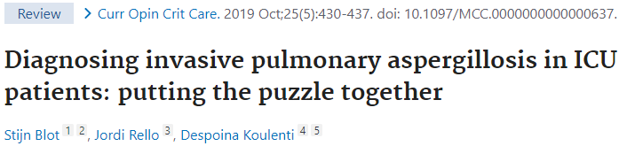
Invasive aspergillosis : Presentation
▶ Mycologic Features
Invasive infection of humans is most frequently caused by
: Aspergillus fumigatus complex > A. f lavus > A. niger > A. terreus
* fumigatus - most common in the lung
* lavus - more commonly causes infection of the larger passageways and sinuses.
* burn wounds are commonly colonized by A. niger and A. f lavus.
▶ Neutropenic patients:
angioinvasion mimics pulmonary embolism + pneumonia
▷ Infection may initially center on the pulmonary arteries and behave
a bit like a pulmonary embolism
▷ Refractory fever is a central finding
(may persist even despite anti-fungal therapy).
Signs of pulmonary infarction
  Dry cough
  Pleuritic chest pain
  Hemoptysis (which can be massive).
▷ Metastatic infection may extend beyond the lungs
  Abscesses in brain, liver, spleen, kidney
  Skin lesions can be diagnostically helpful if present.
▶ Non-neutropenic patients: mimics pneumonia
▷ Course is overall slower and with less prominent fever, making diagnosis more difficult.
▷ Dyspnea is a prominent symptom.
▷ Copious sputum production is often seen.
▷ Fever and chest pain are less frequent than in neutropenic patients.
Notes:
Invasive pulmonary aspergillosis tends to present differently in neutropenic and non-neutropenic patients. However, there may be overlap between these two presentation types. Overall, patients generally develop severe respiratory failure leading to intubation

Slide 11
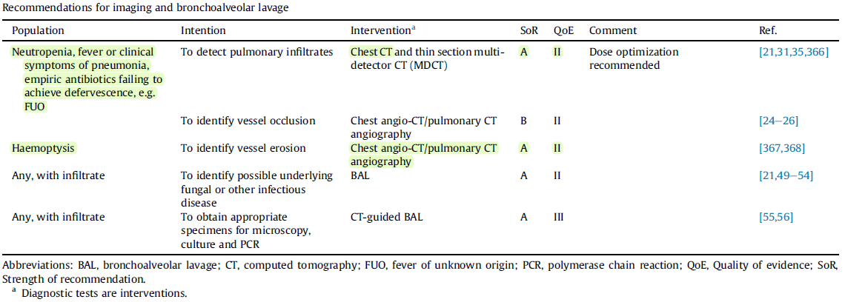
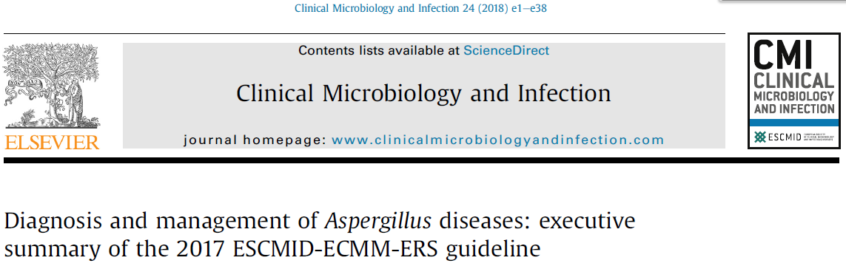
Invasive aspergillosis : Diagnosis
Radiology
Image
+ Microscopy and culture
+ Non-culture based assays

Slide 12
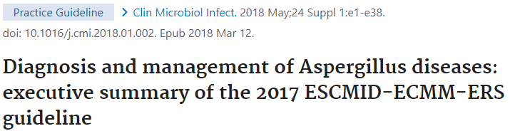
Invasive aspergillosis : Diagnosis
Radiology
▶ CT scan is the modality of choice
▶ Neutropenic patients may present with a classic fungal pattern
Infection often initially centers on the blood vessels >> pulmonary infarction, with subsequent necrosis of infarcted tissue >> cavitation
Initial finding is often nodular infiltrates.
  Patchy, nodular opacities reflect infarction. These can be pleural-based and wedge-shaped.
  Nodular infiltrates may be surrounded by ground-glass opacification due to hemorrhage, generating a “halo sign.”
Later on, cavitation occurs. In neutropenic patients, this may coincide with recovery of the bone marrow and an increase in neutrophil count.
  Necrosis of lung tissue creates cavities in the lung
  The initial cavitation process yields an air-crescent sign
  Clinically, cavitation often correlates with the development of hemoptysis.
▶ non-neutropenic patients often have nonspecific imaging
Infection often centers on bronchi and alveolar tissue (bronchoinvasion).
This leads to a pattern of bronchopneumonia with airspace consolidation, which may look like other forms of pneumonia.
  A “tree in bud” pattern may result from infection of bronchioles.
  Thickening of trachea or bronchial walls may be seen.
Classic features: nodular infiltrates with halo sign, cavitation, and air-crescent signs

Slide 13
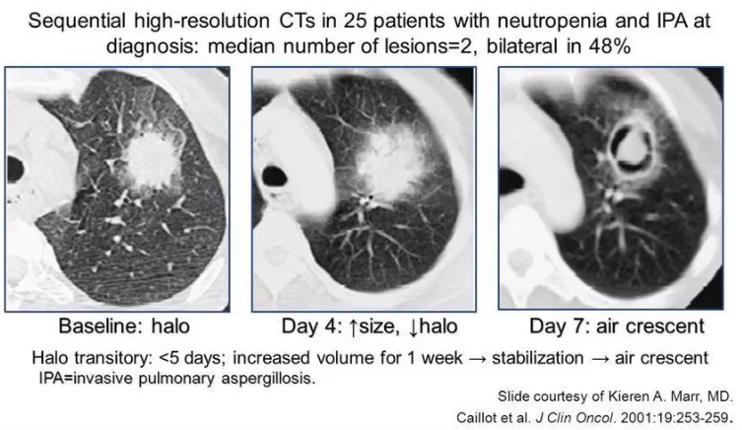
Radiology
Halo sign (early)
Air crescent sign (late)
  Crescent-shaped gas collection within pulmonary nodule or consolidation
  Can progress to extensive cavitation and necrosis
The presence of new nodules with ground-glass halo or reversed halo (atoll) sign is strongly suggestive of the diagnosis of angioinvasive aspergillosis
Notes:
Halo Sign
Infections
Mucormycosis, candidiasis, coccidioidomycosis, cryptococcus
Candida: Involves small blood vessels, random distribution
Tuberculosis, mycobacterium avium intracellulare
Coxiella burnetii
Herpes simplex, varicella-zoster, cytomegalovirus, myxovirus
Bacterial abscess, Pseudomonas aeruginosa, legionella
Primary tumors
Squamous cell carcinoma, Kaposi sarcoma, bronchioloalveolar cell carcinoma, adenocarcinoma
Metastases: Angiosarcoma, Kaposi sarcoma, choriocarcinoma, osteosarcoma, melanoma, hydatiform mole, gastrointestinal malignancies
Pulmonary emboli
Wedge-like consolidation or pulmonary infarcts

Slide 14
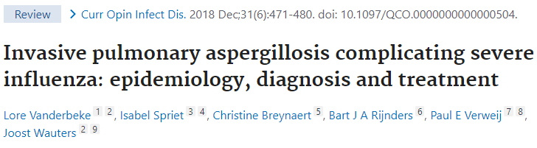
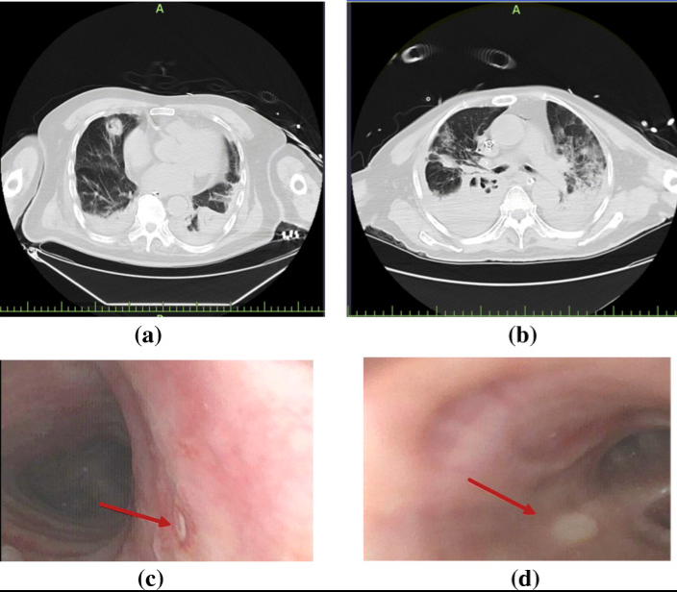
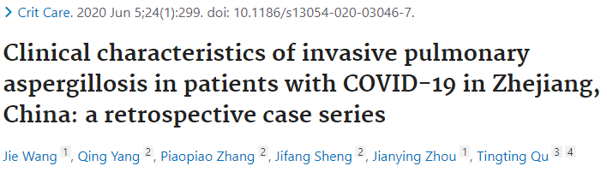
Invasive aspergillosis : Diagnosis
Bronchoscopy
Culture and fungal stain
Galactomannan
PCR
▶ Airway examination for Aspergillus plaques
▶ Invasive pulmonary aspergillosis may be accompanied by Aspergillus tracheobronchitis in up to 15% of patients
sputum culture
Sensitivity: 30-50% range (cf: BAL culture sensitivity is 30-60%, ATS guideline 2019)
Specificity: ~50% among intubated patients
Using a cytological stain to identify them (Gomori methenamine silver)
Culture + fungal staining: positive >> True infection (rather than colonization).
Notes:
Lung CT scans and bronchoscopy findings of patients with COVID-2019 and IPA. Patient 1, 90 years, lung CT scan showed nodules with cavities in the middle lobe of the right lung and consolidation bilateral lower lobes with a small amount of pleural effusion (a); bronchoscopy finding showed small ulcer in the right wall of the trachea (c). Patient 2, 74 years, lung CT scan showed consolidation bilateral lower lobes with multiple irregular cavities in the middle (b); bronchoscopy finding showed right middle bronchial ulcer (d). Red arrow indicated the positions of bronchial ulcers

Slide 15
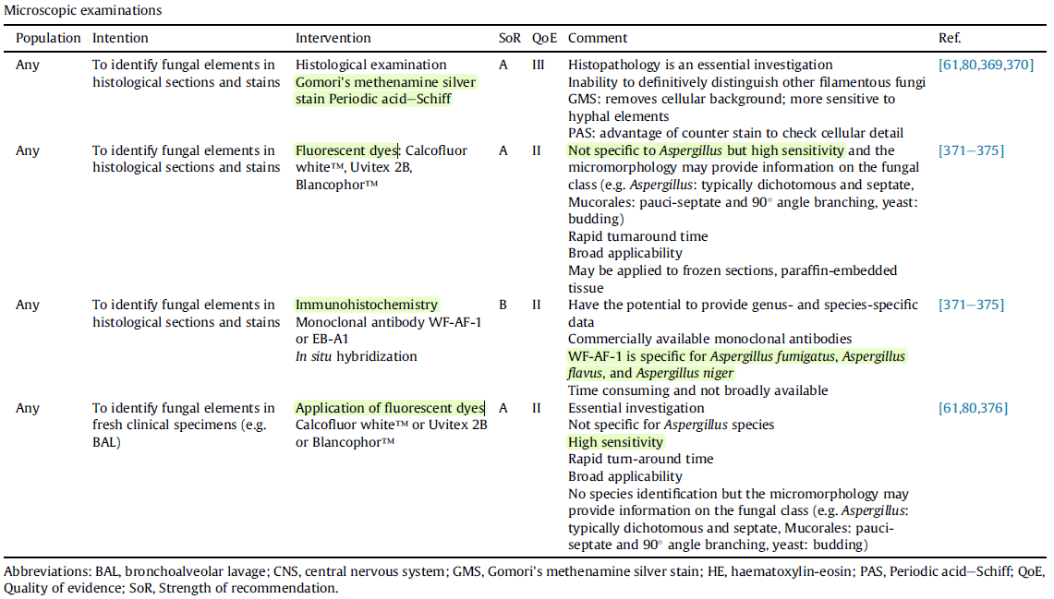
Invasive aspergillosis : Diagnosis
Microscopic, tissue

Slide 16
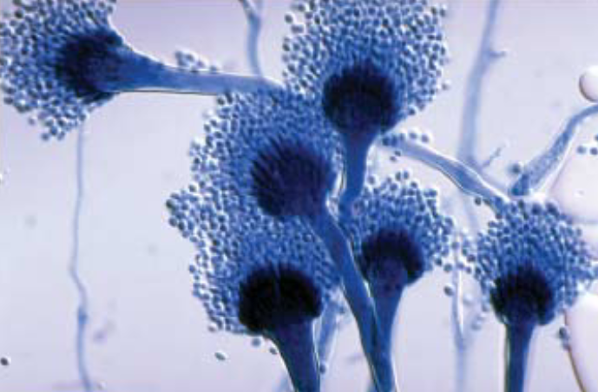
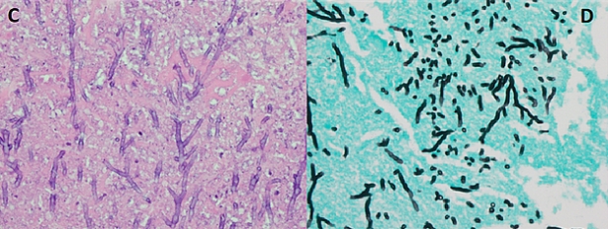
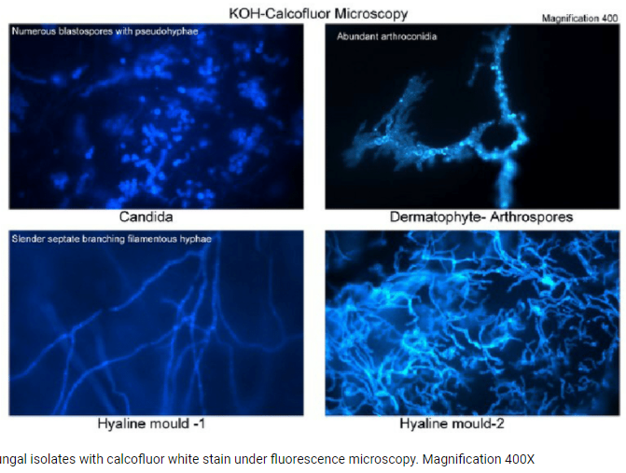
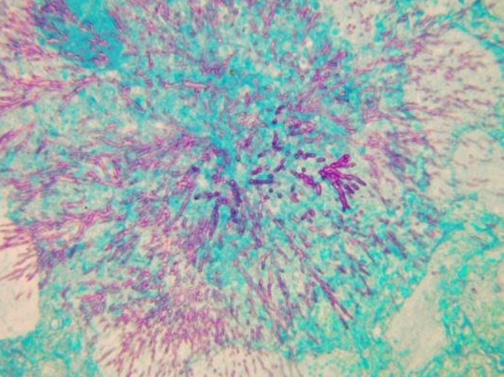
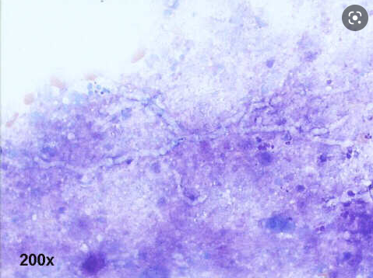
Invasive aspergillosis : Diagnosis
Microscopic, tissue
Definitive diagnosis requires tissue biopsy showing invasion of tissue
  (1) Surgical biopsy (i.e., wedge biopsy).
  (2) Bronchoscopy with trans-bronchial biopsy.
  (3) Interventional radiology trans-thoracic needle biopsy.
Most critically ill patients are too unstable to undergo these procedures
Light microscopy of Aspergillus | Download Scientific Diagram (researchgate.net)
Gomori methenamine silver stain
https://www.researchgate.net/ PAS
BAL sample
Notes:
(C) Numerous branching septate hyphae consistent with Aspergillus species
(D) Numerous septate hyphae showing airspace invasion (Gomori methenamine silver stain).

Slide 17
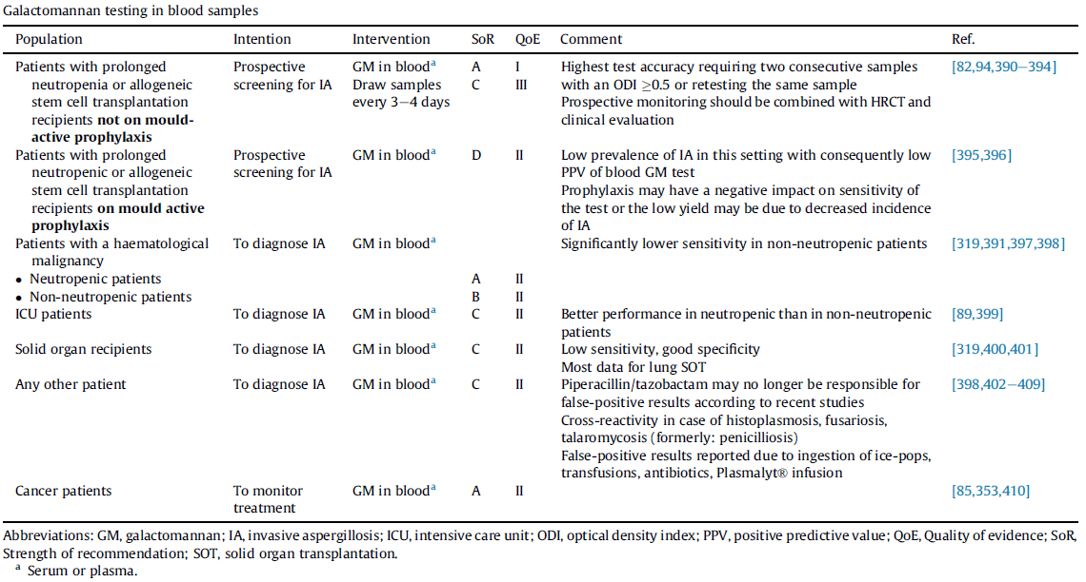

Invasive aspergillosis : Diagnosis
Galactomannan
▶ Serum galactomannan
Most common cutoff is >0.5 ATS guideline 2019
      cutoff index of 0.5 : sensitivity 74%, specificity 85%
      cutoff of 1.0 : sensitivity 79%, specificity 88%
      cutoff of 1.5 : sensitivity 59%, specificity 95%
Galactomannan cross-reacts fungal antigens e.g., penicillium species now renamed talaromycosis, histoplasmosis, fusarium species
also be caused by materials conta. with galactomannan e.g., some blood transfusion bags, some manufactures of plasmalyte, and in one case ingestion of ice-pops
Historically, piperacillin-tazobactam has caused false-positive results, but currently this doesn't seem to be an issue.
Decrease of the ODI
during the first 2 weeks of antifungal therapy
> a reliable predictor
of a satisfactory response
Notes:
Sensitivity s lower in non-neutropenic patients (perhaps ~50%), because circulating neutrophils will clear the galactomannan antigen
Anti-fungal prophylaxis or therapy may likewise decrease sensitivity.

Slide 18
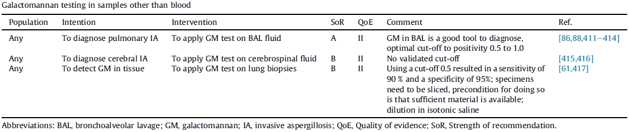
Invasive aspergillosis : Diagnosis
Galactomannan
▶ Bronchoalveolar lavage (BAL) galactomannan
Most commonly used cutoff is >0.5 optical density index
This yields a sensitivity of 79% with specificity of 84%. (ATS guideline 2019)
BAL galactomannan can be somewhat elevated in patients with aspergillus colonization
In non-neutropenic patients, BAL galactomannan may be superior to serum galactomannan, since the infection is centered on the airways.

Slide 19
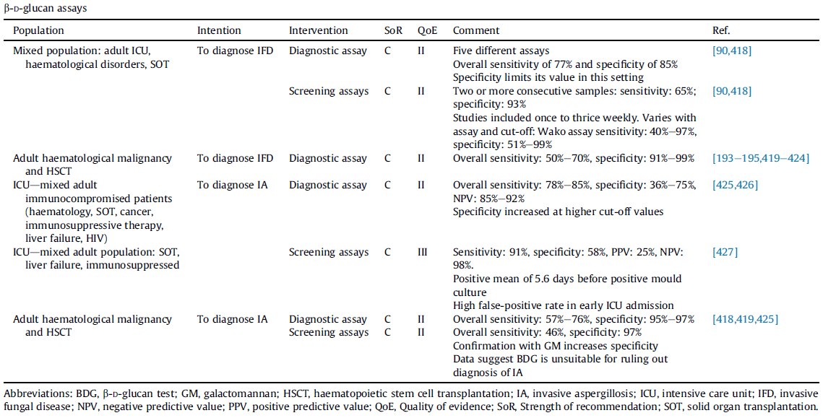
Invasive aspergillosis : Diagnosis
Beta-D glucan
Beta-D-glucan: a cell wall component of nearly all fungi
(except for: Cryptococcus spp., Mucorales spp. including Mucor and Rhizopus, and the yeast phase of Blastomyces dermatitidis)
Not be used as the sole serum test, but may be useful in combination with galactomannan
▶ sensitivity for invasive aspergillus
Sensitivity ~75%.
Sensitivity is not reduced by the use of antifungal agents.
Beta-D-glucan might have superior sensitivity compared to galactomannan in patients who aren't neutropenic.
▶ specificity for invasive aspergillus
less specific than galactomannan, perhaps ~80%.
(1) False-positive: hemodialysis with cellulose membranes, wound packing with gauze, albumin, or intravenous immunoglobulin
(2) Positive results:
other fungal infections
(e.g., Pneumocystis Jiroveci, histoplasmosis, blastomycosis, Candida colonization or invasive infection)
or certain bacteria which contain beta-glucans (e.g., Pseudomonas aeruginosa).

Slide 20
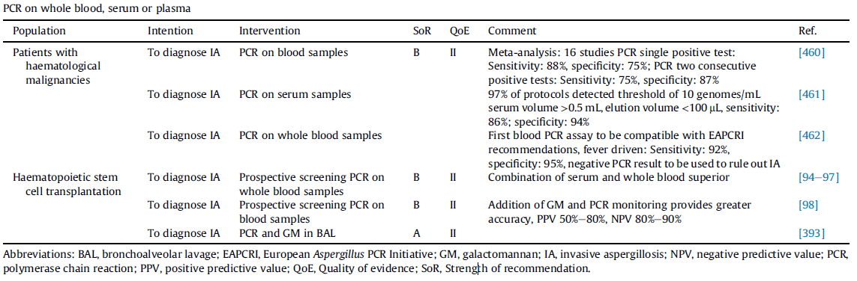
Invasive aspergillosis : Diagnosis
PCR
▶ Serum PCR
Sensitivity: ~80% & Specificity:~75% (ATS guidelines 2019)
This is probably less useful in non-neutropenic patients, among whom Aspergillus is less likely to spread hematogenously.
▶ Bronchoalveolar lavage PCR
Sensitivity: 90% (ATS guidelines 2019)
Not distinguish between colonization versus invasive infection
Positive PCR doesn't prove invasive aspergillosis, but a negative PCR argues strongly against this diagnosis
Prospective screening of high-risk haematological patients by a combination of GM and PCR improves the diagnostic
accuracy and is associated with an earlier diagnosis

Slide 21
Invasive aspergillosis : Approach to Diagnosis
▶ Suspicion for pulmonary aspergillosis
Sputum culture or smear reveals Aspergillus
Imaging findings are highly suggestive of a fungal infection (e.g., nodular infiltrates with cavitation).
Patient has a very high risk for aspergillosis (e.g., prolonged neutropenia) with persistent fevers or lung infiltrates.
“Refractory pneumonia” marked by a combination of the following features:
  i) Lung infiltrates with respiratory failure
  ii) Refractory to antibiotics
  iii) Underlying risk factors for aspergillosis
Investigation of ventilator-associated pneumonia
▶ Diagnostic workup for aspergillosis
CT scan of the chest
Serum galactomannan antigen and beta-D-glucan
Sampling of the lung if possible:
  Endotracheal aspirate for culture, PCR, and fungal stain (if the patient is intubated and too unstable for bronchoscopy)
  Bronchoalveolar lavage for culture & fungal stain, PCR, and galactomannan (if it can be accomplished safely)
▶ Integration of data

Slide 22
Invasive aspergillosis : Treatment
    시작 시점: 임상적으로 의심되면 시작
    This is unclear
    Treatment initiation depends on overall clinical judgement and risk assessment
    치료 기간
    Clinical response, immune reconstitution, recovery from GvHD 를 종합적으로 판단
    Remission 판정을 위해서는 no persistent clinical, imaging(scarring allowed), microbiological evidence 필요
    3 to >50 weeks 로 범위가 넓다

Slide 23
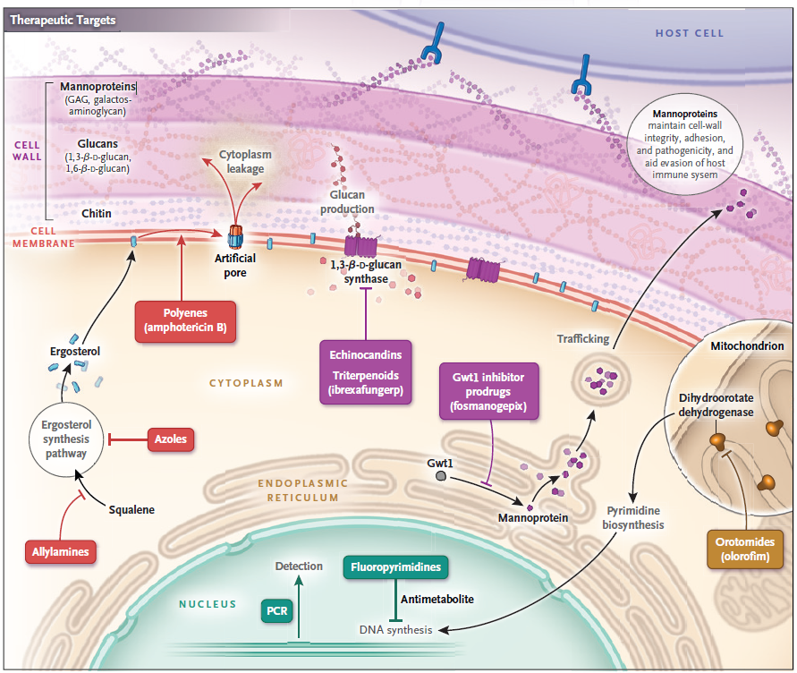
Invasive aspergillosis : Treatment
▶ Three classes of antifungals
① azoles
② polyenes targeting ergosterol
③ echinocandins: targeting synthesis of β-1,3 glucan

Slide 24
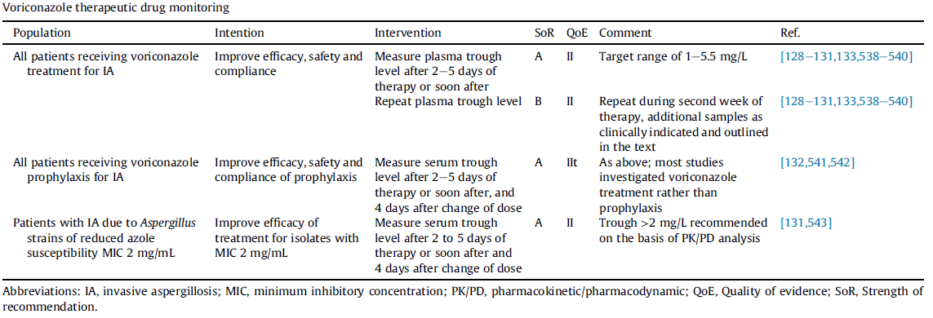
Invasive aspergillosis : Treatment
▶ Voriconazole is traditionally the front-line agent
Dose: 6 mg/kg q12hr for one day followed by 2-4 mg/kg q12hr (intravenously or orally (with excellent absorption))
Metabolized in the liver by CYP2C19 and CYP3A4 systems: drug-drug interactions
Major side-effects : visual disturbance / hepatotoxicity / skin rash / neurological symptoms / QT prolongation
IV contraindication: renal dysfunction, due to its formulation in a cyclodextrin vehicle >> enteral voriconazole is safe
▷Therapeutic drug monitoring
  Check 3-5 days after treatment initiation, and consider repeating the following week (or more frequently PRN). (ESCMID18)
  Target serum trough: 1-5.5 mg/L for most patients, Higher trough levels (2-6 mg/L) are recommended in
  multifocal disease/ disseminated disease including CNS involvement /resistant strains

Slide 25
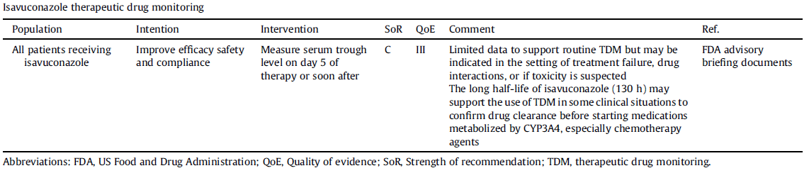
Invasive aspergillosis : Treatment
▶ Isavuconazole
Alternative front-line treatment.
Could be preferred in patients when the specific diagnosis of aspergillosis is unclear, because it covers a broader range of fungal species.
Isavuconazole was non-inferior to voriconazole in the SECURE trial, yet with better tolerance.
Dose: 372 mg IV q8hr for two days, followed by 372 mg IV/PO once daily (372 mg isavuconazonium sulfate = 200 mg isavuconazonium base).
Advantages of isavuconazole over voriconazole:
  (1) Broader spectrum of activity (including mucorales and endemic fungi).
  (2) More favorable safety profile (especially regarding renal dysfunction and QT prolongation).
  (3) Reduced risk of drug-drug interactions/moderate inhibitor of CYP3A4, drug–drug interactions
Notes:
n alternative primary therapeutic option for invasive aspergillosis.
All-cause mortality at day 42 was similar for isavuconazole and voriconazole (19% and 20%)
drug-related adverse events were less common in the isavuconazole group (42%, vs.
60% in the voriconazole group; P<0.001).
moderate inhibitor of CYP3A4, drug–drug interactions
Therapeutic drug monitoring is not necessary with isavuconazole treatment in most cases
additional data are needed for definitive recommendations to be made.
In contrast to other triazoles, isavuconazole causes a shortening of the QT interval

Slide 26
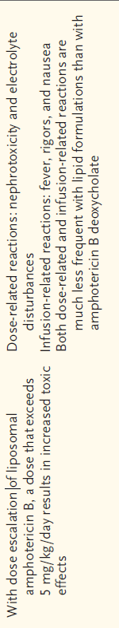
Invasive aspergillosis : Treatment
▶ liposomal amphotericin-B
Not generally a front-line therapy, due to nephrotoxicity.
indicated in selected situations:
  (1) Hepatic failure
  (2) Azole-resistant Aspergillus
▶ Echinocandins (e.g., micafungin, caspofungin)
Not usually recommended for monotherapy.
Synergistic activity when combined with triazoles (e.g., voriconazole).
Combination antifungal therapy isn't usually recommended as primary treatment, but can be used in the following situations:
  (1) Salvage therapy due to clinical failure of an azole
  (2) Known azole-resistance (ESCMID18)
  (3) High regional rates of azole-resistance
  (4) Treating a species with higher rates of resistance (e.g., Aspergillus calidoustus)
▶ Reduction of immunosuppression
Depending on the context, immunosuppression should be limited as much as possible.
▶ Sensitivity testing & infectious disease consultation
Determination of species and their drug sensitivities should be performed if possible

Slide 27
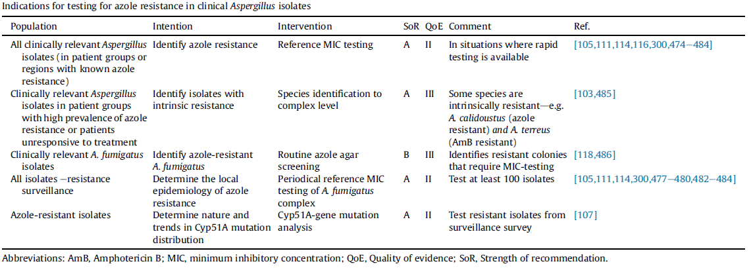
Invasive aspergillosis : Treatment of refractoy disease
A. terreus is infrequently susceptible to amphotericin B
A. calidoustus and A. lentulus : resistant to multiple antifungal agents, including amphotericin B and voriconazole.
▶ Progression and differentiated from stable disease
▶ Assessment (clinical, radiological, mycological criteria): Radiological evidence of progression + Persisting elevated GM
Assessing the response 2wks after treatmet initiation
▶ if failure: look for poor vascular supply + microbological confirmation is recommended as ID
if a viable organism+ >> susceptibility testing is recommended (azole resistance)

Slide 28
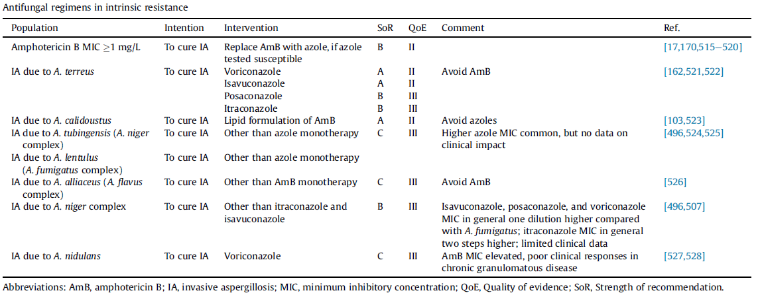
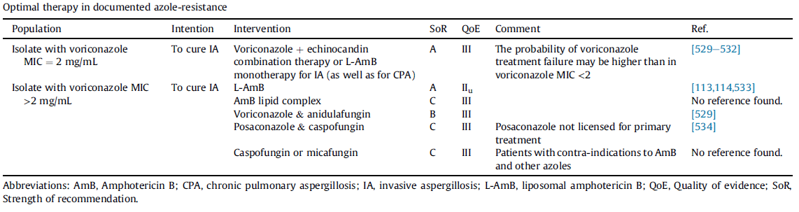

Slide 29
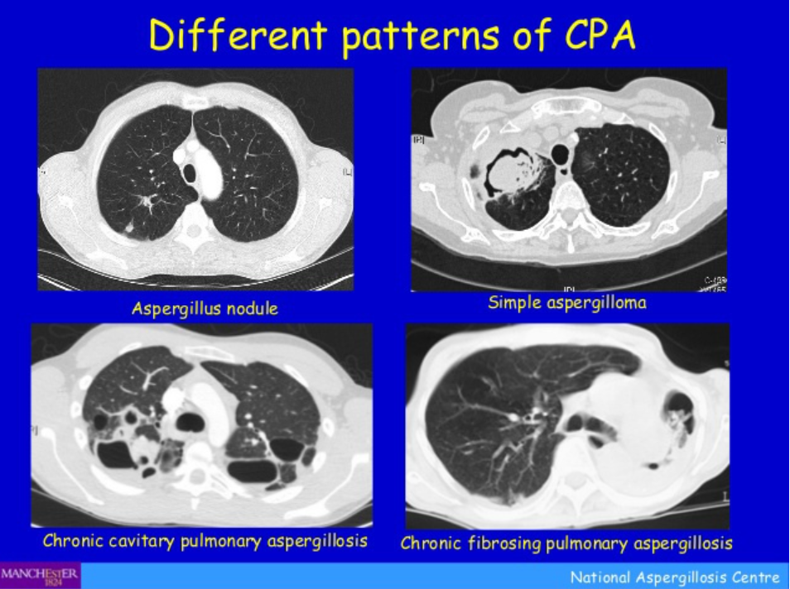
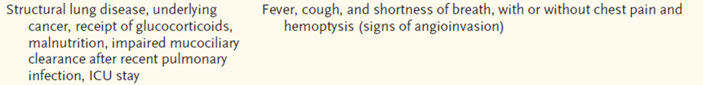
Chronic pulmonary aspergillosis
slowly progressive course over weeks to months, by slowly progressive cavitary lung disease
Chronic pulmonary aspergillosis: cavitating disease, No aspergilloma
Aspergilloma: presence of aspergilloma, fungal ball
Aspergillus traceobronchitis: a further variant of CPA in SOT
Diagnosis: Serum & BAL galactomannan, image at least 3 months
Evidence: Aspergillus culture or serum A. fumigatus IgG
Treatment: prevent life-threatening hemoptysis, QOL improve
  PO Itraconazole 200mg bid (1st)
  Voriconazole, Posaconazole (2nd)
  IV amphotericin B, Echinocandin
  (rapid progression, azole resistant Aspergillus)
  6 month duration of therapy (minimum)
  Relapse is common after disconinuation
  asymptomatic patients can be reassessed every 3–6 months
  IV Tx for CPA is useful in fail or intolerant of triazoles or resistant
  Prednisolone may be considered: underlying symptom control
  Mild/moderate haemoptysis usually responds to tranexamic acid
  Severe hemophtysis: BAE
Notes:
IV Tx for CPA is useful in fail or intolerant of triazoles or resistant
prednisolone may be considered: underlying symptom control (잘 치료되고 있는 환자에서)
mild/moderate haemoptysis usually responds to tranexamic acid
severe hemophtysis: BAE
Cavitary or nodular pulmonary
infiltrate

Slide 30
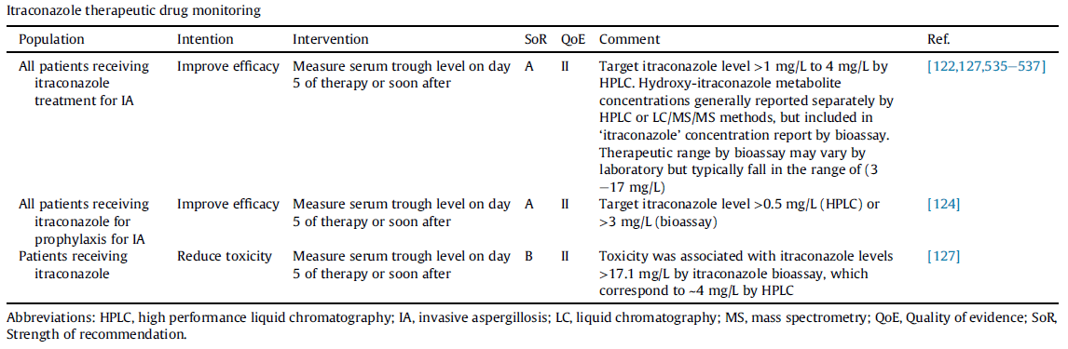
Chronic pulmonary aspergillosis

Slide 31
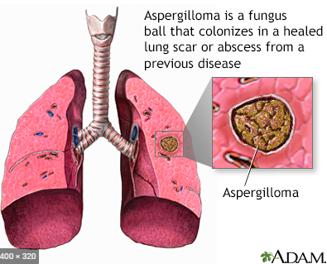
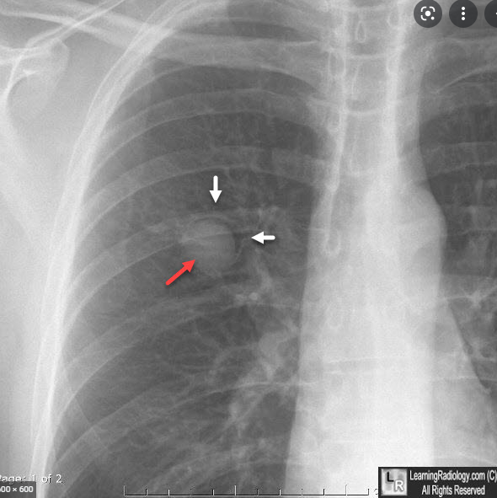
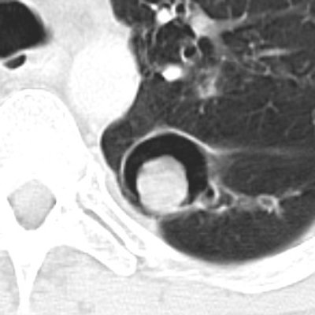
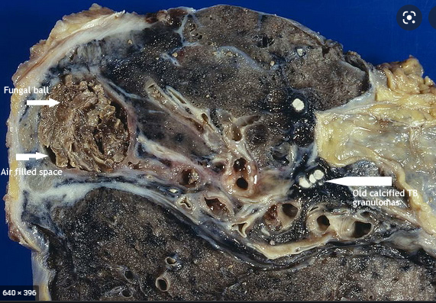
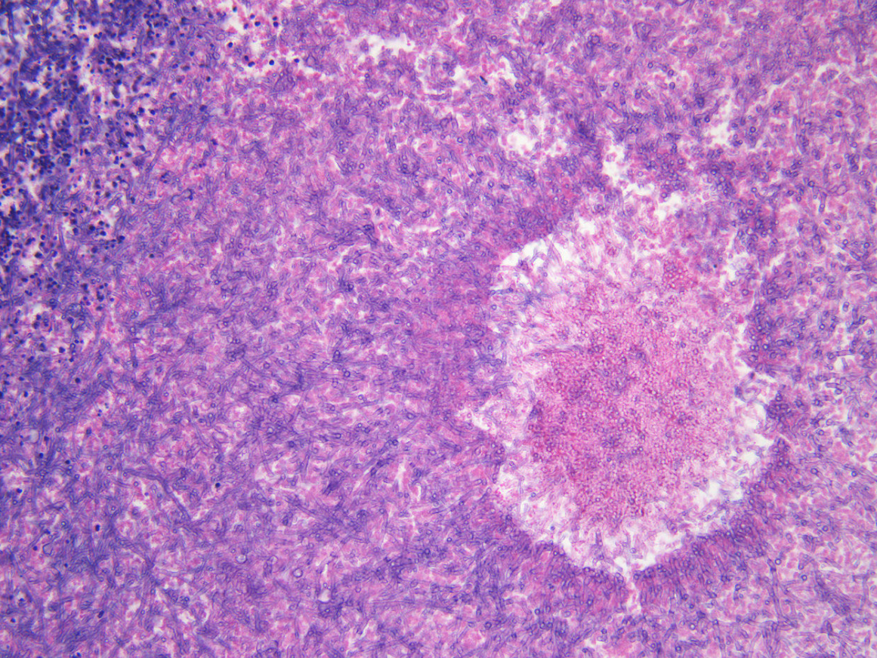
Aspergilloma
thin-walled upper lobe cavity (white arrows) presumably from old TB, with a fungus ball in the dependent portion (red arrow)
> Non-invasive form of pulmonary aspergillosis caused by a fungus ball
> Characteristically develops itself in a pre-existing cavity of the lung
  Also can occur with cavitary ca, and bronchiectasis
  Most common symptom is hemoptysis
  Histologically, these are intertwined hyphae of the aspergillus forming a mycetoma
  Findings:
    Solid, round mass in thin-walled cavity
    Usually in upper lobes
    Moves with changes in positioning
    Crescent-shaped airspace separates the fungus ball from the wall of cavity
    Fungus ball may calcify
LearningRadiology - aspergilloma, aspergillosis, fungus, ball
  > Treatment
  No therapy
  Surgical resection when appropriate
  > Alternative Tx
  itraconazole or voriconazole, BAE
  in case of lung invasion
  or possibility of peri-operatively dissemination
Notes:
a thin walled cavity secondary to tuberculosis , containing a hyperdense soft tissue attenuation with surrounding air lucency characteristic of aspergilloma and air crescent sign . Few fibrotic changes are seen surrounding the cavity . Cavity wall 이 두껍고, pleura 근처에 위치해 있음. 따라서, 어떤 경우에는 pleural thicening이 가장 earlist finding이 되기도 한다.
보통은 asymptomatic 하지만, 가장 흔한 증상은 hemoptysis 이고, 이런 경우 emboli를 고려해봐도 좋고, life threatening 하게 massive hemoptysis 한 경우에는 surgical resection을 하게 됩니다.
tubercular and nontubercular mycobacterial infections are the primary underlying lung conditions predisposing to the formation of aspergilloma
there is a strong recommendation to perform a surgical resection of a simple aspergilloma in symptomatic patients with low surgical risk, if important symptoms are reported and hemoptysis is persistent. Of importance, surgery should also be considered in patients with Aspergillus-localized CPA unresponsive to antifungal therapy

Slide 32
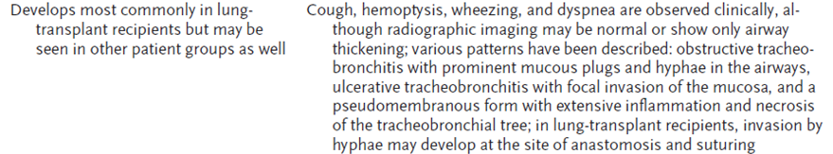
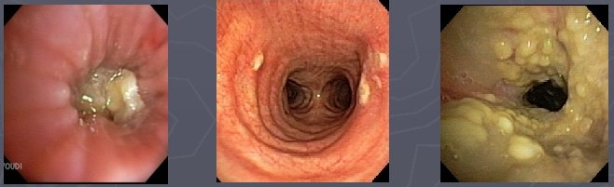
Trachiobronhitis
Can be asymptomatic
and detected only
by surveillance bronchoscopy
typically within three months of transplantation
Chest imaging : normal or reveal areas of airway thickening, patchy infiltrates, consolidation, or centrilobular nodules.
The range of findings
Bronchopleural fistulae
Obstructive type Ulcerative Pseudomembranous
Ref. Denning DW. Thorax 2005;50:812
> Tracheobronchial aspergillosis may also progress to invasive and disseminated disease
Notes:
Tracheobronchial aspergillosis occurs most commonly in lung transplant recipients, typically within three months of transplantation [8,14,24,25].
Tracheobronchial aspergillosis can be asymptomatic and detected only by surveillance bronchoscopy [26]. Reported clinical findings have included fever, cough, wheezing, and/or hemoptysis.
The range of findings in tracheobronchial aspergillosis is varied and includes simple tracheobronchitis, obstructing bronchial aspergillosis, ulcerative tracheobronchitis, necrotizing pseudomembranous tracheobronchitis, and tracheobronchial aspergillosis with bronchopleural fistulae. Tracheobronchial aspergillosis may also progress to invasive and disseminated disease [8]. Tracheobronchial disease can occur early posttransplant at the vulnerable anastomotic site and can be a complication from the use of airway stents
Chest imaging may be normal or reveal areas of airway thickening, patchy infiltrates, consolidation, or centrilobular nodules.

Slide 33
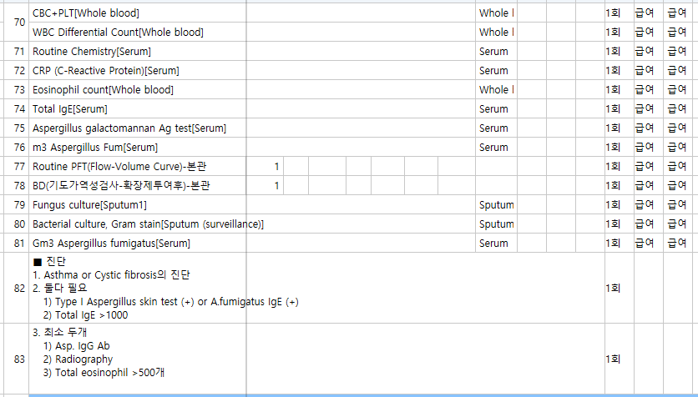
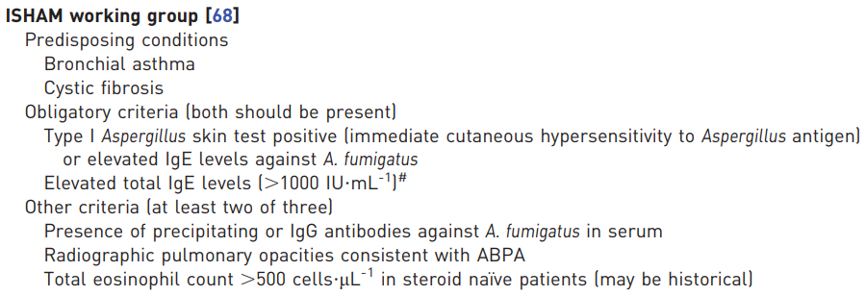
Allergic bronchopulmonary aspergillosis
Hypersensitivity reaction of the lung to Aspergillus inhalation.
Activation of T helper 2 lymphocytes in recruiting eosinophils and other inflammatory mediators.
The incidence of ABPA: patients with asthma is approximately 2% / 1–15% of cystic fibrosis sufferers develop ABPA
The hypersensitivity initially causes bronchospasm and bronchial wall edema, which is IgE-mediated
: bronchial wall damage with loss of muscle and bronchial wall cartilage
: resulting in bronchiectasis (typically central bronchiectasis)
Clin Exp Allergy. 2013;43:850–873.

Slide 34
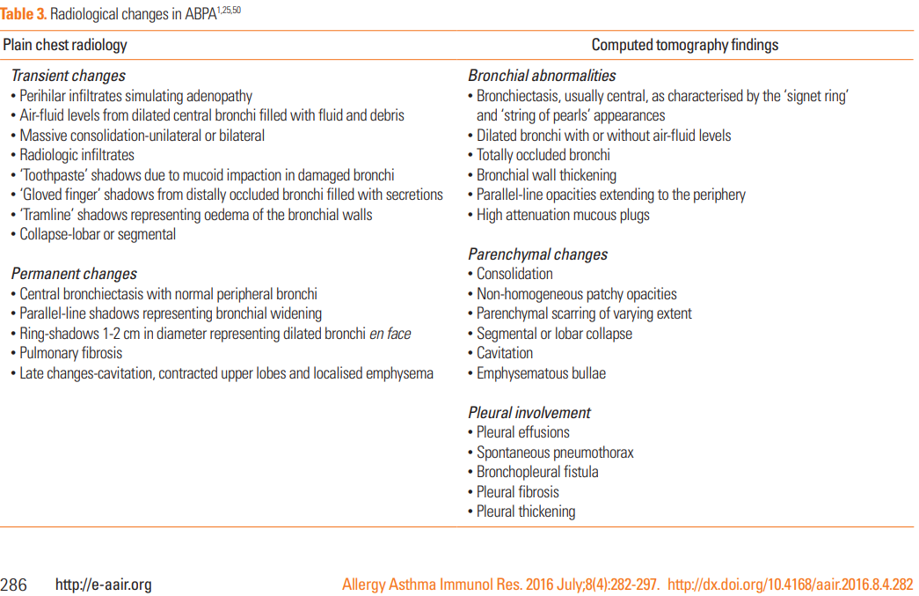
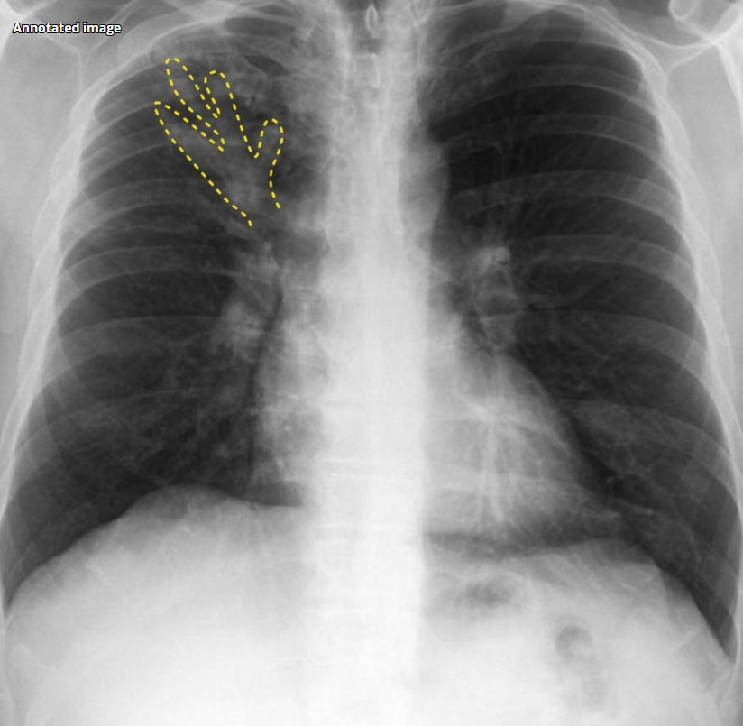
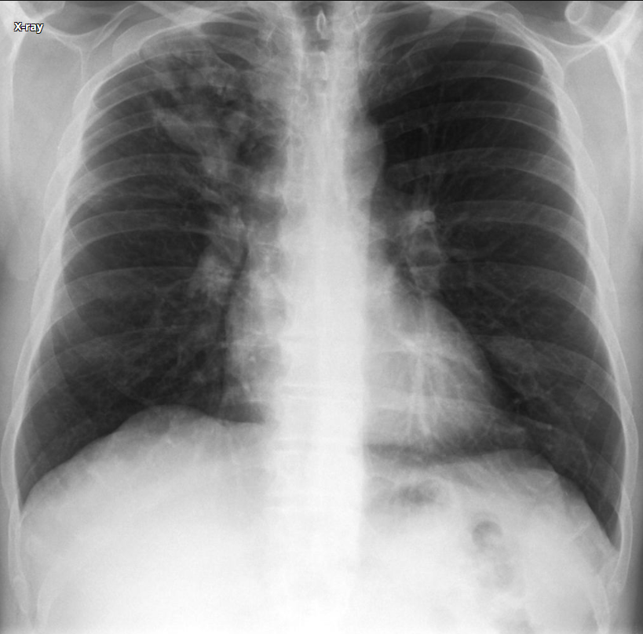
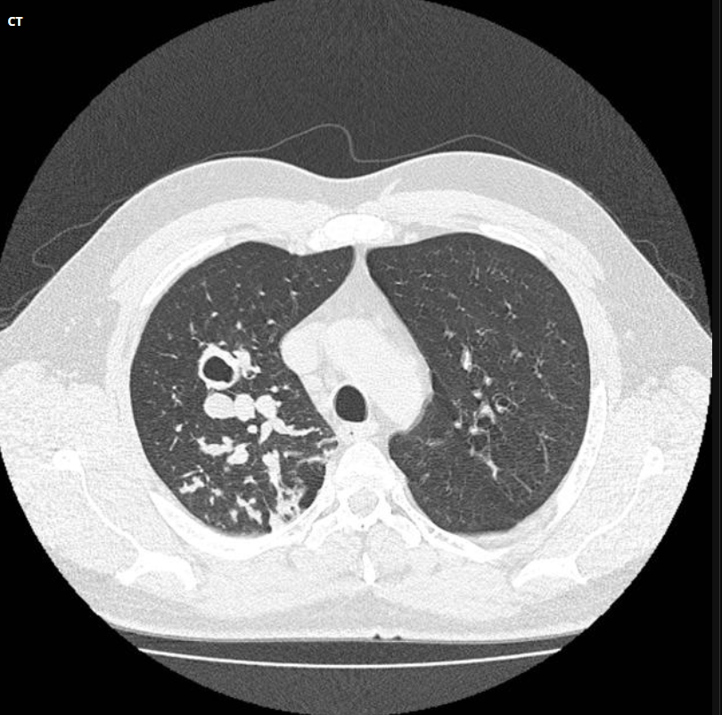
Allergic bronchopulmonary aspergillosis | Radiology Case | Radiopaedia.org
Notes:
Chest x-ray demonstrates tubular branching opacities in the right upper lobe. In the left upper lobe a number of parallel lines extending from the hilum (tram track) suggest bronchiectasis.
Single image through the upper zones confirms the presence of bronchiectasis on the left (somewhat movement degraded). On the right many of the dilated bronchi are filled with secretions.

Slide 35

  > Treatment (du: 3-5 months)
  PL 0.5mg/kg/d for 4wks >
  0.25mg/kg/d for 4wks >
  0.125mg/kg/d for 4wks
  OR add itraconazole 200mg twice daily
  (corticosteroid-sparing effect
  or consider in fail to steroid Tx)
  > Alternative Tx
  oral voriconazole or posaconazole
Agarwal R et al. World J Radiol 2012; 4(4): 141-150
Notes:
A, B: High resolution computed tomography chest scan showing typical central bronchiectasis. The upper panel shows cylindrical bronchiectasis while the lower panel shows cystic bronchiectasis; C: High resolution computed tomography chest scan showing bronchiectasis extending to the periphery. Also seen are mosaic attenuation and centrilobular nodules; D, E: High resolution computed tomography chest scan demonstrating mucus plugging of dilated bronchi (arrows) with evidence of centrilobular nodules in a tree-in-bud fashion (arrowheads); G: High resolution computed tomography chest scan showing central bronchiectasis with extensive areas of mosaic attenuation.
Agarwal R, Khan A, Garg M, Aggarwal AN, Gupta D. Chest radiographic and computed tomographic manifestations in allergic bronchopulmonary aspergillosis. World J Radiol 2012; 4(4): 141-150 [PMID: 22590668 DOI: 10.4329/wjr.v4.i4.141]

Slide 36

Thank you for attention
Kosmidis and Denning. Thorax. 2015; 70: 270-277.

Slide 37
Thank you for attention

Slide 38

Treatment
Primary prophylaxis
    High risk for IA
    AML/MDS induction therapy: posaconazole (A1)
    Allogeneic HSCT with moderate to severe GvHD: posaconazole (A1)

Slide 39

Treatment
Fever-driven(empiric) VS Diagnosis-driven(pre-emptive)

Slide 40

Treatment
Fever-driven(empiric)
대상: Fever refractory to broad-spectrum antibacterial agents (Induction and remission therapy for AML/MDS, conditioning chemo for HSCT)
치료 기간: afebrile, no active infection or infiltrates, recovery of leukocyte count
치료: Chemo for hematologic malignancy, HSCT + neutropenia<500uL for 3d + Fever>38 + broad-spectrum Abx for 4d → Caspofungin(A1)

Slide 41


