Slide 1
Acetyl salicylic acid usage and mortality in critically ill patients with the systemic inflammatory response syndrome and sepsis
Damon P. Eisen, MD; David Reid; Emma S. McBryde, PhD
Crit Care Med 2012; 40: 1761-1767
내과 R2 김규리

Slide 2
Introduction
Systemic inflammatory response syndrome (SIRS) accompanies tissue trauma or infection.
Acetyl salicylic acid (ASA) could have beneficial effects in systemic inflammation accompanying the tissue injury of trauma or severe infection.
Low doses of ASA have been shown to have both anti-inflammatory and pro-inflammation resolution effects via induction of aspirin-triggered lipoxins (ATL) and subsequent influences on numerous mechanisms involved in the inflammatory cascade.
→ We have estimated the association between ASA and mortality in SIRS and sepsis patients, controlling for potential confounding effects of a large number of covariates using propensity analysis.

Slide 3
Materials and Methods
Retrospective cohort study of consecutive intensive care unit admissions between April 2000 and November 2009.
St. Vincent’s Hospital, Melbourne, Australia.
Patients: 7,945 intensive care unit admissions examined.
  SIRS diagnosis: Bone criteria
  When at least two SIRS criteria were met, evidence of current ASA administration was sought by examining drug administration records for the 24-hr period around the time of SIRS detection.
Choice of Covariates.
  a propensity analysis to control as much as possible for the variables
  Patient demographics, in-hospital survival status, and comorbidities, including history of diabetes, ischemic heart disease risk factors and events, and renal, liver, and gastrointestinal disease.
Propensity Matching
  “psmatch2” in Stata version 11

Slide 4
Results
The ASA dose administered was >150 mg in 96% of patients .
7,945 pts
ICU adm
6,131 SIRS
608 repeat admissions
5,523 pts
ASA within 24hrs of onset of SIRS
2,082 pts
3,441 pts
195 death
687 death

Slide 5
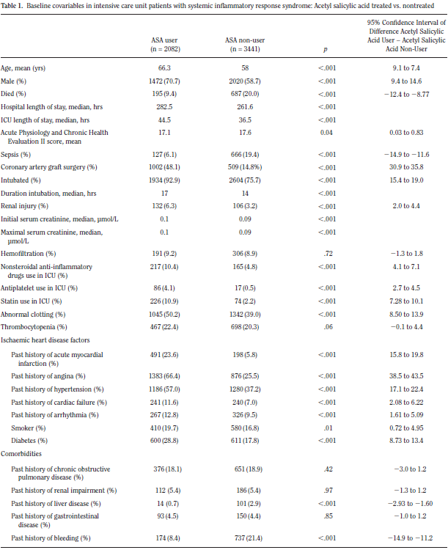

Slide 6
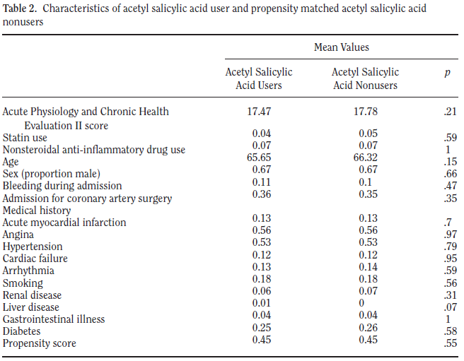
→ 1445 of the 2082 eligible ASA users in the analysis, with 637 rejected on the grounds of inability to find a close propensity match.
→ The 1445 ASA users were matched with 1445 ASA nonusers (1:1 match)

Slide 7
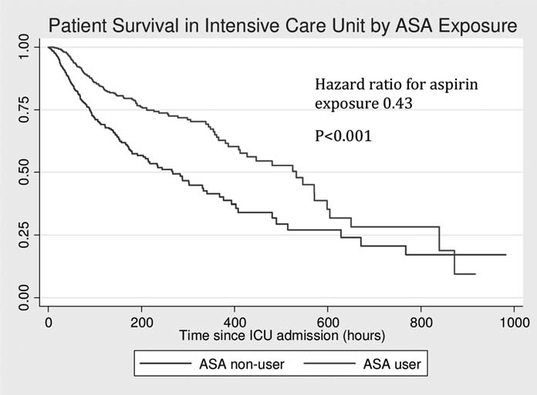
Results
Effect of ASA on mortality after propensity matching
  The ASA group had a 10.9% in-hospital mortality compared with 17.2% in the nonusers (absolute risk difference 26.2%; 95% CI 29.5% to 23.5%) after propensity matching.
  In the 970 patients with proven sepsis, ASA administration was associated with a lower mortality (27.4% vs 42.2%; absolute risk difference 14.8%;95%CI 18.9% to 8.6%)
The estimated hazard ratio for death in the ASA-exposed group was 0.43 (p <0.001).

Slide 8
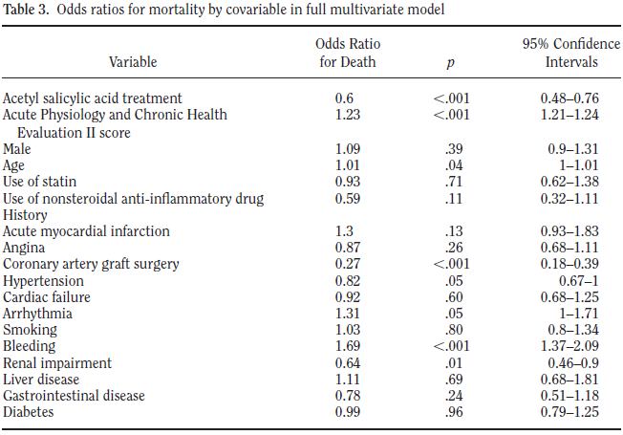
Results

Slide 9
Results of matching propensity scores for ASA for other outcomes
Renal injury
  After propensity matching, ASA users had a 6.2% rate and controls had a 2.9% rate of renal impairment (absolute risk difference 3.3%; 95% CI 2.5%–5.0%).
Bleeding
  Propensity analysis showed the ASA-user bleeding rate was lower, at 8.8%, vs. 17.6%, for the matched nonuser group (absolute risk difference 28.8%, 95% CI 211.1% to 27.3%).
    May be that patients with bleeding had their ASA therapy stopped

Slide 10
Discussion
ASA and NSAIDs act on numerous pathways involved in the sepsis-induced inflammatory cascade.
  ASA is its ability to trigger the synthesis of 15-epi-lipoxin A4 (ATL), which increases nitric oxide synthesis, which inhibits leukocyte endothelial cell interactions and decreases PMN numbers in blister fluid.
  ALT reduces tumor necrosis factor release by T cells.
Low dose of ASA may potentially act to improve sepsis outcomes through inhibition of nuclear factor kappa-B.
  This results in reduced transcription of proinflammatory enzymes, including tumor necrosis factor, interleukin-6, and cyclo-oxygenase, as well as tissue factor.
Potentiation by ASA of the decreased rates of severe sepsis as well as acute lung injury in ICU patients treated before hospitalization with statins has been shown.

Slide 11
Conclusion
Our study shows a strong association between acetyl salicylic acid and survival in intensive care unit systemic inflammatory response syndrome and sepsis patients.
The effect of acetyl salicylic acid treatment on mortality of patients with systemic inflammatory response syndrome and sepsis needs to be evaluated with prospective randomized intervention studies

