Slide 1




Low-Dose Aspirin for Preventing
Recurrent Venous Thromboembolism
Timothy A. Brighton, M.B., B.S., John W. Eikelboom, M.B., B.S., Kristy Mann, M.Biostat., Rebecca Mister, M.Sc., Alexander Gallus, M.B., B.S., Paul Ockelford, M.B., Harry Gibbs, M.B., Wendy Hague, Ph.D., Denis Xavier, M.Sc., Rafael Diaz, M.D., Adrienne Kirby, M.Sc., and John Simes, M.D., for the ASPIRE Investigators*
Kim Young jae
N Engl J Med 2012;367:1979-87.

Slide 2
Introduction
Patients who have had a first episode of unprovoked venous thromboembolism are at high risk for recurrence after anticoagulant therapy is discontinued.
Long-term treatment with a vitamin K antagonist is very effective in preventing a recurrence of venous thromboembolism while treatment continues but has not been shown to improve survival, is associated with a substantially increased risk of bleeding, and is inconvenient for patients.

Slide 3
Introduction
Many patients who have had a first episode of unprovoked venous thromboembolism discontinue anticoagulant therapy after 3 to 6 months despite recommendations to prolong therapy
Low-dose aspirin is a simple, inexpensive, and widely available treatment that is effective for the prevention of arterial vascular events and for the primary prevention of venous thromboembolism in high-risk surgical patients. Aspirin may also be effective in preventing a recurrence of venous thromboembolism after a first event.

Slide 4
Introduction
The objective of our study was to evaluate the efficacy of low-dose aspirin, as compared with placebo, in preventing a recurrence of venous thromboembolism in patients who had completed initial anticoagulation with warfarin after a first unprovoked episode of venous thromboembolism.

Slide 5
Methods
Study design
- The Aspirin to Prevent Recurrent Venous Thromboembolism (ASPIRE) study was a double-blind, randomized, placebo-controlled study of the use of low-dose aspirin in patients who had had a first-ever unprovoked venous thromboembolism and who had completed initial anticoagulation therapy.

Slide 6
Methods
Study design
- We randomly assigned patients who had completed anticoagulation therapy to aspirin, at a dose of 100 mg daily, or placebo;
- Patients were asked to take one tablet daily for a minimum of 2 years. The maximum duration of treatment was subsequently capped at 4 years.

Slide 7
Methods
Patients
- Male and female, at least 18 years of age
- First unprovoked episode of objectively diagnosed symptomatic deep-vein thrombosis involving the popliteal vein or more proximal leg veins or an acute pulmonary embolism.

Slide 8
Methods
Patients
- Venous thromboembolism was considered to be unprovoked if, it occurred in the absence of the following transient risk factors during the preceding 2 months
Confinement to bed for more than 1 week
Major surgery
Trauma requiring a cast
Pregnancy or the puerperium
The use of the oral contraceptive pill or hormone-replacement therapy

Slide 9
Methods
Patients
- Patients were not eligible for inclusion if,
Venous thromboembolism had occurred more than 2 years before enrollment
Indication or contraindication for the use of aspirin, other antiplatelet therapy, or a NSAIDs
Indication for continuing oral anticoagulation therapy
Other medical problems that would interfere with participation in the trial or limit life expectancy

Slide 10
Methods
Follow-up
- Patients attended follow-up visits at 1 month and 6 months after randomization and every 6 months.
- All patients who were enrolled after a first episode of unprovoked deep-vein thrombosis underwent venous ultrasound examination within 1 month after randomization to determine whether there was residual thrombus, in order to distinguish between residual thrombosis and a recurrence of thrombosis in subsequent assessments.

Slide 11
Methods
Outcome measures
- The primary outcome of the study was a recurrence of venous thromboembolism, defined as a composite of symptomatic, objectively confirmed deep-vein thrombosis, nonfatal pulmonary embolism, or fatal pulmonary embolism

Slide 12
Methods
Outcome measures
- The secondary outcomes were major vascular events (a composite of venous thromboembolism, myocardial infarction, stroke, or cardiovascular death)
- Measure of the net clinical benefit (a reduction in the rate of the composite of venous thromboembolism, myocardial infarction, stroke, major bleeding, or death from any cause).

Slide 13
Methods
Outcome measures
- The primary safety outcome was bleeding, either major or clinically relevant nonmajor bleeding
- Major bleeding was defined as overt bleeding that was associated with a decrease in hemoglobin of at least 2 g per deciliter or that necessitated transfusion of 2 or more units of blood, involved a critical site (e.g., retroperitoneal or intracranial bleeding), was disabling, required surgical intervention, or contributed to death.

Slide 14
Methods
Statical analysis
- In the primary analysis, treatment effects (with their 95% confidence intervals) were estimated by means of Cox regression analysis
- We combined the results from the ASPIRE and WARFASA studies by performing a meta-analysis of the log hazard ratios for the treatment effect on vascular events
- All analyses were performed with the use of SAS software, version 9.3 (SAS Institute)

Slide 15
Results
Patients
- From May 2003 through August 2011, a total of 822 patients underwent randomization at 56 sites in five countries
- The baseline characteristics of the patients did not differ significantly between the two groups

Slide 16
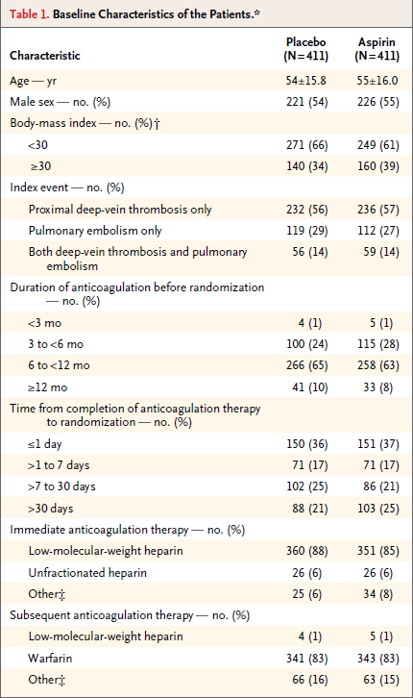

Slide 17
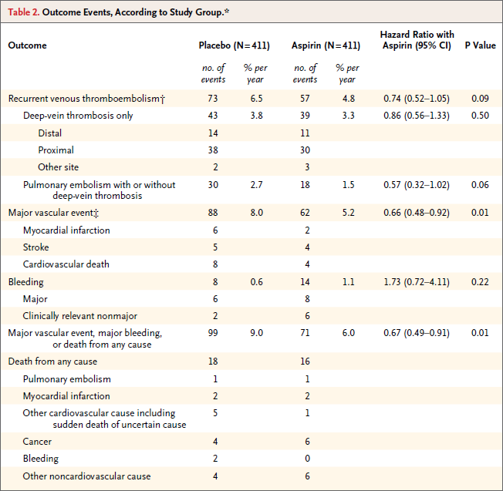

Slide 18
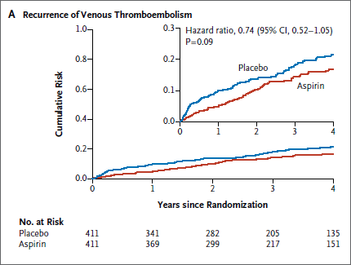

Slide 19
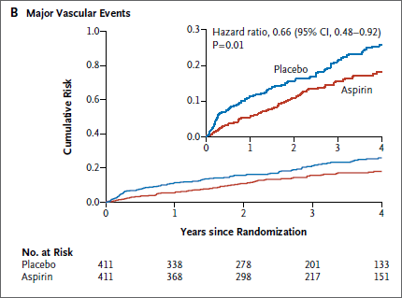

Slide 20
Discussion
The results of the ASPIRE trial did not show a significant reduction in the primary outcome of recurrent venous thromboembolism with aspirin as compared with placebo in patients who had had a first unprovoked venous thromboembolism,
It did show that aspirin reduced the secondary composite outcome of major vascular events by 34% without increasing bleeding and resulted in a significant net clinical benefit

Slide 21
Discussion
The estimated reduction of 26% (95% CI, −5 to 48) in the rate of recurrence of venous thromboembolism with aspirin is consistent with results from the recently reported WARFASA study, which showed a reduction of 42% (95% CI, 7 to 64) in the rate of recurrence of venous thromboembolism

Slide 22
Discussion
WARFASA trial (N Engl J Med 2012;366:1959-67.)
- Venous thromboembolism recurred in 28 of the 205 patients who received aspirin and in 43 of the 197 patients who received placebo (6.6% vs. 11.2% per year; hazard ratio, 0.58; 95% confidence interval [CI], 0.36 to 0.93) (median study period, 24.6 months).
- Adverse events were similar in the two groups.

Slide 23
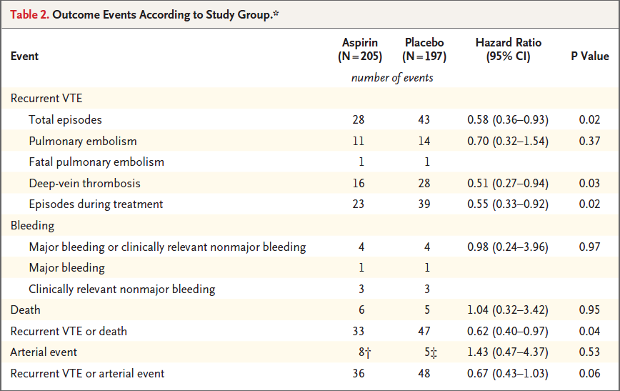
(N Engl J Med 2012;366:1959-67.)

Slide 24
Discussion
The ASPIRE trial by itself was not powered to show a significant reduction in the primary outcome, but when combined with the WARFASA study, a clear effect is evident.

Slide 25
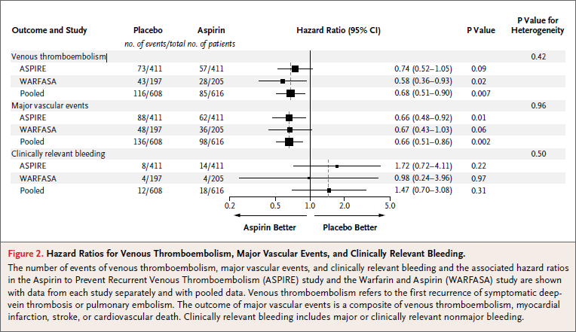

Slide 26
Conclusions
For patients who discontinue anticoagulation, the risk of a late recurrence of venous thromboembolism after a first unprovoked event remains high: approximately 10% in the first year and 30% after 10 years
Treatment with vitamin K antagonists prevents the recurrence of venous thromboembolism, but many patients are unwilling to accept extended therapy because of the risk of bleeding and the inconvenience

Slide 27
Conclusions
Aspirin, although substantially less effective than warfarin, provides an attractive alternative because it is simple and inexpensive and its safety profile is well documented
The ASPIRE study suggests that for every 1000 patients treated for 1 year, aspirin can be expected to be associated with 17 fewer episodes of recurrent venous thromboembolism and 28 fewer major thrombotic events, at the cost of 5 nonfatal bleeding episodes

Slide 28
Conclusions
The findings of the ASPIRE study, especially when considered together with data from the WARFASA study, provide consistent evidence that low-dose aspirin is beneficial in preventing recurrent venous thromboembolism and major vascular events in patients who have had a first episode of unprovoked venous thromboembolism.
Thus, aspirin is an attractive option for such patients once they have completed an initial course of anticoagulation therapy

