Slide 1
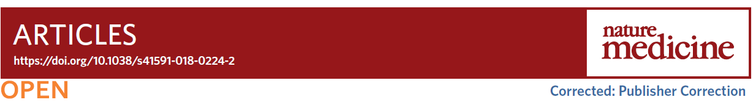
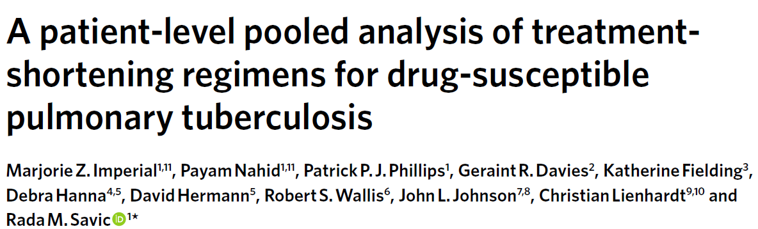
2019.05.14 Tue
호흡기내과 R2 배현경

Slide 2
Introduction
Highly effective Rifampin-based regimens in 70s~80s.
One-size-fits-all (6 months, Isonizid, Rifampin, Pyrazinamide, Ethambutol)
Severe forms of disease
  Leads to undertreatment
Lower disease burden
  Unnecessarily long treatment with potential toxicities

Slide 3
Introduction
Three recent international randomized phase 3 trials
4 month fluoroquinolone-containing regimens, drug-susceptible pulmonary tuberculosis
Gatifloxacin and moxifloxacin for Ethambutol or Isoniazid
3 trials, 4 month regimen, non-inferiority.

Slide 4
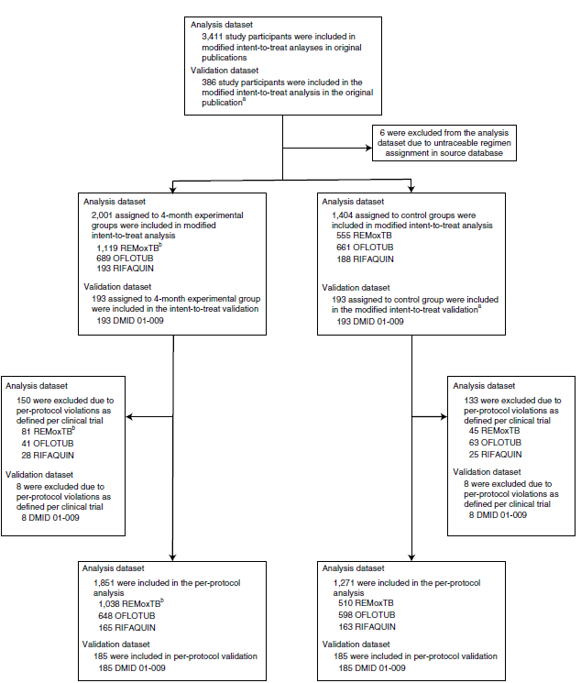

Slide 5
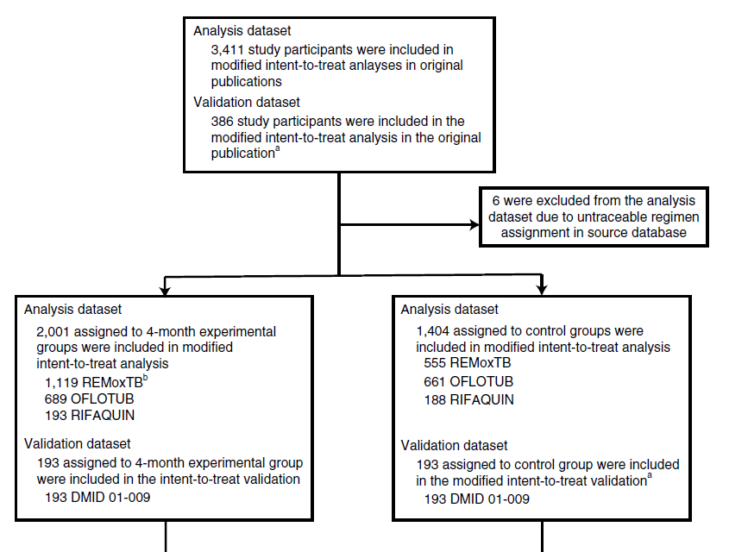

Slide 6
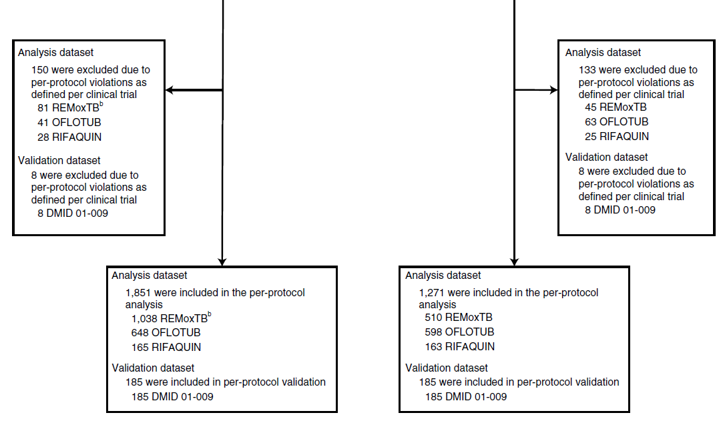

Slide 7
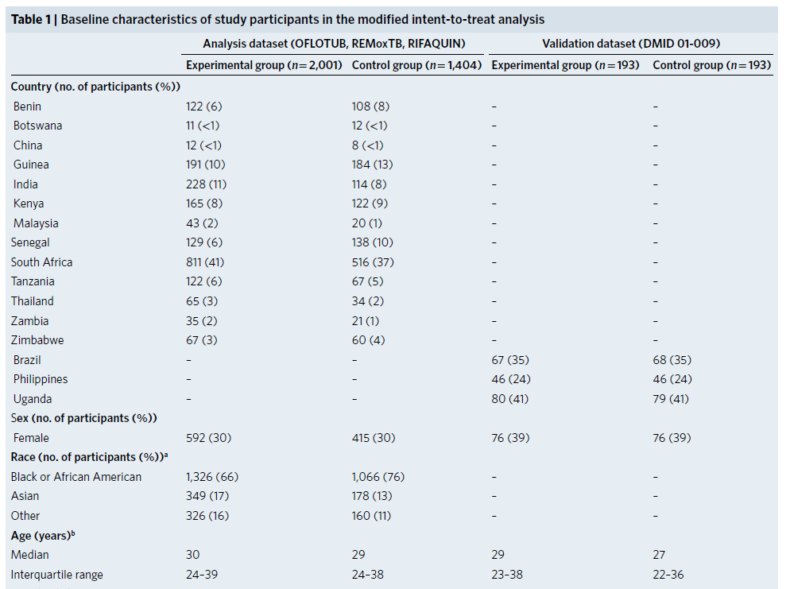

Slide 8
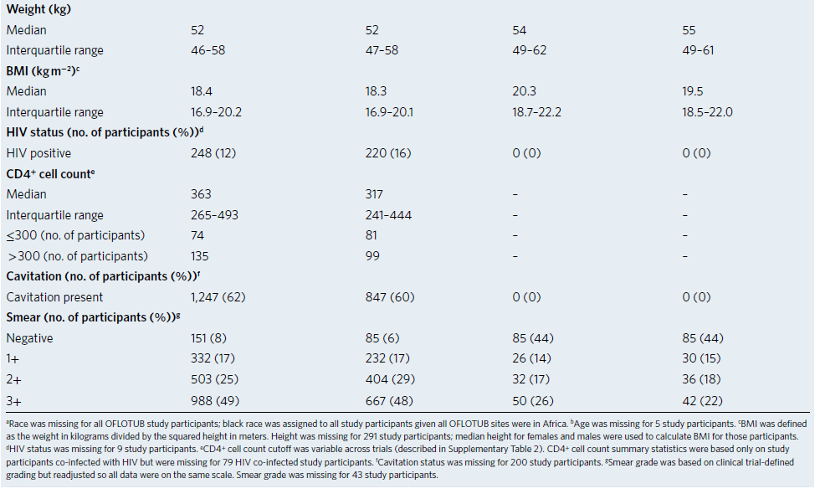

Slide 9
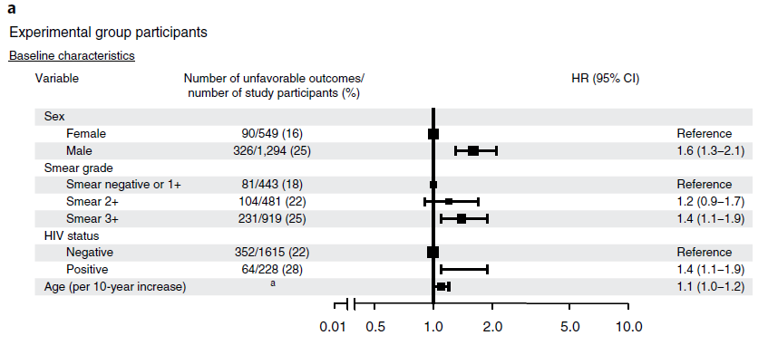
Experimental group
Notes:
남성
G3
HIV
Age

Slide 10
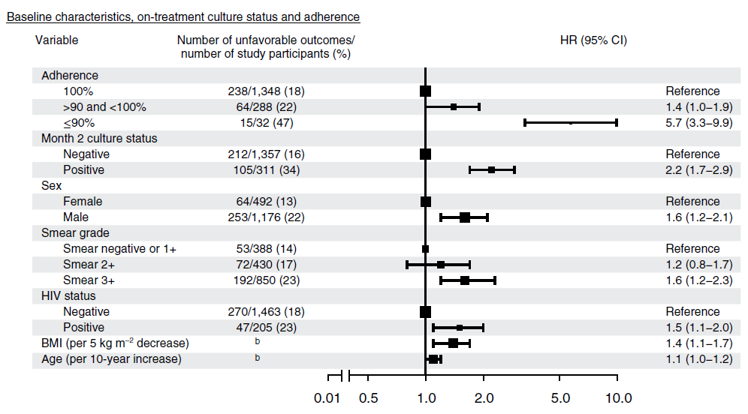
Experimental group
Notes:
Non adherence was the most significant on-treatment risk factor for unfavorable outcomes, with adjusted HR of 5.9, for participants who missed 10% or more
2.4 for who missed LESS than 10%
and
2.4 for participants who missed 10% of prescribed doses relative to participants who completed treatment without any missed doses.

Slide 11
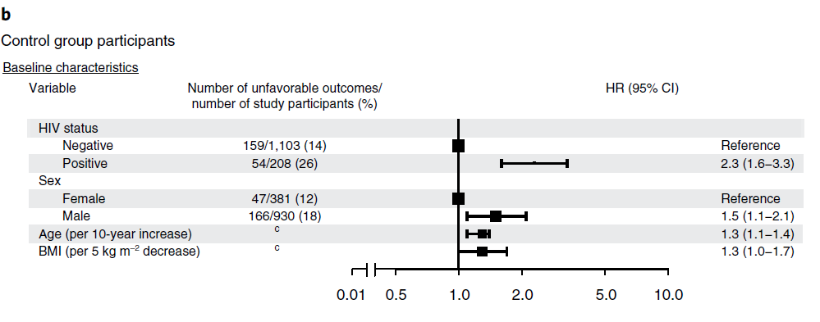
Control group

Slide 12
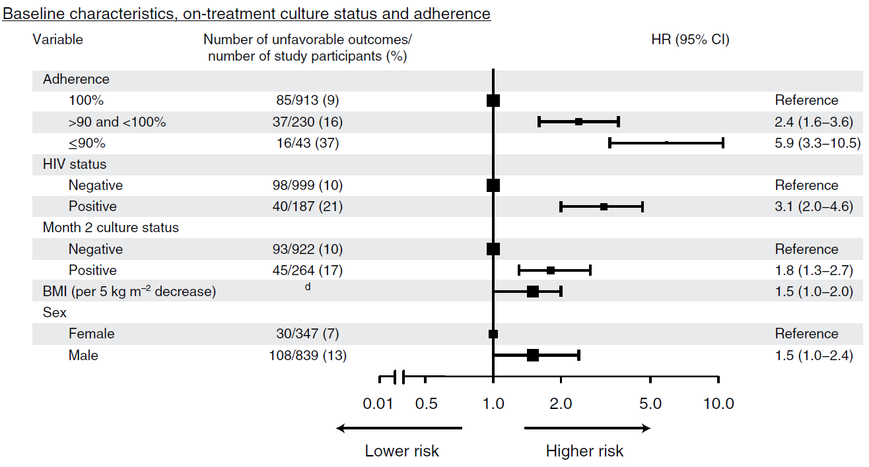
Control group

Slide 13
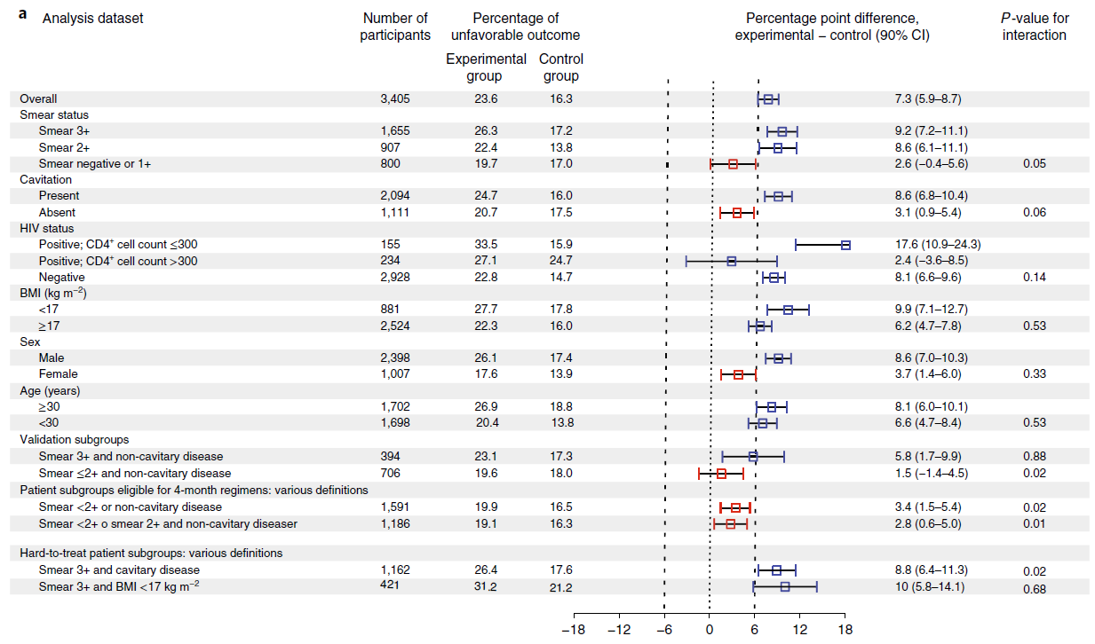
Notes:
보라색 : the percentage of unfavorable outcomes at 24 months for study participants with a baseline negative or 1+ grade smear was similar in experimental and control regimens, indicating non-inferiority (difference in study adjusted Kaplan-meier estimate of unfavorable outcomes, 2.6 ; 90% CI, -0.4 to 5.6 ; p=0.05 for interaction)
빨간 네모는 experimental subgroups이 control subgroup 에 비해 non-inferior 하다는 걸 의미하고, 파란네모는 non-inferiority를 의미하지 않음.
Study participants in the validation dataset were HIV-uninfected adults with non cavitary disease and month 2 culture-negative status

Slide 14
Discussion
Significant risk factors
  Smear G3, HIV seropositivity and adherence of <90%
Minimal disease
  <2+, or non-cavitary disease
  Lower baseline risk for unfavorable outcomes
  Four month regimens were non-inferior (effective)
Hard to treat
  High smears and cavitation
  > 6months to cure all (longer duration)
  Standard treatment

Slide 15
Discussion
This trial was stopped early due to higher rates of unfavorable outcomes in experimental 4-month regimen.
In clinical trials
One-size-fits-all experimental regimens
Inadequate to cure the hardest-to-treat tuberculosis
Treatment duration

Slide 16
Limitation
Data sharing principles, Data collection
Chest radiograph interpretation was not uniform.
Very few pharmacokinetic data were available.
Notes:
정보를 공유하는 건 결핵 치료하는 임상에서, 정보 수집은 trial에서 표준화되지 않았음.
Cavity의 크기나 개수를 분석하지 않음
약물 용량, 약에 어떻게 노출되었는지가 outcome과의 관계를 알 수 없음

Slide 17
Thank you for listening

