Slide 1
6th International Symposium on Autophagy
F2 Kim Song Yee

Slide 2
Autophagy in inflammation and immunity: Vojo Deretic, USA
Direct pathogen elimination assisted by SLRs
PRR regulation and effector function
Inflammasome regulation and autosecretion of alarmins
Cytosolic antigen processing for MHC-II presentation
Notes:
Sequestosome 1 like receptors SLR

Slide 3
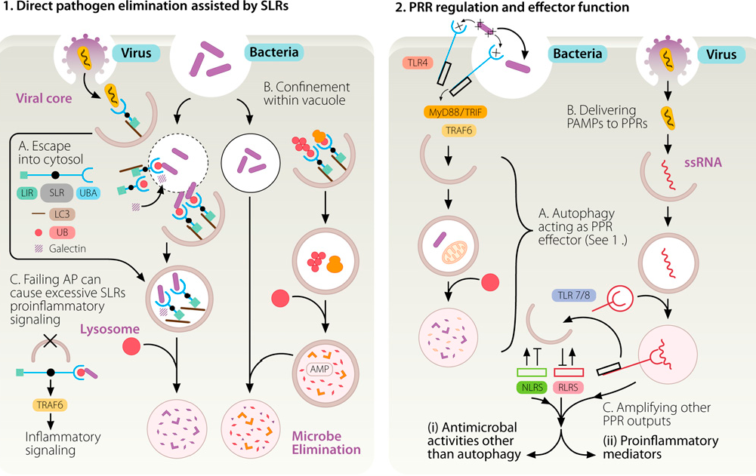
Notes:
LIR LC3 interacting region
PAMP pathogen associated molecular patternb

Slide 4
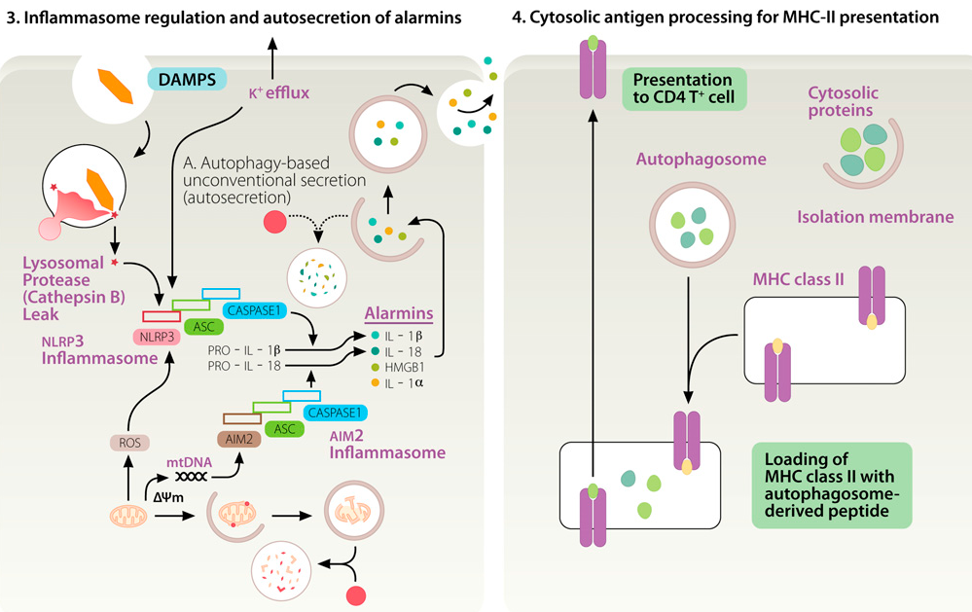

Slide 5
www.pnas.org/cgi/doi/10.1073/pnas.1210500109 ,2012
Autophagy protects against active tuberculosis by suppressing bacterial burden and inflammation
: Vojo Deretic, USA

Slide 6
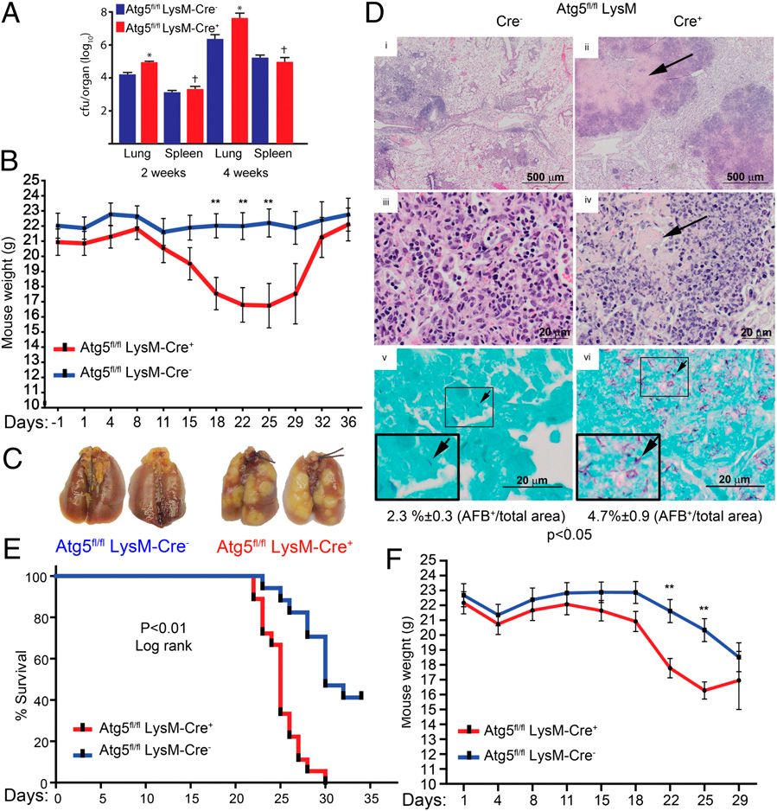
Notes:
Aerogenously TB infected mice

Slide 7
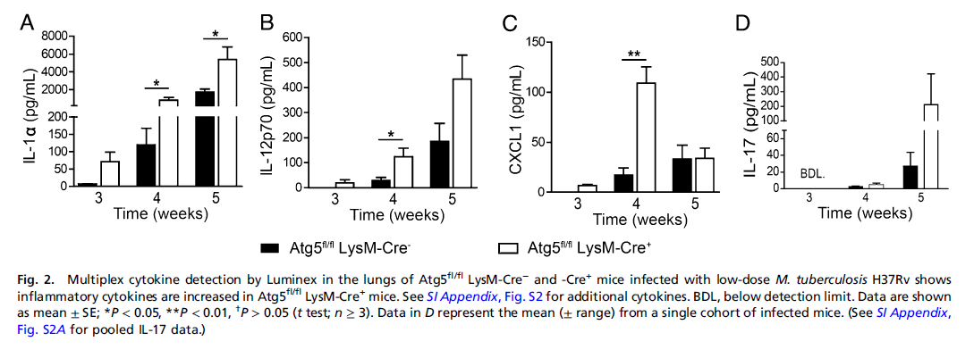

Slide 8
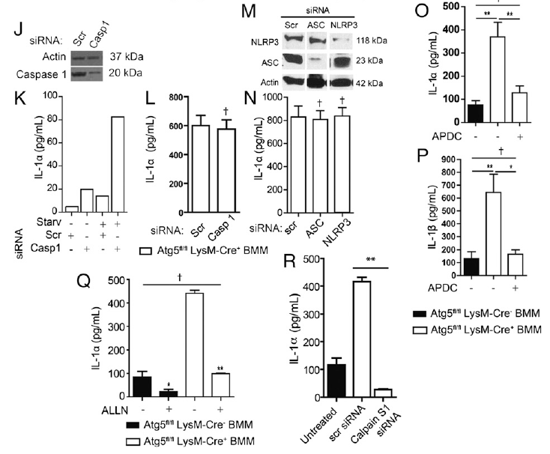
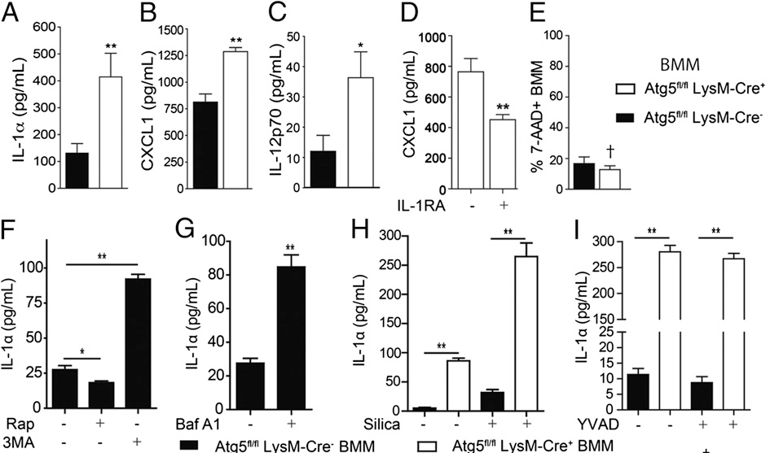
Notes:
inflammasome agonist silica (250 μg/mL)
caspase 1 inhibitor YVAD
ROS antagonist APDC

Slide 9
PLoS Pathog 6(12): e1001230. Doi:10.1371/journal.ppat.1001230
Mycobacterium tuberculosis Eis Regulates Autophagy, Inflammation, and Cell Death through Redox-dependent Signaling
: JU Jung, USA
Notes:
EIS enhanced intracellular survival

Slide 10
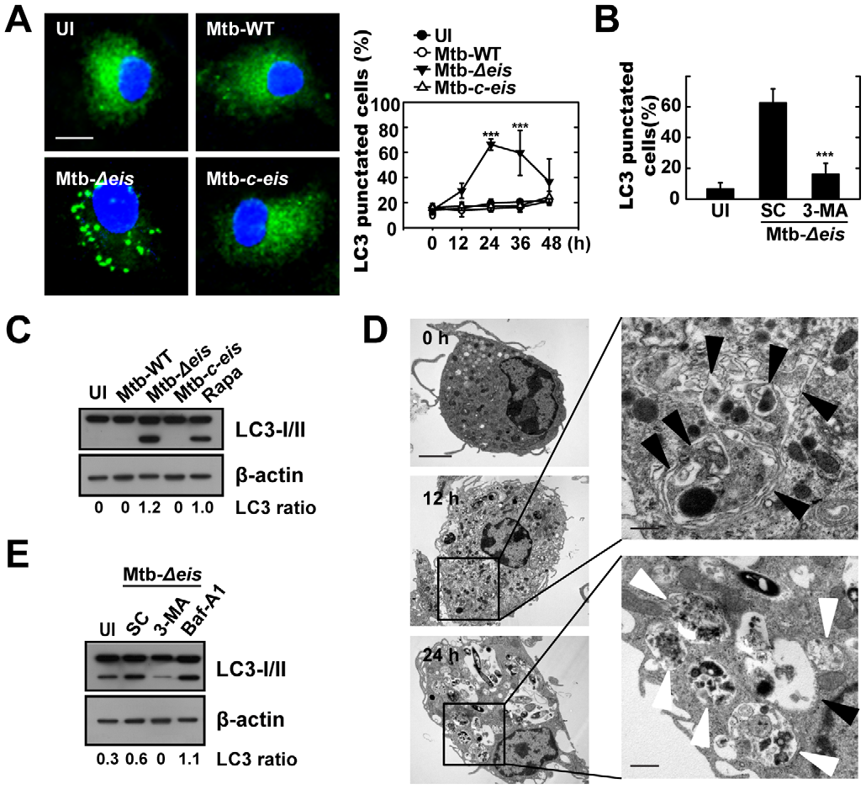
Notes:
Figure 1. Mtb Eis modulates autophagy in macrophages. (A) BMDMs were infected with Mtb-WT, Mtb-Deis, or Mtb-c-eis (MOI = 10) for 4 h (as
described in the Materials and Methods), and then incubated for 24 h (left) or the indicated periods of time (right). Cells were fixed, stained with DAPI
to visualize nuclei (blue), and immunolabeled with an anti-LC3 antibody. Primary antibody was detected using an Alexa Fluor 488-conjugated goat
anti-rabbit IgG (green). Left: representative immunofluorescence images of LC3 punctae; right: quantification of data (LC3-punctated cells were
counted manually). ***p,0.001, vs. Mtb-WT-infected condition. Scale bars, 5 mm. (B) BMDMs were infected with Mtb-Deis in the absence or presence
of 3-methyladenine (3-MA; 10 mM) and subjected to confocal analysis as described in Figure 1A. LC3-punctated cells were counted manually. Each
condition was assayed in triplicate, and at least 250 cells were counted in each well. ***p,0.001, vs. SC. (C) Immunoblot analyses performed using
Abs raised to LC3 or b-actin. Experimental conditions were identical to those outlined in panel A. Gel images representative of three experiments are
shown. (D) Electron micrographs of Mtb-Deis-infected BMDMs under low (left) and high (right) magnification show the accumulation of autophagic
vesicles (black arrow, initial autophagic vacuoles; white arrow, degradative autophagic vacuoles). Scale bars: 2 mm (left), 0.5 mm (right). (E)
Immunoblot analyses performed using Abs raised to LC3 or b-actin. BMDMs were infected with Mtb-Deis in the presence or absence of 3-MA (10 mM)
or bafilomycin A1 (Baf-A1; 100 nM). Gel images representative of three experiments are shown. The ratio of the intensities of the LC3-II/LC3-I and bactin
bands is indicated below each lane (C and E). UI, uninfected; SC, solvent control (0.1% distilled water (B), 0.1% DMSO (E)).
doi:10.1371/journal.ppat.1001230.g001

Slide 11
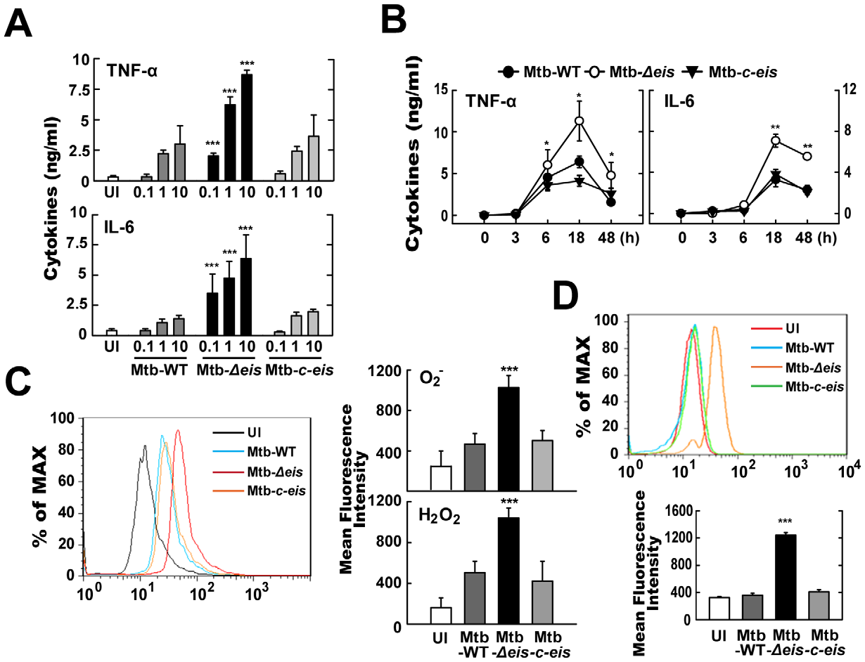
Notes:
Mtb-Deis infection increases production of proinflammatory cytokines and ROS by BMDMs. (A and B) BMDMs were infected
with Mtb-WT, Mtb-Deis or Mtb-c-eis at different MOIs (0.1, 1 and 10) for 18 h (A) or for the indicated periods of time (B; MOI = 10). Supernatants were
assessed by ELISA for levels of TNF-a and IL-6. Data (A and B) are presented as the mean6SD of five experiments. (C and D) BMDMs were stimulated
with Mtb-WT, Mtb-Deis, or Mtb-c-eis for 30 min. Cells were then incubated with 10 mM DHE or 5 mM DCFH-DA for 15 min, washed thoroughly, and
immediately analyzed for superoxide or H2O2 production by flow cytometry (C, Left). Cells were labeled with MitoSOX for 30 min and analyzed for
mitochondrial ROS levels by flow cytometry (D, top). Quantitative analysis of ROS generation (C, right; D, bottom). *p,0.05, **p,0.01, ***p,0.001, vs.
Mtb-WT-infected condition. UI, uninfected.
doi:10.1371/journal.ppat.1001230.g002

Slide 12
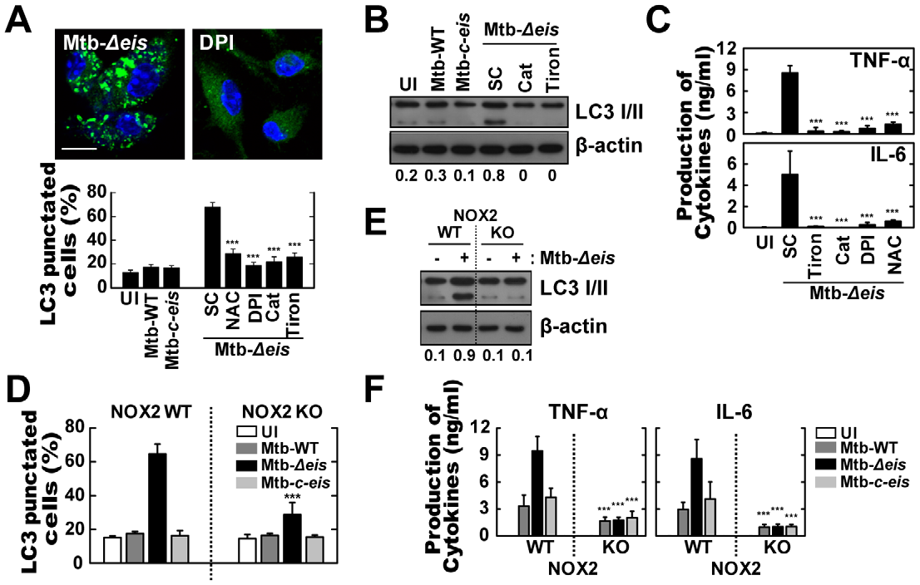
Notes:
Figure 3. Increased ROS generation plays a critical role in autophagy and proinflammatory cytokine production in Mtb-Deisinfected
macrophages. (A–C) BMDMs were infected with Mtb-Deis (MOI = 10) for 18 h in the presence or absence of DPI (10 mM), NAC (20 mM),
catalase (Cat, 1 mU/mL), or tiron (5 mM). (A) Representative immunofluorescence images (top); percentage of endogenous LC3-punctated cells
(bottom). (B) Immunoblot analyses of BMDMs with antibodies raised to LC3 or b-actin. Gel images are representative of three experiments. The ratio
of the intensities of the LC3-II/LC3-I and b-actin bands is indicated below each lane. (C) Experimental conditions were identical to those outlined in
Figure 3A. Supernatants collected 18 h after infection were assessed for cytokine levels by ELISA. Data represent the mean6SD of five experiments.
(D–F) BMDMs from WT and NOX2 KO mice were infected with Mtb-WT, Mtb-Deis, or Mtb-c-eis for 18 h. (D) Numbers of LC3-punctated cells (counted
manually) are shown (at least 250 cells were counted in each well). (E) Immunoblot analyses performed using Abs raised to LC3 or b-actin. BMDMs
from WT and NOX2 KO mice were infected with Mtb-Deis for 18 h. Gel images representative of three experiments are shown. (F) Supernatants
collected 18 h after infection were assessed for cytokine levels by ELISA. Data are presented as the mean6SD of at least three separate experiments,
each performed in triplicate. ***p,0.001, vs. SC (A and C); WT mice (D and F). UI, uninfected; SC, solvent control (0.1% DMSO).
doi:10.1371/journal.ppat.1001230.g003

Slide 13
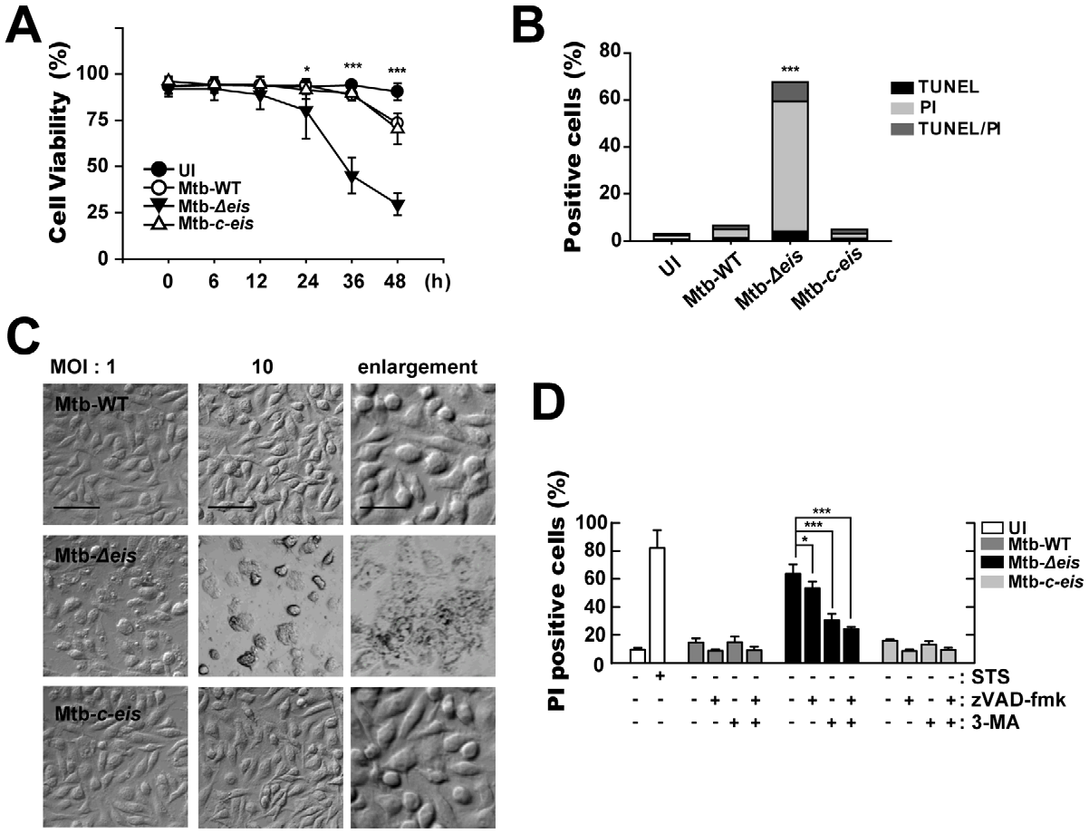
Notes:
Macrophages infected with Mtb-Deis show reduced cell viability and increased caspase-independent cell death. (A) BMDMs
were infected with Mtb-WT, Mtb-Deis, or Mtb-c-eis (MOI = 10) for the indicated periods of time, washed to remove unbound mycobacteria, and then
incubated in complete DMEM at 37uC in 5%CO2. Cell viability was assessed by PI staining and then examined by fluorescence microscopy. (B and C)
Experimental conditions were identical to those outlined in panel A. BMDMs were infected with the three strains of mycobacteria for 36 h. (B)
Apoptosis was assessed using a TUNEL/apoptosis detection kit, according to the manufacturer’s protocol. Cells were then examined under a laserscanning
confocal microscope (LSM 510; Zeiss). Percentages of TUNEL-positive, PI-positive, and TUNEL-/PI-double-positive cells were calculated. Data
are representative of three separate experiments. (C) Morphological changes in BMDMs infected with Mtb-WT, Mtb-Deis, or Mtb-c-eis at MOIs of 1 and
10. Representative images are shown. Scale bars: 50 mm (low magnification), 20 mm (high magnification). (D) Macrophages were infected with Mtb-
WT, Mtb-Deis, or Mtb-c-eis in the presence or absence of zVAD-fmk (20 mM) or 3-MA (10 mM). Staurosporine (STS; 500 nM) was used as a positive
control. After 36 h, cells were stained with PI and then examined by fluorescence microscopy. Data are presented as the mean6SD of at least three
separate experiments, each performed in duplicate. *p,0.05, ***p,0.001, vs. Mtb-WT-infected condition (A and B); Mtb-Deis–infected condition
without inhibitors (D). UI, uninfected.
doi:10.1371/journal.ppat.1001230.g004

Slide 14
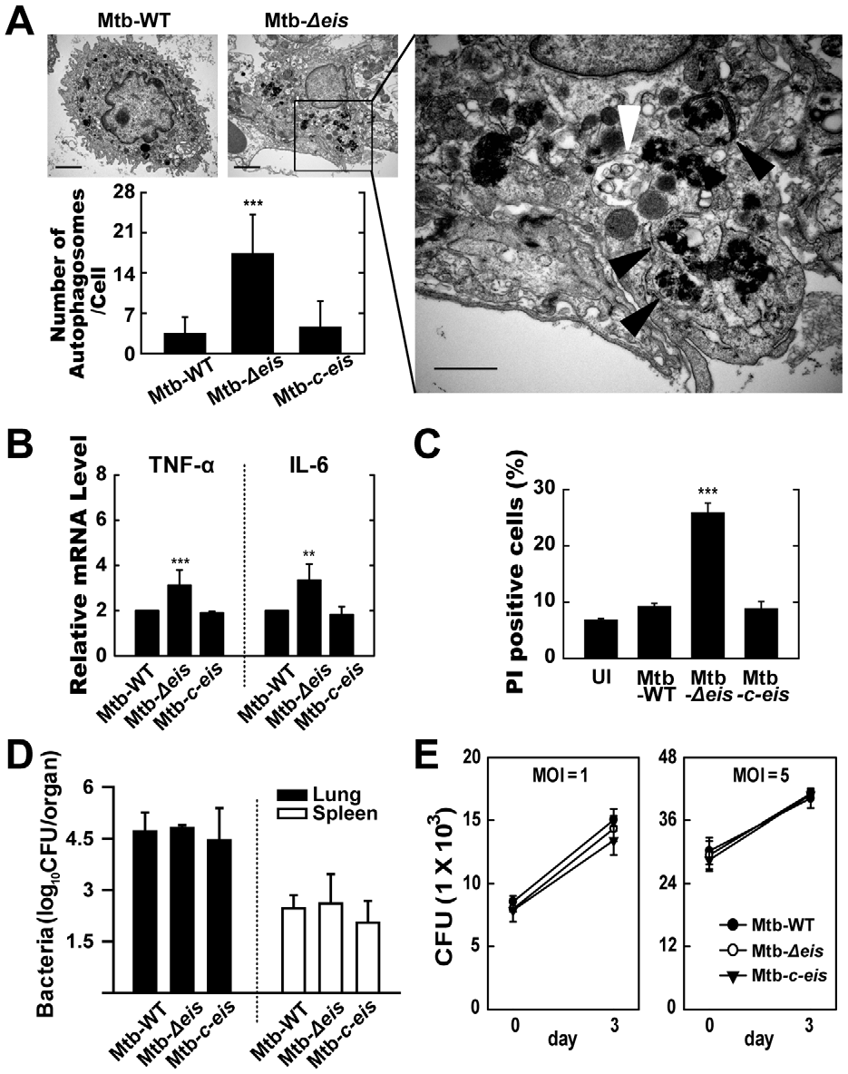
Notes:
In vivo analysis of autophagic vesicles, inflammation, and cell death in infected mice with Mtb-Deis. C57BL/6 mice were
challenged, by aerosol, with 10–30 CFU Mtb-WT, Mtb-Deis, or Mtb-c-eis and sacrificed 4 weeks post-infection. (A) High- and low-magnification
electron micrographs of lung tissue sections from mice infected with Mtb-Deis show accumulation of autophagic vesicles (black arrow, bacteria in
autophagic vacuoles; white arrow, degradative autophagic vacuoles). Scale bars: 2 mm (left upper), 0.5 mm (right). Numbers of autophagic vacuoles
per cell in each TEM section (left lower) (mean6SD; n = 50). (B) Quantitative RT-PCR analysis of lung tissue from Mtb-WT-, Mtb-Deis-, and Mtb-c-eisinfected
mice. Total RNA was extracted from paraffin-embedded lung tissue sections, as described in the Materials and Methods. (C) To assess in vivo
cell death, bronchoalveolar lavage fluid cells from Mtb-WT-, Mtb-Deis-, and Mtb-c-eis-infected mice were subjected to PI staining, and analyzed by
flow cytometry. Data are presented as the mean6SEM (n = 4). (D) Numbers of CFUs in lung and spleen 4 weeks after infection with Mtb-WT, Mtb-Deis,
or Mtb-c-eis. Data are presented as log10 CFU6SEM (n = 4). (E) BMDMs were infected with Mtb-WT, Mtb-Deis, or Mtb-c-eis and then analyzed by CFU
assay. CFU data represent the mean6SD of four individual experiments. **p,0.01, ***p,0.001, vs. Mtb-WT-infected condition. UI, uninfected.
doi:10.1371/journal.ppat.1001230.g006

Slide 15
Suggested study
Human sample (PBMC)
Active TB, Latent TB, Healthy control
Role of MTB EIS in human
Regulation of host immune response by MTB EIS in human

Slide 16
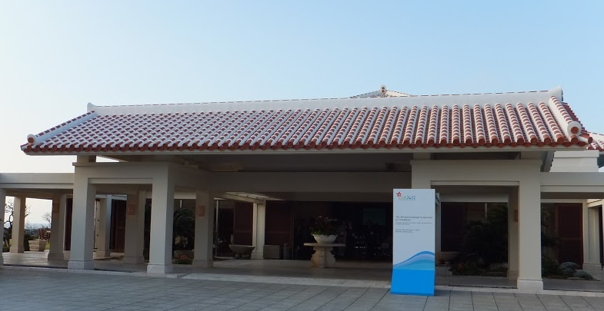


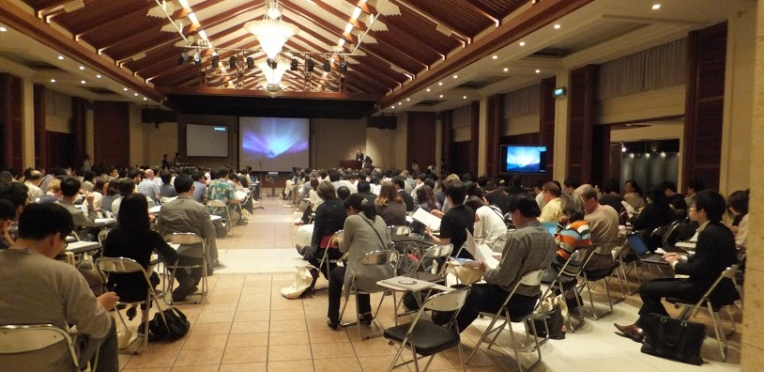
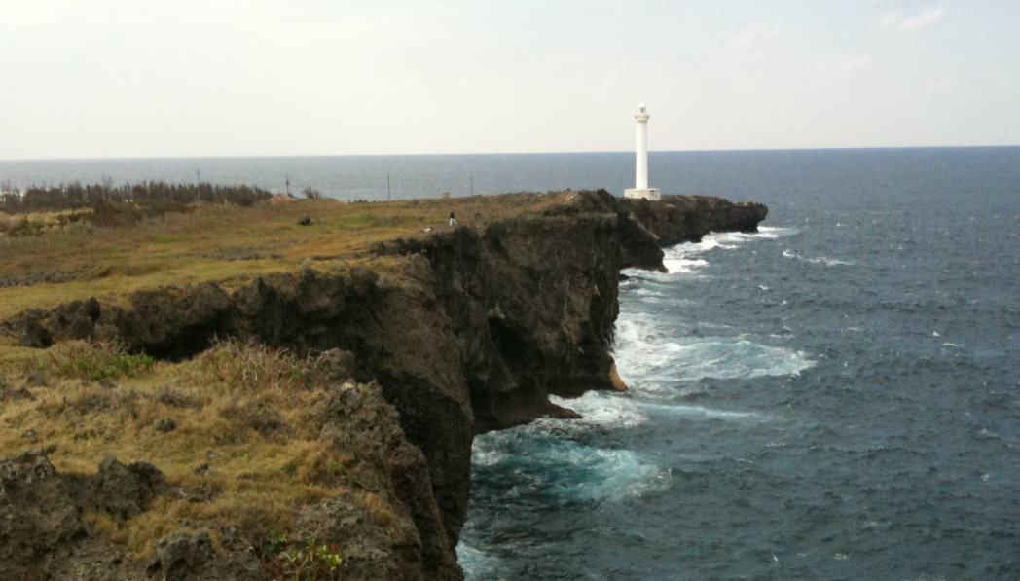


Slide 17
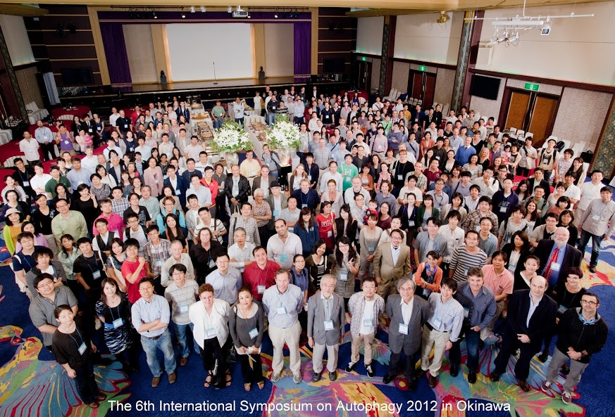
Thank you for your attention!

