Slide 1


Immune checkpoint inhibitor related pneumonitis
Hye Ran Gwon
Notes:
저는 오늘 immune checkpoint inhibitor related pneumonitis 에 대하여 준비하였습니다.

Slide 2
Drug induced ILD (DIILD)
Category | Drug | Incidence
Cytotoxic agent | Bleomycin, Taxene | 7%-21%
mTOR inhibitors | Everolimus | 11%
Multiple target Tx | EGFR inhibitors HER2 inhibitors ALK inhibitors BRAF inhibitors PI3K inhibitors FLT3 inhibitors VEGFR inhibitors CDK4/6 inhibitors | 0.3-0.6% 2.4% 2.5% (95% CI: 1.7%-3.6%) 2.4% (trametinib) 3%-25% 7%-8.5% 0.37% (bevacizumab in combination with FOLFOX and FOLFIRI) 0.3%-2.1
Immune checkpoint inhibitors |  | 1.1%-3.6%
Novel drug | HER2-targeting ADC (trastuzumab-deruxtecan) | 10-15.8% (0-2.4% mortality)
Ther Adv Med Oncol, 2015;7 (2) 122-136, Breast Cancer Res Treat 2021;186 (1) 219-227, Lancet Oncol, 2021; 22 (5) 620-631,
N Engl J Med, 2020;382 (7) 610-621, Lancet Oncol, 2021;22 (6) 779-789, Cancer Res. 2021;81(suppl 13):Abstract nr CT167.
Ann Oncol 2021; 32 (suppl 5) S1283-S1346, J Clin Med, 7 (10) (2018), p. 356
Notes:
약물유발 사이질폐질환(drug-induced interstitial lung diseases, DILD)은 평균적으로 전체 ILD 의 약 3-5%를 차지하고 다음과 같이 다양한 질환에 대한 약물들에 의해 발생할 수 있습니다.
폐실질의 염증이 해소되지 않고 비가역적인 섬유화로 진행되며 심각한 후유증이 발생할 수 있어 주의가 필요합니다.
오늘 리뷰는 immune checkpoint inhibitor related pneumonitis 위주로 준비하였습니다.
programmed cell death-1 (PD-1)에 대한 단일클론항체인 nivolumab, pembrolizumab 등과 programmed cell death-ligand 1 (PD-L1)에 대한 단일클론항체인 atezolizumab, avelumab, durvalumab

Slide 3
Immune checkpoint inhibitor related pneumonitis
Immune-checkpoint inhibitors (ICIs) have emerged as a core pillar of cancer therapy
Many FDA approved agents available for 17 different malignancies as of 2021.12
increasing use in several (neo) adjuvant and maintenance settings
Incidence of checkpoint inhibitor pneumonitis (CIP)
2.7% for all grades and 0.8% for grade 3 or above
0.2% died from pneumonitis
Occurrence of irAEs was related to a better efficacy/survival in patients treated with ICIs
whether CIP can also be taken for an excellent prognostic indicator remains a question
Notes:
(immune checkpoint inhibitor)는 암세포와 T세포의 결합 부위에 결합, 암세포가 T세포의 면역 공격을 회피하지 못하도록 함으로써 항암효과를 나타내는 약제로
전이된 흑색종, 비소세포폐암, 호지킨림프종 등 17 종류의 서로 다른 암종에서 FDA 승인된 다양한 약제들이 있고
최근에는 neoadjuvant, adjuvant 그리고 maintenance setting 등 그 사용 범위도 점차 넓어지고 있습니다.
Incidence 는 평균 2.7% 정도로 알려져 있고, grade 3 이상의 심각한 정도의 pneumonitis 는 0.8% 정도로 알려져 있습니다.
이 중 0.2% 정도는 pneumonitis 로 인해 사망할 정도로 심각하게 나타나는 것으로 알려져 있습니다.
이러한 수치는 모두 통제된 population 을 대상으로 한 대규모 임상 연구를 기반으로 한 수치이고,
최근 real world data 를 기반으로한 meta analaysis 를 보면, all-grade incidence 는 19%, grade 3 이상의 high-grade incidence 는 11% 로 훨씬 더 흔한 것으로 확인되고 있습니다.
일반적으로 immune checkpoint inhibitor 관련 adverse effects 는 전신에서 나타날 수 있으며 다른 장기에서 나타날 경우 efficacy 와 survival 측면에서 benefit 이 있는 것으로 알려져 있으나,
Pneumonitis 같은 경우에는 그 자체가 치명적일 수 있기 때문에, 실제로 checkpoint inhibitor pneumonitis 자체와 암 치료 성적에서의 benefit을 직접적으로 확인한 연구는 없는 상황입니다.

Slide 4
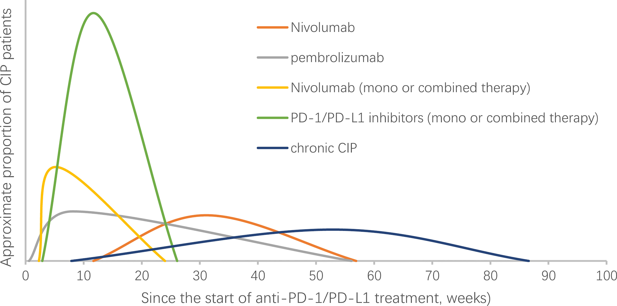
Immune checkpoint inhibitor related pneumonitis
Onset: mean 2.8 mo (9 d to 24 mo)
The onset time may be affected by the ICI agent
combination therapy seemed to have an earlier onset of CIP (median, 2.7 vs. 4.6 months).
NSCLC developed pneumonitis earlier than malignant melanoma (median, 2.1 vs. 5.2 months)
Front. Immunol. (2022) 13:830631.
Notes:
약제 마다 onset 및 duration 에 차이는 있겠으나 median onset time 은 약제 시작후 약 3개월 정도 이고, 빠르면 9일, 늦게는 2년 이상 지난 후에도 나타나기도 합니다.
일반적으로 monotherapy 보다는 combination therapy 를 했을 때 pneumonitis 가 더 일찍 나타나며,
암종에 따라 비소세포폐암 환자에서 악성 흑색종 환자보다 median onset time 이 더 짧았습니다.
Chronic CIP: developed chronic ICI pneumonitis that warrants ≥12 weeks of immunosuppression.; Most cases of ICI pneumonitis improve or resolve with 4–6 weeks of corticosteroid therapy.

Slide 5
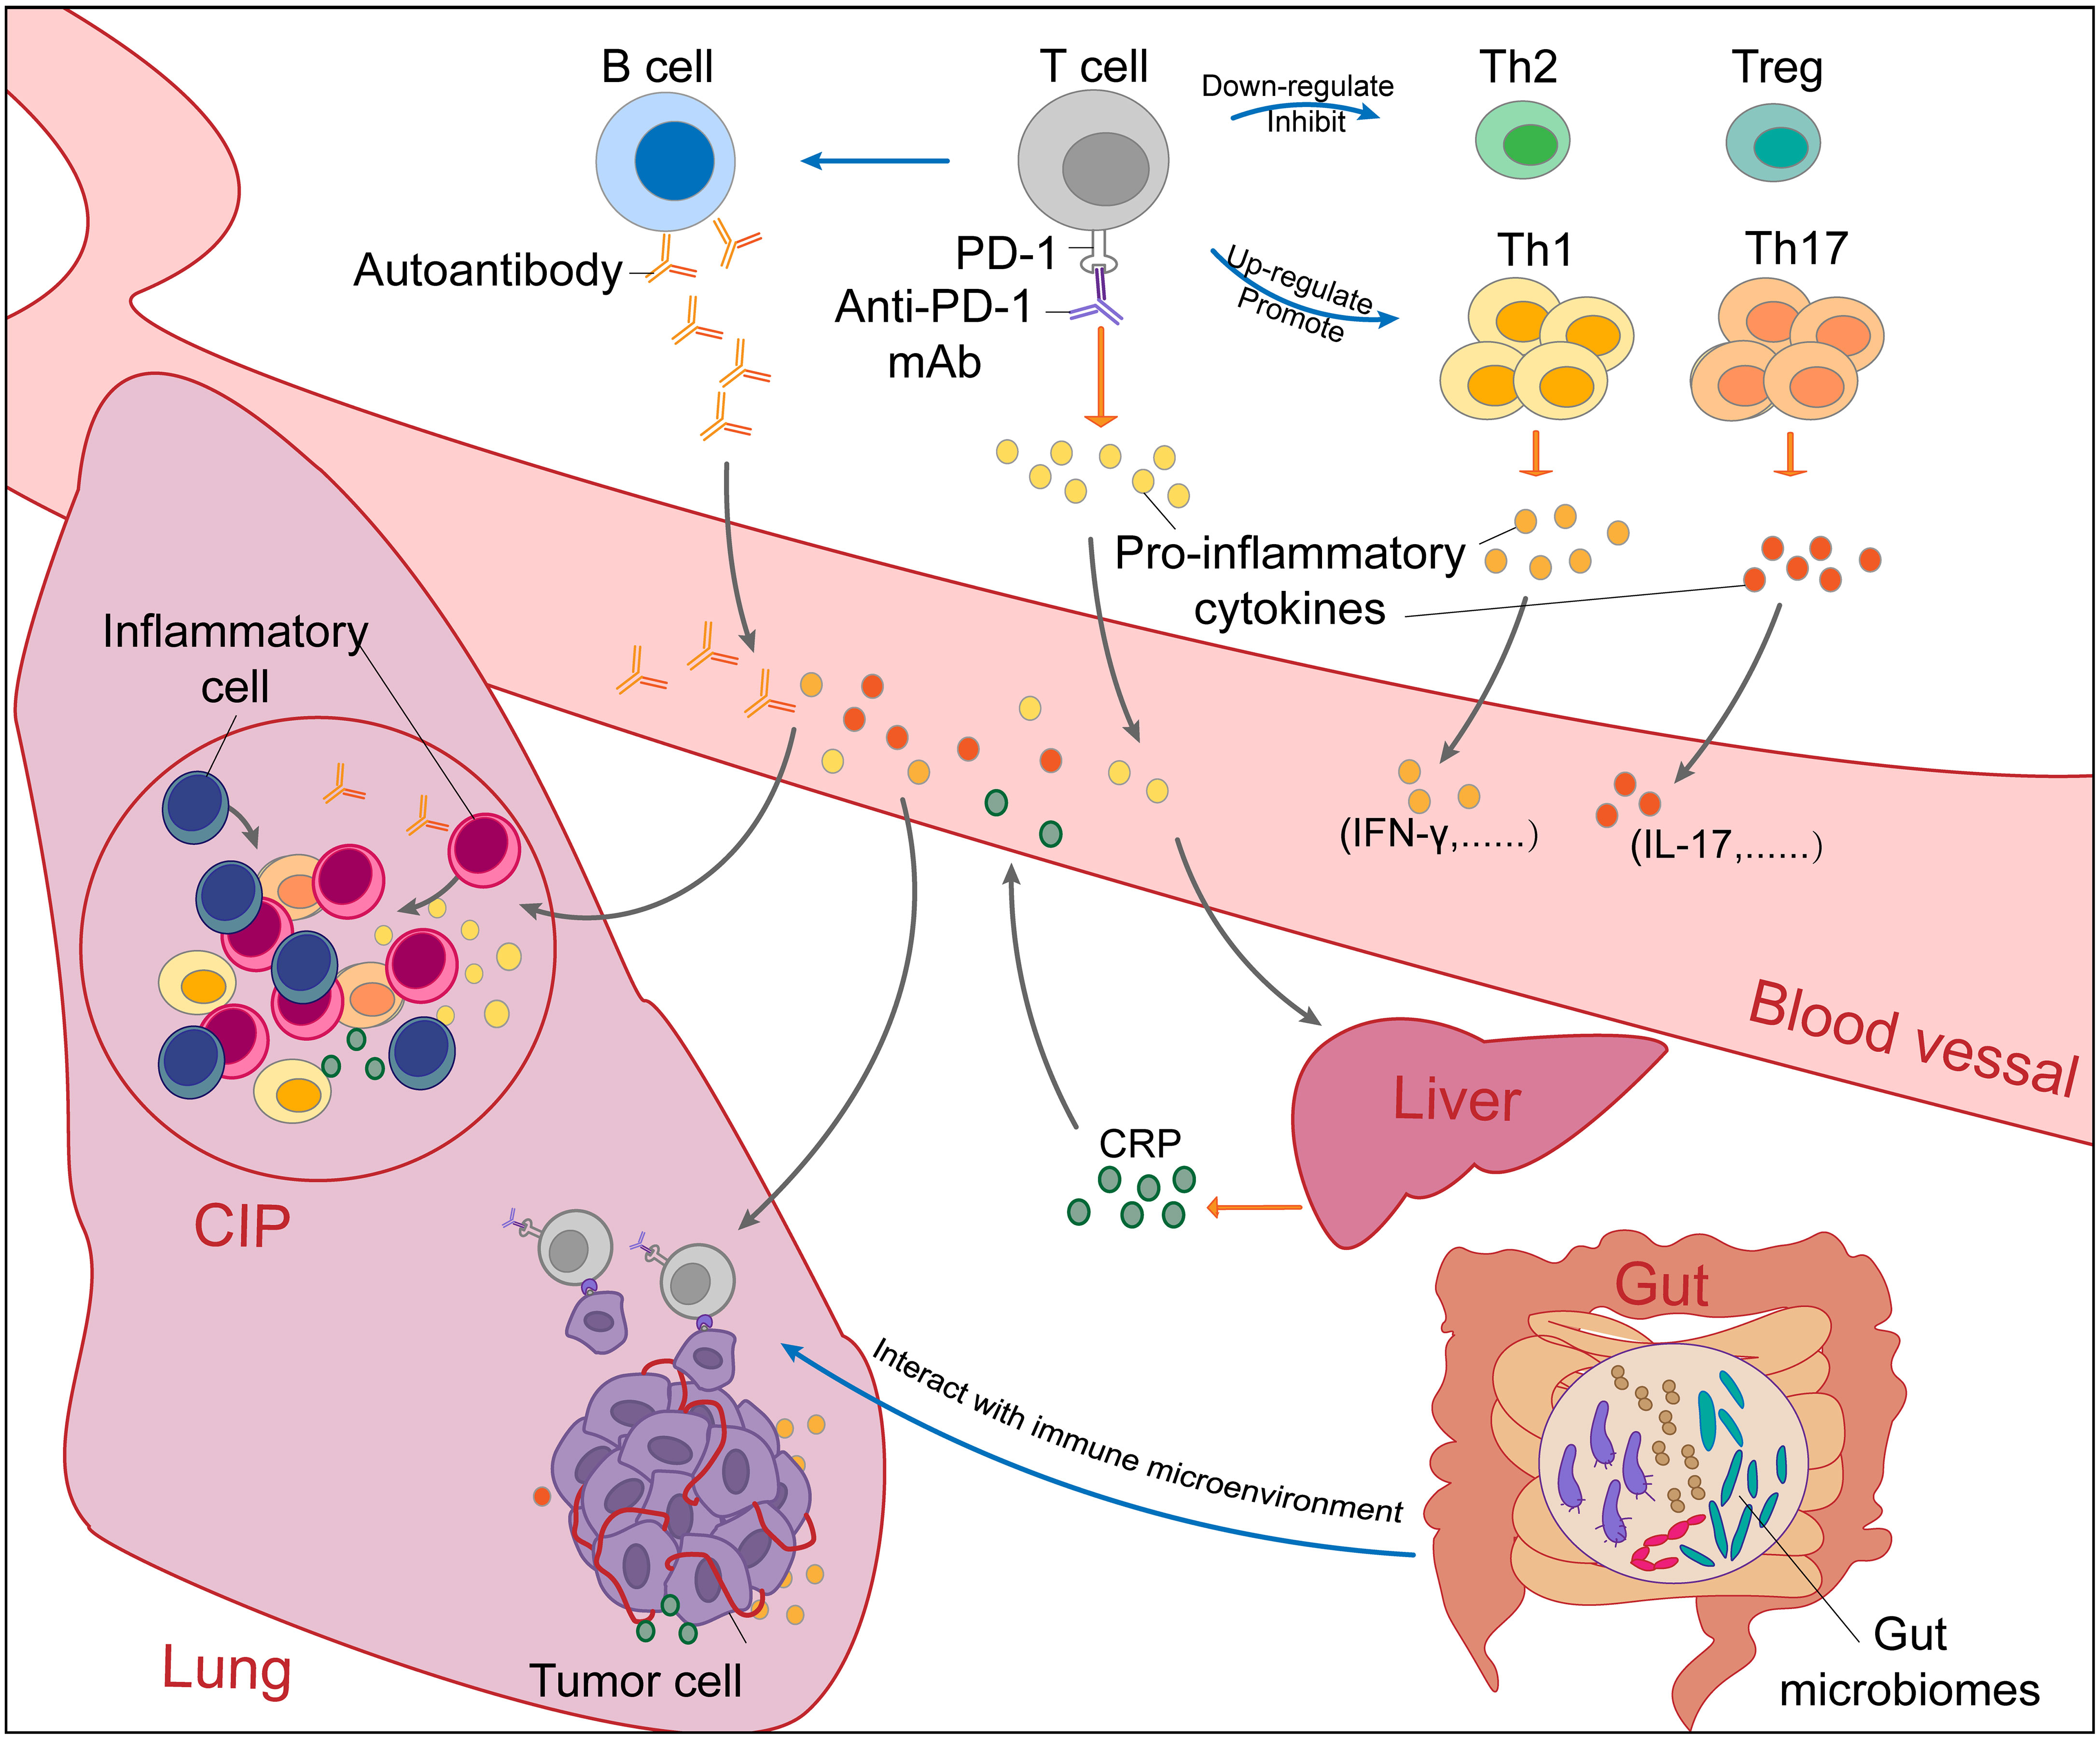
Pathophysiology
the result of a combination of many factors related to immune dysregulation
1. Disordered T Cell Subsets
↑ Th1 and Th17 cells and ↓Th2 cells and Treg
↑ Pro-inflammatory cytokines
2. ↑ preexisting and emerging Auto-Abs
3. Unbalanced Inflammatory Cytokines
↑ Pro-inflammatory cytokines by activated T cells
↑ IL-6, CRP → inflammation and autoimmunity
4. Gut-lung axis
Gut microbiome ↔ lung immune microenvironment
Notes:
암세포의 표면에 있는 면역관문 분자들을 억제함으로써 암세포에 대한 면역반응 및 암세포의 사멸을 유도하는 약물의 항암기전을 고려했을 때,
면역관문억제제에 의한 DILD의 기전은 아래와 같이 면역세포의 활성화에 따른 면역계 부작용으로 추정하고 있습니다.
Disordered T Cell Subsets
↑ Th1 and Th17 cells and ↓Th2 cells and Tregs.
Proinflammatory cytokines → infiltration of inflammatory cells.
Increased Preexisting and Emerging Autoantibodies
Without immunosuppression of Th2 cells and Tregs, excessive immune responses and cytokine secretion of Th1 and Th17 cells will cause autoimmune damage in normal tissues such as the lung.
In addition, autoantibodies increased after PD-1/PD-L1 blockade can also cause normal tissue lesions.
Unbalanced Inflammatory Cytokines
Proinflammatory cytokines secreted by activated T cells promote the infiltration of inflammatory cells
Under the stimulation of IL-6, CRP produced by the liver will promote inflammation and strengthen autoimmunity.
“gut-lung axis”, gut microbiomes can regulate the immune microenvironment in the lung.

Slide 6
Risk factors
Patient factor
  Male gender, smoking history, and early multiline treatment
  Hx of asthma/COPD (5.4% vs. 3.1%) or radiotherapy (6.0% vs. 2.6%)
  Preexisting ILD (31% vs. 12%)
  a high baseline absolute eosinophil count (≥0.125 ×109 cells/L)
Tumor factor
  NSCLC >RCC> melanoma etc.
  all-grade incidence rate of 19%, a high-grade (grade 3 or 4) incidence rate of 11%
  Adenocarcinoma < non-adenocarcinoma (OR 0.38, 95% CI 0.17 – 0.82)
  NSCLC treated with EGFR–TKI + ICIs, an active lung infection
  Extrathoracic metastasis → lower incidence of CIP
Lung Cancer. (2017) 104:111–8.
Oncologist. (2016) 21:643–50.
Thorac Cancer 2018;9:847–855.
Lung Cancer (2020) 150:76–82.
JAMA Oncol. 2016;2(12):1607-1616
Thorac Oncol. (2018) 13:1930–9.
Jama Oncol. (2018) 4:1112–5
J Clin Oncol. (2017) 35:709–17

Slide 7
Risk factors
Type of immune checkpoint inhibitors (ICI)
PD-1 inhibitors > CTLA-4 inhibitors (OR 6.4, 95% CI 3.2 - 12.7)
PD-1 inhibitors > PD-L1 inhibitors (all grade 3.6% vs. 1.3%, grade 3&4 1.1% vs. 0.4%)
Pembrolizumab > nivolumab (OR 2.08, 95% CI 1.52 – 2.85)
Combination (ipilimumab + nivolumab) therapy > monotherapy (nivolumab or ipilimumab alone)
all grade (3.8% vs. 2.3%) and grade 3-4 (2.3% vs. 1.5%)
all-grade CIP (3.47 times) and severe CIP (3.48 times)
there are no data on the incidence of CIP in ICIs plus chemotherapy vs. ICI monotherapy.
No significant relationship with the dose of ICIs and the age of the patients
J Thorac Oncol.(2019) 14:494–502
Ann Oncol.(2017) 28:2377–85
Chest. (2017) 152:271–81
N Engl J Med. (2018) 378:2093–104.
Front Immunol. (2019) 10:108.
Immunotherapy. (2016) 8:1383–91.
Notes:
Incidence of All-Grade Pneumonitis During Monotherapy for NSCLC, Melanoma, and RCC

Slide 8
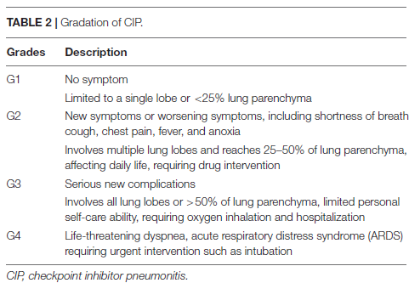
Clinical presentation
Presenting symptoms of ICI therapy–related pneumonitis are variable and nonspecific
necessitating a high index of suspicion and awareness with MDT.
Notes:
약물에 의한 폐손상은 담당 의사의 주의 깊은 관찰과 의심에서 출발한다.
원인으로 추정되는 약물에의 노출 과거력이 중요하며, 필요시 시행된 조직병리진단을 확인하고 다른 원인으로 인한 폐손상 가능성을 배제해야 한다.
특히 항암화학요법 약물에 의한 DILD는 단일의 질병 특유의 진단검사나 조직병리진단은 없는 것이 현실이다.

Slide 9
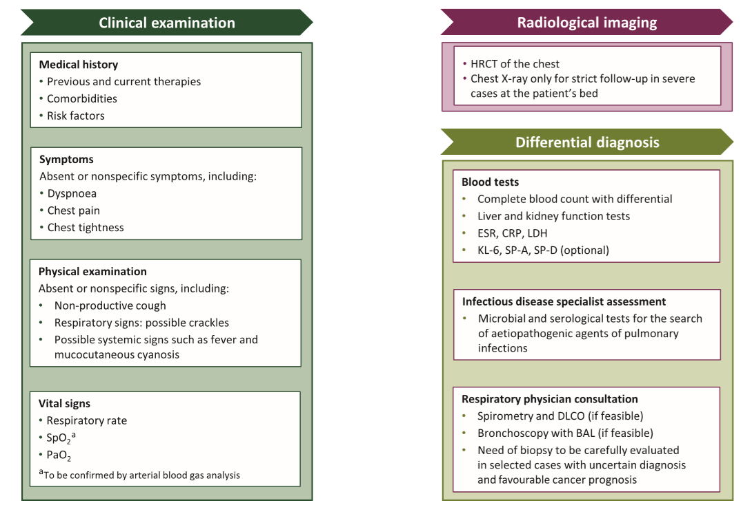

Differential diagnosis
Infectious pneumonia
Radiation pneumonitis
Diffuse alveolar hemorrhage
Pulmonary edema
Lymphangitic carcinomatosis
ESMO open 2022;7 (2) 1-15
Notes:
발생기전과 임상양상이 일정치 않고 진단과 치료에 있어 어려움이 있다.
Lung biopsy
Generally not required for patient management, unless there is doubt as to the aetiology of pulmonary infiltrates, when a VATS biopsy is the method of choice
TBLB : cellular interstitial pneumonitis, organizing pneumonia, diffuse alveolar damage and no abnormalities identified : 다양하게 나타난다
Bronchoscopy with BAL
Supports the identification of infections and is recommended in any symptomatic pneumonia

Slide 10
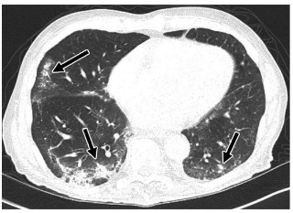
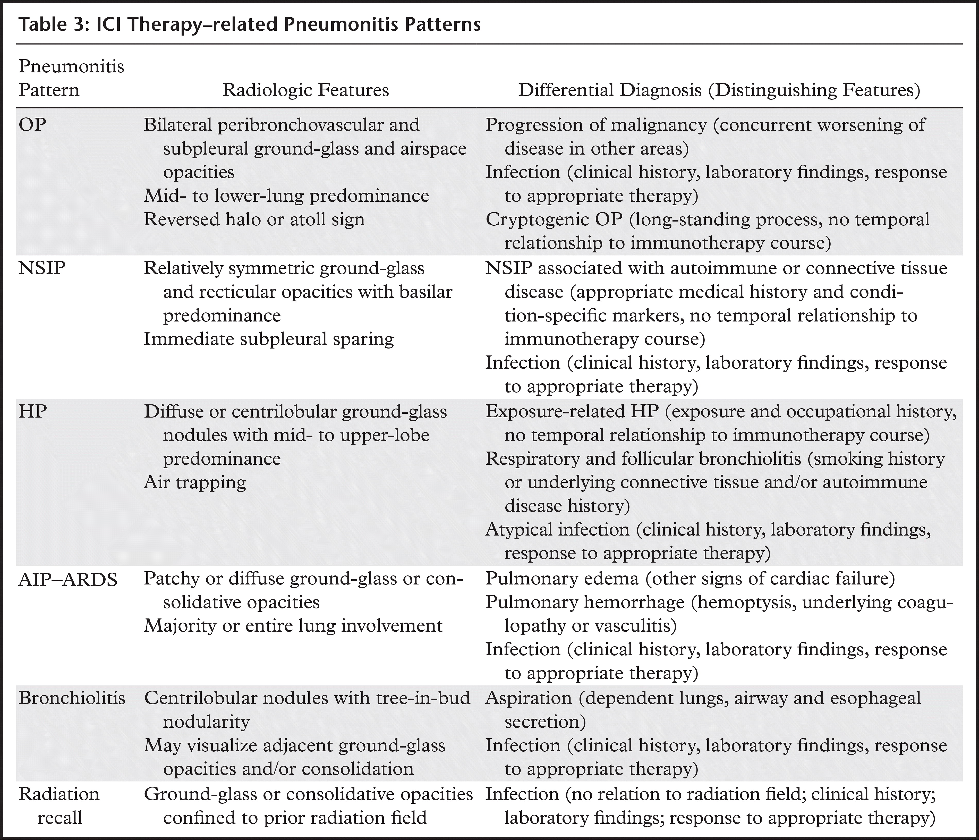
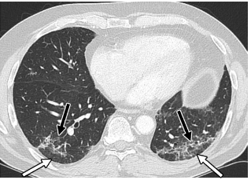
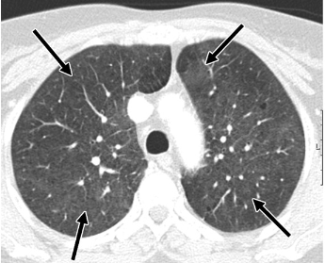
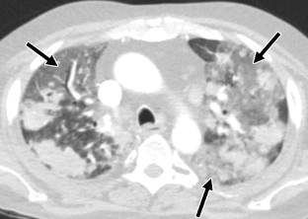
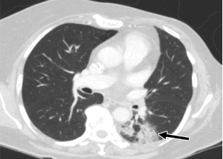
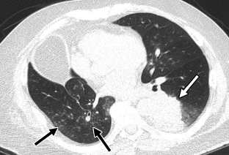
RadioGraphics 2019; 39:1923–1937
Notes:
OP : multifocal peripheral and subpleural mid- and lower-lung airspace consolida-tions (arrows),
NSIP : bilateral lower lobe ground-glass and reticular opacities (black arrows), with regions of immediate subpleural sparing (white arrows)
HP: diffuse centrilobular ground-glass nodules (arrows).
AIP-ARDS: multifocal ground-glass opacities (black arrows), with interval enlargement of several pulmonary masses (white arrows).
Bronchiolitis : centrilobular solid and ground-glass nodularity (black arrows)
Radiation recall : a focal region of ground-glass opacities within the posterior and medial left lower lobe (arrow), with a well-defined linear demarcation from the adjacent normal lung.

Slide 11
BAL and TBLB in Differential diagnosis
No clinical improvement despite ICI withdrawal & steroid therapy or inconclusive differential diagnosis
exclusion of other diseases, such as infection, alveolar hemorrhage and tumor progression
BAL
Lymphocytosis (>30%)
↑ IL-17A (Th1, Th17, Th17/Treg) and IL-35 (Th1, Th17, Th1/Th2) in serum and BALF
TBLB
interstitial pneumonitis, organizing pneumonia, diffuse alveolar damage and no abnormalities identified
BAL and pathological results consistent with CT scan findings (i.g. OP and NSIP) → good response to corticosteroid therapy after discontinuing ICI
ONCOLOGY LETTERS (2020) 20: 611-622
Front. Immunol (2022). 13:830631.
International Immunology (2020), 32(8), 547–557
Notes:
IL‑17A were positively correlated with the percentages of Th1 and Th17 cells as well as the ratio of Th17 to Tregs, but negatively associated with the frequency of Tregs in CIP. Serum levels of IL‑35 were positively correlated with the percentages of Th1 and Tregs, and with the ratio of Th1 to Th2 cells in CIP. A higher frequency of Th1 and Th17 cells, as well as higher ratios of Th17 to Tregs and Th1 to Th2 cells were detected upon development of CIP comparing with the baseline. These data suggested that the activation of Th1 and Th17 cells, as well as Treg inhibition contributed to the imbalanced ratios of Th1 to Th2 and Th17 to Tregs, which resulted in increased secretion of IL‑17A and IL‑35 in the plasma and BALF; ONCOLOGY LETTERS 20: 611-622, 2020

Slide 12
Potential predictive biomarkers of CIP
Susceptible genetic loci likely to be related to irAEs might contribute to predicting the development of CIP
surfactant protein C (SP-C), autoimmune regulator (AIRE), telomerase reverse transcriptase (TERT) and mucin 5B oligomeric mucus/gel forming (MUC5B)
as biomarkers for the early diagnosis of CIP
↑ IL-6, IL-10, neutrophil/lymphocyte, platelet/lymphocyte, and LDH
↓ absolute lymphocyte count and albumin
predictive of severe grade and poor prognosis of CIP
↑ IL-6 with ↓ albumin at the onset of CIP were
Front Oncol (2021) 11:698832.
Notes:
IL‑17A were positively correlated with the percentages of Th1 and Th17 cells as well as the ratio of Th17 to Tregs, but negatively associated with the frequency of Tregs in CIP. Serum levels of IL‑35 were positively correlated with the percentages of Th1 and Tregs, and with the ratio of Th1 to Th2 cells in CIP. A higher frequency of Th1 and Th17 cells, as well as higher ratios of Th17 to Tregs and Th1 to Th2 cells were detected upon development of CIP comparing with the baseline. These data suggested that the activation of Th1 and Th17 cells, as well as Treg inhibition contributed to the imbalanced ratios of Th1 to Th2 and Th17 to Tregs, which resulted in increased secretion of IL‑17A and IL‑35 in the plasma and BALF; ONCOLOGY LETTERS 20: 611-622, 2020

Slide 13
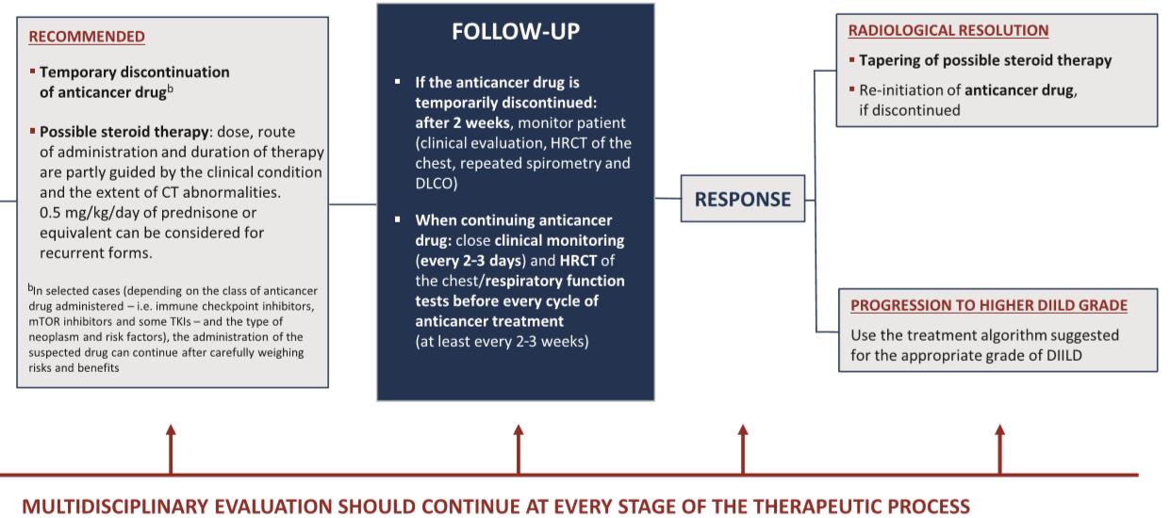
Management – Grade 1
ESMO open 2022;7 (2) 1-15
Notes:
DILD 환자의 치료목적은 염증반응을 억제하고 조직의 섬유화 진행을 늦추는 것이다
DILD 치료의 첫 걸음은 의심되는 약물을 즉각 중단하는 것이다. 약물 투여의 최초 목적과 효과보다 약물의 부작용이 더 심각할 경우 바로 중단해야한다.
코티코스테로이드는 DILD의 치료에서 가장 흔히 동원하고 있다. 원인 약물의 투여를 중단했음에도 경과가 악화하는 경우 사용을 고려한다.

Slide 14
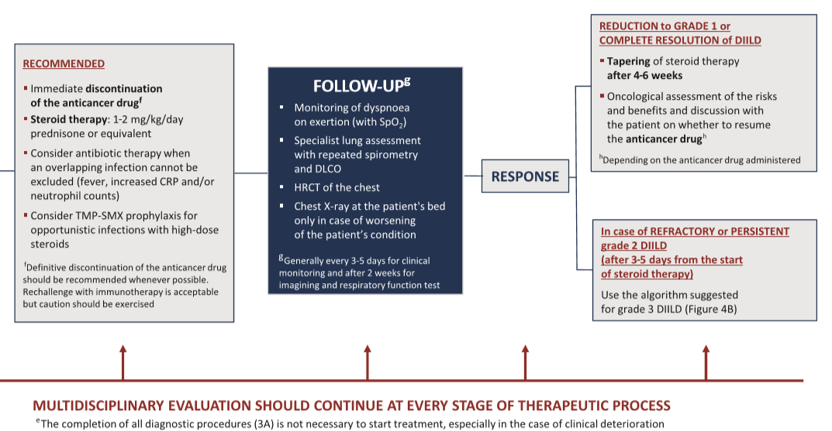
Management – Grade 2
ESMO open 2022;7 (2) 1-15
Notes:
Incidence of All-Grade Pneumonitis During Monotherapy for NSCLC, Melanoma, and RCC

Slide 15
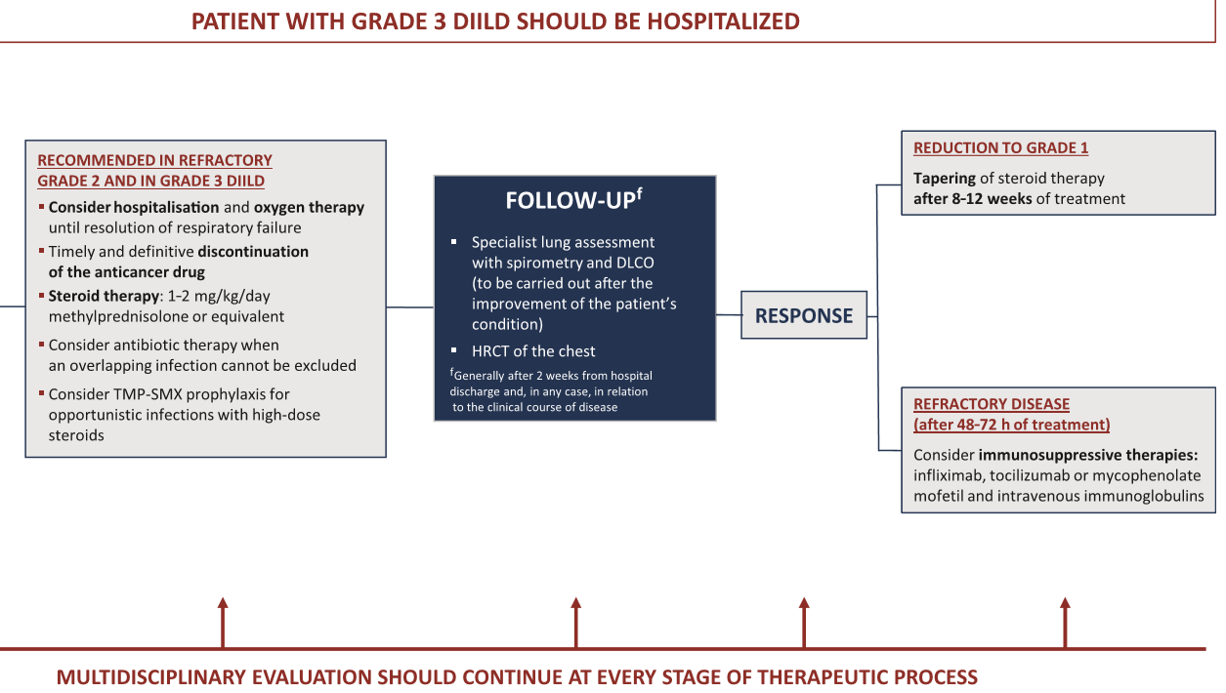
Management – Grade 3
ESMO open 2022;7 (2) 1-15
Notes:
Incidence of All-Grade Pneumonitis During Monotherapy for NSCLC, Melanoma, and RCC

Slide 16
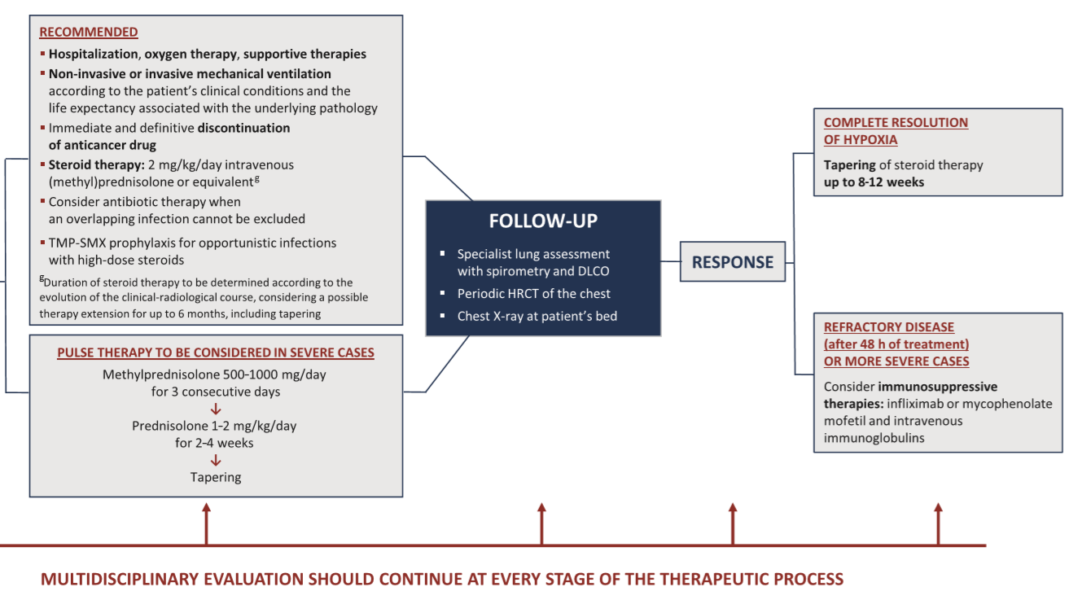
Management – Grade 4
ESMO open 2022;7 (2) 1-15
Notes:
Incidence of All-Grade Pneumonitis During Monotherapy for NSCLC, Melanoma, and RCC

Slide 17
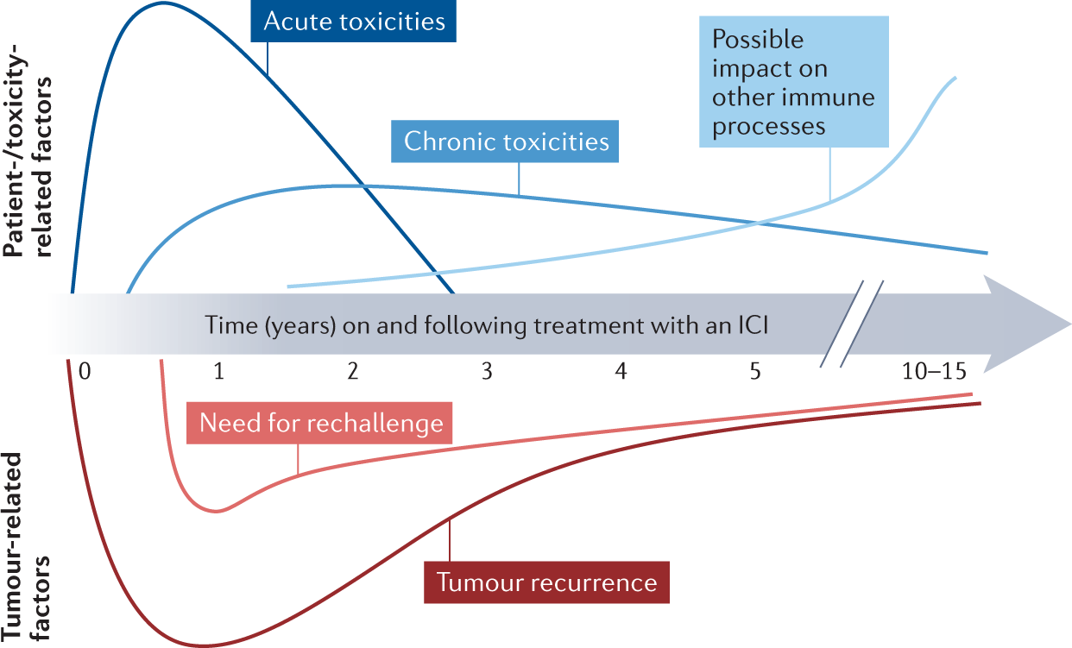
Rechallenge after resolutaion of CIP
Prospective data on the safety of rechallenge are currently lacking
ICI-pneumonitis show higher recurrence rate (OR 2.26, 95% CI: 1.18–4.32) compared with other irAEs
whether an ICI rechallenge could benefit patients depends on the case
consider cancer status, comorbidities, and performance status of patients
inform and discuss with patients whether to rechallenge ICIs
International Immunology, Volume 32, Issue 8, August 2020, Pages 547–557

Slide 18

Notes:
Thank you for your attention

Slide 19
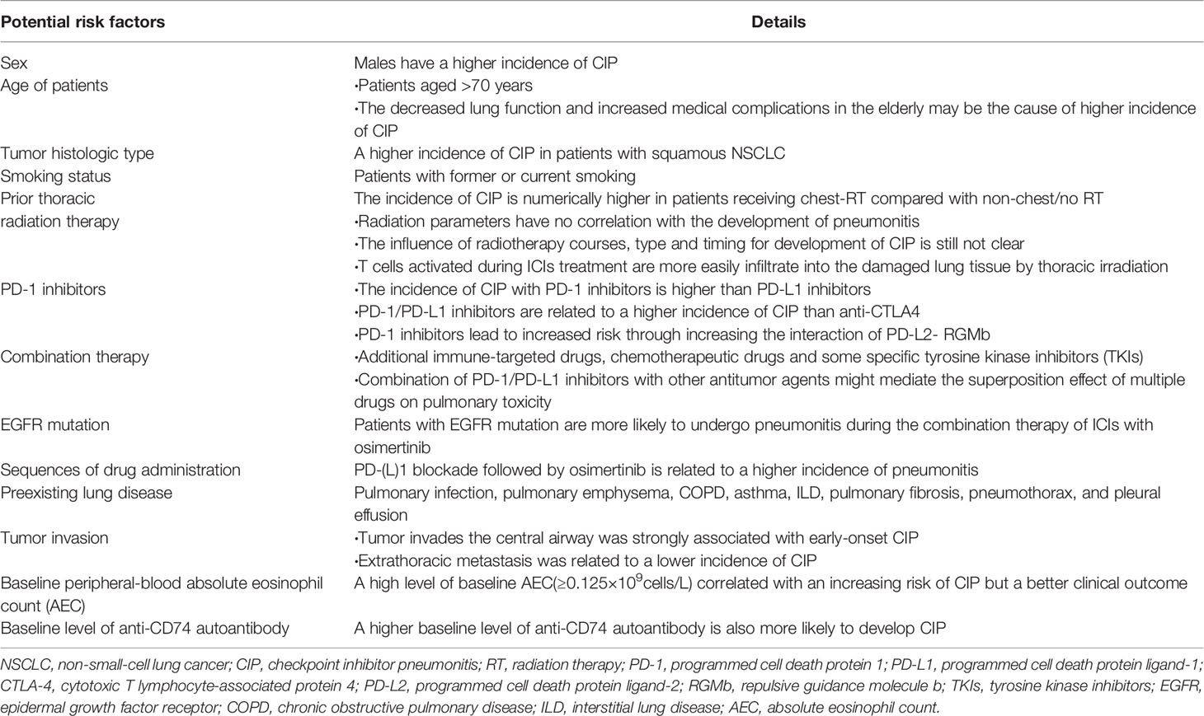

Slide 20
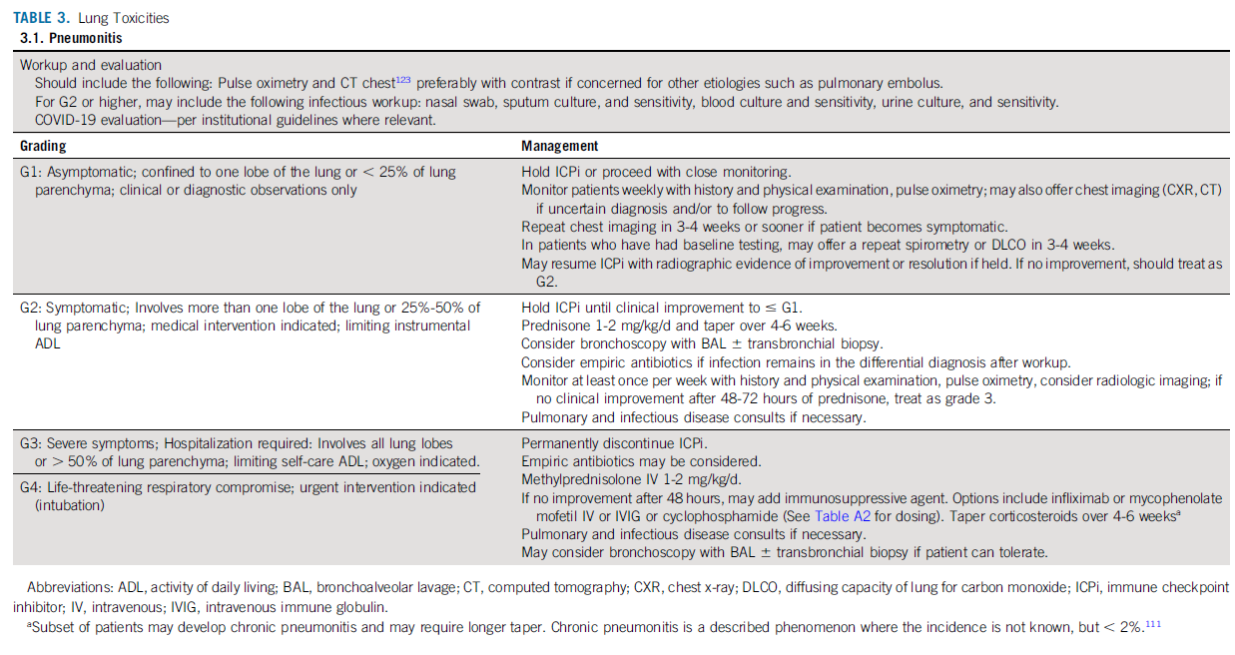
Management based on Grade

Slide 21
Summary of recommendations
Immune-related pneumonitis is documented or suspected | Immunosuppressive treatment should be started immediately
When no possibility to rule out infection using bronchoscopy | Oral or IV broad-spectrum antibiotics should be administered in parallel to the immunosuppressive treatment for grade ≥ 3 pneumonitis
Grade 1–2 | Oral prednisone 1 mg/kg daily or equivalent with clinical assessment every 2–3 days initially is recommended, with additional radiological assessments for grade 2 pneumonitis, and possible ICPi treatment interruption. Following recovery, steroids should be tapered over 4–6 weeks and ICPi treatment reintroduction delayed until the daily steroid dose is ≤ 10 mg of oral prednisone
Grade 3–4 moderate-to-severe cases | Hospitalisation, treatment with high dose IV (methyl)prednisolone 2–4 mg/kg/day or equivalent and permanent discontinuation of ICPi treatment is recommended If there is no improvement after 2 days, additional immunosuppressive strategies, such as infliximab, MMF or cyclophosphamide, are recommended Steroids should be tapered slowly over at least 6 weeks to prevent recurrence
Immune related pneumonitis toxicities
Management of pneumonitis
© 2018 ESMO. All rights reserved. esmo.org/Guidelines/Supportive-and-Palliative-Care/Management-of-Toxicities-from-Immunotherapy

