Slide 1

Hypersensitivity Pneumonitis
In-depth Review
2021.10.28
강사 김솔

Slide 2
Hypersensitivity Pneumonitis
immune-mediated interstitial lung disease (ILD)
caused by inhaled antigens found in the environment
in susceptible and sensitized individuals
Epidemiology & Immunopathogenesis
Diagnosis & Prognostication
Management

Slide 3
Epidemiology of HP
rare disease that can develop in people of all ages, including children
a mean age at diagnosis of 50–60 years
less frequent in smokers or ex- smokers
Varied prevalence
  India : HP was the most common cause of ILD (47.3%)
  UK : 1991 – 2003, 0.9 per 100,000 population
  US : 2004 – 2013, 1.28–1.94 per100,000 population
Mortality
  Fibrotic HP has a higher mortality than non- fibrotic HP
  : 67.5 versus 45.2 per 1,000 person- years (US study)
  In cHP : respiratory failure (42–62%), infection (0–32%) CVD (0–6%)
Notes:
nicotine dampens macrophage activation, decreases lymphocyte proliferation and impairs T cell function, all of which are necessary components of the immune processes implicated in HP pathogenesis

Slide 4

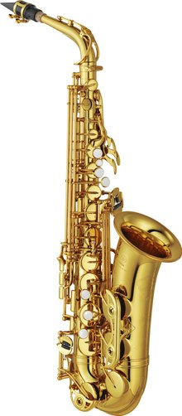
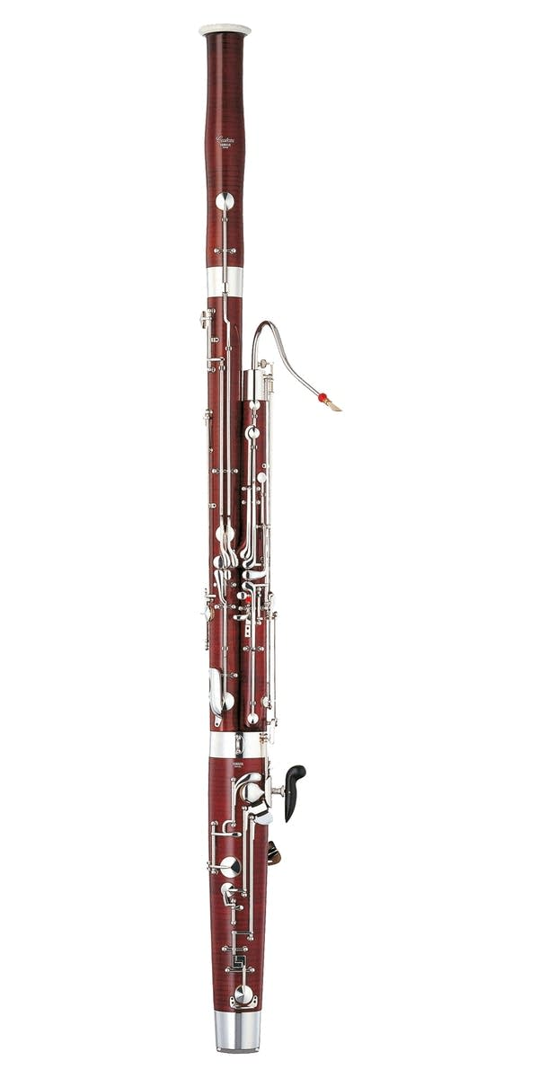
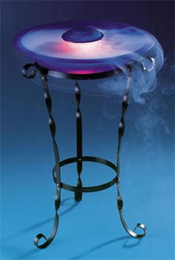
Sources of Antigens Known to Cause HP
Notes:
최근 대두되는 sourse

Slide 5
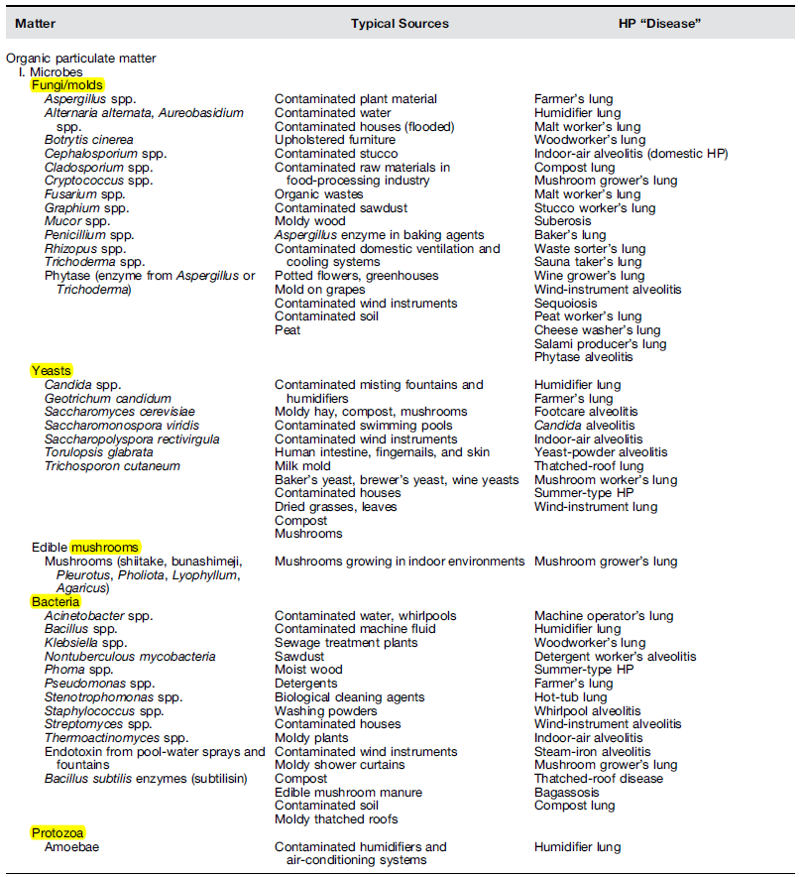
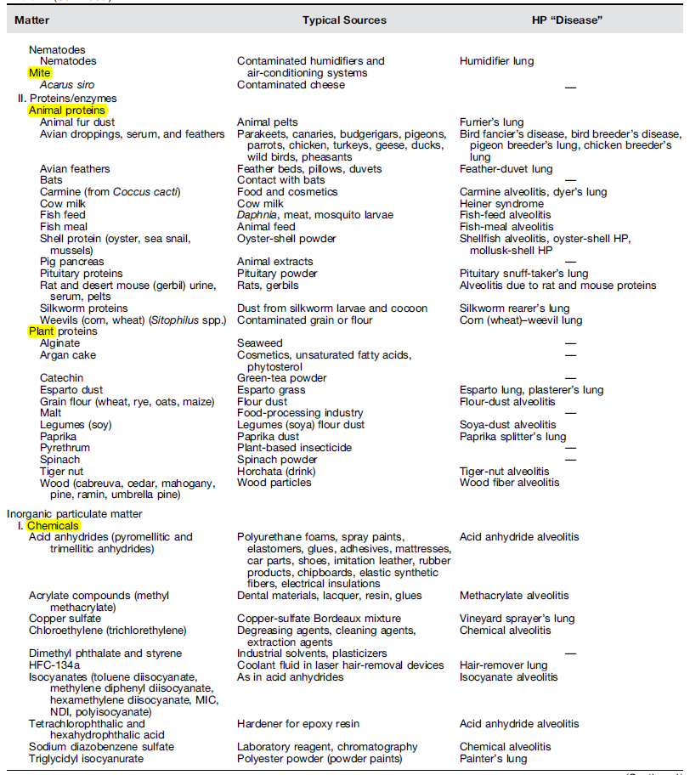
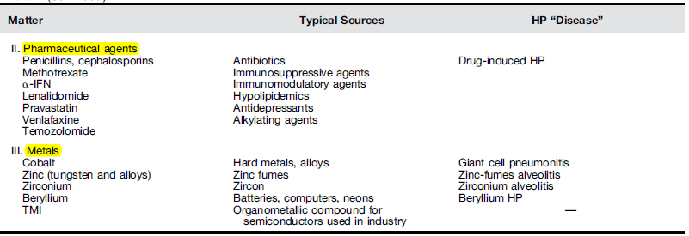
Sources of Antigens Known to Cause HP
ATS/JRS/ALAT Guideline (2020)
acute HP : most cases caused by fungi
chronic HP : about half - avian antigens
Notes:
Sources of Antigens Known to Cause HP

Slide 6
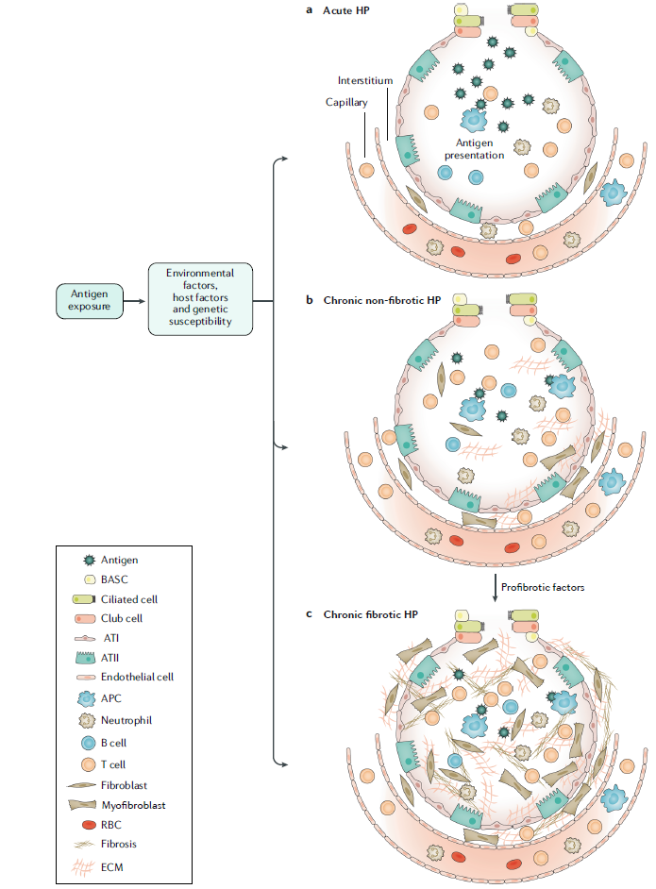
Pathogenesis of HP
Notes:
현재까지 이해된 HP의 병리는 우선 환경요인, host요인 유전적 감수성등 여러 요인이 작용한 상태에서 항원 노출이 되면 면역반응이 증대될수 있고 이것이 acute HP에서 T,B cell과 neutrophil을 recru하여 폐의 inflamation을 유발합니다. 만성으로 이어지면 myofibroblasts가 activatio되고 ECM deposition이 일어납니다. 일부 환자에서는 어떤 진행 요인에 의해 fibroblast 와 myofibroblast cell populations 이 급격하게 팽장차고 ECM deposition이 되면서 폐의 구조를 망가지게 하여 Fibrotic HP로 진행하는 것으로 이해되고 있습니다.
Exposure to antigens in an individual with genetic
predisposition and certain environmental exposures (such as to viruses, pesticides or air
pollution, mainly exposure to particulate matter <2.5 μm in diameter (PM2.5)) may lead
to the development of an exaggerated immune reaction that may result in acute lung
inflammation, characterized by the recruitment of neutrophils as well as T cells and
B cells (panel a). This immune reaction can become chronic (panel b), leading to the
activation of myofibroblasts and the deposition of extracellular matrix (ECM). In some
individuals, in the presence of progressing factors (such as ageing, further exposure or
genetic predisposition), critical pathogenetic changes occur that result in the expansion
and activation of fibroblast and myofibroblast cell populations as well as in the exaggerated
accumulation of ECM and destruction of the lung architecture (panel c). APC, antigenpresenting
cell; ATI, alveolar epithelial type I cell; ATII, alveolar epithelial type II cell;
BASC, bronchioalveolar stem cell; HP, hypersensitivity pneumonitis; RBC, red blood cell.

Slide 7
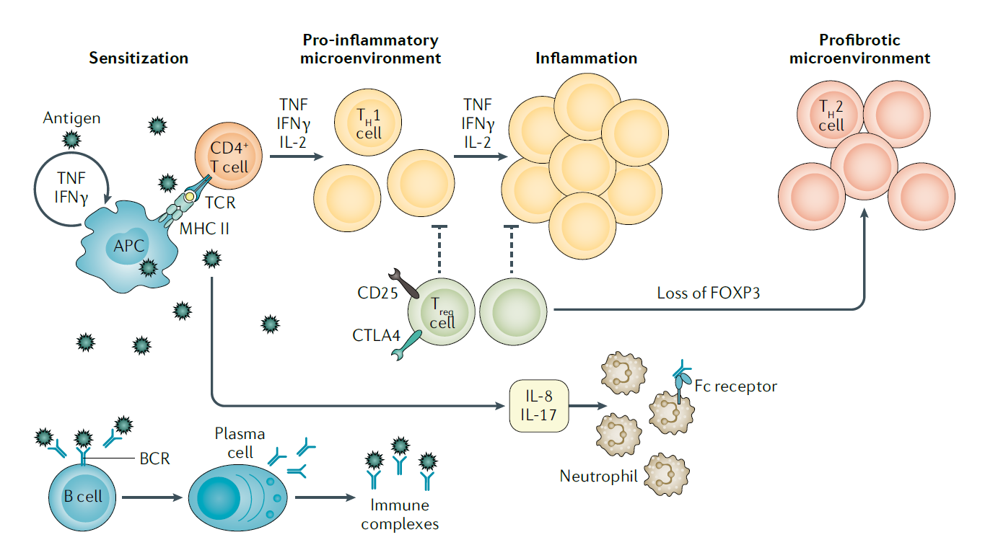
Immunopathology in HP
Notes:
B cell 의 역할도 있지만 main immune reactio은 T celld의해 매게되는 cytokine에 의한 cell proliferation 이고 interferon감마와 TNF가 macrophage에 작용하여 Granoulmatous inflammation을 일으킵니다.
Regulatory Tcell 의 저하가 이것뿐만아니라 FOXP3 transcriptional Facter의 감소로 이이어저 profibrotic response 를 유발하게 됩니다.
Following inhalation, the antigen is phagocytosed and degraded
by antigen- presenting cells (APCs), such as macrophages and dendritic cells, and coupled to major histocompatibility
complex (MHC) class II (MHC II) molecules. The antigen is then recognized by CD4+ T cells through the T cell receptor
(TCR). A T helper 1 (TH1)- type differentiation of CD4+ T cells is initiated through expression of the transcription factor
T- bet, and cytokines such as TNF, IFNγ and IL-2 drive the proliferation and differentiation of these cells. Progression
from sensitization to HP initially requires the accumulation of CD4+ TH1 cells in the lung, creating a pro- inflammatory
microenvironment.
IFNγ and TNF promote the accumulation, activation and aggregation of macrophages, resulting in
the development of granulomatous inflammation. On the other hand, the suppressive activity of regulatory T (Treg) cells
is impaired, which facilitates the amplification of the inflammatory response. Treg cells express the transcription factor
FOXP3 as well as CD25 and CTLA4 on the cell surface. The decrease of FOXP3 expression reduces the suppressive
function of Treg cells (indicated by dashed lines) and some evidence indicates that Treg cells expressing decreased FOXP3
preferentially become TH2- type effectors (which express GATA3 and STAT6), even in an environment that favours TH1 cells.
During chronic HP, a switch from a TH1 to TH2 environment could contribute to the profibrotic response. A B cell response
against the antigens also occurs, leading to the production of specific antibodies and the formation of immune complexes.
IL-17 is likely to be produced by some subpopulations of CD4+ T cells and IL-8 is mainly secreted by alveolar macrophages;
both cytokines are potent chemoattractants for neutrophil recruitment and activation. Neutrophils express receptors
for the constant region of IgG immunoglobulins (FcγRs), favouring the recruitment of these cells to the site of
inflammation and the interaction with antigen–antibody immune complexes, a process involved mainly during
acute HP. BCR, B cell receptor.

Slide 8
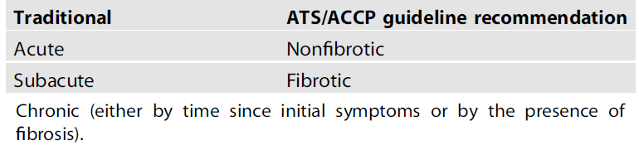
Hypersensitivity Pneumonitis
3. Diagnosis
  Heterogeneous manifestations
  Variable symptoms
  2020 ATS/ACCP guideline
  - Fibrotic (cellular HP) vs Non-fibrotic
  - multidisciplinary discussion, different confidence levels
  - combination of imaging, exposure assess, BAL lymphocytosis & histopathology.
Approximately 40–50% of chronic HP
Notes:
이전에 분류에서 acute와 구분 힘든 subacute는 제거되었고 환자의 예후와 management 에 중요성을 두고 non fibrotic / fibrotic 으로 분류 하는 것을 제시하였습니다.

Slide 9
Diagnosis of HP
  Exposure history
  Clinical features
  HRCT
  lung function : Restrictive, DLCO↓ / Clinical course monitoring / not helpful for DDx
  laboratory tests : specific IgG Antibodies / limited antigens
  BAL cell differentials
  multidisciplinary case review
  Histopathology
  antigen inhalation challenge test
Notes:
antigen inhalation challenge test : To identify the causative antigen
neither standardized nor validated but can, when the result is positive,
confirm the diagnosis of hypersensitivity pneumonitis (HP), whereas a negative test does not rule it out
the risk of severe reactions

Slide 10
6 predictors of a diagnosis of HP
TABLE 3. Significant predictors of hypersensitivity pneumonitis
Variables | Coefficient | Odds Ratio | Confidence Interval
Intercept | −6.57 | – | –
Exposure to a known offending antigen | 3.66 | 38.8 | 11.6–129.6
Positive precipitating antibodies | 1.68 | 5.3 | 2.7–10.4
Recurrent episodes of symptoms | 1.20 | 3.3 | 1.5–7.5
Inspiratory crackles | 1.51 | 4.5 | 1.8–11.7
Symptoms 4–8 h after exposure | 1.97 | 7.2 | 1.8–28.6
Weight loss | 0.70 | 2.0 | 1.0–3.9
Am. J. Respir. Crit. Care Med. 168, 952–958 (2003).
Notes:
If all predictors were present, the probability of HP would be 98%,
with only four or fewer of these six predictors present, the probability of HP would be <50%

Slide 11
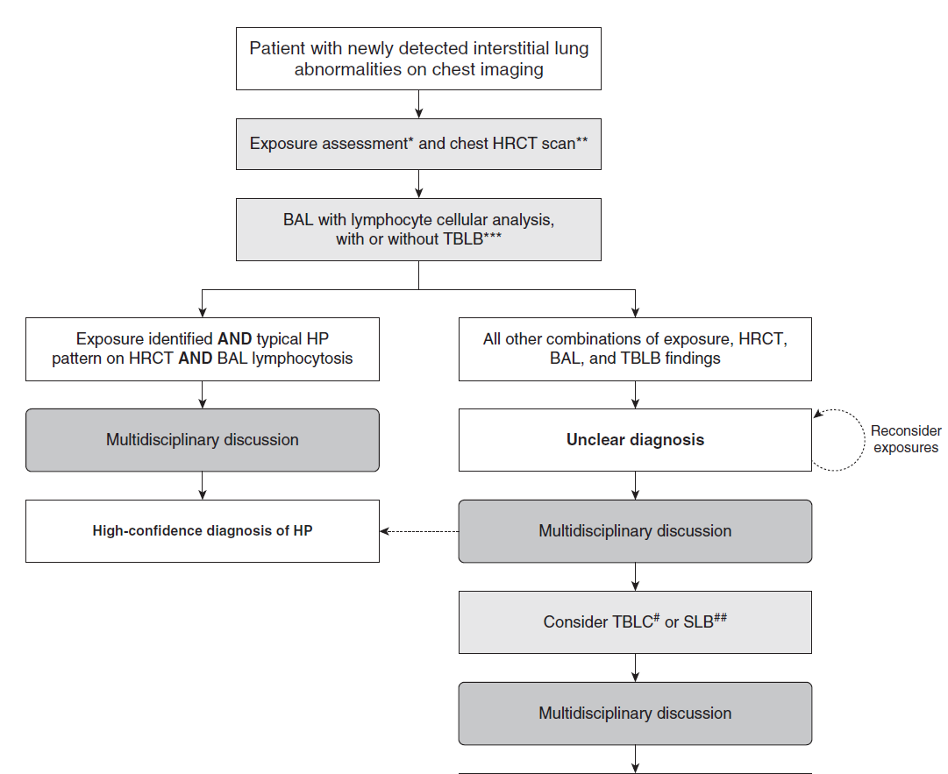
Algorithm of Diagnosis of HP
Notes:
Algorithm for the diagnostic evaluation of possible hypersensitivity pneumonitis (HP). Specific features are described for all steps of the algorithm
in the corresponding sections of the manuscript. A provisional diagnosis may be adequate in patients for whom the differential diagnosis has been
sufficiently narrowed such that further investigations are unlikely to alter management, when invasive testing has unacceptable risks, or when such tests
are declined by the patient. *Exposure assessment includes a thorough clinical history and/or serum IgG testing against potential antigens associated with
HP and/or, in centers with the appropriate expertise and experience, specific inhalational challenge testing as described in References 9, 323, 324, and
325. **High-resolution computed tomography should be performed using the technique described in Table 3 and then reviewed with a thoracic
radiologist. ***Transbronchial lung biopsy is suggested for patients with potential nonfibrotic HP (see question 4, recommendation 1). #TBLC is suggested
for patients with potential nonfibrotic HP, depending on local expertise (see question 5, recommendation 2). ##SLB is infrequently considered in patients
with nonfibrotic HP. HRCT= high-resolution computed tomography; SLB = surgical lung biopsy; TBLB = transbronchial lung biopsy; TBLC = transbronchial
lung cryobiopsy.

Slide 12
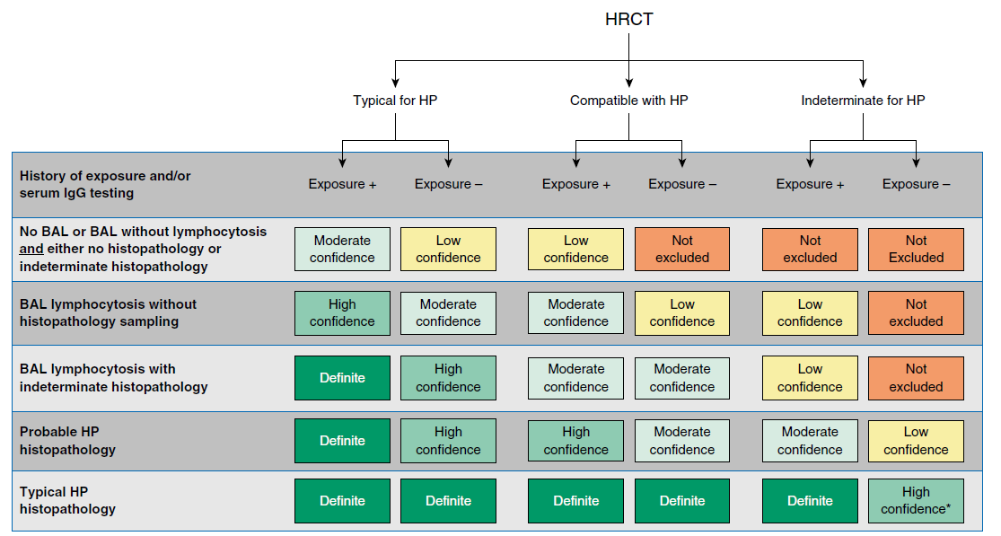
Diagnosis of HP
Algorithm of Diagnosis of HP
B. Chronic HP
Notes:
The recent guideline emphasized the necessity of a multidisciplinary discussion and defined the diagnosis with different confidence levels according to
the combination of imaging, exposure assessment, BAL lymphocytosis and histopathological findings
Figure 6. Hypersensitivity pneumonitis diagnosis based on incorporation of imaging, exposure assessment, BAL lymphocytosis, and histopathological
findings. All confidence levels are subject to multidisciplinary discussion. *Confidence may increase to “definite” if the pathologist’s conclusion persists
after reevaluation in the context of additional clinical information or an expert second opinion on histopathology. HP= hypersensitivity pneumonitis;
HRCT= high-resolution computed tomography.

Slide 13
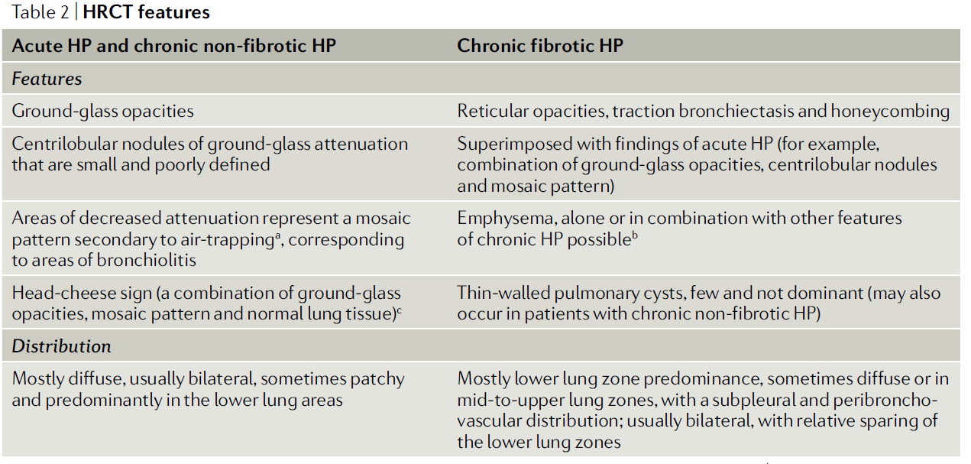
UIP pattern 1/3
NSIP < 15%
Notes:
UIP pattern on HRCT can be seen in one- third of these patients, with an NSIP pattern being observed less frequently (in ~15% of patients)

Slide 14
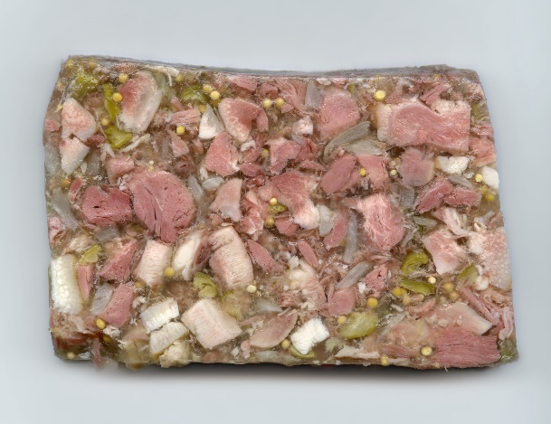
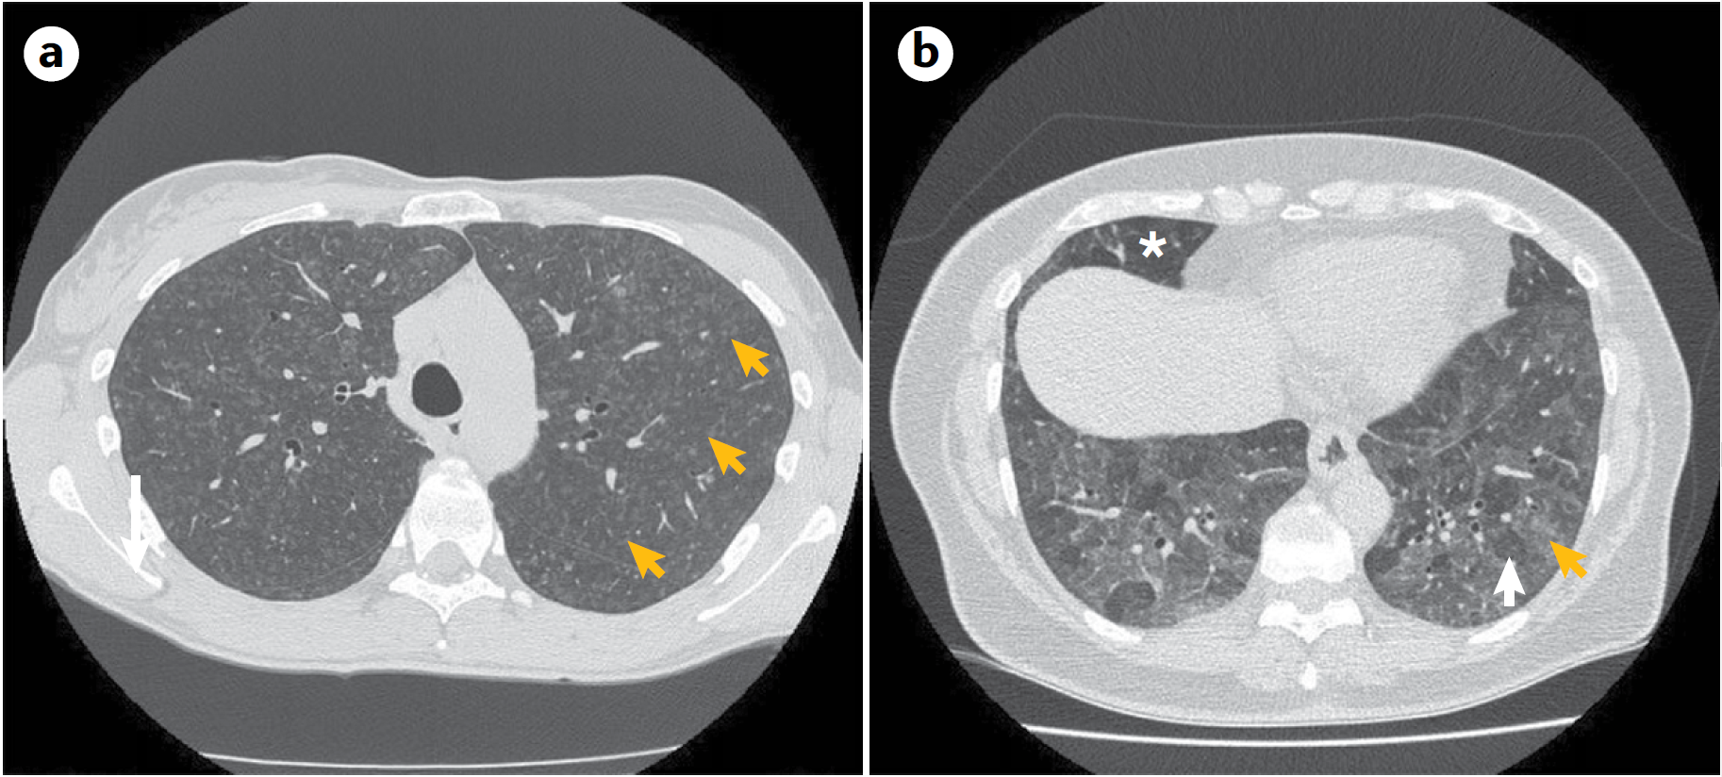
HRCT of acute HP, chronic non-fibrotic HP
head-cheese sign
Notes:
양측성으로 나타나는 diffuse GGO centrilobular noudles
Both lower head-cheese sign 이라고 불리는 GGO + normal lung의 mosaic pattern 나타나며
a | The upper lungs can show diffuse centrilobular nodules
of ground- glass attenuation (arrows) bilaterally. b | The lower lungs can show bilateral
combination of ground- glass opacities (yellow arrow), mosaic pattern (white arrow)
and normal lung tissue (asterisk) — the so- called head- cheese sign. In chronic
non- fibrotic hypersensitivity pneumonitis (HP), similar findings would be observed.
HRCT, high- resolution CT.

Slide 15
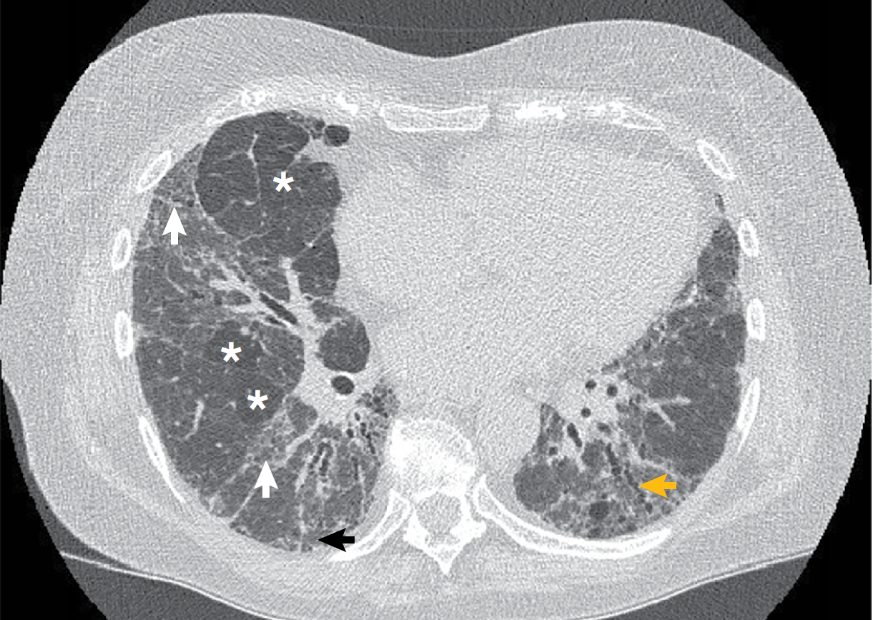
HRCT in chronic fibrotic HP
HRCT diagnosis in the differentiation against IPF or NSIP
accuracy of 88–92%
sensitivity of 44–61%
Notes:
C fibrotic HP : GGO+mosaic pattern, with reticulartion 있는 fibrotic lesion, traction bronchiectasis
The lower lungs of a patient with chronic fibrotic hypersensitivity pneumonitis
(HP) showing a combination of ground- glass opacities
(white arrows), mosaic pattern (asterisks), and fibrotic
lung disease with reticulation (black arrow) and traction
bronchiectasis (yellow arrow). HRCT, high- resolution CT.

Slide 16
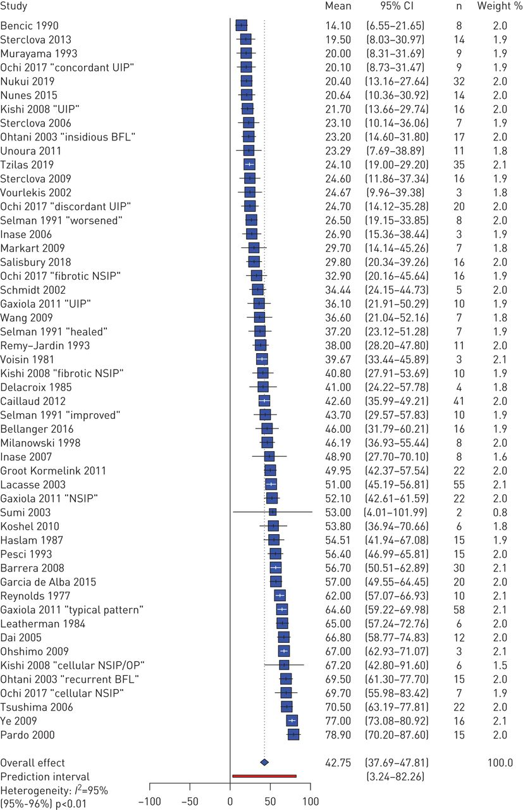
BAL lymphocytosis
Pooled estimate for BAL lymphocyte percentage in chronic hypersensitivity pneumonitis (CHP).
Nicola Adderley et al. Eur Respir J 2020;56:2000206
Notes:
chronic fibrotic HP showing a UIP pattern 와 IPF를 감별하는데는 BAL lymphocytosis of >30% 도움이 된다고 알려저있는데
2020년 ERJ의 metaanalysis 42 studies // than in IPF and other ILDs, the pooled estimate for the BAL lymphocyte proportion was 43%, significantly higher
Pooled estimate for bronchoalveolar lavage (BAL) lymphocyte percentage in chronic hypersensitivity pneumonitis (CHP). CI: confidence interval; UIP: usual interstitial pneumonia; BFL: bird fancier's lung; NSIP: nonspecific interstitial pneumonia; OP: organising pneumonia. For details of the studies, see supplementary material.

Slide 17
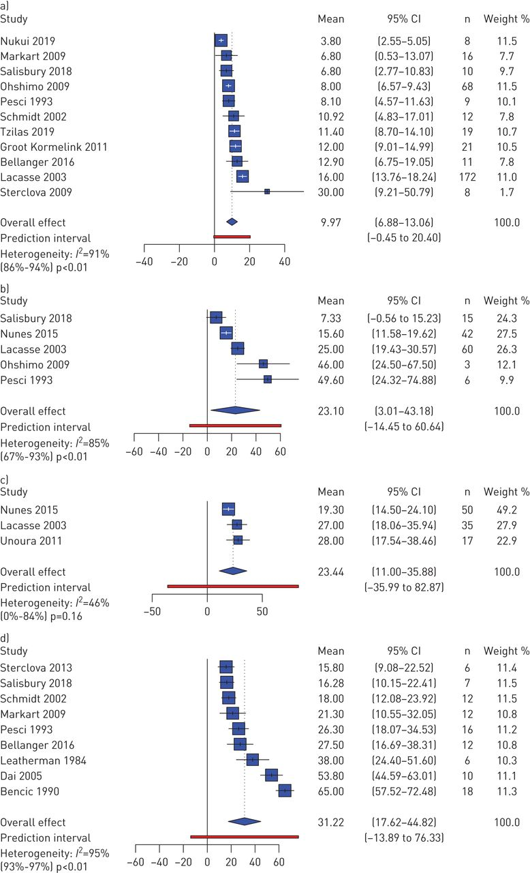
BAL lymphocytosis
Pooled estimates for BAL lymphocyte percentage in
(a) idiopathic pulmonary fibrosis (IPF),
(b) non-IPF idiopathic interstitial pneumonia (IIP)
(c) CTD-ILD
(d) sarcoidosis.
Nicola Adderley et al. Eur Respir J 2020;56:2000206
Notes:
Pooled estimates for bronchoalveolar lavage (BAL) lymphocyte percentage in (a) idiopathic pulmonary fibrosis (IPF), (b) non-IPF idiopathic interstitial pneumonia (IIP), (c) connective-tissue disease associated ILD (CTD-ILD) and (d) sarcoidosis. CI: confidence interval. For details of the studies, see supplementary material.

Slide 18
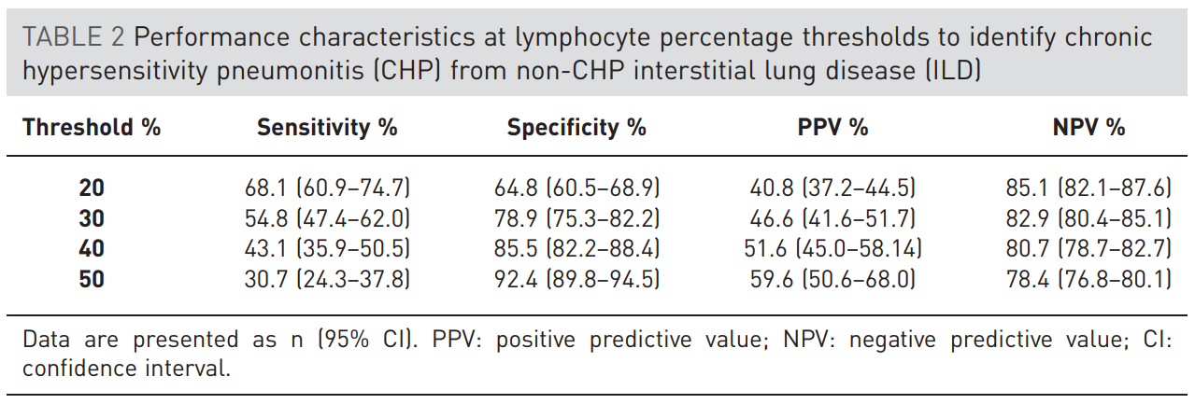
BAL lymphocytosis
Nicola Adderley et al. Eur Respir J 2020;56:2000206
CD4/CD8
  HP results in a low CD4+ to CD8+ ratio
  helpful for the differentiation from pulmonary sarcoidosis, another granulomatous disorder
  limited by its high variability and frequent elevation in chronic HP
Notes:
A lymphocytosis of >20% in BAL 이면 chronic HP and other ILDs 구분하는데 있어 sensitivity of 68% and a specificity of 65%. 보여주는 것을 볼수 있다.

Slide 19
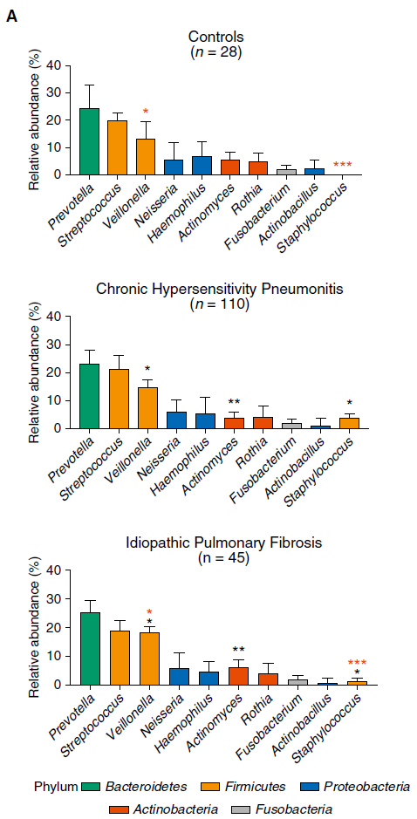
BAL Microbiome
  Distinct differences in the microbial profiles were evident in the lower airways of subjects with CHP and IPF.
  In contrast to IPF, there was no association between bacterial burden and survival in CHP.
Invernizzi, Wu, Barnett, et al.: AJRCCM (2021)
Notes:
최근 BAL 과 관련된 논문

Slide 20
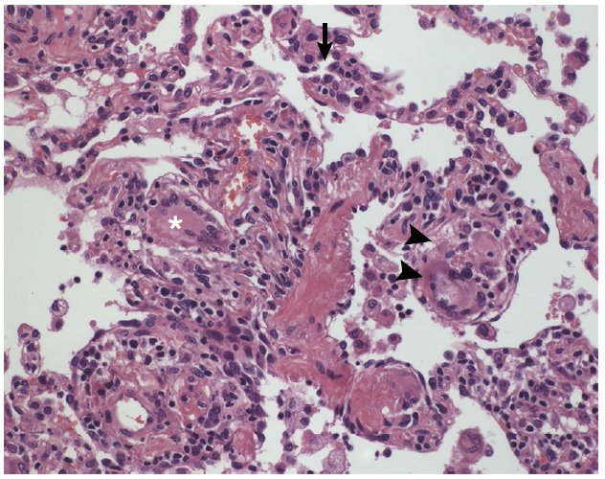
Diagnosis of HP
Histopathology
  Acute HP : usually unnecessary
  ∼ chronic non-fibrotic HP
Cellular interstitial infiltrate (arrow)
loosely formed granuloma (arrowheads)
multinucleated giant cells (asterisk)
- similar In chronic non-fibrotic HP
Notes:
Cellular interstitial infiltrate (arrow) with loosely formed granuloma (arrowheads) and multinucleated giant cells (asterisk). In chronic non- fibrotic hypersensitivity pneumonitis (HP)

Slide 21
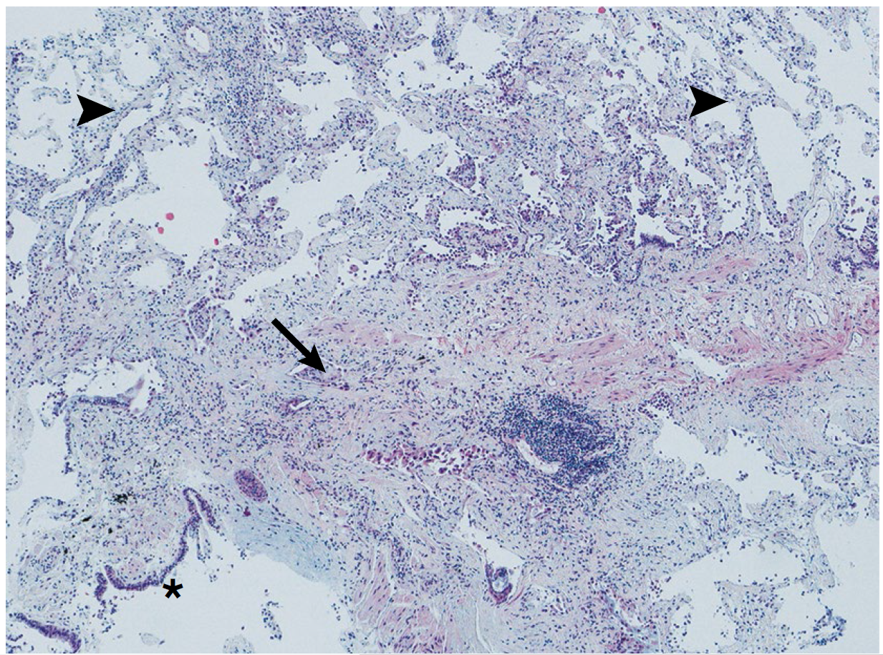
Diagnosis of HP
Histopathology
  chronic fibrotic HP
  ∼ other fibrotic ILDs
  - bronchiolocentric inflammation
  - peribronchiolar fibrosis
  - bronchiolar epithelial hyperplasia
  - granulomas or multinucleated giant cells
  Fibrotic patterns → Poor prognosis
Bronchiolocentric fibrosis with dense fibrosis (arrow)
adjacent to a bronchiole (asterisk)
features of fibrotic NSIP with alveolar septal thickening by fibrosis (arrowheads)
Notes:
Bronchiolocentric fibrosis with dense fibrosis (arrow)
adjacent to a bronchiole (asterisk) and features of fibrotic
non- specific interstitial pneumonia with alveolar septal
thickening by fibrosis (arrowheads).

Slide 22
Diagnosis of HP
ATS guideline recommends or suggests
  newly identified ILD
    recommends the development and validation of a questionnaire
    performing serum IgG testing that targets potential antigens associated with HP
    BAL with lymphocyte cellular analysis
    suggests surgical biopsy
    r/o nonfibrotic HP → TBBx; r/o fibrotic HP → suggests TBLC

Slide 23
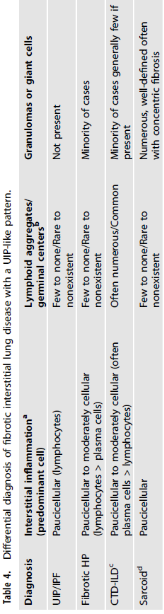
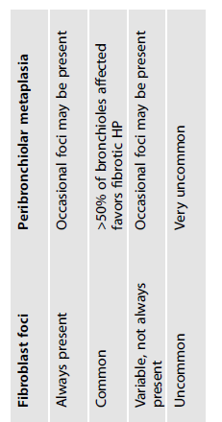
Diagnosis of HP
DDx
  Acute HP : Viral, bacterial infections, Organic dust toxic syndrome
  Chronic non-fibrotic HP : granulomatous diseases (sarcoidosis or tuberculosis)
  Chronic fibrotic HP : all other chronic fibrosing ILDs
  → multidisciplinary decision

Slide 24
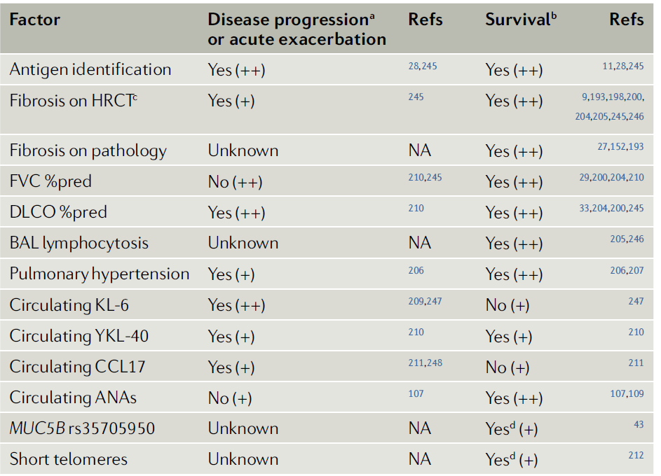
Factors associated with prognosis and/or survival in HP
Better
Mosaic attenuation and/or air-trapping
Pure peribronchiolar fibrosis
Worse
Honeycombing and/or fibrotic NSIP
Pulmonary hypertension
lower FVC at baseline
a ≥10% decline in FVC after 6–12 months
ANA +
Notes:
HP의 예후는 Ag의 종류와 노출 정도, 임상양상에 따라 괭장히 다름. 보통 Acute는 complete remission / Chr. Non-fibrotic HP에서는 Ag 노출을 최소화 하는 것이 재발과 진행으로 가는것을 막는 방법
일반적으로는 IPF 보다 좋다. 다음은 예후, survival과 관련된 factor들
Ag 찾는것이 젤 중요하지만 항상 찾을수 있는 것은 아니고 Biomaker는 임상적 사용에 대한 validation은 안되어 있다.

Slide 25
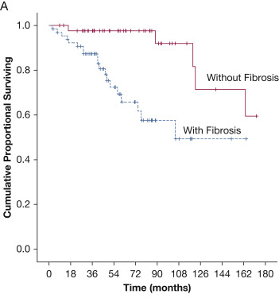
Association of fibrotic patterns with poor prognosis in chronic HP
Chest 152, 502–509 (2017).
Notes:
a cellular NSIP pattern or peribronchiolar inflammation with poorly formed granulomas is associated with a better transplant- free survival than fibrotic pattern

Slide 26
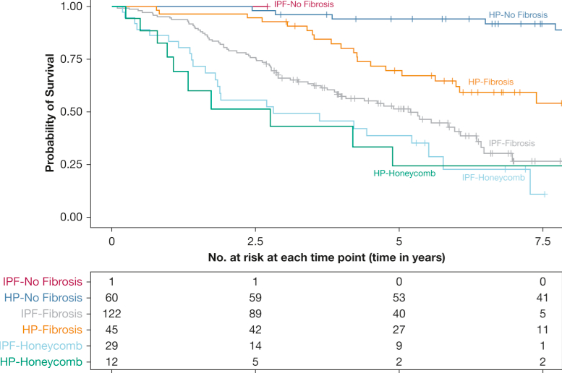
fibrotic features on HRCT are associated with worse outcomes in HP
Chest 155, 699–711 (2019)
Notes:
HRCT study에서 Chr. Nonfibronic HP는 median transplant free survival이 14.7년 이상 / chronic fibrotic HP without honeycombing 8년 / with honeycombing 2.8 years
HRCT study showed that patients with chronic nonfibrotic HP had a median lung transplant- free survival of >14.7 years, compared with >8.0 years for those with chronic fibrotic HP without honeycombing and 2.8 years
in those with honeycombing
Salisbury, M. L. et al. Hypersensitivity pneumonitis:
radiologic phenotypes are associated with distinct
survival time and pulmonary function trajectory.
Chest 155, 699–711 (2019).
This study demonstrates that fibrotic features
on HRCT are associated with worse outcomes
in HP.
Figure 2 Cox model-based survival estimates by clinical diagnosis and radiologic phenotype group. The plot shows that patients with HP without radiologic fibrosis have significantly longer lung transplant-free survival (median, > 14.73 y) than patients with HP (median, 7.95 y) and IPF (median, 5.20 y) with non-honeycomb fibrosis, and patients with HP (median, 2.76 y) and IPF (median, 2.81 y) with radiologic honeycombing. The group of subjects with IPF without fibrosis was small (n = 1), and median survival could not be estimated. Non-honeycomb fibrosis is defined by absence of honeycombing but presence of both traction bronchiectasis and reticulation. The honeycomb groups are defined by presence of honeycombing on high-resolution CT scan. The plot is adjusted for a typical age (61.9 y), sex (51% women), and FVC % predicted (65.6%) profile. See Figure 1 legend for expansion of abbreviations.

Slide 27
Hypersensitivity Pneumonitis
4. Management of HP
  Complete antigen avoidance
  do not gurantee disease regression & stability – ‘Self-perpetuating aspect’
Notes:
자가 지속성하는 경향있어

Slide 28
Management of HP
Acute HP
  Corticosteroids
  : suppress immune responses, but evidence? – no difference in 5yr FVC, FEV1, DCLO
  : faster symptom resolution, but long-term advantage?
  : more fibrotic changes on chest radiographs in not treated Pts
  : various S/E
Notes:
사용하면 초기 증상 완화,

Slide 29
Management of HP
B. Chronic HP
  High amount and longer Hx of exposure – less complete remission
  Corticosteroids
  : nonfibrotic & persistant active inflammation – good response
  : treatment dose and duration?
Notes:
스테로이드에 잘 듣지 않고 진행하면 면역억제제 사용
retrospective longitudinal analysis of patients with chronic fibrotic HP
필요해지는 것은 mortality 증가와연관 있다.

Slide 30
Management of HP
B. Chronic HP
  Immunosuppressive therapy
  : Immunosuppressive therapy requirement → increased mortality
  : Azathioprine or mycophenolate mofetil(MMF)
  - similar incidence of death, lung transplant and respiratory hospitalization compared to prednisolone Tx
  - improved DLCO and a reduced prednisone dose after 1 year of therapy
  - uncertain long-term role
  : Rituximab
  - disease improvement or stabilization (3 ouf 6 pts)
  - B cell depletion may represent an effective therapeutic strategy in at least some patients
ERJ Open Res. 3, 00016-2017 (2017).
Chest 151, 619–625 (2017).
Respirology 19, 353–359 (2014).
Notes:
스테로이드에 잘 듣지 않고 진행하면 면역억제제 사용
retrospective longitudinal analysis of patients with chronic fibrotic HP
필요해지는 것은 mortality 증가와연관 있다.

Slide 31
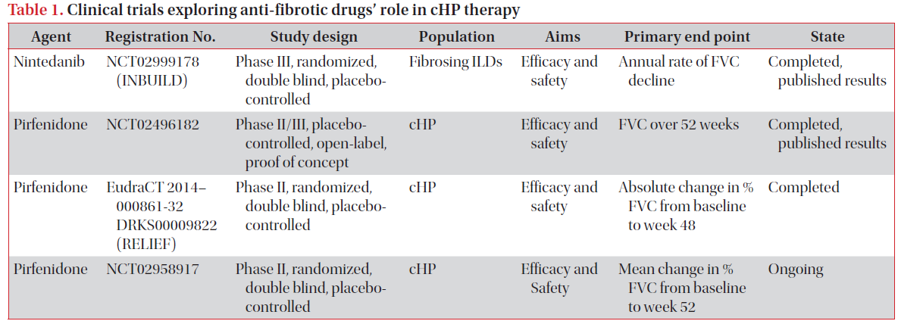
Management of HP
B. Chronic HP
  Antifibrotic Drugs
  : Nintedanib, Pirfenidone
  - may also be beneficial to progressive non-IPF fibrotic ILD, including chronic fibrotic HP
N. Engl. J. Med. 381, 1718–1727 (2019).
Lancet Respir. Med. 8, 147–157 (2020).
Notes:
스테로이드에 잘 듣지 않고 진행하면 면역억제제 사용
retrospective longitudinal analysis of patients with chronic fibrotic HP
필요해지는 것은 mortality 증가와연관 있다.
Pirfenidone : reduce the rate of FVC decline

Slide 32
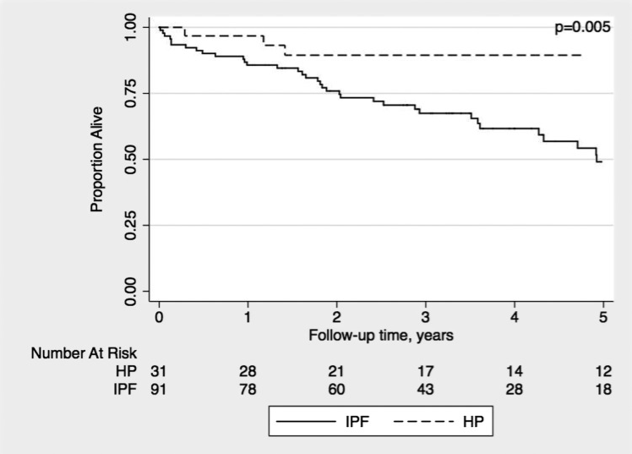
Management of HP
B. Chronic HP
  Lung tranplantation
  : greater post-transplant survival in HP than in IPF
  : lower risk of death than IPF (HR 0.25; P = 0.013)
  - Two of 31 HP pts developed recurrent disease in their allografts
  ⇒ Importance of antigen avoidance after lung transplant
Chest 147, 1558–1565 (2015).
Notes:
183 patients undergoing lung transplantation for ILD (including 31 with HP and 91 with IPF), 1- year, 3- year and 5- year survival was 96%, 89% and 86% for those with HP and 86%, 67% and 49% for those with IPF, respectively.

Slide 33
Hypersensitivity Pneumonitis
Summary
Incompletely understood mechanism
Lack of international diagnostic guidelines
Multidiciplinary decision
needed to clarify the role of immunosuppressive therapy
Clinicians suspicion

Slide 34

Hypersensitivity pneumonitis: Current concepts in pathogenesis, diagnosis, and treatment, Allergy. 2021;00:1–12.
Hypersensitivity pneumonitis, Nature reviews (2020) 6:65.
Diagnosis of hypersensitivity pneumonitis in adults: an official ATS/JRS/ALAT clinical practice guideline. Am. J. Respir. Crit. Care. Med. 202, e36–e69 (2020).
Notes:
Thank you

