Slide 1
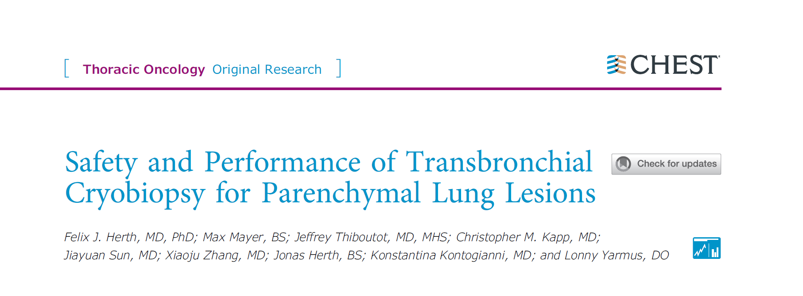
호흡기내과 R1 이동욱

Slide 2
Background
Parenchymal pulmonary lesions (PPLs) : focal radiographic opacities that can indicate evidence of malignancy
PPL suspicious for malignancy → transthoracic needle Bx, surgical resection, flexible bronchoscopy
  Bronchoscopy : 70% yield for PPL
  Surgical lung Bx : high diagnostic yield but high mortality rate (1.7-16%) / Benign diagnosis on 10-30% of cases
Minimally invasive approach is important
Notes:
Parenchymal pulmonary lesions (PPLs) are focal radiographic opacities that can indicate evidence of malignancy
Early diagnosis is critical to administering curative therapy or intervention
-> reliable, minimal invasive technique is needed, particularly in high-risk pts.
American College of Chest Physicians’ guideline : management based on surgical risk and malignant potential
PPL
PPL suspicious for malignancy → transthoracic needle Bx, surgical resection, flexible bronchoscopy

Slide 3
Background
Transbronchial lung cryobiopsy (TLCB)
Larger specimen with more alveolated tissue, superior architectural preservation, minimal crush artifact → higher yield but increased risk of bleeding and pneumothorax
Guideline recommend use of TLCB for diagnosis of ILD, but data are limited in non-ILD disease
The use of TLCB for PPLs has not been studied widely
Retrospective cohort study to evaluate the safety profile of TLCB for the diagnosis of PPLs
Notes:
American College of Chest Physicians guideline
Implement of TLCB for PPLs : barrier due to increased risk compared to traditional biopsy

Slide 4
Methods
Multicenter, retrospective cohort study
  Thoraxklink-Heidelberg University Hospital (Heidelberg, Germany)
  Shanghai Chest Hospital, Shanghai Jiao Tong University (Shanghai, China).
Inclusion
  TLCB under GEA for suspected lung cancer from 2015 through 2019
  age>18
  Undiagnosed pulmonary lesion > 2 cm, clinical indication to undergo bronchoscopy
Exclusion
  All patients with endobronchial disease found at the time of bronchoscopy
  clinical contraindication to bronchoscopy
  AntiPlt except aspirin, Plt<50L/cu mm, no informed consent

Slide 5
Methods
GEA, intubated using a rigid bronchoscope (14mm) with jet vent
3 to 5 TLCB samples per patient, 1.9- or 2.4-mm cryoprobes (Erbe)
Localization : r-EBUS, fluoroscopy, or both
Specimen, cryoprobe, and flexible bronchoscope removed en bloc
Biopsy specimens : placed in formalin → H/E staining, paraffin blocks

Slide 6
Methods
Monitor : HR 60-120, SBP 90-150, DBP 50-100, pneumothorax, SpO2>92%
Bleeding category
Postprocedural CXR within 2hr of the procedure
Pneumothorax → chest tube insertion or 2hr CXR f/u → discharge with short term f/u if decreased
Grade 0 | Traces of blood not requiring suctioning
Grade 1 | Bleeding requiring suction to clear
Grade 2 | Bleeding requiring wedging of the biopsied segment with the flexible bronchoscope, iced saline, or both
Grade 3 | Bleeding requiring further intervention such as inflation of the bronchial blocker, use of fibrin sealant, or both
Grade 4 | Bleeding requiring surgical intervention, cardiopulmonary instability, transfusion of packed RBCs, cessation of the procedure, admission to the ICU, or a combination thereof.
Notes:
radialendobronchial ultrasound

Slide 7
Methods
Procedural results : diagnostic or nondiagnostic
Diagnostic : specific pathologic or microbiologic diagnosis
  Malignancy : true positive
  Benign (granuloma, fibrosis, or infection) : repeat CT for <6mo
Nondiagnostic
  Atypia or lung parenchyma without pathologic findings
  Another diagnostic test (repeat bronchoscopy, CT scan-guided biopsy, or VATS)

Slide 8
Methods
Primary outcome : incidence of adverse events resulting from TLCB; bleeding and pneumothorax
Secondary outcome : predictors of adverse events, diagnostic yield
Statistics
  Univariate and multivariate logistic regression models
  P value of < 0.05

Slide 9
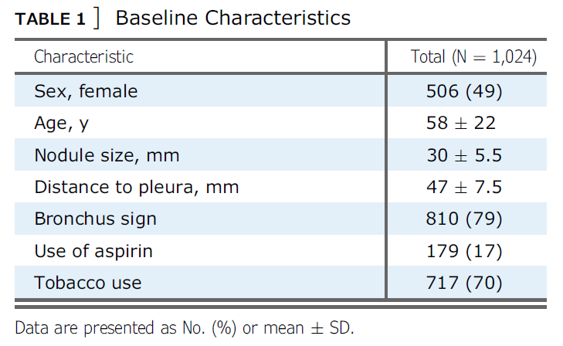
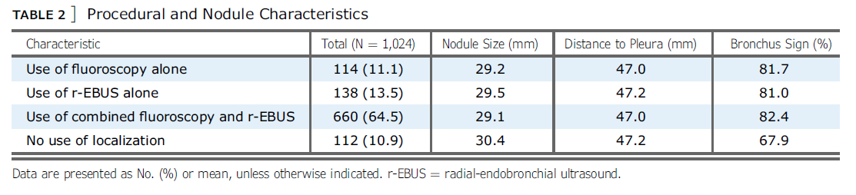
Results – Characteristics
1024 Patients (701/323)
Targeted Pulmonary Lesions | N=1024
Left upper lobe | 334 (32.6%)
Left lower lobe | 136 (13.1%)
Right upper lobe | 270 (26.4%)
Right middle lobe | 100 (9.8%)
Right lower lobe | 184 (18.1%)

Slide 10
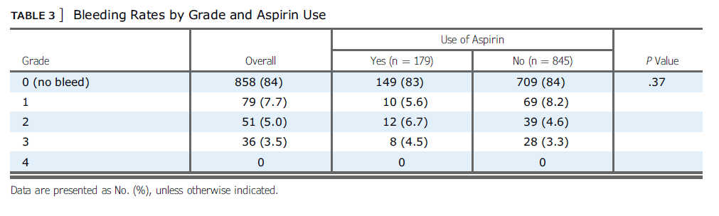
Results – Complications
Bleeding

Slide 11
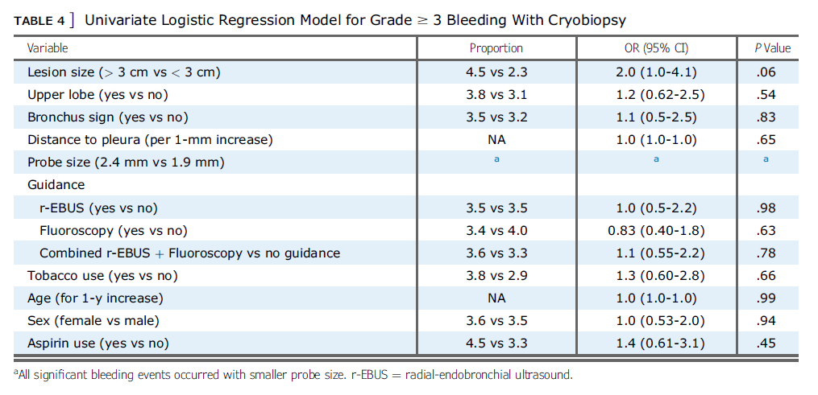
Results – Complications
No significant patient or procedural predictors of bleeding

Slide 12
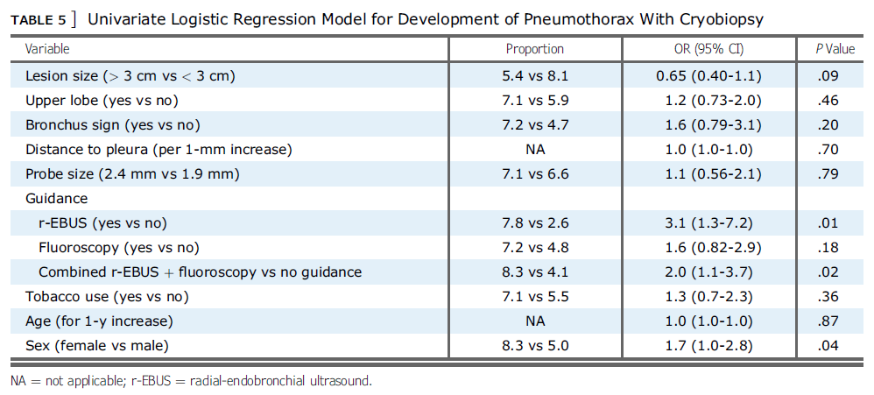
Results – Complications
Pneumothorax
  68 patients (6.6%) after TLCB
  64 patients (6.3%) required tube thoracostomy
  Removed within 4 days, and no cases of prolonged air leak occurred.

Slide 13
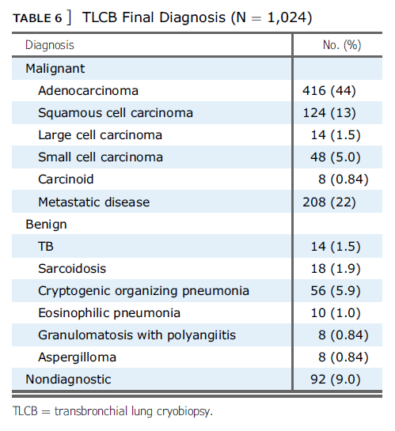
Results – Diagnostic Yield
Overall diagnostic yield : 91% (932/1024)

Slide 14
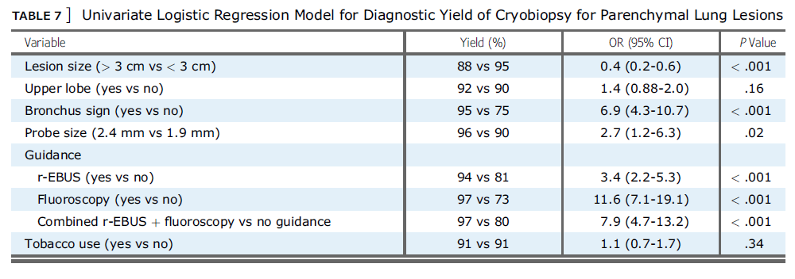
Results – Diagnostic Yield
Predictors of a diagnostic biopsy
Bronchus sign / Larger probe size / Use of localization (fluoroscopy or r-EBUS)
Notes:
Higher yield : r-EBUS, fluoroscopy, or both with TLCB

Slide 15
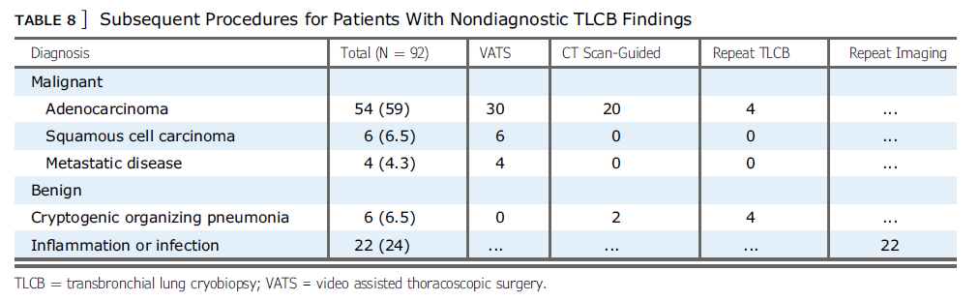
Results – Diagnostic Yield
Non-diagnostic : mostly malignant (64/92, 69.5%)

Slide 16
Discussion
TLCB in patients with ILD → increased risk of bleeding/pneumothorax
  Significant bleeding (grades 2-4) : 4%-56%, Pneumothorax : 2.6%-19%
Bleeding events
  >1/2 of bleeding events : grade 1
  grade≥3 : 3.5%
  life threatening, ICU admission, surgical intervention : none
Pneumothorax : 6.6%
  TLCB for ILD (2.6%-19%) / NAB (15%-25%) / traditional TBLB (1%)
Notes:
Existing studies and guidelines for TLCB : concentrated primarily on ILD, not PPLs
Grade 1 : (requiring only suction)
Lower than TLCB for ILD (2.6%-19%)
Lower than transthoracic NAB (15%-25%)
Higher than traditional TBLB (1%)
Increased rate of tube thoracostomy after pneumothorax, but none experienced prolonged air leak

Slide 17
Discussion
Diagnostic yield of TLCB : 91% of diagnostic yield vs 70% of traditional
  Higher yield : r-EBUS, fluoroscopy, or both with TLCB
Limitations
  Retrospective design, likely a large degree of selection bias
  High-volume, experienced academic centers
  Roughly 80% of the nodules demonstrated a bronchus sign
  Nodules <2cm were excluded
  Use of rigid bronchoscopy : requires physicians with advanced training
  May not be generalizable, will need to be replicated in multicenter, prospective trials
  Newly designed cryoprobe (more flexible, smaller) → prospective trial
Notes:
bronchus sign → may skew the data toward a higher diagnostic yield
no data for diagnostic yield for small PPLs

Slide 18
Interpretation
Lung cancer screening programs have become more mainstream with identification of more PPLs.
A clear need exists to improve the diagnostic yield of peripheral bronchoscopy.
This is the largest study to date evaluating the safety profile of TLCB.
Complication rates are comparable with those for traditional flexible bronchoscopy, and no serious adverse events occurred.
Prospective randomized trials are required to validate the safety profile and diagnostic yield of TLCB for PPLs.

Slide 19
Thank you

