Slide 1
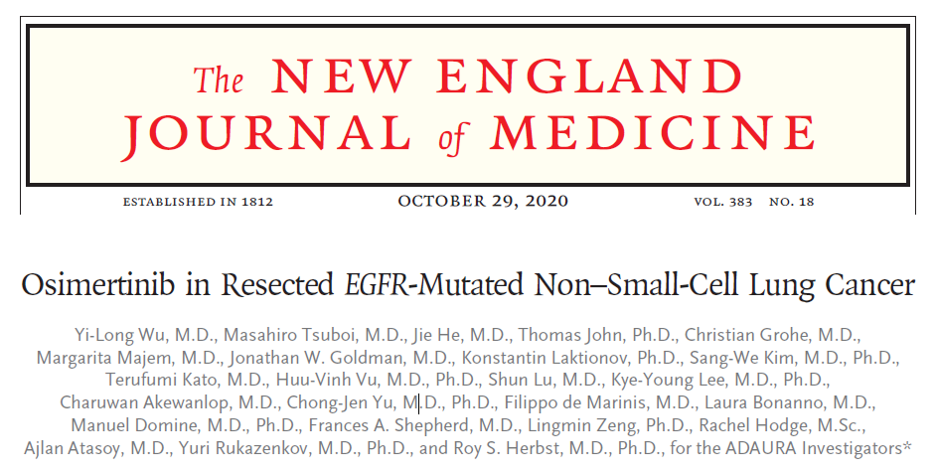
2021.10.5(화)
호흡기내과 3년차 전공의 윤지훈
Pf. 이상훈

Slide 2
Introduction
30% of patient with NSCLC :: Resectable disease
Adjuvant chemotherapy : Cisplatin-based
  Stage II – IIIA : Completely resected
  Stage IB : Selected patient
However, remains high disease recurrence or die
  5yr f/u : Stage IB (45%) – Stage III (76%)
  Regardless of the use of postoperative chemotherapy

Slide 3
Introduction
EGFR (Epidermal growth factor receptor)
  Common oncogenic driver mutation in NSCLC (Ex19del / L858R)
  EGFR-TKI : 1st-line treatment for EGFR mutation (+) advanced NSCLC
Osimertinib
  3rd generation oral EGFR-TKI
  Standard-of-care therapy
    previously untreated EGFR mutation (+) advanced NSCLC
    CNS metastasis
  Efficacy and Safety in NSCLC (Superior to gefitinib, erlotinib)

Slide 4
Introduction
ADAURA trial
  In patient with completely resected Stage IB – IIIA
  Efficacy and safety of Osimertinib (as compared with placebo)
  Cuff-off date : 2022.2 (Primary event-based analysis)
  Trial
    Phase 3
    Double-blind
    Placebo-controlled
    Randomized
    International trial

Slide 5
Methods
Trial patient

Slide 6
Methods
Primary endpoint
  Patient with stage II – IIIA disease
  Disease-free survival
Secondary endpoint
  Overall population of patient with Stage IB – IIIA disease
  Disease-free survival
  (+ overall survival / health-related QOL / safety)
Pre-specified end point
  Recurrence site / Time to CNS recurrence

Slide 7
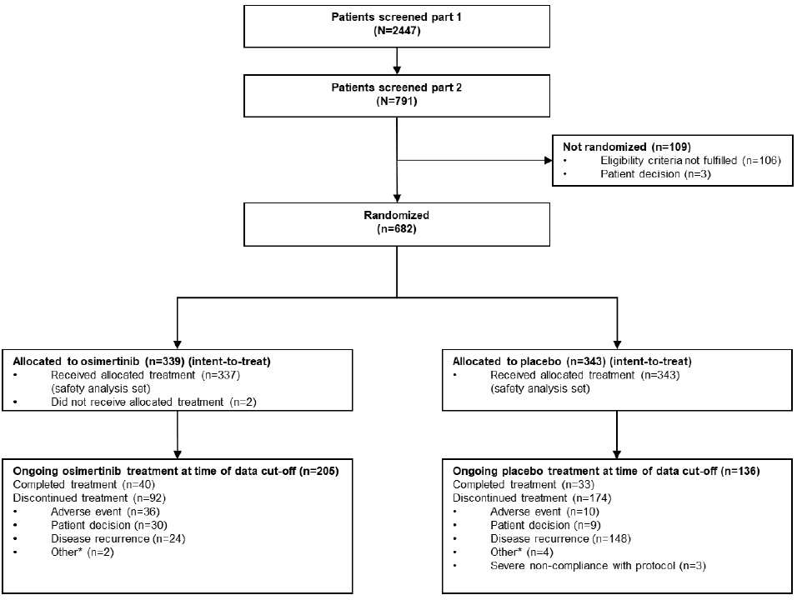
Result
Cuff-off date : 2022.2
* Interim analysis : 2020.1
- Randomization : 682
  Osimertinib : 339
  Placebo : 343
  * 2015.11 – 2019.2
- Duration of treatment
  Osimertinib : 22.5 month
  Placebo : 18.7 month

Slide 8
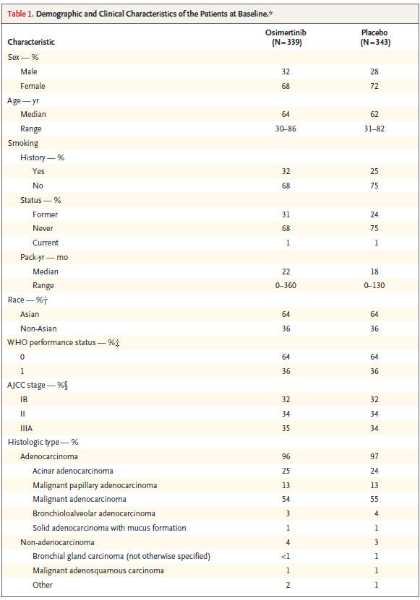
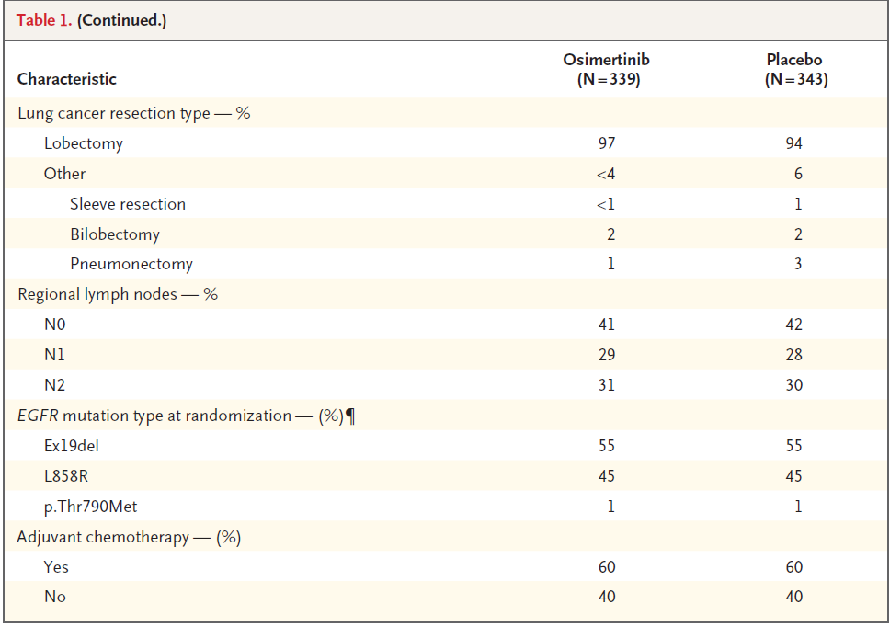
Baseline characteristics
Baseline characteristics

Slide 9
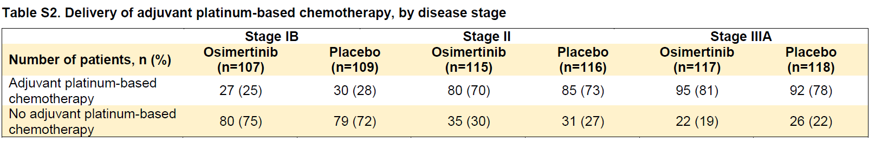
Result
Adjuvant Platinum-based chemotherapy

Slide 10
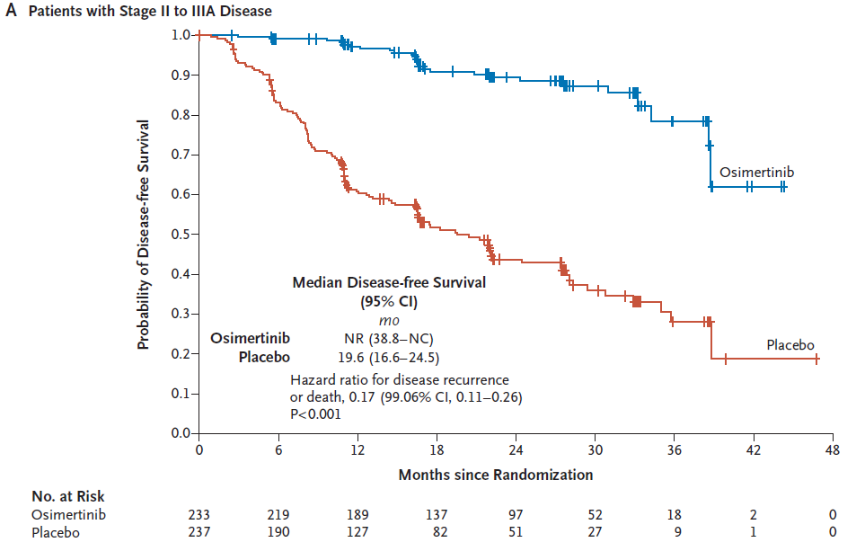
Result
Stage II-IIIA (470 patient)
- Disease recur / Death : 286/682
  Osimertinib group : 156/339 (33%)
  Placebo : 130/343 (55%)
- Disease-free at 24 month
  Osimertinib : 90% [84-93, CI 95%]
  Placebo : 44% [37-51, CI 95%]
- Overall hazard ratio
  Disease recurrence or death
  0.17 [99.06% CI, 0.11-0.26;P<0.001]
  83% reduction in the risk of disease recurrence of death

Slide 11
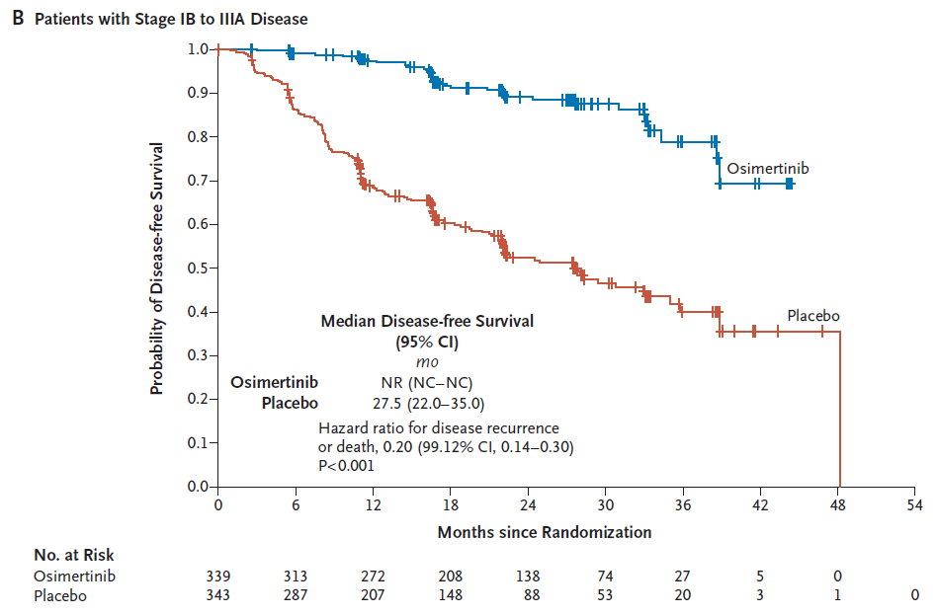
Result
Overall population (682 patient)
- Disease recur / Death : 196/682
  Osimertinib group : 37/339 (11%)
  Placebo : 159/343 (43%)
- Disease-free at 24 month
  Osimertinib : 89% [85-92, CI 95%]
  Placebo : 52% [46-58, CI 95%]
- Overall hazard ratio
  Disease recurrence or death
  0.20 [99.12% CI, 0.14-0.30;P<0.001]
  80% reduction in the risk of disease recurrence of death

Slide 12
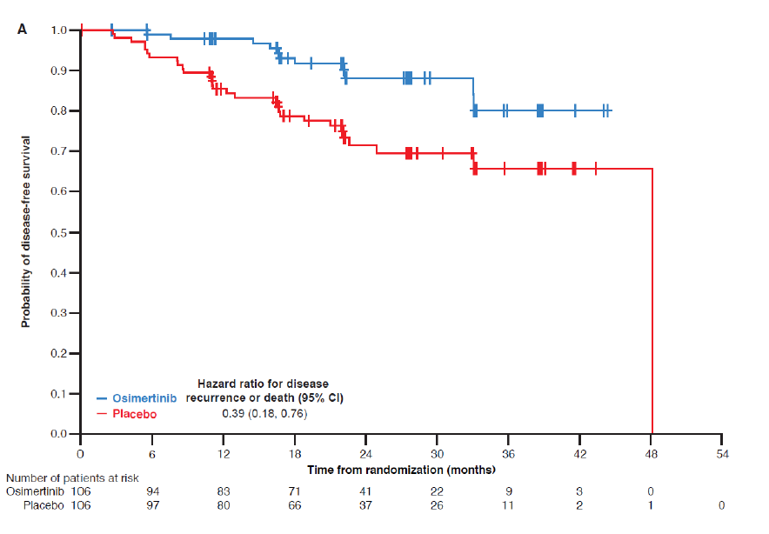
Result
Disease-free survival by disease stage
:: Stage IB
- Disease-free at 24 month
  Osimertinib : 88% [78-94, CI 95%]
  Placebo : 71% [60-80, CI 95%]
- Overall hazard ratio
  Disease recurrence or death
  0.39 [95% CI, 0.18-0.76]

Slide 13
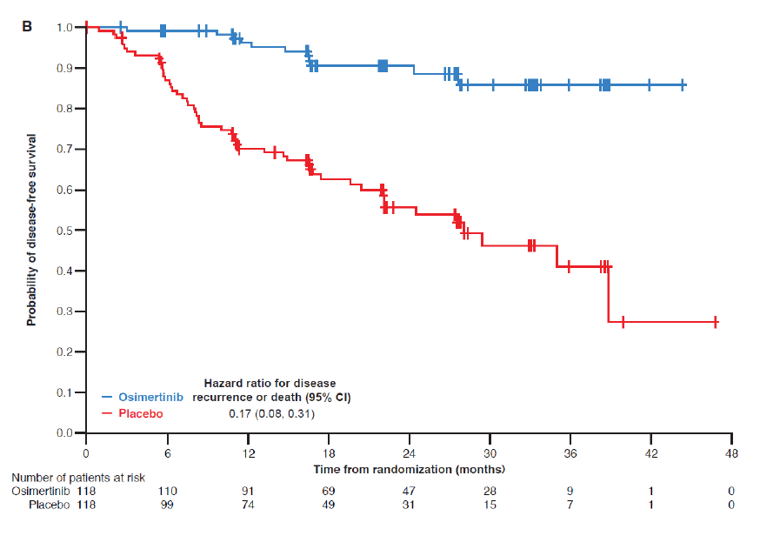
Result
Disease-free survival by disease stage
:: Stage II
- Disease-free at 24 month
  Osimertinib : 91% [82-95, CI 95%]
  Placebo : 56% [45-65, CI 95%]
- Overall hazard ratio
  Disease recurrence or death
  0.17 [95% CI, 0.08-0.31]

Slide 14
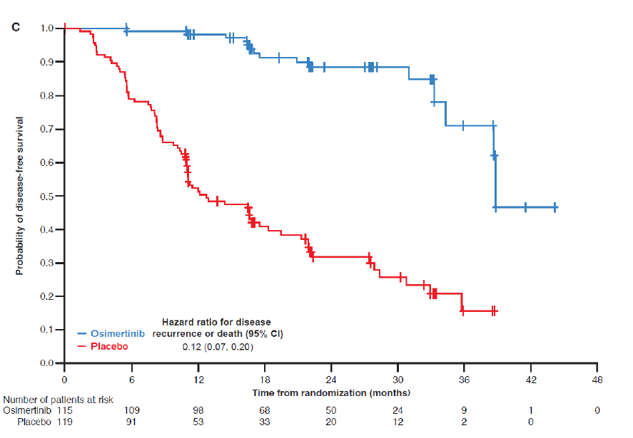
Result
Disease-free survival by disease stage
:: Stage IIIA
- Disease-free at 24 month
  Osimertinib : 88% [79-94, CI 95%]
  Placebo : 32% [23-41, CI 95%]
- Overall hazard ratio
  Disease recurrence or death
  0.12 [95% CI, 0.07-0.20]

Slide 15
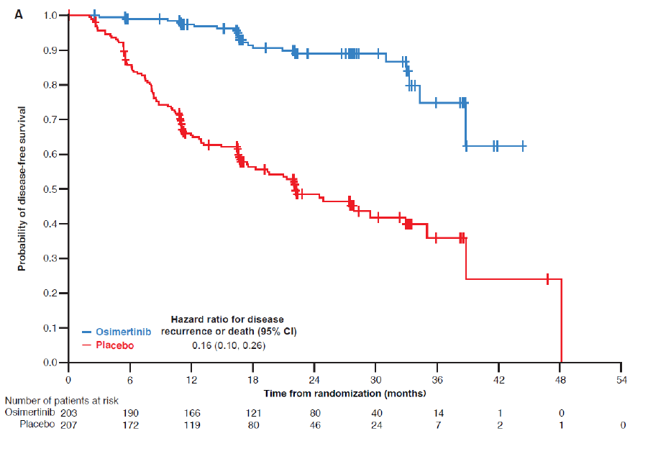
Result
Disease-free survival
(with) Adjuvant chemotherapy
- Disease-free at 24 month
  Osimertinib : 89% [83-93, CI 95%]
  Placebo : 49% [41-56, CI 95%]
- Overall hazard ratio
  Disease recurrence or death
  0.16 [95% CI, 0.10-0.26]

Slide 16
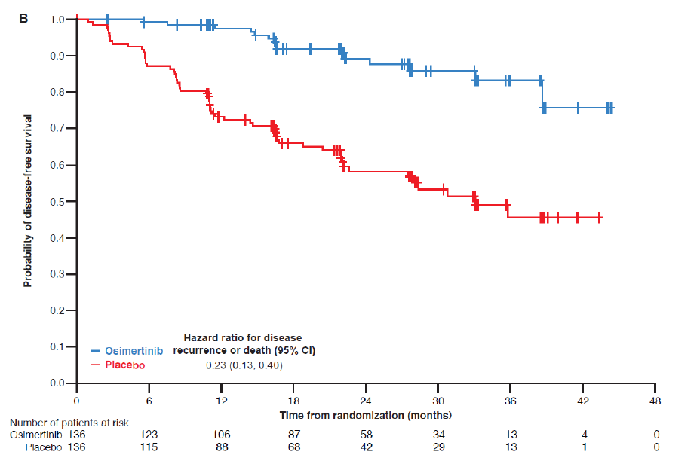
Result
Disease-free survival
(without) Adjuvant chemotherapy
- Disease-free at 24 month
  Osimertinib : 89% [81-94, CI 95%]
  Placebo : 58% [49-67, CI 95%]
- Overall hazard ratio
  Disease recurrence or death
  0.23 [95% CI, 0.13-0.40]

Slide 17
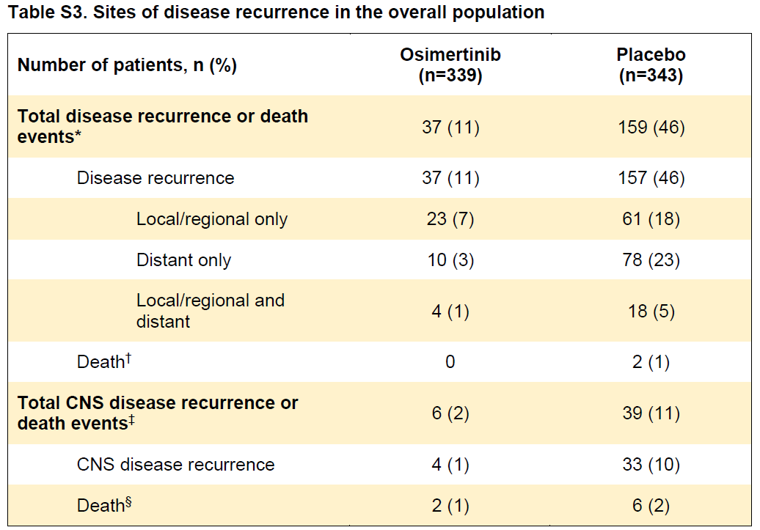
Result
Disease recurrence
- Loco/regional
  Osimertinib : 23 (of 339)(7%)
  Placebo : 61 (of 343)(28%)
Distant recur
  Osimertinib : 10 (of 339)(3%)
  Placebo : 78 (of 343)(23%)
CNS recur
  Osimertinib : 4 (of 339)(1%)
  Placebo : 33 (of 343)(10%)
  Overall hazard ratio : 0.18 [95% CI, 0.10-0.33] :: 82% reduction in the risk

Slide 18
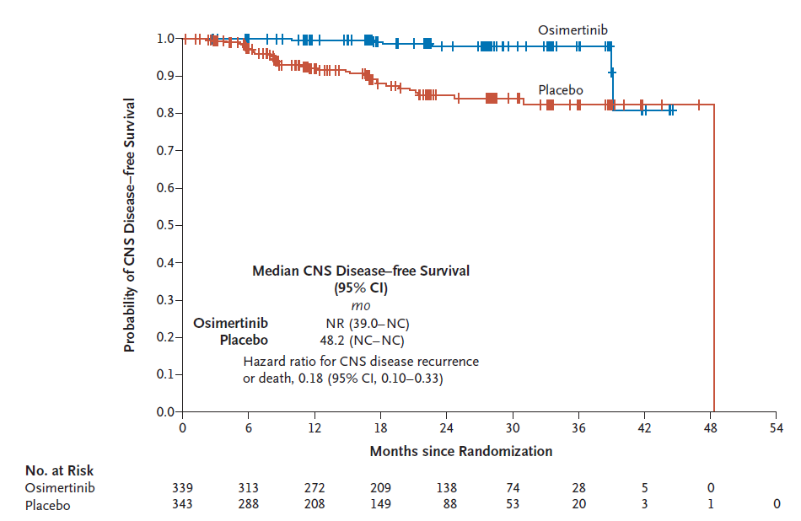
Result
CNS recur
- CNS recur
  Osimertinib : 4 (of 339)(1%)
  Placebo : 33 (of 343)(10%)
- Disease-free at 24 month
  Osimertinib : 98% [95-99, CI 95%]
  Placebo : 85% [80-89, CI 95%]
- Overall hazard ratio
  0.18 [95% CI, 0.10-0.33]
  82% reduction in the risk of disease recurrence

Slide 19
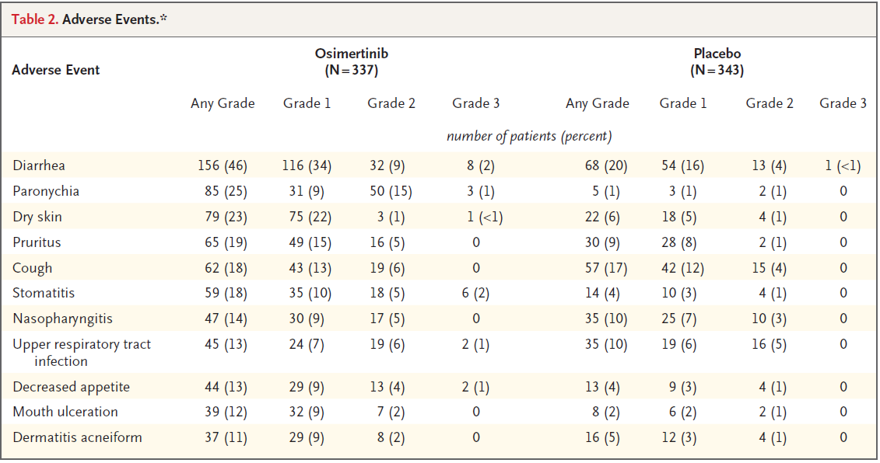
Result
Adverse event
(Total)
Osimertinib
: 329 (in 337, 98%)
Placebo
: 306 (in 343, 89%)

Slide 20
Result
Adverse event
(Grade 3 or higher)
Osimertinib
: 68 (in 337, 20%)
Placebo
: 46 (in 343, 13%)

Slide 21
Result
Adverse event
(Severe)
Osimertinib
: 54 (in 337, 16%)
Placebo
: 42 (in 343, 12%)

Slide 22
Result
Adverse event
(Fatal)
Osimertinib
: (-)
Placebo
: 1 (Pul.embolism)

Slide 23
Discussion
Patient with resected EGFR mutation (+) NSCLC
Received Osimertinib
  Significantly longer disease-free survival
    Consistently across all pre-defined subgroups
  24month disease free survival
    Stage II – IIIA : 90% (Osimertinib) vs 44% (Placecbo)
    :: Hazard ratio 0.17 (99.06% CI, 0.11-0.26; P<0.001)
    Stage IB – IIIA : 89% (Osimertinib) vs 52% (Placebo)
    :: Hazard ratio 0.20 (99.12% CI, 0.14-0.30; P<0.001)
  80% reduction in the risk of disease recurrence or death

Slide 24
Discussion
Osimertinib : Disease-free survival benefit
  All disease stage : Stage IB / II / IIIA
  Irrespective of whether patients received adjuvant CTx
Disease recurrence
  High in placebo group
  Highlight the need for more effective adjuvant treatment option
    Osimertinib : Fewer locoregional / distant / CNS recurrence
    CNS disease-free survival : Meningeal increase!!
    * EGFR mutation : Predictor of brain metastasis

Slide 25
Discussion
Osimertinib
  Highly potent and selective EGFR-TKI
    Induce apoptosis
    Have higher potency against mutant EGFR (than Gefitinib / Erlotinib)
  More clinically significant exposure in the brain than other EGFR-TKIs
  Improved treatment outcomes in patients with resected disease
    Stage IB – IIIA EGFR mutation (+) NSCLC
    After complete tumor resection
Interim analysis (Cuff-off date : 2022.2)
  Result were immature
  follow-up is ongoing

