Slide 1

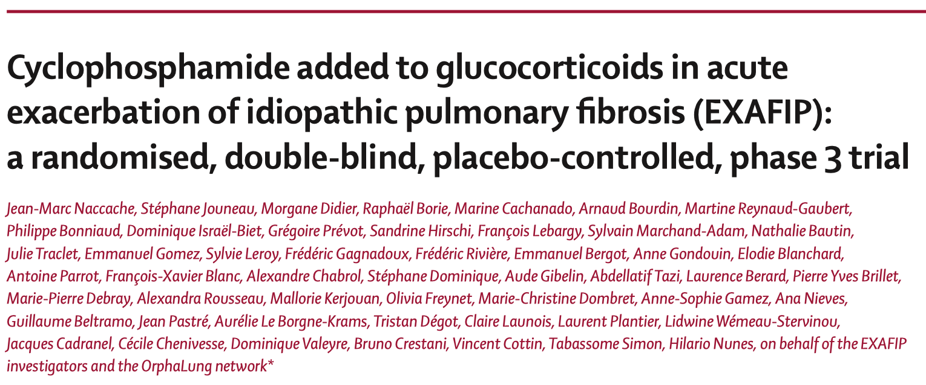

호흡기내과 R2 김지훈

Slide 2
Introduction
Idiopathic pulmonary fibrosis (IPF)
• Worsening dyspnea and a progressive loss of function
• 5–10% annual incidence of acute exacerbation
Acute exacerbation
• Acute, clinically significant respiratory deteriorations characterised by new alveolar opacities
• The cause is elusive : Intrinsic acceleration of the underlying fibrotic disease or acute injury in response
to external stimuli (ie, infection or micro-aspiration)
• Overall 3-month mortality of more than 50% and reaching up to 90% requiring mechanical ventilation.
• Up to 46% of deaths in patients with IPF are preceded by an acute exacerbation.
• No treatment has been proven effective for acute exacerbation of IPF
→ The 2011 international guidelines on IPF recommended the use of glucocorticoids
Notes:
2016년 study 개시 당시에는 no treatment has been proven effective for acute exacerbation of IPF.
◦Biological inflammatory response is frequently associated → IV MPL pulse 같은 high -dose glucocorticoid 사용을 지지
◦thrombomodulin alfa : no efficacy
◦The 2011 international guidelines on IPF recommended the use of glucocorticoids

Slide 3
Introduction
Potential immunosuppressive therapy
• Biological inflammatory response is frequently associated with acute exacerbation
• Several research groups advocate administering immunosuppressants, especially cyclophosphamide,
as either first-line or rescue therapy when glucocorticoids do not work.
• PANTHER trial
◦ Stable, mild-to moderate IPF.
◦ Three-drug regimen : Prednisone, Azathioprine, and N-acetylcysteine
◦ Immunosuppression was harmful
- By all-cause mortality at a mean follow-up of 32 weeks
- Aso increased occurrence of acute exacerbations compared with placebo.
EXAFIP study
• Cyclophosphamide added to glucocorticoids in acute exacerbation of idiopathic pulmonary fibrosis
(EXAFIP)
• Phase 3, investigator-initiated, randomised, double-blind, placebo-controlled trial
Notes:
•Several research groups advocate administering other immunosuppressants, especially cyclophosphamide, as either first-line or rescue therapy when glucocorticoids do not work.
(7) Cottin V, Crestani B, Cadranel J, et al. French practical guidelines for the diagnosis and management of idiopathic pulmonary fibrosis—2017 update. Full-length version. Rev Mal Respir 2017; 34: 900–68.
Phase III studies are randomized controlled multicenter trials on large patient groups (300–3,000 or more depending upon the disease/medical condition studied) and are aimed at being the definitive assessment of how effective the drug is, in comparison with current 'gold standard' treatment. B

Slide 4
Methods – Design and patient selection
Phase 3, investigator-initiated, randomised, double-blind, placebo-controlled trial
35 departments across 31 hospitals in France
Inclusion - Adults (≥18 years) with an acute exacerbation of IPF
  Diagnosed by the investigator (all authors) using American Thoracic Society, the European Respiratory Society, the Japanese Respiratory Society, and the Latin American Thoracic Association 2011 international guidelines and 2007 IPF Clinical Research Network criteria
  Suspected acute exacerbation of IPF was included
    missing CT or endotracheal aspirate or bronchoscopy data
Exclusion
  Receiving mechanical ventilation
  Active infection
  Active cancer
  Registered on the lung transplant waiting list

Slide 5
Methods – Randomisation and Procedures
Randomly assigned in a 1:1 ratio using a web-based system (CleanWEB)
  According to the severity of IPF(severe or non-severe)
  Block-balanced with variable block sizes of four or six patients.
* Severe IPF
• FVC < 50% or
• DLCO < 35%
• Previously unknown IPF, 최초 acute exacerbation은 non severe로 분류
Received either Cyclophosphamide or Placebo
  Intravenous pulses of *cyclophosphamide (600 mg/m²) plus uromitexan as haemorrhagic cystitis prophylaxis (200 mg/m²) (at the time of cyclophosphamide administration and then again, 4 h later) or placebo, at days 0, 15, 30, and 60
  *adapted for age, renal function, and neutrophil count, with a maximum dose of 1·2
  All patients received standardised high-dose glucocorticoids (methylprednisolone 10 mg/kg per day for 3 days) followed by a progressive tapering to 10 mg per day for patients weighing more than 65 kg and 7.5 mg per day for those weighing 65 kg or less at month 6.
  Received prophylaxis against Pneumocystis jiroveci pneumonia with co-trimoxazole or atovaquone.
  The introduction of pirfenidone or nintedanib was authorised at any point

Slide 6
Methods – Outcomes
Assessed at day 15, 30, and 60, and month 3 and 6
The primary outcome was 3-month all-cause mortality.
The main secondary outcomes were overall survival at 6 and 12 months.
Other outcomes included death from respiratory cause at month 3 and 6, respiratory morbidity between the final results available before acute exacerbation and month 6 (including worsening dyspnoea, worsening in gas exchanges, a decrease in FVC of ≥10% of predicted value, or a DLCO of ≥15% of predicted value), variation of the extent of interstitial fibrosing features on high-resolution CT between the final results available before acute exacerbation and month 6 (appendix p 3), and analysis of risk factors of mortality at month 3.
Notes:
EUBS-TBNA 와 ultrasonographic feature 는 3차 병원 thoracic oncology 에 의해 분석되었고 clinical T1b 이거나 더 높은 경우 nonpheripheral T1a tumor 가 있는 경우 EBUS-TBNA 를 시행하였다
LN

Slide 7
Methods – Statistical Analysis
The primary outcome was compared between groups with a χ² test
  Missing primary outcome data were replaced with the worst-case (death) imputation method.
For secondary outcomes, proportions between groups were compared with the exact method, and median differences were estimated with Mood’s method.
  Data concerning worsening dyspnea with visual analogue scale were missing in most patients and excluded from the analysis.
Survival was estimated with the Kaplan-Meier method considering the time from random assignment to death by any cause, with censoring at the date of transplant or of last follow-up visit.
An unadjusted analysis was done to select potential risk factors of clinical interest at the p value threshold of 0.2
All tests were two-sided and p values of less than 0.05 were considered significant.
Notes:
sex, age, IPF severity, baseline antifibrotic therapy before acute exacerbation of IPF, C-reactive protein, partial pressure of oxygen (PaO2) to fraction of inspired oxygen (FiO2) ratio, high-resolution CT classification of acute exacerbation of IPF, highresolution CT pattern of new abnormalities in acute exacerbation of IPF (appendix p 3), and time between the first signs and symptoms and administration of treatment (methylprednisolone) for acute exacerbation of IPF.
#Hypothesis
In a systematic review based on all reported series between 1993 and 2006, the 3-month mortality was estimated to be 67·1% (95% CI 56·2–76·5).
-> Placebo 67%, Cyclophosphamide pulse wil decrease by 25% (42%)

Slide 8
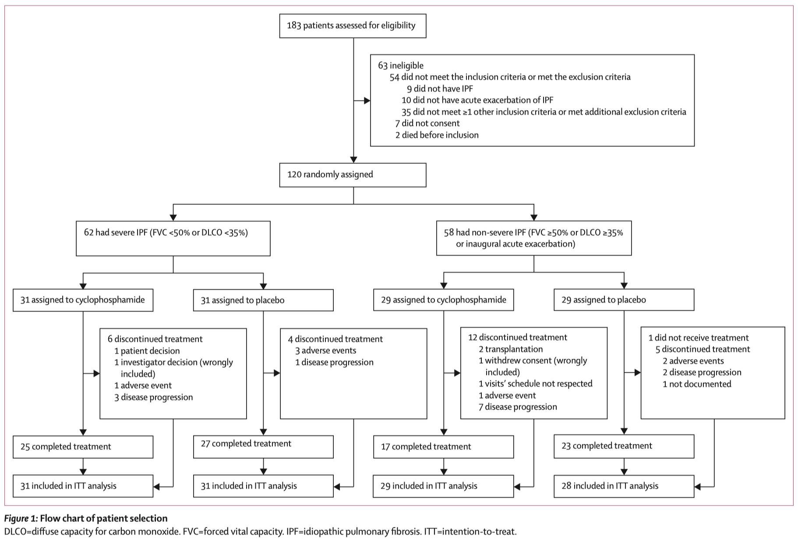
Results – Patient Selection
Notes:
Between Jan 22, 2016, and July 19, 2018, 183 patients were assessed
183 patients 중 120명 randomly assigned
119 patients (62 [52%] with severe IPF)
•at least one dose of cyclophosphamide (n=60) or placebo (n=59)
•non-sever IPF 중 1명은 치료 받지 않아 제외하고 계산함
•One patient died before he received treatment.

Slide 9
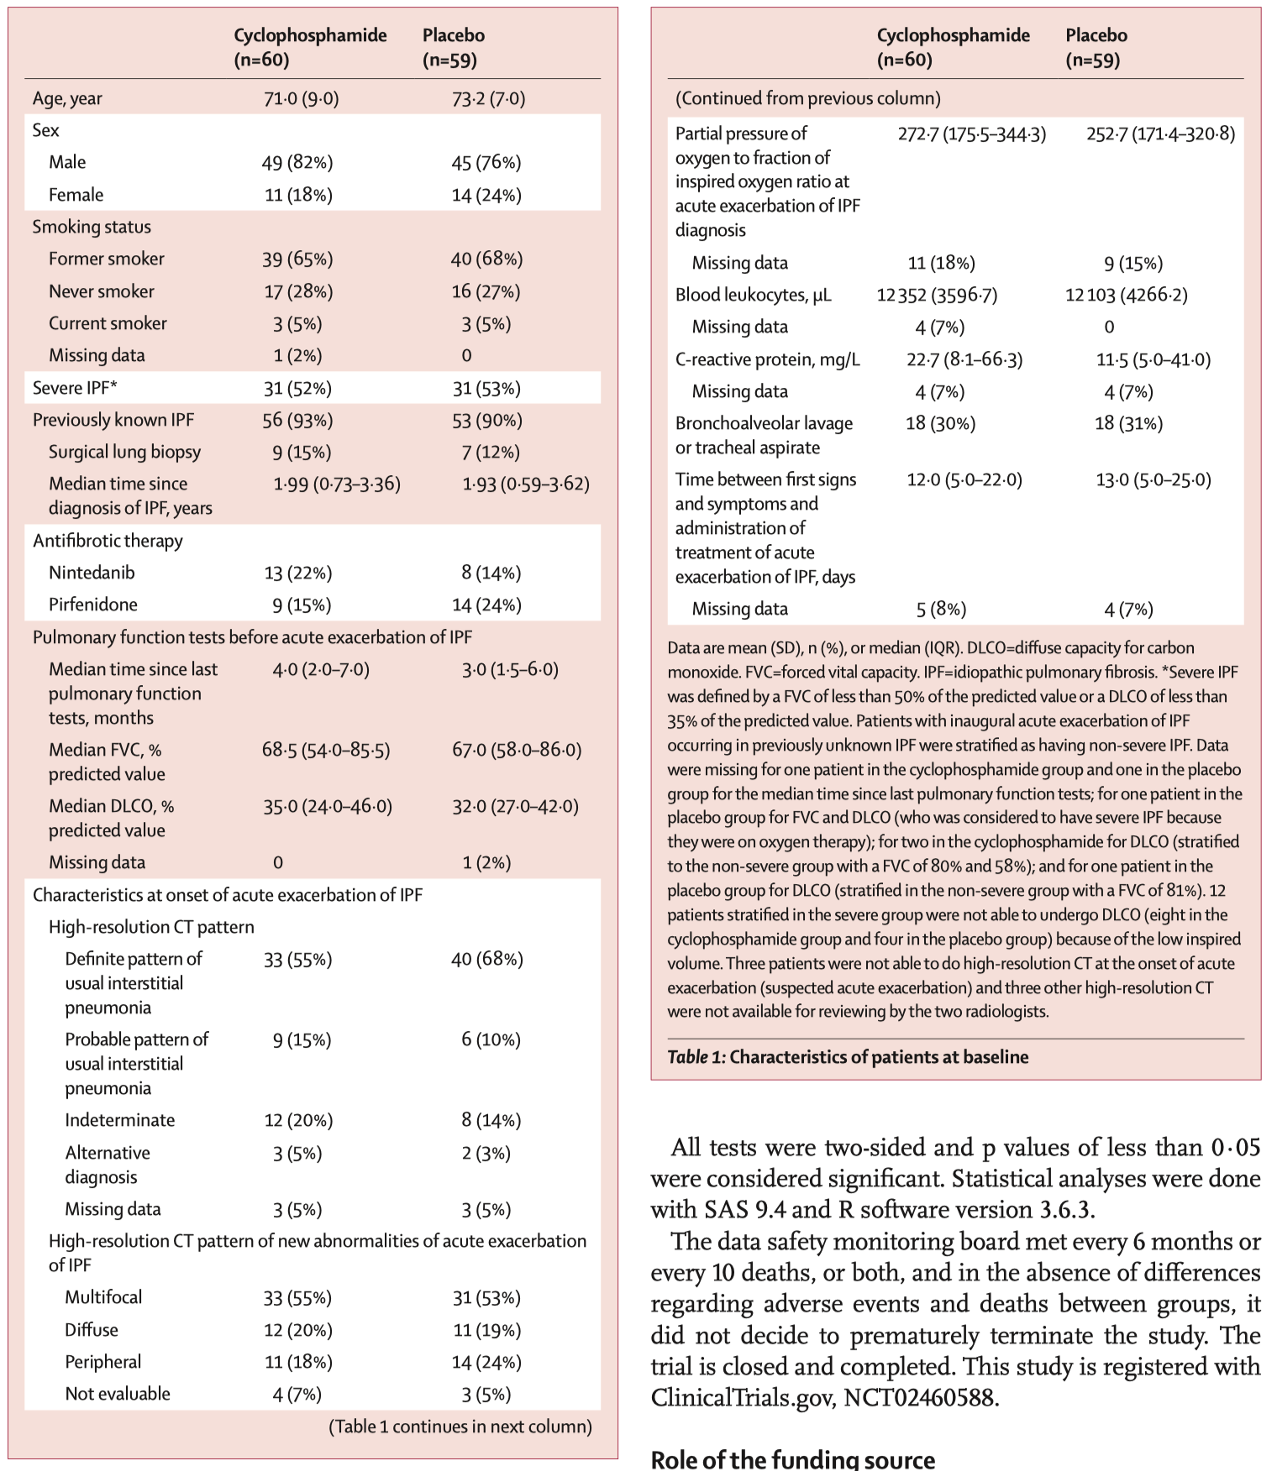
Results – Baseline Characteristic
Notes:
mean age of patients was 72·2 years
62 (52%) patients had severe IPF

Slide 10
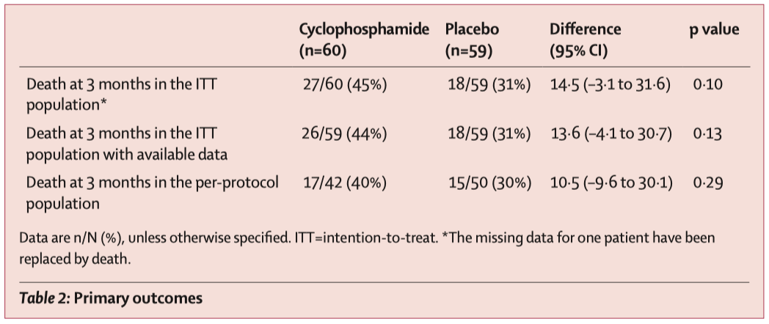
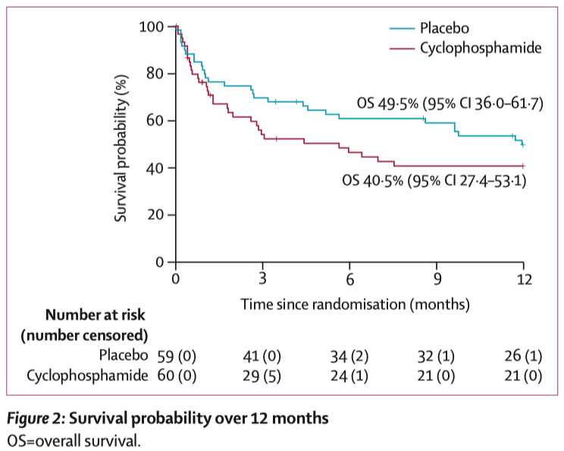
Results – Primary Outcome
Primary outcome - adjustment by IPF severity
Similar results : odds ratio [OR] 1.89 [95% CI 0.89–4.04]
Severe IPF의 cyclophosphamide group의 death 가 높지만 유의미한 영향은 없었음
  Non-severe IPF, 9 deaths in each group, OR 0·97 [0·45 to 2·07]
  Severe IPF, 18 deaths in the cyclophosphamide group and 9 deaths in the placebo group,
  OR 2·00 [1·07 to 3·74]; p=0·10
Notes:
>Table 2 Primary Outcome table
•45 31 차이 14%, p value 0.10
•위의 건 missing data 언급
•intention to treat 인데 per protocol도 큰 차이 안 난다 언급
>Figure 2 Survival probability over 12 month
•시간이 지나도 cyclophosphamide의 survival 이 낮다
•(갈수록 좁혀짐?)
Adj은 표에는 없지만..

Slide 11
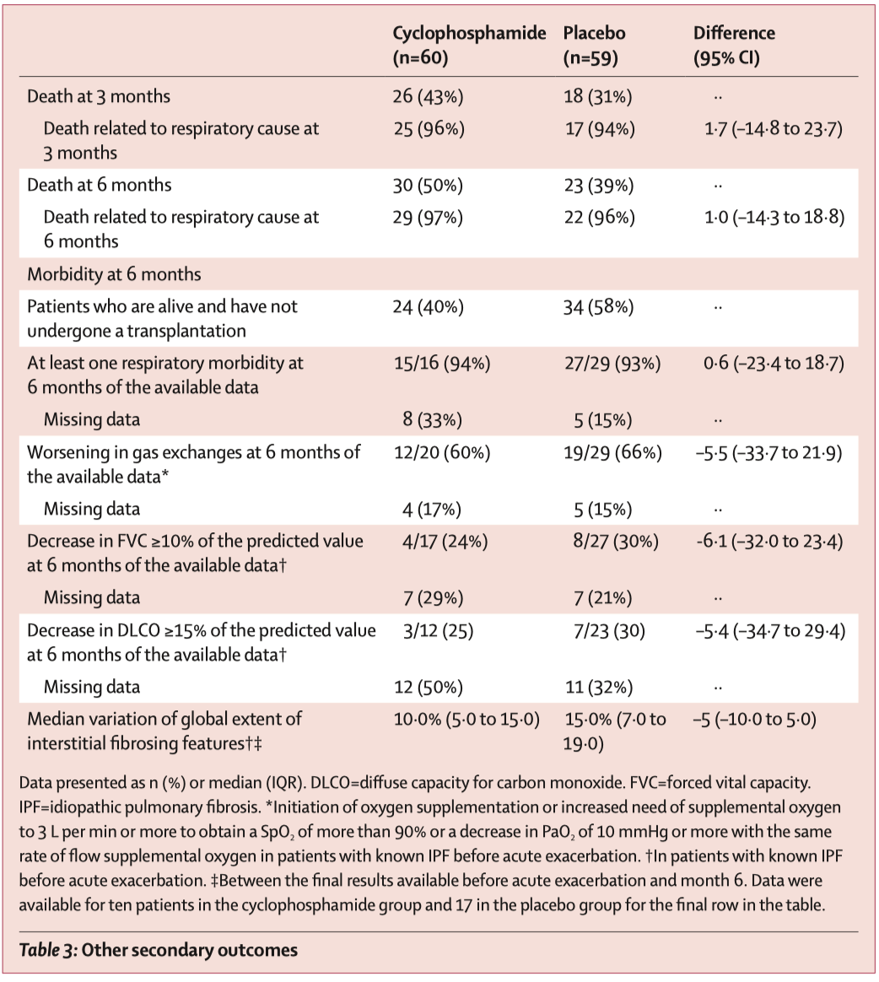
Results – Other Secondary
Outcomes
Notes:
>Table3 : Other secondary outcomes
•None of the secondary outcomes differed significantly between the two groups
•(6, 12mo survival / Death from rest. cause at 3, 6mo / Respiratory morbidity diff. before and 6mo / Variation of extend of Intersitial fibrosis feature / RF of mortality at 3mo)
•At 6 months, 29 (97%) of 30 deaths in the cyclophosphamide group and 22 (96%) of 23 deaths in the placebo group were related to a respiratory cause.
•In the adjusted analysis, independent from the treatment received, severe IPF compared with non-severe IPF was associated with a higher risk of death at 3 months (OR 2·62 [95% CI 1·12–6·12]). Baseline antifibrotic therapy before acute exacerbation of IPF was associated with a lower risk of death at 3 months (OR 0·33 [0·13–0·82]).

Slide 12
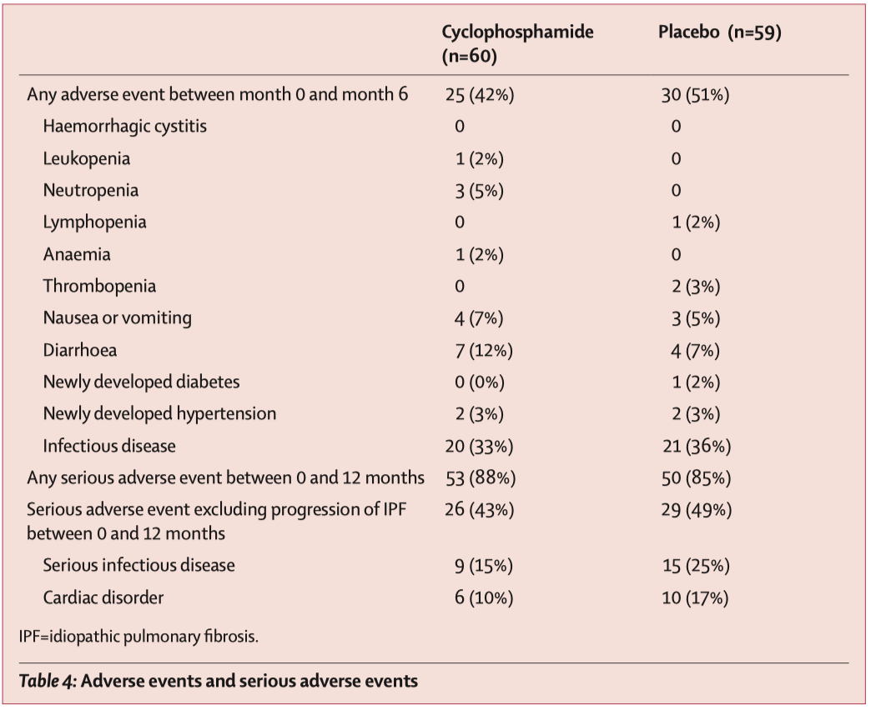
Results – Adverse events
Notes:
>Table4 : Adverse events
•25 (42%) patients in the cyclophosphamide group and 30 (51%) in the placebo group had an adverse event by the 6 months follow-up
•Leukopenia, neutropenia, lymphopenia, anaemia, and thrombopenia were present in less than 10% of the patients.
•No haemorrhagic cystitis was observed
•The overall incidence of serious adverse events did not differ notably between groups;
◦111 serious adverse events occurred in 53 (88%) of 60 patients in the cyclophosphamide group
◦135 events in 50 (85%) of 59 patients in the placebo group.

Slide 13
Discussion
In patients with acute exacerbation of IPF adding intravenous cyclophosphamide pulses to glucocorticoids
  Did not reduce all-cause mortality in patients with acute exacerbation of IPF
  Non-significant higher mortality at 3 month, especially in those with severe IPF
  Consistent with those of the PANTHER trial
Increased infection risk?
  But no difference in the incidence of all infectious-related serious adverse events.
No difference in 6 month morbidity?
  Suggesting the absence of a benefit of cyclophosphamide in this subgroup of patients
Limitations
  Mechanical ventilation of excluded
Notes:
Increased 3-month mortality (6mo에선 두드러지지 않음

Slide 14
Conclusion
These findings provide evidence against the use of intravenous cyclophosphamide
This is the first trial to show that in patients with acute exacerbation of IPF, cyclophosphamide has no clinical benefit.

Slide 15


