Slide 1
Journal Club
호흡기내과 강사 지현우

Slide 2
“You can leave your mask on”:
effects on cardiopulmonary parameters of different airway protective masks at rest and during maximal exercise.
Mapelli M, Salvioni E, De Martino F, Mattavelli I, Gugliandolo P, Vignati C, Farina S, Palermo P, Campodonico J, Maragna R, Lo Russo G, Bonomi A, Sciomer S, Agostoni P.
Eur Respir J. 2021 Sep 16;58(3):2004473.
doi: 10.1183/13993003.04473-2020. PMID: 33678608.

Slide 3
Introduction
COVID-19 pandemic has heavily influenced social life and health organization all over the world
The use of protective masks has been indicated as essential to reduce viral transmission
There is a general belief that their use is associated with shortness of breath during exercise and the need for greater respiratory effort even at rest

Slide 4
Introduction
In this study, we aimed to evaluate cardiorespiratory parameters, both rest and during maximal exertion, through a CPET to highlight any differences with the use of protective masks compared to normal conditions

Slide 5
Methods
Study design
: Interventional, prospective, randomized, double-blind and crossover
Study population
  Total 12 healthy subjects were enrolled in July 2020
  Inclusion criteria
  : age ≥18 years, signed informed consent
  Exclusion criteria
  : underlying cardiopulmonary disease, h/o COVID-19 infection, inability to perform maximal exercise, professional athletes

Slide 6
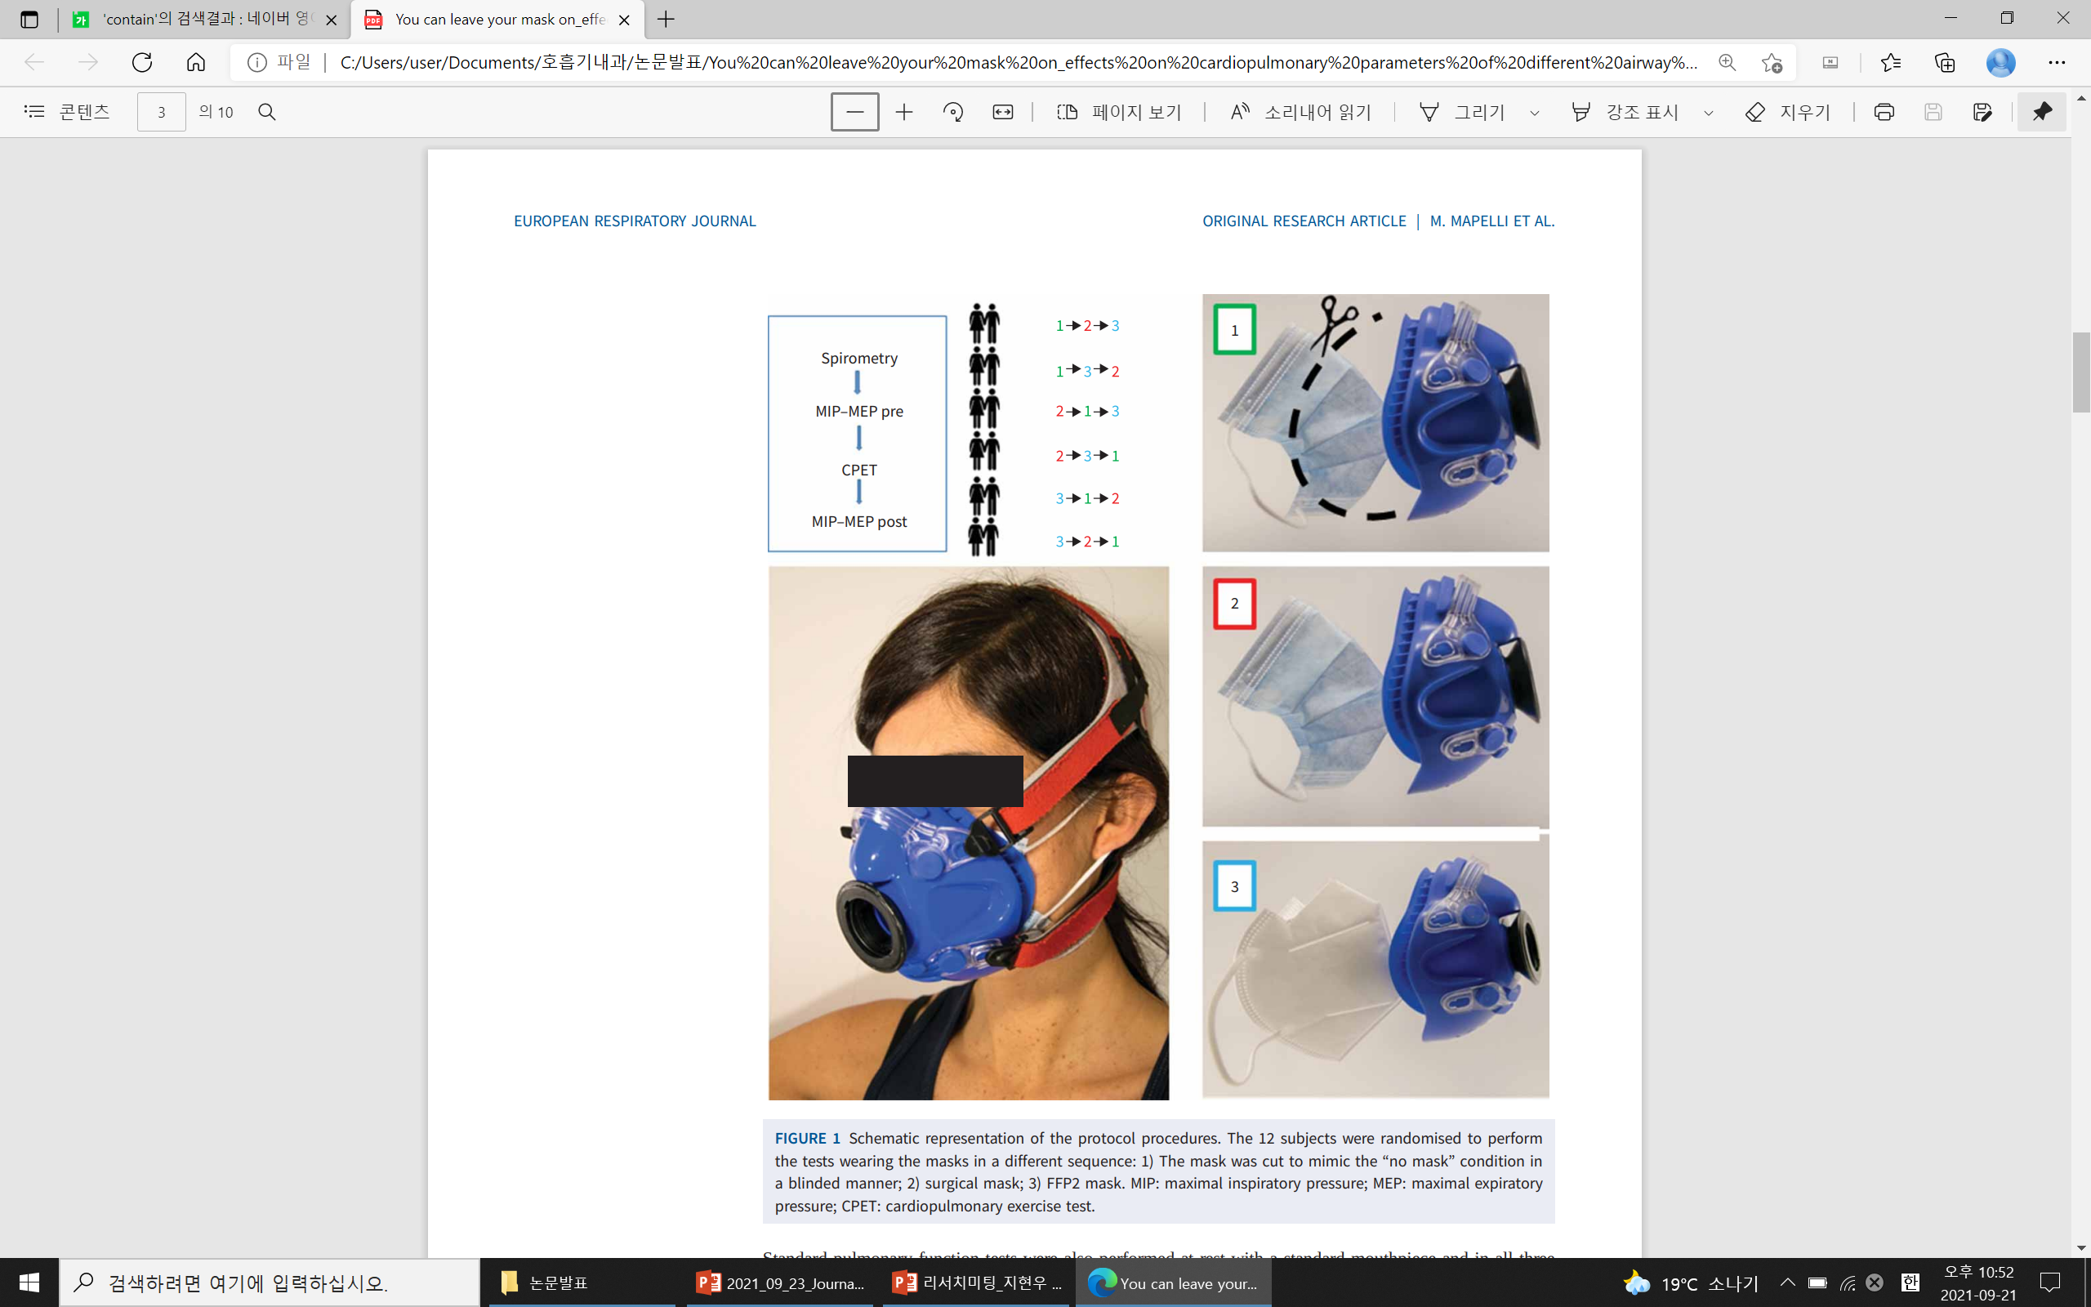
Methods
All subjects underwent three consecutive tests performed at least 24h apart but within a 2-week
No mask condition
Surgical mask
FFP2 mask

Slide 7


Methods

Slide 8
Methods
CPET
  Symptom-limited incremental exercise tests were performed on an electronically braked cycle ergometer using a personalized ramp protocol aimed at achieving peak exercise in ~10 min
  Monitoring
  : Ventilation rate(V_{E}), respiratory gases, hear rate, 12-lead ECG, saturation(S_{aO2}), blood pressure
  Calculated
    : Anaerobic threshold (V-slope analysis), Peak exercise (highest V_{O2}), Respiratory gas exchange ratio (V_{CO2}/V_{O2})

Slide 9
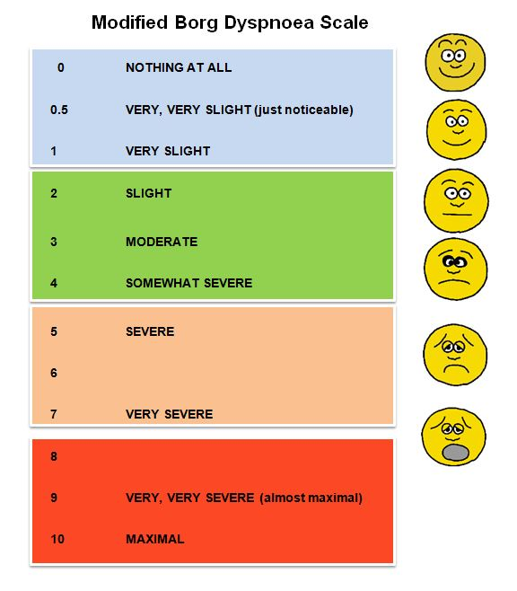
Methods
The Borg scale was used to assess the subjects’ degree of dyspnea at rest, after 3min, after 6min and at peak exercise

Slide 10
Methods
MIP, MEP were assessed immediately before and after the end of each exercise
Standard pulmonary function tests were also performed at rest with a standard mouthpiece and in all three study conditions through the CPET mask

Slide 11
Methods
Statistical analysis
  Differences between the three protocol conditions were analysed by ANOVA
  Trends were assessed by ANCOVA
  SAS statistical package v. 9.4 (SAS Institute Inc., Cary, NC, USA)
  Two-sided, p<0.05 was considered statistically significant

Slide 12
Result
Baseline
  All subjects completed the study protocol
  Age: 40.8±12.4 years
  Six male, Six female
  Spirometry : FEV₁ 108±19%, FVC 104±15%

Slide 13
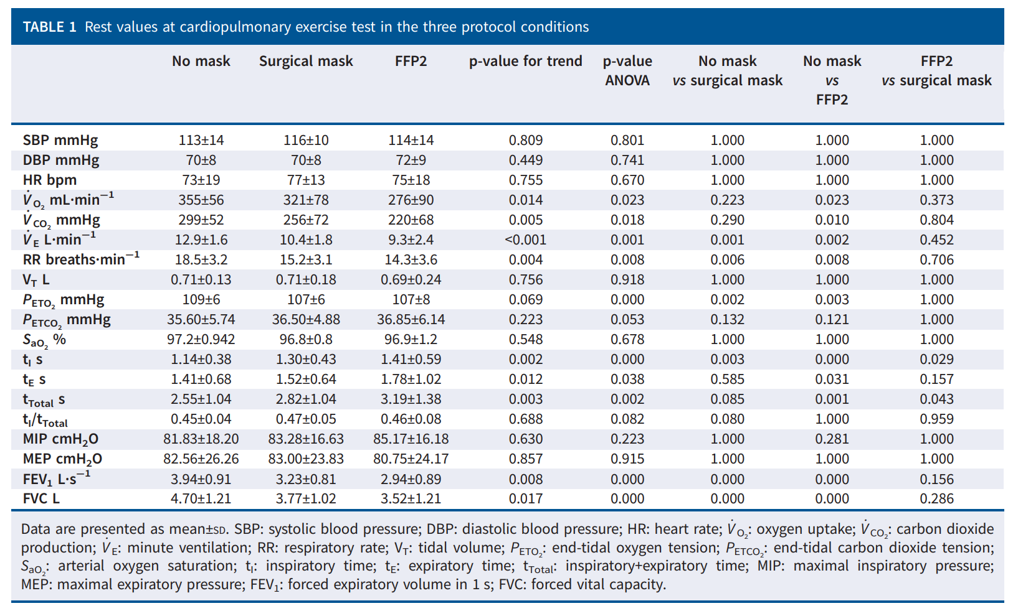
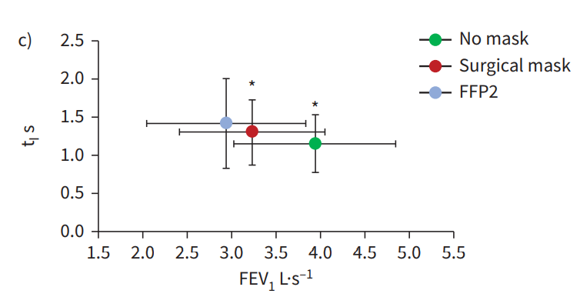
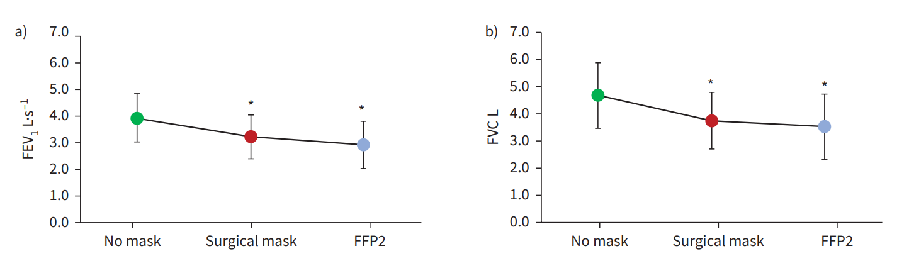
Results – Data at rest

Slide 14
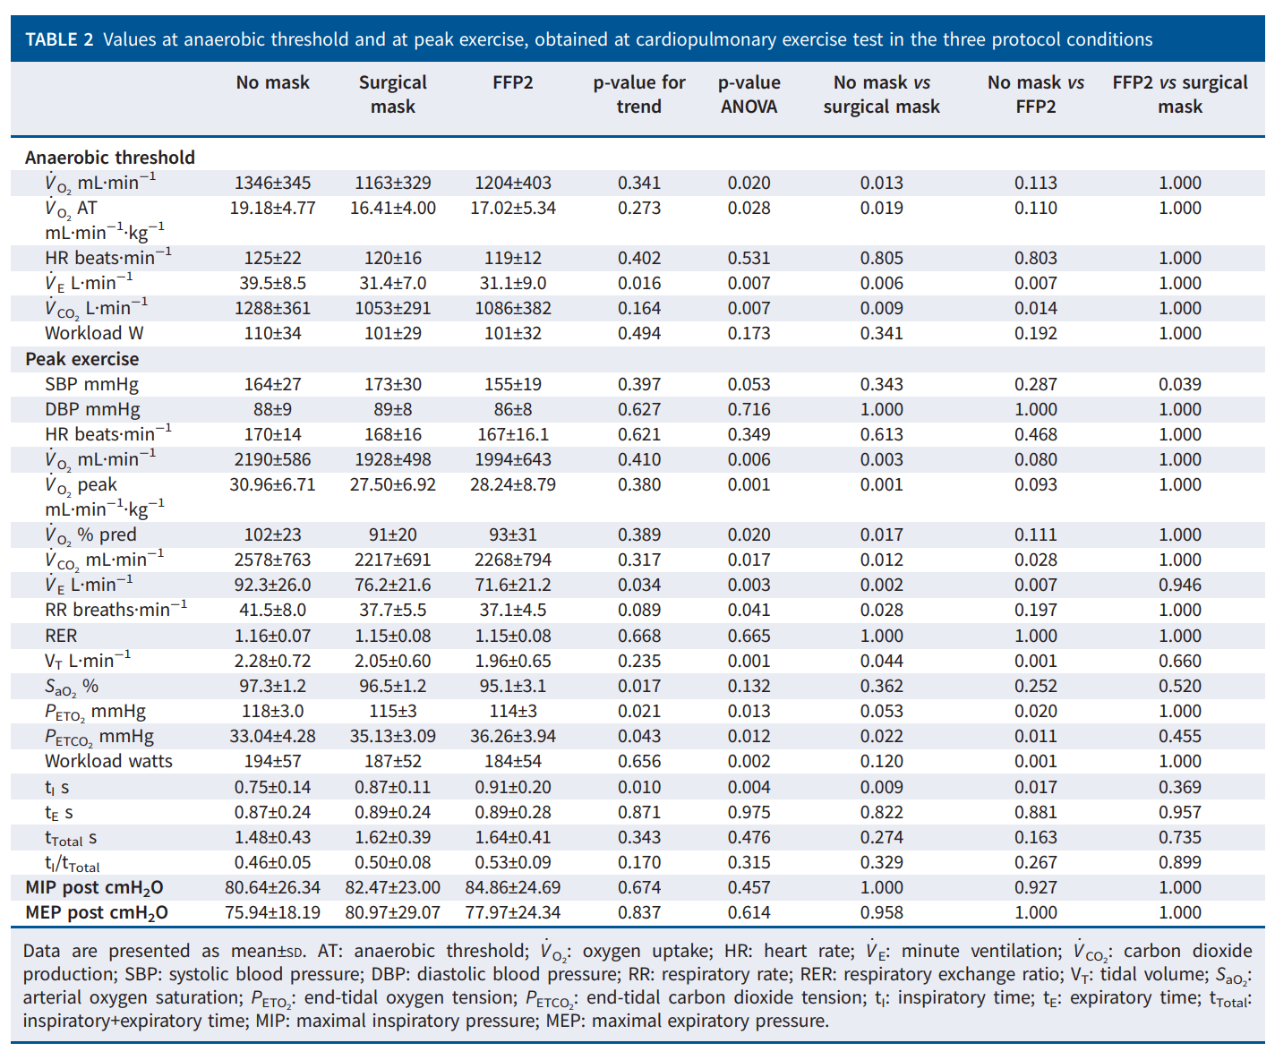
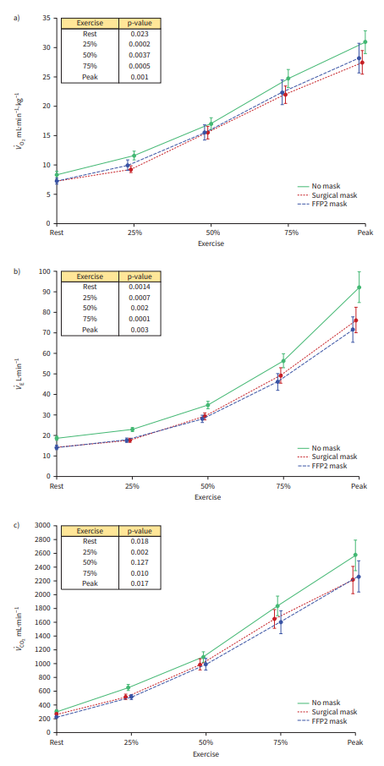
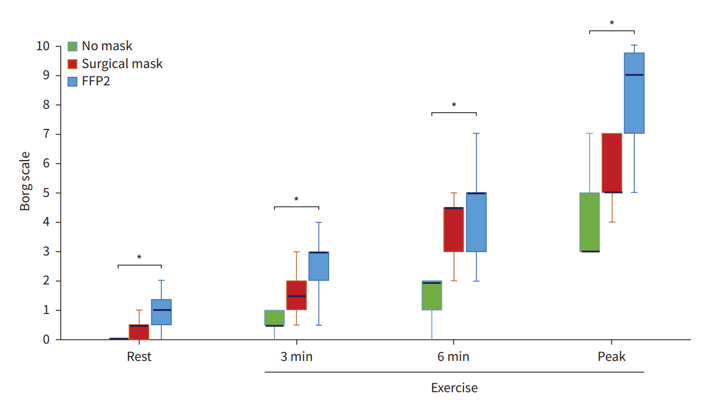
Results – Exercise data
V_{O2}/work: 9.7±1.0, 9.4±0.9, 9.7±1.3 respectively, p=NS
V_{E}/V_{CO2} slope (Ventilatory efficiency): 27.5±3.7, 28.1±3.7, 26.6±5.0 respectively, p=NS
Y-intercept: 4.9±2.1L, 3.3±1.4L, 3.5±1.4 respectively, p=NS

Slide 15
Discussion
In this experimental study, we demonstrated how the use of protective masks is associated with a significant worsening of FEV1 and FVC and of cardiorespiratory parameters both at rest and at peak exercise.
  At rest: V_{O2}↓, V_{CO2}↓, V_{E}↓
  → d/t RR reduction which was paralleled by an increase in t_{I}
  At exercise: Dyspnea↑, peak V_{O2}↓
  → d/t V_{E} reduction owing to a decrease in both RR and V_{T}
  with parallel increase in t_{I}

Slide 16
Discussion
The subjects were representative of the general population (peak V_{O2}: 102% of the predicted value)
Spirometry with different masks showed a reduction in FEV1 and FVC that was paralleled by a longer t_{I}. This datum is consistent with an increased resistance to airflow during inspiration
A progressive reduction of V_{E}, V_{O2}, V_{CO2} was observed. These changes could be explained by a rapid adaptation of chemoreceptor to the increased airflow resistance → to minimize their respiratory effort

Slide 17
Discussion
Protective masks did not affect gas exchange kinetics pattern, given than the V_{E}/V_{CO2}, V_{O2}/work relationships were unchanged
Of note, true ventilatory limitation was not observed
  Peak exercise breathing reserve always > 20L/min
We did not observe signs of respiratory fatigue, as shown by an unchanged peak exercise MIP and MEP, or ventilator limitation to exercise

Slide 18
Discussion
Limitations
  Flow/volume curves during exercise were not performed
  Our results were obtained in a population of middle-age healty subjects
  It is possible that the silicon mask per se influenced the respiratory function, albeit minimally
  Do not performed with different exercise protocols, or in different ambient conditions

Slide 19
Conclusions
In conclusion, the use of protective masks in healthy middle-aged subjects
  1) slightly influences cardiorespiratory variables at rest and during exercise
  2) reduced peak V_{O2} by ~10% due to an increase in airflow resistance, although V_{E} limitation was far from being reached
Accordingly, the general population should be aware that the use of protective masks in healthy subjects is associated with modest respiratory discomfort but their use is safe even during maximal exercise, albeit with a slightly reduction in performance

Slide 20
감사합니다.

