Slide 1


Allergic Bronchopulmonary Aspergillosis
Topic Review
호흡기내과 강사 박영목

Slide 2
Overview
Spectrum of Pulmonary Aspergillosis
Definition
Epidemiology
Pathogenesis
Symptoms & Signs
Radiology
Diagnosis
Treatment

Slide 3
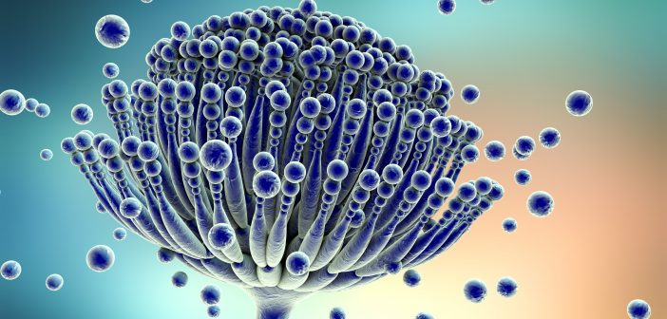
Aspergillus(누룩곰팡이): Saprophytic conidial mold
isolated abundantly from outdoor (i.e. soil, construction dust)
and indoor (i.e. hospitals) environment
Respir Med 2018 Aug; 141: 121-131
Notes:
Saprotrophs; organisms, particularly fungi, which obtain nutrients directly from dead organic matter or wastes
부생성, 부생균류, 동식물의 죽은 조직 등 생명이 없는 유기물에서 양분을 흡수하는 병원체
A conidium (분생자, Spore, plural conidia), sometimes termed an asexual chlamydospore or chlamydoconidium (plural chlamydoconidia),^{[1]} is an asexual,^{[2]} non-motile spore of a fungus.

Slide 4
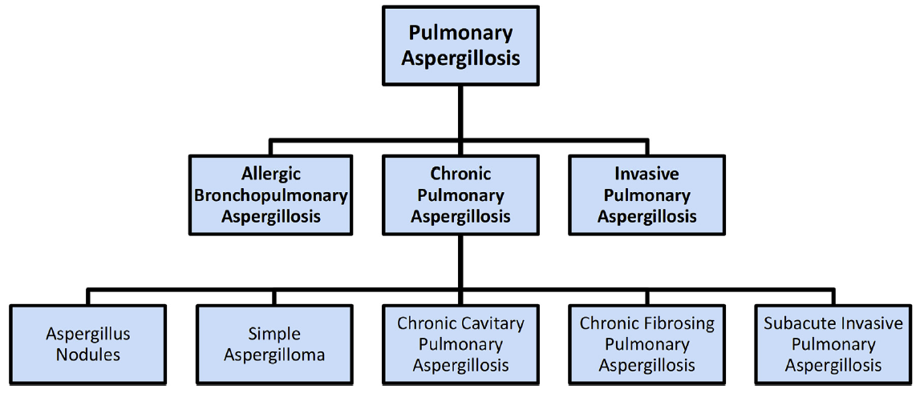
Spectrum of Pulmonary Aspergillosis
Respir Med 2018 Aug; 141: 121-131

Slide 5
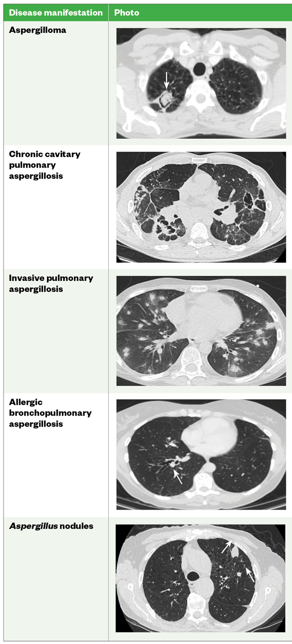
Pulmonary Aspergillosis

Slide 6
ABPA
Definition
ABPA is a complex hypersensitivity reaction in response to colonization of the airways with Aspergillus fumigatus that occurs almost exclusively in patients with asthma or cystic fibrosis
Prevalence
  Among patients with persistent asthma – 1~2%, up to 28%
  Among patients with cystic fibrosis – 2~9%
  Rarely in BRC, Chronic granulomatous disease, and Lung T recipients
Up To Date

Slide 7
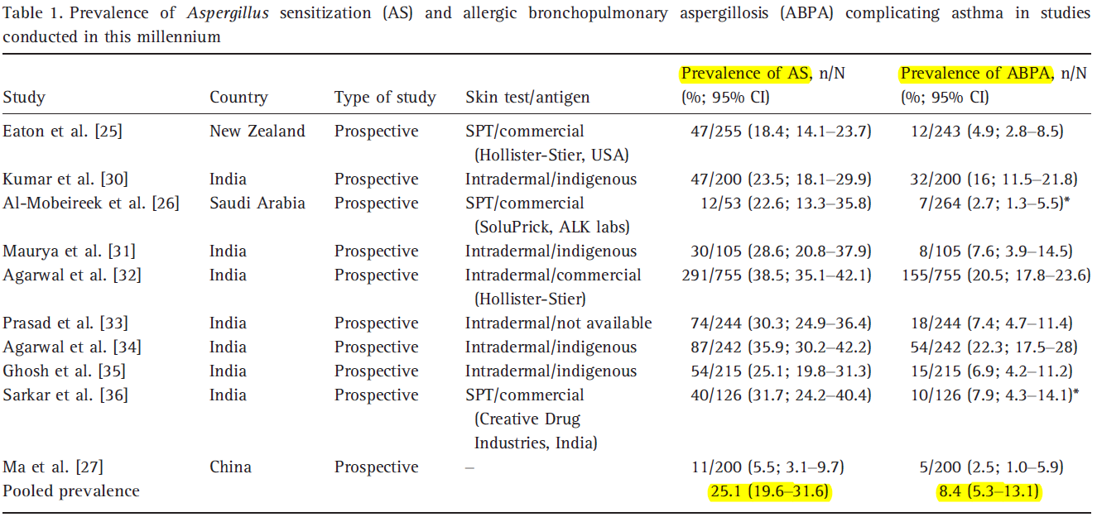
Asthma: 193 million
ABPA: 4.8 million (range 1.4–6.8)
Clin Exp Allergy. 2013 Aug; 43(8): 850-73

Slide 8
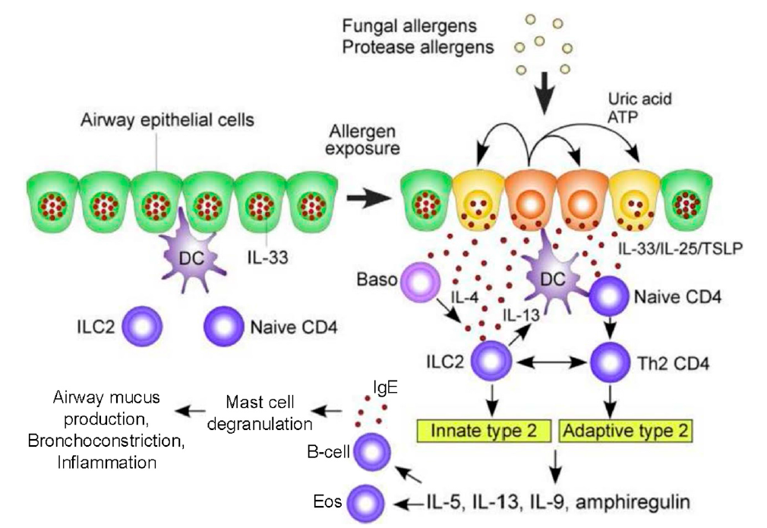
J Fungi (Basel). 2016 Jun 6; 2(2)

Slide 9
Symptom & Sign
Poorly controlled asthma (but, 19% of ABPA pts had well-controlled asthma)
Wheezing
Hemoptysis
Productive cough
Low grade fever
Weight loss
Malaise
Fatigue

Slide 10
Radiology
Usual findings
  Bronchiectasis (central)
  Mucoid impaction
  Mosaic attenuation
  Centrilobular nodules
  Tree-in-bud opacities
  Pleuropulmonary fibrosis
Uncommon
  Milliary nodular opacities, perihilar opacities simulating hilar LNE, pleural effusions, pulmonary masses

Slide 11
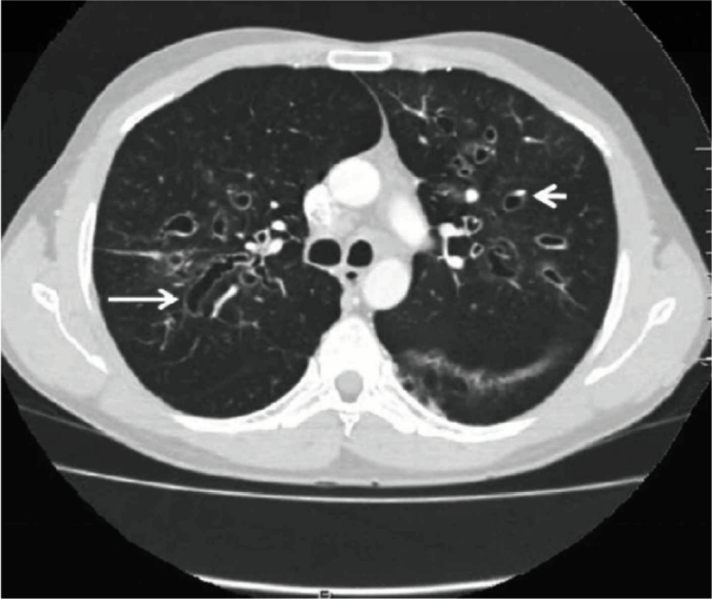
Central bronchiectasis
Cureus. 2019; 11(4): e4550

Slide 12
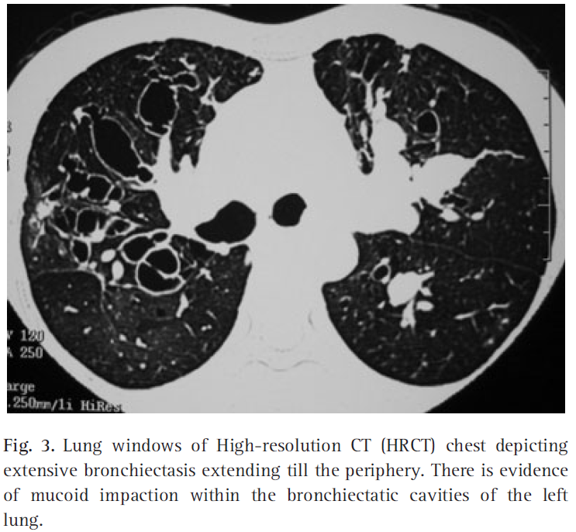
Extensive bronchiectasis
Clin Exp Allergy. 2013 Aug; 43(8): 850-73

Slide 13
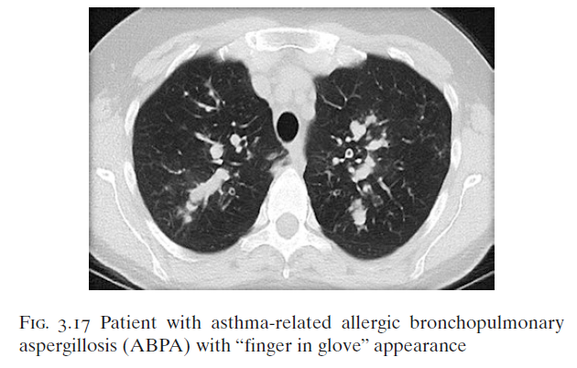
Finger in glove
M.M. Salvatore et al. (2018) Chest CT for Non-Radiologist. Switzerland: Springer

Slide 14
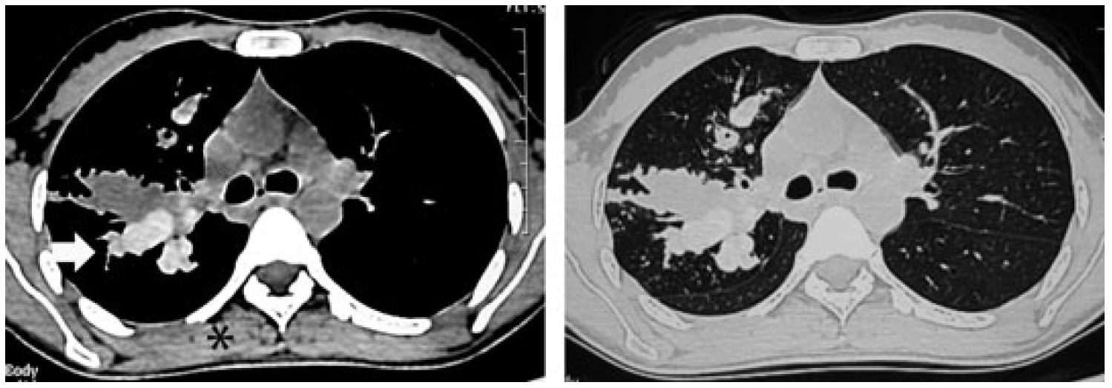
High-attenuation mucus (HAM)
Pathognomonic (100% specificity)
Independent predictor of poor outcomes
Clin Exp Allergy. 2013 Aug; 43(8): 850-73
Notes:
Eosinophilic mucus plug ??
Mucoid impaction of airways is a common finding.
Mucus plugs in ABPA are generally hypodense but can have high CT attenuation values in up to 20% of patients [84]. High-attenuation mucus (HAM), defined as mucus visually denser than paraspinal skeletal muscle, is a pathognomonic finding of ABPA (Fig. 4) [32,115–117]. High-attenuation mucus remains an important radiological sign in distinguishing ABPA from other causes of bronchiectasis as its presence confirms ABPA as the cause of the underlying bronchiectasis.

Slide 15
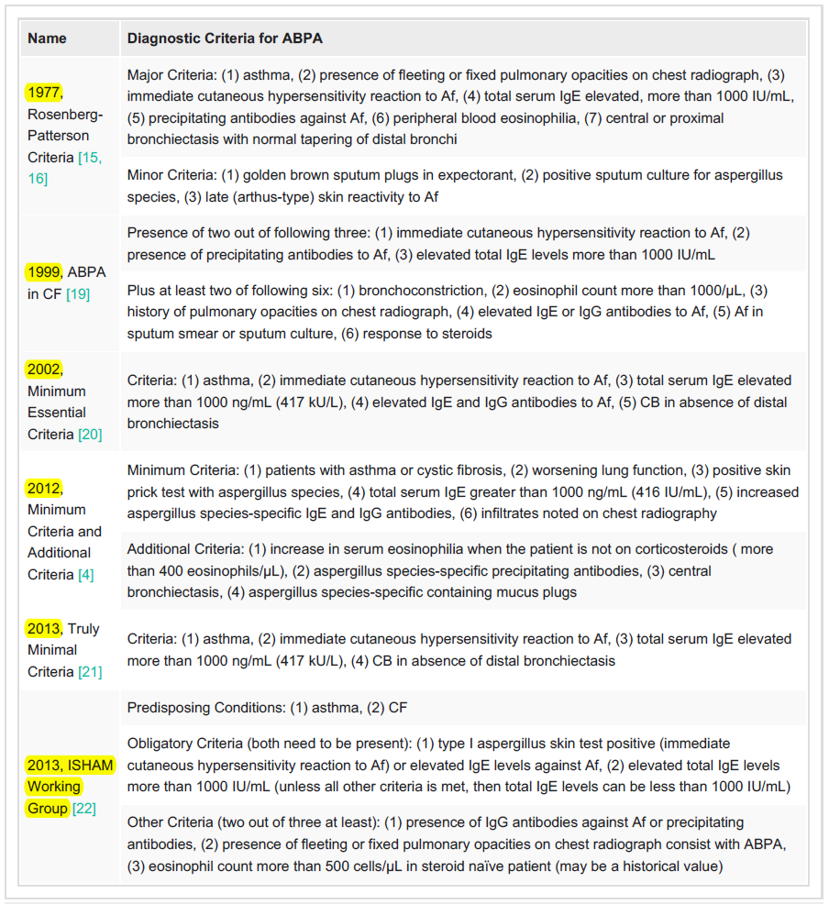

Slide 16

Diagnosis
Predisposing conditions – Bronchial Asthma, Cystic fibrosis
Obligatory criteria (both should be present)
  Positive Type I Aspergillus skin test (immediate cutaneous hypersensitivity to Aspergillus antigen) OR elevated IgE against A. fumigatus
  Total IgE levels (>1000 IU/mL)
Other criteria (at least two of three)
  Serum precipitating OR IgG antibodies against A. fumigatus
  Radiographic pulmonary opacities consistent with ABPA
  Total eosinophil count >500 cells/mcL in steroid naïve patients (may be historical)
Clin Exp Allergy. 2013 Aug; 43(8): 850-73
Notes:
Culture of A. fumigatus in sputum is supportive but not diagnostic of ABPA because the fungus can also be grown in other
pulmonary diseases due to ubiquitous nature of the fungi.
Bronchial provocation with Aspergillus antigens are not recommended as it can cause fatal bronchospasm.
Routine pulmonary function tests are helpful in categorizing the severity of asthma and the underlying lung disease. However, lung function tests can be normal in ABPA and a normal spirometry should not exclude the diagnosis of ABPA [84].

Slide 17
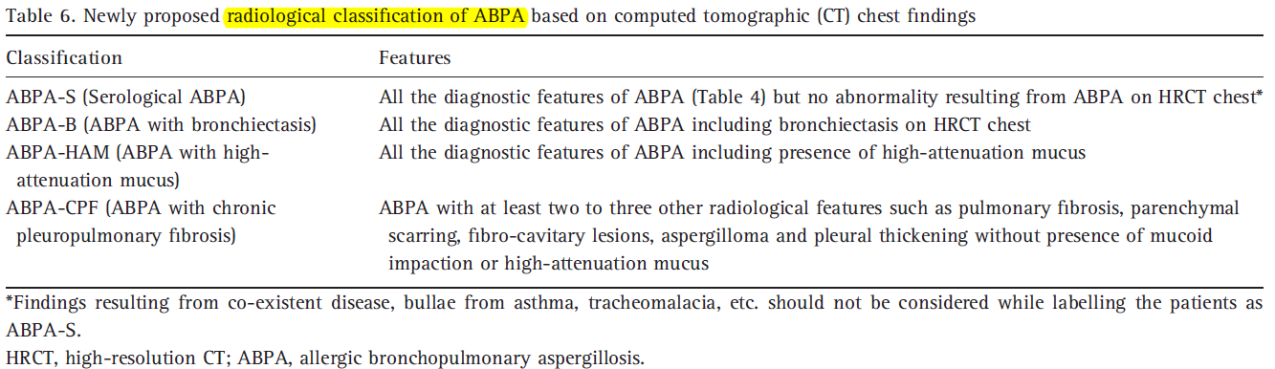
Radiological classification
Clin Exp Allergy. 2013 Aug; 43(8): 850-73

Slide 18
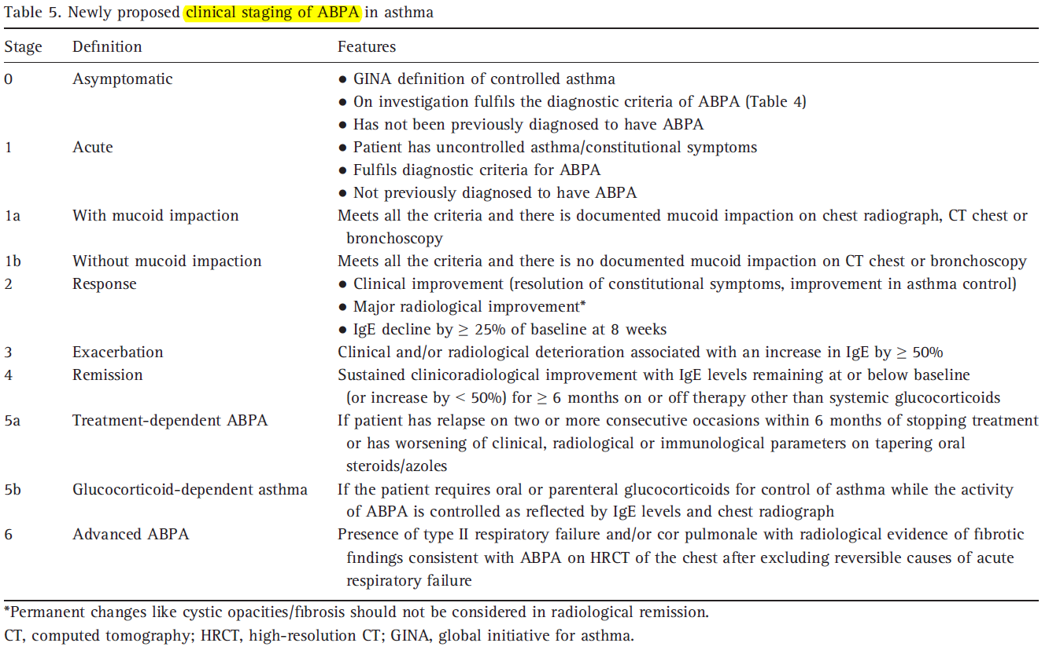
Clin Exp Allergy. 2013 Aug; 43(8): 850-73

Slide 19
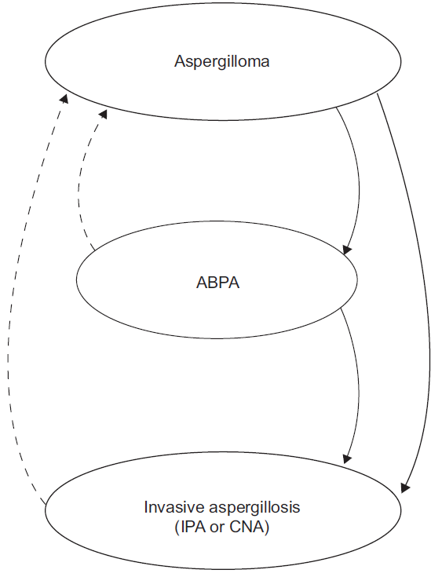
Natural course
Untreated?
Inexorable inflammatory process causing…
  Large airway collapse
  Bronchiectasis
  Chronic pulmonary aspergillosis
  Cor pulmonale
  Type 2 respiratory failure
Eur Respir Rev 2011; 20: 121, 156-174
Clin Exp Allergy. 2013 Aug; 43(8): 850-73
Notes:
Aspergillus overlap syndrome

Slide 20
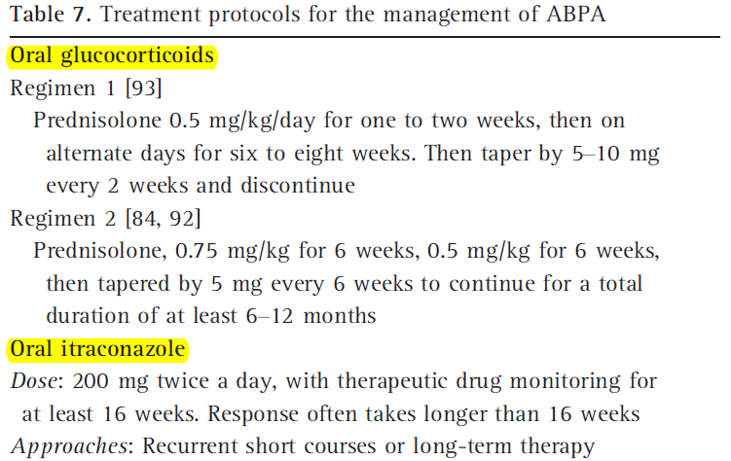
Treatment
Clin Exp Allergy. 2013 Aug; 43(8): 850-73

Slide 21
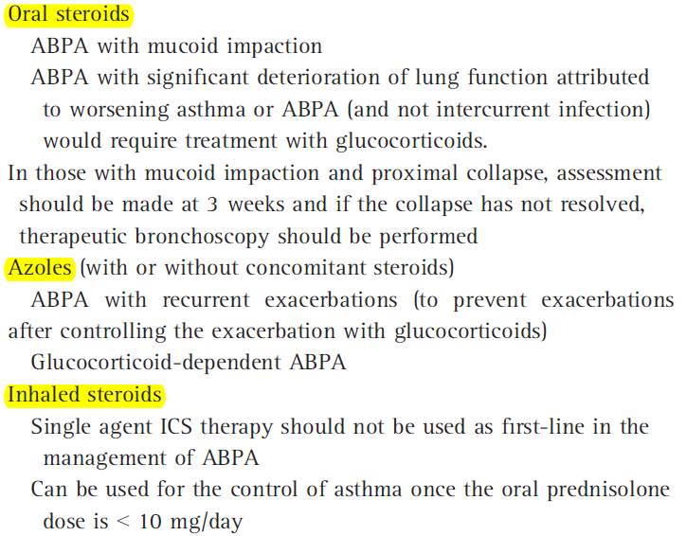
Which agent to use?
Clin Exp Allergy. 2013 Aug; 43(8): 850-73

Slide 22
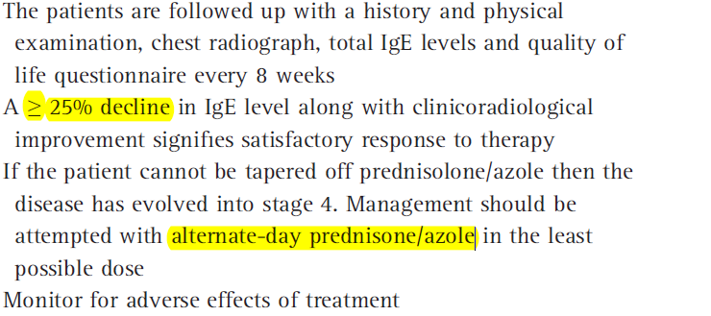
Follow-up and monitoring
Clin Exp Allergy. 2013 Aug; 43(8): 850-73

Slide 23
Other therapies
Nebulized amphotericin and ICS
Omalizumab (humanized monoclonal antiboty against IgE)
Steroid pulse for severe exacerbation of ABPA
Voriconazole, Posaconazole
Nebulized hypertonic saline (7%, 4-5mL)
Environmental control – avoid gardening, agricultural and farm-related activities

Slide 24
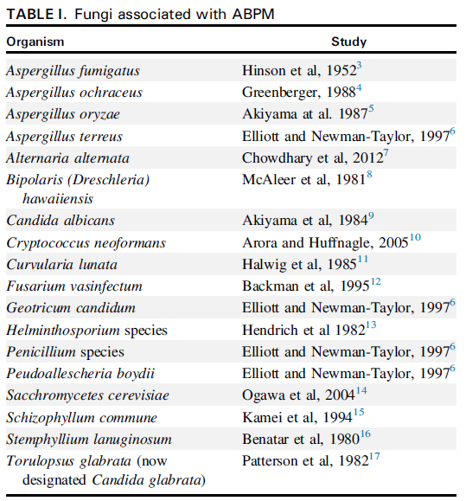
Allergic bronchopulmonary mycosis (ABPM)
JACI 2014 Nov; 2(6):703-8
Notes:
Rare disease with less than 150 cases reported globally

Slide 25
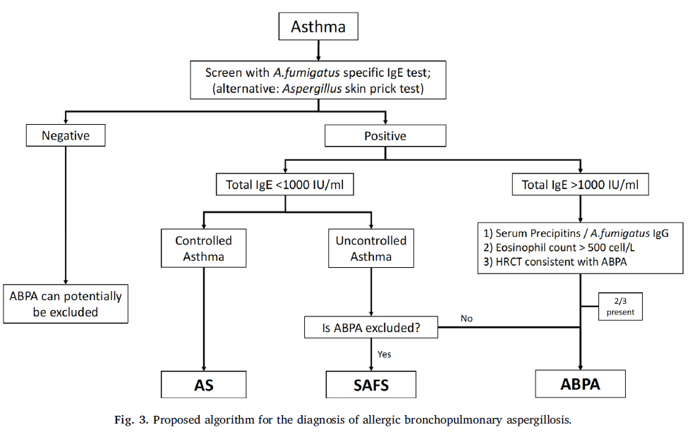
Summary
Respir Med 2018 Aug; 141: 121-131
Notes:
Aspergillus sensitization (AS)
Severe asthma with fungal sensitization (SAFS)

Slide 26


