Slide 1
Research Meeting
Mortaility and Sepsis prediction Model
M.D. Sung

Slide 2
Mortality and Sudden Cardiac Arrest

Slide 3
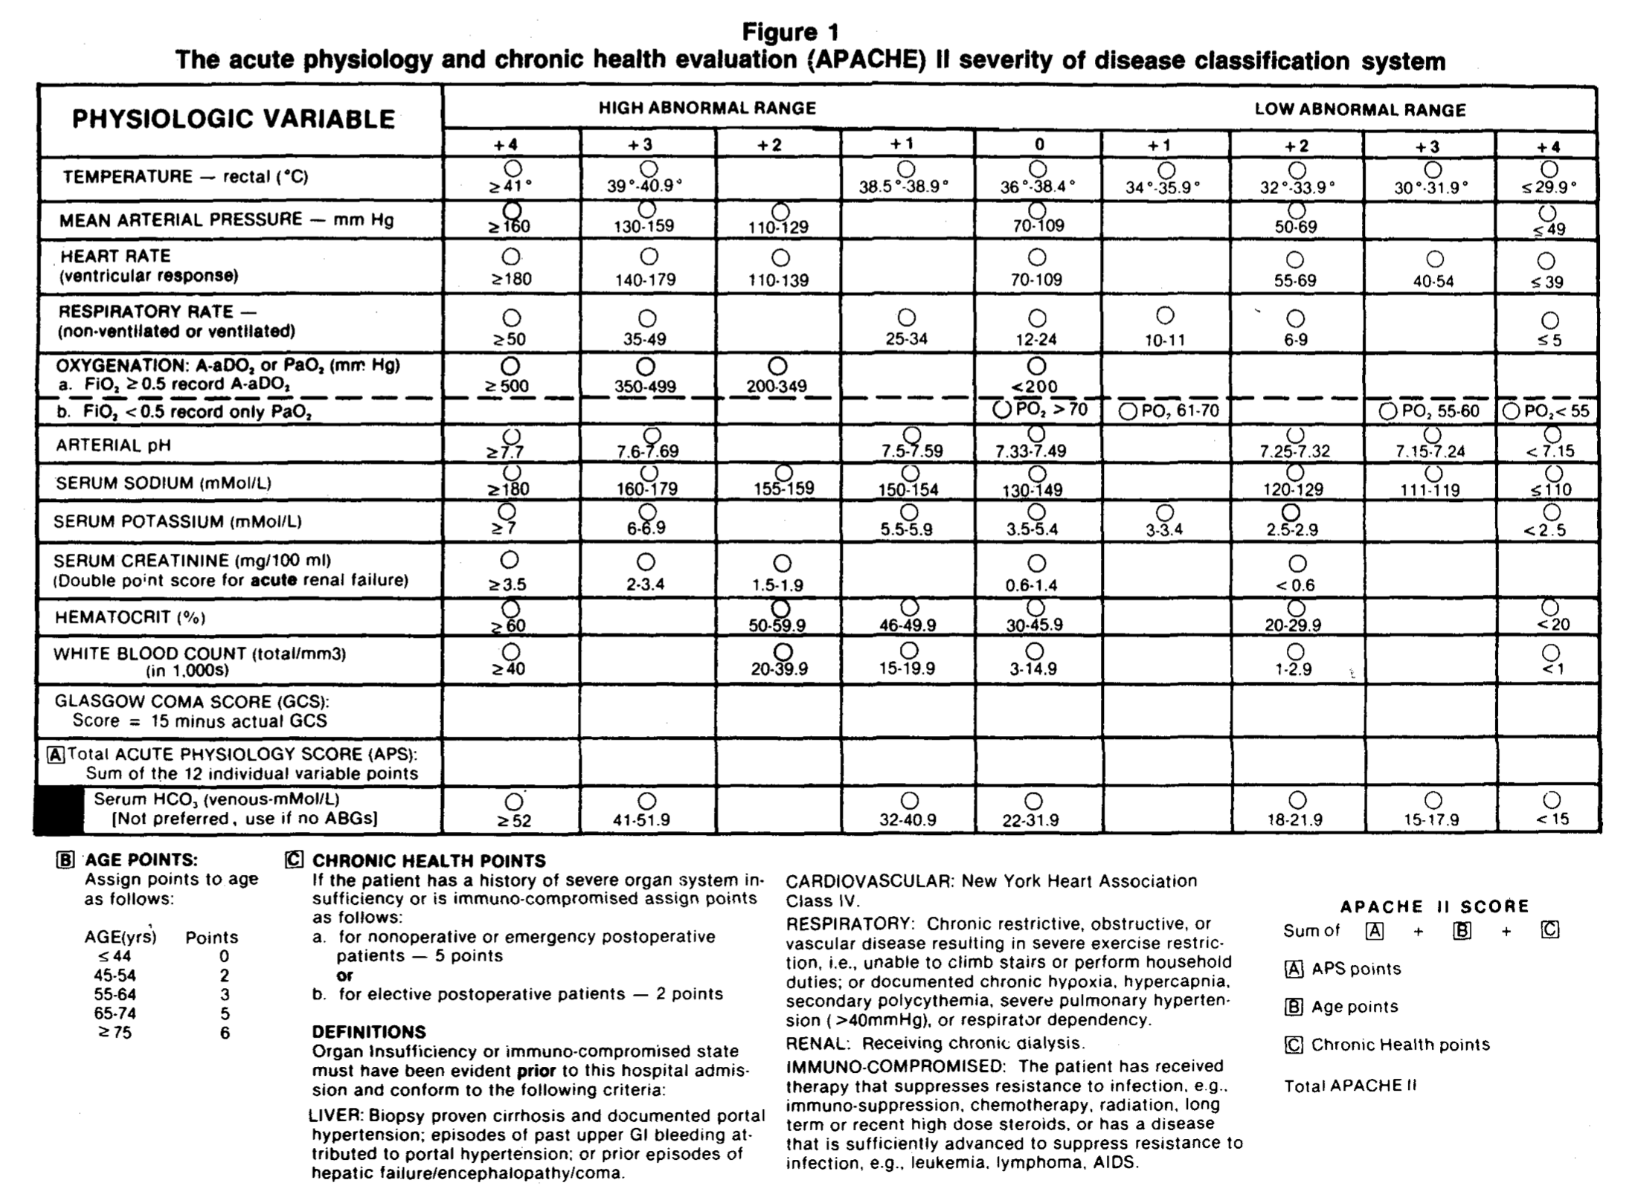

Slide 4
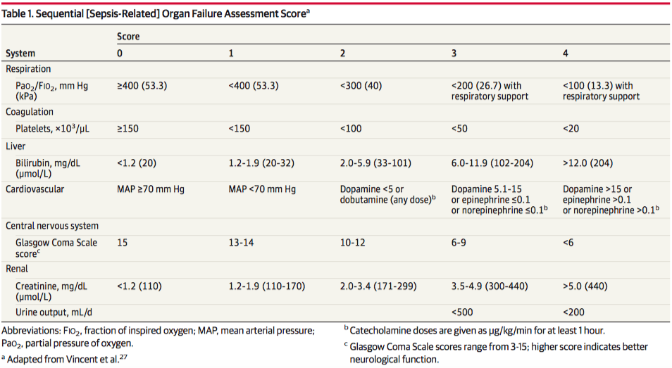

Slide 5
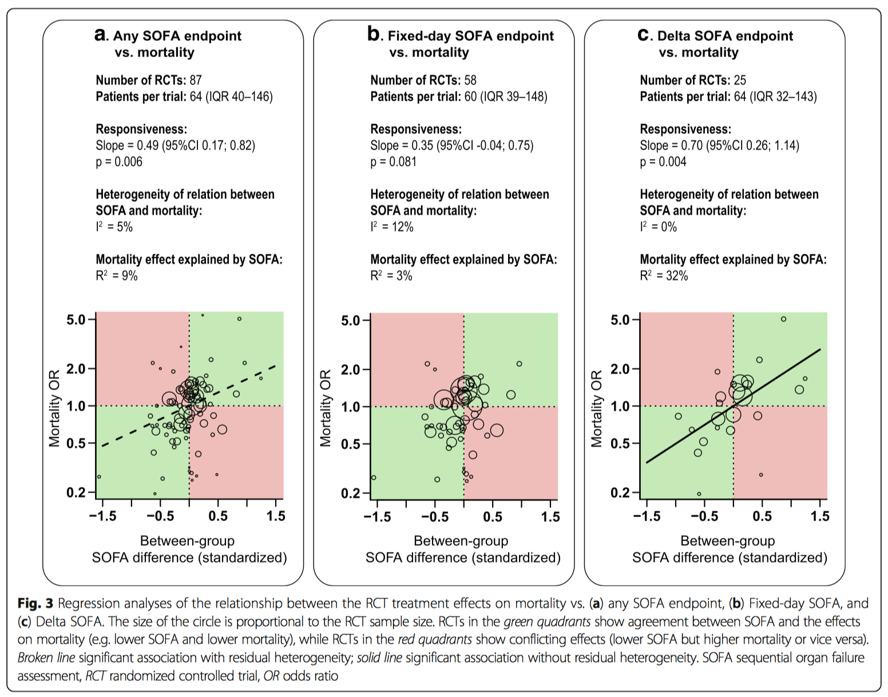
de Grooth, H.-J., et al.(2017). SOFA and mortality endpoints in randomized controlled trials: a systematic review and meta-regression analysis, 1–9.

Slide 6
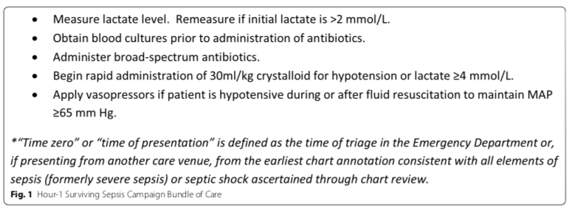
Sepsis – 1Hr. Bundle

Slide 7
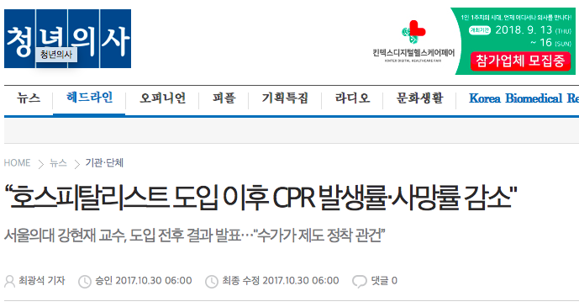

Slide 8
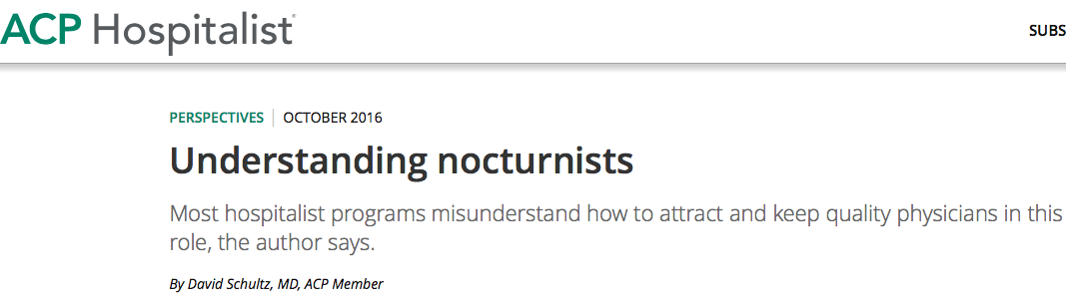

Slide 10
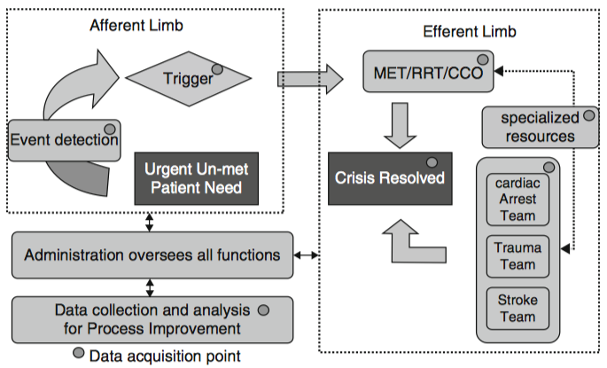
Rapid Response System

Slide 12
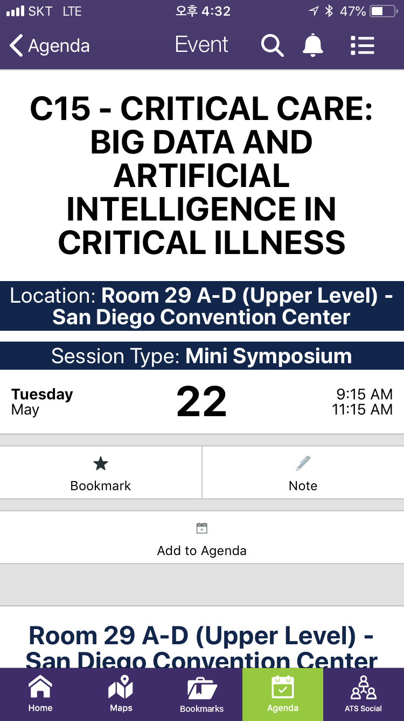

Slide 13


Slide 14
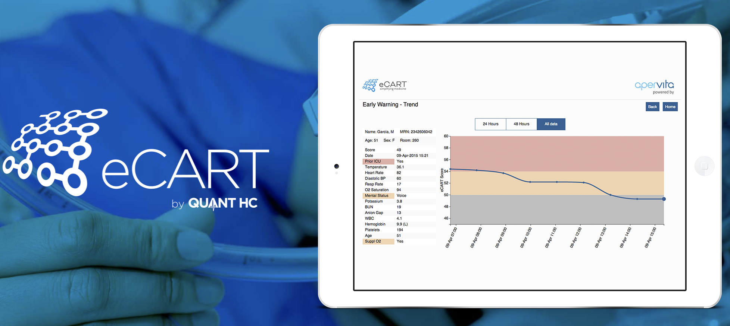

Slide 15
ICU
WARD
Mortality
Mortality
Sepsis
Sepsis

Slide 16
Severance
ICU
MIMIC III
Mortality
Sepsis

Slide 17


Slide 18
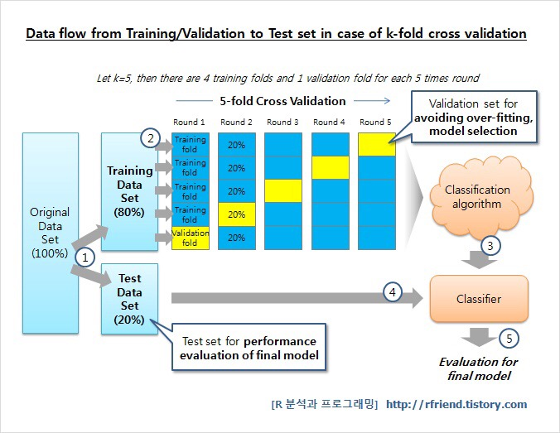
Machine Learning Pipeline

Slide 19
Mortality And Cardiac arrest

Slide 20
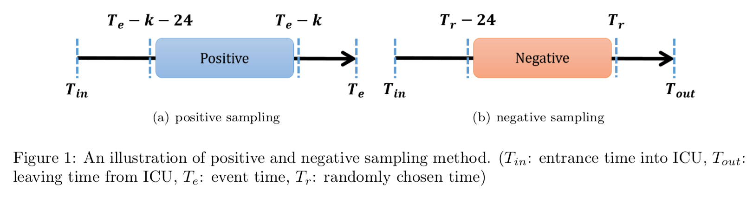

Slide 21
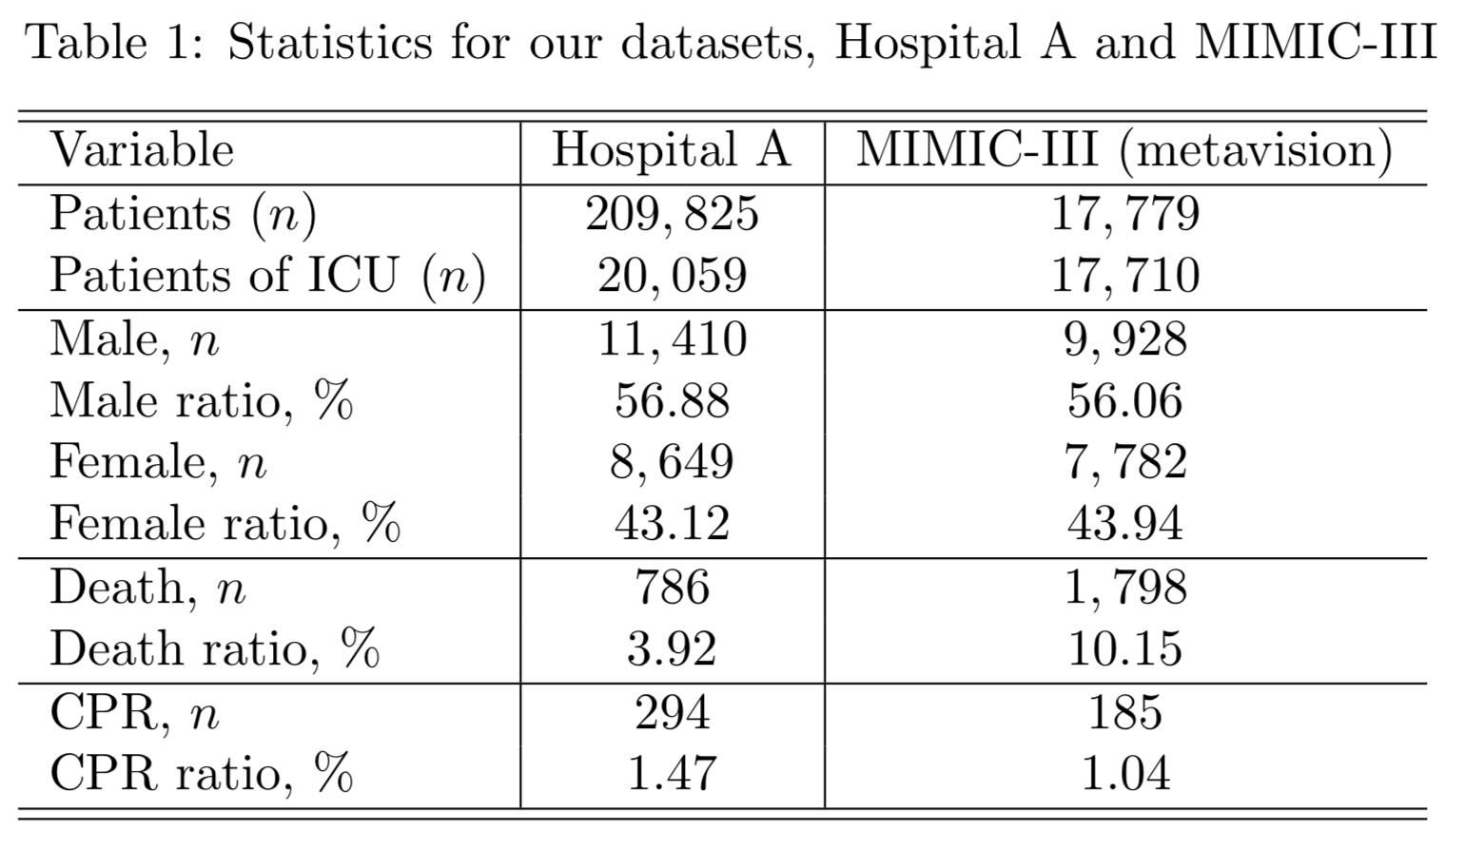

Slide 22
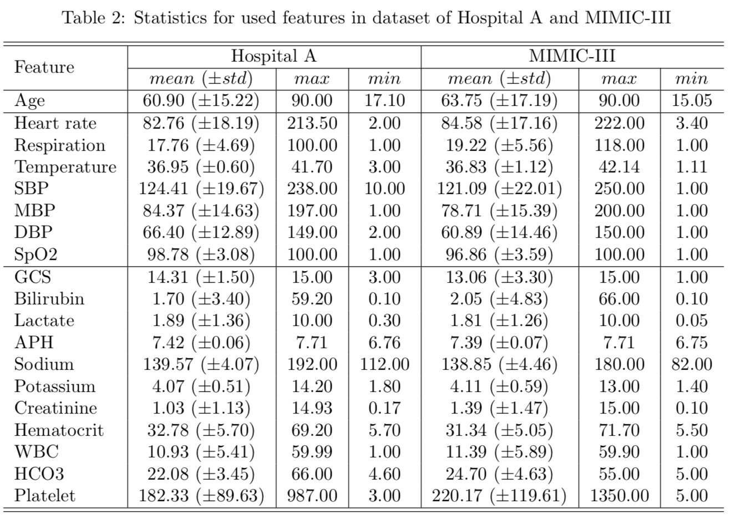

Slide 23
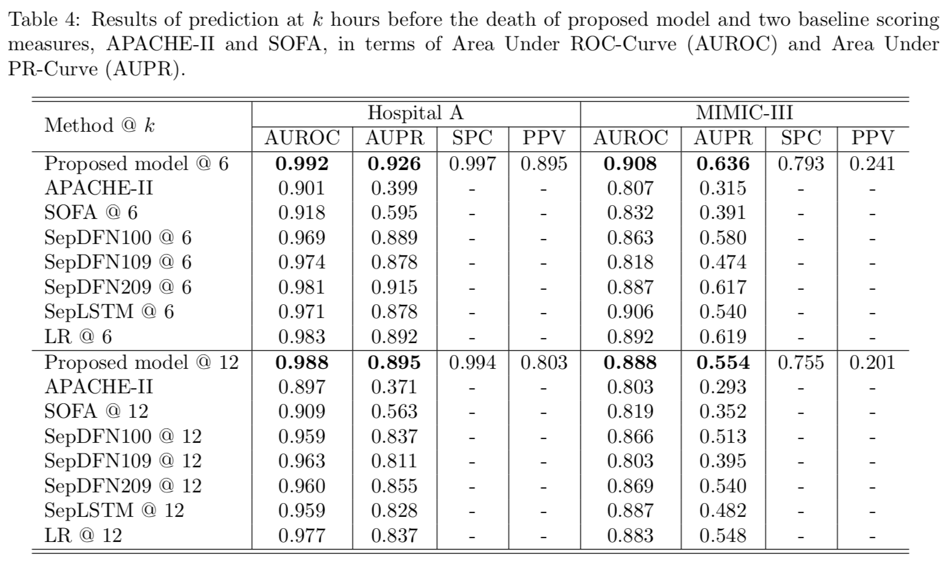

Slide 24
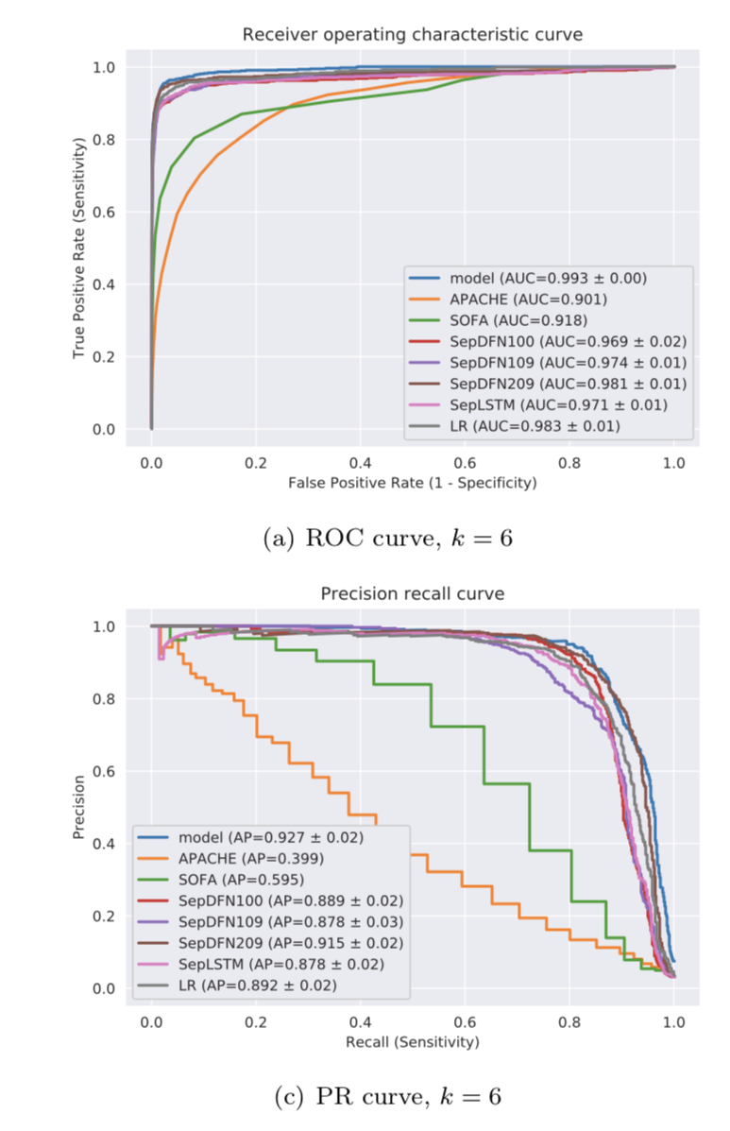
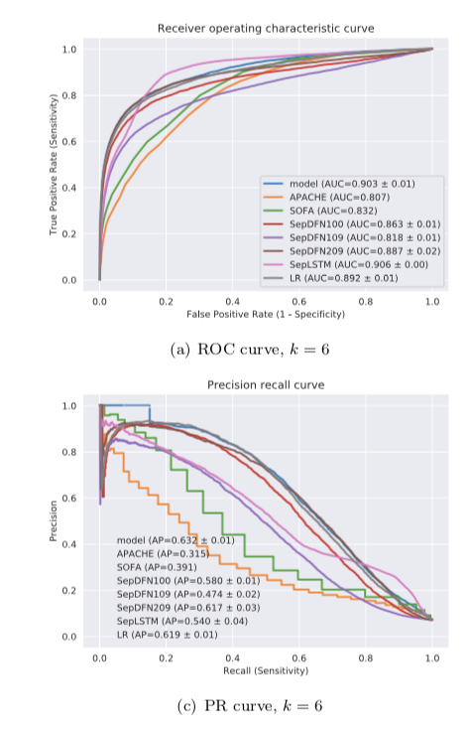
Severance hospital and AUROC
MIMIC III and AUROC

Slide 25
Sepsis

Slide 26
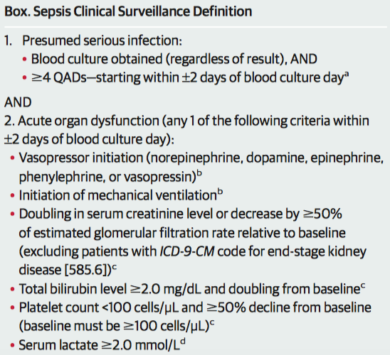
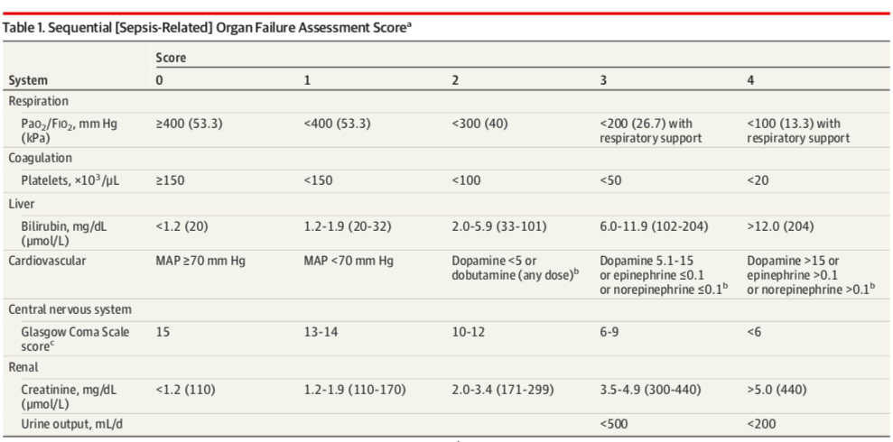
Life threatening
INFECTION
Host dysregulation
Organ Dysfunction
SOFA score

Slide 27
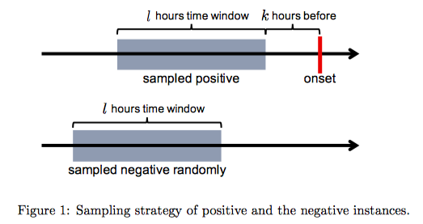
Model
Features
Features

Slide 28
Features
K hours ago
Event

Slide 29
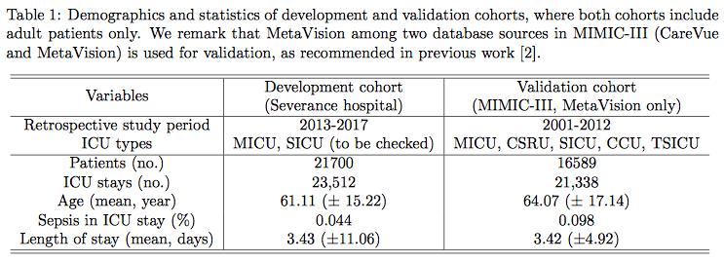
MICU, SICU, HICU, NCIU, CCU

Slide 30
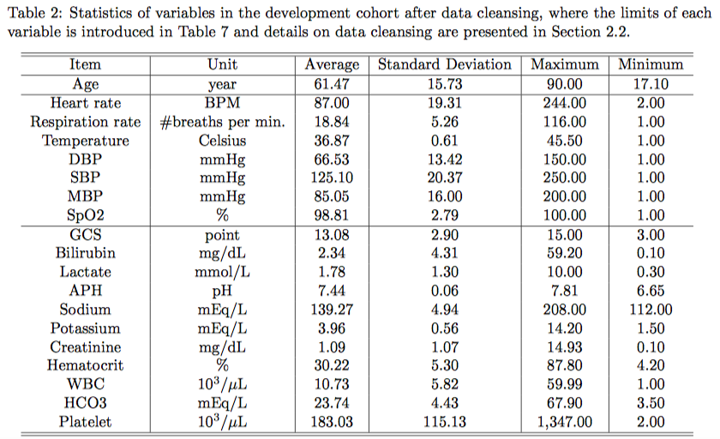

Slide 31
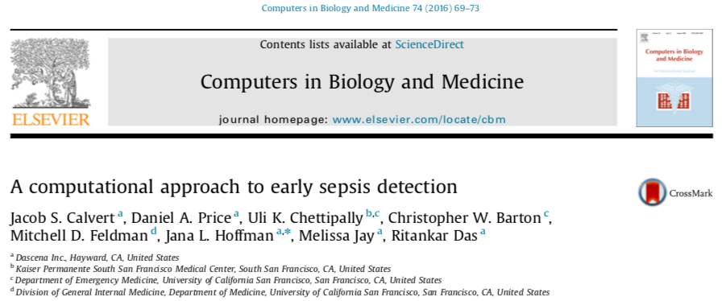
Calvert, J. S., et al. (2016). A computational approach to early sepsis detection. Computers in Biology and Medicine, 74(C), 69–73.

Slide 32
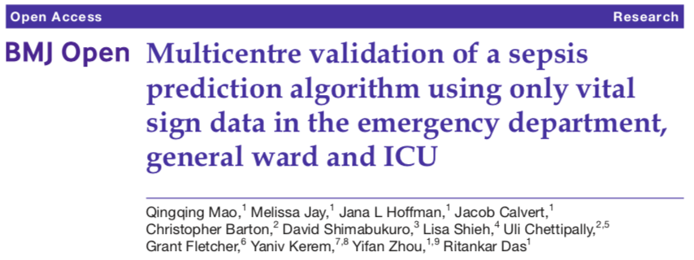
Mao, Q., et al. (2018). Multicentre validation of a sepsis prediction algorithm using only vital sign data in the emergency department, general ward and ICU.
BMJ Open, 8(1), e017833–11.

Slide 33
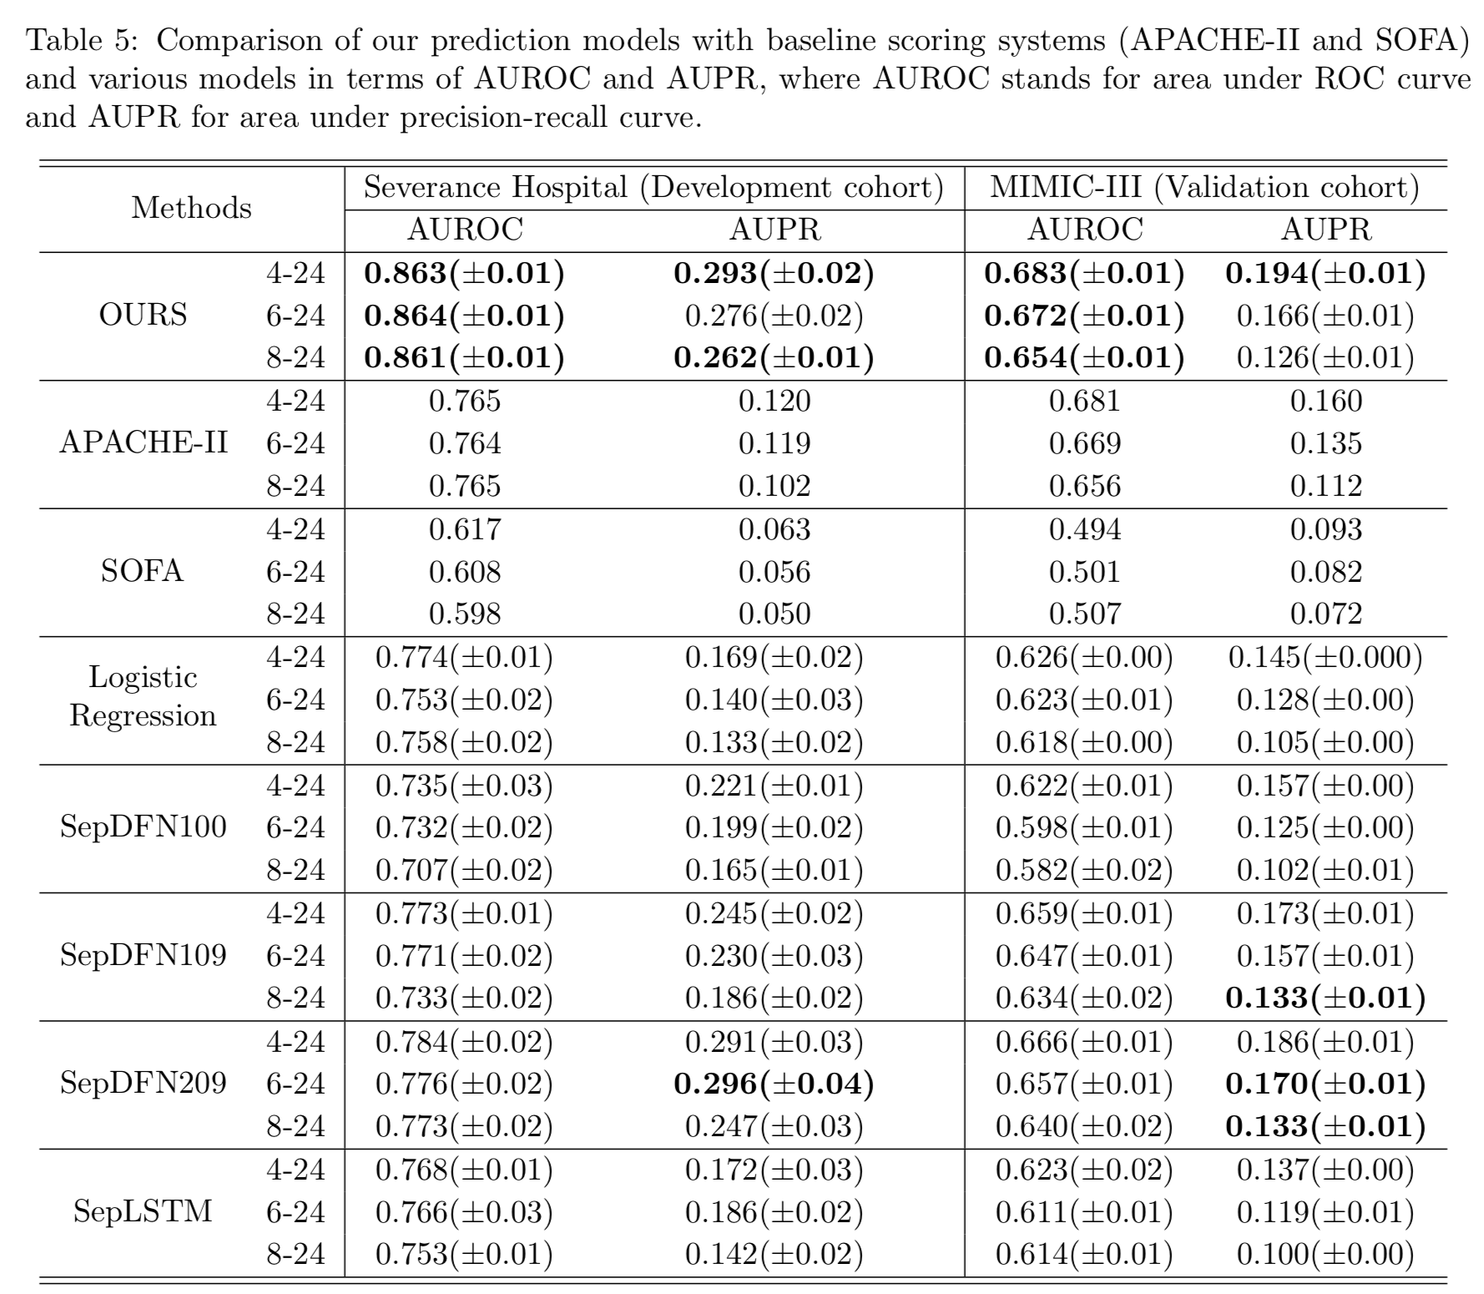

Slide 34
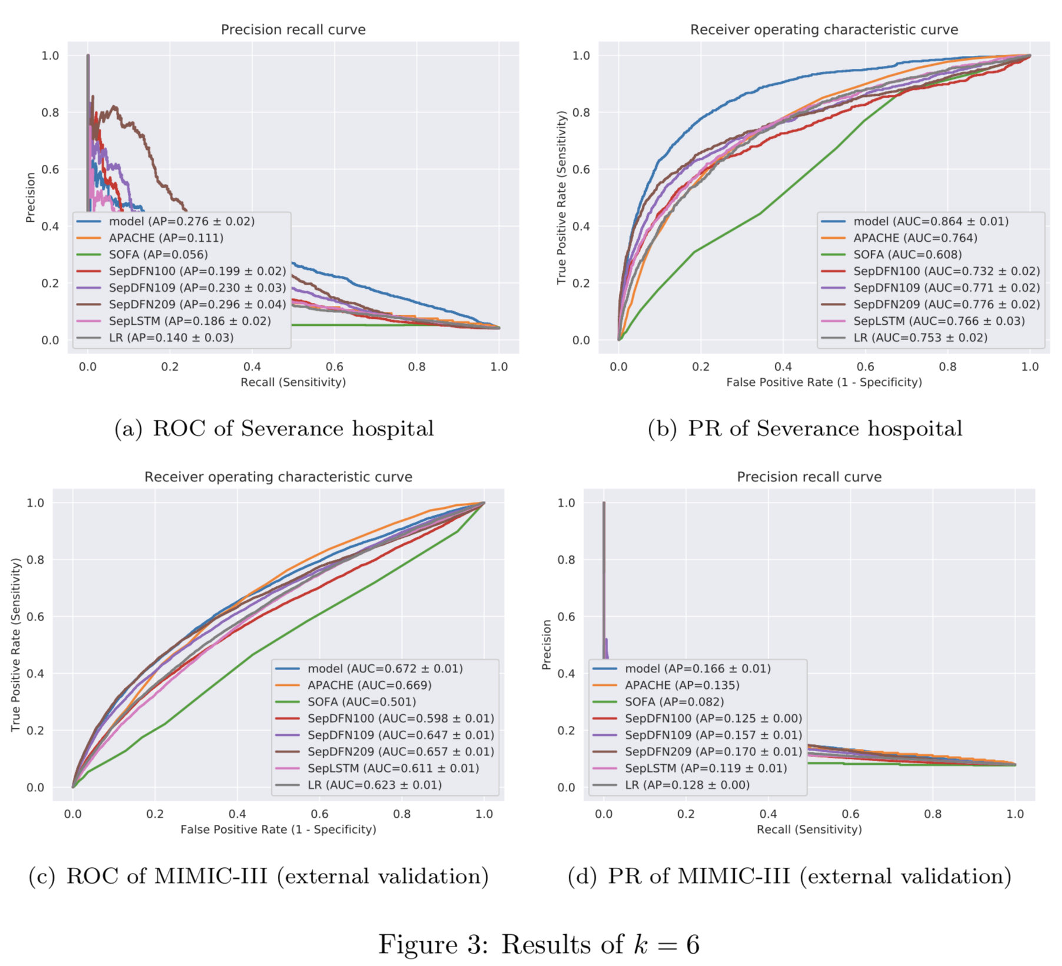

Slide 35
In the future…

Slide 36
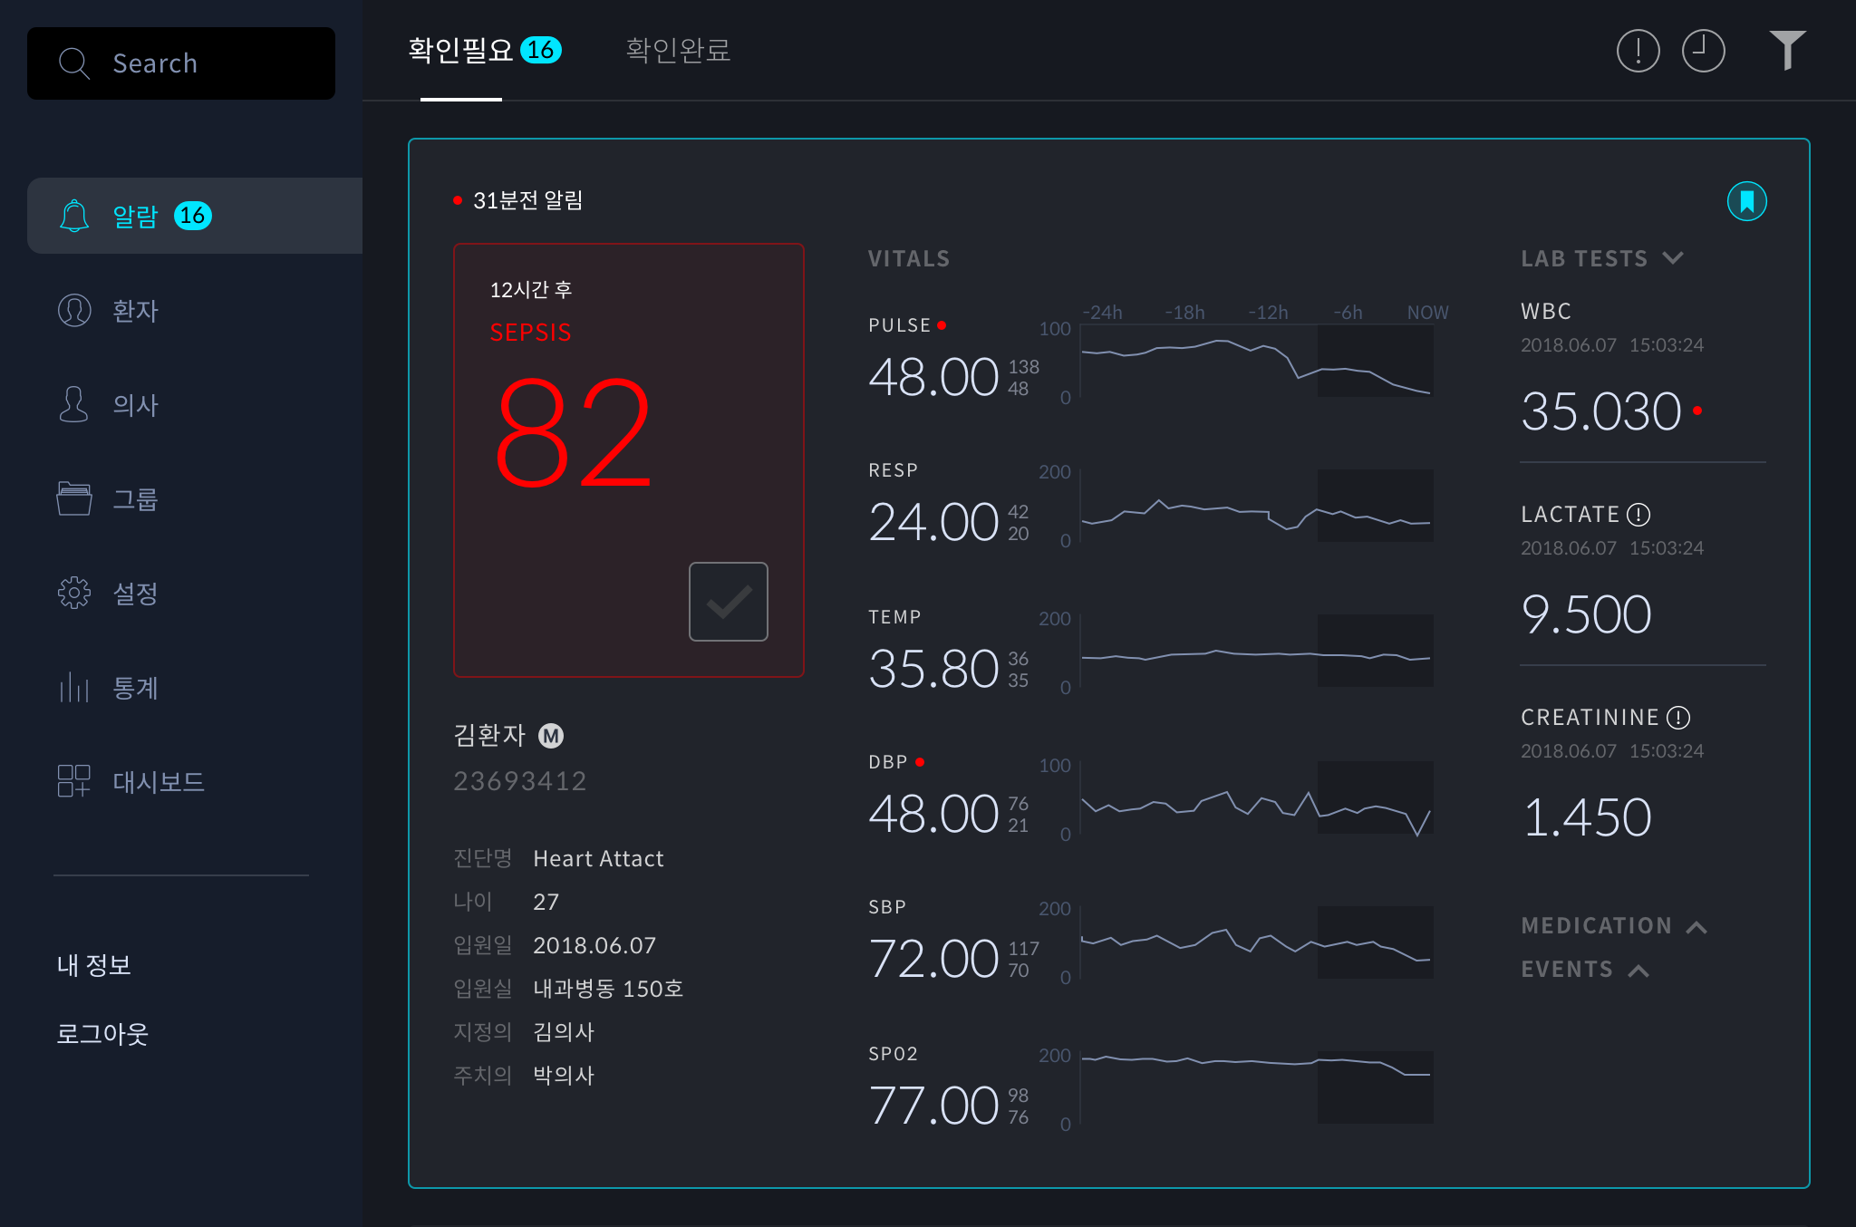

Slide 37
