Slide 1
Guidelines for Management of
Incidental Pulmonary Nodules
Detected on CT Images
: From the Fleischner Society 2017
F. 최지수

Slide 2
Introduction
These guidelines
- apply to incidental nodules.
- do not apply to patients younger than 35 years,
immunocompromised patients, or patients with cancer.
For lung cancer screening, adherence to the existing American College of Radiology Lung CT Screening Reporting and Data System (Lung-RADS) guidelines is recommended.

Slide 3
For solid nodules, the minimum threshold size for routine follow-up has been increased, and fewer follow-up examinations are recommended for stable nodules.
For subsolid nodules, a longer period is recommended before initial follow-up, and the total length of follow-up has been extended to 5 years.
the average of long- and short-axis diameters

Slide 4
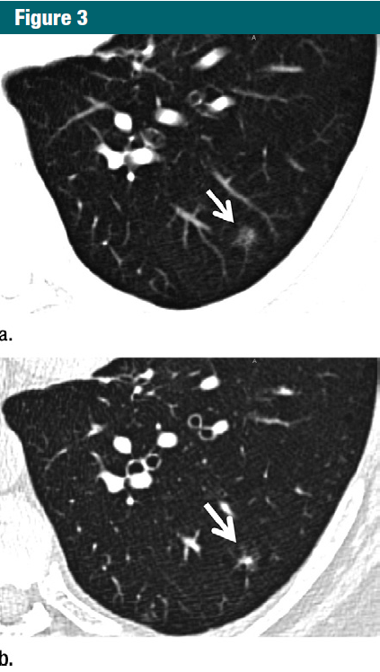
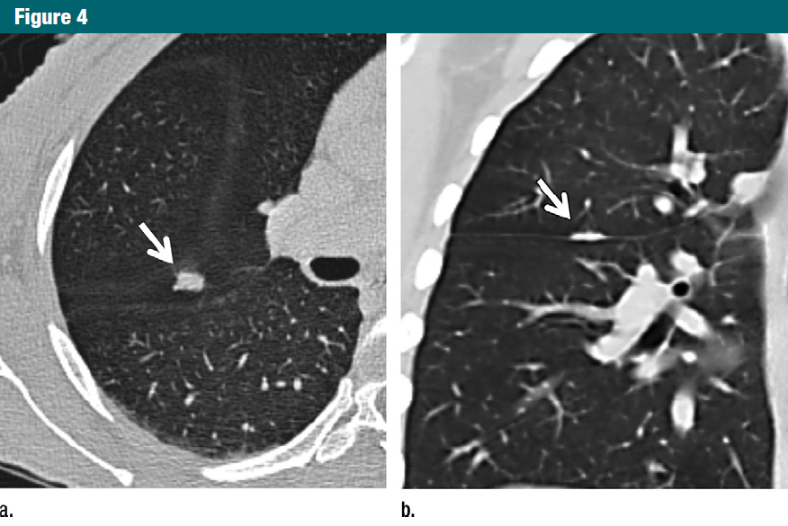
All CT scans of the thorax in adults should be reconstructed and archived with
- contiguous thin sections (1.5 mm, typically 1.0 mm).
- routine acquisition and archiving of off-axis (coronal and sagittal) reconstructed series.

Slide 5
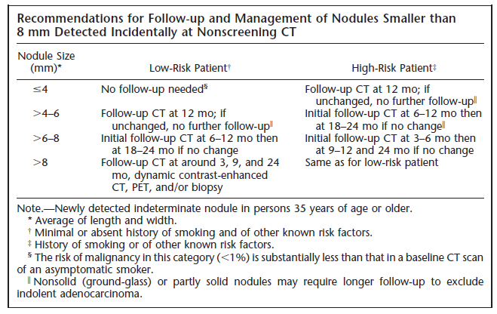
For solid nodule…

Slide 6
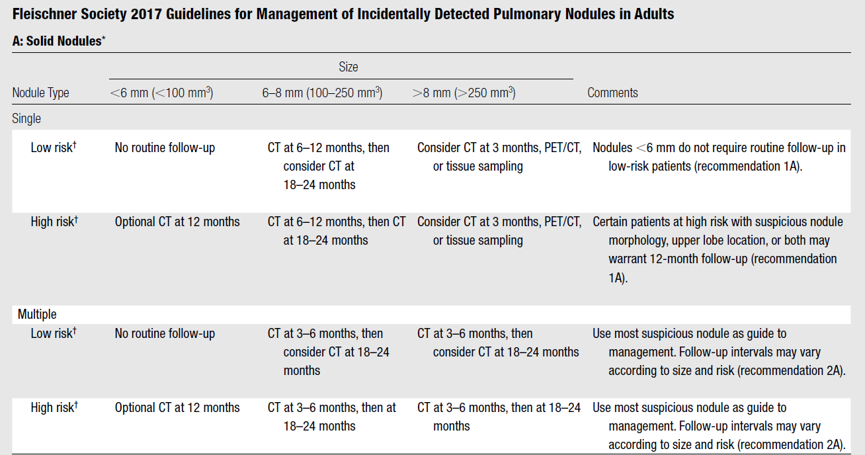
Grade 1A
- the risk of cancer in nodules < 6 mm
: less than 1%, even in patients at high risk.
Grade 2A
- suspicious morphology, upper lobe location, or both can increase cancer risk into the 1%–5% range

Slide 7
Grade 1C
Grade 1B
an estimated average risk of malignancy of approximately 0.5%–2.0%

Slide 8
Grade 1A

Slide 9
Grade 2B

Slide 10
Grade 1B
- Number of nodules: 1~4 → malignancy
- Peripheral and lower zone, Size of nodules wide range → metastasis
Notes:
Peripheral and lower zone, Size of nodules wide range -> metastasis
Number of nodules: 1~4 -> malignancy

Slide 11
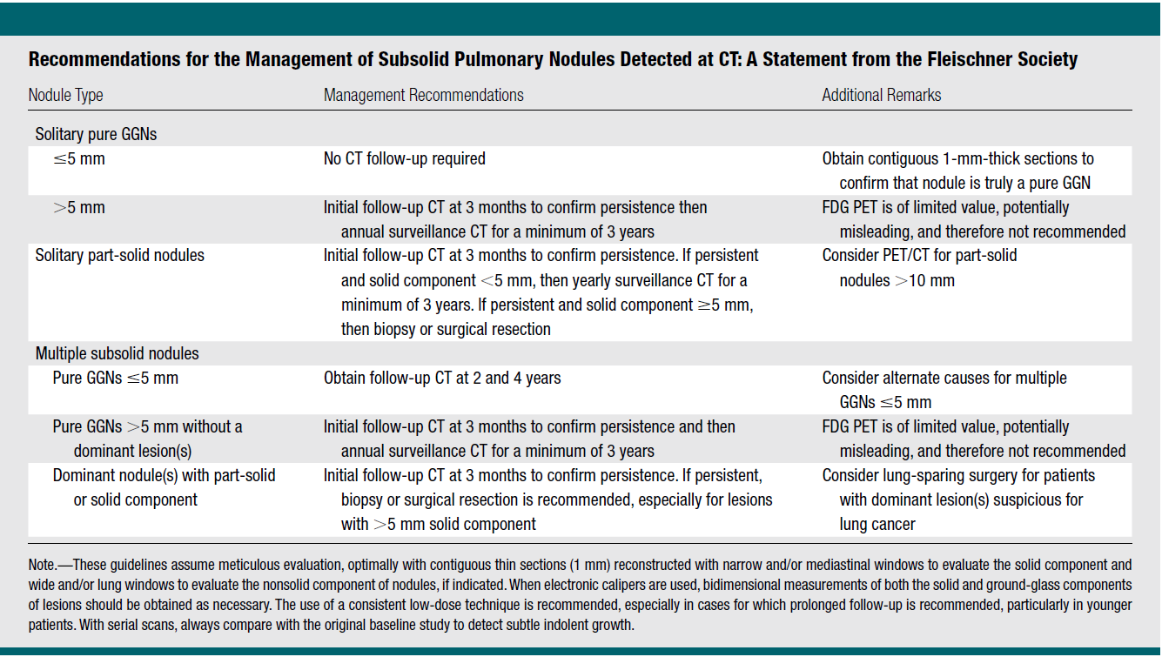
For subsolid nodule…

Slide 12
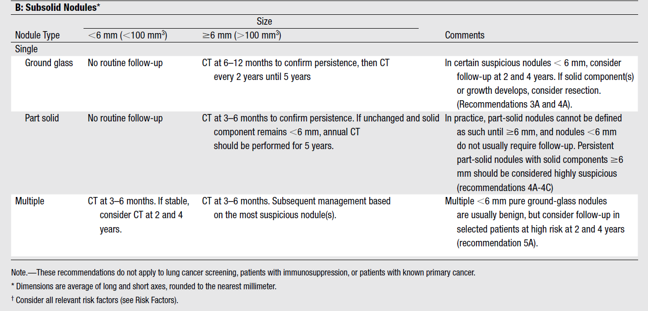
Grade 1B

Slide 13
Grade 1C
For nodules with
- particularly suspicious morphology
(ex, lobulated margins or cystic components)
- a growing solid component
- a solid component larger than 8 mm
→ PET/CT, biopsy, or resection are recommended
(Grade IB)

Slide 14
Grade 1B

Slide 15
Grade 1C

Slide 16
Risk Factors for Malignancy: General Considerations
Nodule Size and Morphology: large, marginal spiculation
Nodule Location: upper lobes, right lung
Nodule Multiplicity
Nodule Growth Rate
Emphysema and Fibrosis
Age, Sex (female > male), Race (black men, native Hawaiian men), and Family History
Tobacco and Other Inhaled Carcinogens (asbestos, uranium, or radon..)

Slide 17
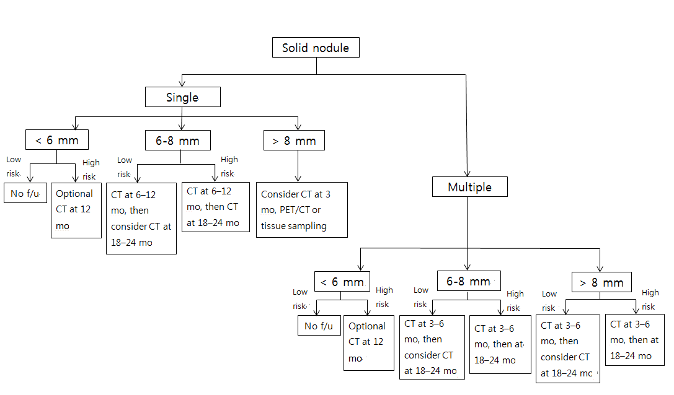
For solid nodule…

Slide 18
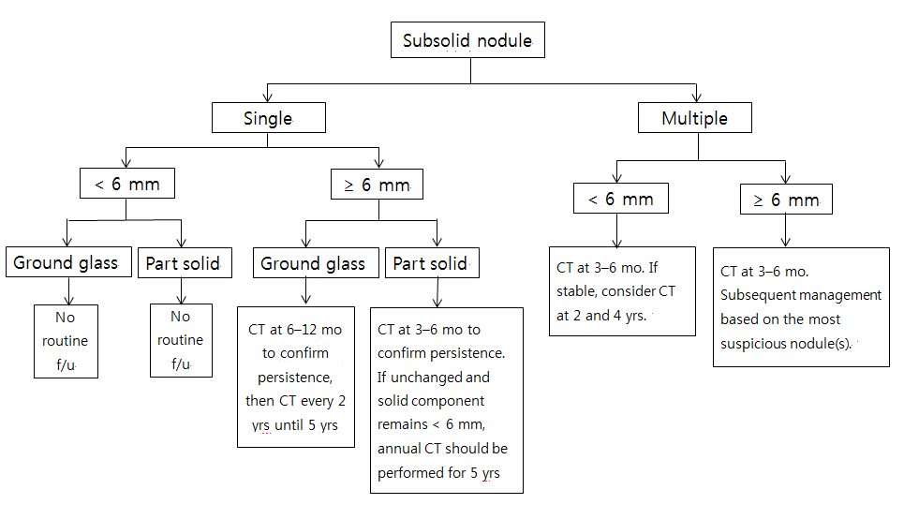
For subsolid nodule…

Slide 19
Thank you for your attention!

