Slide 1
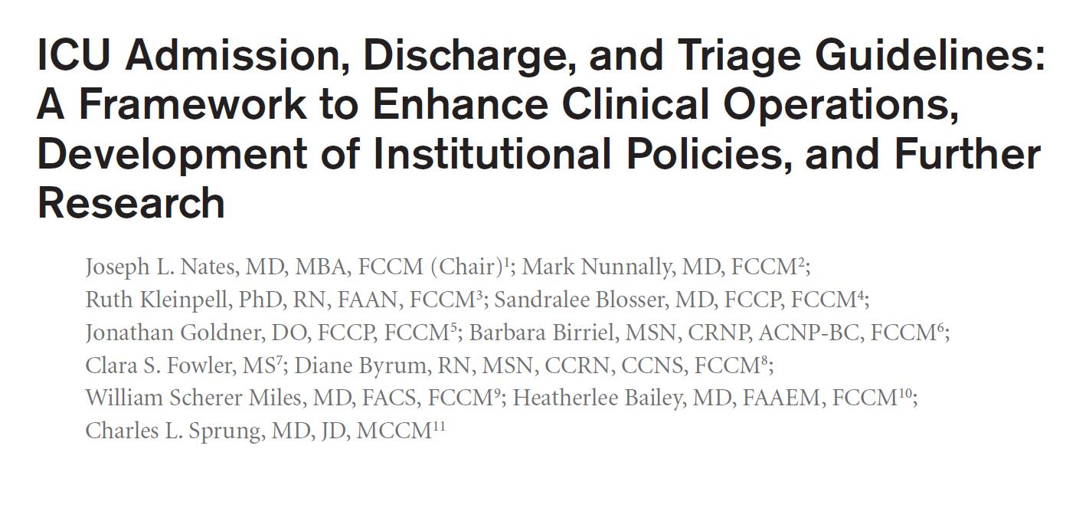
Critical Care Medicine
Issue: Volume 44(8), August 2016, p 1553–1602
Chi-Young Kim
Division of Pulmonology
Department Of internal medicine
Yonsei University College of Medicine
Notes:
발표를 맡게된 강사 김치영입니다.
이번에 제가 맡게 된 주제는 2016년 revised 된 ICU admission

Slide 2
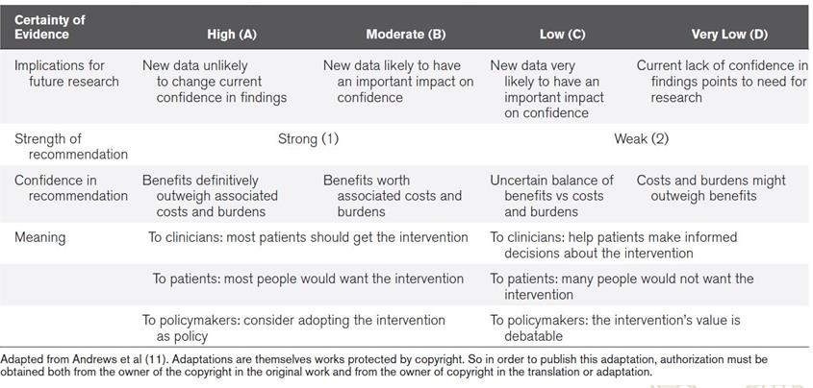
Scoring for Certainty of Evidence and Strength of Recommendation
Notes:
Strong or weak
Evidence certainty

Slide 3
ICU
The ICU is an area within a medical facility equipped with advanced technologies such as ventilators and personnel trained to provide intensive, advanced life-supportive care to critically ill patients
These units can be general or specialized and can be organized by specific systems, pathologies, or problems (e.g., neurological, burn, or trauma ICUs, and medical or surgical ICUs) or by age groups (e.g., adult or PICUs)
Notes:
자원은 한정되있고 , ICU 입실은 힘들기 때문에 이에 대한 adm guideline 이 필요하다.

Slide 4
To optimize resource use
Specific patient needs that can be only addressed in the ICU environment, such as life-supportive therapies
Available clinical expertise
Prioritization according to the patient’s condition
Diagnosis
Bed availability
Objective parameters at the time of referral, such as respiratory rate
Potential for the patient to benefit from interventions
Prognosis
(grade 2D)
Notes:
제한된 자원사용을 최적화 하기위해서는
상기 사항들을 조합해서 결정해야함.

Slide 5
ICU admission
Using the following tools for bed allocation during the admission and triage processes (ungraded)
Guide to resource allocation of intensive monitoring and care including levels of monitoring, care, and nursing ratios
Notes:
뺄까 말까

Slide 6
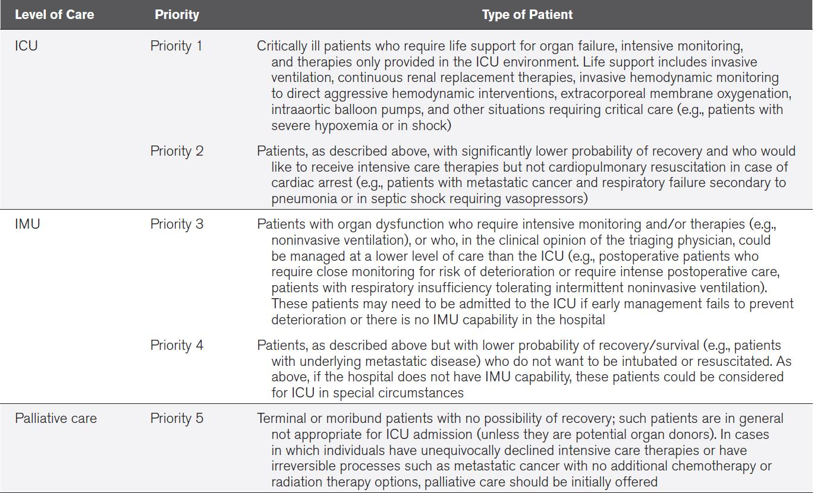
ICU Admission Prioritization Framework
(grade 2D)
Notes:
이전 가이드 라인에서는 세모델-prioritization, diagnosis model, objective parameter model로 나누어서 설명을 했었음.
모든 이러한 모델은 한계가 있고,어느 것도 적절하게 검증되지 않았다
현재 ICU 입학에 대한 모든 것을 포괄하는, 명확한 기준을 보여주는 결정적인 연구는 없다.]
We suggest patients needing life-sustaining interventions who have a higher probability of recovery
and would accept cardiopulmonary resuscitation receive a higher priority for ICU admission than
those with a significantly lower probability of recovery who choose not to receive cardiopulmonary
resuscitation (Table 4)

Slide 7
Identifying the Required Level of Care
Level 0 : regular hospitalized patients with
no intensive monitoring or care requirements
Level I : patients requiring additional monitoring
such as continuous electrocardiographic monitoring
Level II : patients requiring more frequent monitoring
and interventions (single-organ dysfunction)
Level III : patients requiring life-supportive therapies
(single or multiorgan failure , which can only be provided
in the ICU)
Notes:
이 분류와 각 환자의 특정한 감시와 관리 필요성에 초점을 맞추고 있ICU과 다른 병동 서비스 간의 분열을 제거한다.
이논문
In 1999, a group of experts appointed by the Department of Health in the United Kingdom and led by Dr. Valerie Day suggested that patients in the hospital should be assigned a level of care based on an assessment of their clinical needs, regardless of their location (46). In their review of critical care services published in 2000, they described these levels as follows:

Slide 8
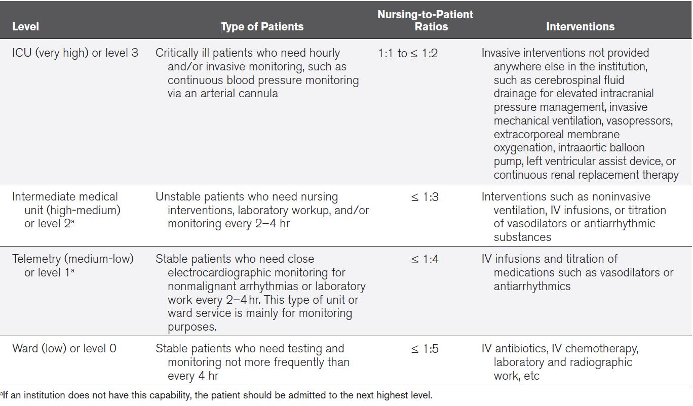
Guide to Resource Allocation of Intensive Monitoring and Care

Slide 9
Care in the ICU vs Ward(Intensive Care)
Patients with invasive mechanical ventilation or complex life-threatening conditions, including those with sepsis, be treated in an ICU
Patients should not be weaned from mechanical ventilation on the general ward unless the ward is a high dependency/intermediate unit (grade 2C)
Critically ill patients in the ED or on the general ward be transferred to a higher level of care, such as the ICU, in an expeditious manner (grade 2D)
Notes:
신속하게 옮겨져야 한다.
The ICU provides better monitoring, decreased endotracheal tube–related complications, and more active ventilator management

Slide 10
General ICU vs Specialized ICU
Avoiding admitting to a specialized ICU patients with a primary diagnosis not associated with that specialty (i.e., boarding) (grade 2C)
Admission of neurocritically ill patients to a neuro-ICU, especially those with a diagnosis of intracerebral hemorrhage or head injury (grade 2C)
Notes:
Multispecialty or general ICUs are typically located within smaller, community-based hospitals or may be utilized in tertiary institutions for critically ill patients who have diagnoses that do not fit into one of the specialty ICUs. However, the complexities of critical care make it difficult to conclusively demonstrate efficacy for specialization (63). Studies have suggested that the organization and management of an ICU may have more of an effect on outcomes (64, 65). ICU specialization is likely motivated by physician convenience and the pooling of clinical resources around specialty departments to improve efficiency (66). Although some studies have shown the benefit of specialization of ICUs for certain fields, the literature does not support a survival benefit for specialized over general ICU care in the case of common admitting diagnoses such as acute coronary syndrome, ischemic stroke, intracranial hemorrhage, pneumonia, abdominal surgery, or coronary artery bypass graft surgery. Admission to a specialized ICU of a patient with a primary diagnosis not associated with that specialty (i.e., “boarding”) is associated with increased risk-adjusted mortality (66).

Slide 11
Different Staffing Models
High-intensity ICU model
-> intensivist responsible for day-to-day management of
the patient, either in a “closed ICU” setting (in which
the intensivist serves as the primary physician) or
through a hospital protocol for mandatory intensivist
consultation (grade 1B)
optimizing ICU nursing resources and nursing ratios
(consideration available nursing resources, patients’
needs, and patients’ medical complexity (grade 2D)
Notes:
nursing resources (e.g., levels of education, support personnel, specific workloads),

Slide 12
TRIAGE - General Considerations
Every ICU institute methods for prioritizing and triaging patients, with policies and guidelines (ungraded)
Triage decisions are made explicitly and without bias
Ethnic origin, race, sex, social status, sexual preference, or financial status should never be considered in triage decisions (ungraded)
Triage is the process of placing patients at their most appropriate level of care, based upon their need for medical treatment and the assessment that they will benefit from ICU care

Slide 13
In general, patients admitted to the ICU
one or more of the following criteria:
->Require care involving specialized competency of ICU staff
that is not widely available elsewhere in the hospital
(e.g., MV, ECMO, IABP).
->Have clinical instability
(e.g., status epilepticus, hypoxemia, and hypotension)
-> Be at high risk for imminent decline
(e.g., impending intubation)
Overtriage is more acceptable and preferable to undertriage.
(grade 2D)

Slide 14
Transfer to the ICU From the ED
Minimizing the transfer time of critically ill patients from the ED to the ICU (< 6hr in nontrauma patients) (grade 2D).
Considering the frequent lack of rapid ICU bed availability, emergency medicine practitioners be prepared to deliver critical care in the ED (ungraded).
Notes:
In many hospitals, the majority of ICU admissions are through the ED. Patients are seen and stabilized by emergency medicine personnel. Because of a shortage of readily available empty beds in many ICUs, patients may spend hours being cared for in the ED by its staff. In one survey of 3,562 ED caregivers, half answered that ED patients requiring admission to the ICU were rarely transferred from the ED to the ICU within 1 hour (138). In a cross-sectional analytical study, ED patients with a 6-hour or higher delay in ICU transfer had higher ICU mortality (10.7% vs 8.4% for patients transferred within 6 hr; p < 0.01) and hospital mortality (17.4% vs 12.9%; p < 0.001) (59). In a study of trauma and emergency general surgery patients, the authors concluded that experienced clinicians could effectively triage more critically injured patients to earlier ICU admission and thereby prevent any increased mortality associated with a longer ED stay. The authors initially categorized patients as “nondelayed” when the transfer occurred within the first 3 hours, but they changed the time threshold to compare their results to the findings of Chalfin et al (59). They found that patients admitted with less than a 6-hour delay were more seriously injured and had worse outcomes than those admitted with a longer delay (139). Horwitz et al (140) showed that the transfer of a patient from the ED to an internal medicine ward is associated with adverse events that can be due to issues with poor communication, environment, workload, information technology, patient flow, and assignment of responsibility. The authors suggested that system-based interventions aimed at these issues could improve patient safety. These findings also suggest the existence of a care gap between the ED and the ward that should not necessarily be solved in the ICU. With a projected increase in numbers of critically ill patients presenting to EDs, the shortage of intensivists, and the shortage of readily available ICU beds, there will be an increased emphasis on the provision of critical care by the ED physician (141). A potential alternative could be the admission of some of these patients to intermediate care units.

Slide 15
ICU Transfer
From ED to a Less Intense Level of Care
→ close monitoring and timely intervention for those who are triaged to the ward. These interventions might reduce delayed transfers to the ICU of undertriaged patients and prevent acute deterioration of those still requiring stabilization after hospital admission (grade 2D)
Unplanned ICU Admissions From the Operating Room
→ patients with risk factors for postoperative instability
or decompensation be closely monitored and managed in
a higher level of care unit than the ward in the immediate
postoperative period (ungraded)
Notes:
Delgado et al (142) found that ED patients admitted to a less intense level of care with pneumonia, chronic obstructive pulmonary disease, myocardial infarction, or sepsis were at increased risk for unplanned transfer to the ICU. The authors concluded that “better triage from the ED, earlier intervention, or closer monitoring to prevent acute decompensation” might benefit this population. In another study of patients with community-acquired pneumonia, Brown et al (143) showed that initial ward triage of patients who were later transferred to the ICU was associated with a twofold higher 30-day mortality rate. Likewise, a retrospective Australian study showed that patients transferred to the ICU within 24 hours of admission to the ward from the ED had a significantly higher 30-day mortality rate than patients admitted to the ICU directly from the ED (144). Other studies also show that patients transferred to a more intense level of care following admission to the hospital have higher mortality and LOS (145–147). RRSs were created to minimize delays in ICU admission through early recognition and response to patients who are deteriorating in general wards. Use of these teams is discussed further in Use of Outreach Programs to Supplement ICU Care section.

Slide 16
Triage
Elderly (> 80 yr) patients
-patient’s comorbidities, severity of illness, prehospital functional
status, and patient preferences with regard to life-sustaining
treatment, not on their chronological age (grade 2C)
Patients With Malignancies
- with careful consideration of their long-term prognosis (ungraded)
- in particular cancer patients with advanced disease, be reassessed
and discussed with the patient, next of kin, legal representative,
or power of attorney at regular intervals (ungraded)

Slide 17
Triage in Epidemics
Not using scoring systems alone to determine level of care or removal from higher levels of care
(not accurate in predicting individual mortality (Grade 2C)
All hospitals and regional areas develop a coordinated triage plan for epidemics
The hospital plans should include both triage and dissemination of patients throughout the hospital (ungraded)
Nontraditional settings be considered and utilized for the care of critically ill patients (ungraded)
Notes:
줄이자

Slide 18
Triage in Natural Disasters
In areas at risk, ICUs be prepared to deal with the victims of not only external disasters but also internal disasters.
(collapse of surrounding services in large-scale disasters
such as an earthquake, tsunami, or major tornado)
Every ICU should have general disaster and evacuation plans
such as those required by the Joint Commission Standards
in the United States (ungraded)
Notes:
두개 합치던지 빼던지

Slide 19
ICU Discharge- Timing
Day Versus Night Discharge
→ Avoid discharge from ICU “after hours (“night shift”,
after 7 PM in institutions with 12-hr shifts) (grade 2C)
Weekday Versus Weekend Discharge
→ Weekend discharge from the ICU has not been found
to be associated with increased mortality (ungraded)

Slide 20
Discharge Strategies to Reduce ICU
High risk patients for mortality and readmission
(high severity of illness, multiple comorbidities,
physiologic instability, and ongoing organ support)
→ step-down unit or LTACH as opposed to the regular ward
(grade 2C)
Long-Term Acute-Care Hospitals
→ provide continuing care expected to be needed for
at least 25 days after discharge from an acute-care hospital
→ many ICU-level services
(vasoactive medications , mechanical ventilation)
Notes:
Long term acute care hospiral
Step-down units are variously referred to as “high-dependency units,” “intermediate care units,” or “transitional care units.”

Slide 21
To Supplement ICU Care
Readmission to ICU
→ Standardized process for discharge from the ICU
(both oral and written formats)
→ may reduce readmission rate (ungraded)
RRS Intervention Prior to ICU Admission
→ early review of acutely ill non-ICU patients
→ to prevent unnecessary ICU admissions (grade 2C)
ICU Consult Teams in the Wards
→ facilitate transition from the ICU
→ assist ward staff in the management of deteriorating patients
→ facilitate transfer to ICU, and reduce rates of readmission to
critical care (grade 2C)

Slide 22
Conclusion
The decision to admit to the ICU can be very easy when resources are abundant or very difficult when limited.
Scarce resources may threaten or impede the allocation of critical care services to patients; misusing these resources can aggravate the problem.
We need to further develop preventive strategies to reduce the burden of critical illness, educate our noncritical care colleagues about these interventions, and improve our outreach, developing early identification and intervention systems.

Slide 23


