Slide 1
Tuberculosis Infection Screening among High-risk HCWs
in Severance
Youngmok Park
Division of Pulmonology
Department of Internal Medicine
Yonsei University College of Medicine

Slide 2
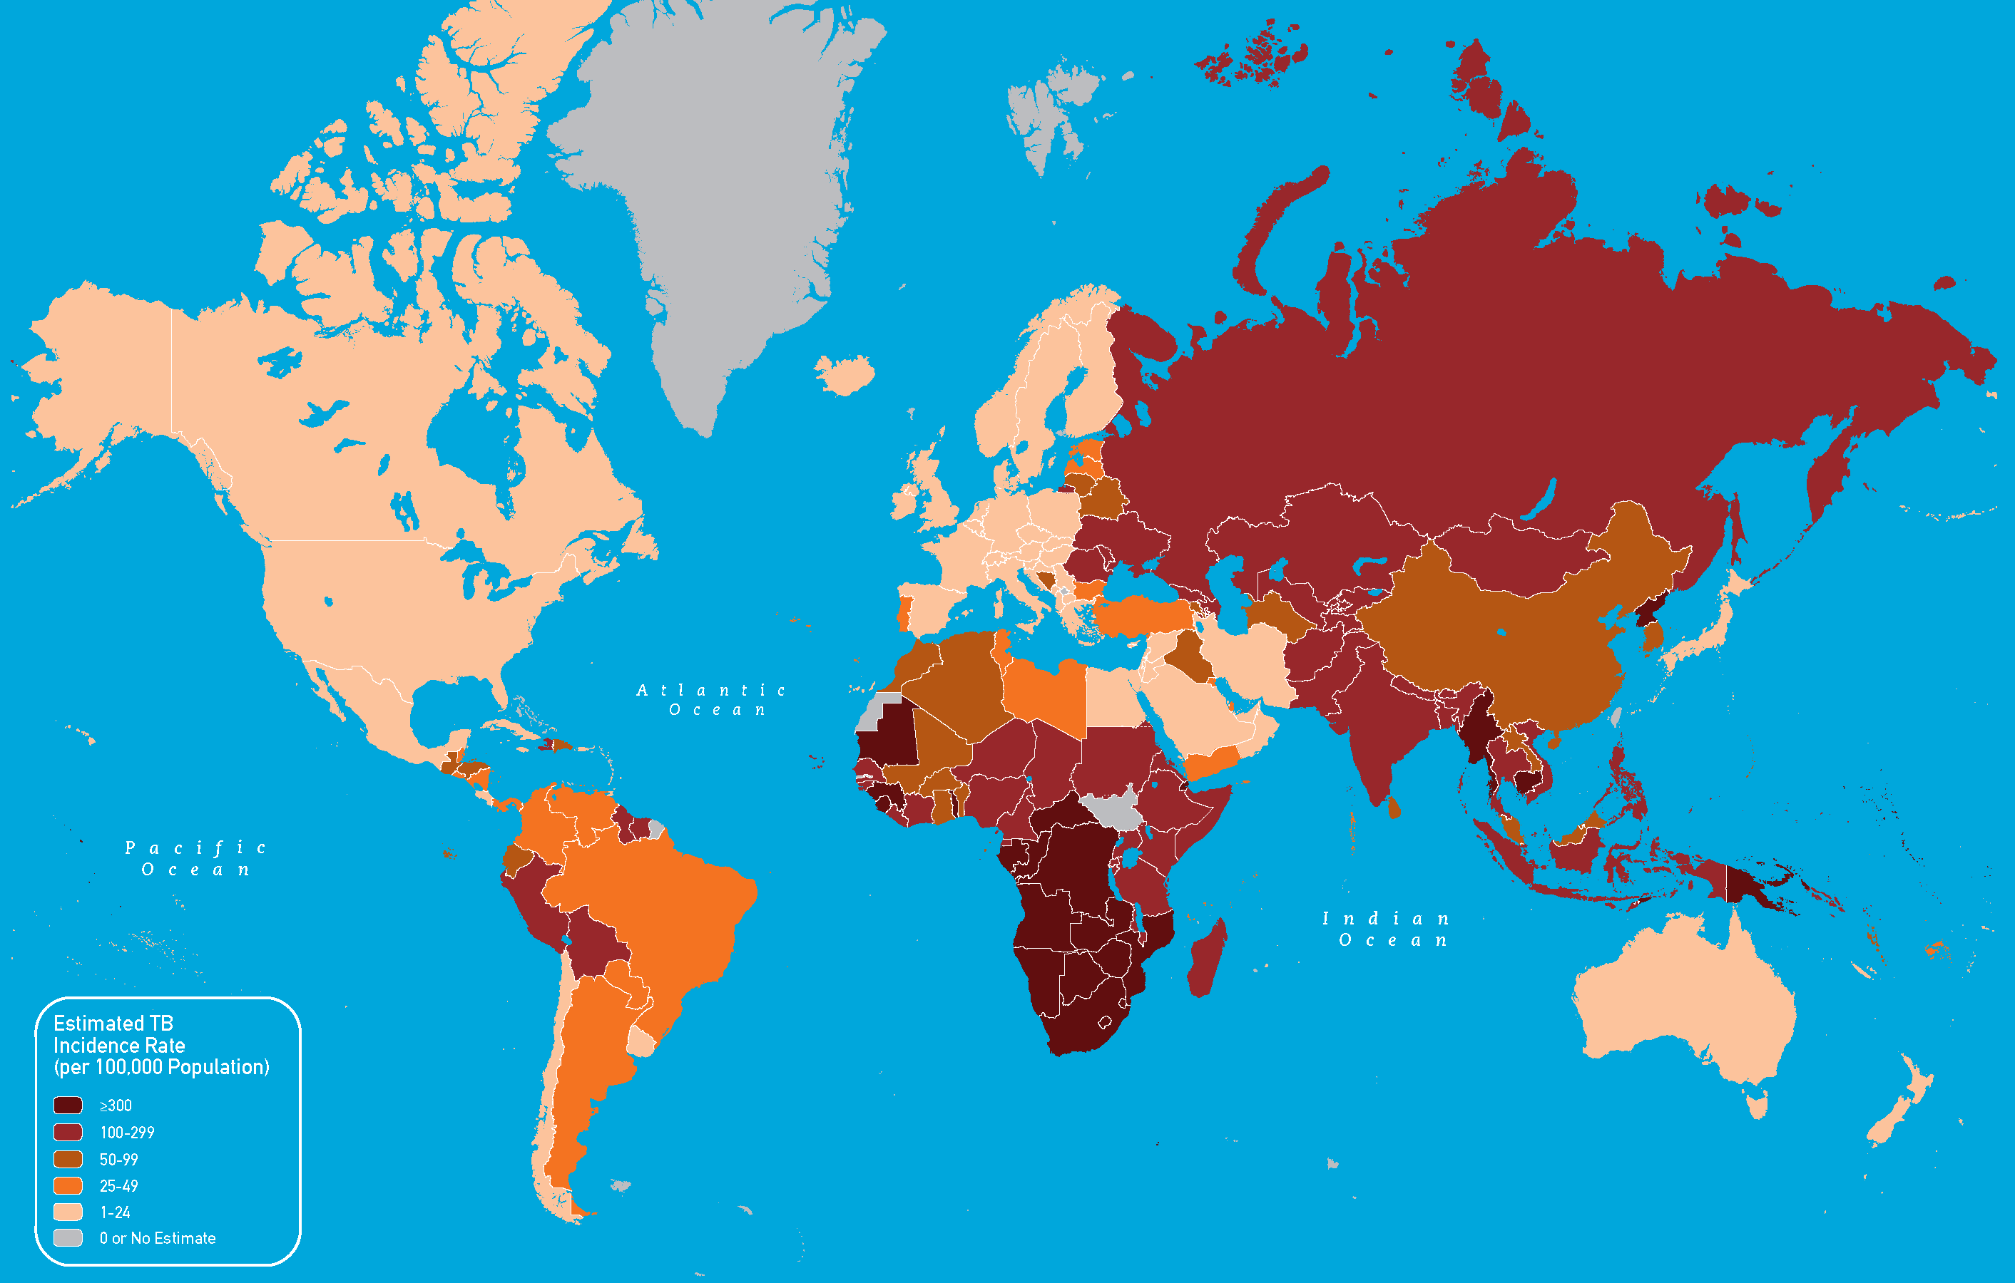
CDC, Estimated Tb incidence rates, 2010

Slide 3
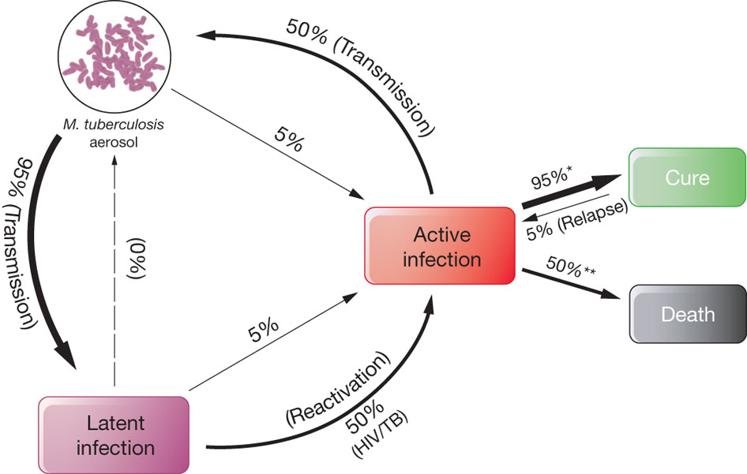
Koul et al. Nature 2011
Notes:
M. tuberculosis aerosol transmission and progression to infectious TB or non-infectious (latent) disease. A sizeable pool of latently infected people may relapse into active TB, years after their first exposure to the bacterium. Latent TB is commonly activated by immune suppression, as in the case of HIV. In cases of drug-susceptible (DS)-TB (denoted by an asterisk), 95% of patients recover upon treatment, whereas 5% relapse. If untreated (denoted by two asterisks), high mortality results.
www.nature.com
The challenge of new drug discovery for tuberculosis
Anil Koul,^{1,}
Eric Arnoult,^{2,}
Nacer Lounis,^{1,}
Jerome Guillemont^{2,}
& Koen Andries^{1,}
Journal name:Nature Volume: 469, Pages:483–490 Date published:(27 January 2011) DOI:doi:10.1038/nature09657

Slide 4
LTBI to TB disease
HIV infection
MTB infection within 2 yrs
Infants and children <4yr
DM
CKD
Certain hematologic disorders (Lymphoma, Leukemia)
Other specific malignancies (H&N cancer, lung cancer)
BWt ≥10% below IBW
Prolonged steroid use
Hx of untreated or inadequately treated TB
CDC, Guidelines for Preventing the Transmission
of Mycobacterium tuberculosis in Health Care Facilities, 2005

Slide 5
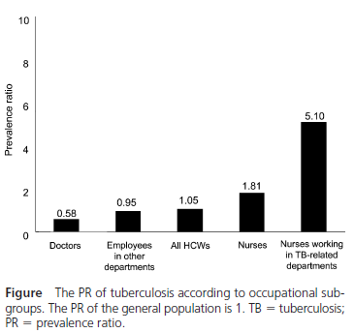
TB in HCWs
N=8433, 2001-2006
Occurrence of TB cases among HCWs
TB in 61 HCWs (0.72%)
Nurses at Tb-related department :
RR 3.4 (1.52-8.25, P=0.005)
PR 5.1 (3.23-8.42)
Jo et al. Int J Tuberc Lung Dis 2007

Slide 6
Prevention
CDC, Guidelines for Preventing the Transmission of Mycobacterium Tuberculosis in Health Care Facilities, 2005
Decrease has occurred in
the number of Tb outbreaks in health-care settings reported to CDC
Health-care-associated transmission of M.Tb to PTs and HCWs

Slide 7
Prevention
대한 결핵 및 호흡기학회, 결핵 진료지침, 2014
결핵환자에 노출될 가능성이 높거나 결핵환자를 직접 진료하거나 간호하는 부서의 직원은 정기적인 결핵검진을 받아야 한다 (IIIA)
결핵균에 노출될 위험이 높은 검사를 시행하는 직원은 정기적인 결핵검진을 받아야 한다 (IIIA)

Slide 8
Should be screened HCWs
Administrators or managers
Bronchoscopy staff
ED staff
Food service staff
Health aides
Health and safety staff
ICU staff
Laboratory staff
Nurses
Pathology laboratory staff
Patient transport staff, including EMS
Pediatric staff
Physicians (assistant, attending,
fellow, resident, or intern)
- Including anesthesiologis,
pathologist, psychiatritis,
psychologist
Radiology staff
CDC, Guidelines for Preventing the Transmission
of Mycobacterium tuberculosis in Health Care Facilities, 2005

Slide 9
CDC guideline
Initial two-step TST or IGRA + Annual Tb screen
(-) : Annual M.Tb infection test + Sx screen
(+) : one CXR + Annual Sx screen
If disease is excluded, HCWs should be treated for LTBI unless medically contraindicated.
CDC, Guidelines for Preventing the Transmission
of Mycobacterium tuberculosis in Health Care Facilities, 2005

Slide 10
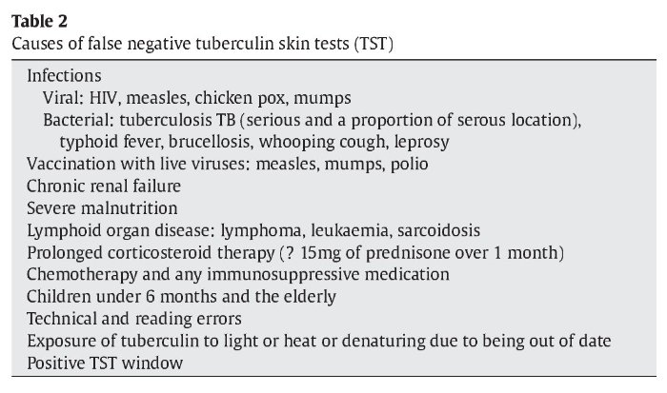
Tuberculin skin test
Two visit
BCG vaccination
Subjective results
False + / False –
Boosted reaction

Slide 11
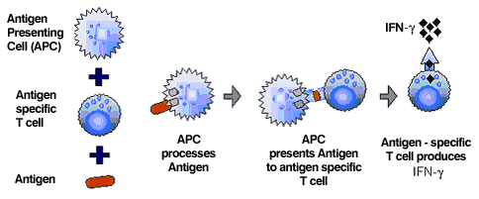
IGRA
High specificity
Less affected by prior BCG vaccination
Single patient visit
objective results
Low reproducibility
High cost

Slide 12
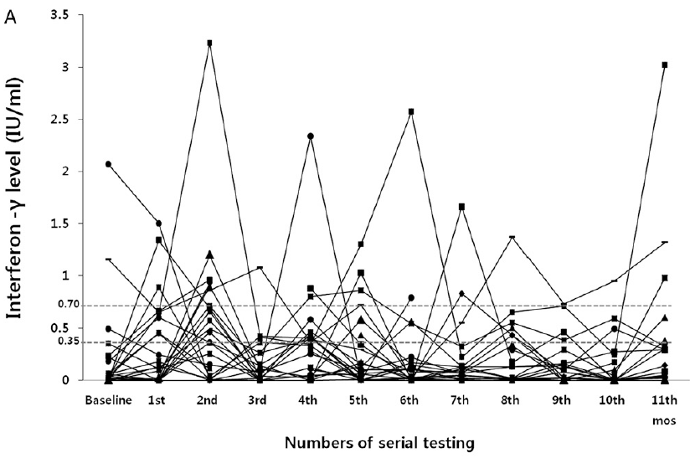
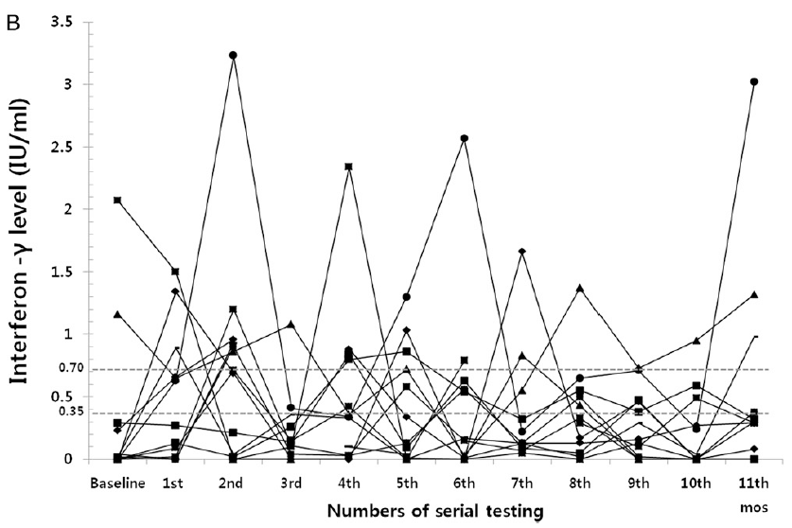
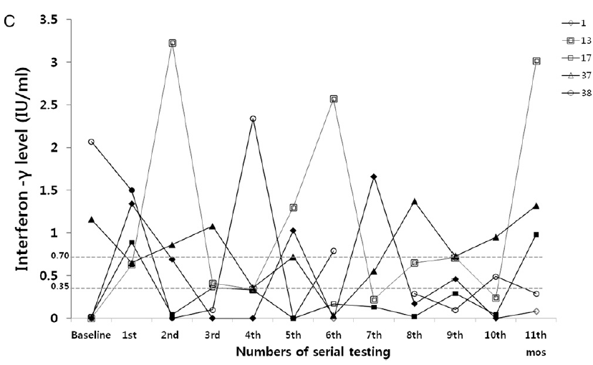
N=49
Conversion or reversion : 25 (52%)
<0.35 to ≥0.75 : 13 (27%)
≥2 fluctuations : 5 (10%)
Park et al. Chest 2012;142(6);1461-1468

Slide 13
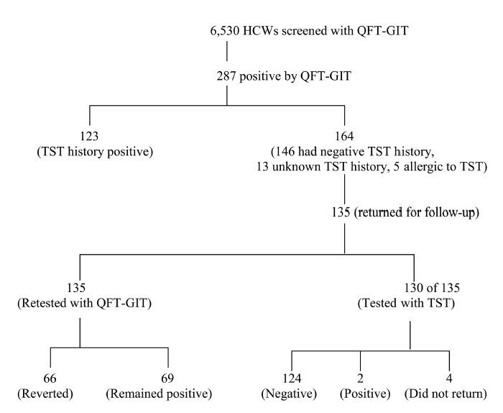
2008.1-2008.12
University of Illinois College of Medicine affiliated medical center
Gandra et al. Infect Control Hosp Epidemiol 2010

Slide 14
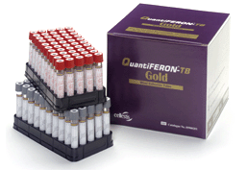
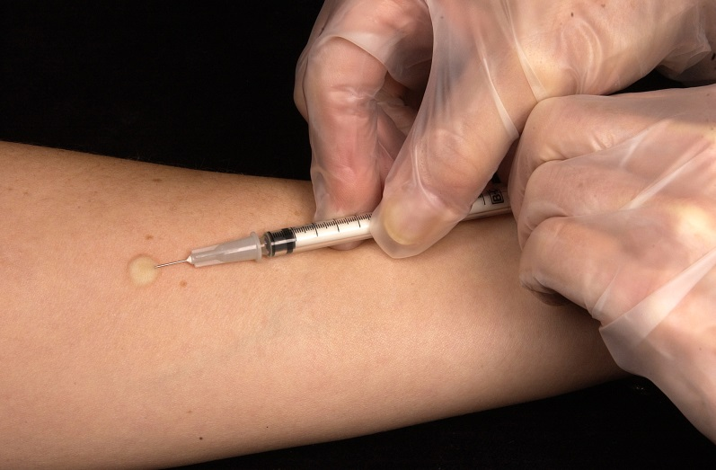
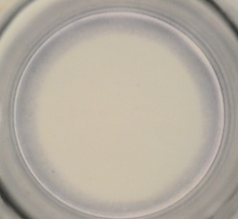
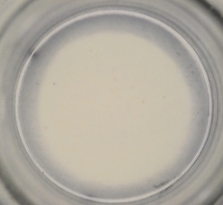
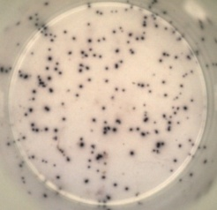
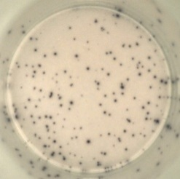
or

Slide 15
Data of
Severance hospital

Slide 16
Methods
Population : High-risk HCWs in Severance hospital
1st : 2009.11월 (One step TST + CXR)
2nd : 2011.11월 (TST + CXR + questionnaire), 2011.10~ Two step
3rd : 2013.1월 (TST + CXR)
4th : 2014.1월 (TST + CXR)
5th : 2015.1월 (CXR only)
High-risk HCWs
ER, ICU, 감염내과, 호흡기내과, 흉부외과, 알레르기내과 의사/간호사
미생물파트 임상병리사, 영상 촬영파트, 영상 사무직

Slide 17
Methods
TST ≥ 3회
Conversion : TST2-TST1≥ 6mm

Slide 18
Results
N=166

Slide 19
Table 1 | N=166 |  | 결측값
Age, y, median (range) | 24 | (22-61) | 0
Gender |  |  | 0
Male | 20 | 12.0%
Female | 146 | 88.0%
BMI, Kg/m2, median (range) | 20 | (17-28) | 94
Health care professions
의사 | 8 | 4.8%
간호사 | 112 | 67.5%
기능원 | 7 | 4.2%
임상병리사 | 15 | 9.0%
방사선기사 | 23 | 13.9%
기타 | 1 | 0.6%
Months served as healthcare profession, m, median (range) | 32 | 1.8-376.2 | 6
<6m | 16 | 7.8%
6m - 24m | 57 | 34.3%
24m- 60m | 39 | 23.5%
>60m | 51 | 30.7%
Work department |  |  | 8
1: OPD | 15 | 9.5%
2: ER | 42 | 26.6%
3: Admission | 64 | 40.5%
4: Others | 37 | 23.4%

Slide 20
HCWs (2009-2014) :629
TST <3회 : 436
TST ≥3회 : 166
3rd TST- : 139 (90%)
3rd TST+ : 27 (14%)
f/u loss : 62
4th TST : 77
Conversion : 17 (10%)
4th TST- : 68 (88%)
4th TST+ : 9 (12%)
f/u loss : 51
5th TST : 17
Conversion : 8 (10%)
5th TST- : 13 (76%)
5th TST+ : 4 (24%)
f/u loss : 11
6th TST : 2
Conversion : 4 (24%)
6th TST- : 2 (100%)
6th TST+ : 0 (0%)

Slide 21
3rd - Conversion : 17
Tested with IGRA 15 (88%)
IGRA (+) : 4 (23.5%)
LTBI Tx : 3 (18%)
4th - Conversion : 8
IGRA 6 (75%)
IGRA (+) : 3 (38%)
LTBI Tx : 3 (38%)
5th - Conversion : 4
IGRA 3 (75%)
IGRA (+) : 0 (0%)
LTBI Tx : 0 (0%)
Total : 29/166 (18%)
IGRA 24 (83%)
IGRA (+) : 7 (24%)
LTBI Tx : 6 (21%)

Slide 22
Table 2 | N=166
TST conversion | 29 | 17.5%
TST conversion duration, m, median, (IQR) | 23 | (14-44)
Health care professions
의사 (N=8) | 3 | 37.5%
간호사 (N=112) | 18 | 16.1%
기능원 (N=7) | 1 | 14.3%
임상병리사 (N=15) | 3 | 20.0%
방사선기사 (N=23) | 4 | 17.4%
기타 (N=1) | 0 | 0.0%
Work department
1: OPD (N=15) | 6 | 40.0%
2: ER (N=42) | 11 | 26.2%
3: Admission (N=64) | 6 | 9.4%
4: Others (N=37) | 6 | 16.2%
Results of QFT-GIT
Positive | 7 | 28.0%
Negative | 18 | 72.0%
IFN-gamma conc, IU/mL, median (IQR) | 0.06 | 0.00-1.29

Slide 23
Table 3 | Converted (N=29) |  | Non-converted (N=137) |  | P
Age, y, median (range) | 25 | (22-56) | 24 | (22-61) | 0.176
Gender |  |  |  |  | 0.651
Male | 5 | 17.2% | 15 | 11%
Female | 24 | 82.8% | 122 | 89%
BMI, Kg/m2, median (range) | 20 | (17-26) | 20 | (17-28) | 0.612
Health care professions
의사 | 3 | 10.3% | 5 | 3.6%
간호사 | 18 | 62.1% | 94 | 68.6%
기능원 | 1 | 3.4% | 6 | 4.4%
임상병리사 | 3 | 10.3% | 12 | 8.8%
방사선기사 | 4 | 13.8% | 19 | 13.9%
기타 | 0 | 0.0% | 1 | 0.7%
Months served as healthcare profession, median (range) | 32 | (2.9-376.2) | 30 | (1.8-375.9) | 0.419
<6m | 2 | 6.9 | 11 | 8.0%
6m - 24m | 10 | 34.5 | 47 | 34.3%
24m- 60m | 5 | 17.2 | 34 | 24.8%
>60m | 12 | 41.4 | 39 | 28.5%
Work department
1: OPD | 6 | 20.7% | 9 | 7.0%
2: ER | 11 | 37.9% | 31 | 24.0%
3: Admission | 6 | 20.7% | 58 | 45.0%
4: Others | 6 | 20.7% | 31 | 24.0%

Slide 24
Discussion
TST 양전율 : 17.5 %
TST 양전까지의 기간 : median 23 개월, IQR 14-44개월
TST 양전자 중 IGRA 시행률 : 24명/29명 (83%)
TST 양전자 중 IGRA 양성률 : 7명/29명 (24%)
-> Discordance between TST & IGRA
TST 양전자 중 LTBI 치료 : 6명/29명 (21%)
TST 양전자 & IGRA (+) 중 LTBI 치료 : 6명/7명 (86%)

Slide 25
Discussion
전체 대상자 (629 명) 중 Active Tb 발생 : 1명
  -> 고위험군 검진을 통한 조기발견의 실효성 ?

Slide 26
Limitations
Small sample size
Limited information (ex> Tb patient contact Hx, BCG Hx. etc)
부서 이동 정보 없음
간호사 비율 높음

Slide 27
To Do
More sample, More information (survey)
Conversion group vs. Non-conversion group
Annual conversion rate ?
High-risk HCWs vs. Low-risk HCWs

Slide 28

Notes:
경청해주셔서 감사합니다.

