Slide 1
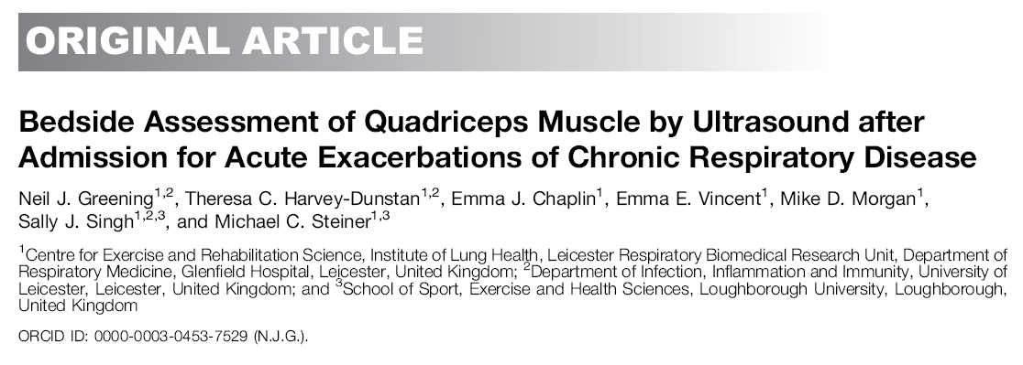
2015.10.20
R1 최연직

Slide 2

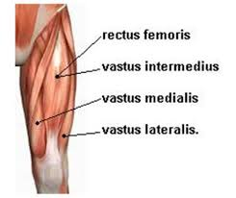

Slide 3
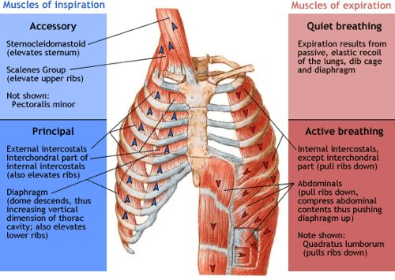

Slide 4
Introduction
Hospitalization for COPD, CRDs
  worse health status
  higher risk of subsequent readmission
  death
Measurements obtained during routine clinical care during hospitalization
  can predict short-term outcomes
  In-hospital mortality & length of hospital stay

Slide 5
Introduction
Identifying those at risk of readmission over the longer term
  More challenging
  In the stable COPD: previous exacerbations
    The single most powerful predictor of subsequent events
The risk of subsequent events after hospitalization over the longer term
  Known systemic features of the disease
    skeletal muscle function and mass
    symptom burden in the stable state

Slide 6
Introduction
Pts who has been hospitalized for an acute exacerbation
  The predictive value of these indices: unknown.
  technologies for assessing muscle function & mass used at the bedside
    not available
    limited in this setting by their reliance on patient effort
US assessment of quadriceps cross-sectional area (Qcsa)
  a surrogate for lower limb muscle mass
  can be performed at the bedside
  independent of patient effort

Slide 7
Methods
a randomized controlled trial
  an early rehabilitation intervention initiated
  during hospitalization for acute exacerbation of CRD
Outcome measures
  performed at recruitment (within 48 h of acute admission)
  apart from spirometry & shuttle walk tests at hospital discharge
Qcsa
  measured by B mode US
  The rectus femoris of the Rt leg
    a single muscle of the quadriceps
    to allow whole muscle on a single image

Slide 8
Methods
The primary outcome
  hospital readmission at 12 months
  from local hospital databases & general practice records
Date of admission & length of hospital stay
  recorded at 12 months
Death
  from hospital databases, general practice records & death certificates
  At 12 months

Slide 9
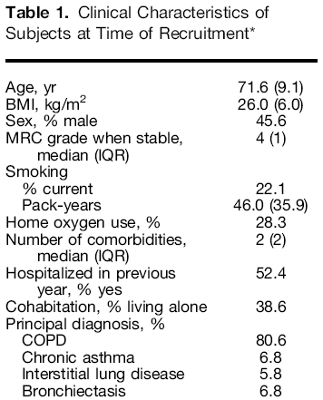
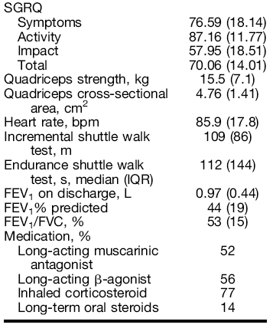
Results

Slide 10
Results
A total of 191 subjects underwent US to determine the Qcsa
  were included at baseline & in the analysis.
  96% of those enrolled Pts
130 of the subjects (68%)
  Readmitted or died in the year after their index admission
    121 were admitted
    9 died without readmission
Mean time to readmission or death: 120days
Test–retest correlation between Lt & Rt Qcsa: 0.92
the intraclass correlation coefficient or Cronbach’s α: 0.95

Slide 11
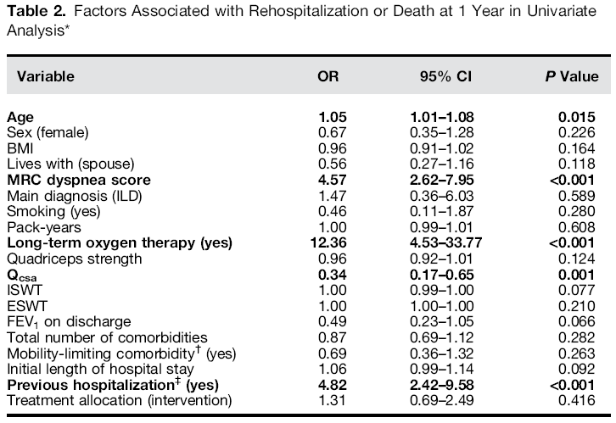
Results
Notes:
In the univariate logistic regression analysis of all available in-hospital assessments, the risk of either hospitalization or death was calculated.
재입원에 중요한 factor로서 MRC grade, home oxygen use, quadriceps cross-sectional area, and previous hospitalization and age

Slide 12
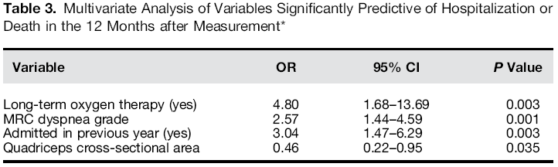
Results
Notes:
일변량 분석에서 다변량 분석으로 접근할시 중요한 factor로는 Factors associated independently with further hospitalization were MRC grade, quadriceps cross-sectional area, previous hospitalization, and home oxygen use. Age was not significantly associated

Slide 13
Results
Participants were grouped into quartiles
  based on their quadriceps mass
  Quartile 1 range, 0.816–1.407 cm²/m²
  Quartile 2 range, 1.408–1.722 cm²/m²
  Quartile 3 range, 1.731–2.053 cm²/m²
  Quartile 4 range, 2.059–3.500 cm²/m²
Subjects with a smaller Qcsa
  a lower body mass index & weight
  to be weaker
  a trend to worse FEV1
  a longer index length of hospital stay

Slide 14
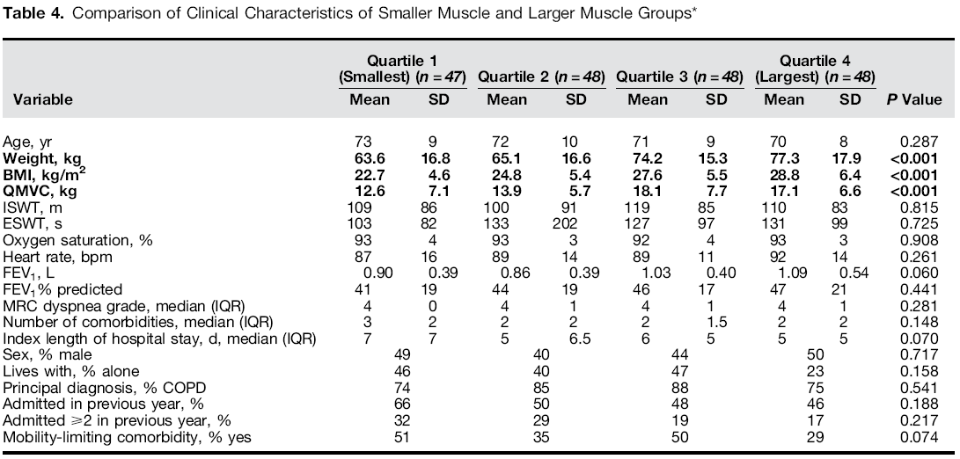
Results

Slide 15
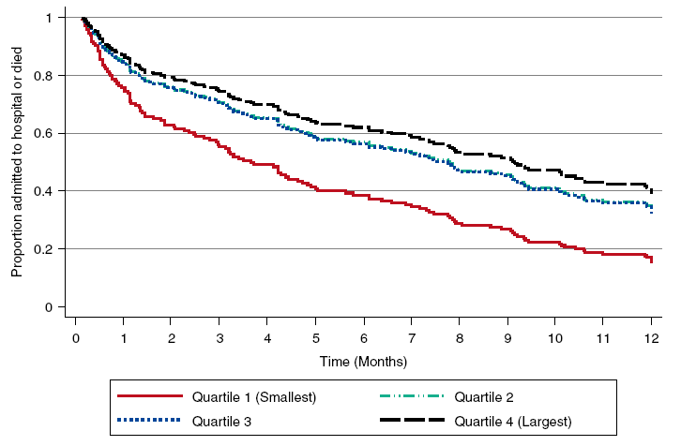
Results
Notes:
Risk of Hospitalization: the mean numbers of admission
quartile 1 (smallest muscle), 2.5(95% CI, 1.4–3.2);
quartile 2, 1.3 (95% CI, 0.8–1.7);
quartile 3, 1.5 (95% CI, 1.0–2.0);
quartile 4 (largest muscle), 1.7 (95% CI,1.0–2.4) (P = 0.025)
Risk of hospitalization, using Cox regression, was significantly higher in the smallest muscle group compared with largest

Slide 16
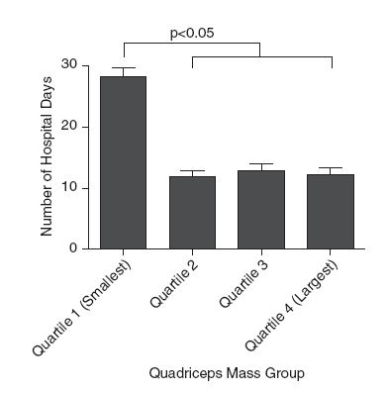
Results
The number of hospital days
  significantly higher in the smallest muscle group
Notes:
The number of hospital days in the year after the original admission was significantly higher in the smallest muscle group

Slide 17
Results
Mortality
  13 (28%) in the smallest muscle group(quartile 1)
  10 (21%) in quartile 2
  7 (15%) in quartile 3
  5 (10%) in the largest muscle group (quartile 4)
  no difference between groups at 12 months
No difference when correcting for
  MRC dyspnea grade, previous hospitalization, home oxygen use & treatment allocation using Cox regression
between intervention and usual care groups
  similar in all quadriceps subgroups

Slide 18
Discussion
Indices of muscle function measured early during hospitalization
  influence the risk of readmission over the subsequent 12 months
Qcsa
  independently associated with hospital readmission or death
  remained significant alongside MRC dyspnea grade, home oxygen use, hospitalization in the previous 12 months
  a marker of muscle mass in the current study
  By US vs CT, dual-energy X-ray absorptiometry
      independent of patient effort
      can be performed at the bedsid
  progressive wasting in the intensive care environment
  a more sensitive and reliable measure of muscle mass

Slide 19
Discussion
The impact of an exacerbation of respiratory disease
  determined by a combination of the severity of the acute event & the premorbid condition of the Pt
  measures of the physical condition of the Pt
    predict longer term readmission risk
  Nonvolitional measures such as US: discriminatory
    when performed during the acute event
Notes:
This contrasts with volitional measurements such as muscle strength or walking performance, which were not predictive when performed in this setting, presumably because they were influenced by the acuity of the event.

Slide 20
Discussion
higher proportion in the mean number of hospital days between the smallest and largest muscle groups
Skeletal muscle dysfunction
  Important for admission to hospital, the severity & duration of the admission
Large musle mass
  be better able to cope with the insult of a severe illness & hospitalization
  resulting in a shorter length of stay
  Interventions to support: no reduction in hospital admissions after pulmonary rehabilitation

Slide 21
Discussion
no statistically significant difference in mortality between the smallest muscle & largest muscle groups
In other studies, reduced muscle function (mass & strength)
  an independent predictor of mortality in COPD
measures of muscle function
  recorded during hospital admission
  provide an opportunity for future risk stratification.

Slide 22
Discussion
no difference in hospitalization rate between an early rehabilitation intervention and usual care
on the basis of quadriceps size, no difference in mortality or efficacy of the intervention in any particular subgroup.

Slide 23
Discussion
Limitations
  a secondary, subgroup analysis of a clinical trial & risk stratification: not the purpose of the investigation
  Qcsa, using US: not a routine measure
  limited data for any of these tests in the acute hospital setting.

Slide 24
Conclusion
smaller lower limb muscle mass in the acute care setting is a risk factor for subsequent unscheduled admission to hospital for exacerbations of CRD. Such measurements may have value in both clinical practice and as a risk stratification tool in these populations.

