Slide 1
Lung Cancer Screening with LDCT
Youngmok Park
Division of Pulmonology
Department of Internal medicine
Yonsei University College of Medicine

Slide 2
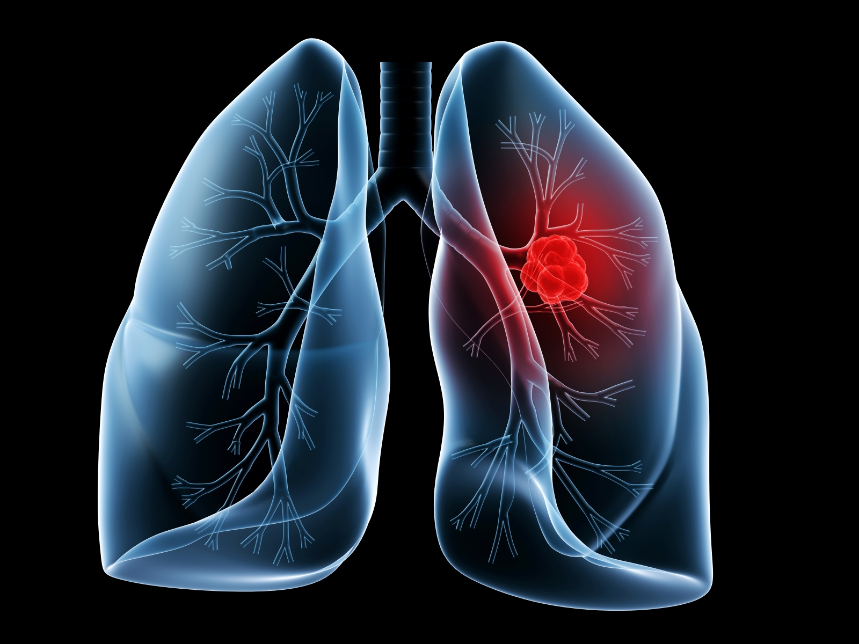
Lung Cancer

Slide 3
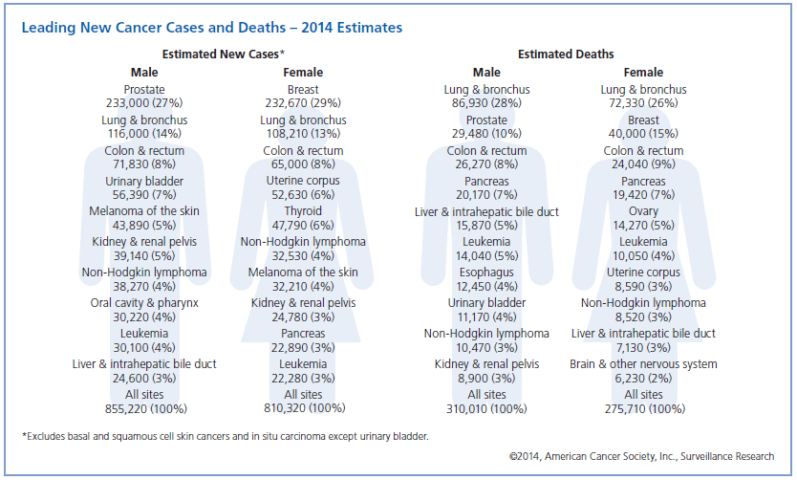
American Cancer Society, Cancer Facts & Figures, 2014

Slide 4
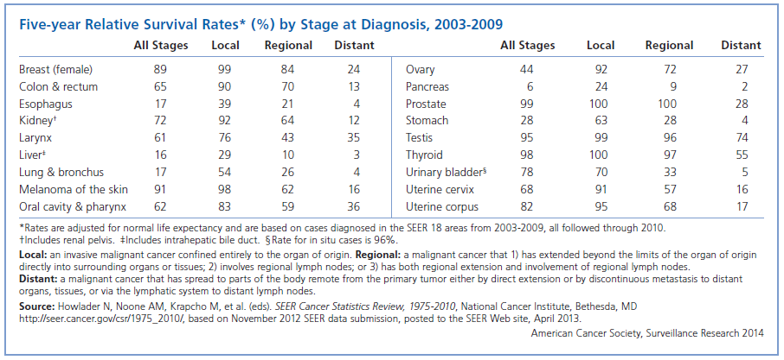
15%
American Cancer Society, Cancer Facts & Figures, 2014

Slide 5
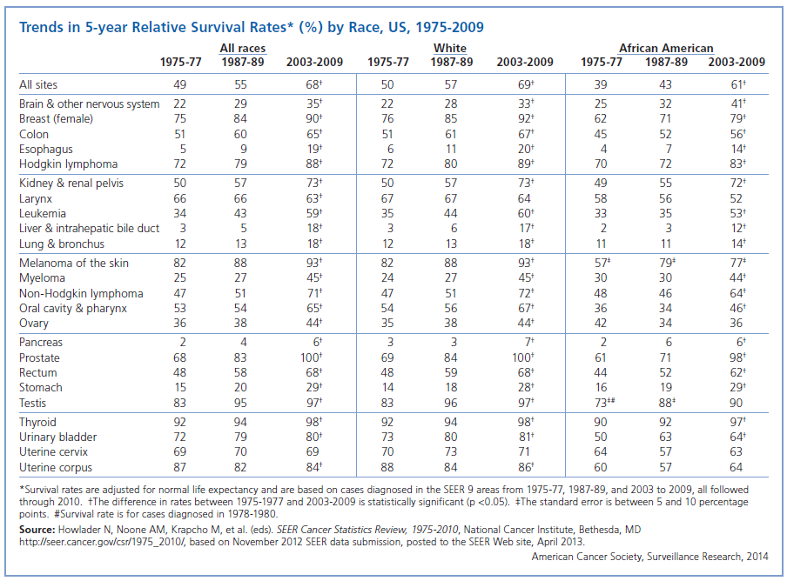
American Cancer Society, Cancer Facts & Figures, 2014

Slide 6
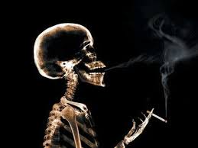
Risk Factors

Slide 7
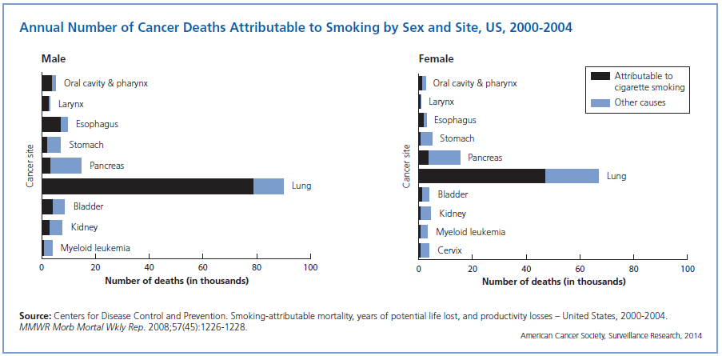
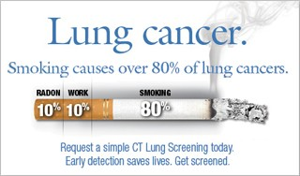
American Cancer Society, Cancer Facts & Figures, 2014

Slide 8
Screening: why ?
Goal: cancer mortality reduction
Detect asymptomatic cancers
Asymptomatic cancers = better prognosis (?)

Slide 9
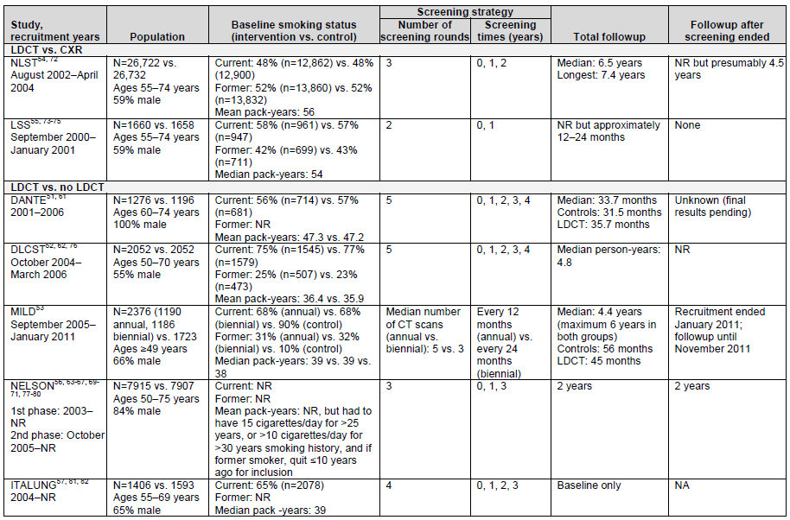
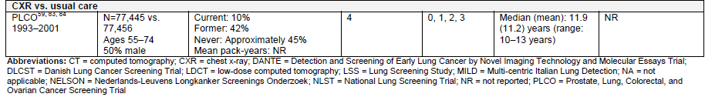
Lung Cancer Screening

Slide 10
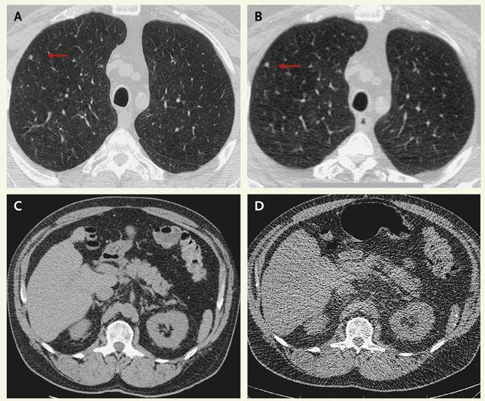
CT of the Chest
Routine
Low-dose
938mGy/cm
15.9 mSv
88mGy/cm
1.5 mSv
Smith-Bindman, N Engl J Med 2010;10.1056
Notes:
Computed Tomography (CT) of the Chest -- Routine (Left) versus Low Dose (Right). The surveillance of small pulmonary nodules is a common indication for chest CT, and several protocols can be used for these studies. Routine chest CT (Panel A) is associated with a radiation dose to the patient that is 10 times that of low-dose chest CT (Panel B) (dose-length product, 938 mGy per centimeter vs. 88 mGy per centimeter; effective dose, 15.9 mSv vs. 1.5 mSv) -- yet each shows the small pulmonary nodule equally well (Panels A and B, arrows). The pulmonary parenchyma and upper abdomen are better visualized on the higher-dose routine scan (Panels A and C, respectively) than the low-dose scan (Panels B and D, respectively), but these areas are irrelevant to follow-up of a small pulmonary nodule. A recent survey of radiologists who perform chest CT showed that low-dose CT was not routinely used for examinations performed solely for the purpose of nodule follow-up and that most radiologists were unaware of the CT settings used for initial versus follow-up CT.1 Standardization of CT protocols could result in substantial reduction in patients' radiation doses without loss of diagnostic accuracy. Images courtesy of Dr. Michael J. Flynn, Department of Radiology, Henry Ford Health Systems.

Slide 11
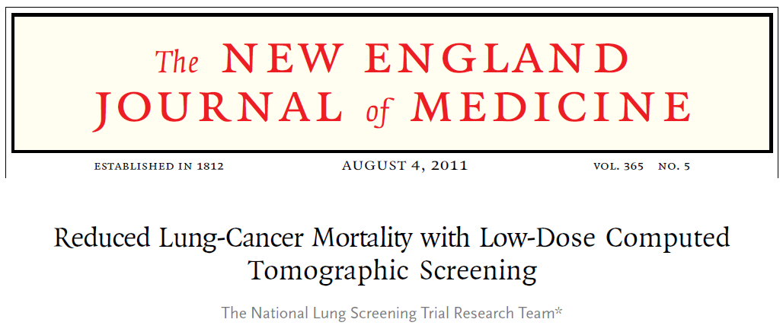

Slide 12
National Lung Screening Trial
Determine effect on lung cancer mortality
Determine magnitude if any of stage shift
Delineate adverse events
Determine the ratio between risks and benefits

Slide 13
High Risk Participants
55-74 yrs, Males and Females
Asymptomatic current or former smokers ≥ 30 pack yrs
Former smokers must have quit within ≤ 15 yrs
No prior Hx lung cancer
No Hx any cancer within past 5 years
No chest CT within prior 18 months
Aug 2002 ~ April 2004, 33 centers, US
Randomized, Multicenter

Slide 14
NLST Trial Design
CT Arm : 26,722
53,454
High-Risk
Subjects
Randomize
CXR Arm : 26,732
3 annual screens: T0, T1, T2

Slide 15
CT Arm
Randomize
CXR Arm
2nd Interim Analysis
1st Interim Analysis
3rd Interim Analysis
Final Analysis
T₀
02 03 04 05 06 07 08 09 10
T₁
T₂
Follow up
median 6.5 yrs
max 7.4 yrs

Slide 16
Results Classifications
[-] Screen
  No significant findings –or – minimal findings not significant for lung cancer
[-] Screen
  Significant findings unrelated to lung cancer
  [Some form of diagnostic recommendation required; e.g., echocardiogram for suspected pulmonary hypertension)
[+] Screen
  Nodule ≥4mm or findings potentially related to lung cancer
  [diagnostic recommendation of some form required]

Slide 17
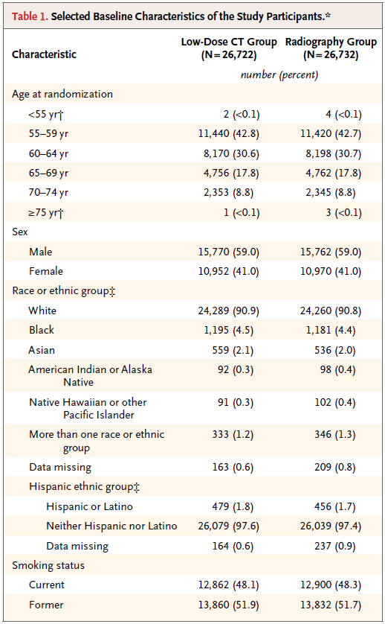

Slide 18
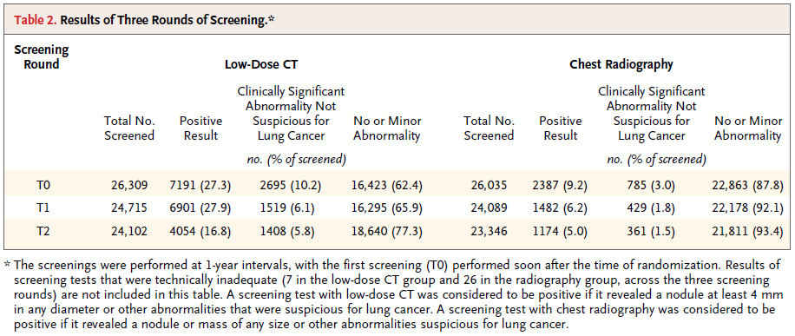

Slide 19
NLST - Result
  55 to 74 yrs, >30 pcyr, active or stop <15 yrs
 | n | Positive (diam≥4mm) | Lung cancers | Lung cancer deaths | Risk Reduction
Low-dose CT | 26,722 | 18,146 (68.5%) | 1,060 | 356 (1.3%) 247/100,000 prs-yrs | 20.0% (95% CI 6.8–26.7 P=0.004)
Chest X-ray | 26,732 | 5,043 (19.2%) | 941 | 443(1.6%) 309/100,000 prs-yrs
NNS to prevent 1 lung cancer death = 320

Slide 20
Cause of Death (CT arm)
 | n | % | Reduction vs control group
Lung cancer | 427 | 22.9% | 20% (6.8 – 26.7, P=0.004)
Other Neoplasm | 416 | 22.3% | 3.2% (p = 0.28)
Cardiovascular Illness | 486 | 26.1%
Respiratory Illness | 175 | 9.4%
Complication of medical or surgical care | 12 | 0.6%
Other | 349 | 18.7%
All | 1865 |  | 6.2% (1.2 – 13.6%, P = 0.02)

Slide 21
Unanswered Questions
CT Screen = 26,722
Positive = 18,146 (68.5%)
Cancer = 1,060 (5.8%)

Slide 22
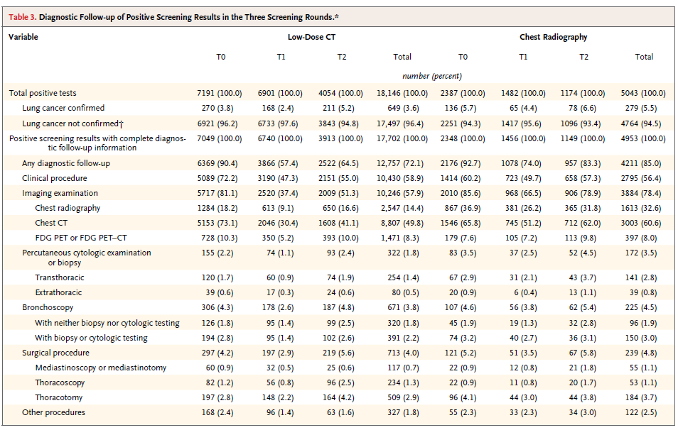
False Positive
Follow-up CT
FOB
Tissue biopsy
Surgery
Cost
Radiation
Complication
Patient Anxiety

Slide 23
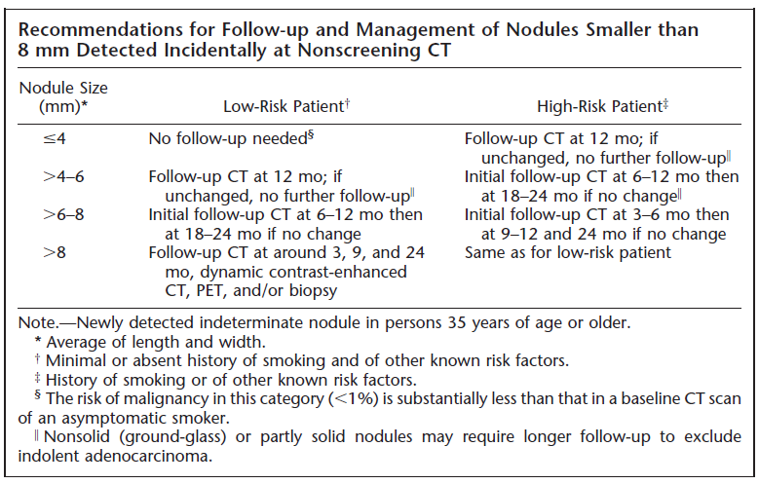
Heber MacMahon, Radiology 2005; 237:395-400

Slide 24
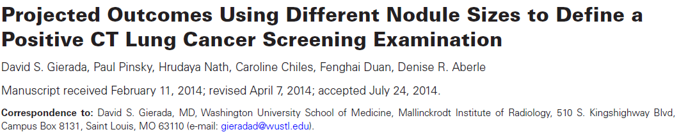

Slide 25
Study Design
Use higher nodule size threshold
maintain adequate sensitivity and specificity
Retrospective analysis of NLST data
CT arm (26,722)
Positive : noncalcified lung nodules ≥4mm, other findings suspicious for lung cancer (ex. Enlarged hilar or mediastinal LN, etc.)
≤4mm, 4~9mm, ≥10mm

Slide 26
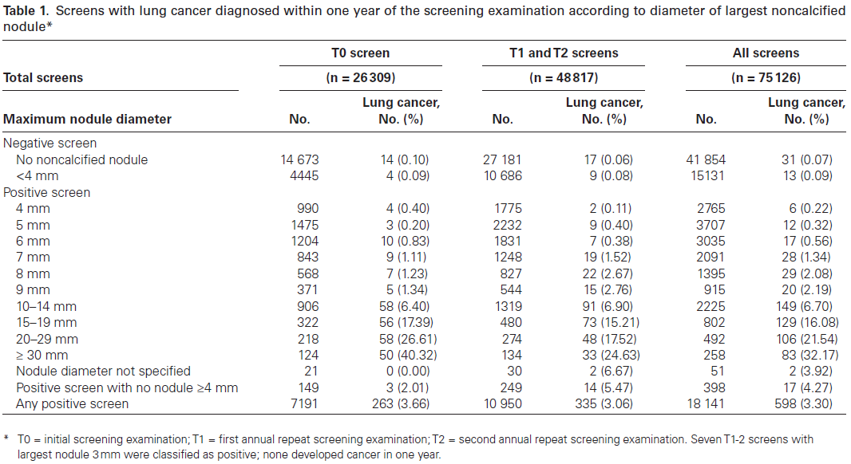
64%
0.8%
12%

Slide 27
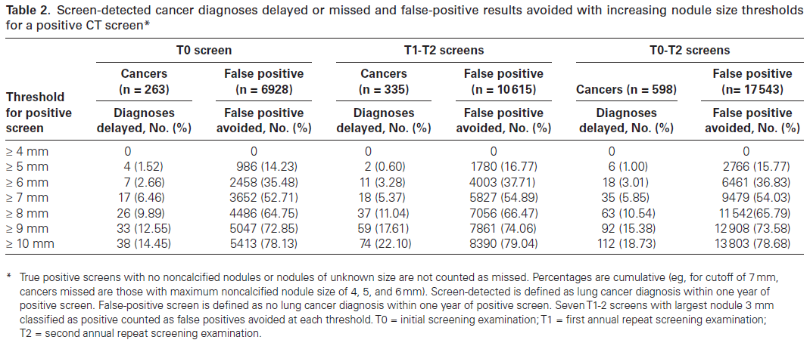

Slide 28
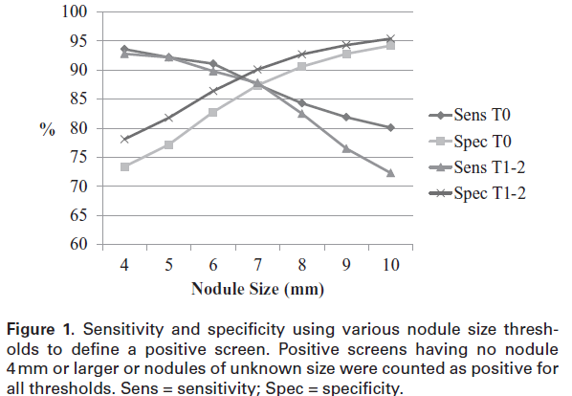
93.6%
94.2%
80.1%
73.4%

Slide 29
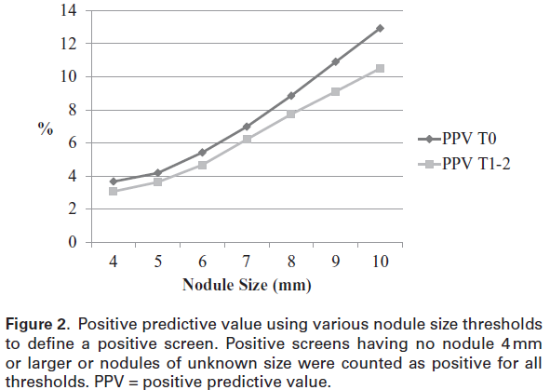
12.9%
3.7%

Slide 30
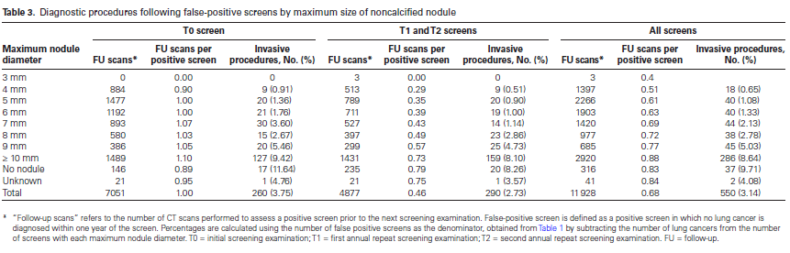

Slide 31
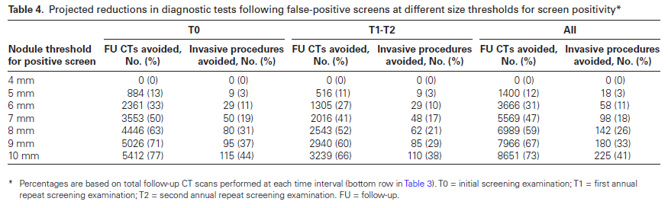

Slide 32
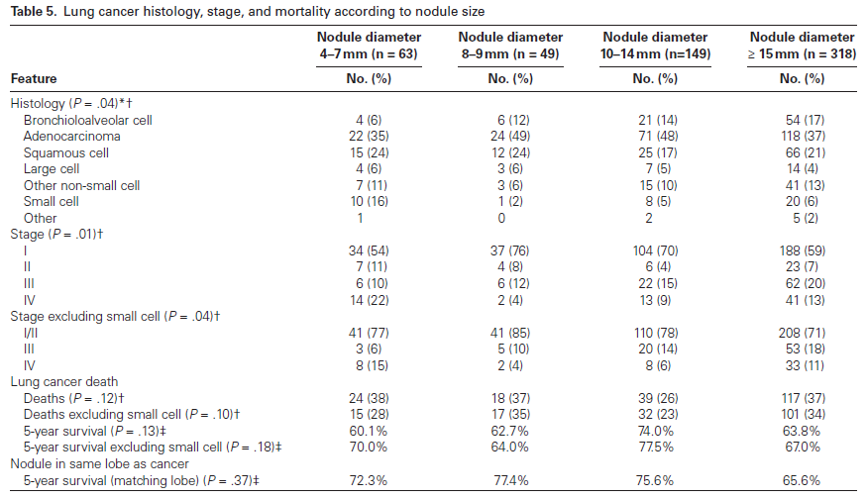

Slide 33
Conclusion
Each milimeter ↑
steadily increase of delayed or missed diagnosis
marked decrease in false-positive rates.
Follow-up test↓
25% of invasive procedures↓ (8mm threashold)
Threshold | Delayed/Missed Dx↑ | FP↓
5mm | 1.0% | 1/8
6mm | 3.0% | 1/3
7mm | 5.9% | 1/2
8mm | 10.5% | 2/3

Slide 34
Conclusion
Nodule size → survival or lung cancer mortality ? Not clear
No other screening studies have examined the effects of different nodule size thresholds.
NCCN guidelines on lung cancer(2014) : raised the threshold for positive screen to 6mm
Risk models considering patient factors and nodule characteristics other than size

Slide 35
Take Home Message
NLST : 1st RCT to proove benefit of LDCT screening reducing lung cancer mortality (20%)
Rasing the nodule size threshold for a positive screen,
reduces false-positive CT screen
reduced medical resource utilization
delay in the diagnosis of lung cancer
but, small impact of all lung cancer cases
affect cost-effectiveness of LDCT screening

Slide 36

Notes:
경청해주셔서 감사합니다.

