Slide 1
Case
Radiology
Dong-jin Im

Slide 2
Case
47/M
Phx
  HBV carrier x 25 yrs
CC
  2013. 12
  Both posterior thigh pain

Slide 3
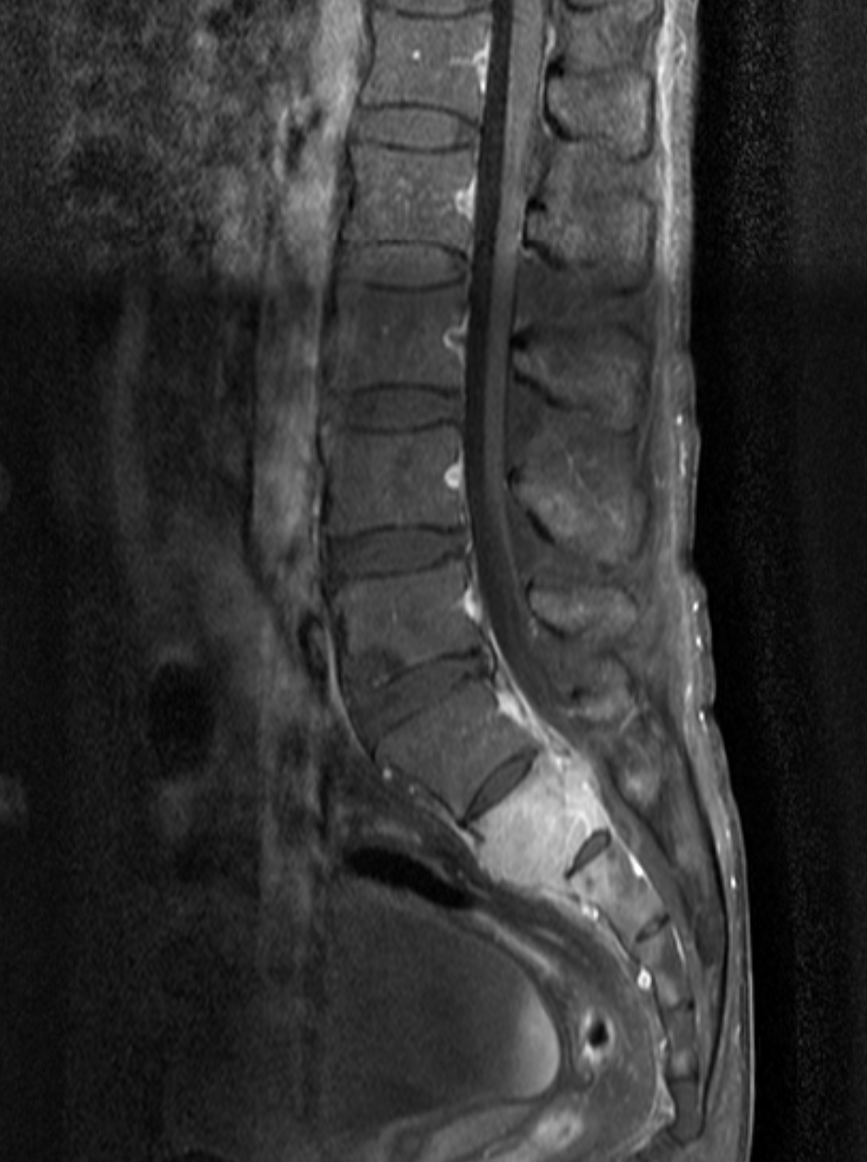
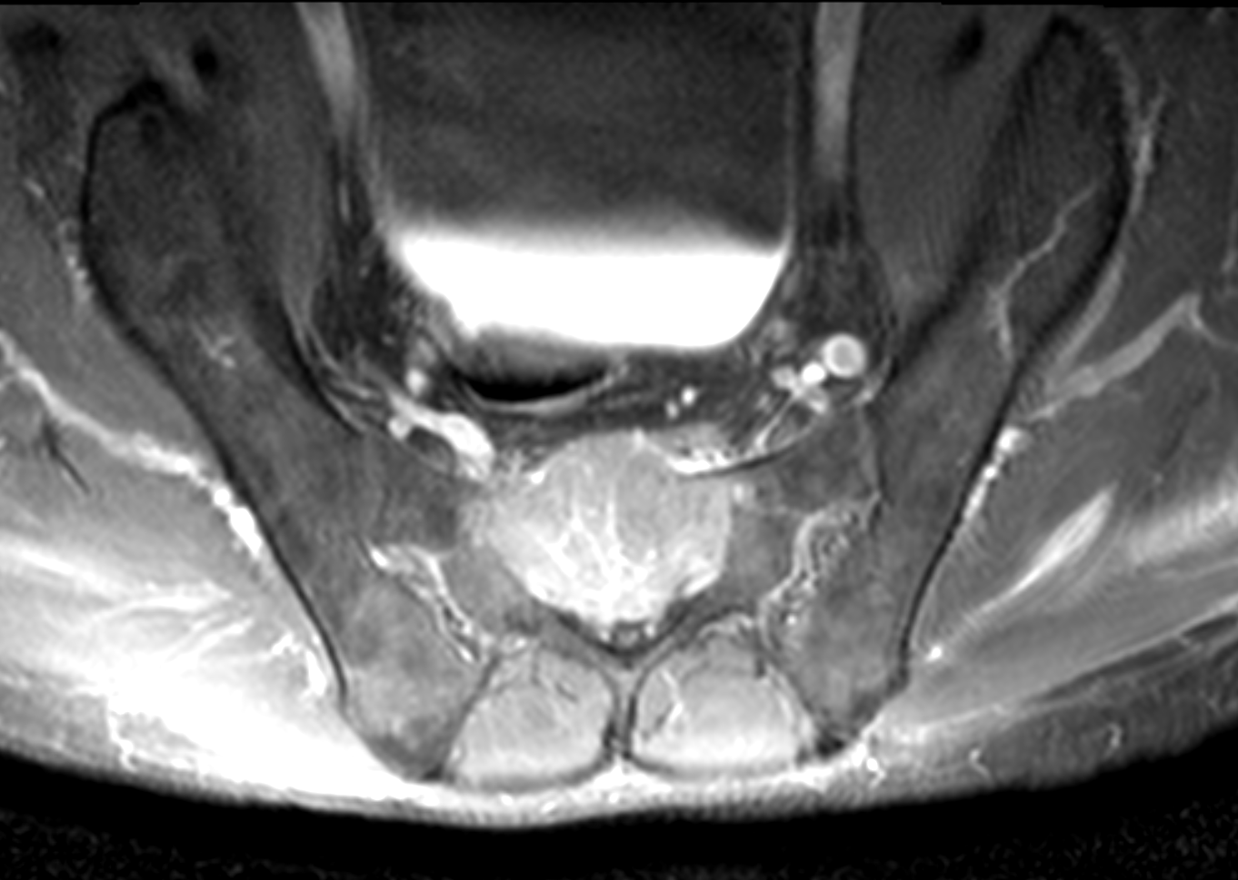
2013-12-23 L-spine MR
Notes:
Highly suggestive bone met
- diffuse involvement of S2 and focal involvmenet of S3
- heterogeneous enhancement with retropulsion astasis at S2 and 3

Slide 4
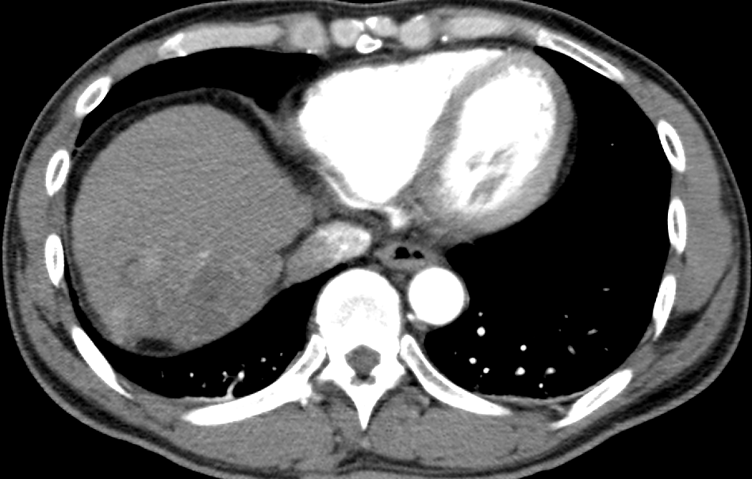
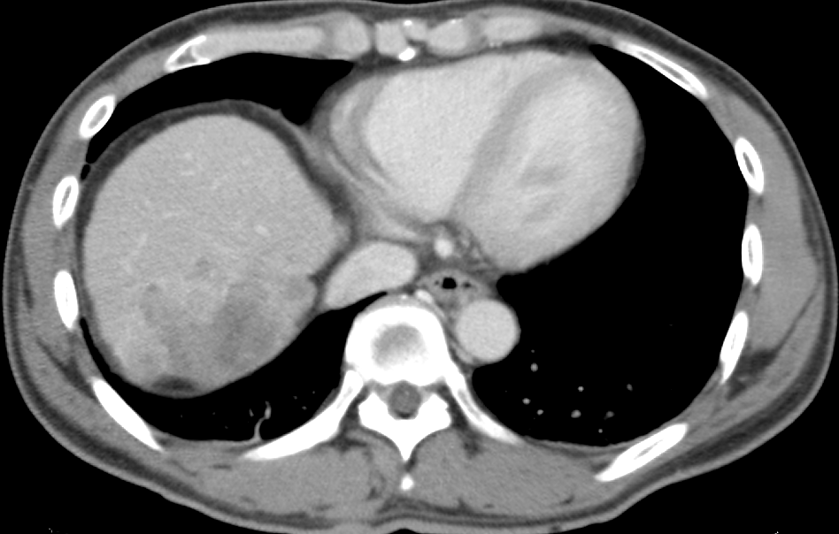
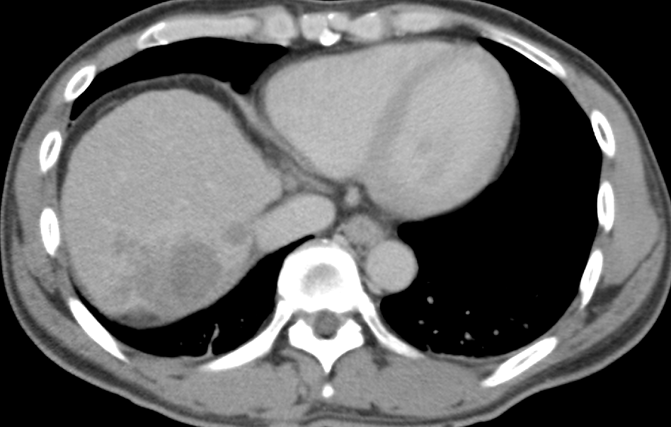
2013-12-24 CT liver
AFP 73457.81
CEA 3.85
PIVKA-II 49941
Notes:
7.7 츠 r/o HCC with bone metastasis

Slide 5
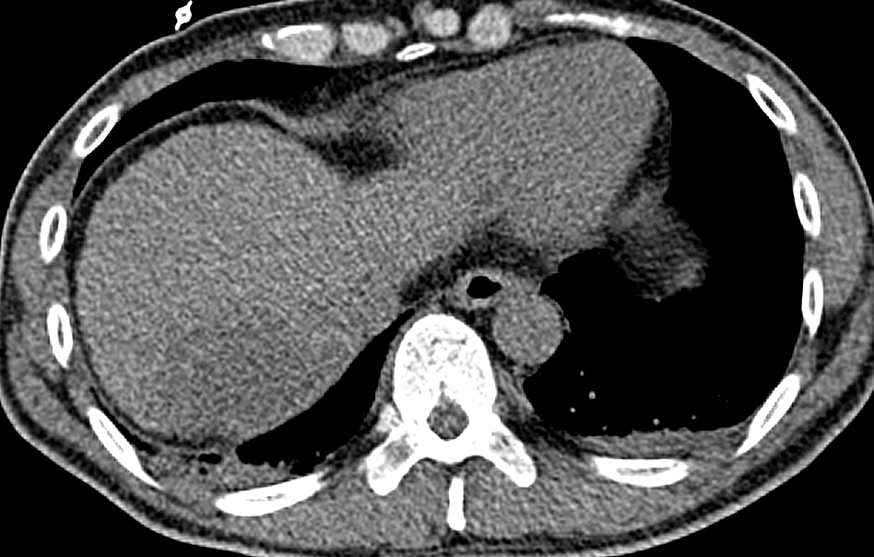
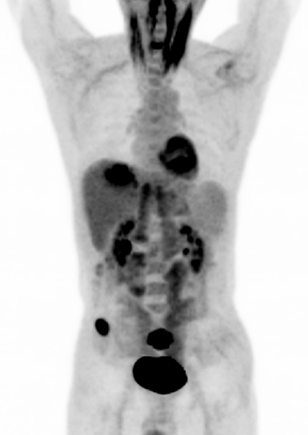
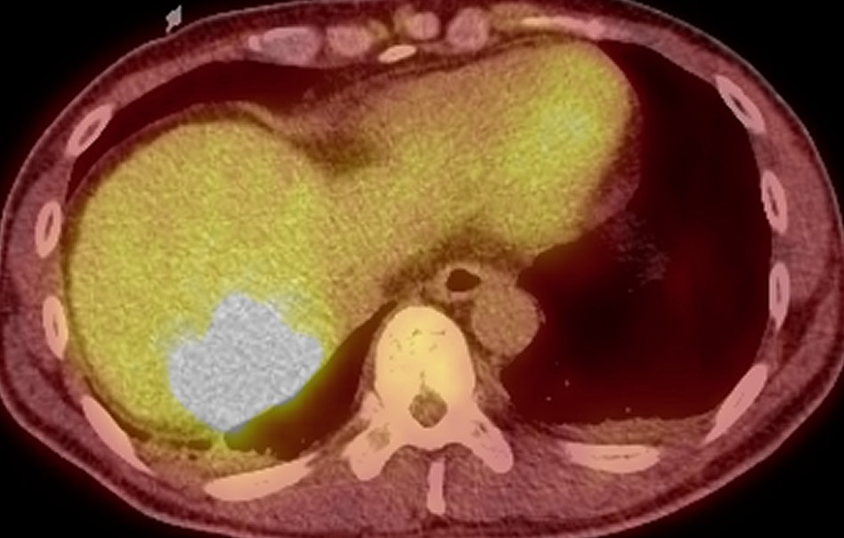
2013-12-26 PET-CT
Notes:
1. Large, infiltrative low attenuating lesion in S7 of the liver with intense FDG uptake, suggestive of high grade malignancy.
2. Osteolytic lesions with intense FDG uptake in right iliac bone and sacrum, consistent with metastasis.
3. Emphysematous bullae in both upper lung.

Slide 6
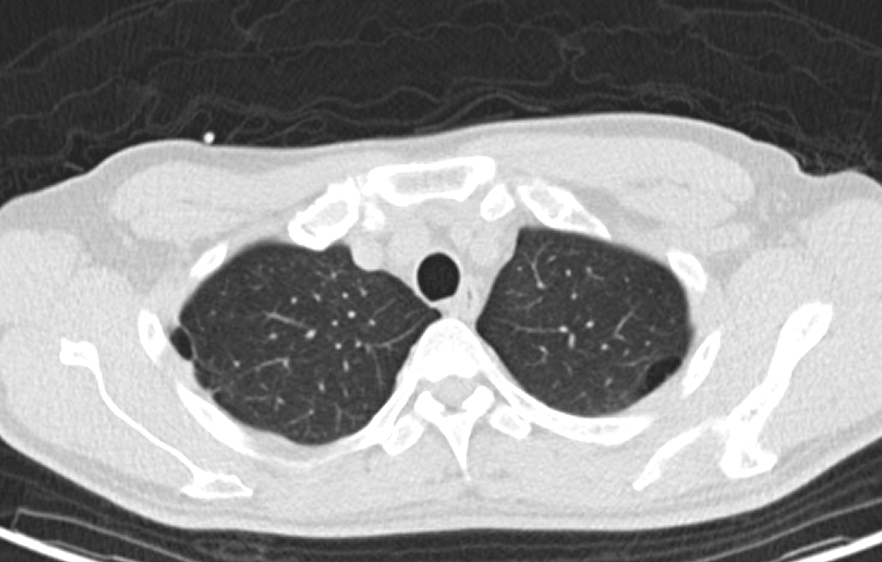
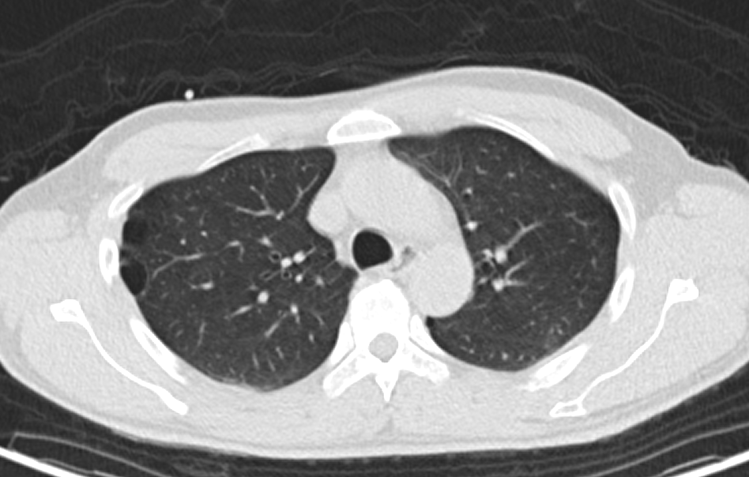
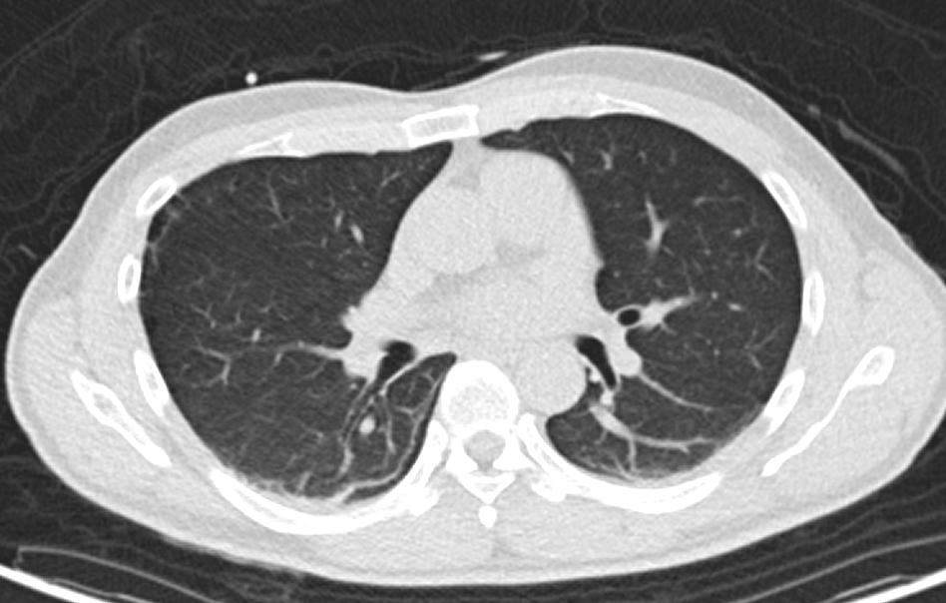
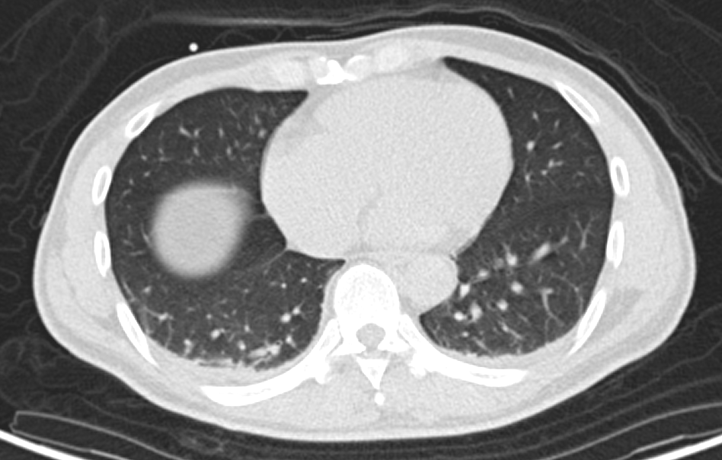
2013-12-26 PET-CT
Notes:
Emphysematous bullae in both upper lung.
Yttrium radioembolization
palliative RT for spine metastasis

Slide 7
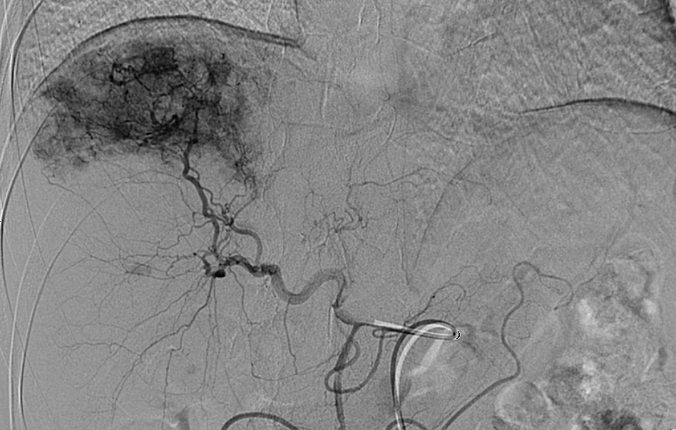
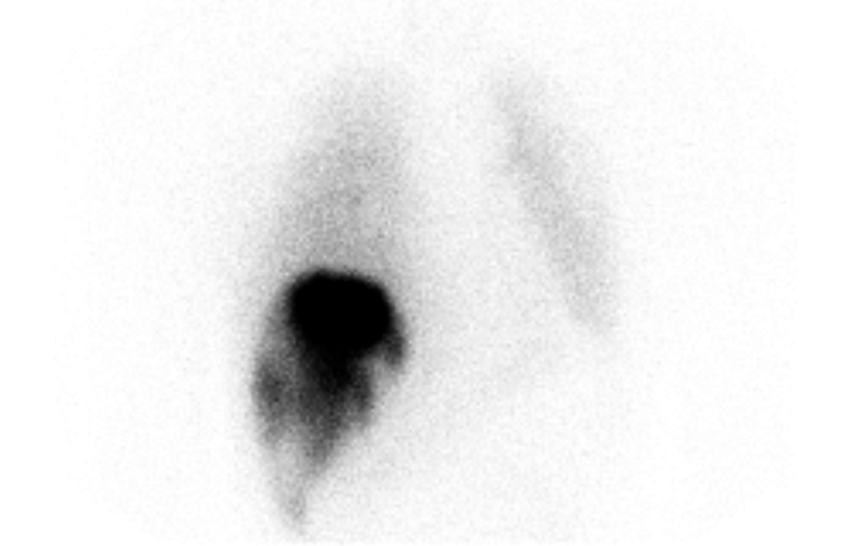
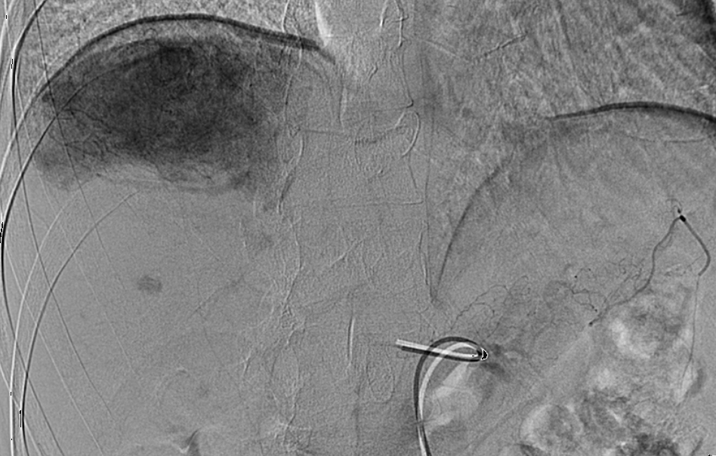
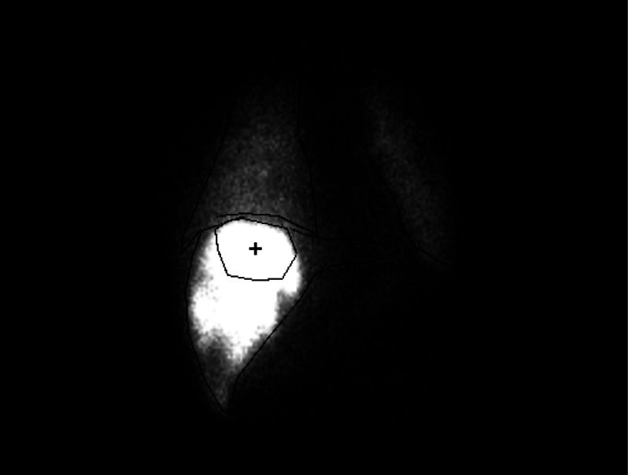
2014-01-02 radioembolization(pre)
2014-01-02 lung perfusion scan
Notes:
16.23 LungShunting (%)

Slide 8
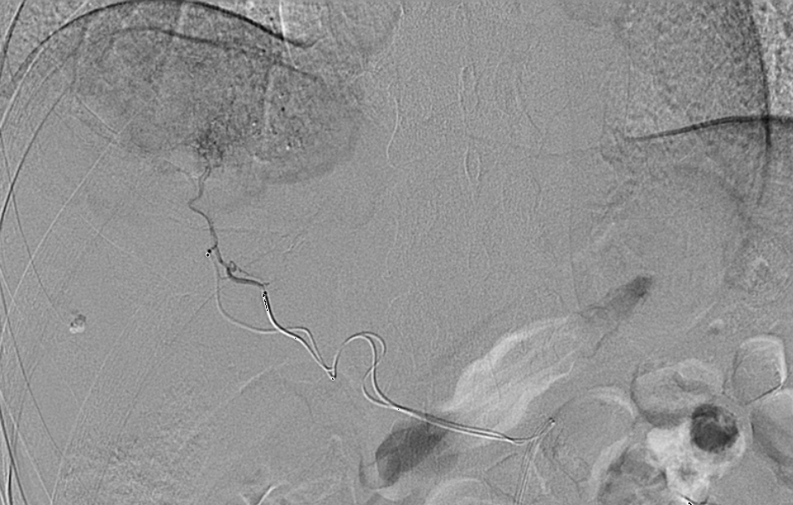
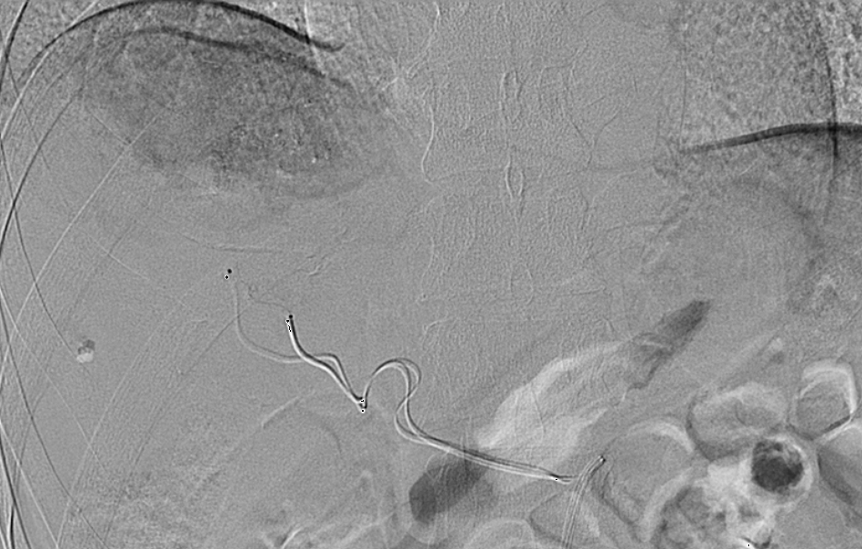
2014-01-14 radioembolization
Notes:
Celiac artery에 6F sheath를 insertion하고 3F microcatheter 2개를 Rt. superior segmental artery와 mid hepatic artery에 각각 위치시킴.
Rt. hepatic artery에는 2GBg를 mid hepatic artery는 1GBg의 Yttrium을 각각 infusion함.
Puncture site는 perclosure로 지혈함.

Slide 9
CC
  2014. 03
  10일 전부터 계단 15칸만 올라가도 숨차는 증상

Slide 10
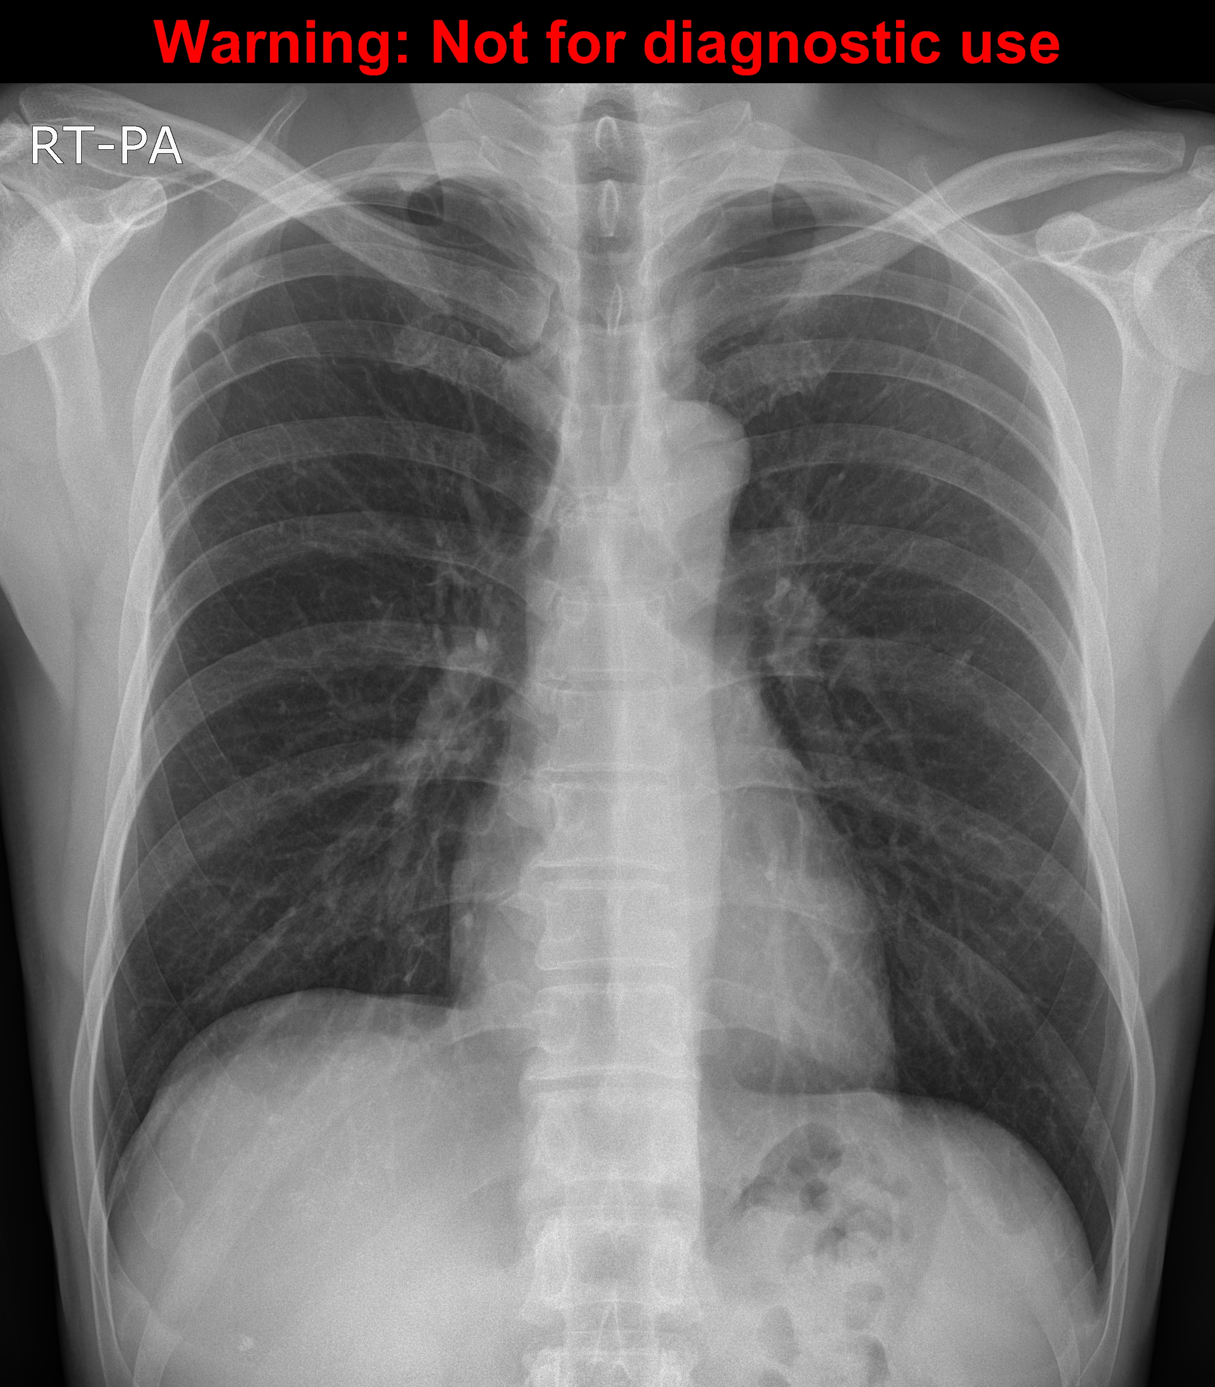
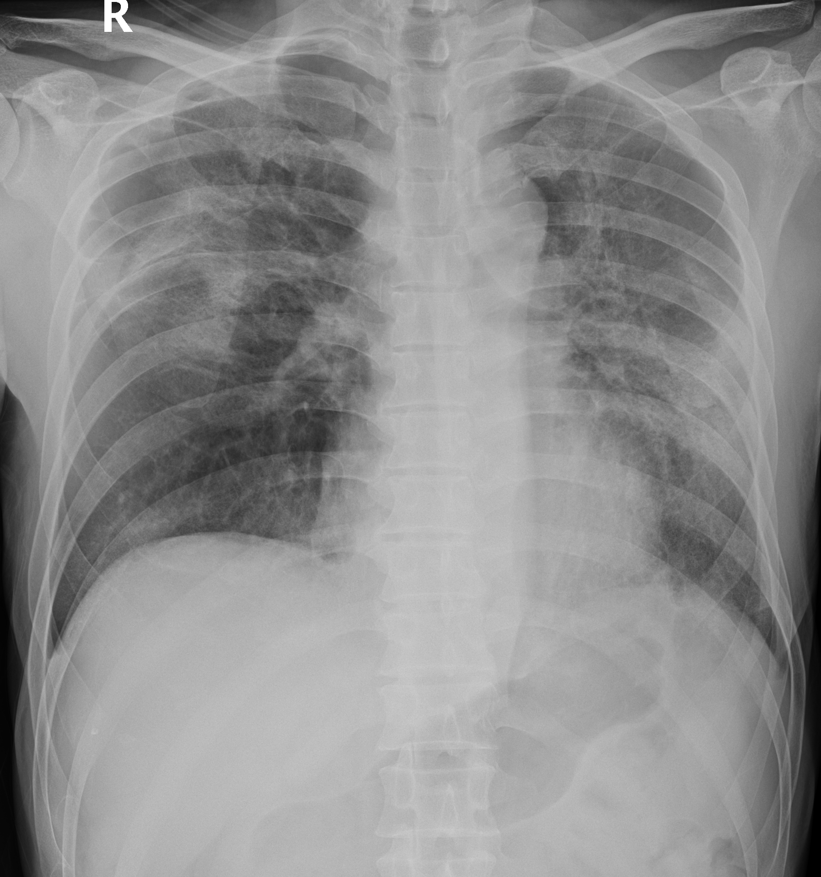
2014-01-13 chest pa
2014-03-19 chest AP
Notes:
Diffuse consolidation and GGO in both lungs, R/O pneumonia.
Bullous change in RUL.
D-dimer 764

Slide 11
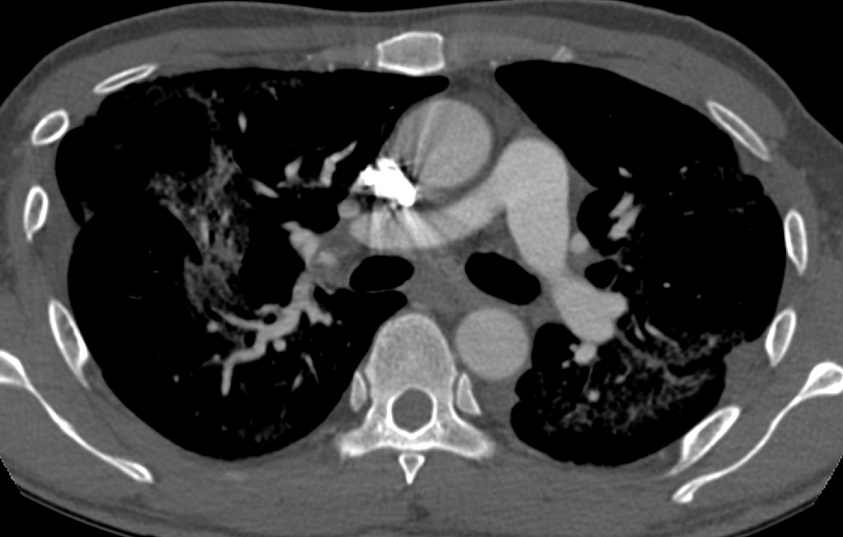
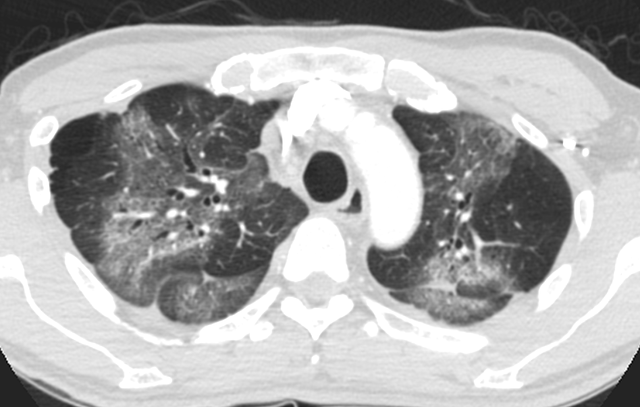
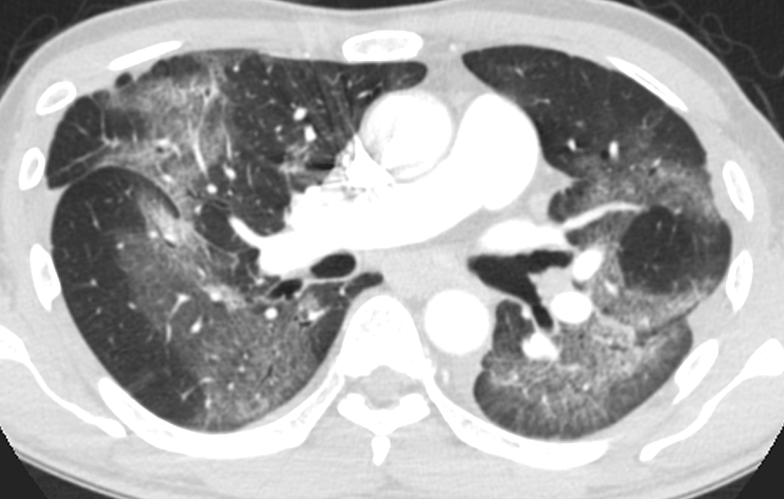
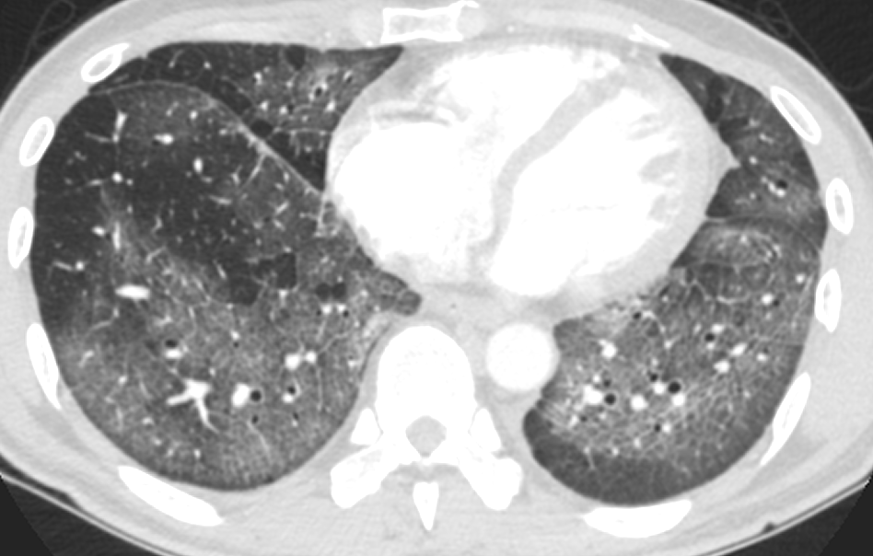
2014-03-19 pulmonary embolism CT
Notes:
No visible intraluminal filling defects at both pulmonary arteries.
Diffuse GGO with intralobular, interlobular interstitial thickenings at both lungs.

Slide 12
Impression
Radiation pneumonitis caused by Yttrium-90 microspheres

Slide 13
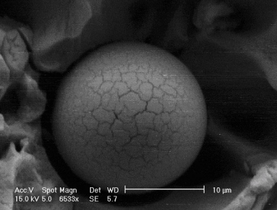
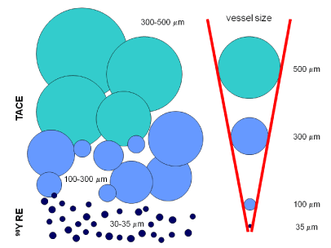
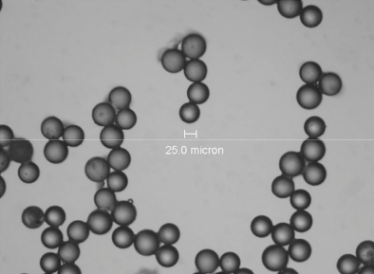
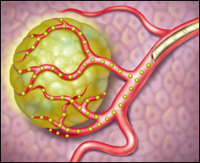
Transarterial radioembolization
Transarterial radioembolization (TARE)
  Selective internal radiation treatment (SIRT)
  Yttrium-90 microsphere therapy
Yttrium-90 microsphere
  Trans-hepatic arterial administration
  Embolic microscopic particle
  To deliver lethal doses of radiation (200-300Gy)
  To create a zone of high radiation exposure
  20-30µm; terminal branch of hepatic a. or portal v.
  Microspheres :
    SIR-Spheres®; resin, 20 - 60 ㎛
    TheraSphere®; glass, 20 - 30 ㎛.
Semin Nucl Med 2010; 40:105-121
Biomed Imaging Interv J 2006; 2(3):e43

Slide 14
Transarterial radioembolization
Unresectable hepatic malignancy
  Primary: HCC, CCC
  Metastasis: rectal cancer
Complication
  Early : fatigue, abdominal pain, nausea, vomiting, anorexia, fever
  Late : GI ulceration, cholecystitis, pancreatitis, pneumonitis
Brachytherapy 2013; 12:573-579
Biomed Imaging Interv J 2006; 2(3):e43

Slide 15
Radiation pneumonitis caused by Yttrium-90 microspheres
Etiology
  Intratumoral arteriovenous shunting
Diagnosis
  Clinical findings
  Functional findings
  Radiographic findings
  Without other infectious /inflammatory /cytotoxic etiologies
J Vasc Interv Radiol 2012; 23:669–674
Int. J. Radiation Oncology Biol. Phys. 1995; 33:919-924

Slide 16
Radiation pneumonitis caused by Yttrium-90 microspheres
Etiology
  Intratumoral arteriovenous shunting
Diagnosis
  Clinical findings
    1-2 months after therapy
    Nonproductive cough, dyspnea, fever
    BAL: Bronchoalveolar lymphcytosis and eosinohilia
  Functional findings
    PFT: restrictive pattern
  Radiographic findings
  Without other infectious /inflammatory /cytotoxic etiologies
J Vasc Interv Radiol 2012; 23:669–674
Int. J. Radiation Oncology Biol. Phys. 1995; 33:919-924

Slide 17
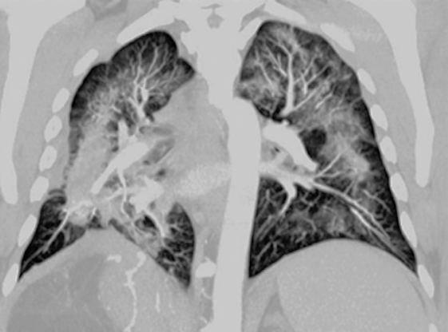
Radiation pneumonitis caused by Yttrium-90 microspheres
Etiology
  Intratumoral arteriovenous shunting
Diagnosis
  Clinical findings
  Functional findings
  Radiographic findings
    Confluent GGO/consolidation
    Relative peripheral/hilar sparing, aymmetric
    Fibrosis, traction bronchiectasis, focal honeycombing
  Without other infectious /inflammatory /cytotoxic etiologies
J Vasc Interv Radiol 2012; 23:669–674
Int. J. Radiation Oncology Biol. Phys. 1995; 33:919-924

Slide 18
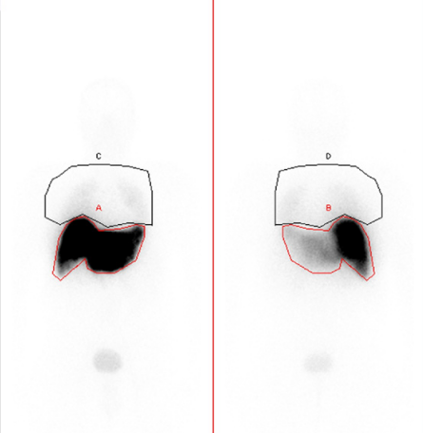


Radiation pneumonitis caused by Yttrium-90 microspheres
Lung perfusion scan
  Scintigraphy with Tc-99m MAA (macroaggregated albumin)
  Liver-lung shunt calculation
  < 20%
    < 13% (1995)
AAPM 2011 annual meeting
Semin Nucl Med 2010; 40:105-121
J Vasc Interv Radiol 2012; 23:669–674
Int. J. Radiation Oncology Biol. Phys. 1995; 33:919-924
Notes:
30–90 ㎛
American Association of Physicists in Medicine
single < 30 Gy, cumulative < 50 Gy

Slide 19
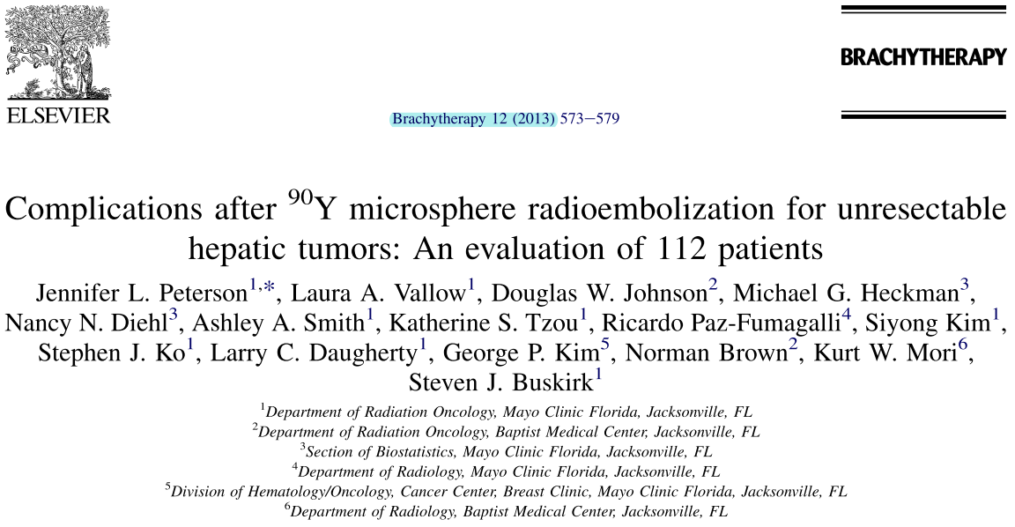
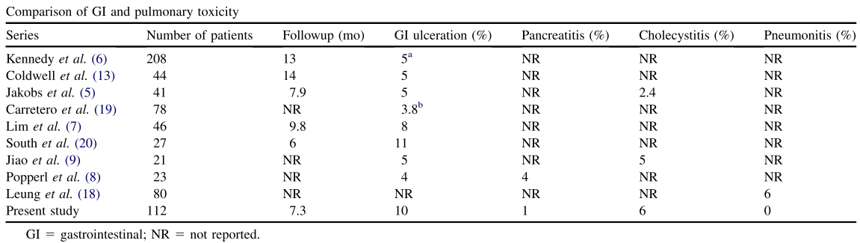
Radiation pneumonitis caused by Yttrium-90 microspheres
Brachytherapy 2013; 12:573-579

Slide 20
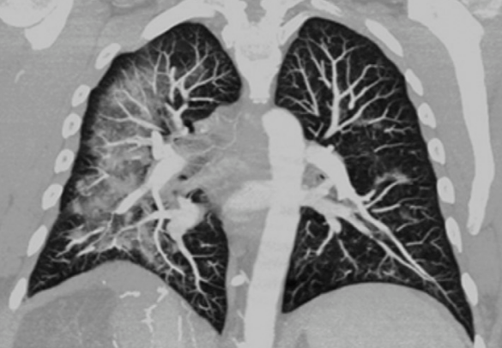
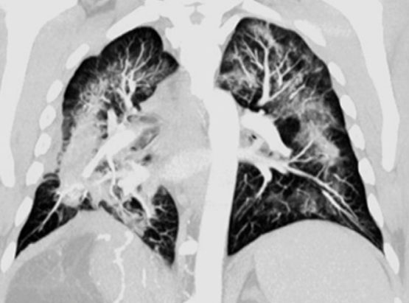
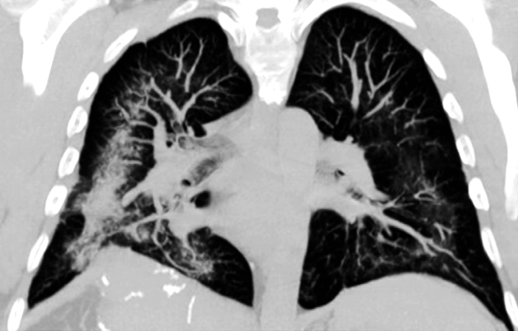
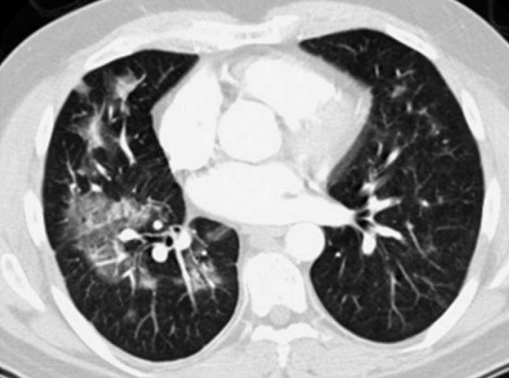
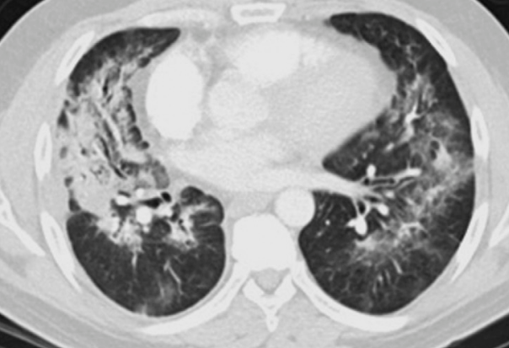
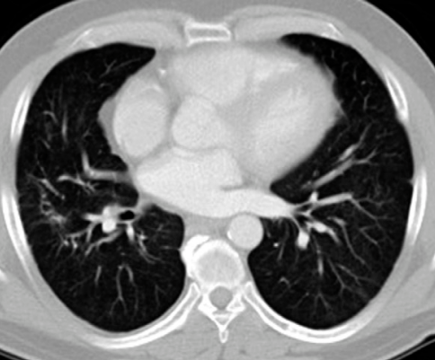
Radiation pneumonitis caused by Yttrium-90 microspheres
3 weeks after TARE
4 weeks after oral steroid
9 months later
Case: 50/F GIST of proximal jejunum with liver metastsis
J Vasc Interv Radiol 2012; 23:669–674
Notes:
50-year-old white man was diagnosed in 2001 with a
gastrointestinal stromal tumor (GIST) of the proximal jeju-
Num
of 21% / 9.3%
23.0 Gy 7.0.
31.0 Gy 13.0.
Three weeks after the second radioembolization treat-
ment, the patient developed progressive dyspnea and chest
tightness without fever, cough, or hemoptysis.
4 weeks

