Slide 1
VATS conference
2014. 7.17
Department of pathology

Slide 2
CASE 1
M/22
SS12-56773

Slide 3
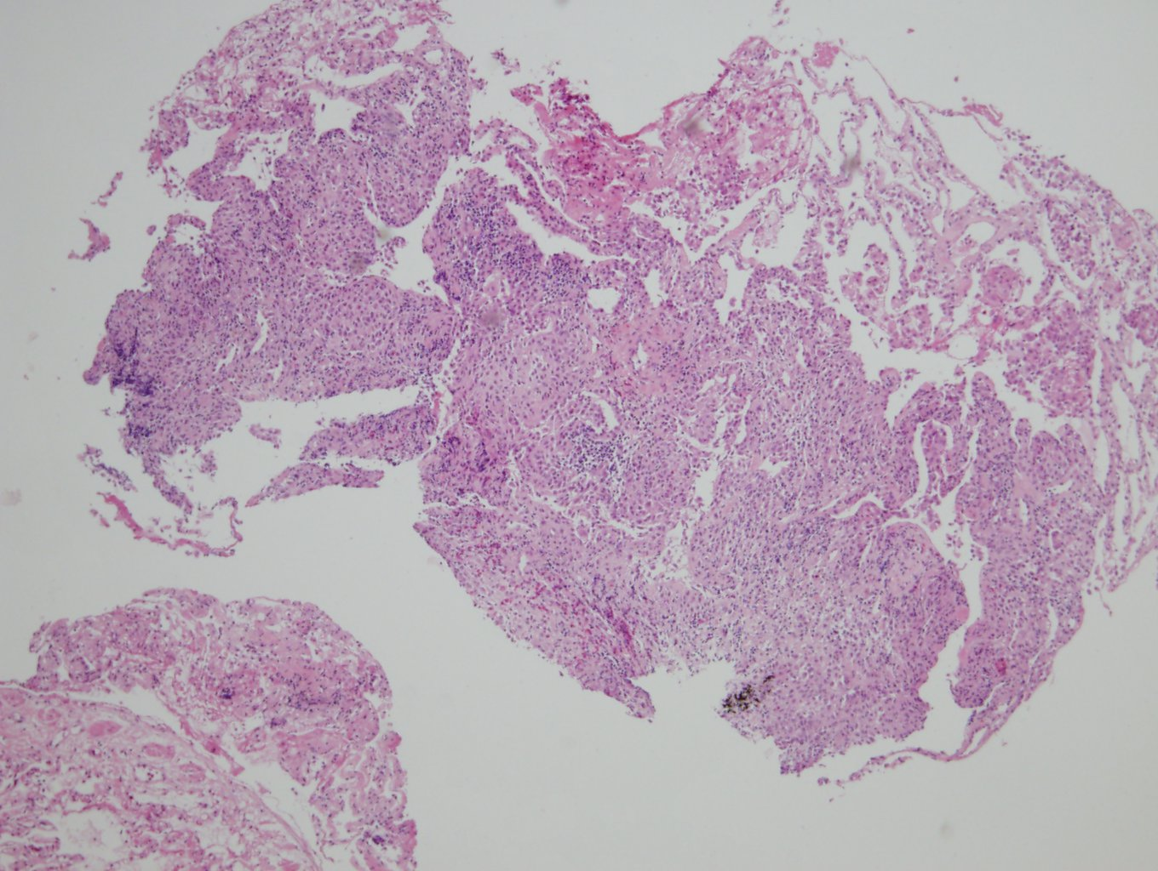

Slide 4
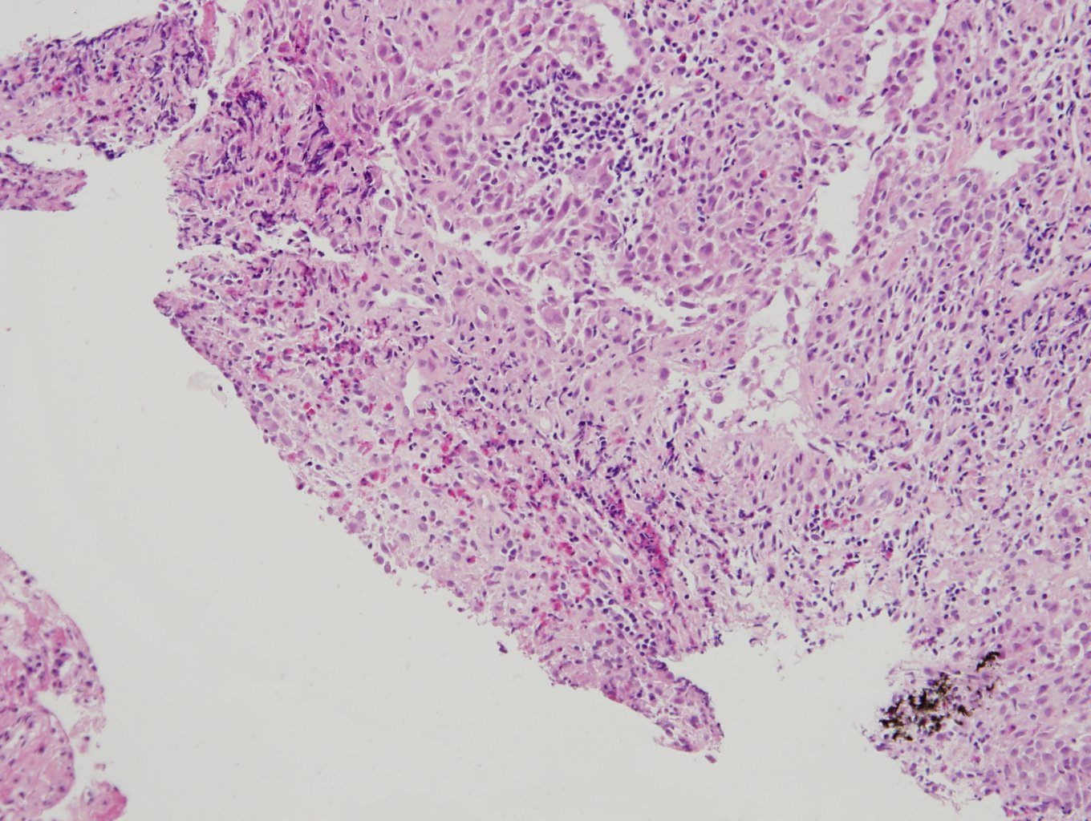

Slide 5
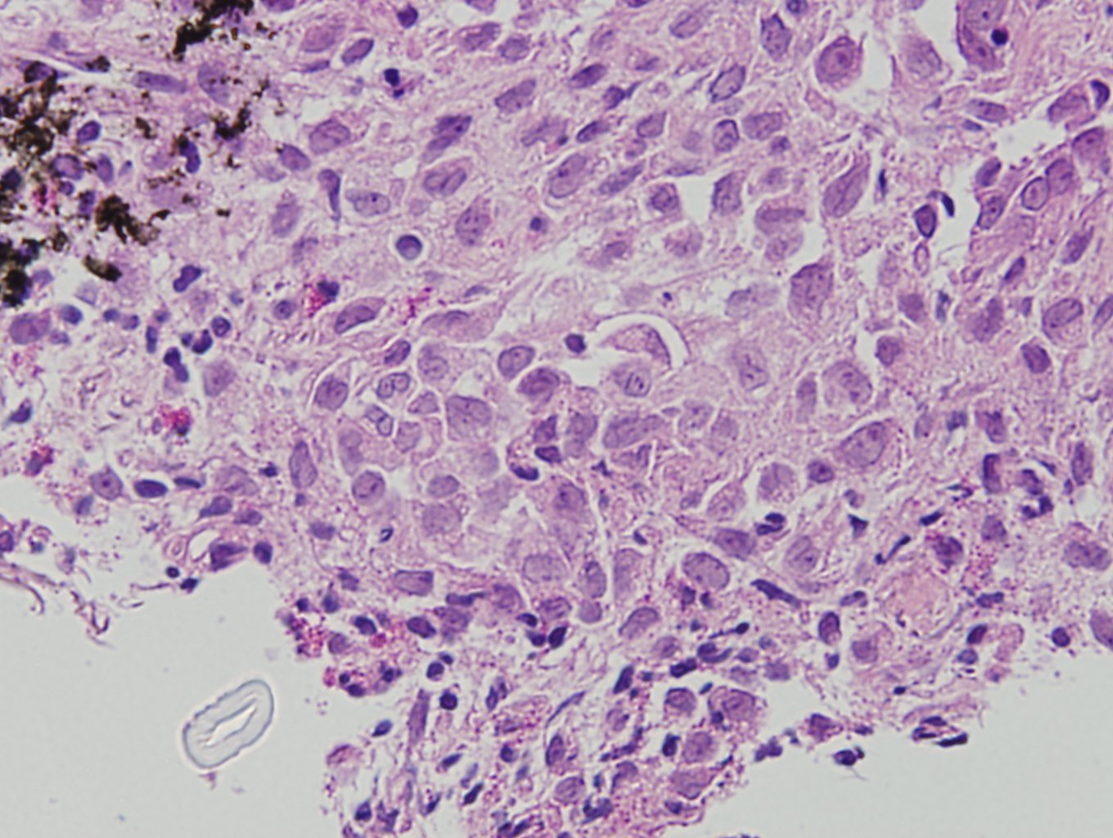

Slide 6
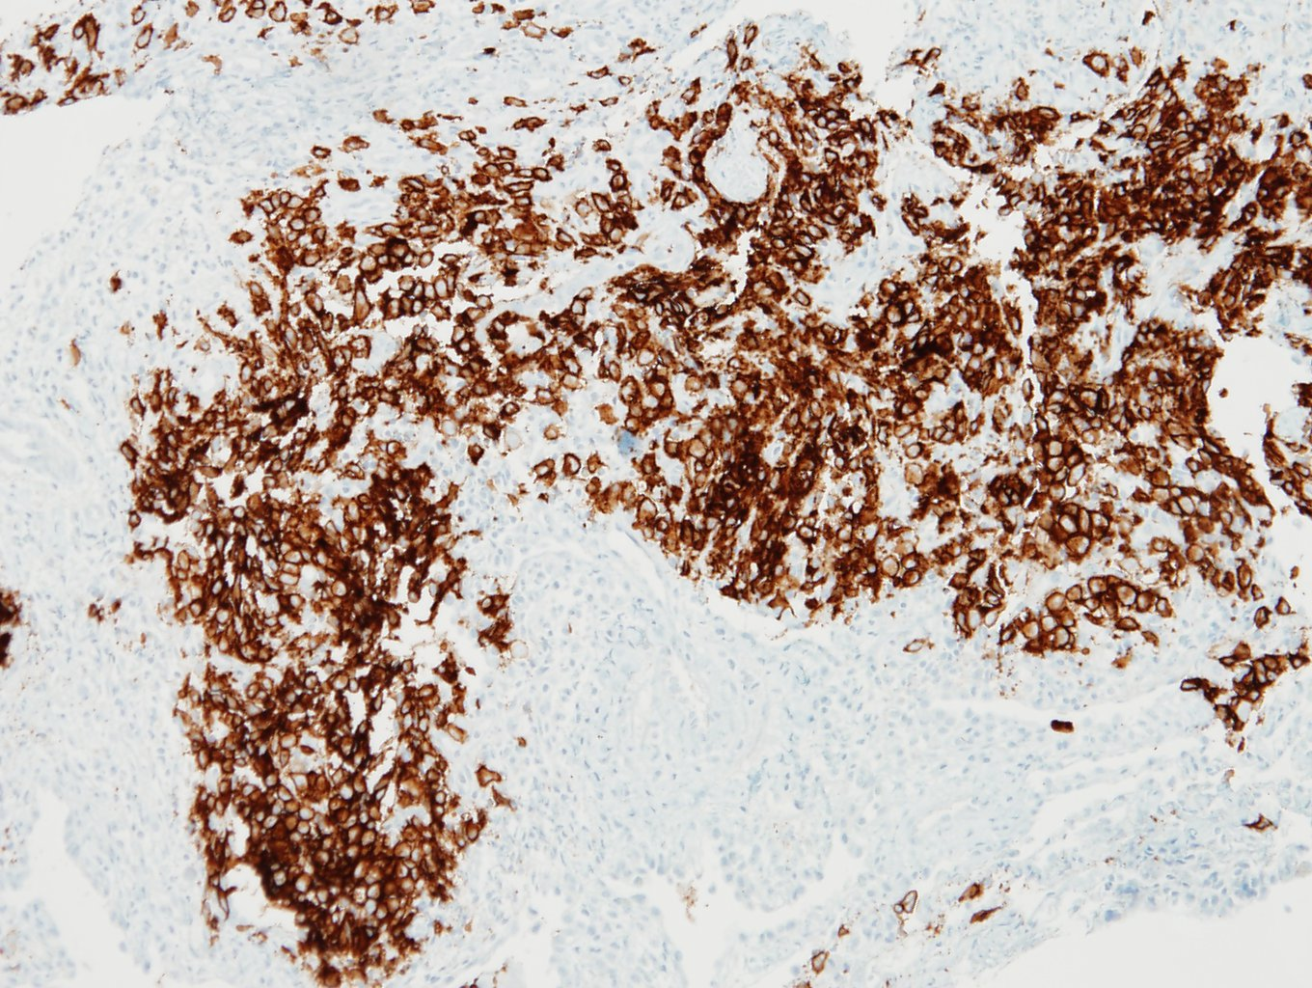

Slide 7
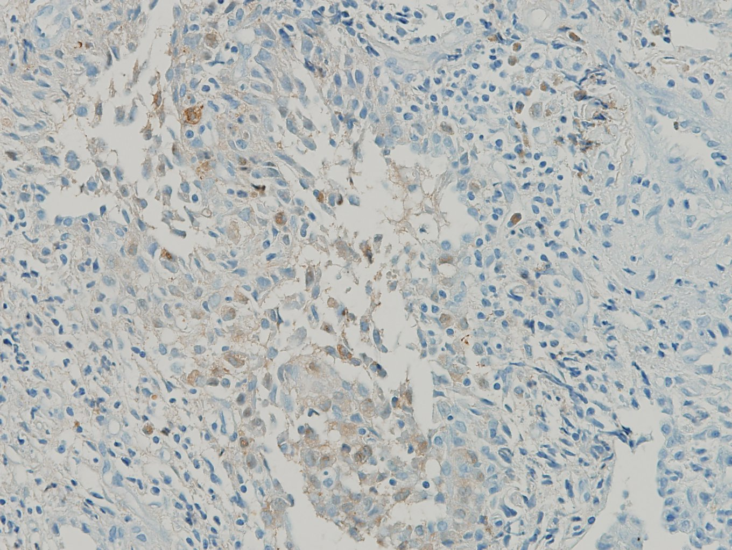

Slide 8
Lung, right upper lobe, transbronchial lung biopsy:
Langerhans cell histiocytosis, see note
Note) Immunohistochemicall staining result
CD1a, S-100 protein: positive

Slide 9
CASE 2
M/34
SS14-34960

Slide 10
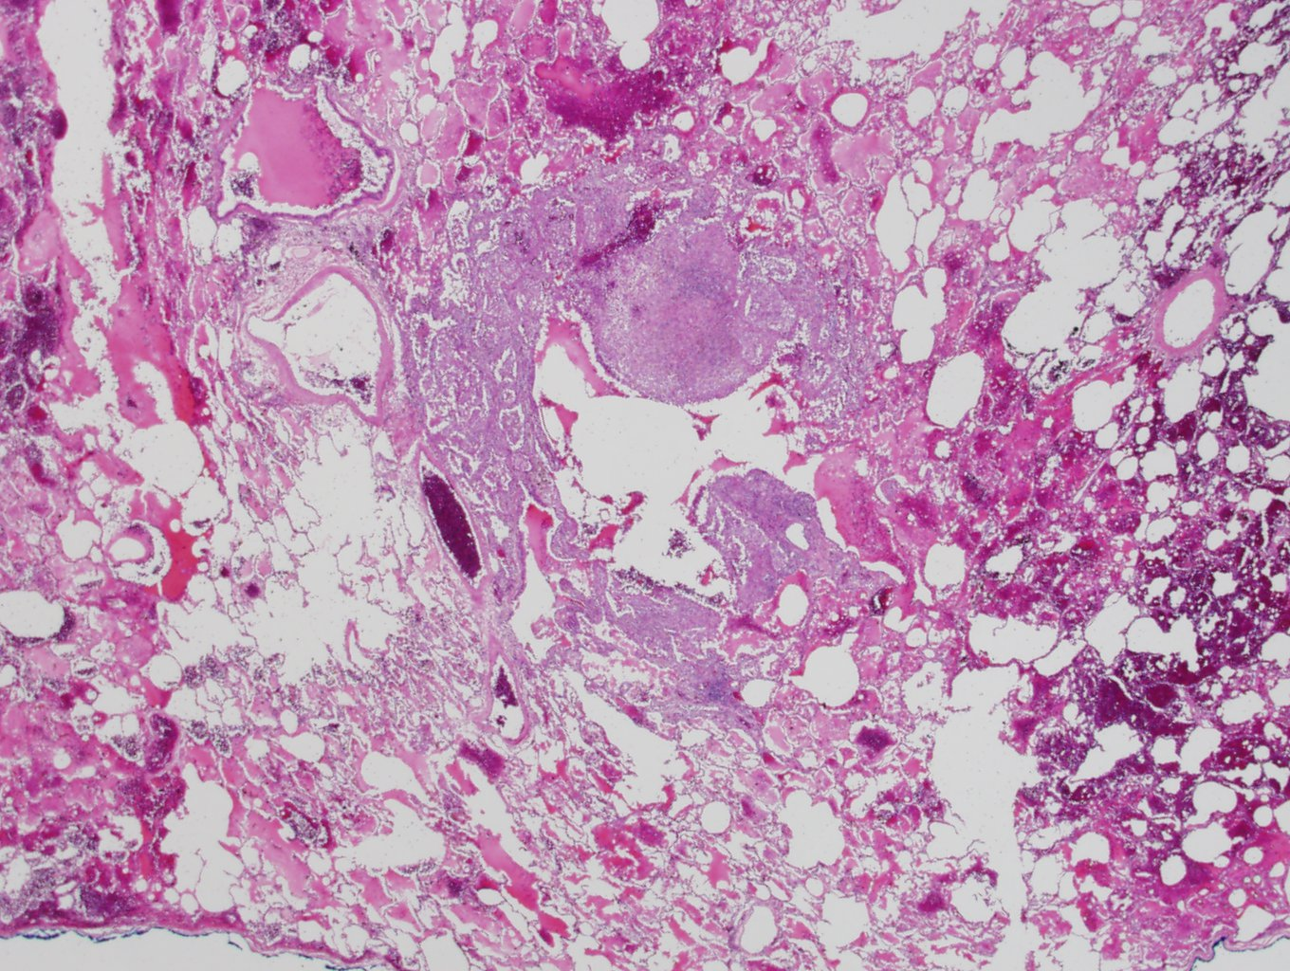

Slide 11
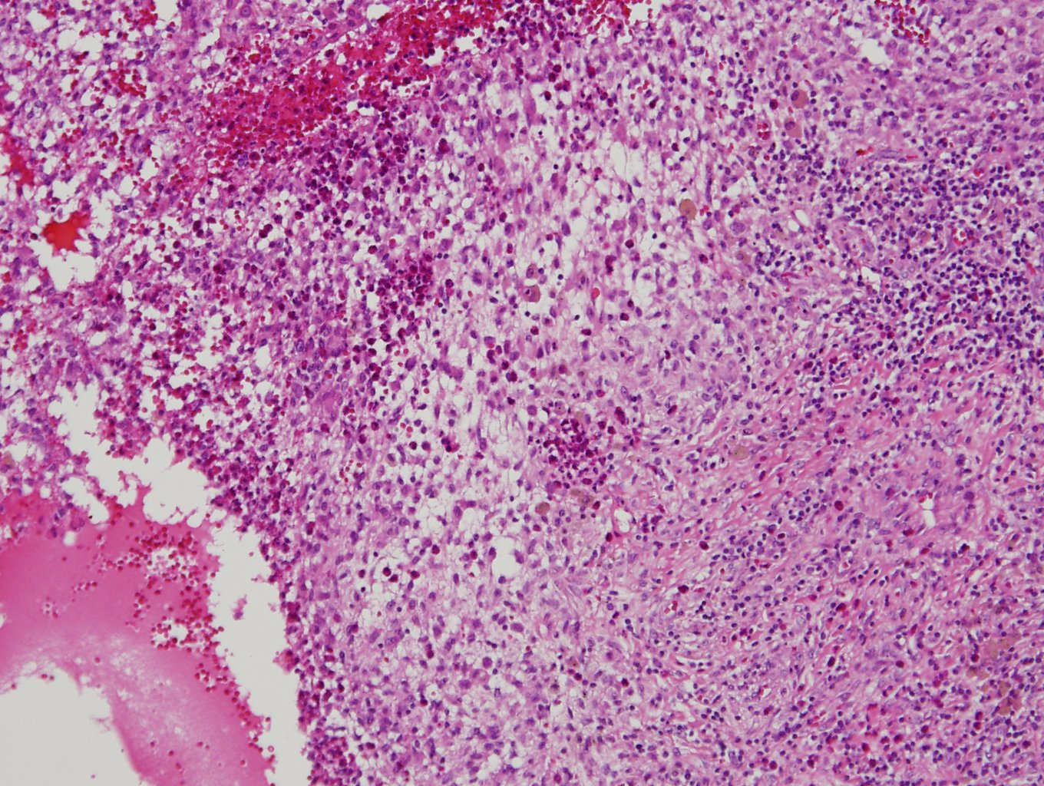

Slide 12
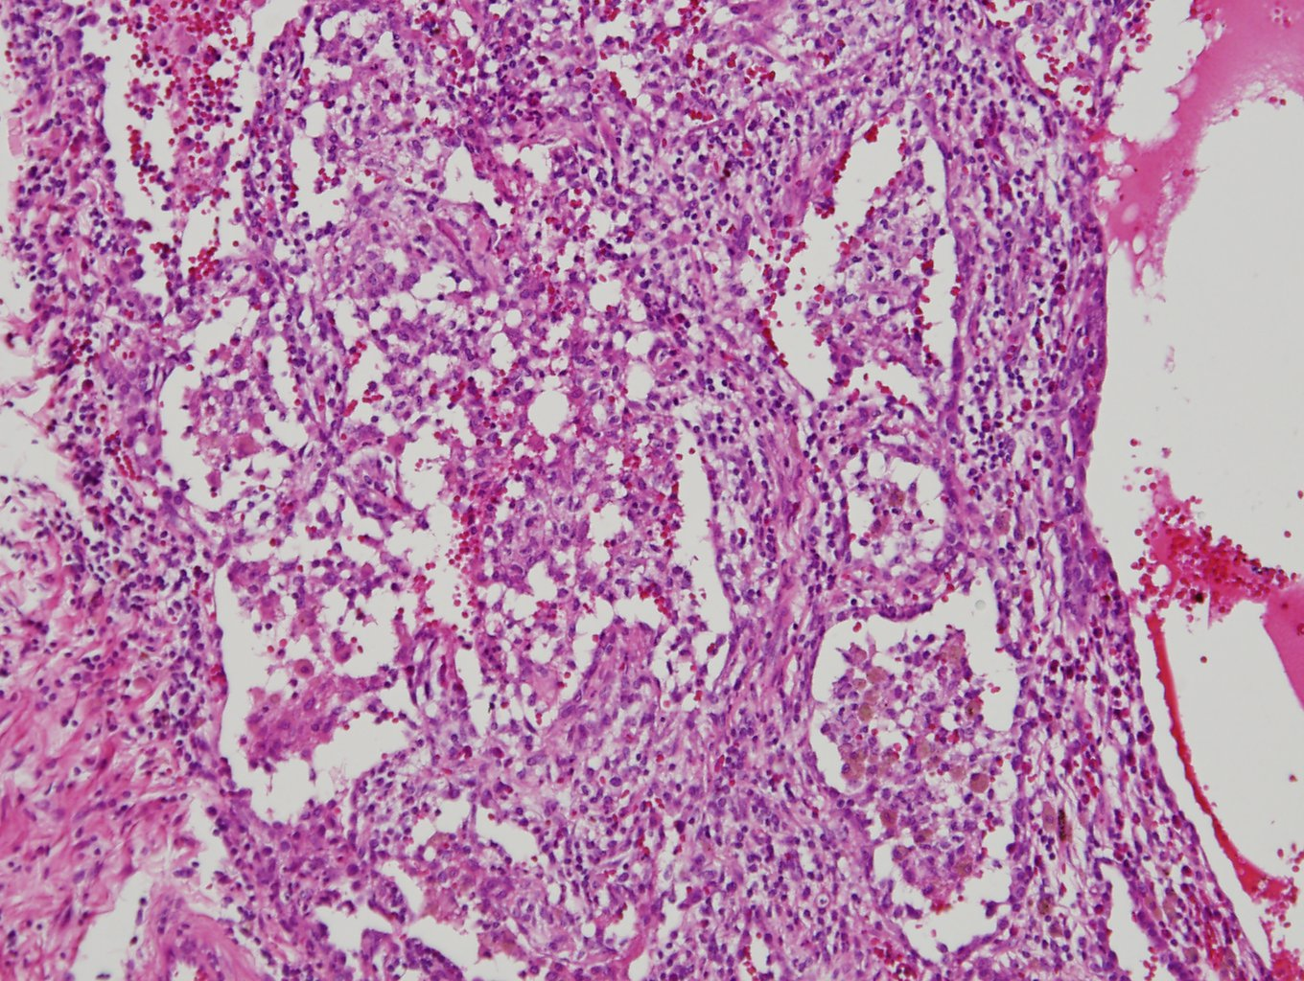

Slide 13
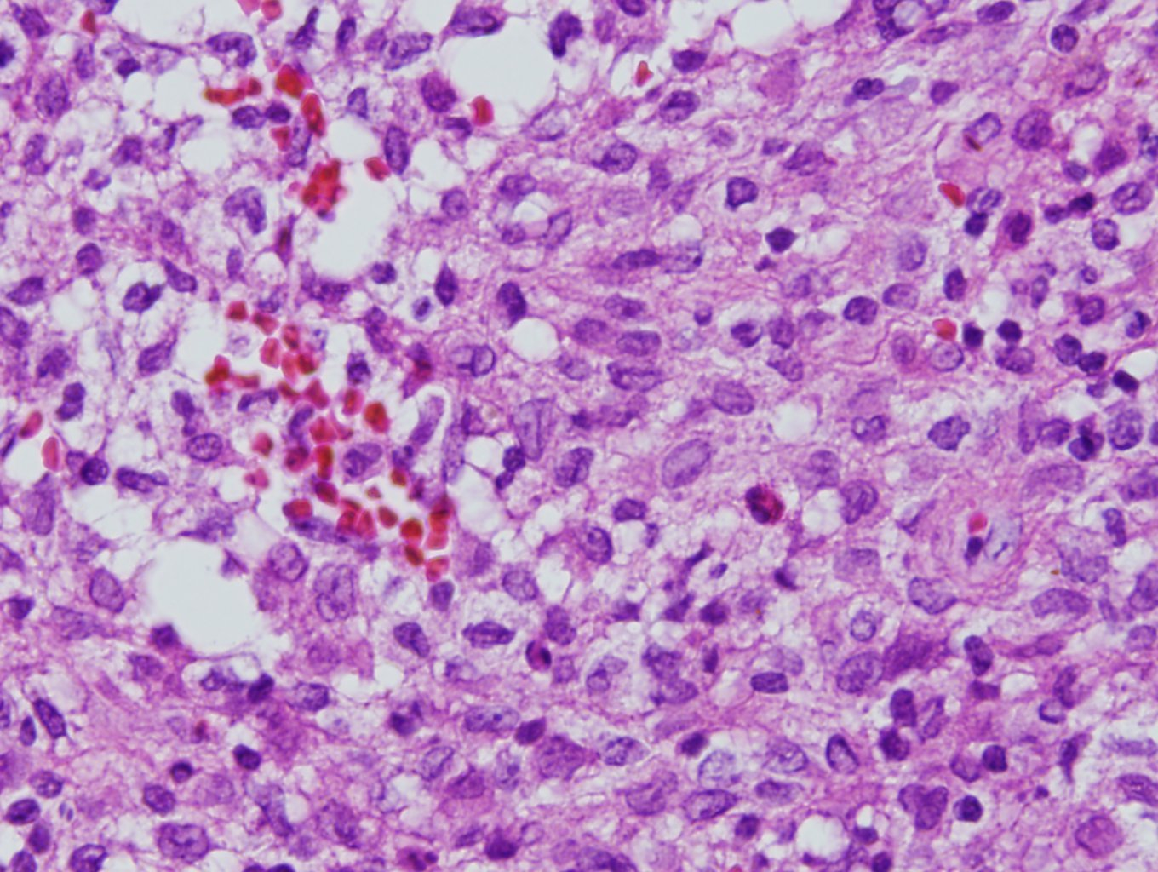

Slide 14
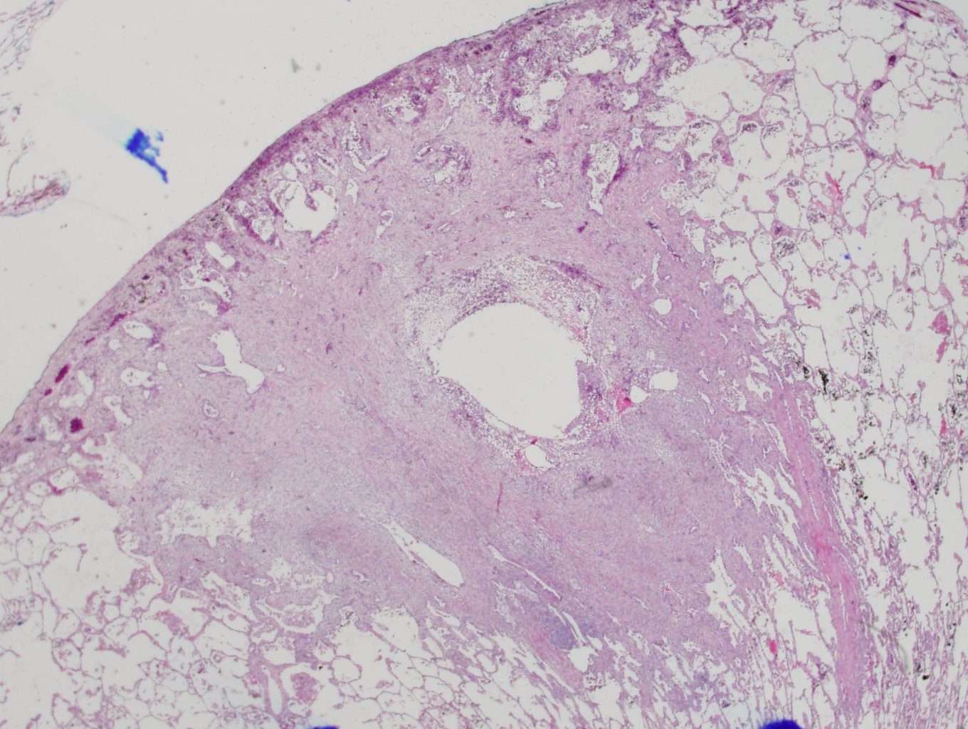

Slide 15
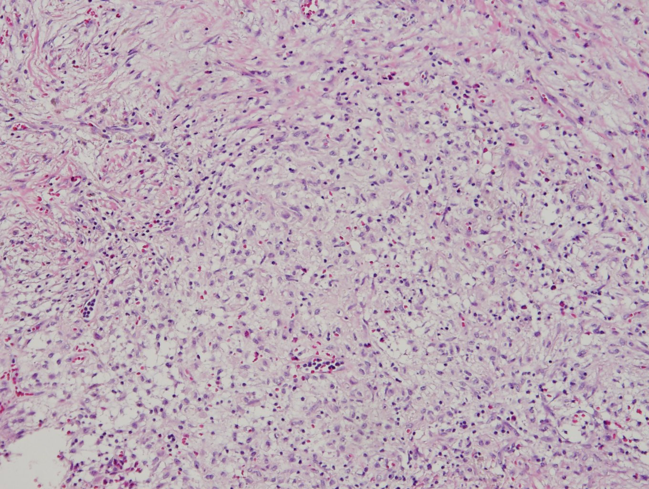

Slide 16
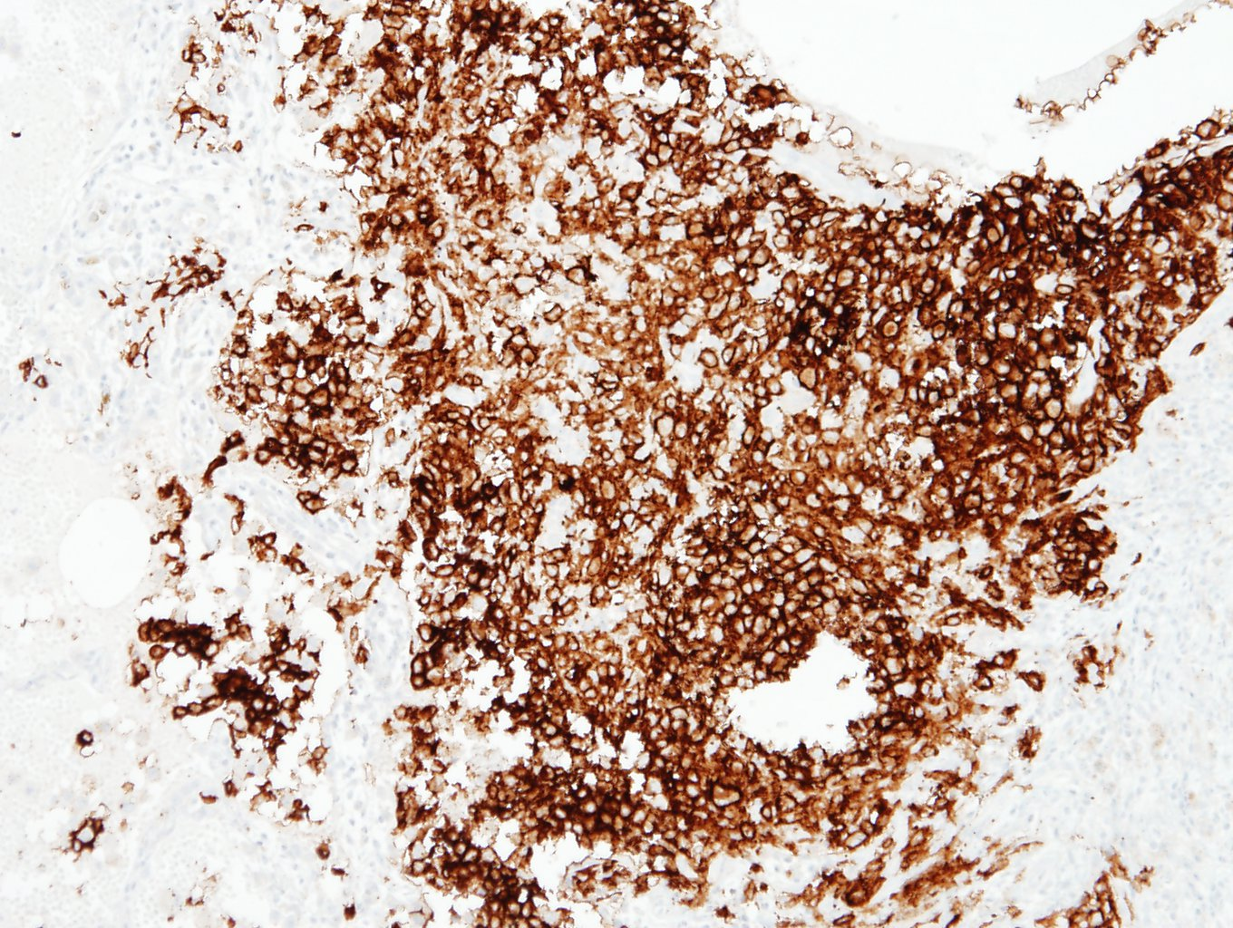
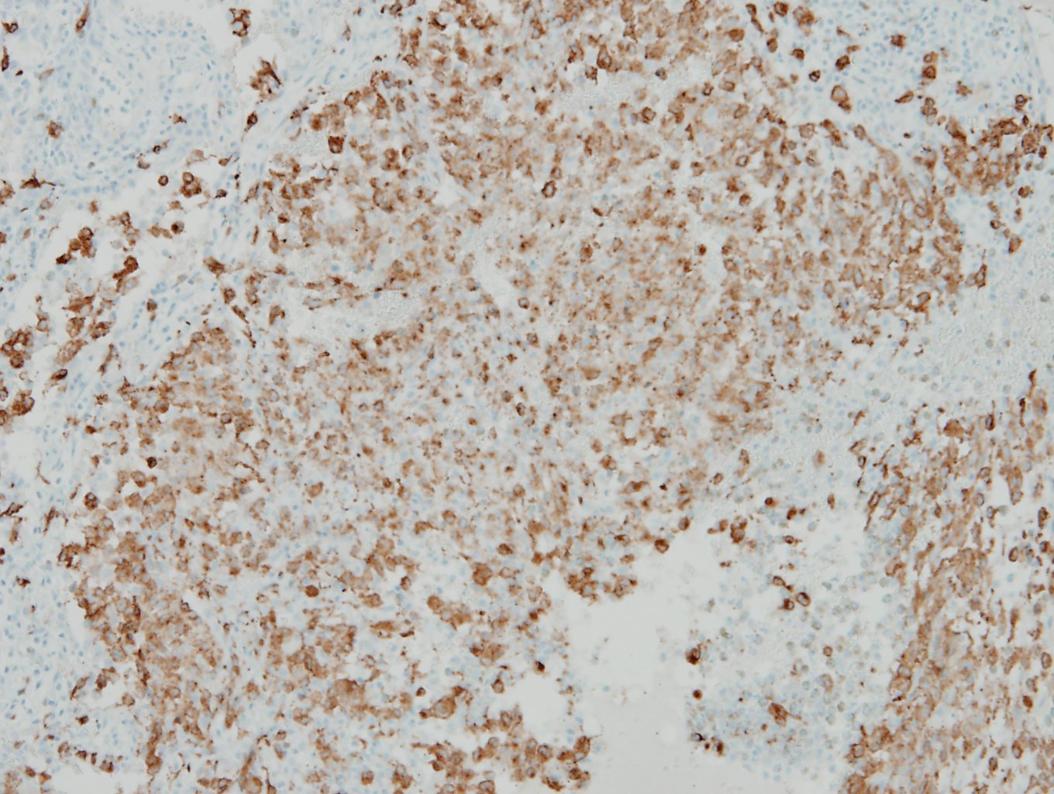
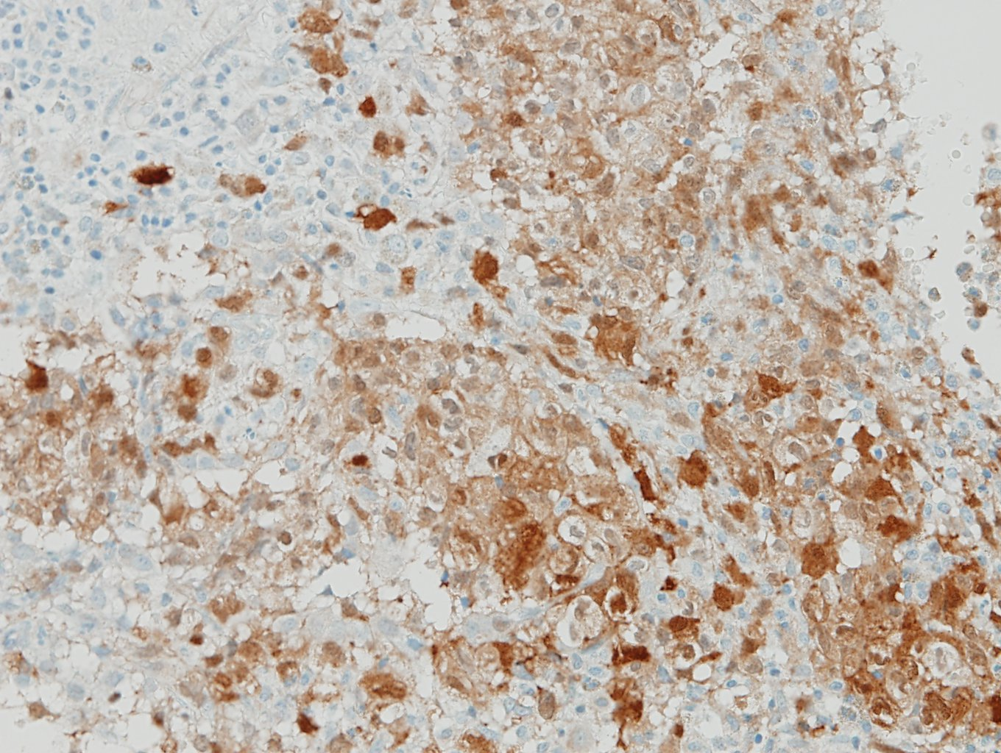
CD1a
Langerin
S-100

Slide 17
Lung, right upper lobe, wedge resection:
Lung, right upper lobe (lower): Langerhans cell histiocytosis, see note.
Lung, right upper lobe 2 (upper): Langerhans cell histiocytosis, see note.
Note) The immunohistochemical stain results:
CD1a, S-100 protein and langerin: Positive in Langerhans cells

Slide 18
Langerhans cell histiocytosis
Neoplastic disorder of Langerhans cells
● Also called eosinophilic granuloma, Langerhans cell granulomatosis, histiocytosis X (“H-X”)
● Usually ages 20-39 years
● Strongly associated with smokers
● 50% of cases only involve lung; 20% with multicentric disease (bone, skin, lymph nodes, spleen, pituitary) have lung involvement
● Often associated with pneumothorax, Pneumocystis carinii pneumonia, Respiratory bronchiolitis
● Lung biopsy is necessary for a definitive diagnosis, although may not be required if imaging findings are highly characteristic

Slide 19
Langerhans cell histiocytosis
* Gross finding
-Lesion of upper lobes, local or diffuse, with nodules and cavitary lesions and late honeycombing
Microscopic finding
● Interstitial scarring with nodular aggregates of Langerhans cells with a bronchiolocentric distribution; stallate shape or round nodule
● Langerhans cells have abundant eosinophilic cytoplasm and grooved nuclei with indented nuclear membranes
● Also prominent eosinophils and mesothelial cells
● Nodular lesions → cystic change, cavitation
● Older lesions have fewer eosinophils and more interstitial fibrosis
● Sarcomatous variant has significant atypia and mitotic figures

