Slide 1
VATS conference
2014. 6.26
Department of pathology

Slide 2
CASE 1
F/57
SS14-01588
SS14-01587

Slide 3
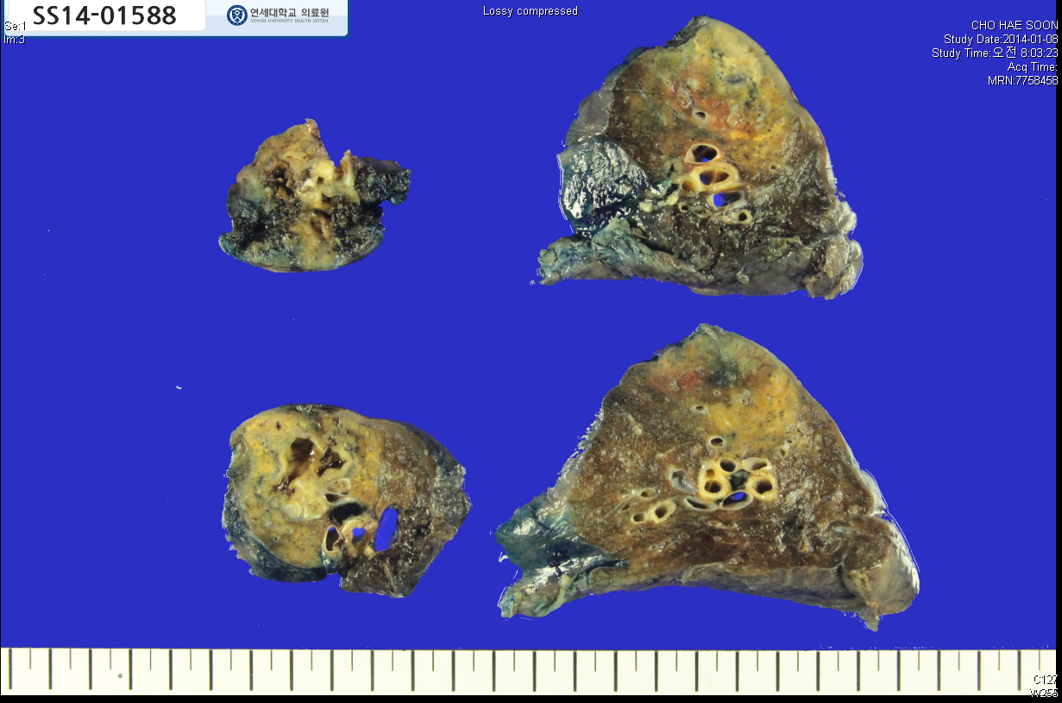

Slide 4
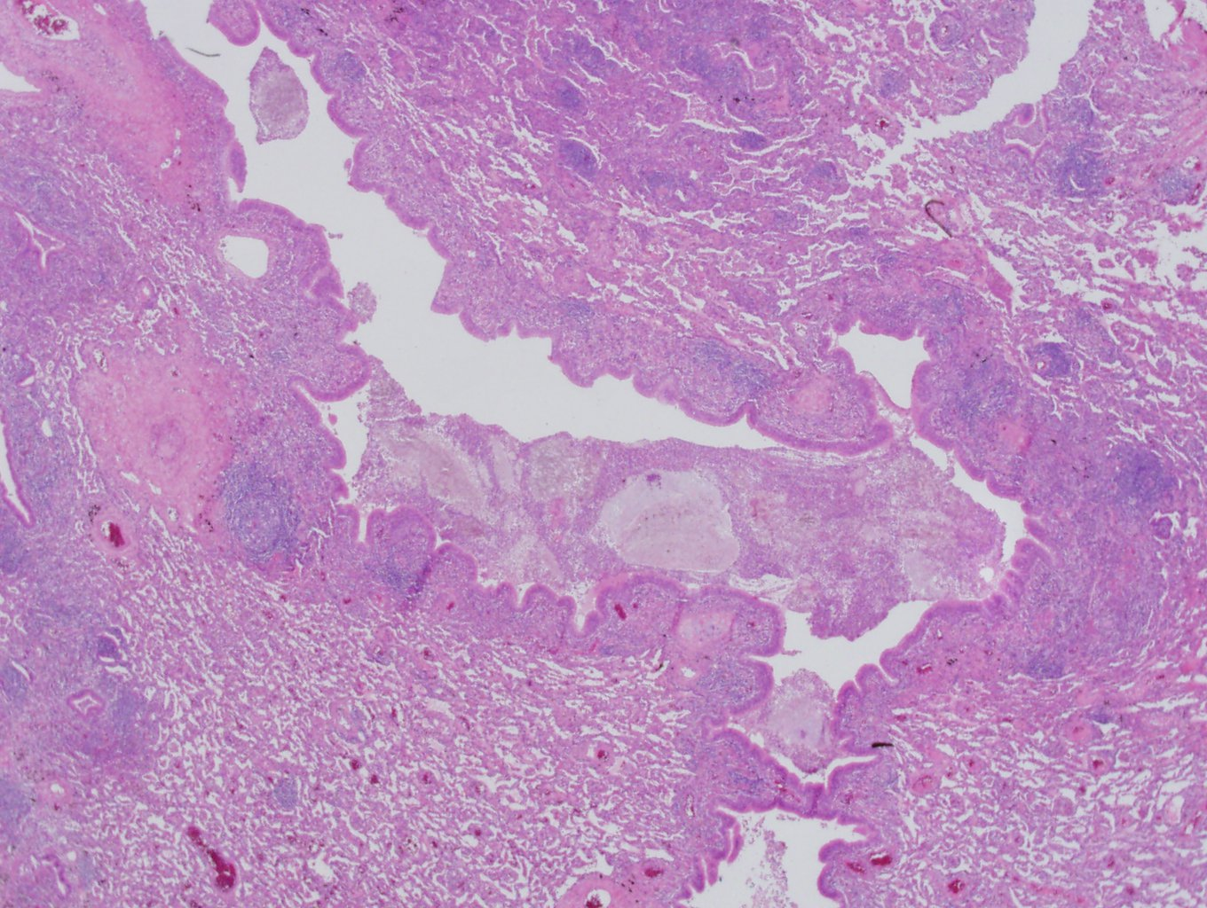

Slide 5
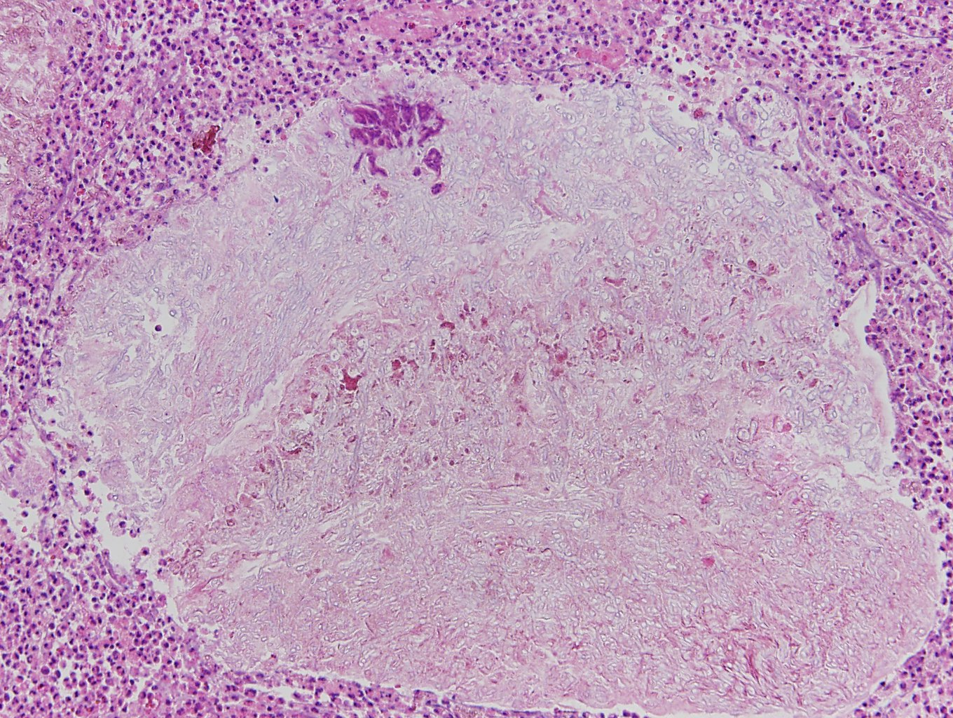

Slide 6
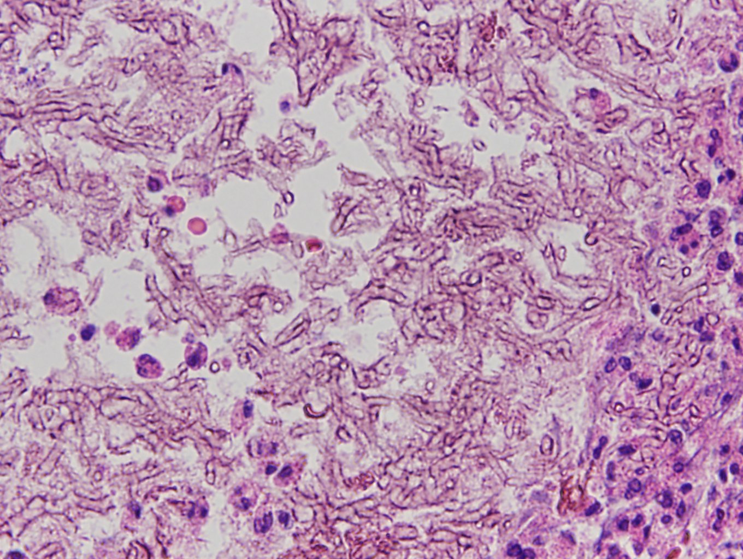

Slide 7
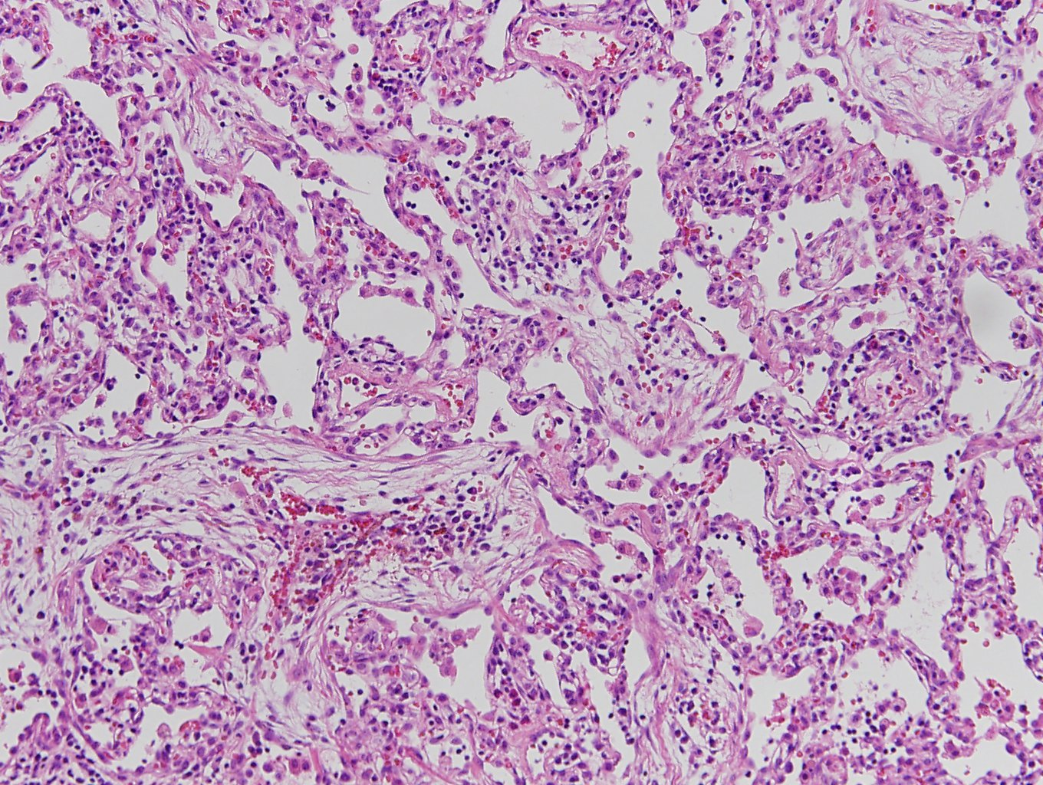

Slide 8
Lung, right lower lobe lobe, lobectomy:
1. Aspergilloma with bronchiectasis and necroinflammatory exudate
2. Organizing pnemonia

Slide 9
CASE 2
M/64
SS13-12128
SS13-12074

Slide 10
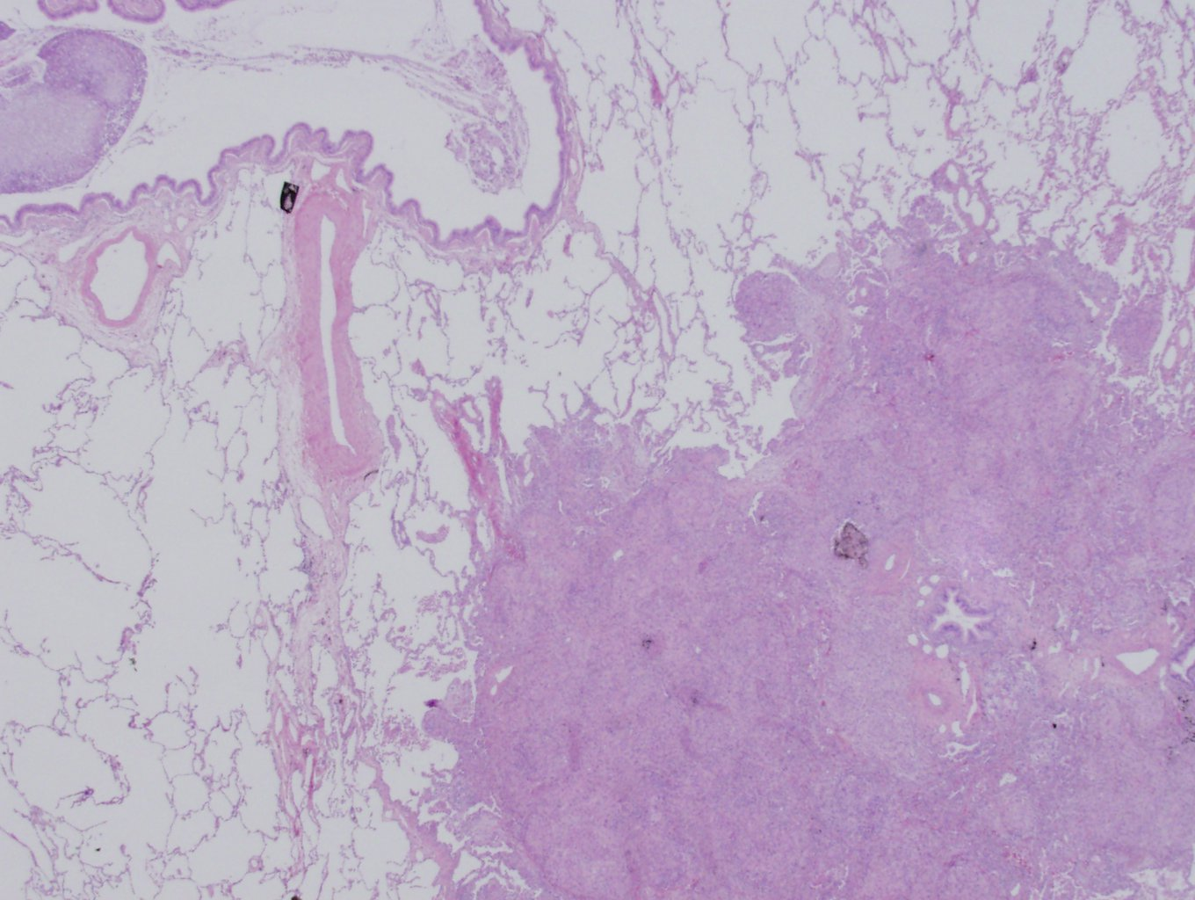

Slide 11
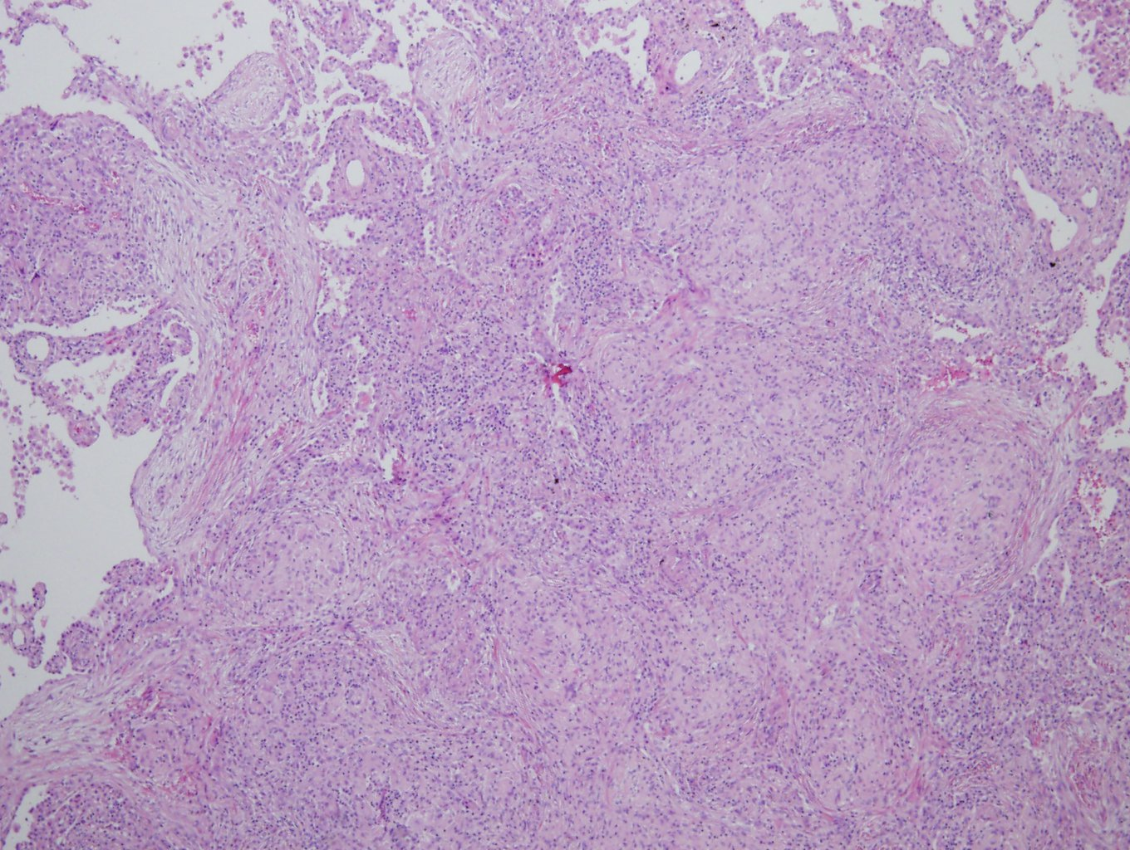

Slide 12
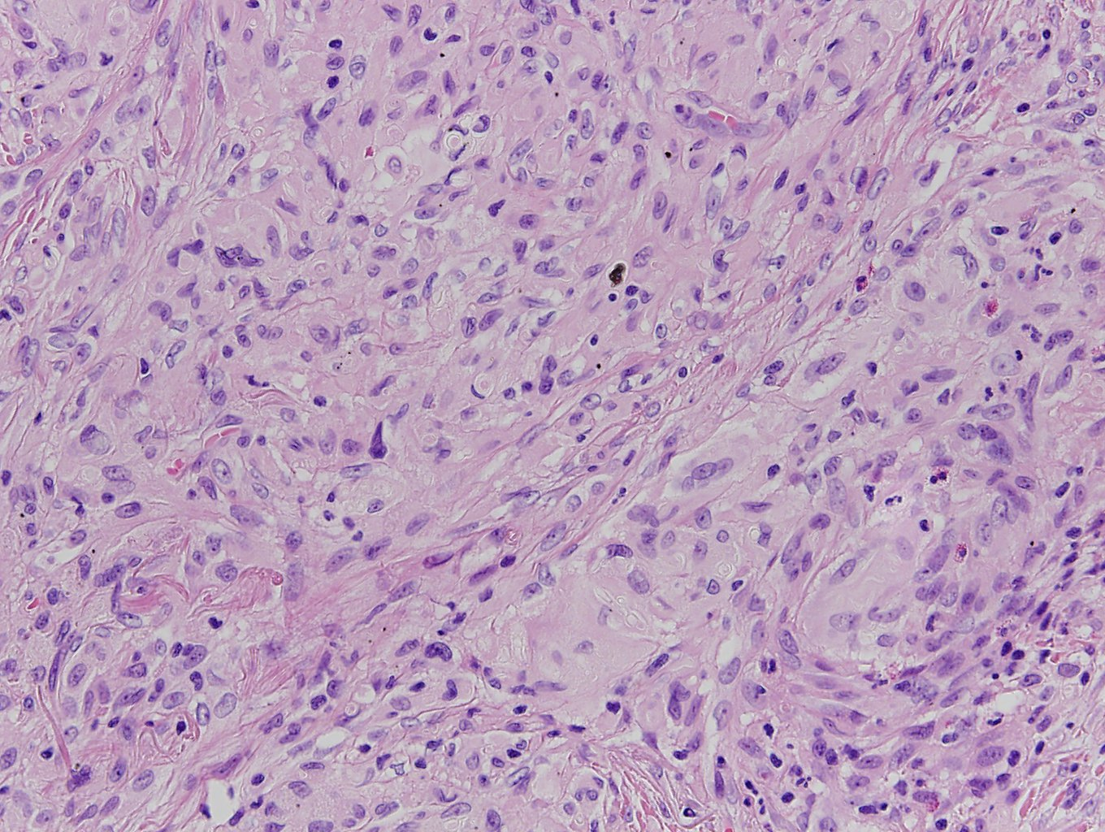

Slide 13
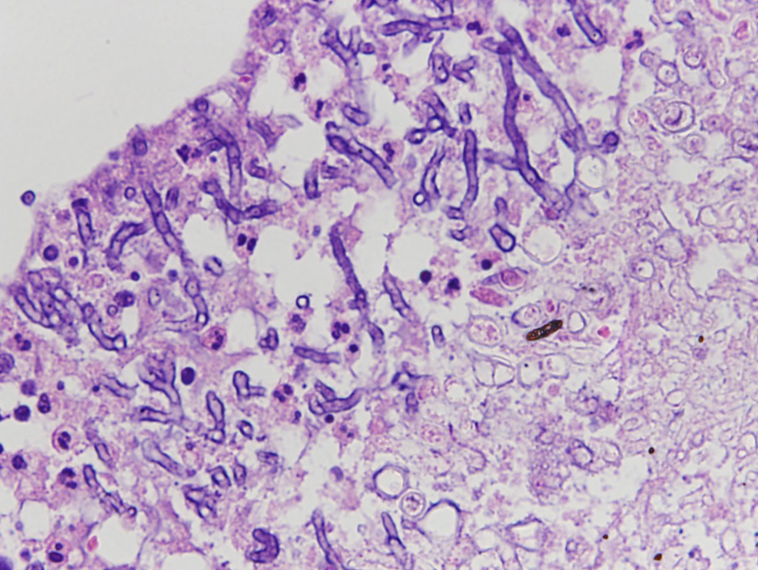

Slide 14
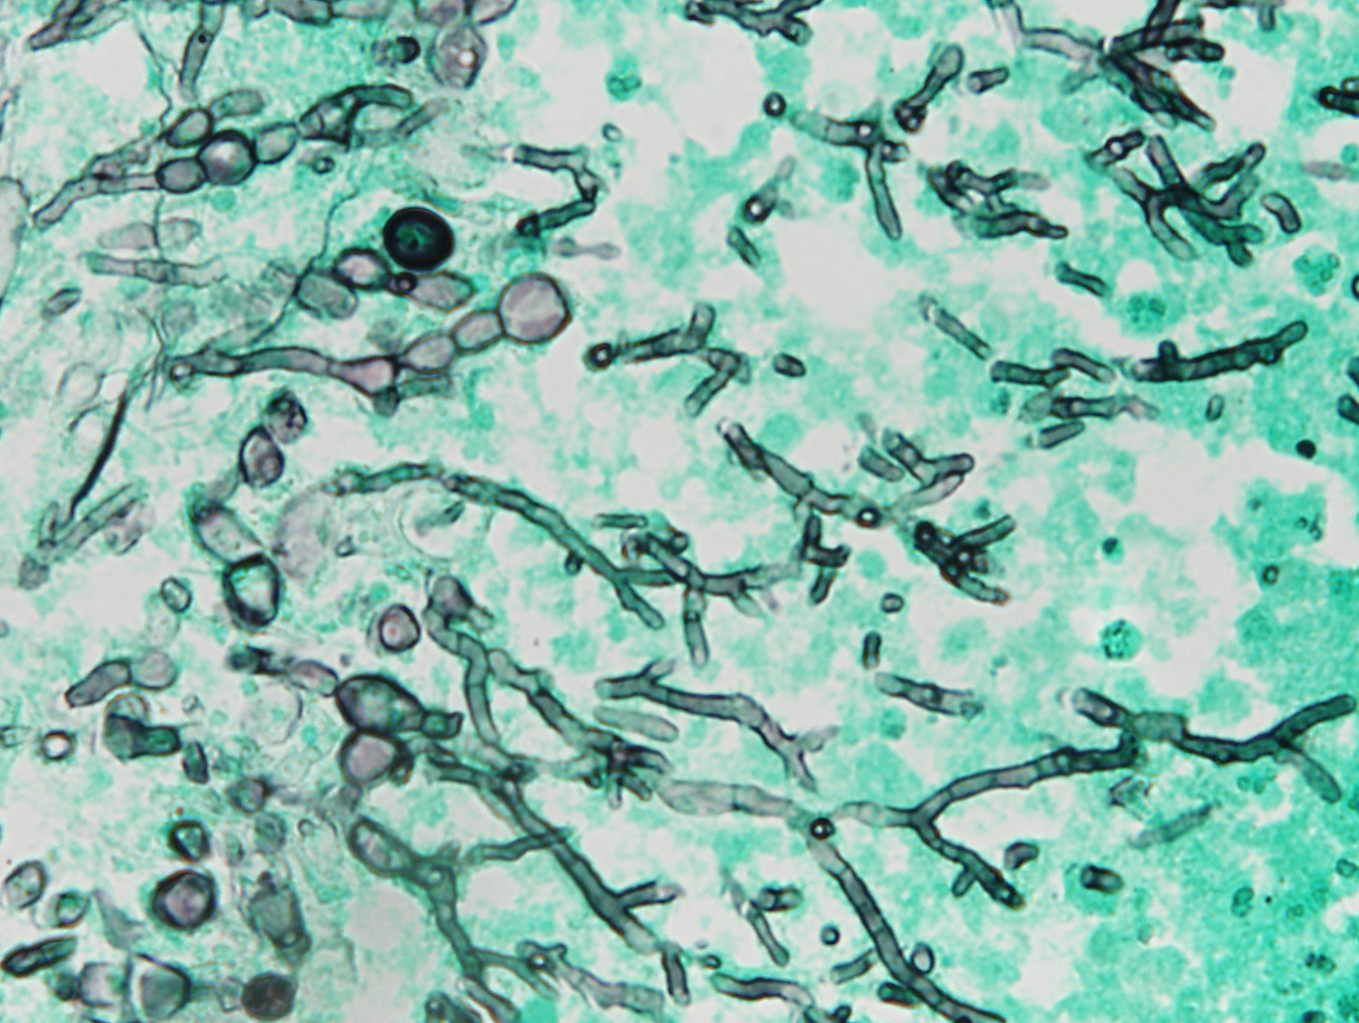

Slide 15
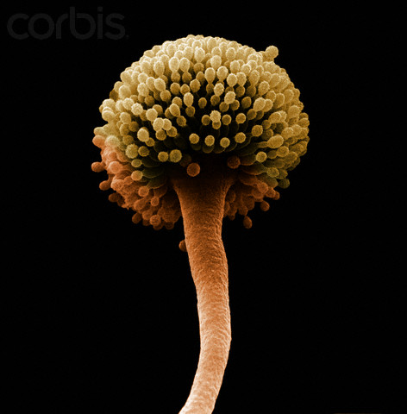
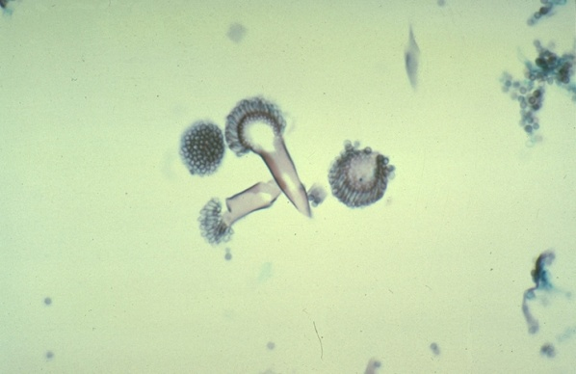
Cytologic feature of Aspergillus
Long, thin, septated hyphae (3~6um)
Branching acute angle (45˚)
Arranged in parallel and radiate form
Conidial or fruiting body
D/Dx:
1) Fusarium: wider, 90 ˚
2) Pseudoallescheria boydii: thinner, hapazard branching
3) Zygomycetes (Mucormycosis): wider (10~15um), nonseptate, irregular branching point (90 ˚)

Slide 16
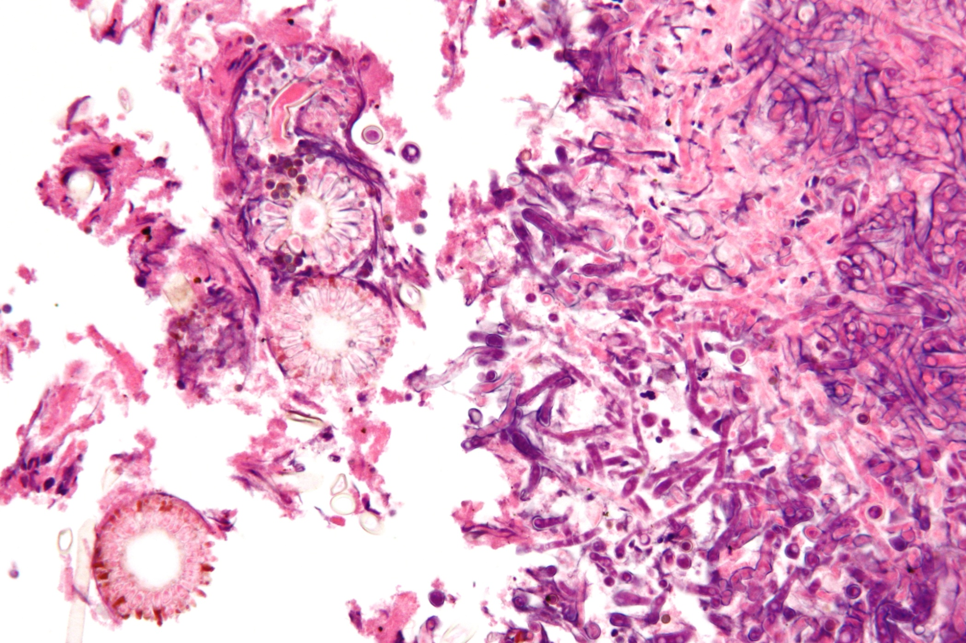

Slide 17
Lung, right middle lobe, wedge resection:
Fungal infection wtih multifocal granulomatous inflammation and focal necrosis, most consistent with aspergillosis, see note
Note) The special stain result:
D-PAS and GMS reveal fungal hyphae
** Invasive aspergillosis:
1) Aspergillus pneumonia
2) Necrotizing tracheobronchitis
3) Necrotizing granulomatous inflammation
4) Chronic necrotizing aspergillosis
-vascular occlusion by fungus, ischemic infarct, bronchial wall invasion by fungus (-)
-→ necrotizing granulomatous inflammation (+)
; limited form of invasive aspergillosis
bronchocentric granuloma

Slide 18
CASE 3
M/44
SS11-11197

Slide 19
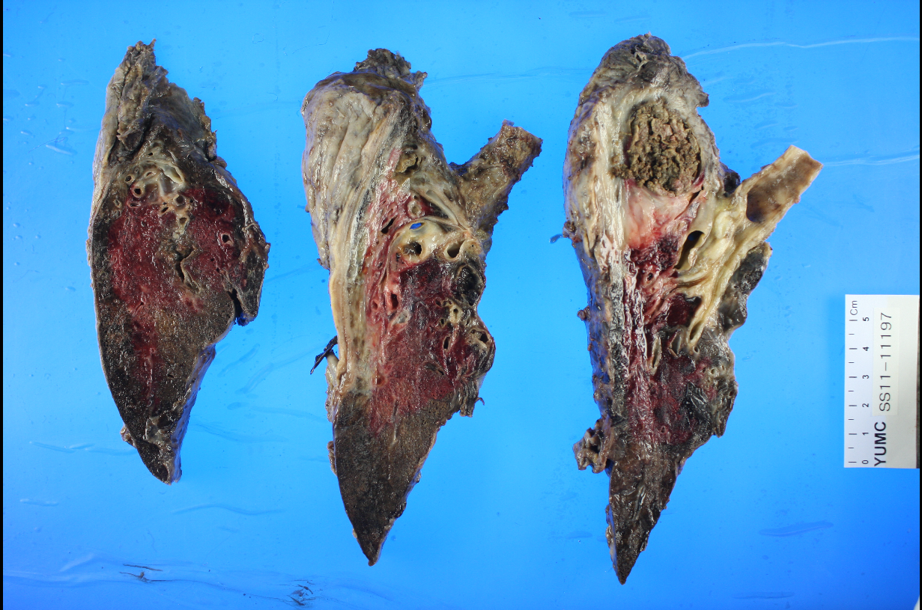

Slide 20
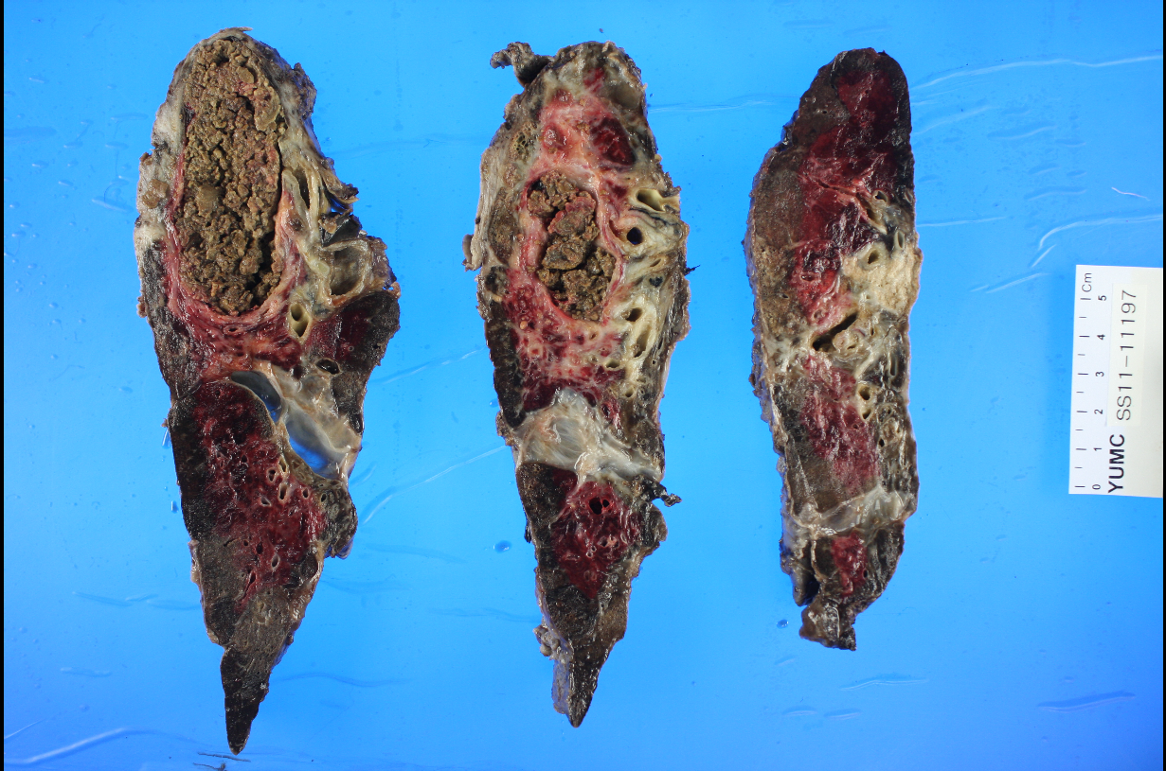

Slide 21
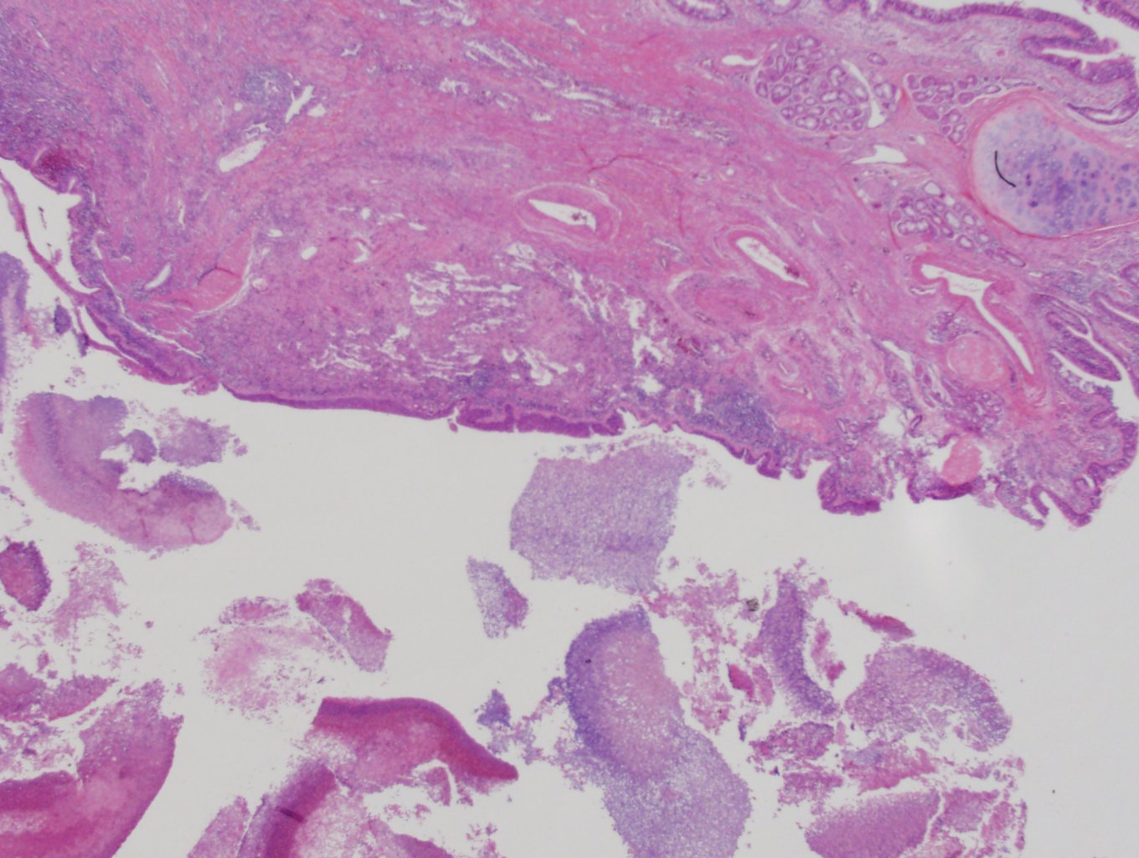

Slide 22
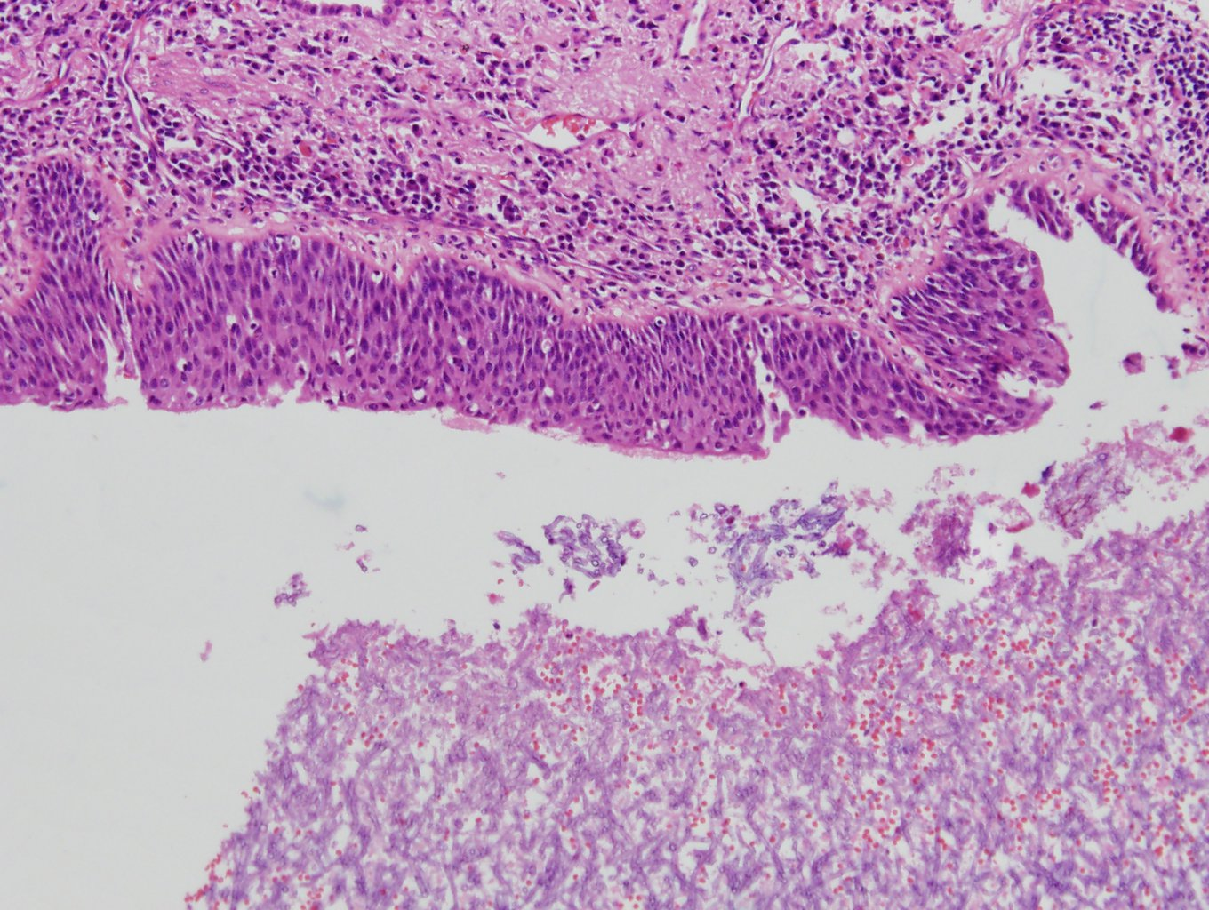

Slide 23
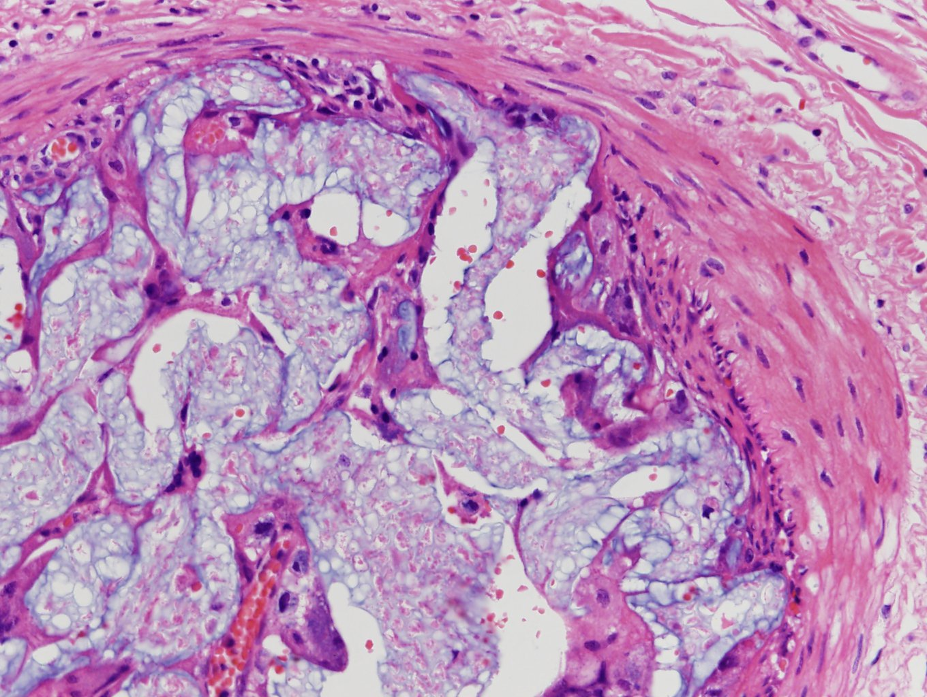

Slide 24
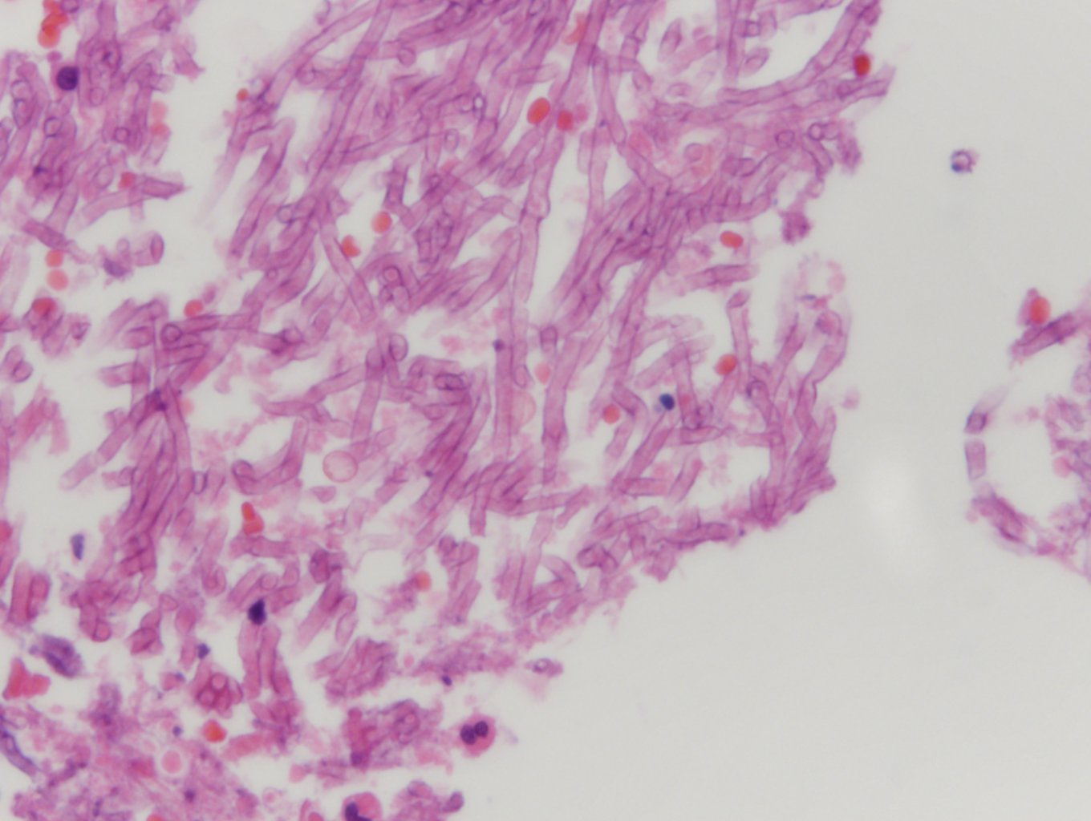

Slide 25
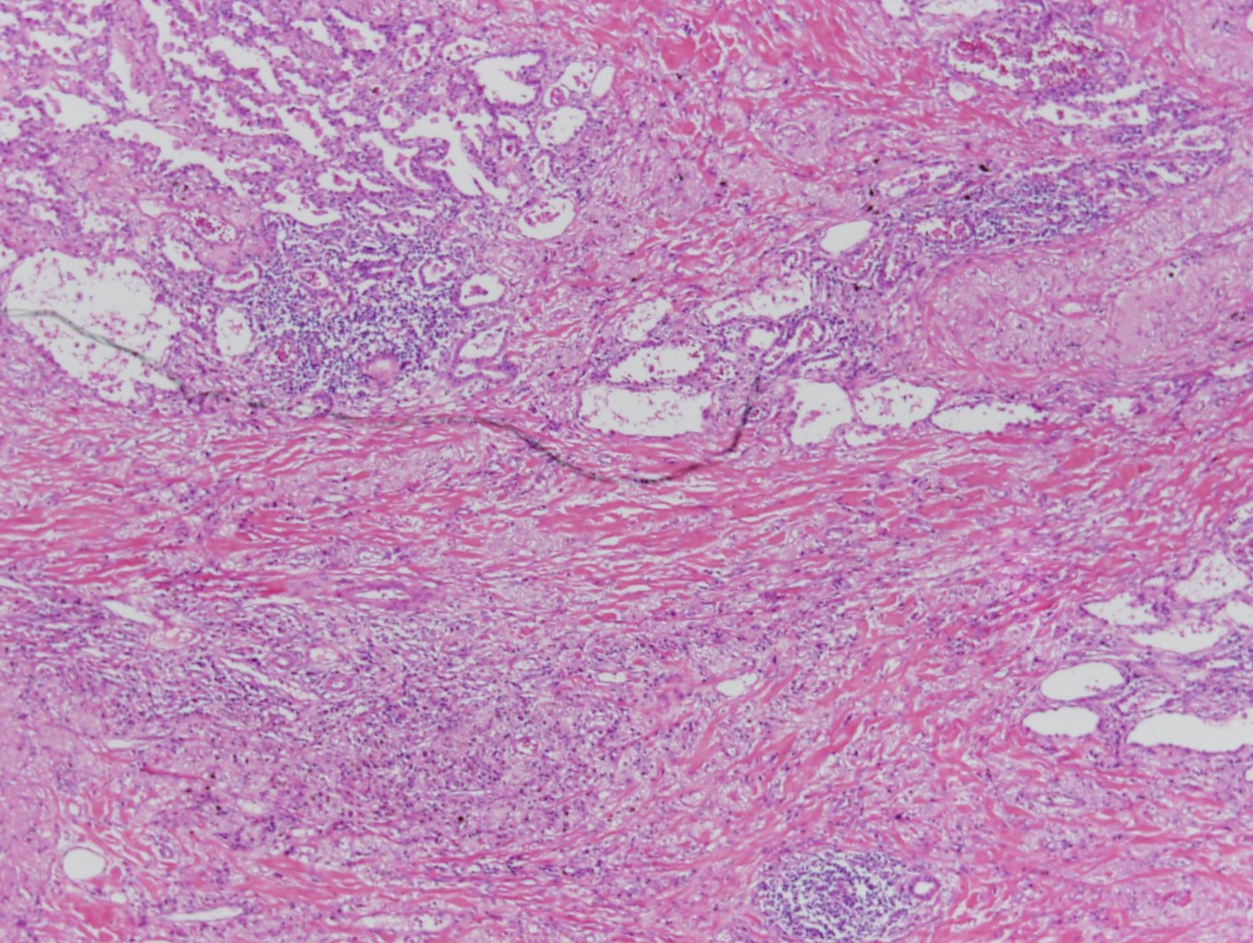

Slide 26
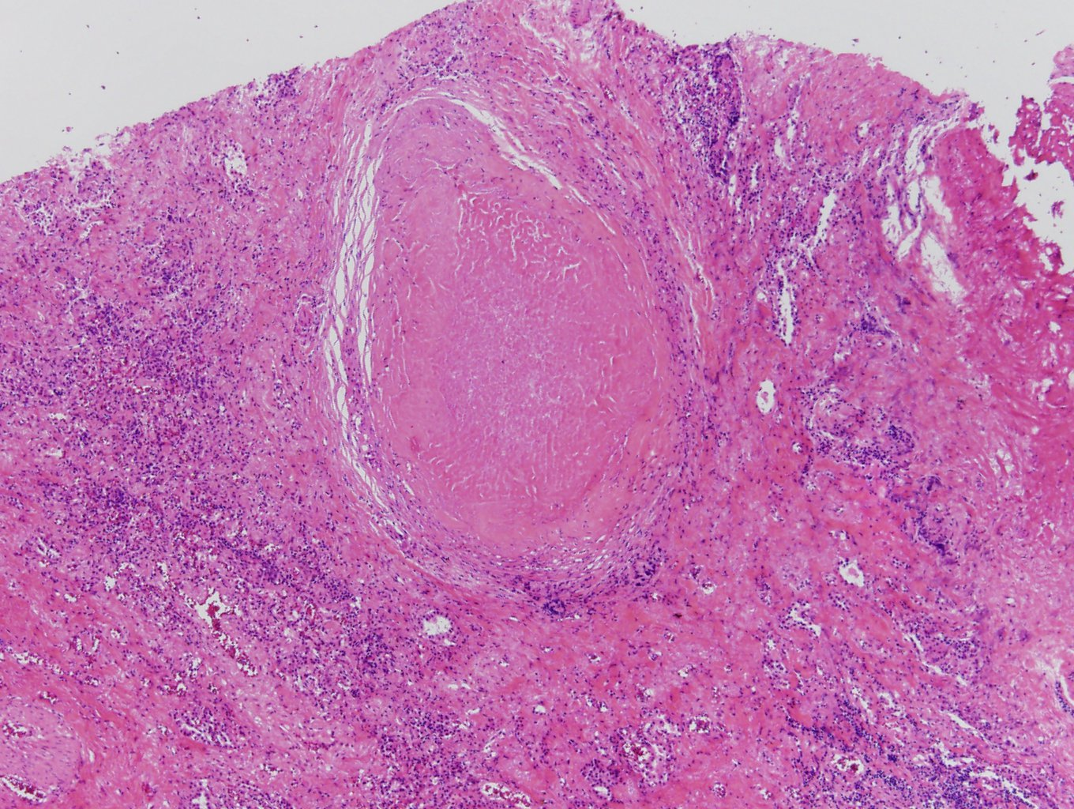

Slide 27
Lung, left upper lobe:
1. Aspergilloma
2. Bronchiectasis with peribronchial fibrosis and acute and chronic non-specific inflammation
Lung, left lower lobe:
Bronchiectasis with peribronchial fibrosis and acute and chronic non-specific inflammation (abscess)
Pleura, separately sent: 1. Fibrosis with chronic inflammation, empyema
2. Chronic granulomatous inflammation with caseous nerosis and fibrosis, suggestive of tuberculosis
Lymph nodes, interstitial (0/1), subcarinal (0/12) and peribronchial (0/6); total (0/19): Reactive hyperplasia
Fungal organism, labeled "lung": Aspergilloma

