Slide 1
VATS conference
2014. 5.29
Department of pathology

Slide 2
CASE 1
F/42
SS13-50064
SS13-50086
SS14-21477

Slide 3
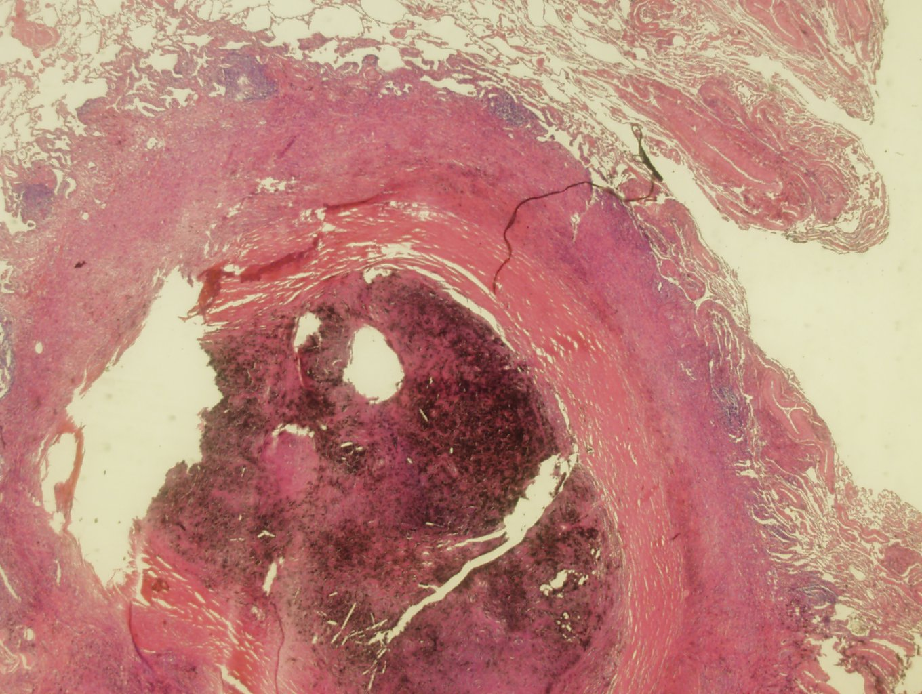

Slide 4
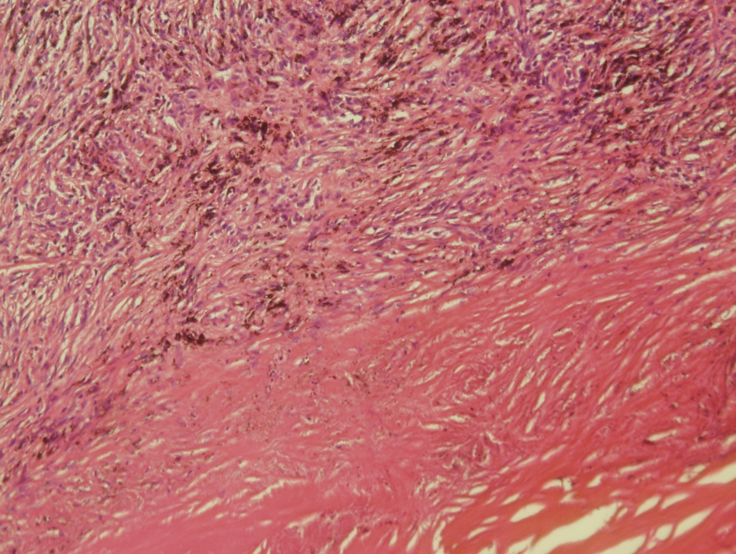

Slide 5
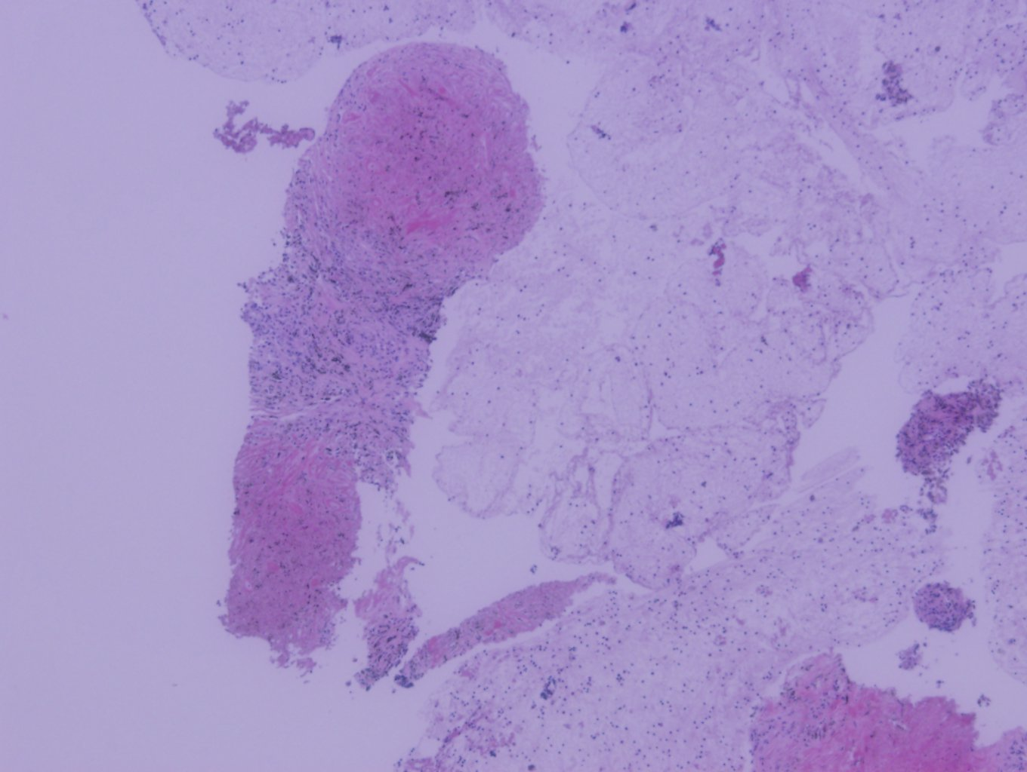

Slide 6
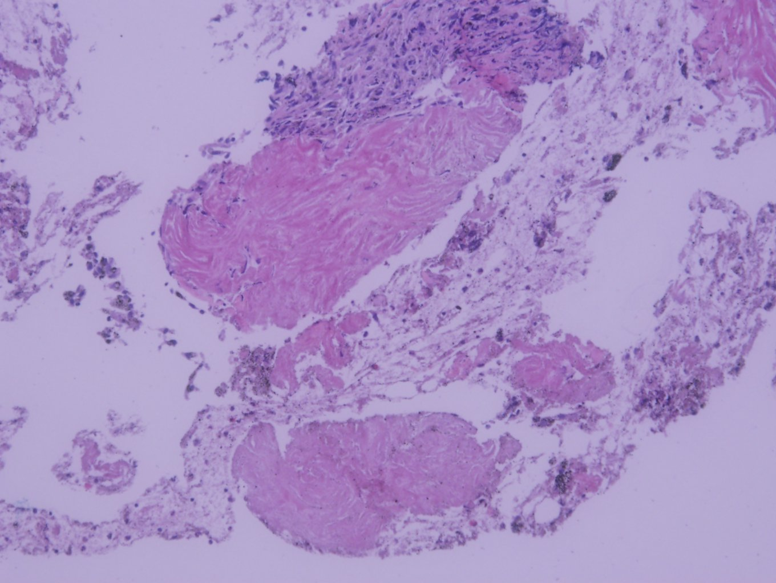

Slide 7
[SS13-50064]
Lymph node, EBUS:
Labeled "LN7": Reactive hyperplasia, see note.
Labeled "LN4R": Reactive hyperplasia
Labeled "LN11R": Few tiny fragments of sclerotic fibrosis without lymphoid tissue
Note) The congo red stain result: negative
[Additional report]
보내주신 림프절 조직 (labeled "LN7", "LN4R" and "LN11R") 에서 추가로 congo red stain을 시행하였으나 음성 소견입니다.
[SS14-21477]
Lung, right upper lobe, biopsy under VATS / Lung, right middle lobe, biopsy under VATS:
A, Lung, right upper lobe:
1. Chondroid hamartoma
◇ Tumor size: 0.4x0.3cm
◇ Resection margin: Free from tumor
2. Silicotic nodule (0.1cm)
B. Lung, right middle lobe: Silicotic nodule (0.7cm)

Slide 8
Silicosis
Reaction to inhaled crystalline silica
Most prevalent chronic occupational disease in the world, due to foundry work, sandblasting, stone cutting and coal mining
Silica causes macrophages to release mediators which stimulate fibroblasts
Disease associated with Silica Exposure
Nodular silicosis: 20+ yrs → silicotic nodules
Acute silicosis: 1-3 yrs → Alveolar proteinosis
Mixed dust fibrosis: 20+ yrs → Stellate interstitial fibrosis
** Nodular silicosis
Small, discrete, hyalinized nodules, Upper lobe, LN
Also in liver, spleen, BM etc
Concentrically arranged, hyalinized collagen bundles, surround by dust-filled histiocyte

Slide 9
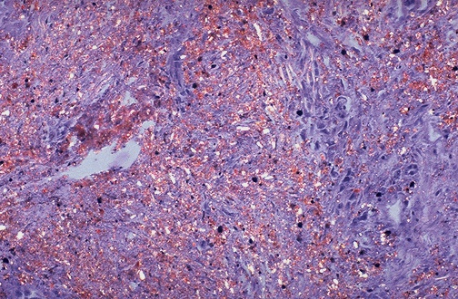
Silicosis
- needle-like spicules with pointed ends, 5 microns or less, birefringent with polarization

Slide 10
CASE 2
M/36
SS07-14051

Slide 11
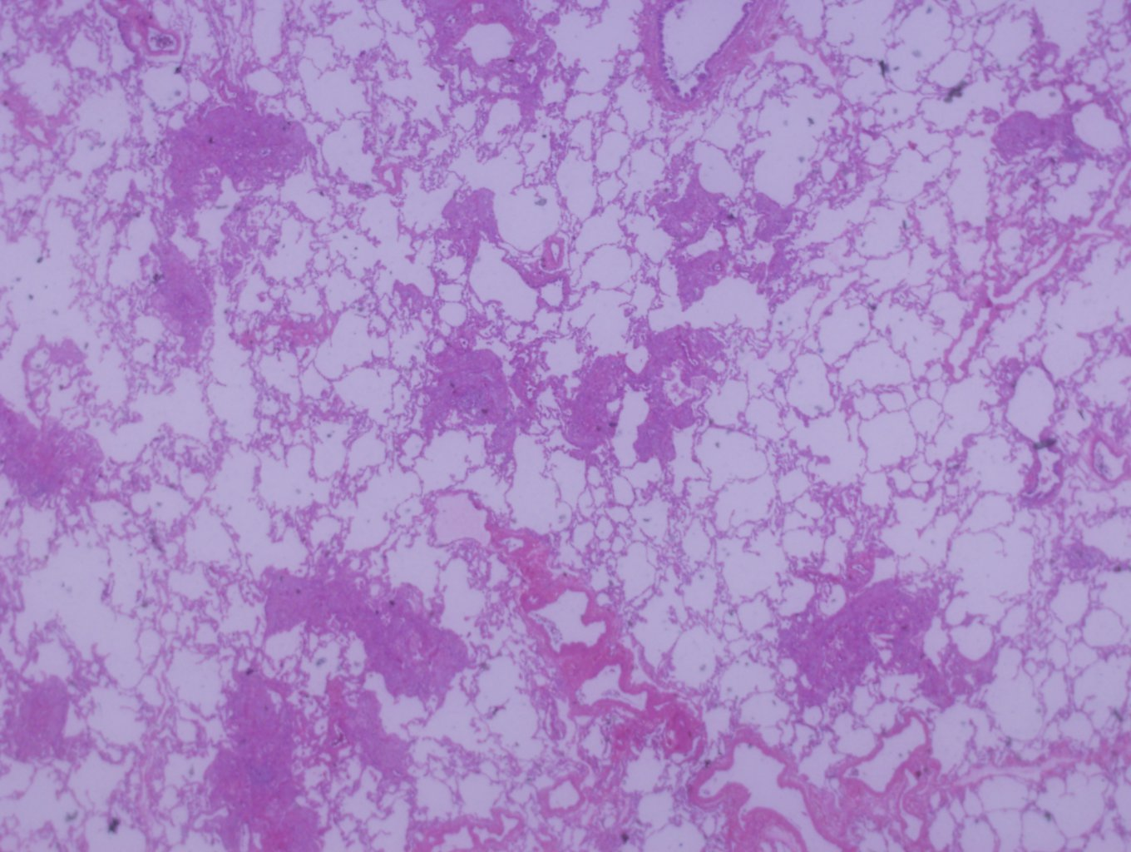

Slide 12
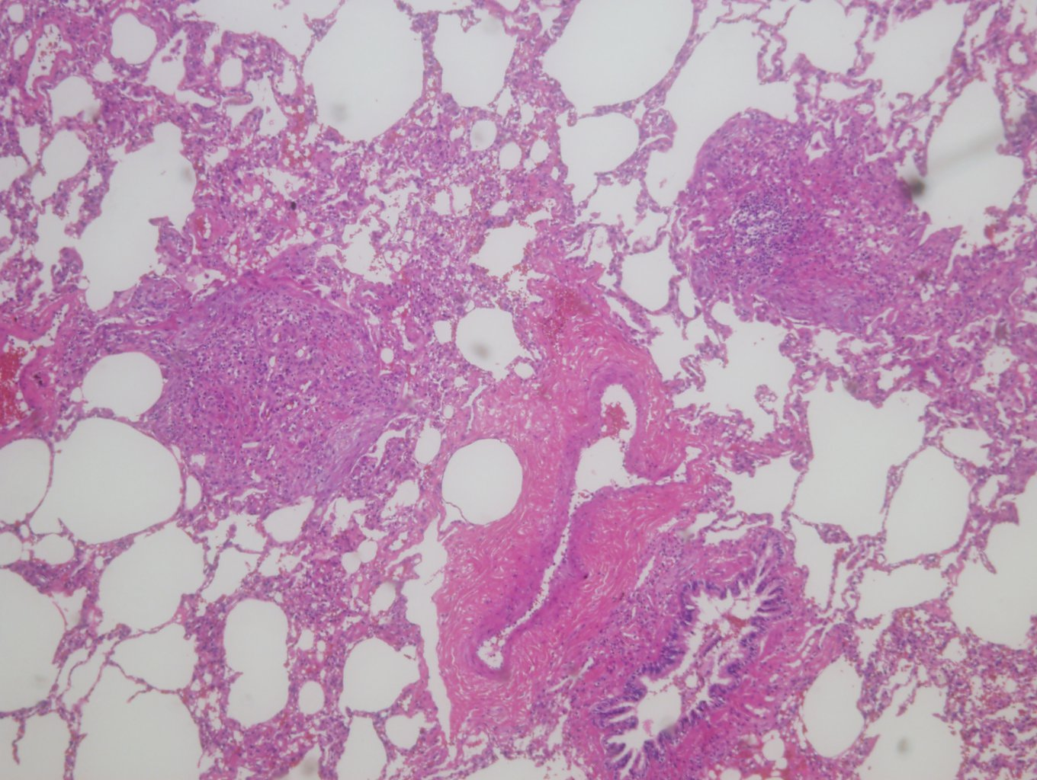

Slide 13
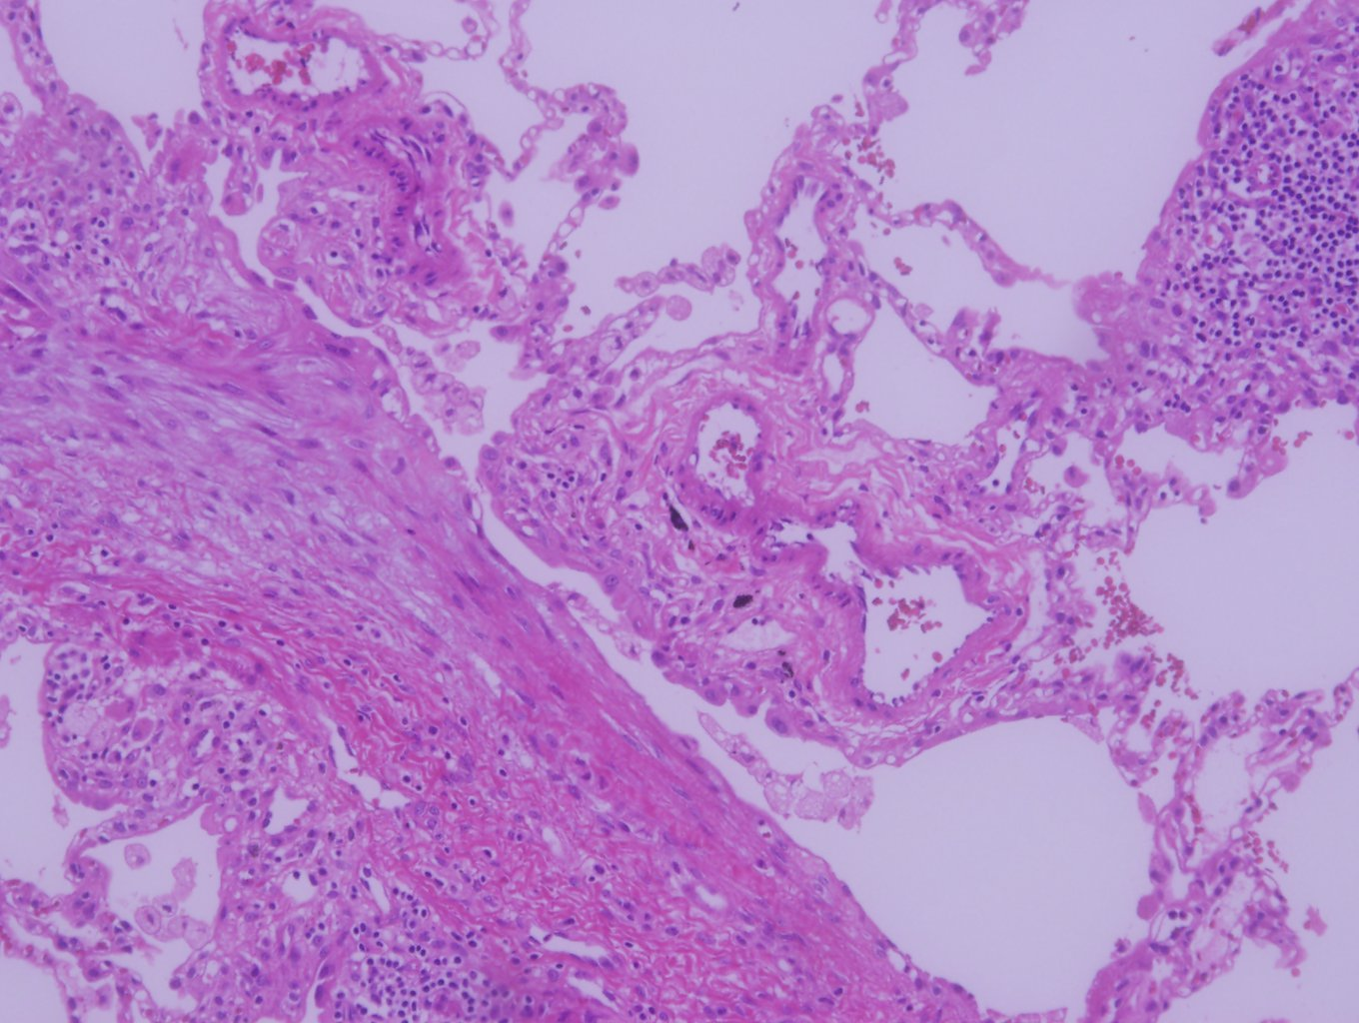

Slide 14
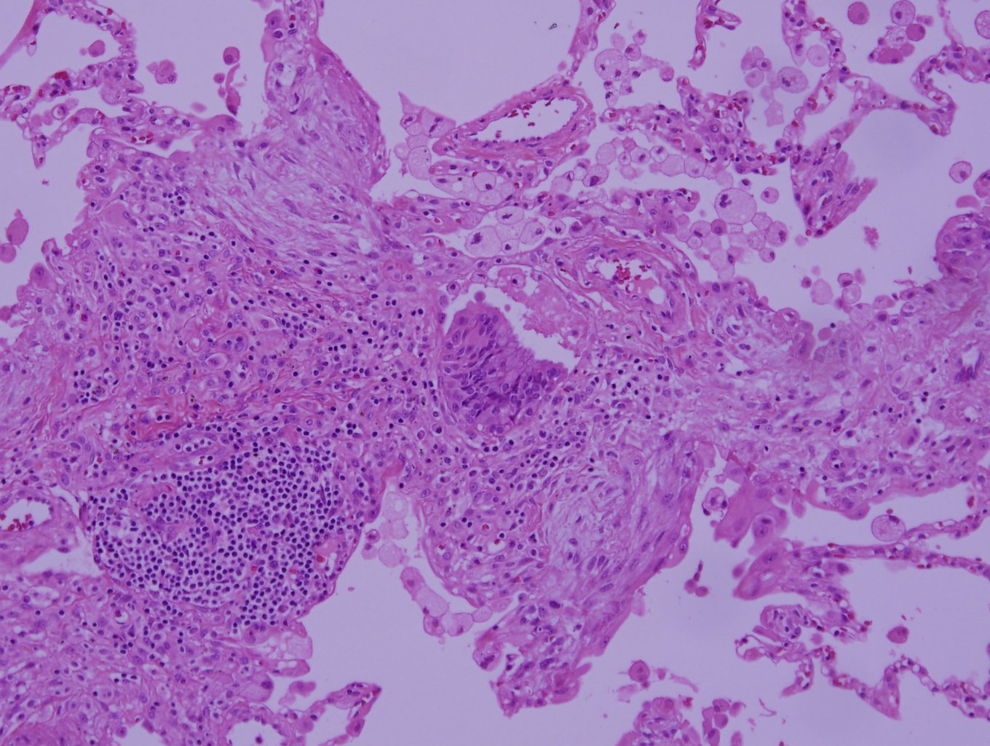

Slide 15
Lung, right middle lobe and right upper lobe, biopsy:
Multifocal patchy young fibroblastic proliferation, chronic inflammatory cell infitration around respiratory bronchiole associated with foamy histiocytic aggregation, see note
Note:
1. Foreign material 혹은 toxic material 의 inhalation 에 의한 병변일 가능성이 높고, 상당기간 지속적으로 allergen 에 노출된 hypersensitivity pneumonitis 의 가능성도 있습니다. viral pneumonia 의 가능성을 완전히 배제할 수는 없지만 그 가능성은 떨어집니다. 임상적으로 correlation 하시기 바랍니다.
2. 본 증례는 타기관의 심폐병리 전문가인 이교영 교수님께 의뢰하였습니다.

Slide 16
Hypersensitivity pnemonia
Synonym: extrinsic allergic alveolitis
Immunologic reaction to infaled Ags.
Etiologic agent: bacteria, fungi, animal protein, chemicals
→ ‘Farmer’s lung’, ‘air conditioner lung’ etc.; thermophilic actinomycetes.
Histologic triad
Chronic interstitial pneumonia (peribronchiolar parenchyme); constant finding, narrowing of lumen, minimal fibrosis
Ill-defined non-necrotizing granulomas; 2/3
Foci of bronchiolitis obliterans-organizing pneumonia; ½~2/3
- Interstitial fibrosis; only in advanced disease

Slide 17
Hypersensitivity pnemonia
Pathologic diagnosis: triad, but not always present
-granulomas+ cellular chronic interstitial pneumonia; highly suggestive
-clinical information and lab. Test
- exposure source may not be identifiable.
** Differential diagnosis
UIP; Scanty cellualr, honeycomb, no granuloma, no BOOP
LIP; dense cellular, diffuse, no BOOP
Sarcoidosis; No interstitial pneumonia, Well-formed granuloma, lymphangitic distribution

Slide 18
CASE 3
M/64
SS14-16631

Slide 19
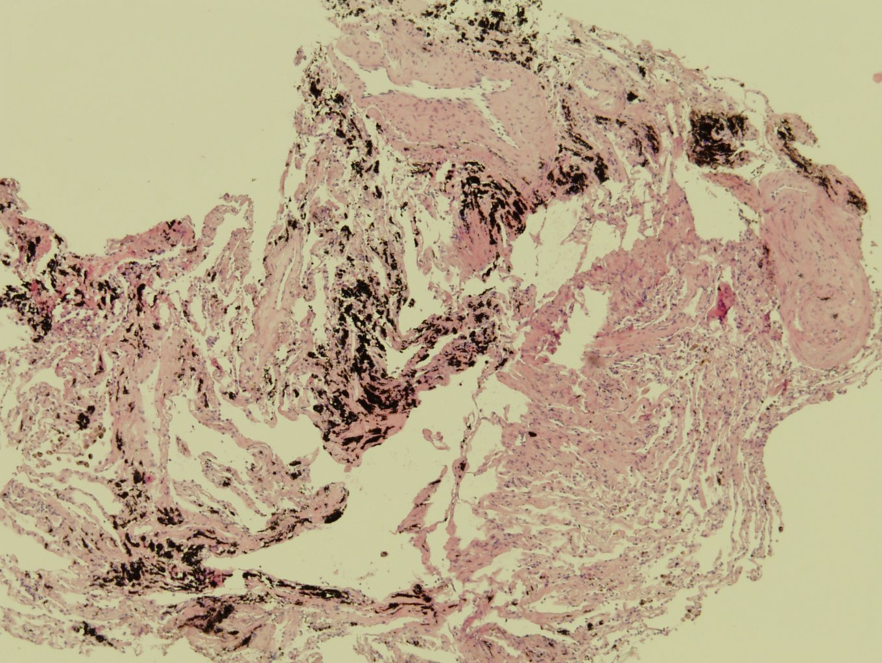

Slide 20
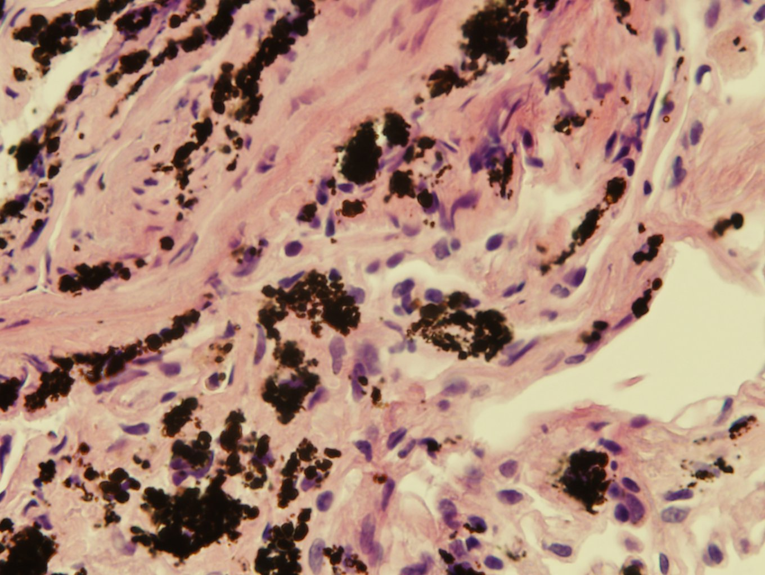

Slide 21
Pneumoconiosis
Non-neoplastic disease due to inhalation of mineral dust, other particulates, toxic fumes and vapors, exclusive of asthma, bronchitis and emphysema
Amount of dust retained in lungs depends on particulate size (dangerous: 1-5 mm, particles reach and impact in terminal small airways and alveoli)
Large particles resist dissolution, may evoke fibrosing collagenous pneumoconiosis (silicosis); quartz directly injures membranes by interacting with free radicals

Slide 22
Siderosis (Welder’s pneumoconiosis)
Associated with iron workers and welders
Welders exposed to fumes with metal oxide particles 0.1 to 1.0 um in diameter (iron, titanium, manganese and aluminum)
Lungs usually heavily pigmented without significant fibrosis
Aluminum has higher risk for significant pulmonary disease
Concurrent cigarette smoking, asbestos exposure may complicate clinical and pathologic findings
Micro: dust within interstitium, usually iron predominates

