Slide 1
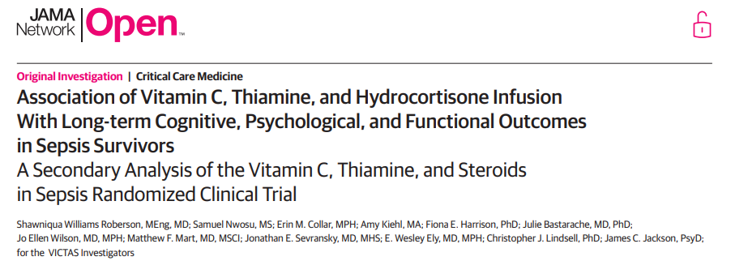
Journal Club
03/07/2023 (Tue)
Presentor : R3 정지혜
Moderator : Pf. 정경수

Slide 2
KEYPOINTs
Question Does early antioxidant and anti-inflammatory therapy improve the long-term cognitive, psychological, and functional outcomes in adults with sepsis?
Findings In this secondary analysis of a randomized clinical trial involving 213 survivors of sepsis with respiratory and/or cardiovascular dysfunction, early treatment with vitamin C, thiamine, and hydrocortisone resulted in no improvement in many domains, worse immediate memory scores, and higher odds of posttraumatic stress disorder compared with placebo.

Slide 3
ABSTRACT
Sepsis long-term cognitive impairment and worse psychological and functional outcomes.
Potential mechanisms include intracerebral oxidative stress and inflammation
the intervention and control groups in the Vitamin C, Thiamine, and Steroids in Sepsis (VICTAS) randomized clinical trial.

Slide 4
ABSTRACT
The intervention group received
intravenous vitamin C (1.5 g),
thiamine hydrochloride (100 mg),
and hydrocortisone sodium succinate (50 mg)
every 6 hours for 96 hours or until death or intensive care unit discharge.
The control group received matching placebo.

Slide 5
ABSTRACT
Cognitive performance, risk of posttraumatic stress disorder and depression, and functional status were assessed
: during a 1-hour telephone call 6 months after randomization
In survivors of sepsis, treatment with vitamin C, thiamine, and hydrocortisone did not improve or had worse cognitive, psychological, and functional outcomes at 6 months compared with patients who received placebo.
These findings challenge the hypothesis.

Slide 6
INTRODUCTION
Sepsis
: systemic inflammatory response to infection that
frequently leads to multiorgan system failure, increased mortality, and long-term cognitive and functional impairment.

Slide 7
INTRODUCTION
Almost 2 million sepsis cases in the US annually, nearly 55% require intensive care unit (ICU) admission and 20% to 30% die.
3 to 4 times greater risk of moderate to severe cognitive impairment compared with patients who are hospitalized without sepsis.
At greater risk of postintensive care syndrome (PICS), a collection of symptoms conferring long-term cognitive and psychological deterioration as well as worse quality of life.
sepsis-associated cognitive, psychological, and functional decline remain a major public health problem.

Slide 8
INTRODUCTION
Combination of oxidative stress and prolonged neuroinflammation
Increases in reactive oxygen species induce cellular damage, which, when combined with persistent activation of microglia, can contribute to blood-brain barrier dysfunction, loss of synapses, and neuronal cell death.
Vitamin C is a potent antioxidant and may prevent cognitive decline after sepsis by protecting cells against oxidative lipid damage.
Both vitamin C and hydrocortisone have been associated with decreases in markers of acute inflammation and could act synergistically to prevent and repair endothelial cell dysfunction.

Slide 9
INTRODUCTION
Thiamine deficiency increases inflammatory markers and is associated with cognitive impairment.
These findings suggest that a combination of vitamin C, hydrocortisone, and thiamine may protect patients against postsepsis cognitive impairment. In addition, some studies have suggested a survival advantage from the same therapeutic approach.
However, of 5 large randomized clinical trials, all but 1 failed to demonstrate a survival benefit from vitamin C–based therapy.

Slide 10
INTRODUCTION
The multicenter, double-blind, placebo-controlled Vitamin C, Thiamine, and Steroids in Sepsis (VICTAS)
: August 2018 and July 2019
The trial was designed a priori to evaluate the primary objective of effects on mortality and ventilator- and vasopressor-free days, which were shown to be unaffected by the treatment regimen.
We hypothesized that, among survivors of sepsis requiring vasopressor or ventilator support, early treatment with high-dose vitamin C, thiamine, and hydrocortisone improves functional status 6 months after randomization

Slide 11
METHODs – Study procedure
Recruited at 43 hospitals across the US.
Participants were randomized 1:1 to either the intervention or control group.
The VICTAS trial,
: Approved by the institutional review board of the Johns Hopkins Hospital.
: Consolidated Standards of Reporting Trials (CONSORT) reporting guideline

Slide 12
METHODs – Study procedure
Control group : IV vitamin C (1.5 g), thiamine hydrochloride (100 mg), and hydrocortisone sodium succinate (50 mg) administered within 4 hours of randomization and every 6 hours thereafter for up to 96 hours or until death or ICU discharge (whichever occurred first).
Placebo injections of normal saline matched by volume at the same frequency.
All other clinical management of participants, including enteral vitamin supplementation and nutrition, was at the discretion of the clinicians

Slide 13
METHODs - Measurement of Long-term Outcomes
Follow-up assessments were conducted through January 2020.
Delirium, global cognitive function, attention, working memory capacity, immediate and delayed memory, language conceptualization, verbal attraction, verbal fluency
Posttraumatic Stress Disorder, Depression

Slide 14
METHODs - Measurement of Long-term Outcomes
Telephone interviews lasted approximately 60 minutes.
In cases where the participant was unable or unwilling to undergo formal cognitive and psychological assessment by telephone (eg, due to illness, excessive fatigue, or cognitive deterioration), functional status and health care use data were gathered from a designated surrogate.

Slide 15
METHODs - Statistical Analysis
Categorical variables : frequencies and proportions.
Continuous variables : means with SDs or medians with IQRs.
Comparisons between groups, with 2-tailed P values, used a multivariable proportional odds logistic regression for ordinal outcomes and a binary logistic regression for dichotomous outcomes.
Adjusted covariates: age, sex, race and ethnicity, educational level, Acute Physiology and Chronic Health Evaluation version II score, diabetes, neurological or cardiovascular comorbidity, number of days requiring mechanical ventilation, and ICU length of stay.
P < .05 was considered to be statistically significant.

Slide 16
METHODs - Statistical Analysis
This secondary analysis reported on the key secondary objective for the VICTAS trial. The trial was explicitly powered for the primary objective and was administratively terminated after recruiting 501 participants. The secondary analysis was specified a priori with the intent to describe the magnitude of differences between groups rather than to focus on hypothesis tests. Therefore, no adjustments for multiplicity were made, and adjusted effect sizes (ie, odds ratios [ORs]) with 95% CIs were reported. Multiple imputation based on predictive mean matching was used to overcome missing covariate data. Approximately one-third of participants who were interviewed at follow-up were unable or unwilling to complete the full battery of cognitive and psychological assessments.

Slide 17
METHODs - Statistical Analysis
In less than 7% of included participants who were unable to complete a given assessment due to cognitive impairment, the lowest possible score was assigned.
All analyses were conducted between February 2021 and December 2022 using R, version 3.4.3 (R Foundation for Statistical Computing)

Slide 18
RESULTs - Enrollment and Patient Characteristics
The flowchart of enrollment, randomization, and follow-up of VICTAS trial participants is depicted in Figure 1.
Of the 501 participants randomized, 198 (39.5%) died prior to undergoing long-term outcome assessment (196 died within 180 days of randomization and 2 died after 180 days of randomization but before their 5- to 8-month follow-up window ended).
Of the remaining 303 participants, 4 (1.3%) withdrew from the study and 40 (13.2%) did not agree to follow-up assessment.
Of the 285 participants available for follow-up, 32 (11.2%) could not be reached within their 5- to 8-month follow-up window and 13 (4.6%) had a truncated follow-up window due to administrative termination of the trial. One participant was administratively withdrawn due to incarceration, and 26 (9.1%) refused assessment at follow-up

Slide 19
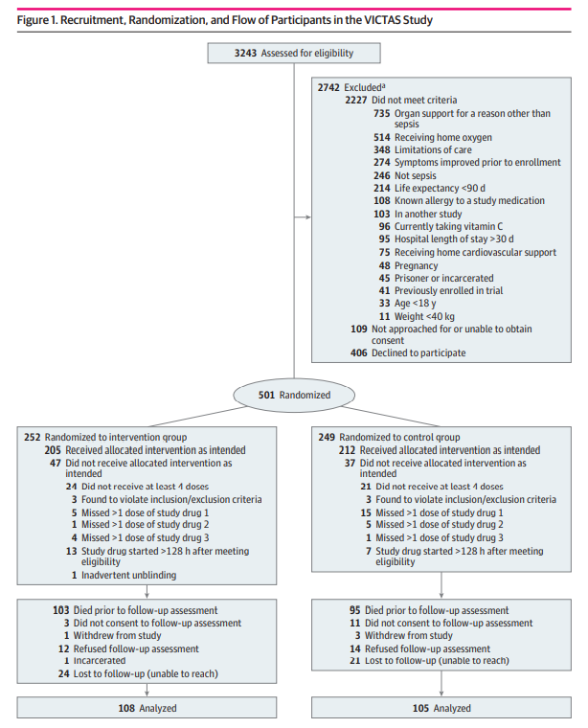

Slide 20
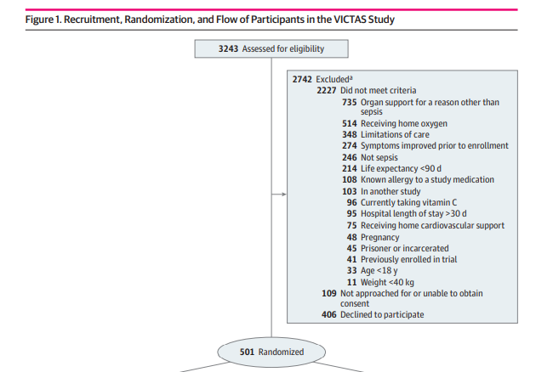

Slide 21
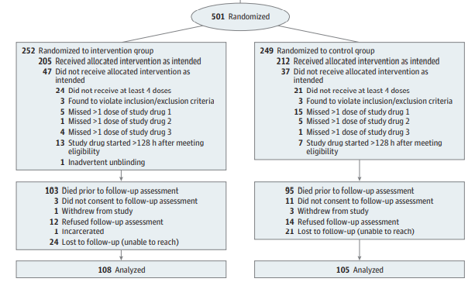

Slide 22
RESULTs - Enrollment and Patient Characteristics
The final sample included 213 participants, 108 vs. 105.
median (IQR) age of 57 (47-67) years
101 females (47.4%) and 112 males (52.6%).

Slide 23
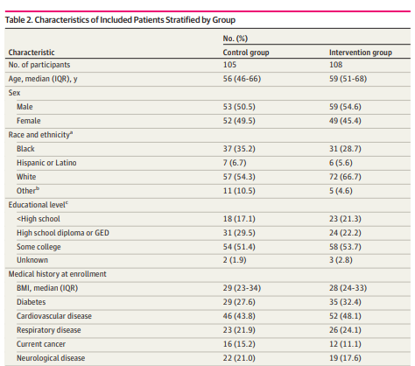
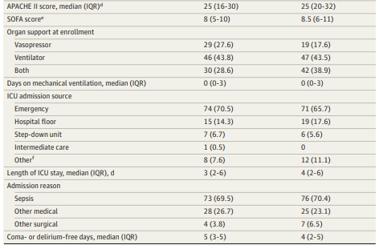
RESULTs - Enrollment and Patient Characteristics

Slide 24
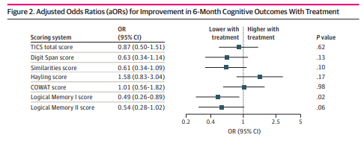
RESULTs – Cognitive Outcomes
No delirium at the time of assessment.

Slide 25
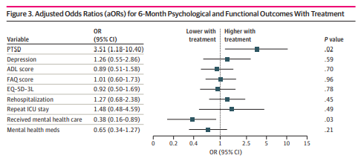
RESULTs - Psychological and Functional Outcomes

Slide 26
RESULTs – Health care use
The odds of rehospitalization were similar between the intervention and control groups (aOR, 1.09; 95% CI, 0.56-2.12; P = .79)
Participants in the intervention group had lower odds than those in the control group of receiving formal psychiatric, psychological, or mental health care during the 6 months after discharge (aOR, 0.38; 95% CI, 0.16-0.89; P = .03)
The intervention group also had lower odds than the control group of reporting medication use for depression or anxiety, although this difference was not statistically significant (aOR, 0.65; 95% CI, 0.34-1.27; P = .21)

Slide 27
DISCUSSION
We found no evidence of the benefit
On the contrary, participants in the intervention group had lower immediate memory scores and higher odds of PTSD compared with participants in the control group.
No improvement in mortality and other hospital-based outcomes with vitamin C therapy.

Slide 28
DISCUSSION
The cognitive scores of both the intervention and control groups were similar in magnitude to those reported in other cohorts of ICU survivors.
The rates of depression, PTSD, and functional disability were also commensurate with those previously reported and consistent with the outcomes typically observed in PICS.

Slide 29
DISCUSSION
The increased odds of PTSD
: less by the role of vitamin C as an antioxidant
more by its modulation of neurotransmitter metabolism in the brain.
Vitamin C facilitates the conversion of dopamine to norepinephrine.
Norepinephrine : primary messenger of the locus coeruleus, which mediates physical and emotional responses to stress and facilitates the consolidation of aversive memories. Blockade of norepinephrine receptors enables fear extinction in animals that are subjected to stressful stimuli, reinforcing the hypothesis that norepinephrine transmission plays an important role in the pathogenesis of PTSD.

Slide 30
DISCUSSION
Coadministration of hydrocortisone with norepinephrine potentiates fear memory responses and may have acted synergistically to increase risk of PTSD in the VICTAS trial participants. Alternatively, exogenous norepinephrine and/or corticosteroids may have played a role.

Slide 31
DISCUSSION
Postsepsis cognitive decline include intracerebral oxidative stress, inflammation, and endothelial dysfunction.
Dose, timing, or duration of therapy was insufficient to provide adequate cellular protection. The intervention was limited to the ICU stay (median of 3 days).
Sedation and paralysis practices—in particular, number of ICU days with opiates or neuromuscular blockade—may contribute to psychiatric symptoms after critical illness.
Benzodiazepines : risk of ICU delirium, which is also associated with longterm cognitive impairment.

Slide 32
LIMITATIONs
First, interpretation was restricted to those who survived sepsis.
Second, a common problem among studies of cognitive and psychological outcomes after critical illness is the unplanned nature of inclusion and the resultant difficulty in adequately assessing for premorbid cognitive and psychological disorders.

Slide 33
LIMITATIONs
Third, 40 of 303 eligible participants (13.2%) did not consent to follow-up assessment. Furthermore, the VICTAS trial was administratively terminated due to withdrawal of funding, leading to a truncated follow-up window for a small proportion (4.6%) of eligible participants. ; patient refusal
Fourth, for pragmatic purposes, we selected brief screening tools as psychological outcome measures. Although these tools are well accepted and have high sensitivity and specificity for detection of PTSD and depression, formal diagnosis requires in-depth evaluation by a trained mental health professional.

Slide 34
CONCLUSIONs
In the VICTAS trial, for survivors of sepsis who were treated early with vitamin C, thiamine, and hydrocortisone in the ICU, the cognitive, psychological, and functional outcomes at the 6-month follow-up either were unaffected by the regimen or were worse than for patients who received placebo.
These results do not support antioxidant and anti-inflammatory therapy and suggest that antioxidant and anti-inflammatory therapy does not mitigate the development of long-term cognitive, psychological, and functional impairment in patients with sepsis who require cardiovascular or respiratory support in the ICU.

Slide 35
Thank You for Your Attention

